Slide 1
Guatemala through the eyes of a 13 year old.

Slide 2
I got to spend a week in Guatemala. Despite all of the violence and poverty surrounding this country, what I experienced was a beautiful land full of kind, loving people. Though I only got to spend a short time there, it left a lasting impact on my life. These are just a few images with the stories behind them that made my previous trip so special. I hope you enjoy taking a look into my journey as a 13-year-old in this wonderful place.

Slide 3
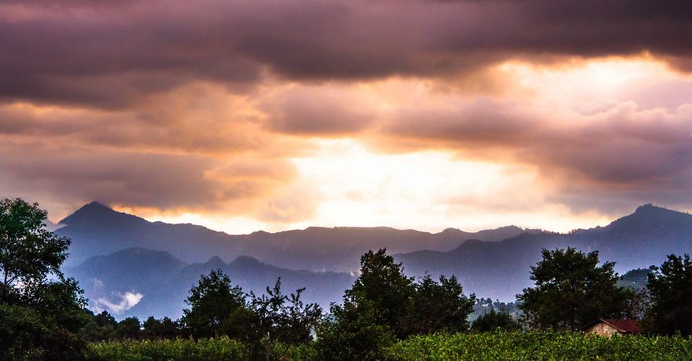
A glorious sunset over the village in the mountains

Slide 4
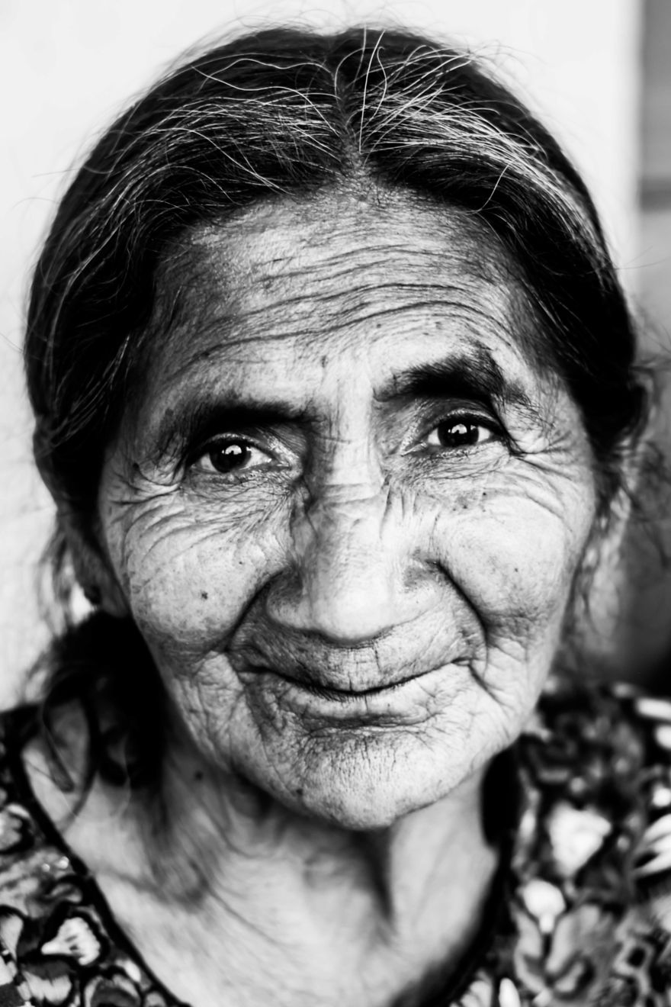
I had the immense honor and pleasure of meeting this beautiful lady
Living by a coffee plantation in the mountains of Guatemala, all of her family had died. She lived by herself in a straw hut and cleaned her neighbor’s house to try and make a living. She hardly had any food, and all of her teeth were gone. With so many hardships and so much sorrow in this lady’s life, you would think she would be heartbroken and devastated. However, her face and personality radiated joy. Her eyes twinkled and even though she had no teeth, it seemed as if a hidden smile was always there. I was in awe at her joy and happiness in life even when she had nothing. When I asked to take her picture, she looked up at me and made a smile in her own special way. It was a beautiful moment that I will remember for a long time!

Slide 5
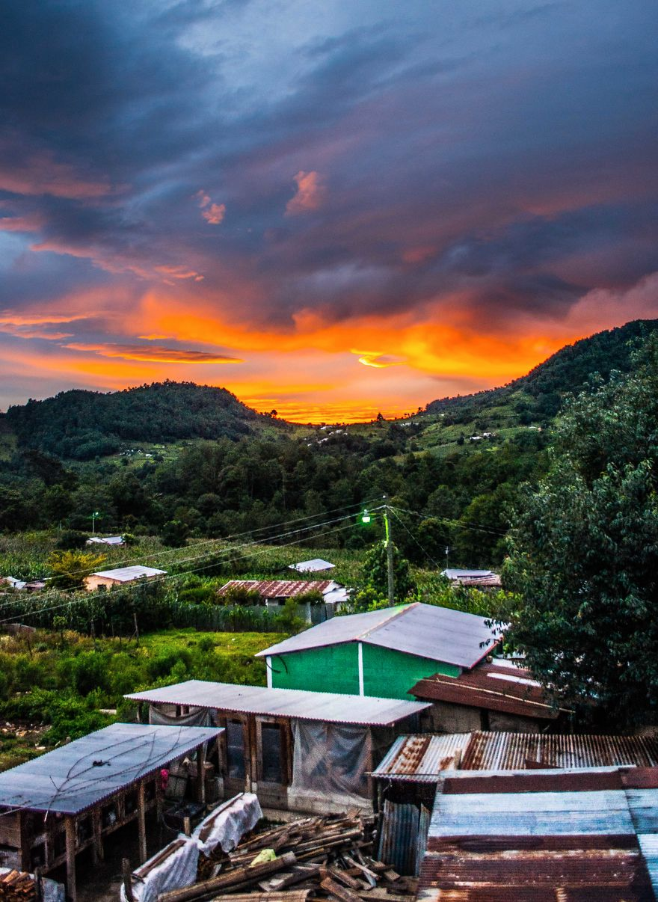
The contrast of the sunrise with the poverty of the village below really struck me.

Slide 6
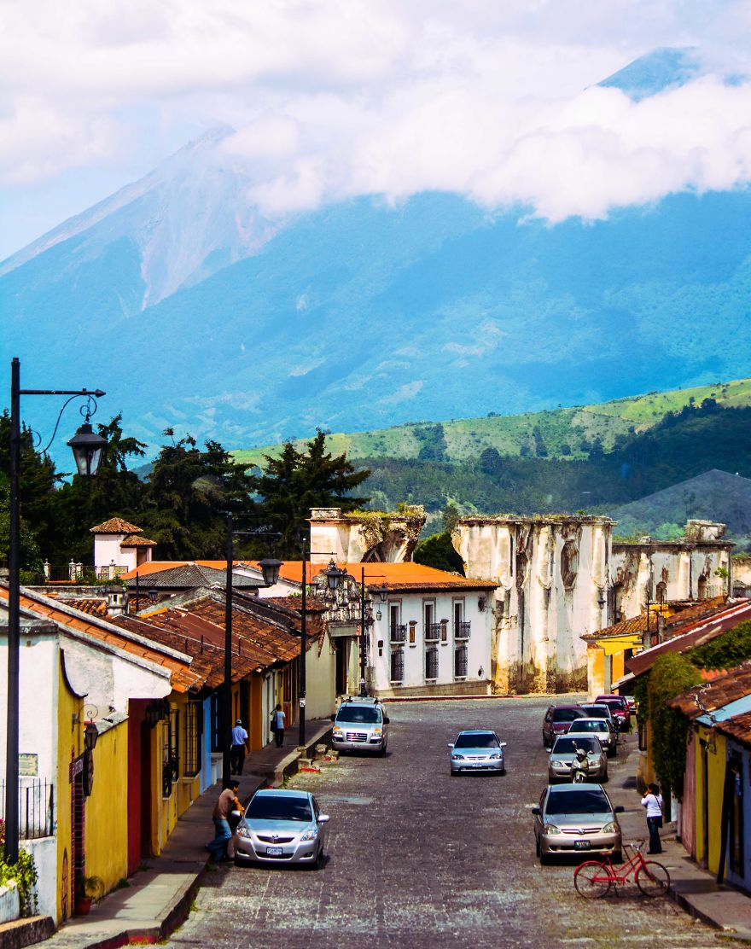
A village nestled in the mountains - With cobblestone streets and century-old buildings, the cars driving through and electrical lamps almost seemed out of place.

Slide 7
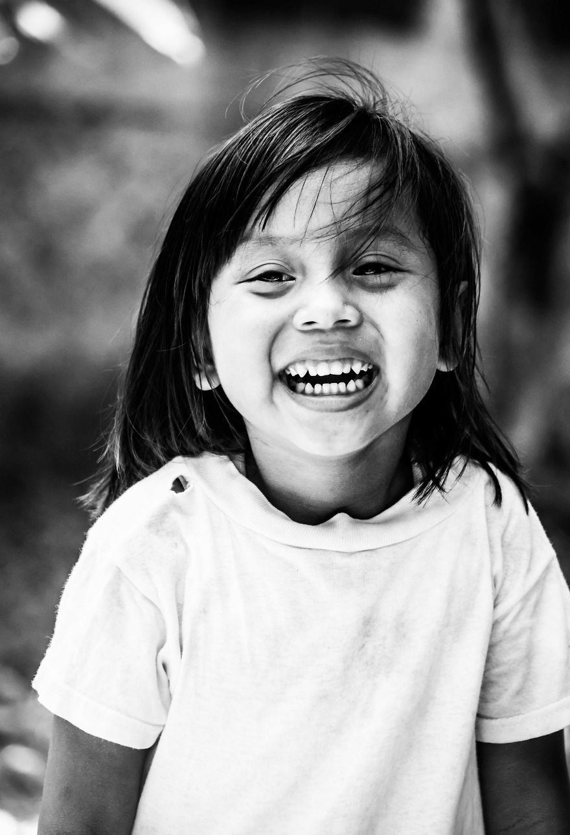
Orphanage
Seeing the kids smiling faces even when their situations were not the best really encouraged and inspired me. While playing tag with the children I noticed this beautiful girl. Even though her shirt was torn she was smiling a huge, warm smile at me. I was so happy to get a photo to remember the moment!

Slide 8
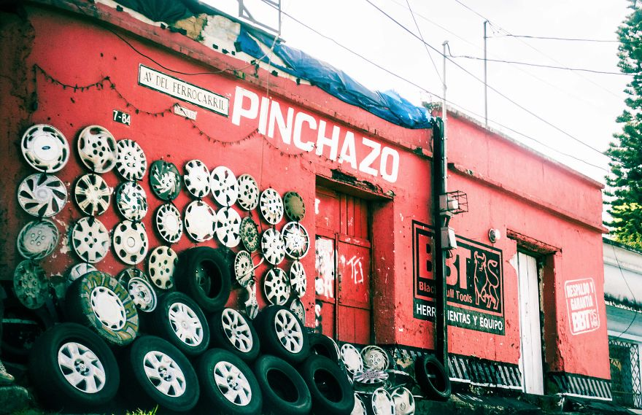
Pinchazo in Guatemala City
Though there was poverty and trash throughout the city, in every corner and avenue was something beautiful in its simplicity.

Slide 9
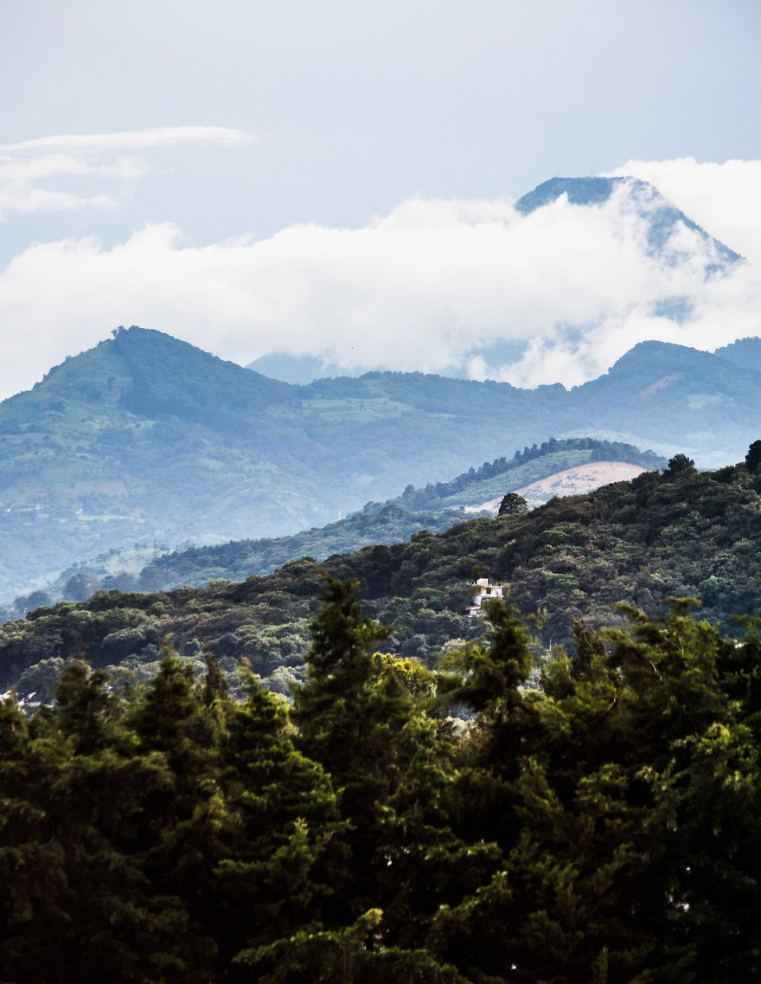
Clouds surround the volcano by the compound
We almost never saw the volcano due to the cloud coverage, but when we did it was a sight to behold.

Slide 10
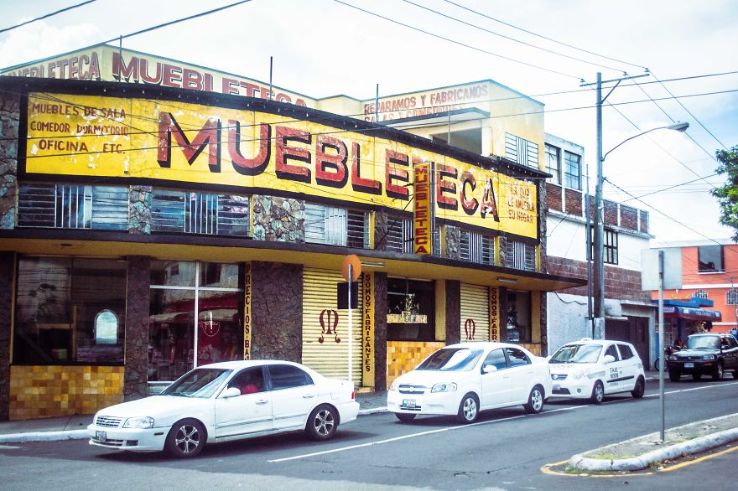
Mueble Eca on the corner of a street in Guatemala City
A drive through the city was a journey of sounds, sights, and colors.

Slide 11
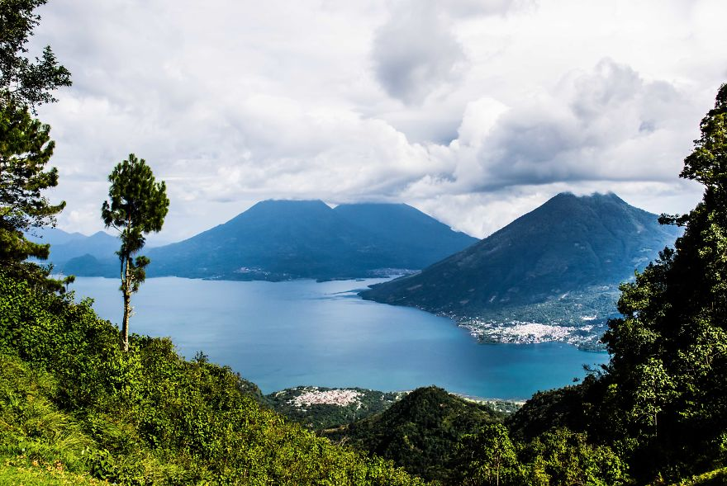
Mountain views stretching for miles

Slide 12
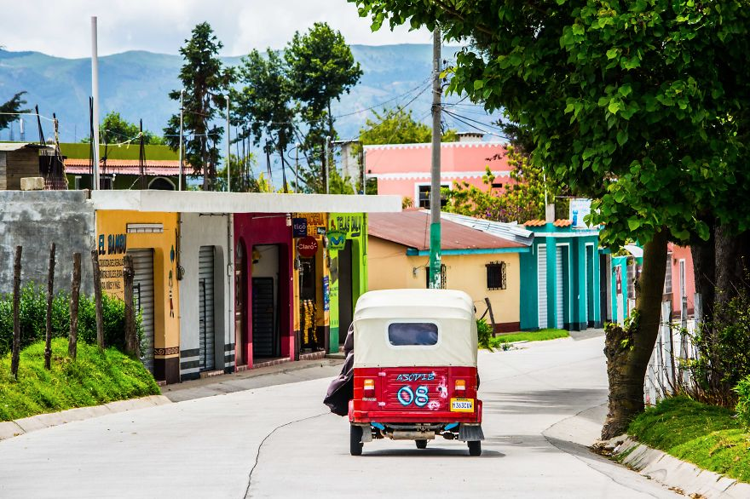
One of my favorite things about the villages was the color
Though the houses were not elaborate, everyone added something to the overall beauty of the village.

Slide 13
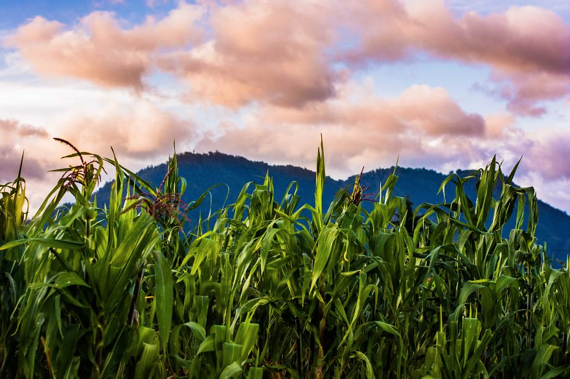
Corn fields surrounding us on our overnight stay in the village

Slide 14
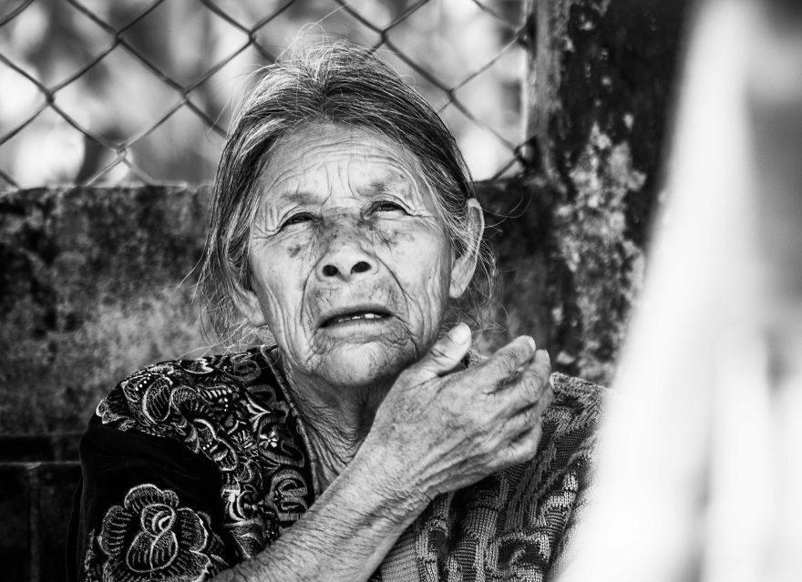
A beautiful lady we were able to see at a clinic
In all of the hardships it seemed she was facing, I couldn’t help but see the courage and strength in her face.

Slide 15
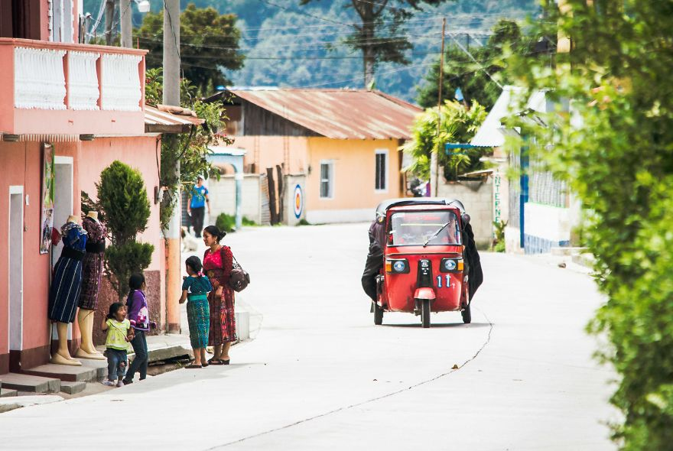
A family stands outside a small clothing store as a taxi races by

Slide 16
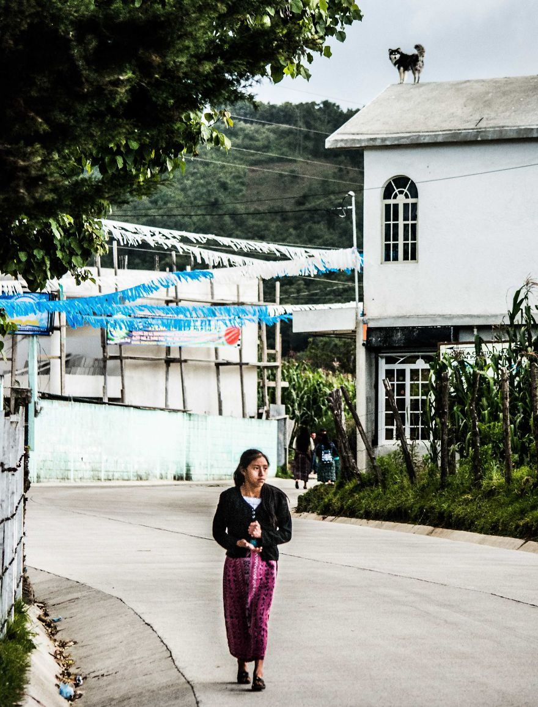
A dog perches on the rooftop overlooking the village road
Every time I see the look of discouragement on this girl’s face I am reminded ten-fold how blessed I am.

Slide 17
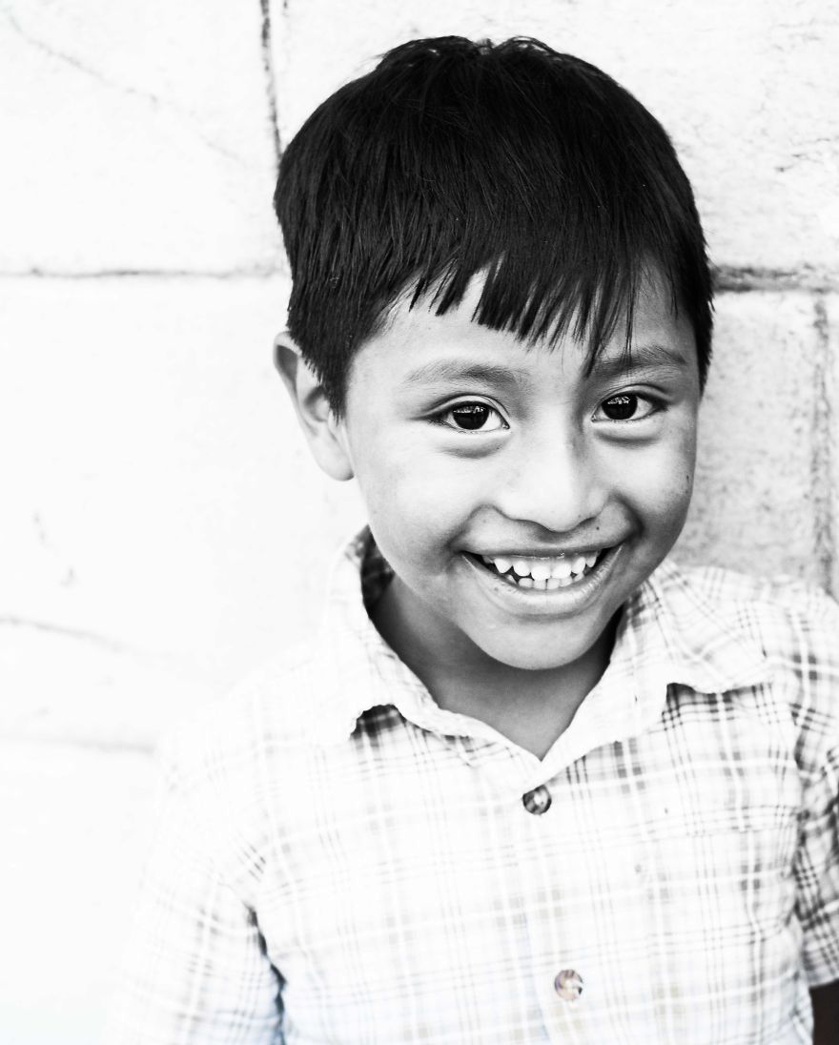
One of my favorite experiences of the trip was playing with the kids in the villages

Slide 18
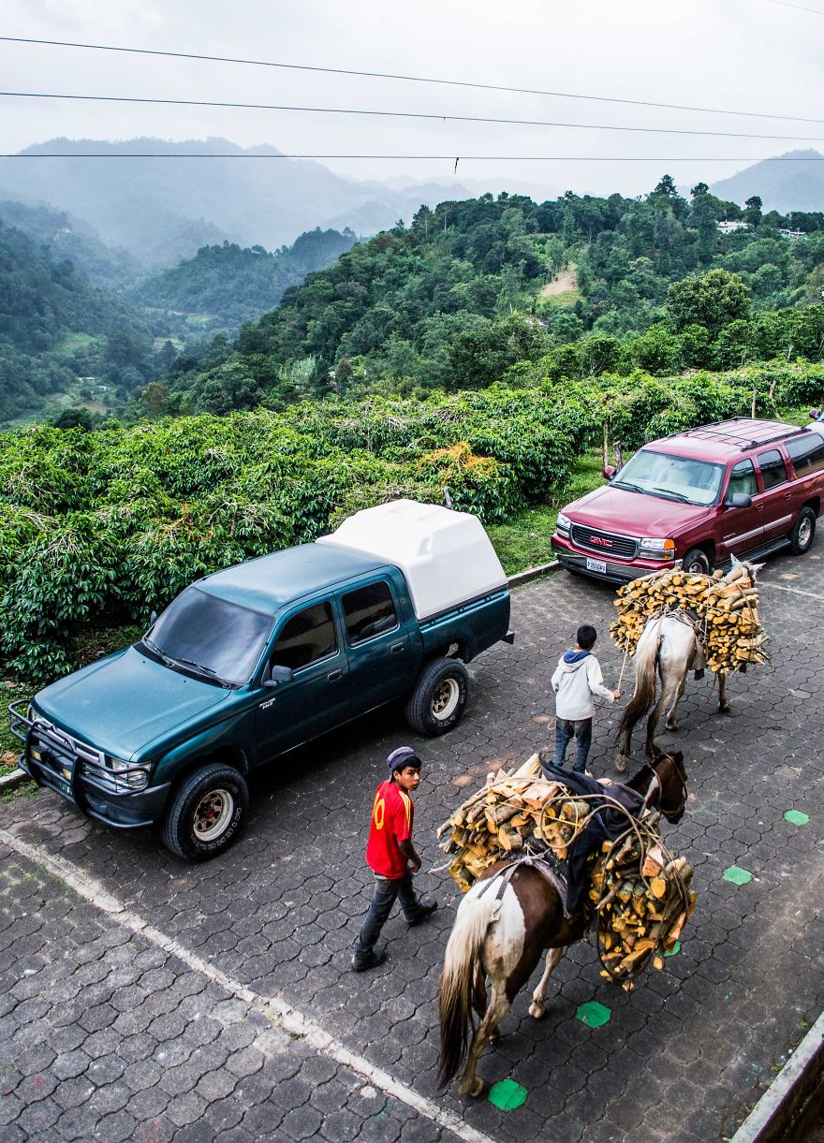
Young boys my age bringing wood up the mountain

Slide 19
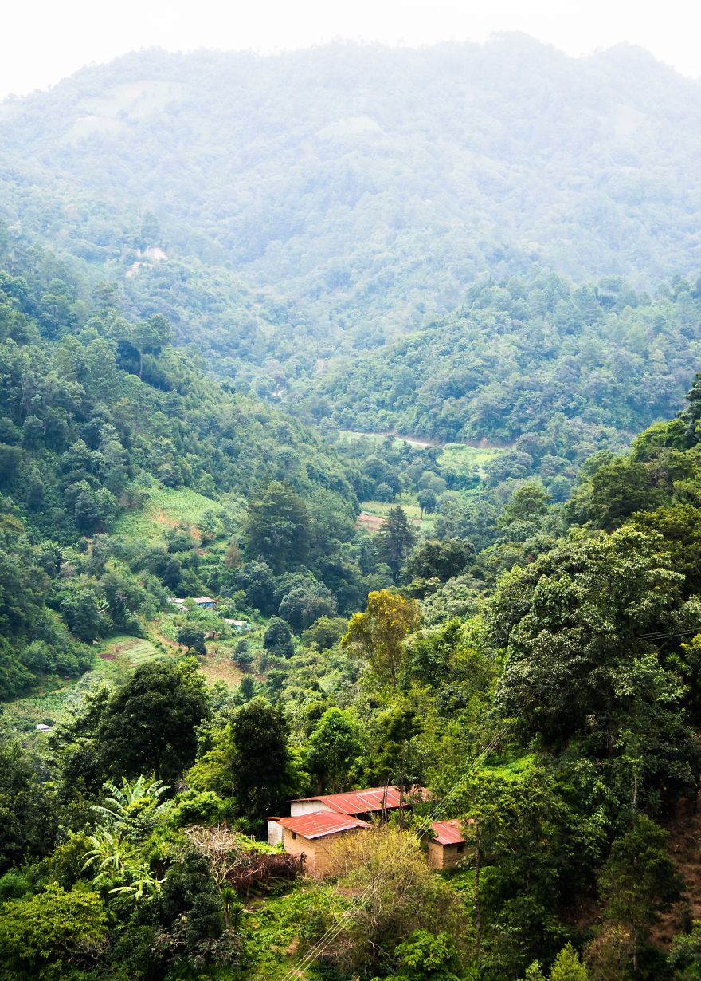
The view from the coffee plantations overlooking the mountains.
The natural beauty of surroundings never failed to take my breath away.

Slide 20
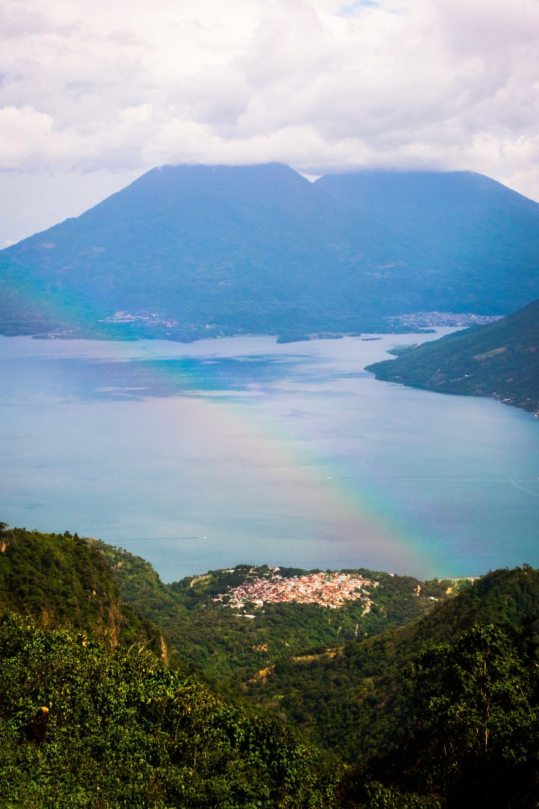
A rainbow appears overlooking the city

Slide 21
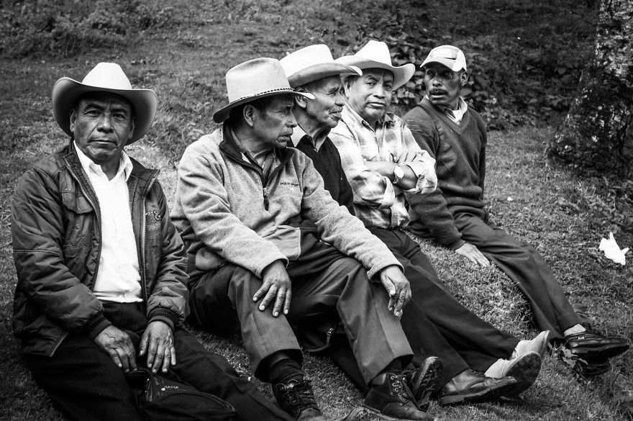
Experience, wisdom, perseverance. Just a few words I would use to describe these men

Slide 22
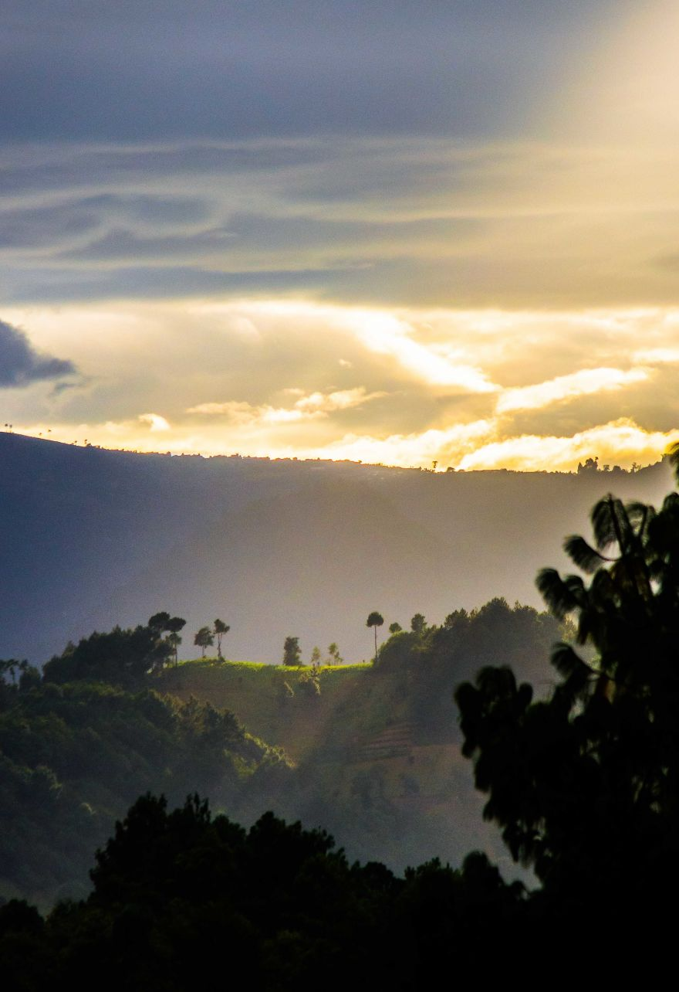
As I look to travel to this country again in just a few short days, I am so thankful for what I have already experienced. I only cannot wait to go back

