Slide 1
Traveling In Cuba Feels Like Taking A Plane Back In Time
by Yanay Tsabary

Slide 2
My name is Yanay, and I’m traveling in Central America for a few months. After rain started dropping everywhere, I wanted to travel. I decided to check out Cuba.
Life in Cuba is very different from everything I knew before leaving Israel and traveling to the Caribbean area. Life is very simple and internet free, so when people are not working, they are sitting outside talking to each other. The structures are built in colonial style; and when Cubans are not riding a horse, they are usually driving classic American cars from the 50’s.
My trip to Cuba has definitely been an interesting journey. These are some of the pictures I came back with.

Slide 3
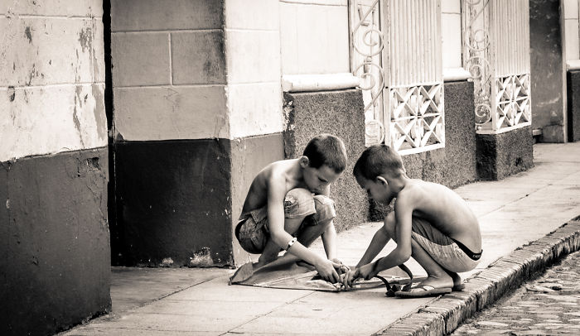

Slide 4
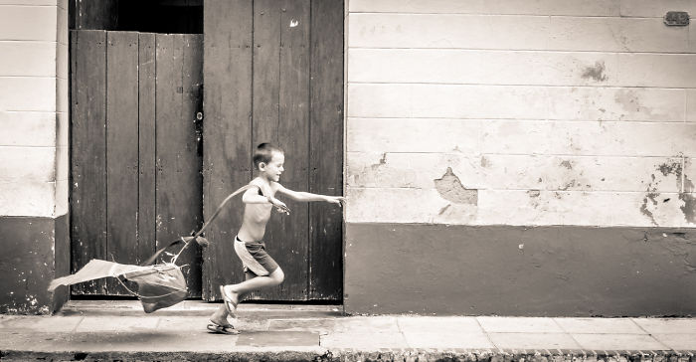

Slide 5
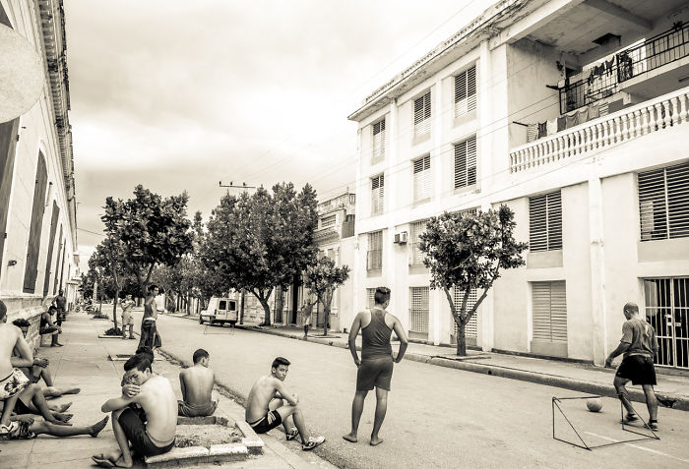

Slide 6


Slide 7

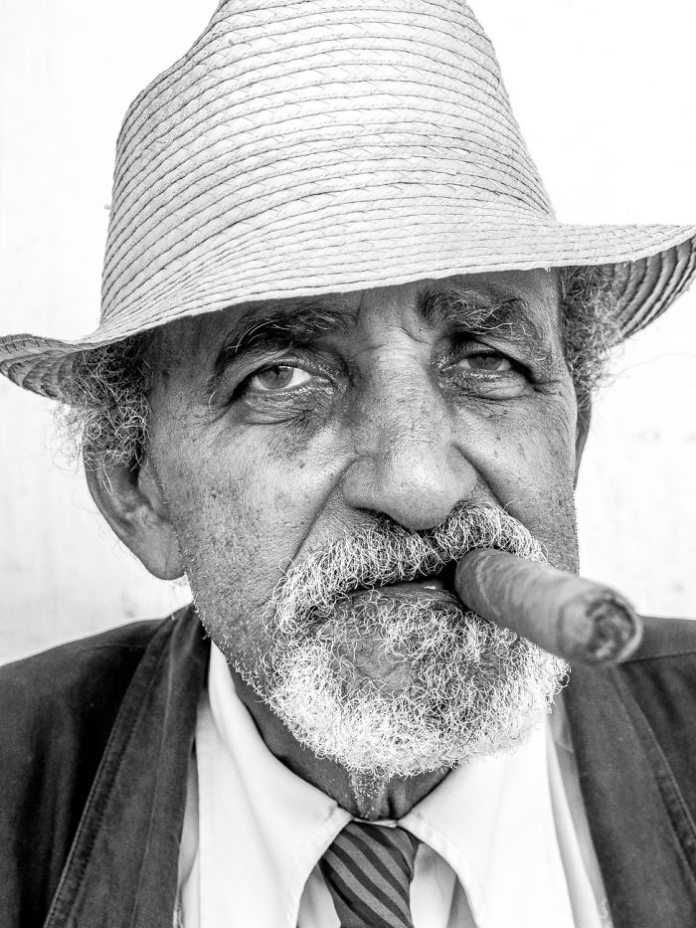

Slide 8
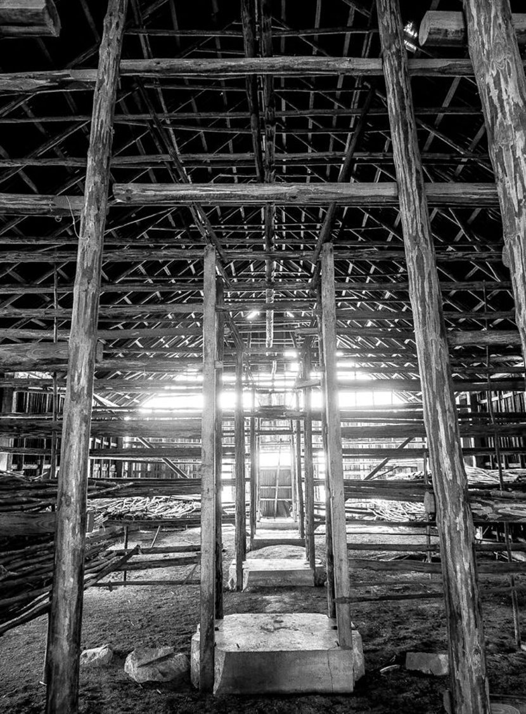
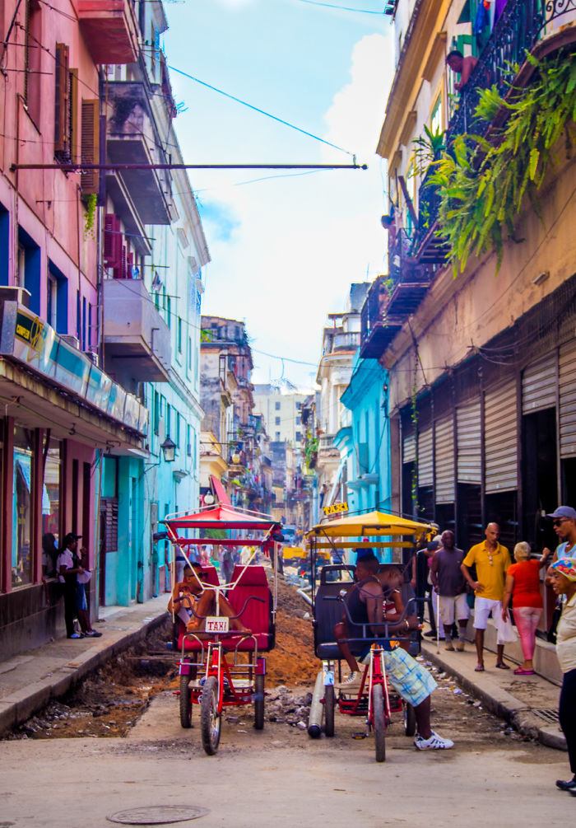

Slide 9
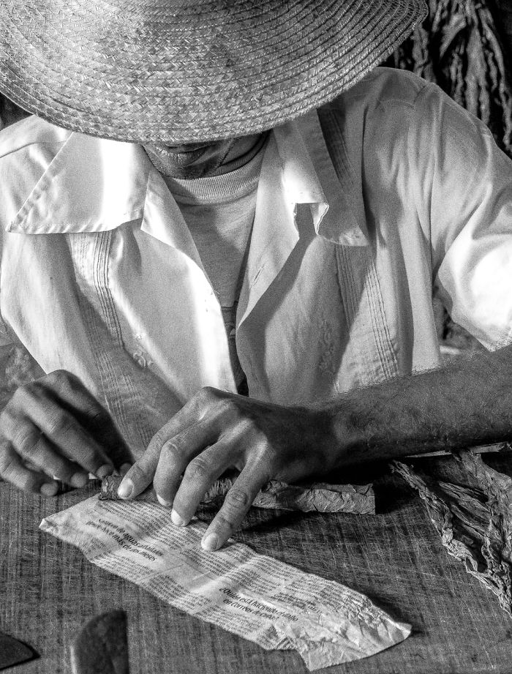
Cuba has a long history and a proud tradition of making quality cigars.

Slide 10
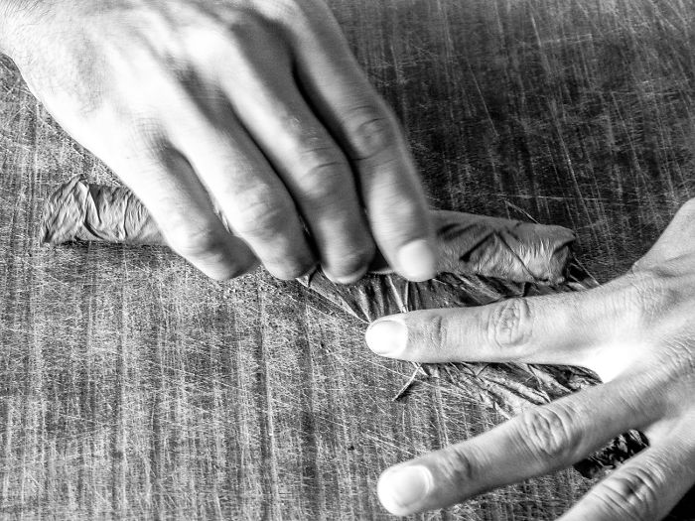

Slide 11


Slide 12
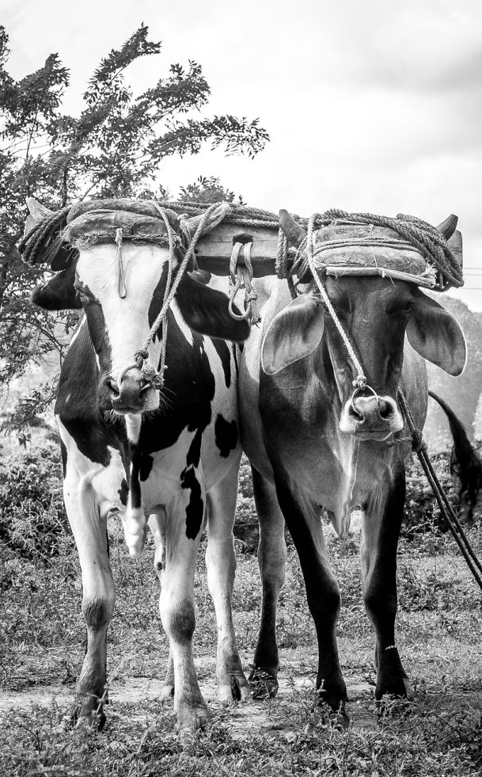
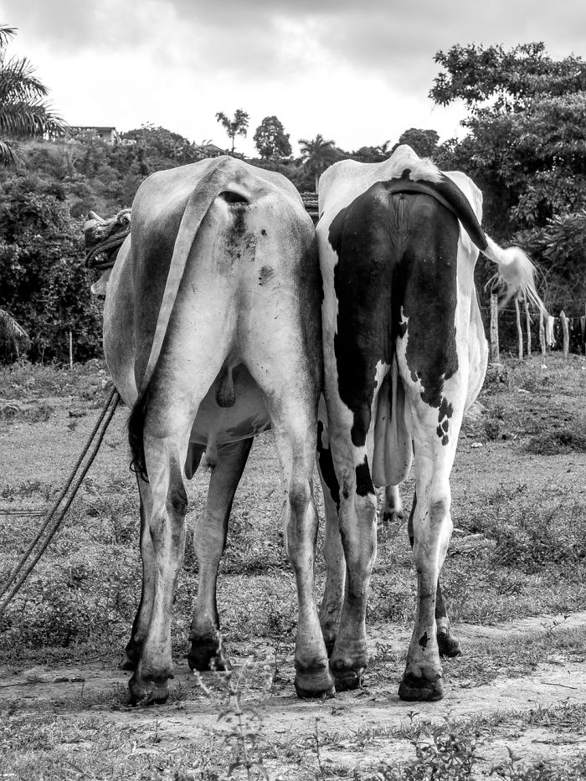

Slide 13
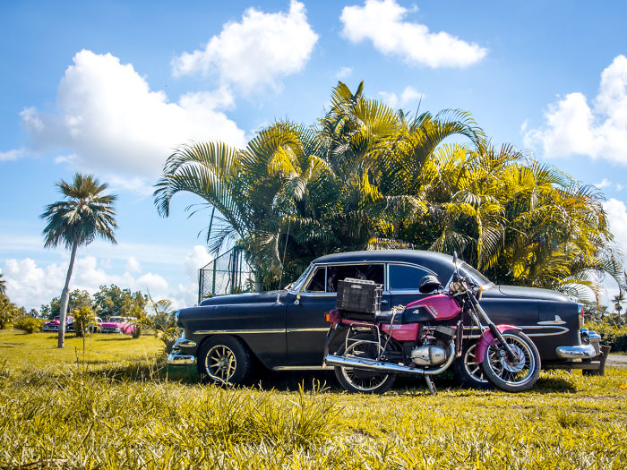

Slide 14
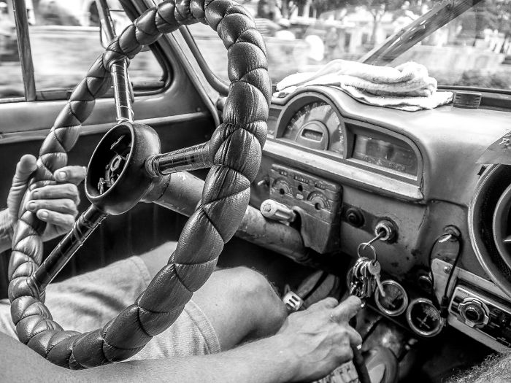

Slide 15


Slide 16
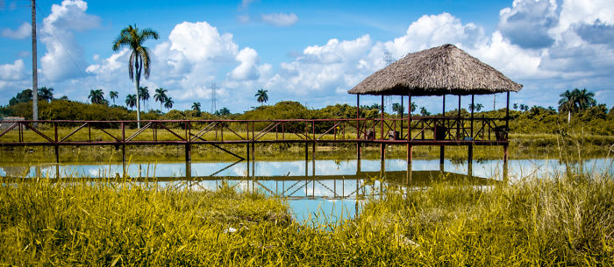

Slide 17
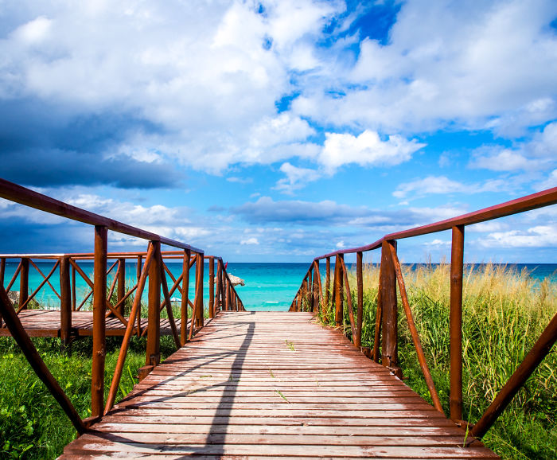

Slide 18
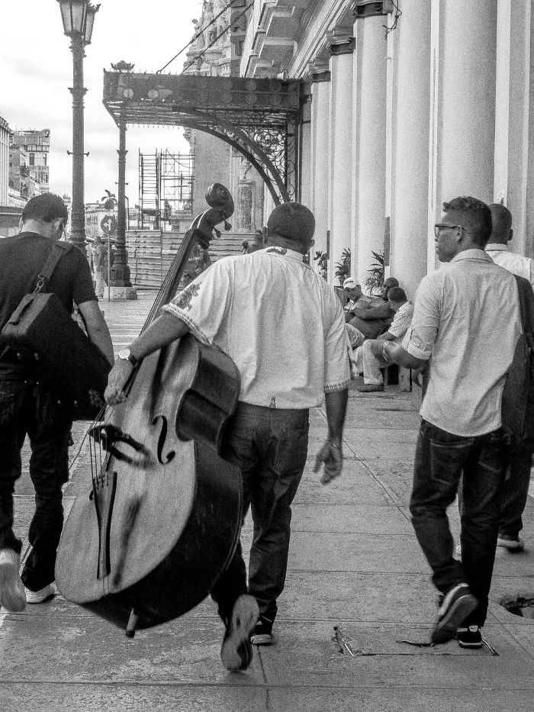
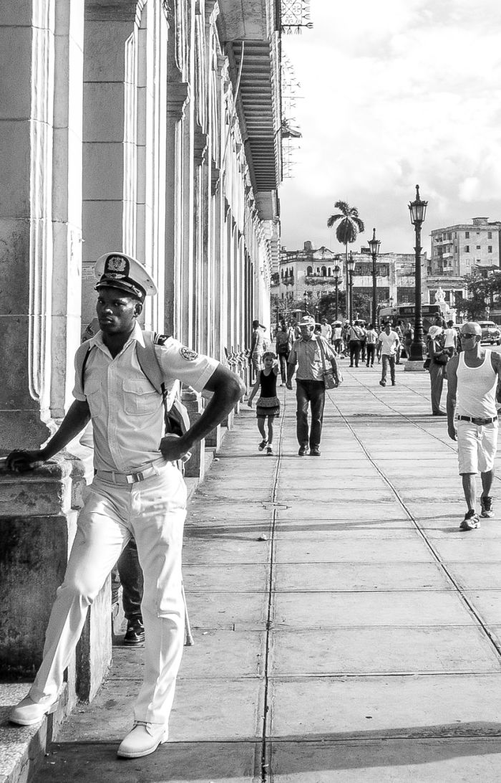

Slide 19
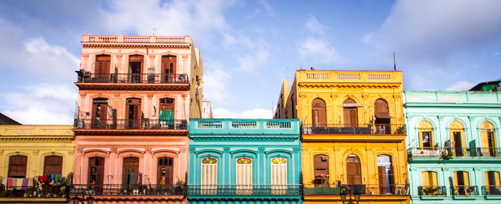

Slide 20
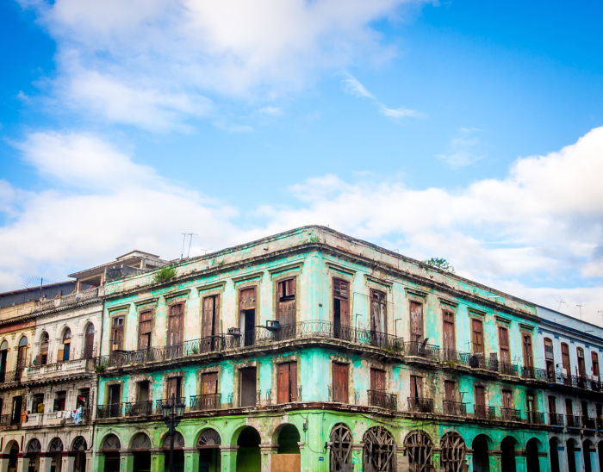

Slide 21
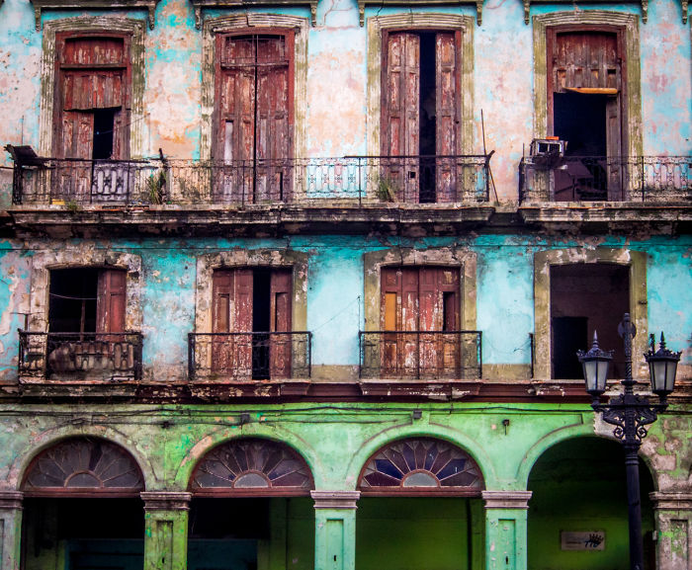

Slide 22
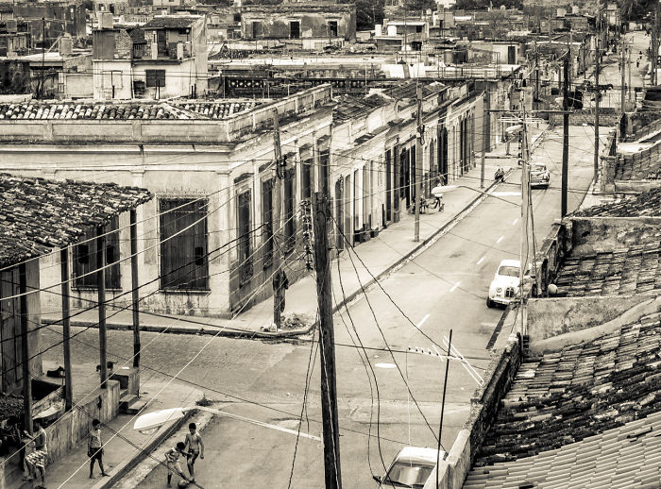

Slide 23
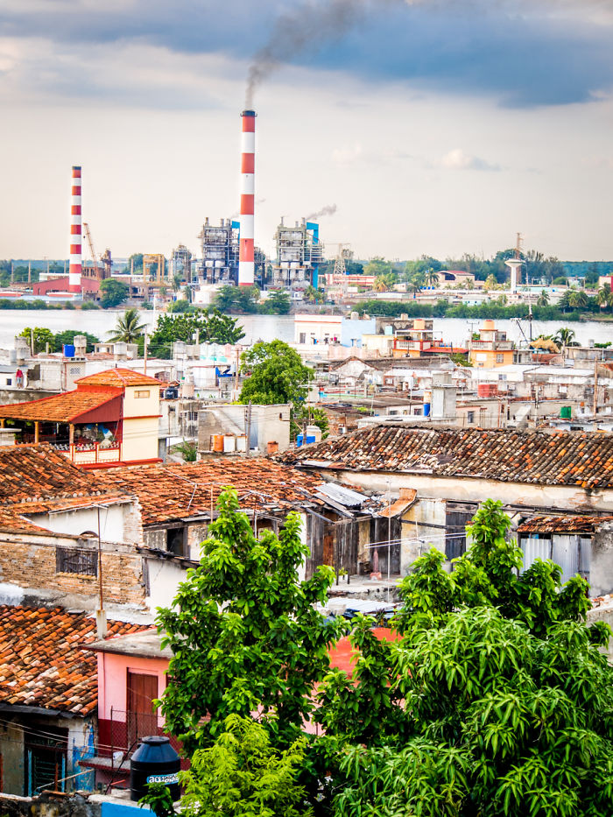

Slide 24
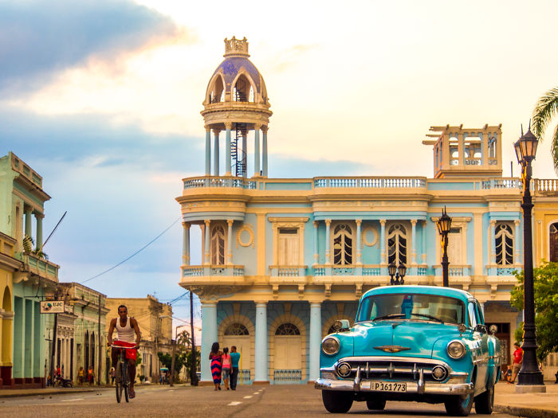

Slide 25


Slide 26
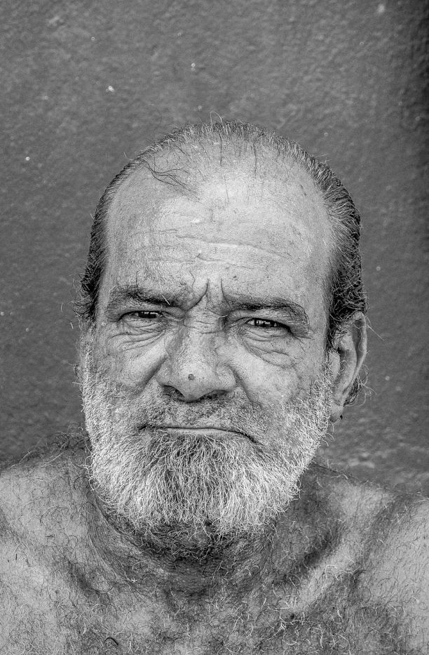
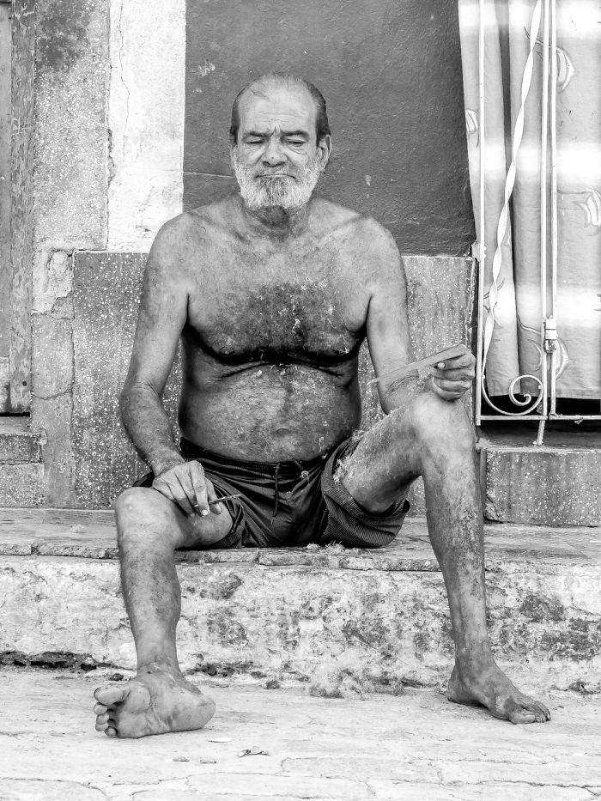

Slide 27

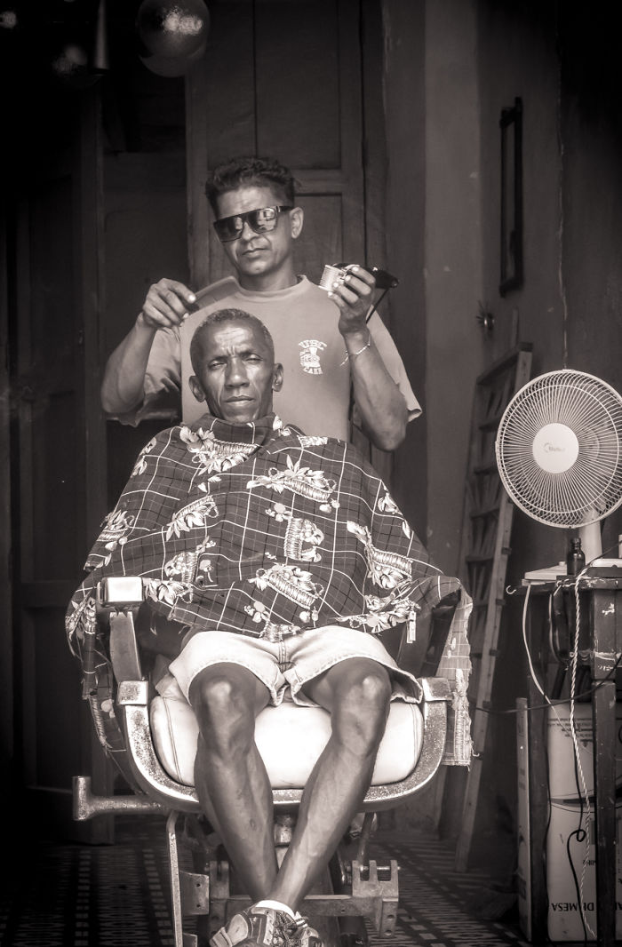

Slide 28



Slide 29


Slide 30


Slide 31


