Slide 1
Six tribes that have avoided contact with the “civilized” world.

Slide 2
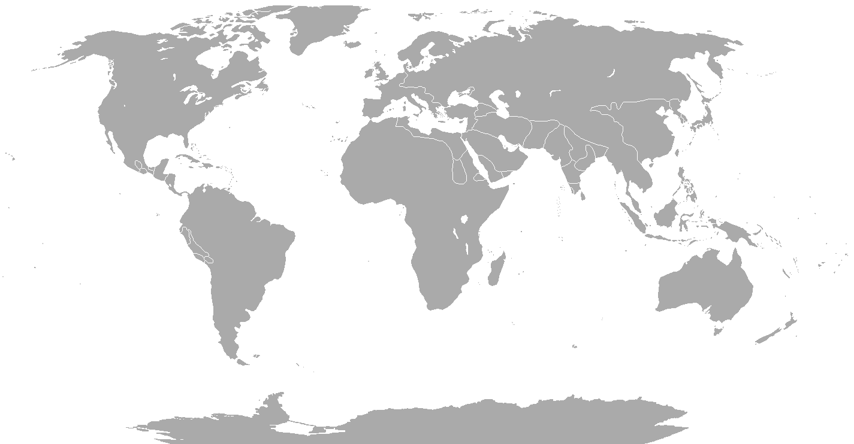

Slide 3
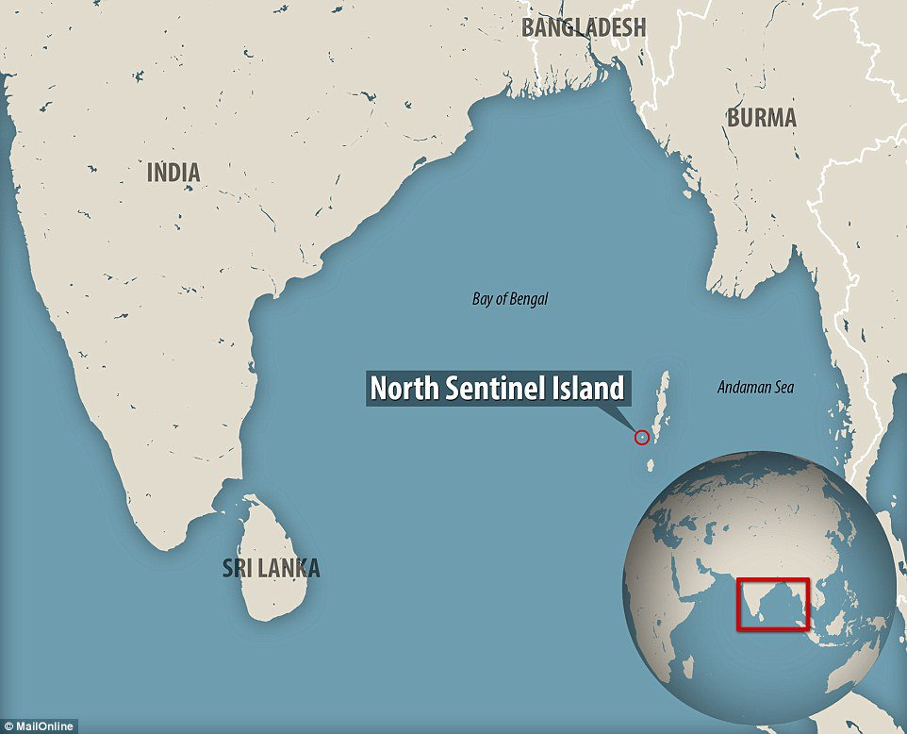
The Sentinelese people

Slide 4
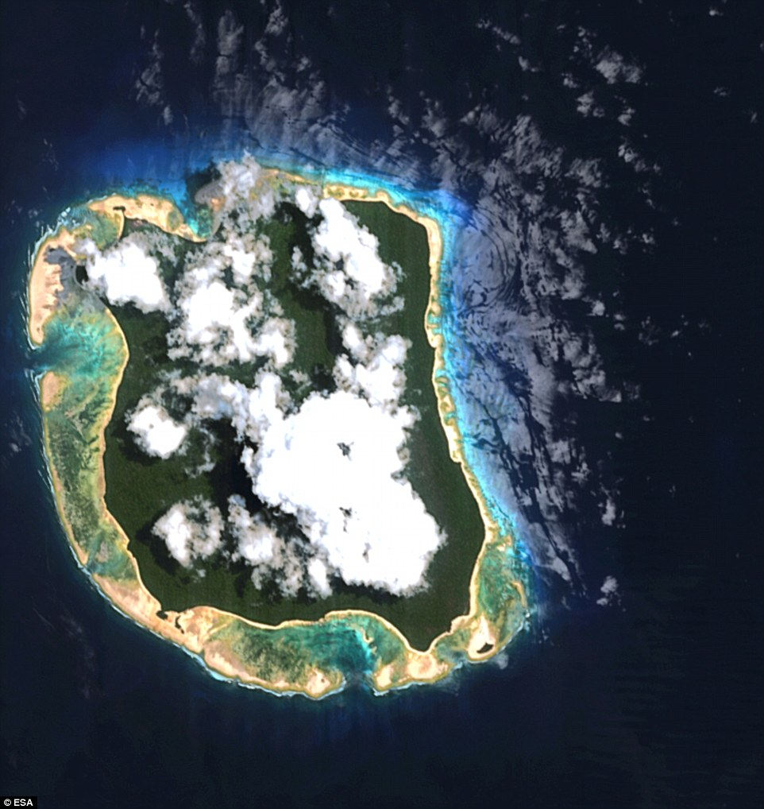

Slide 5
The Sentinelese people, also called the Sentineli, the Senteneli, the Sentenelese, and/or the North Sentinel Islanders, are an indigenous people of the Andaman Islands, in the Bay of Bengal. They inhabit North Sentinel Island, which lies westward off the southern tip of the Great Andaman archipelago. The Sentinelese maintain an essentially hunter-gatherer society subsisting through hunting, fishing, and collecting wild plants. There is no evidence of either agricultural practices or methods of producing fire. Their language remains unclassified and is not mutually intelligible with the Jarawa language of their nearest neighbors

Slide 6
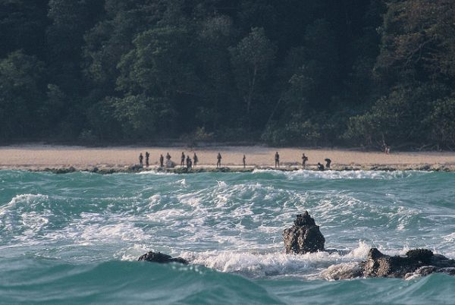

Slide 7
Isolated
North Sentinel Island is amazingly well suited to both support and isolate a tribe like the Sentinelese. It's too small to interest settlers or colonial powers, especially when there are bigger, better islands within a few hours' sailing time. And unlike many of those islands, North Sentinel has no natural harbors, so there's no good place for a ship to take shelter from a storm. Furthermore, the island is surrounded by a ring of submerged coral reefs that prevent large ships from approaching. This was especially true during the age of sail, when ships had no way of quickly maneuvering out of harm's way once they realized that the reefs were there. Narrow openings in these reefs allow small boats to slip through and land on the beach, but these are passable only in good weather and calm seas, which occur as infrequently as two months out of the year. For the remaining ten months, the island cannot be safely approached from the sea.

Slide 8
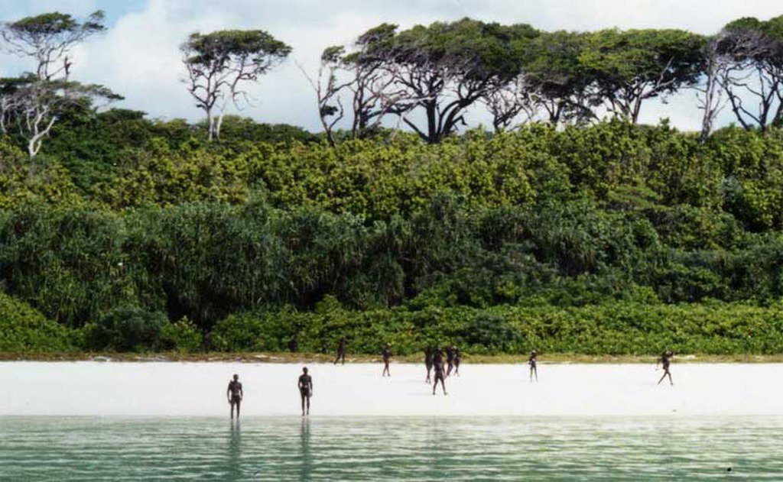
On January 26, 2006, two men were killed when fishing illegally in the area. A coastguard helicopter tried to retrieve their bodies but was unable to land because of a shower of arrows from the locals.

Slide 9
The Sentinelese are believed to have lived on the island for 60,000 years! After this unthinkable period of time in isolation, it’s no surprise that they are so hostile to outsiders, which may be due to past conflicts with the outside world. In order to protect the Tribe and prevent unnecessary violence, the Indian government has also made it illegal to approach it closer than three miles. Due to the inability to study the tribe and the island, we don’t know much about them. It is estimated that the tribe counts between 50 and 400 members and lives exclusively by hunting and gathering. Though it is difficult to observe the island from the air because of the dense tree cover, it is established that the Sentinelese are not familiar with agriculture. Their drive to protect their culture from the outside world is probably the reason they have survived in isolation for so many years. Who knows how long they will manage to live in the middle of the ocean without having the slightest interest in the “civilized” rest of the world. And perhaps being without contact with us is a good thing.

Slide 10
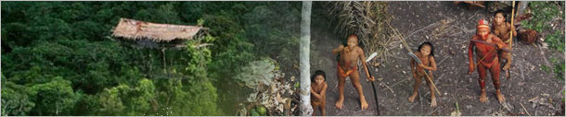
Five other Isolated Groups Who Had No Idea That Civilization Existed

Slide 11
The Korowai Tribe
The Korowai tribe of Papua, Indonesia, was first contacted in the 1970s by archaeologists and missionaries, at which point they were still using stone tools and living in wooden treehouses. Since then, they uh ... yeah, they pretty much still just do the stone tool and treehouse scene.
The Korowai believed that the entire world would be destroyed by an earthquake if they ever changed their customs.

Slide 12
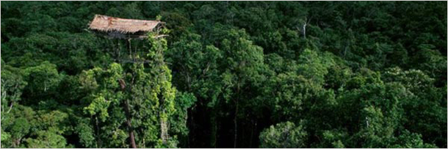
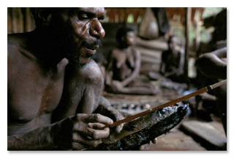

Slide 13
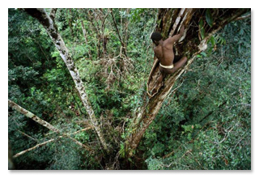

Slide 14
The Man of the Hole, aka the Loneliest Man on Earth
There is a man currently living in isolation in the Brazilian rainforest. He has been there for at least 15 years. He builds his own palm huts and digs five-foot-deep rectangular holes in the middle of each. We don't know what he uses them for, because these huts are abandoned as soon as anybody gets anywhere near them. No other people in the area build huts like this, which has led researchers to believe that this man is the last surviving member of his tribe. No one knows what language he speaks or the name of his ex-tribe, so we shall call him Rectanglor, of the Rectangulons, because he probably doesn't get the Internet in that rectangle; what's he gonna say about it?

Slide 15
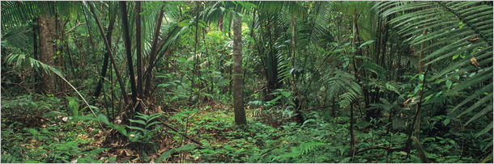

Slide 16
The Old Believers
In 1978, Soviet geologists looking for iron ore deposits by helicopter spotted a wood cabin in the remote woods of Siberia. When they returned to the cabin on foot, they found a family dressed in burlap, eating out of hand-carved vessels and apparently living off the forest. Family members huddled in astonished fear, yelling "This is for our sins!" at the newcomers. The family, the Lykovs, weren't the only ones living like this. Other, similar groups remained in isolation in the Siberian taiga at least up until 1990, largely unaware of the modern world. Listen, we don't care what their sins were: Nobody deserves burlap underwear.

Slide 17
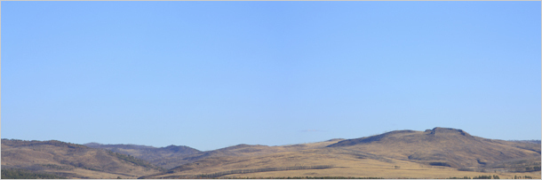
They're members of a Russian religious sect called the Old Believers, which split from the mainline Russian church in the 17th century over dogmatic changes and a particularly contentious game of Monopoly. Since then, groups of Old Believers have been fleeing from the Russian government for centuries. Some escaped overseas, some sought asylum in other countries, while others looked around the vast, empty, unfriendly expanse of Northern Russia and said, "What about just going over there? Nobody goes over there."

Slide 18
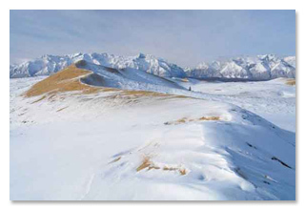

Slide 19
The Mashco-Piro Tribe
The Mashco-Piro tribe recently started making time-displaced, half-naked guest appearances beside a Peruvian river popular with Western tourists. Nobody knows why the tribe suddenly started showing up at the river, but according to specialists, so far they have mainly shown interest in metal cooking pots and machetes. So we're going to say it's either a whole tribe of Iron Chefs, or else they're melting the stuff down to build some kind of primitive machete-tank.

Slide 20
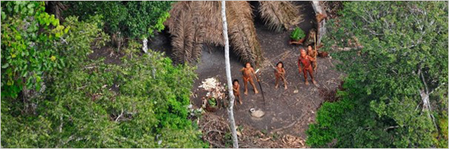
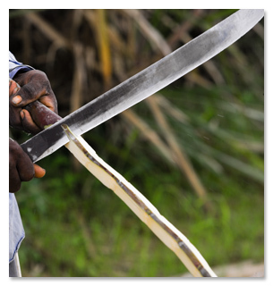

Slide 21
Peru's government opted for the controversial "not attacking all new people with chainsaws" path of diplomacy. They tried to limit exposure for the tribe, presumably not willing to risk facing the wrath of the Mashco Machetank, and banned tourists from going ashore on the river to make contact. Unfortunately, now private operators in Peru have started offering "human safaris" where oblivious tourists with a misplaced sense of entitlement to all of human history can deliberately seek out uncontacted tribes. In short, Peru tried to do the right thing and not screw with a whole group of people by sending in anthropologists and greedy developers, but now an entire society's only impression of the civilized world is fat Dutch tourists in fanny packs snapping Instagram photos of their "savage" wangs.

Slide 22
The Pintupi Aboriginals
In 1984, a small group from the Pintupi tribe ran into a white person in the desert. This doesn't sound too strange, until you consider that this was the first time anyone in the indigenous group had seen a white person, and that Australia was first infested by honkeys all the way back in 1788. One Pintupi later said that he mistook the "pink man" he saw for an evil spirit at first. Then, learning what pink dudes did to the rest of the aborigines on the continent, decided to stick with that assessment. Luckily, the Pintupi missed the race-massacre window by a few decades, and instead their first meeting with the white man involved being invited into a Toyota and then going for a joyride in the desert while Australian rock band Midnight Oil blasted on the radio.

Slide 23
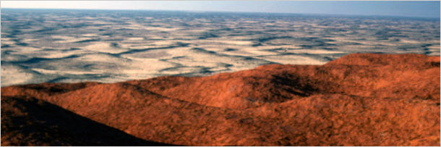
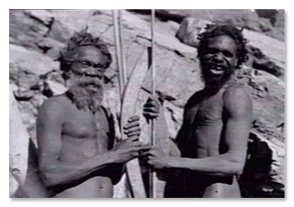
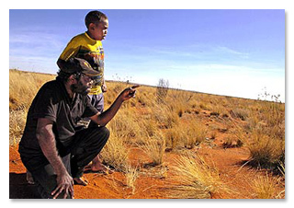

Slide 24
They were two things: nomadic, and in Australia. Pretty much either of those traits involves possibly not seeing another human being for decades. When you put them both together, you basically get a tribe of Aussie ninjas. In fact, the group almost didn't get discovered at all. Shortly before they ran into white people for the first time, the Pintupi attempted contact with a group of Westernized Australian aboriginals. Unfortunately, the nomads' appearance, which included belts made out of human hair and six-foot-long spears, was bizarre enough to scare even Australians, a people who voluntarily live in Nature's end boss level. One of the Westernized Australians fired a warning shot into the air with a rifle, and the Pintupi fled.

Slide 25
Common feature
These groups live in difficult environments – places were few people would want to go or places that were difficult to access. What little awareness they may have had of “civilized” people were more than likely negative which reinforced their desire to remain separate from the rest of humanity.

