Slide 1
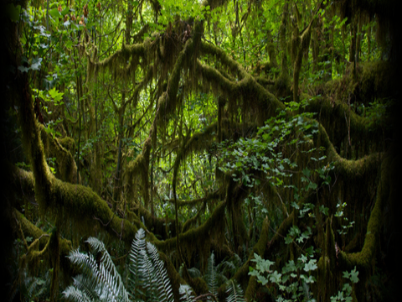
Places In Each of the Guianas!
Often not considered part of Latin America – No “official” Spanish or Portuguese is spoken in them
Places In Each of the Guianas!•
Notes:
Animated, scrolling text over rainforest background
(Basic)
To reproduce the text effects on this slide, do the following:
On the Home tab, in the Slides group, click Layout, and then click Blank.
On the Insert tab, in the Text group, click Text Box, and then on the slide, drag to draw the text box.
Enter text in the text box. (Note: You may want to add a bullet point at the end of your text, as in the example above. On the Insert tab, in the Text group, click Symbol. In the Symbol dialog box, in the Font list, select (normal text). In the Subset list, select General Punctuation. In the Character Code box, enter 2022 to select BULLET, and then click Insert.)
Select the text. On the Home tab, in the Font group, do the following:
In the Font list, select Gill Sans MT.
In the Font Size list, select 36.
Click Bold.
Click the arrow next to Font Color, and then under Theme Colors click White, Background 1 (first row, first option from the left).
On the Home tab, in the Paragraph group, click Align Text Left to align the text left in the text box. (Note: If the text wraps to more than one line, drag the adjustment handles on the text box to widen it until the text fits on one line.)
Drag the text box to the left of the lower left edge of the slide. (Note: To see beyond the edges of the slide, on the View tab, click Zoom, and then in the Zoom dialog box, in the Percent box, enter 40%.)
To reproduce the animation effects on this slide, do the following:
On the Animations tab, in the Advanced Animation group, click Add Animation, and then under Entrance click Fly In.
On the Animations tab, in the Animation group, click the Show Additional Effect Options dialog box launcher. In the Fly In dialog box, do the following:
on the Effect tab, under Settings, in the Direction list, click From Right.
On the Timing tab, In the Start list, select With Previous.
In the Duration box, enter 16 seconds.
In the Repeat list, select Until End of Slide.
On the slide, select the text box. On the Home tab, in the Clipboard group, click the arrow next to Copy, and then click Duplicate.
Select the second text box. On the Animations tab, in the Timing group, in the Delay box, estimate the number of seconds required for the first text string to scroll into the slide and enter that amount. The example above uses 8 seconds. Your text may require more or less time. Adjust the Delay setting as necessary to make the second text string immediately follow the first.
On the slide, drag the second text box on top of the first text box.
On the slide, select both text boxes. On the Home tab, in the Drawing group, click Arrange, point to Align, and then do the following:
Click Align Selected Objects.
Click Align Middle.
Click Align Center.
To reproduce the background effects on this slide, do the following:
On the Design tab, in the Background group, click Background Styles, and then click Format Background. In the Format Background dialog box, click Fill in the left pane, and then select Picture or texture fill in the Fill pane. Under Insert from, click File. In the Insert Picture dialog box, select a picture, and then click Insert.
On the Home tab, in the Drawing group, click Shapes, and then under Rectangles click Rectangle (first option from the left). On the slide, drag to draw a rectangle.
Select the rectangle. Under Drawing Tools, on the Format tab, in the Size group, do the following:
In the Shape Height box, enter 7.5”.
In the Shape Width box, enter 1”.
Under Drawing Tools, on the Format tab, in the Shape Styles group, click Shape Outline, and then click No Outline.
Also on the Format tab, in the Shape Styles group, click Shape Fill, click Gradient, and then click More Gradients. In the Format Shape dialog box, click Fill in the left pane, select Gradient fill in the Fill pane, and then do the following:
In the Type list, select Linear.
Click the button next to Direction, and then click Linear Right (first row).
Under Gradient stops, click Add gradient stops or Remove gradient stops until two stops appear in the slider.
Also under Gradient stops, customize the gradient stops as follows:
Select the first stop in the slider, and then do the following:
In the Position box, enter 0%.
Click the button next to Color, and then under Theme Colors click Black, Text 1 (first row, second option from the left).
In the Transparency box, enter 0%.
Select the next stop in the slider, and then do the following:
In the Position box, enter 100%.
Click the button next to Color, and then under Theme Colors click Black, Text 1 (first row, second option from the left).
In the Transparency box, enter 100%.
On the slide, select the rectangle. On the Home tab, in the Drawing group, click Arrange, point to Align, and then do the following:
Click Align to Slide.
Click Align Left.
Click Align Middle.
Select the rectangle. On the Home tab, in the Clipboard group, click the arrow next to Copy, and then click Duplicate.
Select the duplicate rectangle. Under Drawing Tools, on the Format tab, in the Shape Styles group, click Shape Fill, point to Gradient, and then click Linear Left (second row).
With the duplicate rectangle still selected, on the Home tab, in the Drawing group, click Arrange, point to Align, and then do the following:
Click Align to Slide.
Click Align Right.
Click Align Middle.

Slide 2
The Guianas aren't often thought of as a travel destination, but they have much to offer. These South American former colonies of various European empires that rose and fell since medieval times are a big melting pot of European, Caribbean and indigenous cultures. Guyana is English-speaking, whereas Suriname is Dutch-speaking, and French Guiana is obviously French-speaking. While the former two are now sovereign states in their own right, French Guiana is still considered to be a part of France - an overseas territory. Discover the best destinations to visit in these fascinating countries:

Slide 3
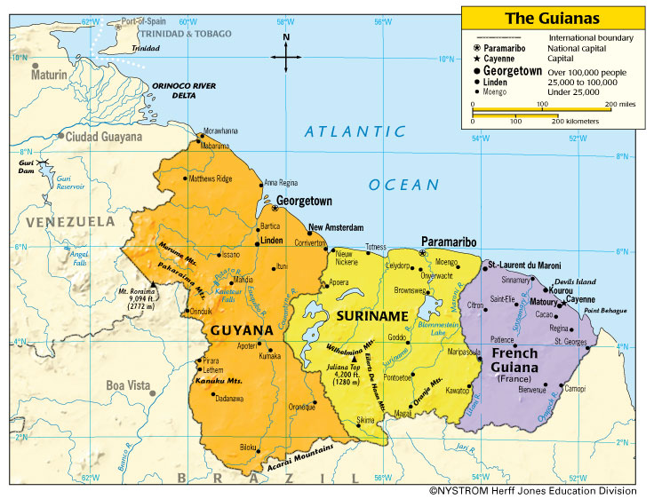
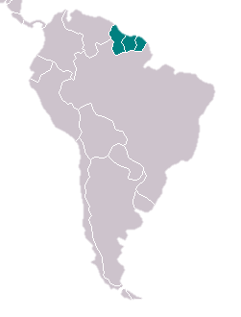
Venezuela
Brazil

Slide 4
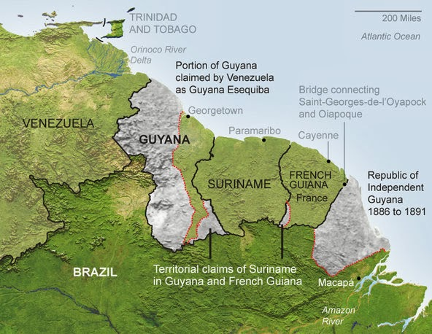
Boundary Disputes

Slide 5
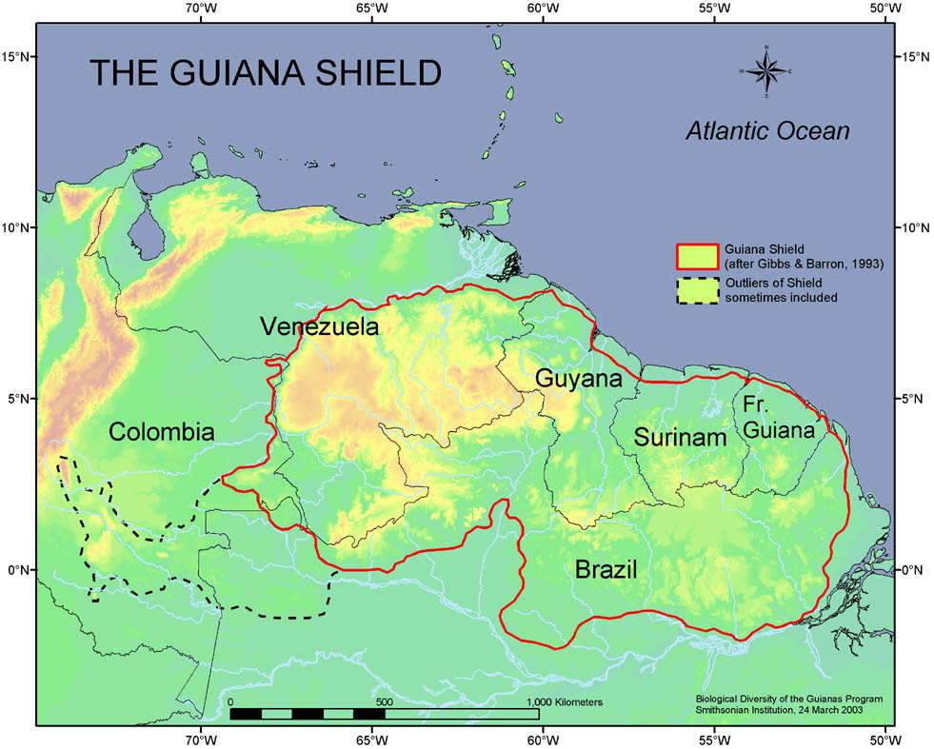

Slide 6
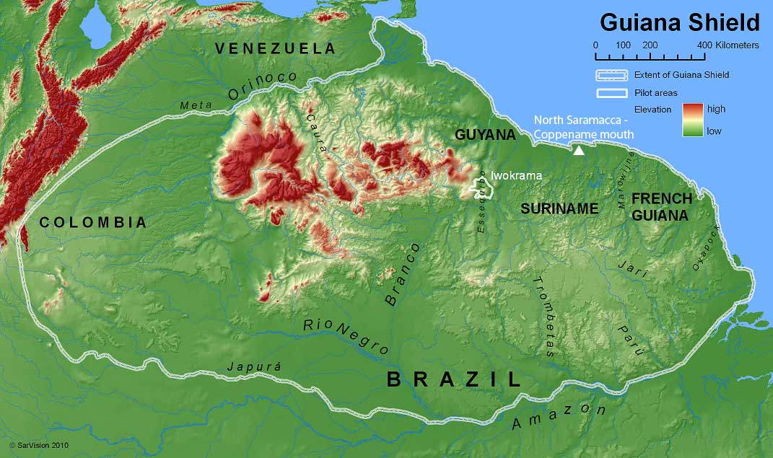

Slide 7
Guyana

Slide 8
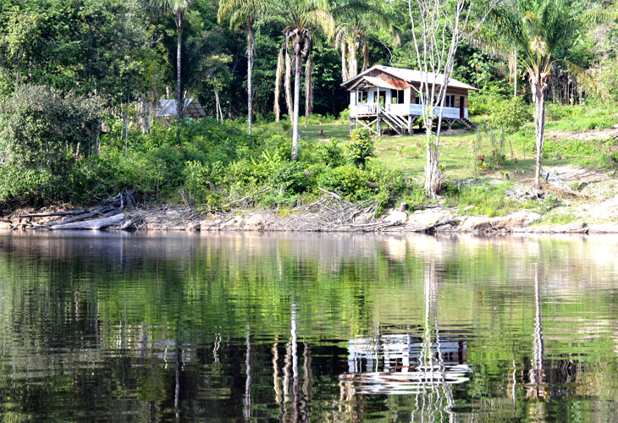
4. Linden

Slide 9
For nearly a century, this settlement was Guyana’s mining hub, with many prospectors and miners seeking their fortunes here. They came to mine bauxite, which is one of the substances used to produce aluminum. Following the early days as a tented outpost, Linden became increasingly mechanized. Nowadays, many of the shaft mines are no longer operational. Be sure to take a trip to Gluck Island on the Essequibo River, where you’ll be able to see red howler monkeys and plenty of tropical birds.

Slide 10
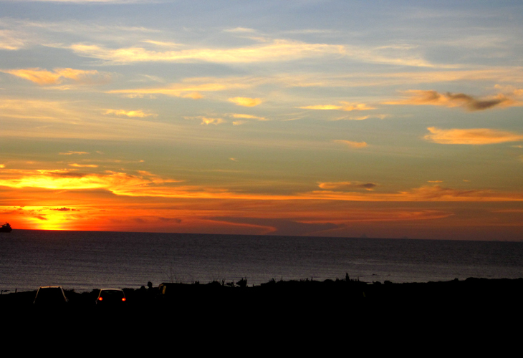
3. Kanuku Mountains

Slide 11
This mountain range is home to numerous great peaks, which are divided down the middle by the long and winding water channels of the Rupununi River. Either side of the river’s banks are diamond-shaped highland regions that are home to a whole myriad of mammalian species and old growth forests. If you fancy traveling to this part of Guyana, be warned that it’s rather remote – you have to traverse great stretches of savannah before getting here. Expect to see harpy eagles and giant otters in the area.

Slide 12
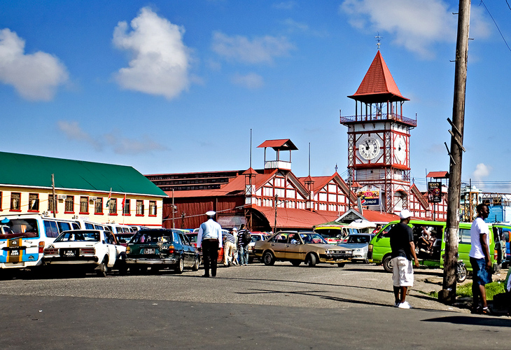
2. Georgetown

Slide 13
It’s sad to think that the Guyanese capital’s glory days are long gone, but there’s still much to see in this old colonial city. During the colonial era, Georgetown actually went from Dutch, to French, then British rule. Each of the great powers left a piece of themselves within the city, from Stabroek market, to the whitewashed St. George’s Cathedral. Should you want to familiarize yourself with the local history, a visit to the national museum wouldn’t go amiss. You can also sample the delights of the nearby Demerara Rum Distillery if you fancy a drink!

Slide 14
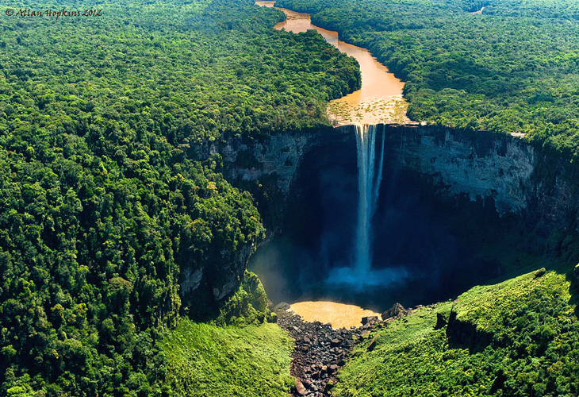
1. Kaieteur Falls

Slide 15
This is the largest single drop waterfall in the world by volume of water. It’s also four times as high as Niagara Falls. The waterfall is located in Kaieteur National Park in the middle of Guyana’s rainforest, so you’ll need to catch a plane from Georgetown if you really must see it. However, a huge added bonus is that you’re ly to have the entire place almost to yourself, which is a rarity when you consider the popularity of the world’s other major waterfalls.

Slide 16
Official languages | English
Recognised regional languages | 9 languages
Vernacular language | Guyanese Creole
Other languages | 6 languages
Ethnic groups (2002) | 43.45% Indian 30.2% Black (African) 16.73% Mixed 9.16% Amerindian 0.2% Portuguese 0.19% Chinese 0.06% European 0.01% Others ^{[1}

Slide 17
Religion | 57.4% Christian 28.4% Hindu 7.2% Muslim 0.5% Rastafarian 0.1% Bahá'í 1.3% Other 0.9% Not Stated 1.4% None
Government | Unitary presidential republic
Legislature | National Assembly

Slide 18
Area
• Total | 214,970 km² (83,000 sq mi) (85th)
• Water (%) | 8.4
Population
• 2016 estimate | 735,909^{[3]} (165th)
• 2012 census | 747,884^{[4]}
• Density | 3.502/km² (9.1/sq mi) (232nd or 8th least-densely populated in the world)

Slide 19
GDP (PPP) | 2016 estimate
• Total | $6.093 billion^{[5]}
• Per capita | $7,919^{[5]}
GDP (nominal) | 2016 estimate
• Total | $3.456 billion^{[5]}
• Per capita | $4,492^{[5]}
GDP per capita (PPP based) is gross domestic product converted to international dollars using purchasing power parity rates and divided by total population. An international dollar has the same purchasing power over GDP as a U.S. dollar has in the United States
Nominal GDP is gross domestic product (GDP) evaluated at current market prices, GDP being the monetary value of all the finished goods and services produced within a country’s borders in a specific time period. Nominal differs from real GDP in that it includes changes in prices due to inflation or a rise in the overall price level.

Slide 20
Exports
  US$621.6 million (2006 estimate)
  sugar, gold, bauxite/alumina, rice, shrimp, molasses, rum, timber
Imports
  US$706.9 million (2006 estimate)
  manufactured items, machinery, petroleum, food
Major trading partners
  Canada, US, UK, Portugal, Jamaica, Trinidad and Tobago, China, Cuba, Singapore, Japan , Brazil, Suriname (2009)

Slide 21
Other scenes from Guyana

Slide 22
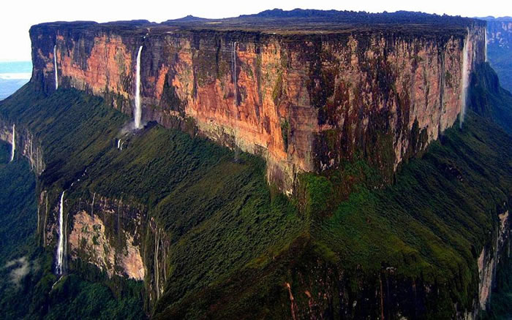

Slide 23
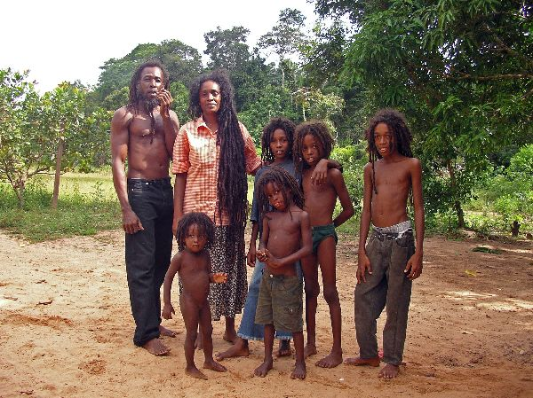

Slide 24
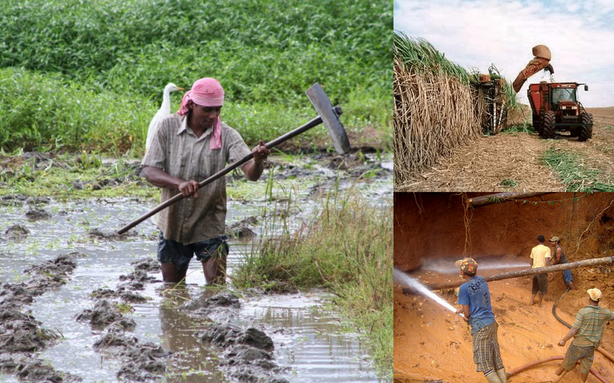

Slide 25
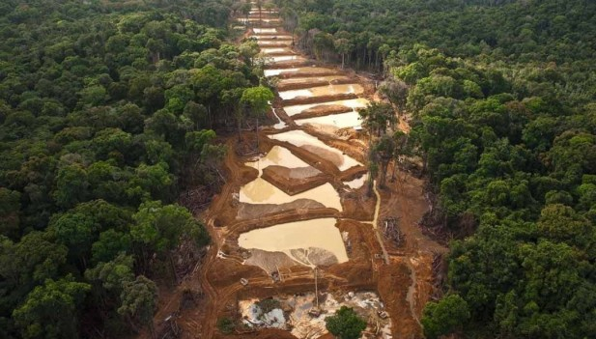

Slide 26
Suriname

Slide 27
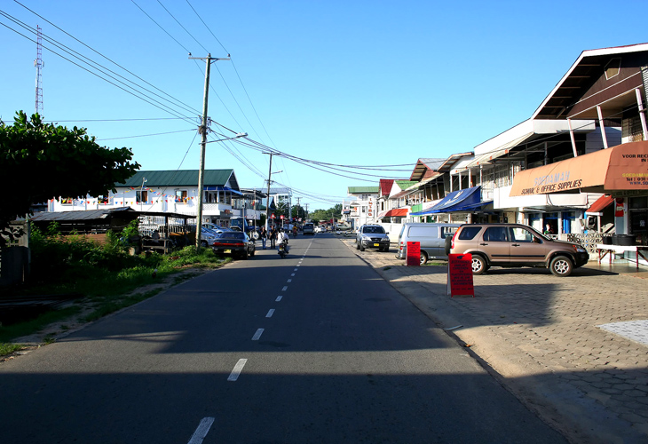
4. Nieuwe Nickerie

Slide 28
Although only just over 12,000 people call this town home, it’s actually the third-largest settlement in Suriname. It was once the main center for the collection of gutta-balata, which is latex that’s extracted in a similar way to how rubber is extracted from rubber trees. Nowadays, the local economy is served by nearby rice and banana plantations. The Bigi Pan, a swamp and reservoir that’s home to over 100 bird varieties, is worth visiting when you’re in the town, as are the plantations and the port.

Slide 29
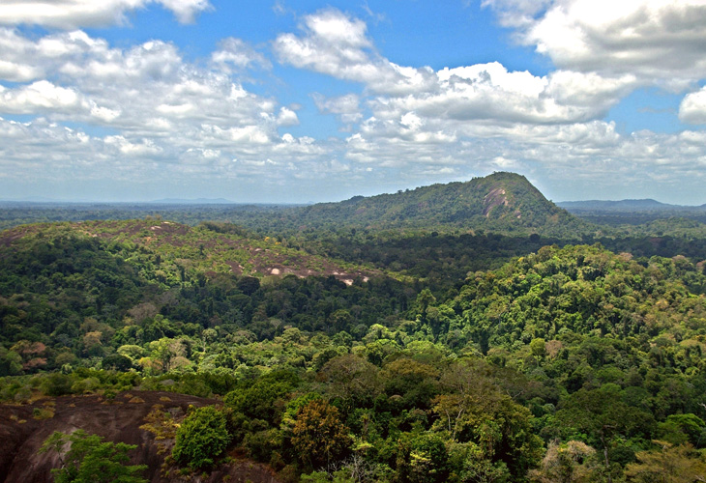
3. Central Suriname Nature Reserve

Slide 30
Some 12% of Suriname’s entire land area is protected by this nature reserve, which is home to many plants and animals that can only be found in the Guianas. Raleigh Falls is one of the main attractions in the reserve – it’s a long and low staircase of water that cascades down from the Coppename River. Spider monkeys, electric eels and a breath-taking array of exotic birds can be seen in the area. If you’re a keen hiker, you can make your way up Voltzberg, a 240-meter-high granite dome that offers spectacular 360-degree views of the surrounding jungle.

Slide 31
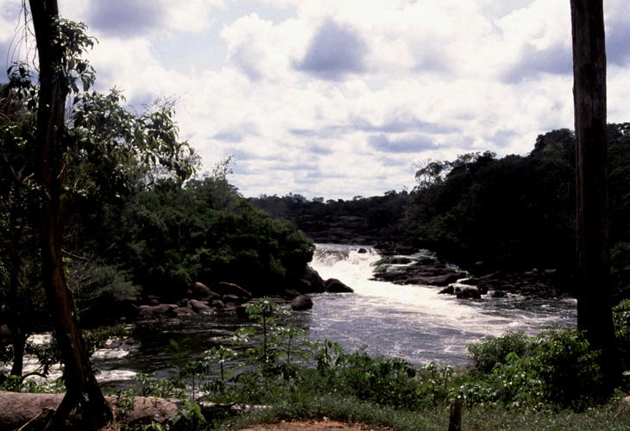
2. Galibi Coppename Nature Reserve

Slide 32
This beautiful nature reserve was first established back in 1969, and is situated at the mouth of the Coppename River. Birdwatchers love coming here, because they can see plenty of different and exotic species. In addition, nature lovers can also spot endangered manitees, as well as the largest extant species of turtle in the world – the leatherback. The Foundation for Nature Conservation in Suriname organizes several tours at the reserve to promote conservation, research and responsible tourism. Laying season (April to August) for leatherback turtles is a great time to visit.

Slide 33
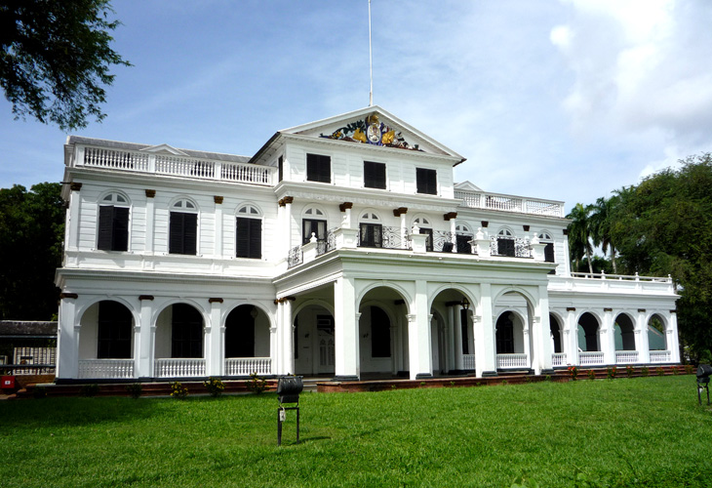
1. Paramaribo

Slide 34
Many people say that this is by far the most interesting capital city in the Guianas, and I happen to agree. It’s a high-energy city that’s got plenty of things to see and do. The Dutch colonial inner city is a UNESCO World Heritage Site, and the colonial architecture that abounds throughout is really pretty. For lunch, be sure to stop at one of the many Indian roti shops found throughout the city. What’s particularly interesting about this city is that it’s highly multi-ethnic, which isn’t something you really expect to find in a former Dutch colony on the shores of the Atlantic Ocean.

Slide 35
Official languages | Dutch
Recognized regional languages | Sranan Tongo creole Sarnami Hindustani (Bhojpuri) Javanese
Ethnic groups (2012) | 27.4% East Indian 21.7% Maroon 15.7% Creole/Afro-Surinamese^{[1]} 13.7% Javanese 13.4% Mixed 1% White 7.2% others^{[2][3][4]}

Slide 36
Government | Unitary parliamentary republic
Legislature | National Assembly
Area
• Total | 163,821 km² (63,252 sq mi) (92nd)
• Water (%) | 1.1
Population
• July 2014 estimate | 573,311^{[5]} (166th)
• 2012 census | 541,638^{[3]}
• Density | 2.9/km² (7.5/sq mi) (231st)

Slide 37
GDP (PPP) | 2014 estimate
• Total | $9.188 billion^{[6]}
• Per capita | $16,623^{[6]}
GDP (nominal) | 2014 estimate
• Total | $5.297 billion^{[6]}
• Per capita | $9,583^{[6]}
Trade: Exports (2012): $2.563 billion: alumina, gold, crude oil, lumber, shrimp and fish, rice, bananas. Major consumers: US 26.1%, Belgium 17.6%, UAE 12.1%, Canada 10.4%, Guyana 6.5%, France 5.6%, Barbados 4.7%.^{[5]}
Imports (2012): $1.782 billion: capital equipment, petroleum, foodstuffs, cotton, consumer goods. Major suppliers: US 25.8%, Netherlands 15.8%, China 9.8%, UAE 7.9%, Antigua and Barbuda 7.3%, Netherlands Antilles 5.4%, Japan 4.2%.^{[5]}

Slide 38
More scenes of Suriname

Slide 39
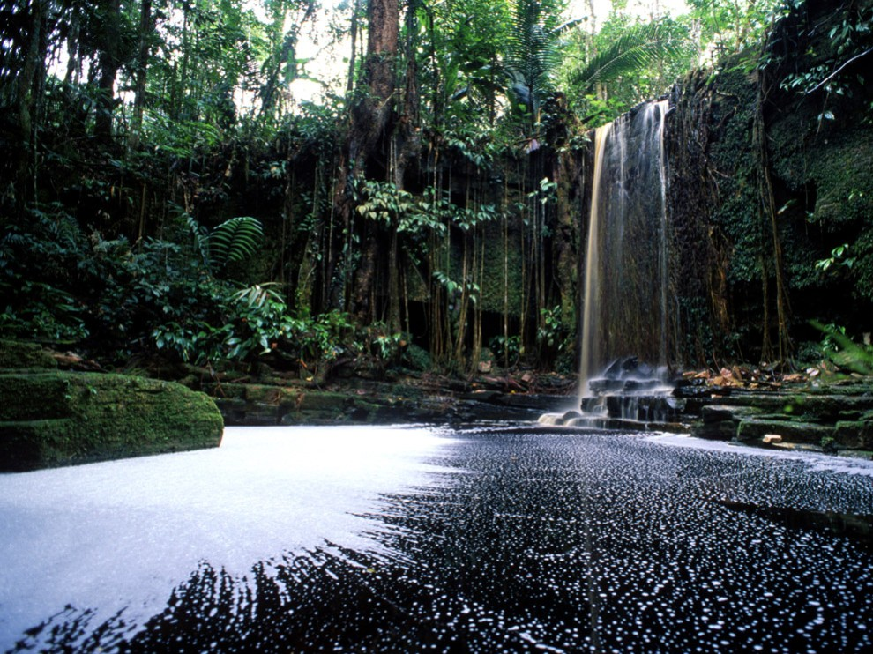

Slide 40
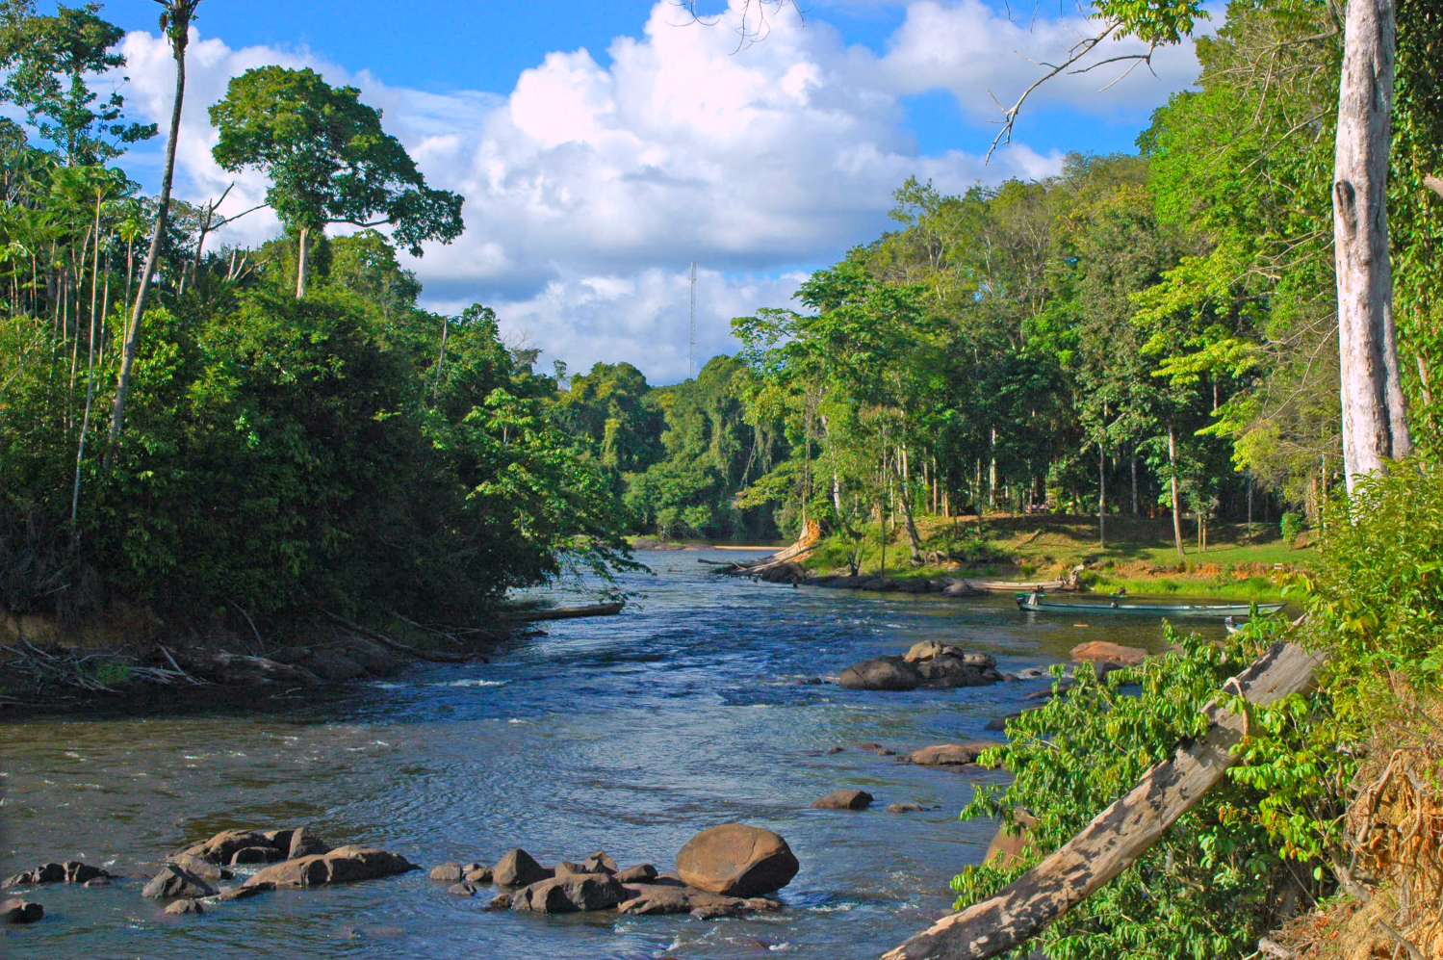

Slide 41
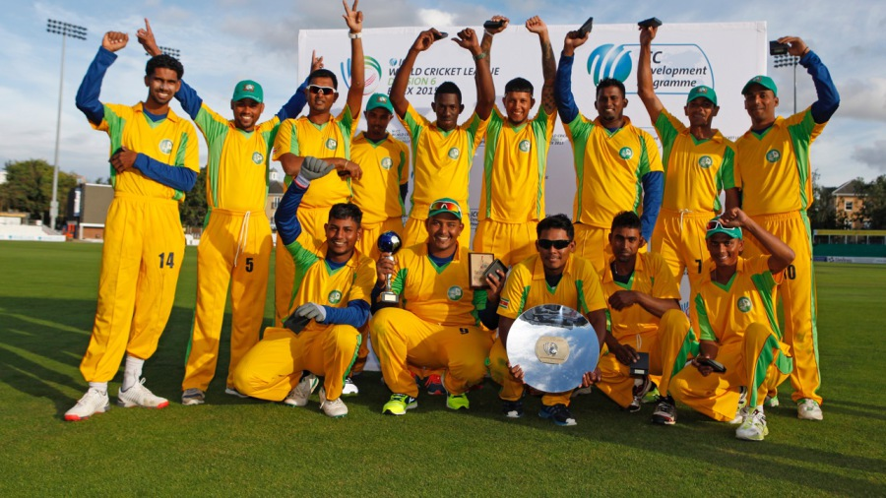

Slide 42
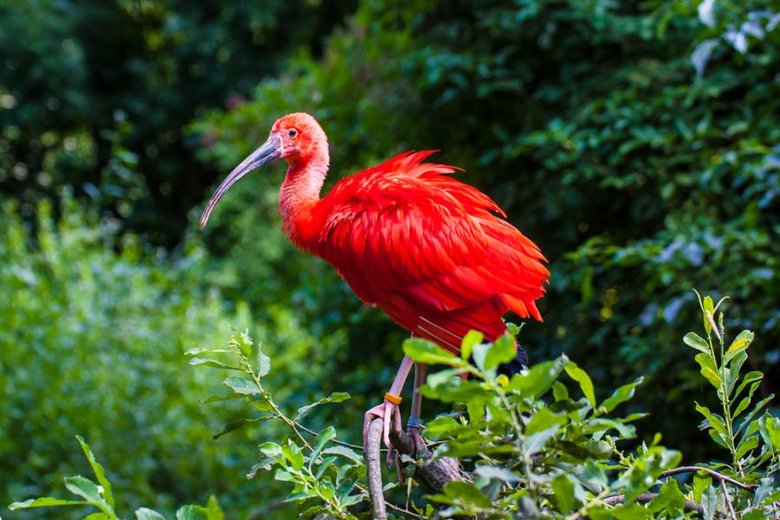

Slide 43
French Guiana

Slide 44
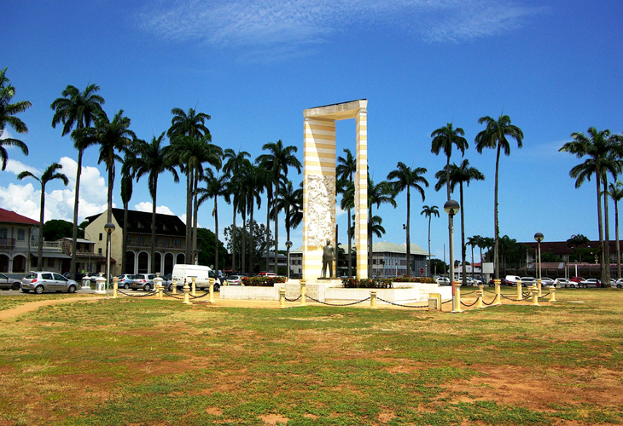
4. Cayenne

Slide 45
Lying on the banks of the Cayenne River estuary that empties into the Atlantic, Cayenne was founded by the French in 1643, with the first permanent settlement being established in 1664. The next 100 years saw Cayenne change hands between the French, Dutch and English, and the mid-19th Century saw it turned into a French penal colony. In the modern-day city, be sure to go people-watching along the palm-tree-lined Place des Palmistes, visit the central market to find yourself a piece of fine Amerindian basketry, and be a culture vulture at the Museum of Guianan Culture.

Slide 46
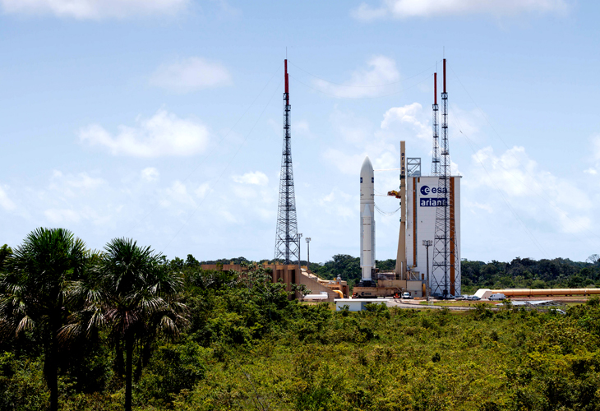
3. Guiana Space Center

Slide 47
Who would have thought that a little tropical country such as French Guiana would be home to a space center? The one in question was established back in 1964, when the French government decided that the location it selected would be perfect due to the region’s low population density and distance from storm tracks and earthquake zones. The European Space Agency, the French Space Agency and Arianespace all operate here. If you happen to be in the country at the right time, you might even get to witness a space launch from the jungle! Up to nine launches take place at the Guiana Space Center every year.

Slide 48
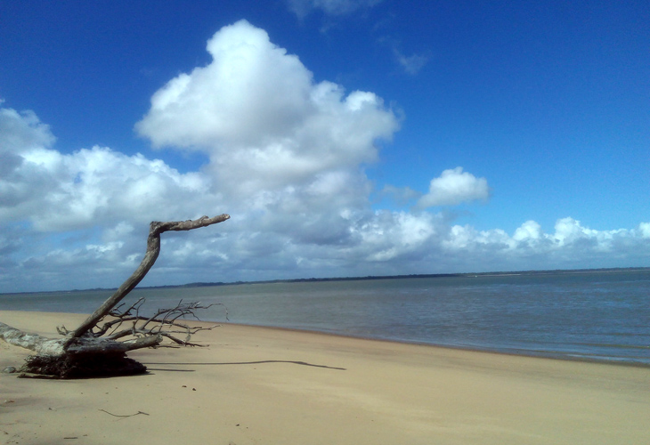
2. Hattes Beach

Slide 49
This beach is the single most important nesting site for leatherback turtles in the entire world, with up to 80 of them hauling themselves up it to lay their eggs every single night during nesting season. These gentle creatures are 6 ½ feet long on average and weigh around 900lbs. Many Amerindian settlements also lie in the vicinity of this most ecologically-important of beaches, which offer you a great opportunity to take in what life was before European settlers established their various colonies in the region.

Slide 50
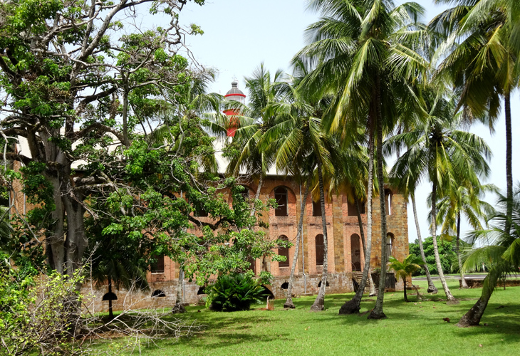
1. Salvation Islands

Slide 51
These devastatingly beautiful islands belie their dark history – they were once home to the infamous Devil’s Island, a French penal colony. France’s worst criminals (together with the wrongfully-convicted) were sent here to endure hard labor and horrific conditions with almost no chance of ever making it out alive. The seven-mile stretch to the Guianan mainland is infested with sharks, but that didn’t deter the s of Papillon from attempting to escape. On your visit, you’ll ly arrive at Isle Royale, which is the largest of the three islands. Nowadays, you can enjoy the old buildings that have been converted into hotels, together with an abundant array of wildlife.

Slide 52
Country | France
Prefecture | Cayenne
Departments | 1
Government
• President of the Assembly | Rodolphe Alexandre (PSG)
Area
• Total | 83,534 km² (32,253 sq mi)
Population (January 2013)^{[1]}
• Total | 250,109
• Density | 3.0/km² (7.8/sq mi)

Slide 53
GDP (2012)^{[2]} | Ranked 27th
Total | €3.8 billion (US$4.9 bn)
Per capita | €15,400 (US$20,000)
As a part of France, French Guiana is part of the European Union and the Eurozone; its currency is the euro. French Guiana is heavily dependent on mainland France for subsidies, trade, and goods.The main traditional industries are fishing (accounting for 5% of exports in 2012), gold mining (accounting for 32% of exports in 2012) and timber (accounting for 1% of exports in 2012).^{[15]} In addition, the Guiana Space Centre has played a significant role in the local economy since it was established in Kourou in 1964: it accounted directly and indirectly for 16% of French Guiana's GDP in 2002 (down from 26% in 1994, as the French Guianan economy is becoming increasingly diversified).^{[16]} The Guiana Space Centre employed 1,659 people in 2012.^{[17]}

Slide 54
Other scenes of French Guiana

Slide 55
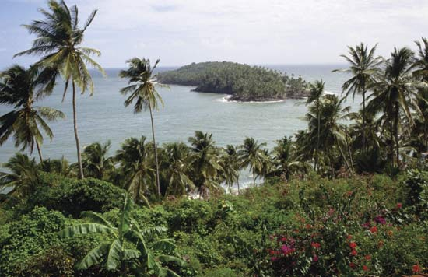
Devil’s Island

Slide 56
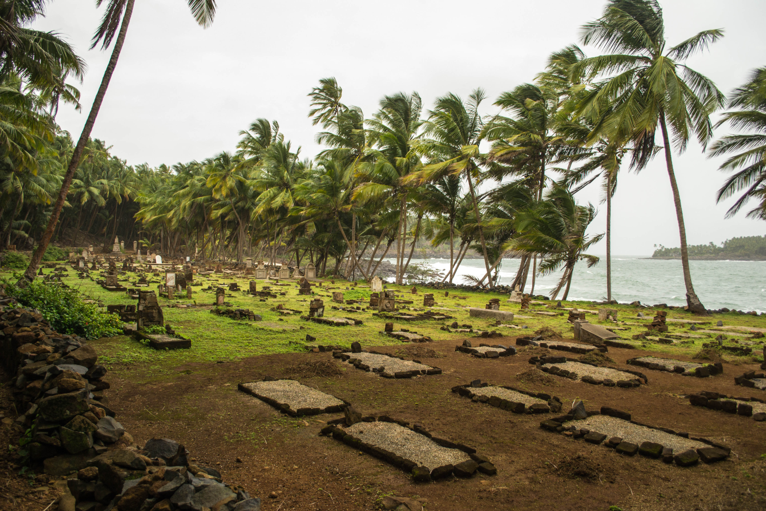
Devil’s Island

Slide 57
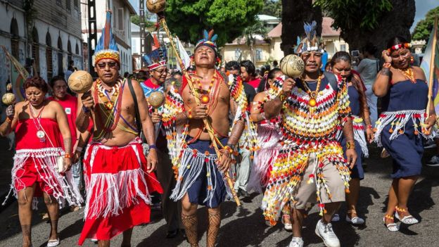

Slide 58
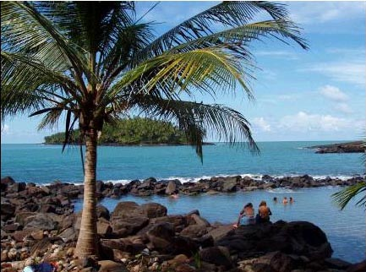

Slide 59
Flora and Fauna of the Guianas

Slide 60
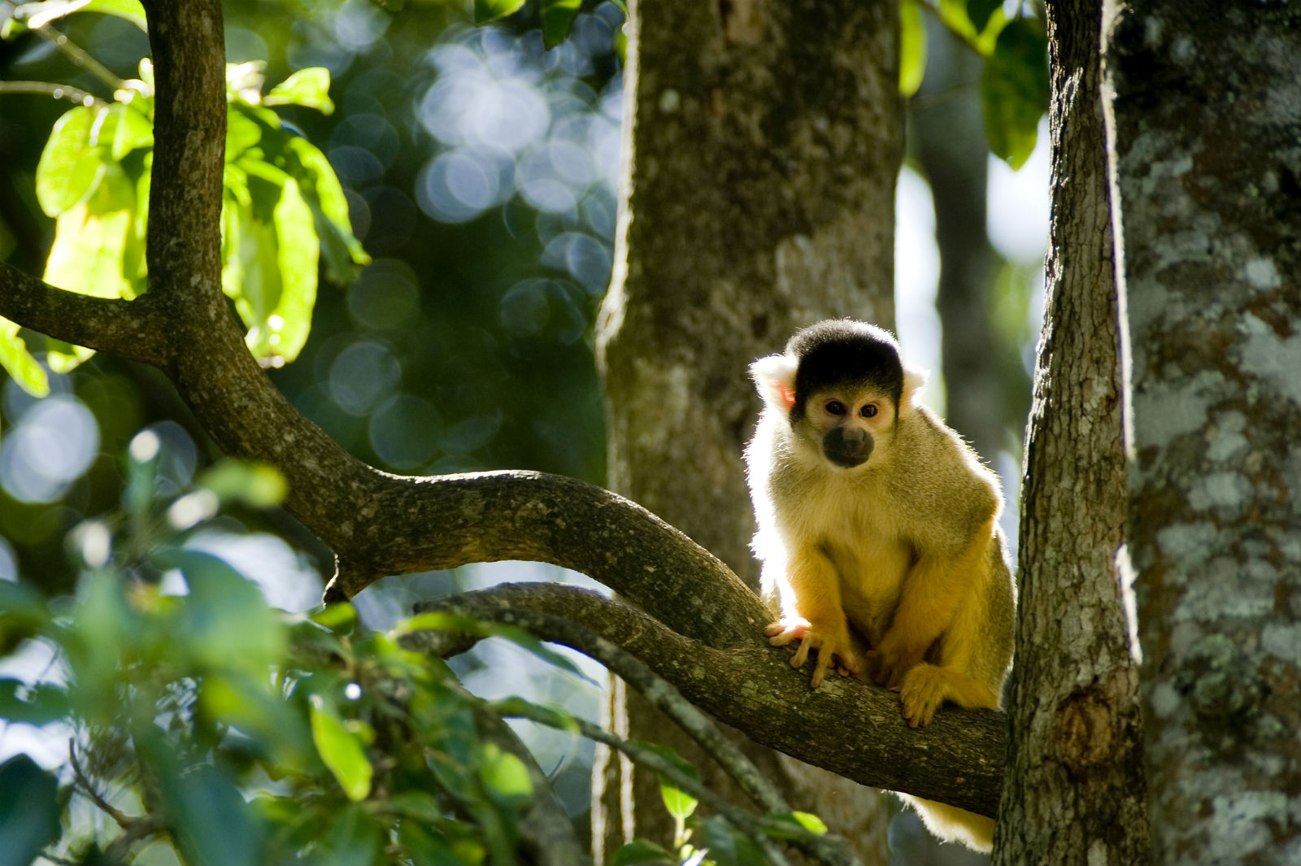

Slide 61
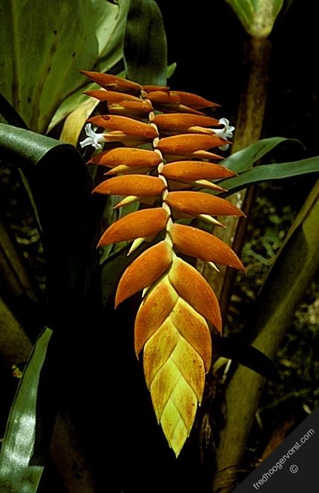
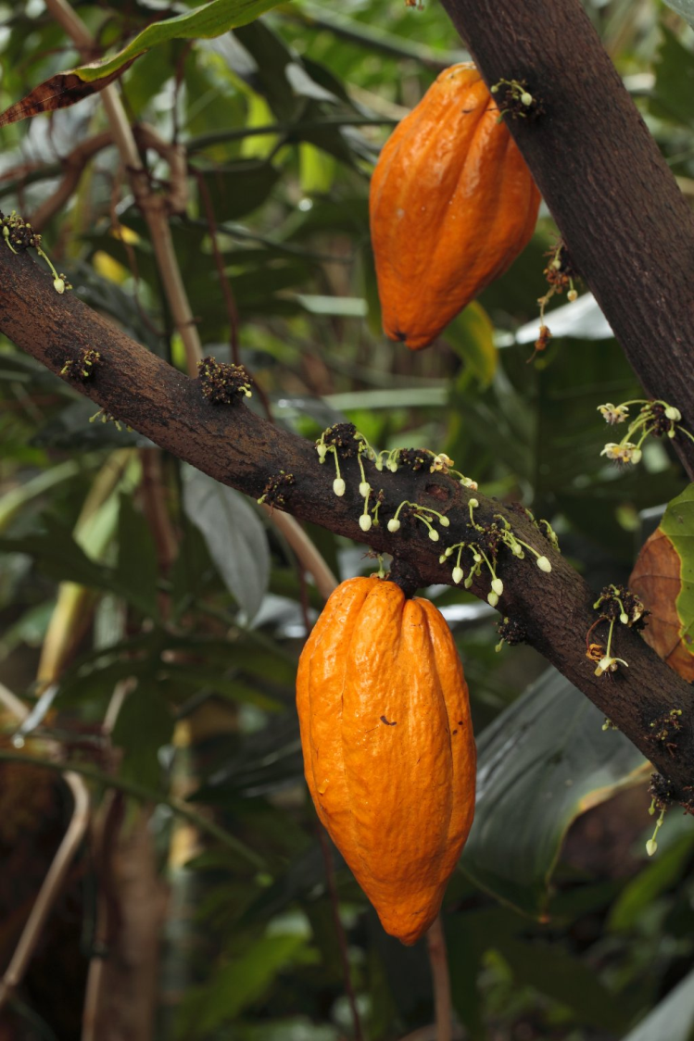

Slide 62
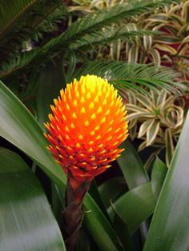
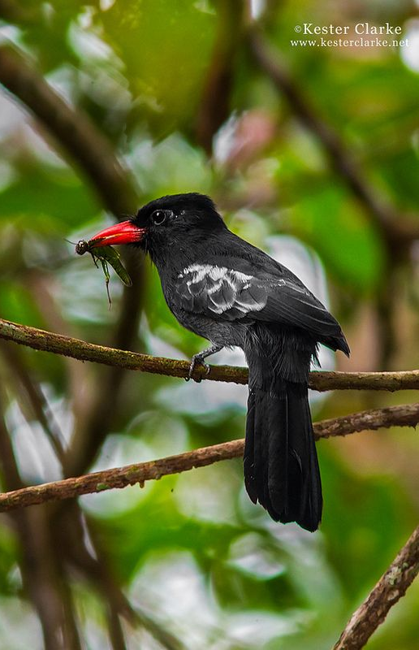

Slide 63
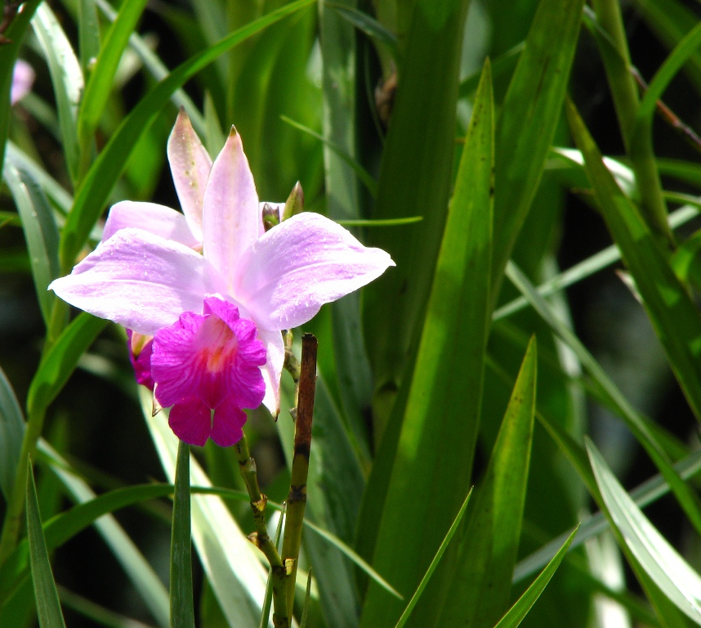
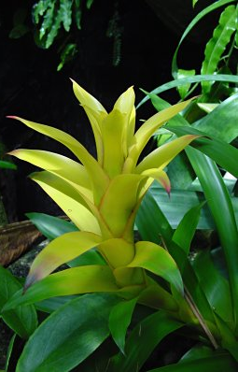

Slide 64
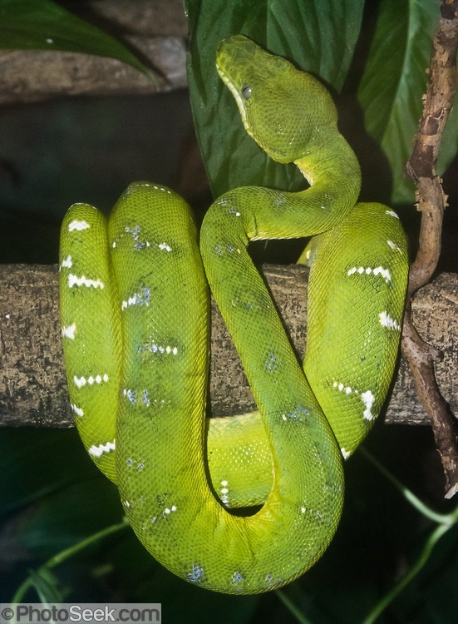
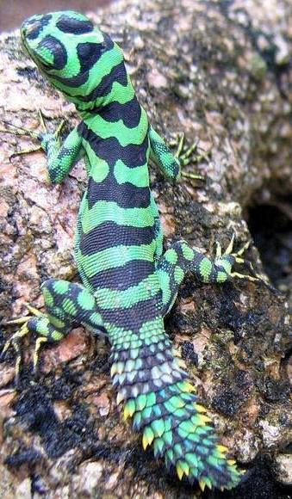

Slide 65
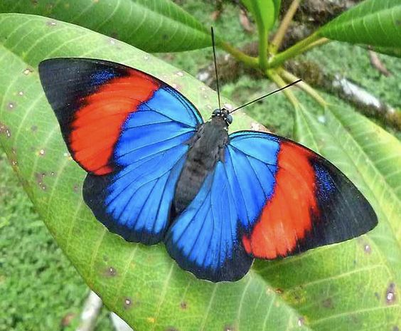

Slide 66
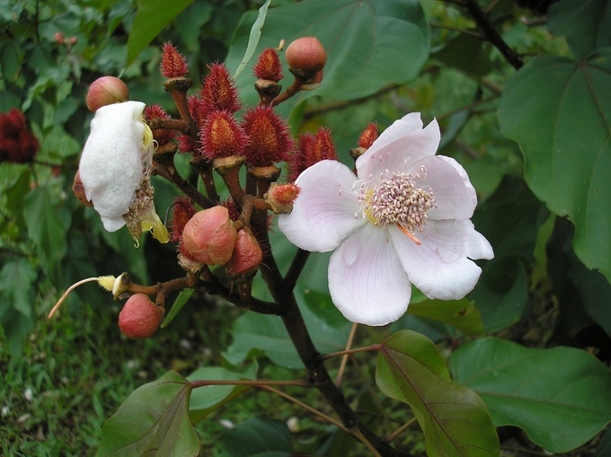

Slide 67
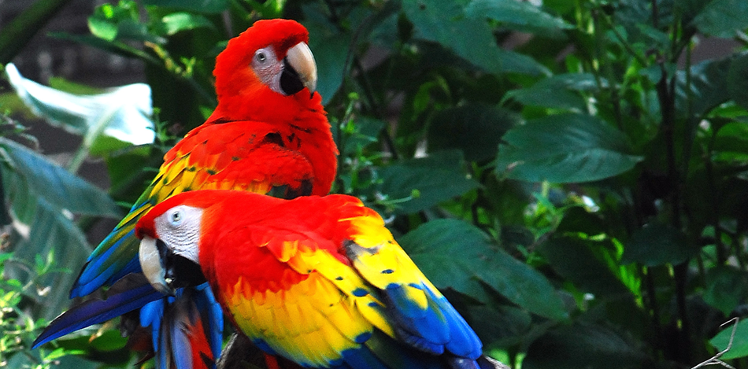

Slide 68
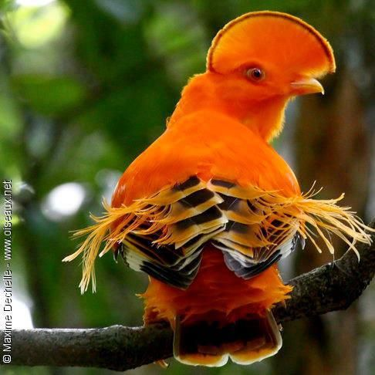
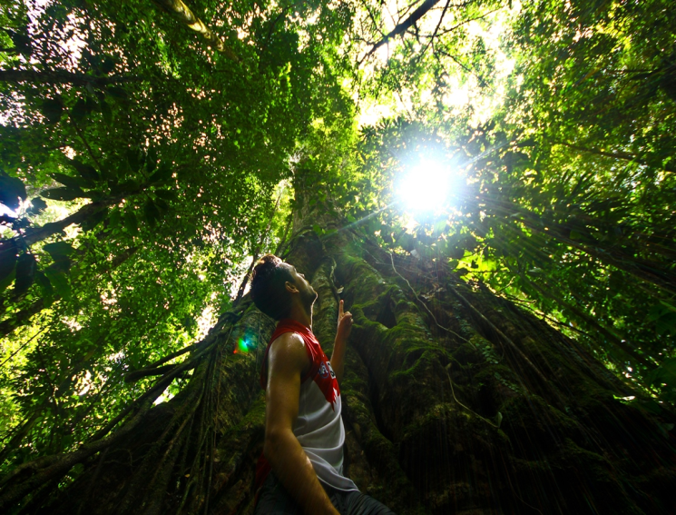
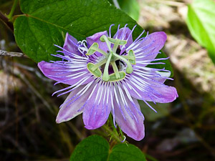
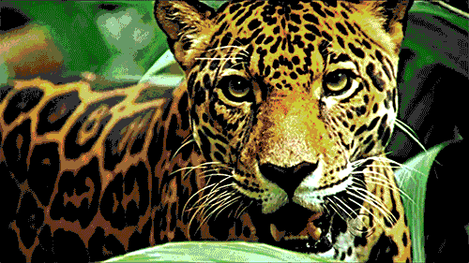

Slide 69
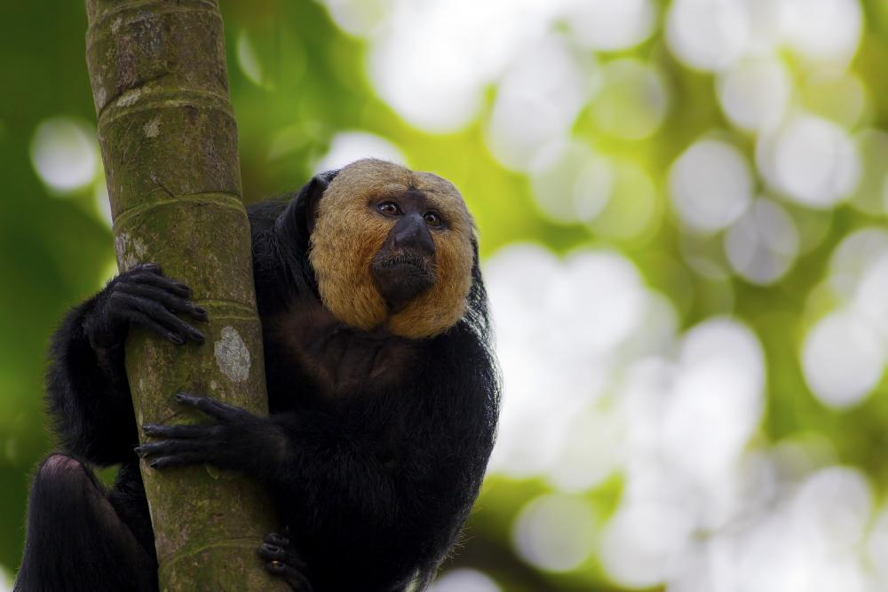

Slide 70
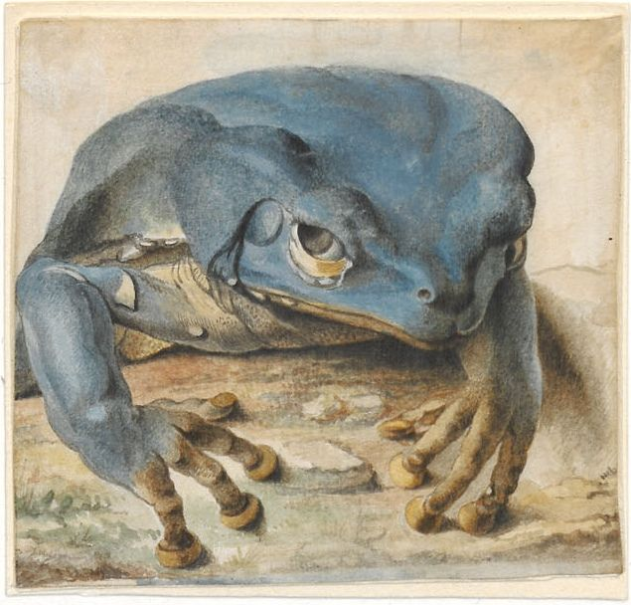

Slide 71
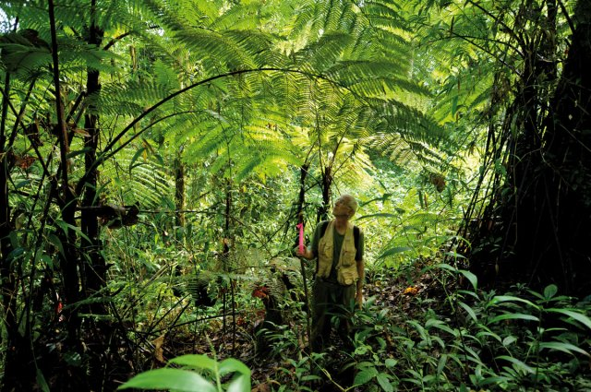

Slide 72
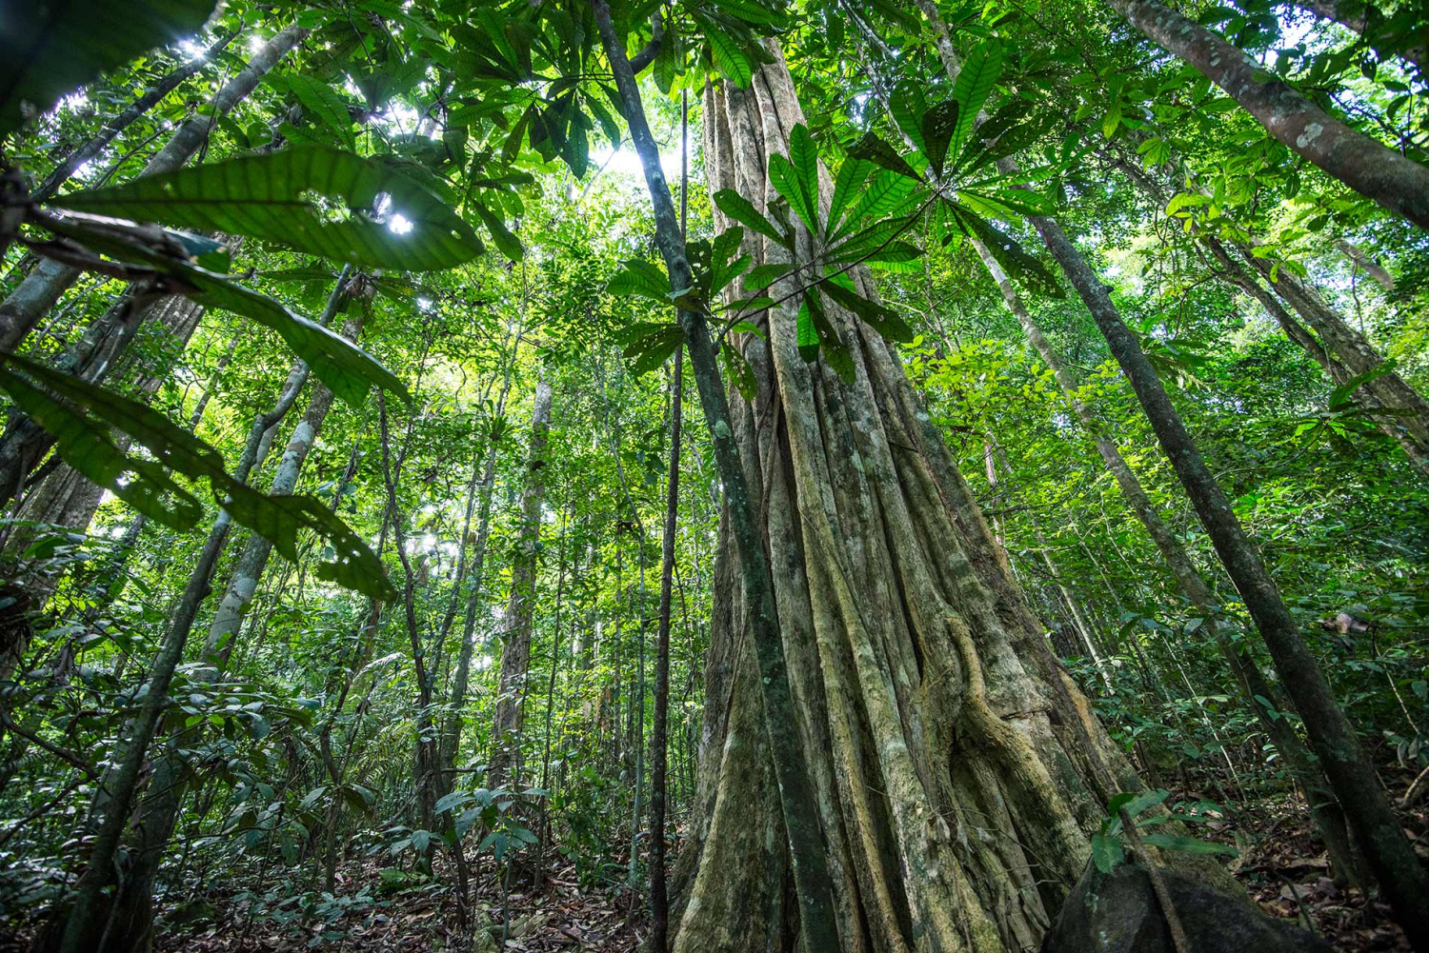

Slide 73


