Slide 1
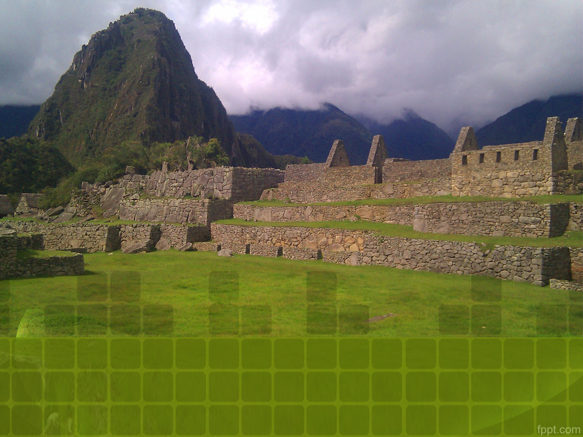
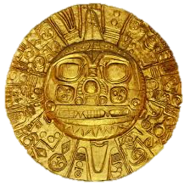
Mysterious Machu Picchu

Slide 2
The Mystery
Machu Picchu is an Incan citadel set high in the Andes Mountains in Peru, above the Urubamba River valley. Built in the 15th century and later abandoned, it’s renowned for its sophisticated dry-stone walls that fuse huge blocks without the use of mortar, intriguing buildings that play on astronomical alignments, and panoramic views. Its exact former use remains a mystery.

Slide 3
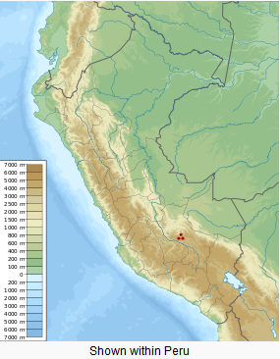

Slide 4
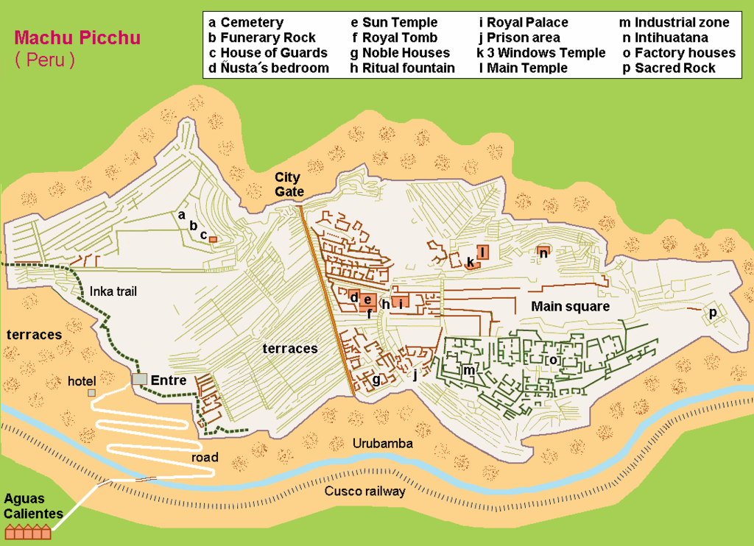

Slide 5
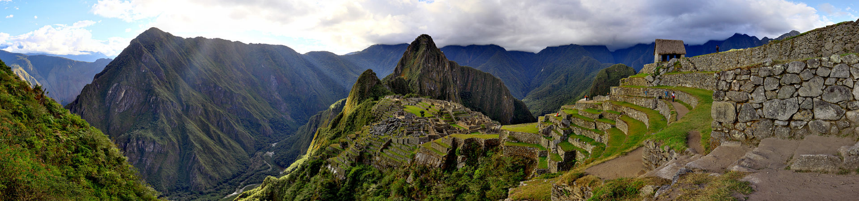
On important buildings such as the Temple of the Sun, the stonework has fantastic precision, but where structures are less important, the stonework is very much less precise. Nevertheless, many of these buildings maintained much of their stonework for many centuries despite earthquakes and nature’s relentless drive to recover and recycles all natural materials on the earth. The organic materials succumbed to natures decomposing processes, but the stonework held up much longer.

Slide 6
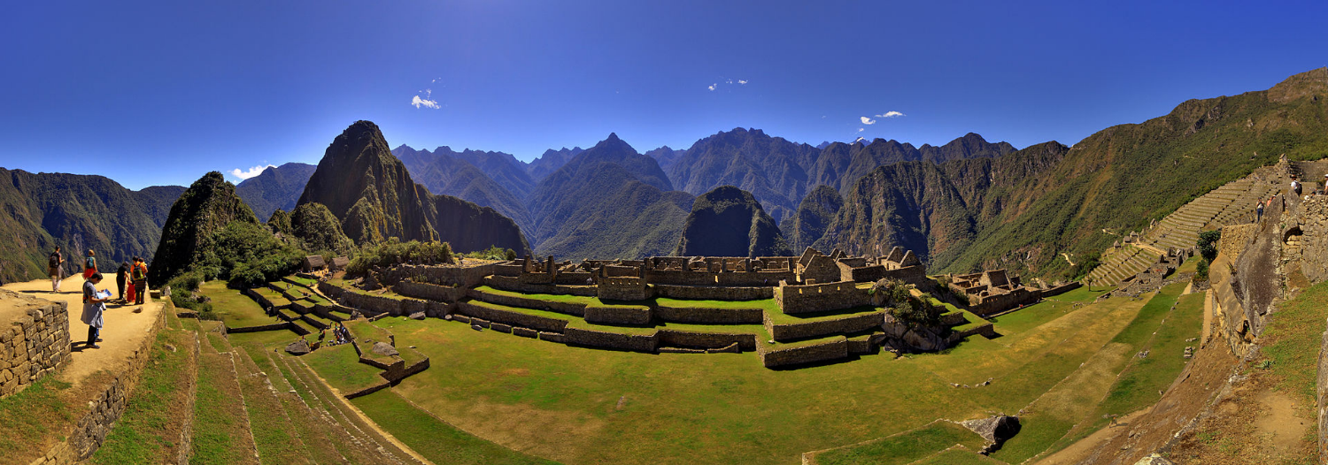
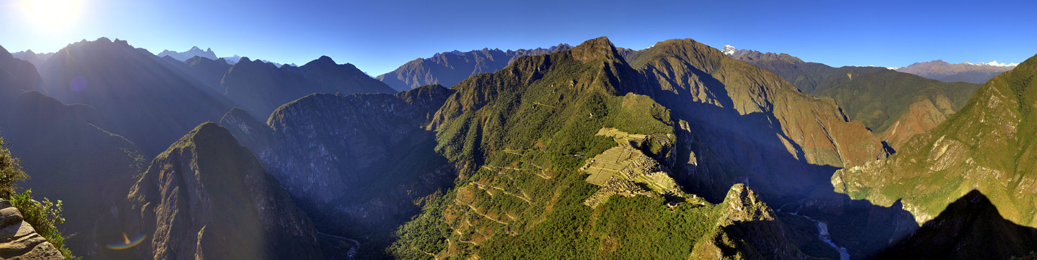
Just imagine sometimes living above or within the clouds and at other times seeing such spectacular scenery. One can understand why this may have been a very spiritual place for the Incas – like living on the edge between heaven and earth.

Slide 7
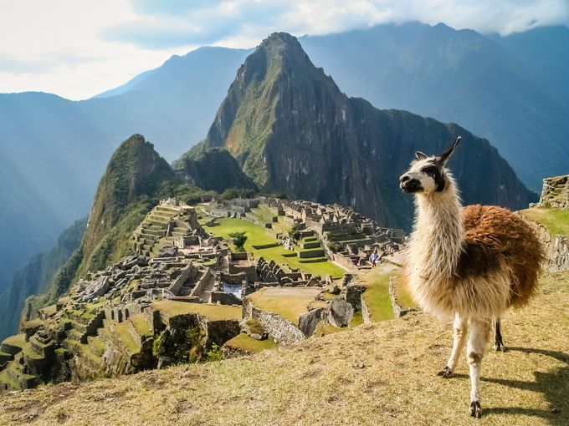

Slide 8
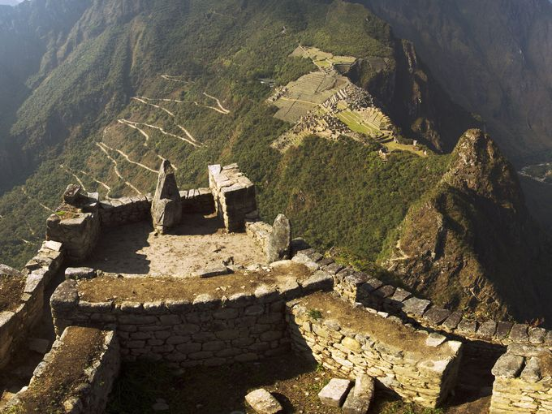

Slide 9
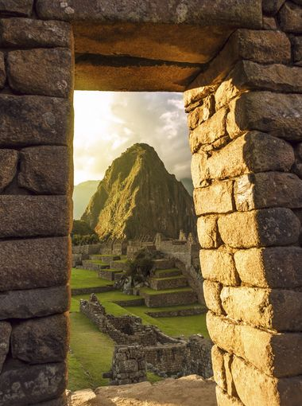

Slide 10
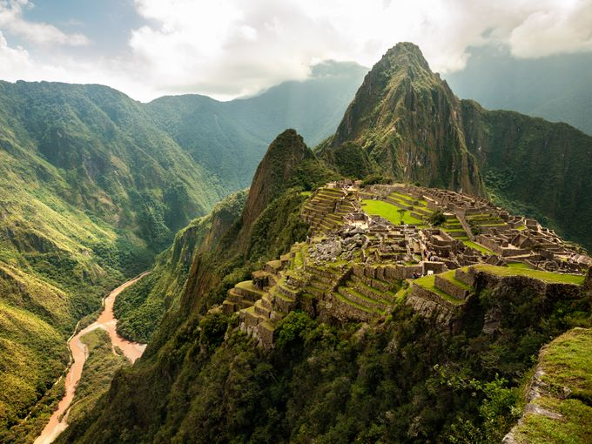

Slide 11
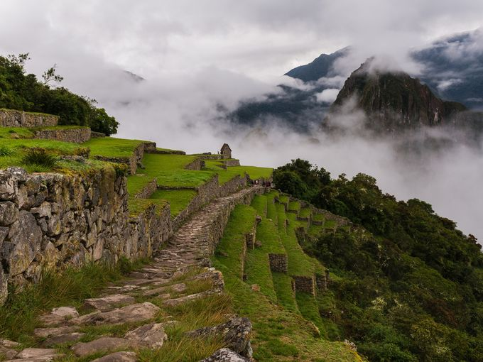

Slide 12
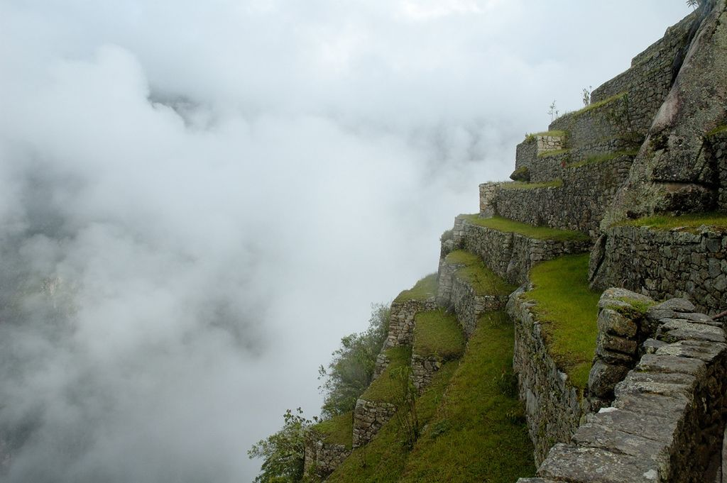

Slide 13
The city sits in a saddle between the two mountains Machu Picchu and Huayna Picchu, with a commanding view down two valleys and a nearly impassable mountain at its back. It has a water supply from springs that cannot be blocked easily, and enough land to grow food for about four times as many people as ever lived there. The hillsides leading to it were terraced, to provide more farmland to grow crops, and to steepen the slopes that invaders would have to ascend. The terraces reduced soil erosion and protected against landslides. Two high-altitude routes from Machu Picchu cross the mountains back to Cusco, one through the sun gate, and the other across the Inca bridge. Both could be blocked easily, should invaders approach along them.

Slide 14
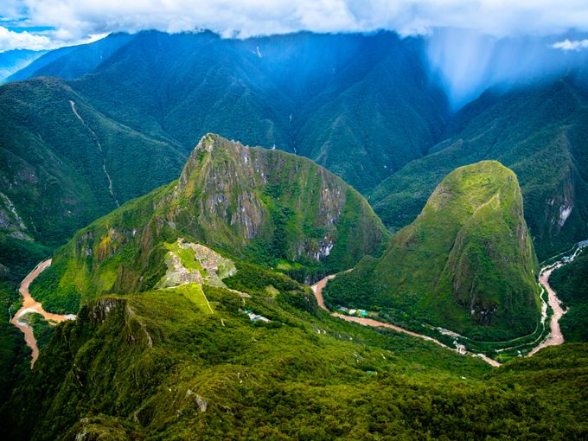

Slide 15
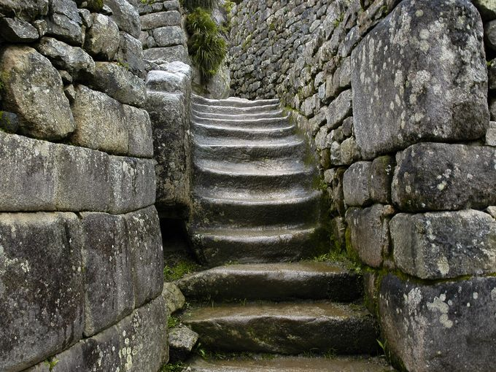

Slide 16
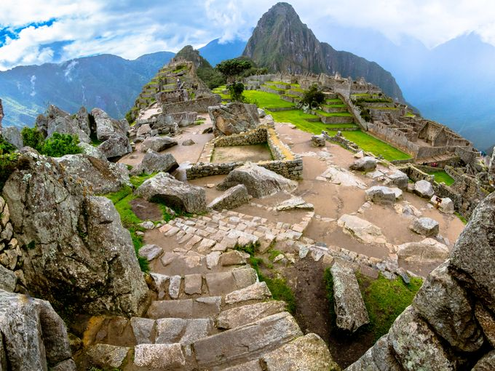

Slide 17
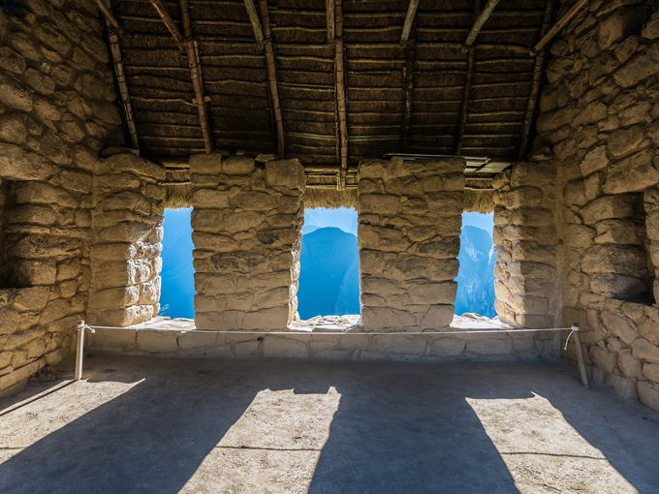

Slide 18
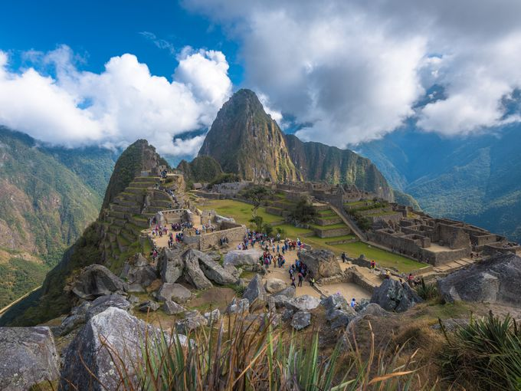

Slide 19
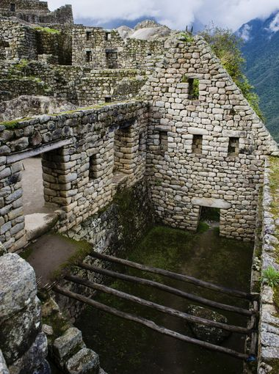

Slide 20
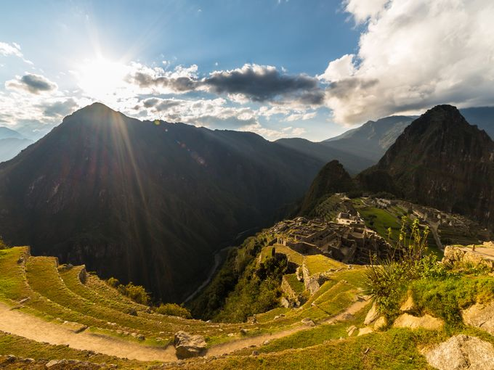

Slide 21
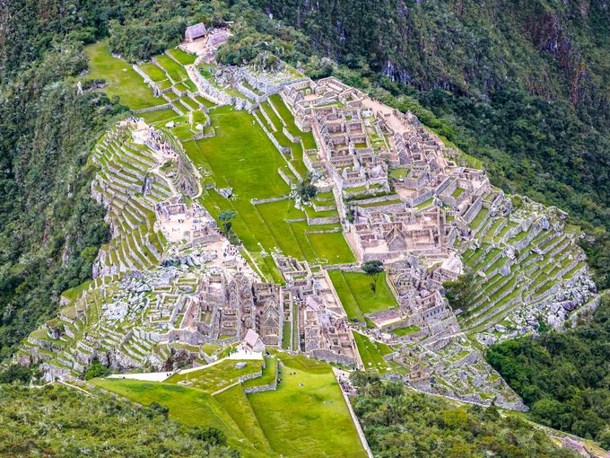

Slide 22
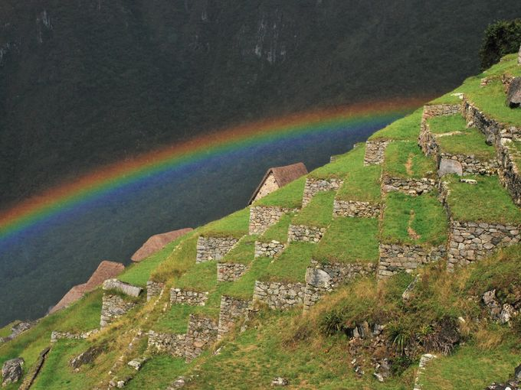

Slide 23
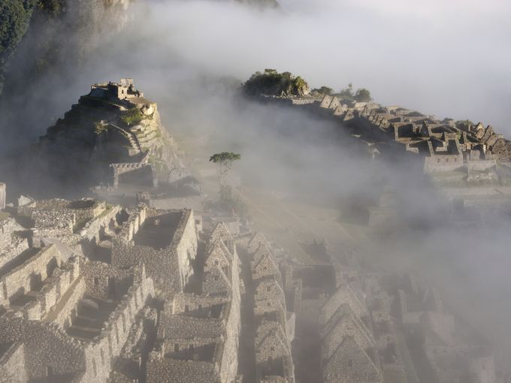

Slide 24
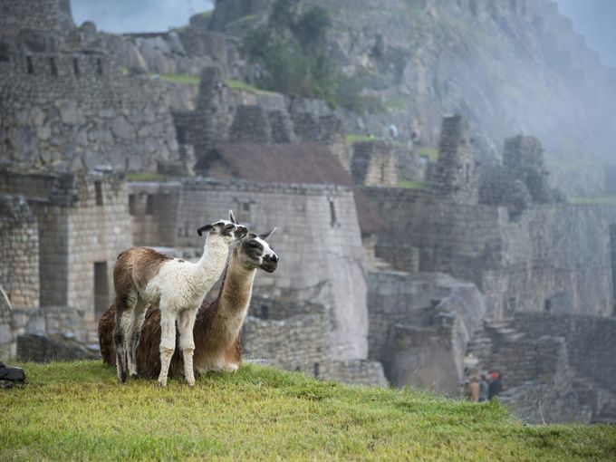

Slide 25
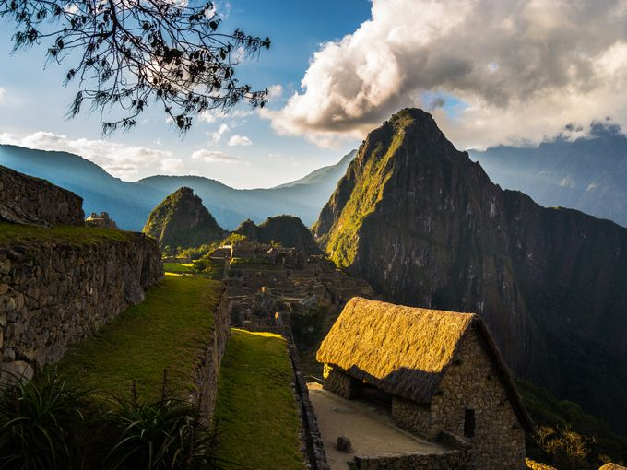

Slide 26
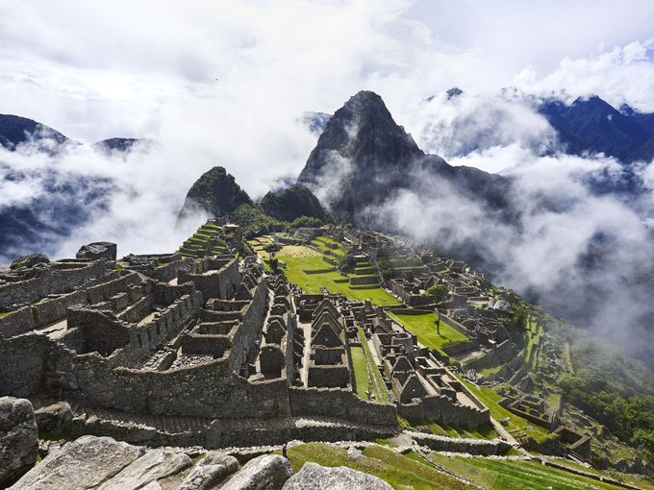

Slide 27
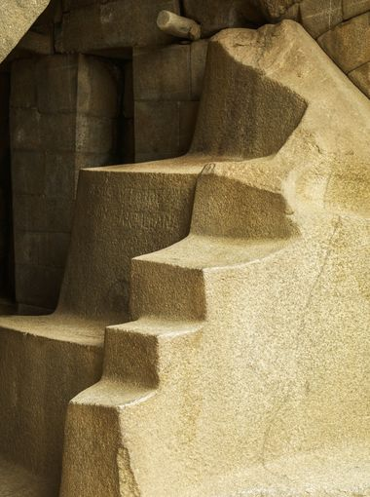

Slide 28
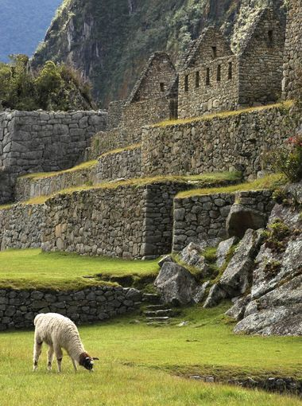

Slide 29
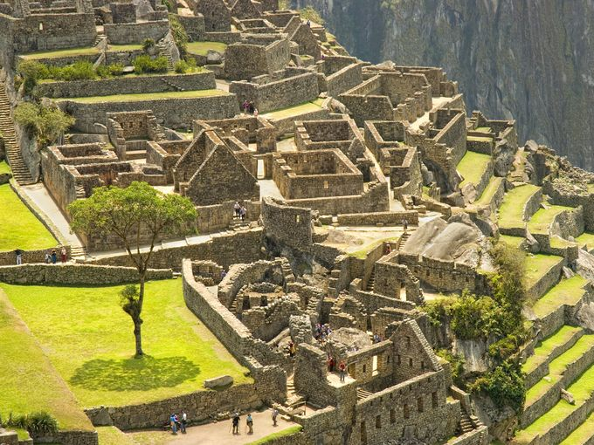

Slide 30
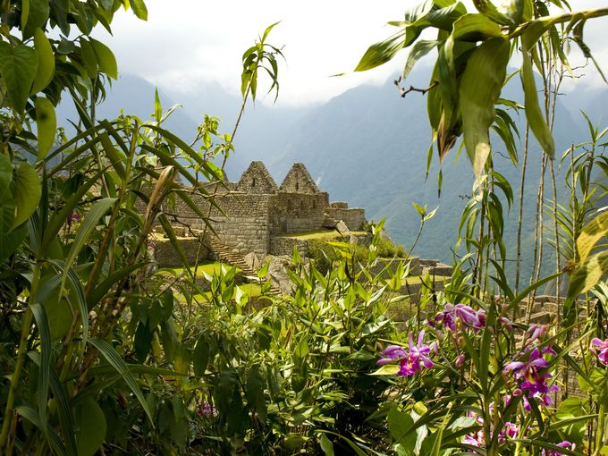

Slide 31
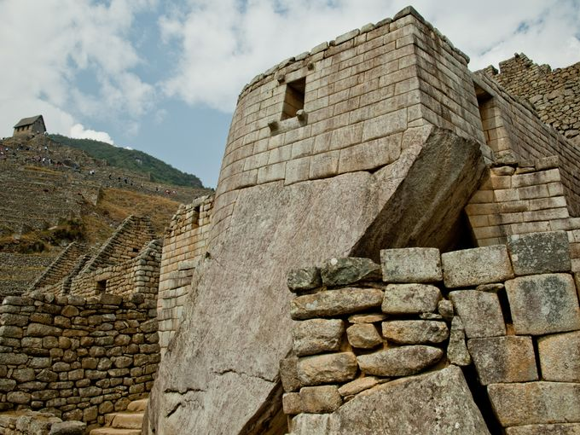

Slide 32
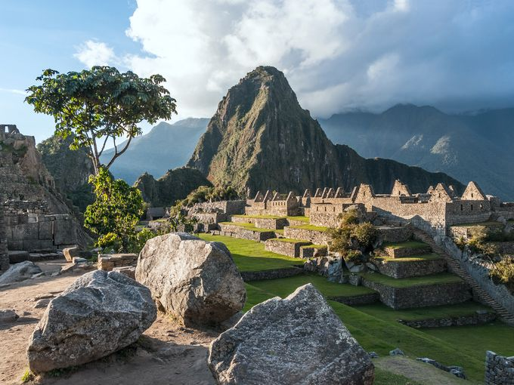

Slide 33
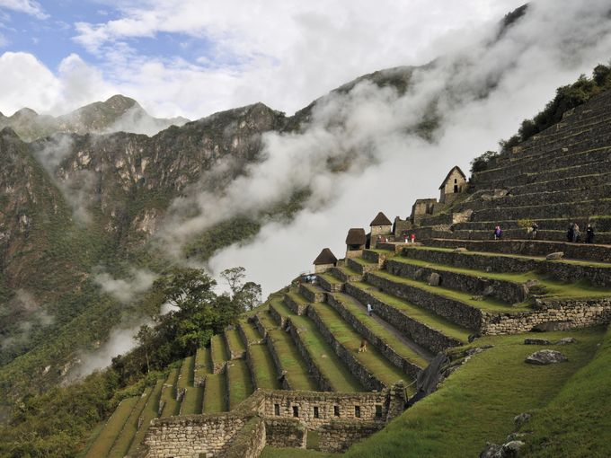

Slide 34
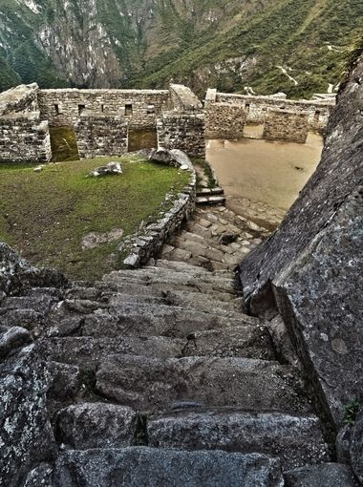

Slide 35
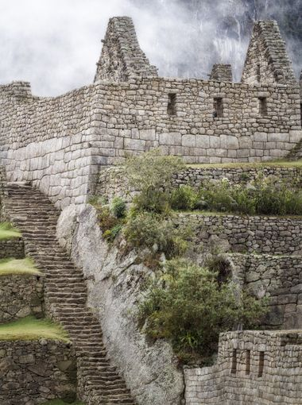

Slide 36
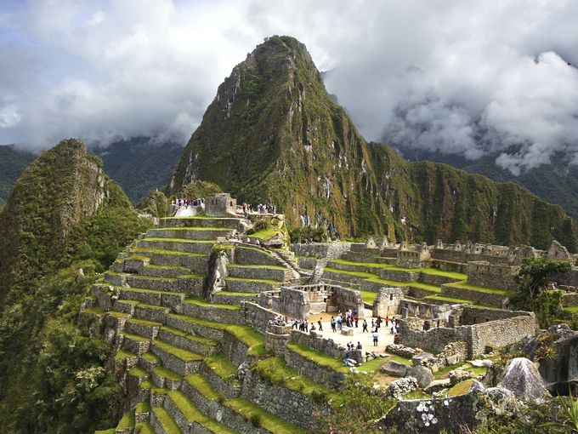

Slide 37
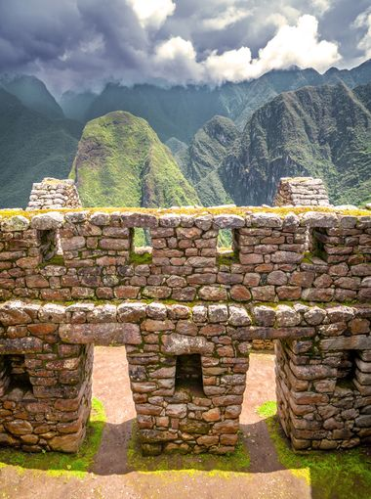

Slide 38
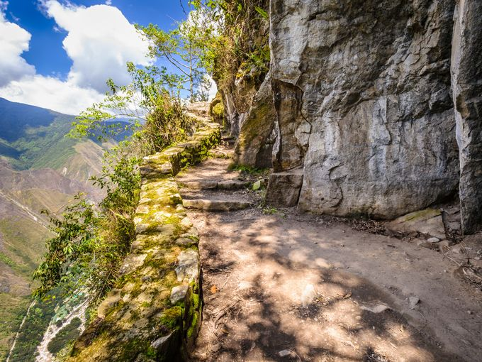

Slide 39
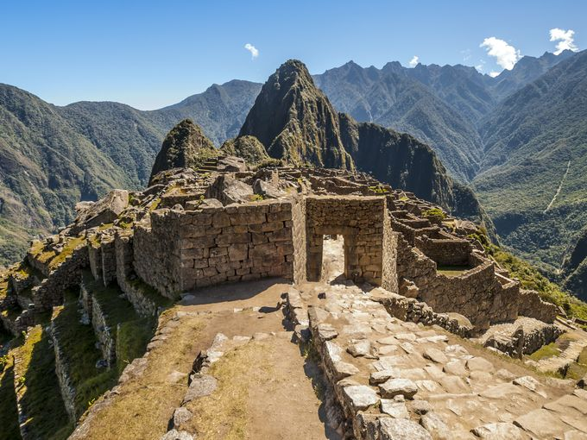

Slide 40
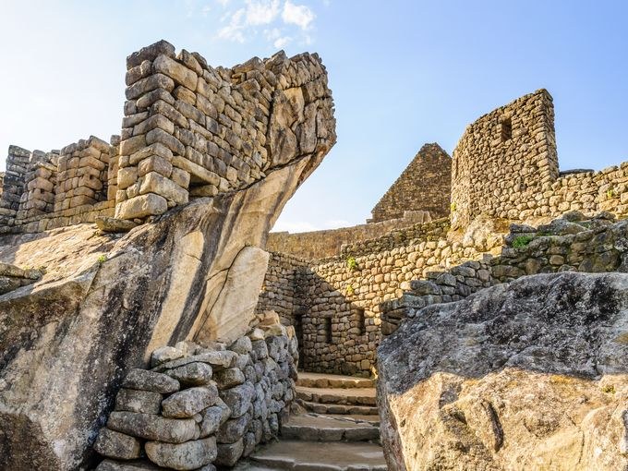

Slide 41
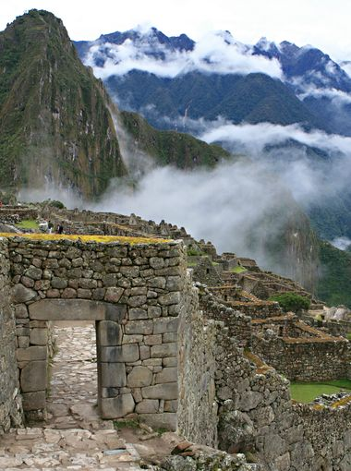

Slide 42
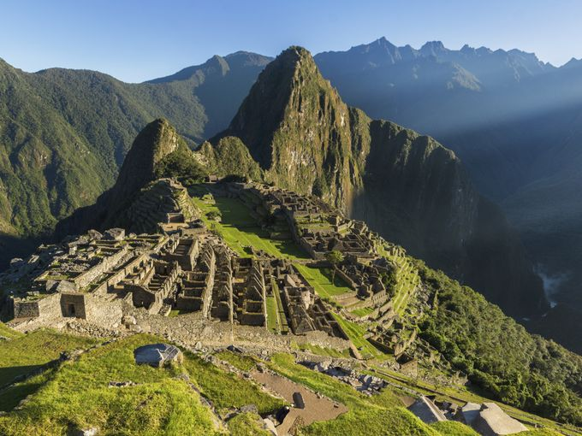

Slide 43
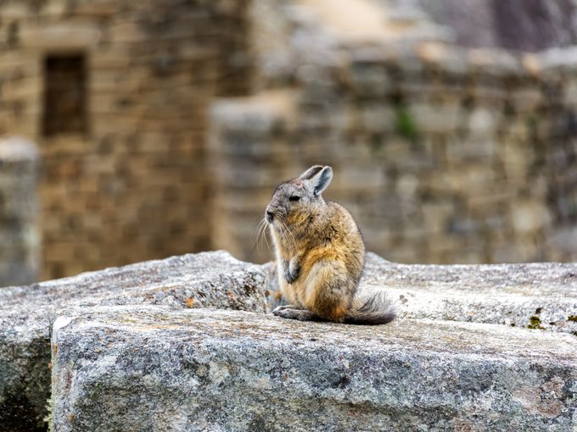

Slide 44
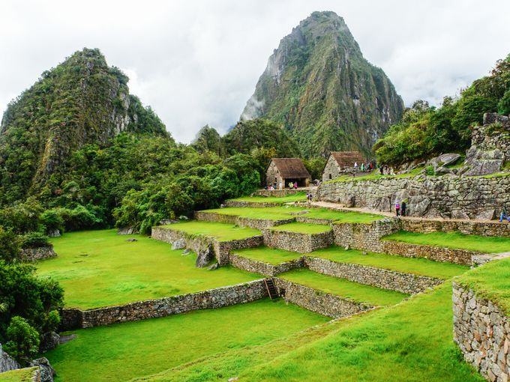

Slide 45
Working WITH the conditions nature provided.
Heavy rainfall required terraces and stone chips to drain rain water and prevent mud slides, landslides, erosion and flooding. Terraces were layered with stone chips, sand, dirt and top soil, to absorb water and prevent it from running down the mountain. Similar layering protected the large city center from flooding. Multiple canals and reserves provide water throughout the city that could be supplied to the terraces for irrigation and to prevent erosion and flooding.

Slide 46
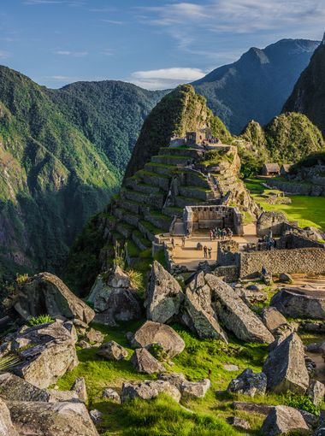

Slide 47
Fantastic Construction
The central buildings use the classical Inca architectural style of polished dry-stone walls of regular shape. The Incas were masters of this technique, called ashlar, in which blocks of stone are cut to fit together tightly without mortar. The section of the mountain where Machu Picchu was built provided various challenges that the Incas solved with local materials. One issue was the seismic activity due to two fault lines. It made mortar and similar building methods nearly useless. Instead, the Inca mined stoned from the quarry at the site, lined them up and shaped them to fit together perfectly, stabilizing the structures. Inca walls have many stabilizing features: doors and windows are trapezoidal, narrowing from bottom to top; corners usually are rounded; inside corners often incline slightly into the rooms; and outside corners were often tied together by "L"-shaped blocks; walls are offset slightly from row to row rather than rising straight from bottom to top.

Slide 48
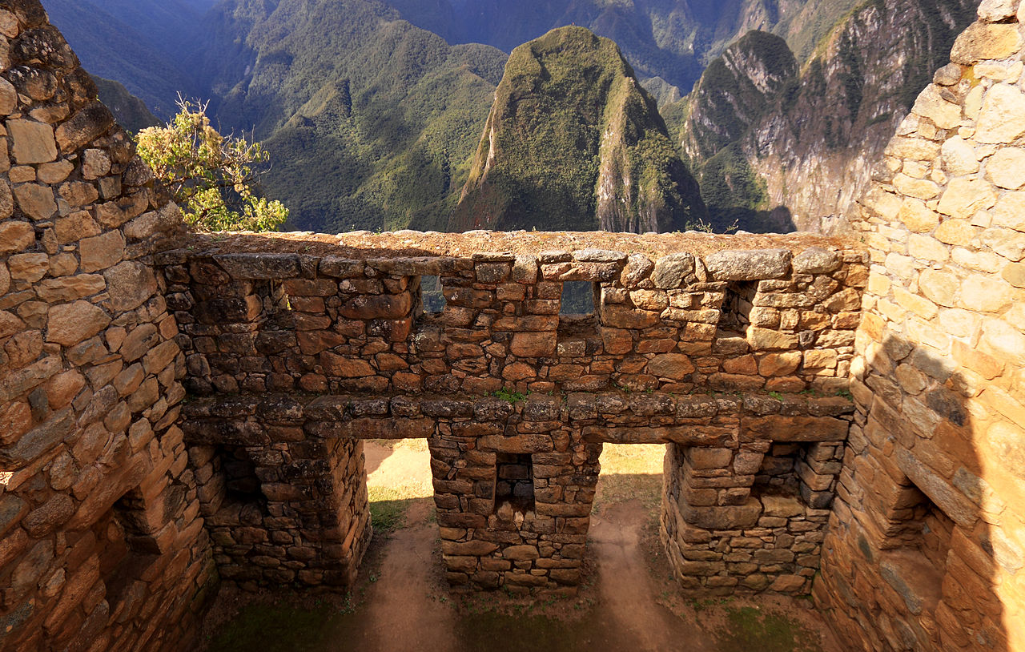

Slide 49
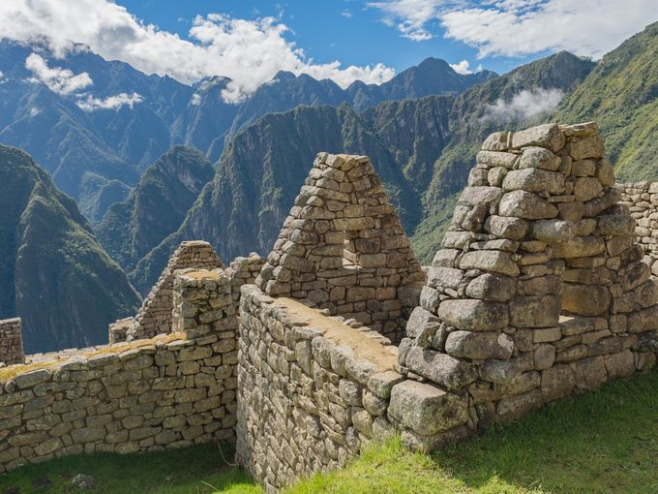

Slide 50
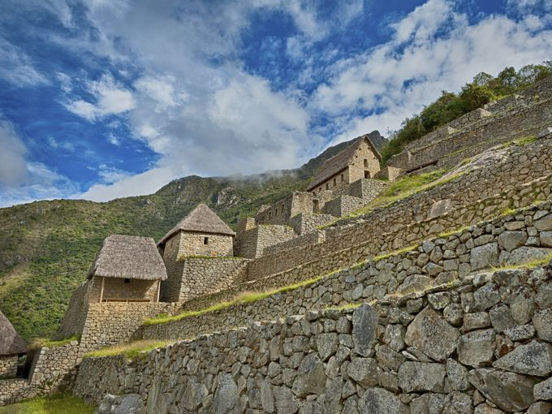

Slide 51
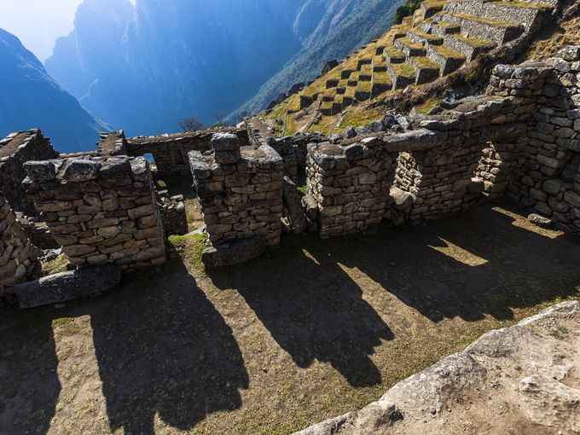

Slide 52
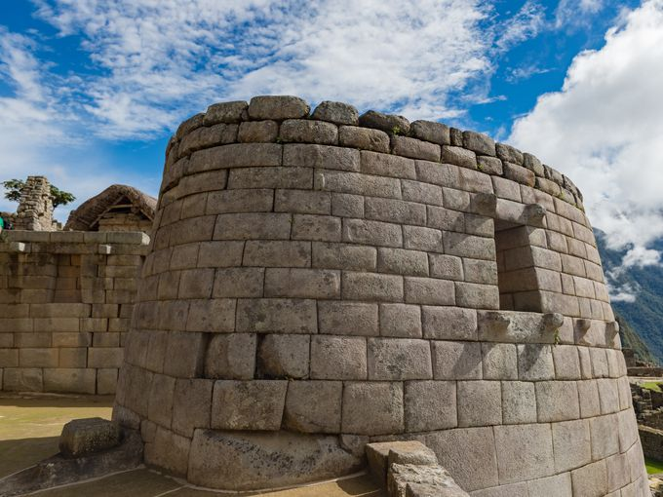
Temple of the Sun

Slide 53

The sculptures carved out from the rock bottom of the sun temple are interpreted as "Water mirrors for observing the sky".

Slide 54


Slide 55


Slide 56


Slide 57

Temple of the Sun

Slide 58


Slide 59


Slide 60


Slide 61


Slide 62

Nature persistently attempts to reclaim dominion over natural materials with the goal of recycling them, so it required constant maintenance to insure that they served their intended purposes.

Slide 63


Slide 64

Inti Watana is believed to have been designed as an astronomic clock or calendar by the Incas

Slide 65


Slide 66


Slide 67

Reminder: Nature will try to take back and recycle any natural material if given half a chance

Slide 68

View of the city of Machu Picchu in 1912 showing the original ruins after major clearing and before modern reconstruction work began. Nature was doing a fine job of reclaiming and recycling natural materials – stone takes longer than organic materials.

