Slide 1
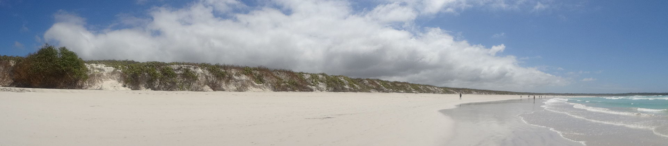
Galapagos Islands

Slide 2


Slide 3
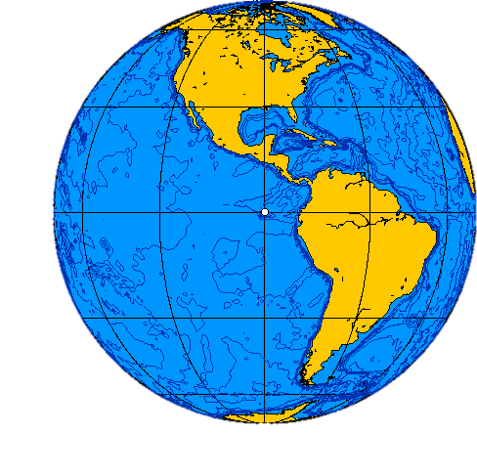

Slide 4
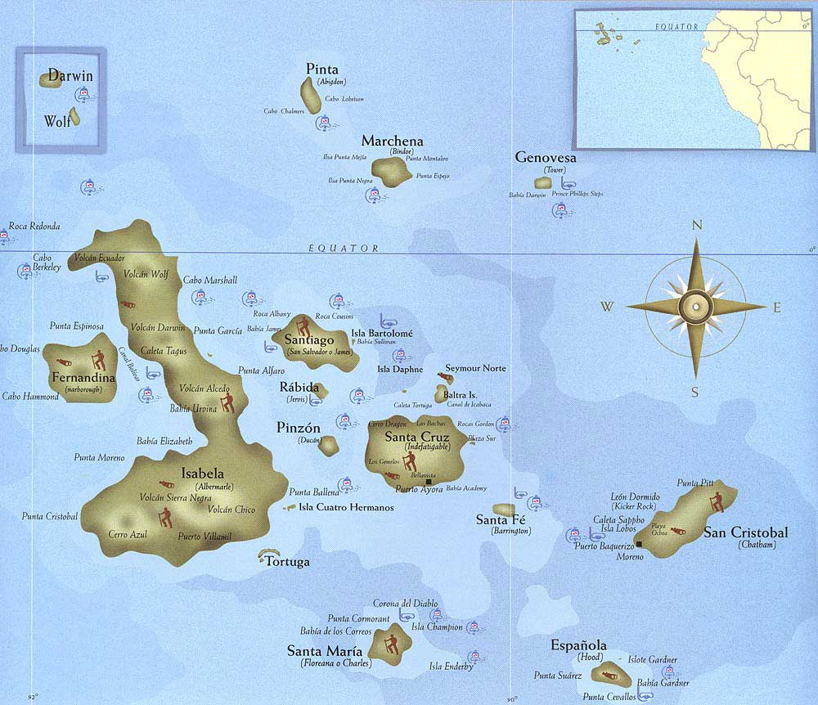

Slide 5
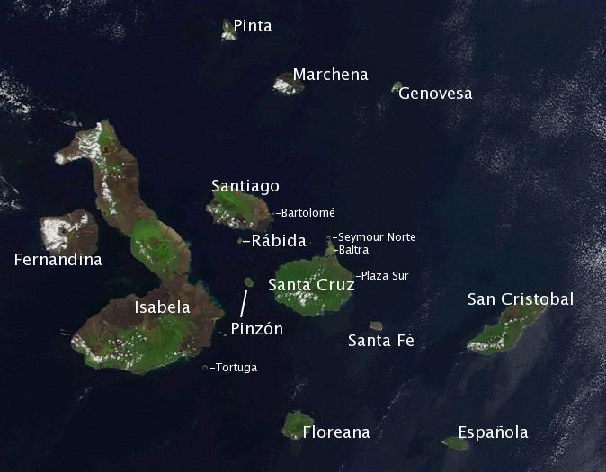

Slide 6
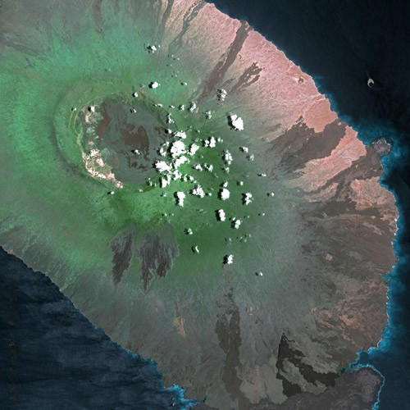
Isabela seen from Spot Satellite.

Slide 7
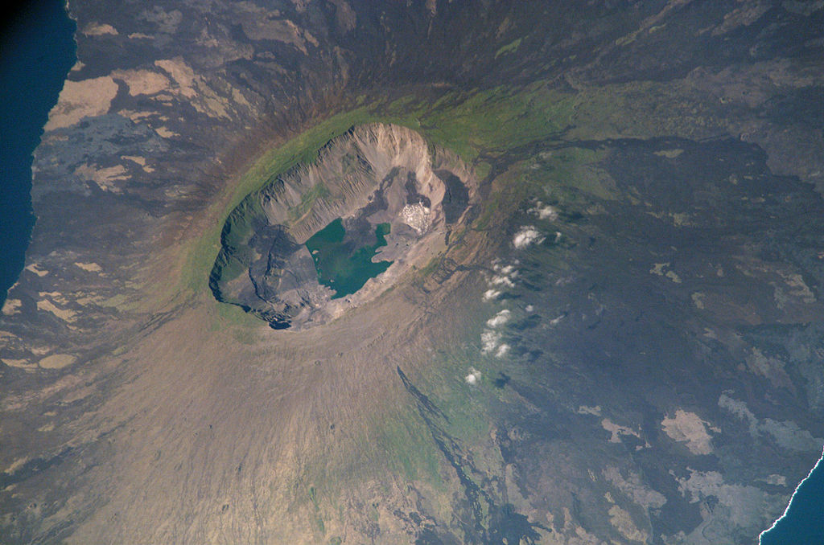
La Cumbre volcano, Fernandina Island,

Slide 8
Thankfully, as I found out (albeit the hard way) you don’t have to love boats to having an amazing time in the Galapagos. I won’t lie — you will have to spend some time on the water, but you can minimize seasick time and maximize pure enjoyment. Here’s how.

Slide 9
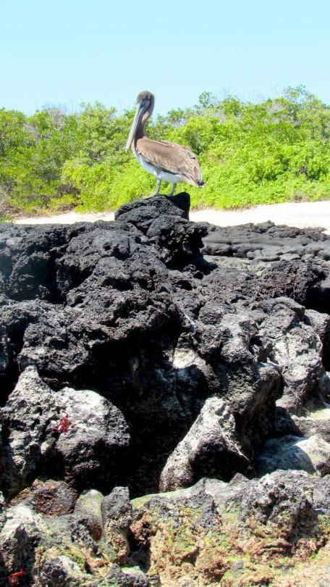
This pelican is looking for a little land time. (Photo: Leah Ginsberg)

Slide 10
1. Use a travel advisor.
It’s not so easy to arrange plans to travel in the Galapagos from the U.S. There are lots of quirks and restrictions and rules that you may not be aware of, plus many of the providers and accommodations don’t have English-speakers. It’s not that you can’t do it on your own (especially if you speak Spanish), but finding a travel agent who is used to dealing with the islands will make your life a whole lot easier.

Slide 11
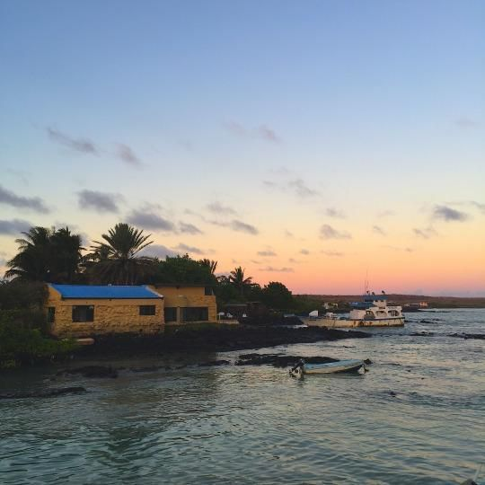
2. Choose a home base.
I stayed on the main island, Santa Cruz, which is home to about 12,000 to 20,000 full-time residents (depending on who you talk to), and is a truly enjoyable little town with a lively marina area, shopping, and some yummy local food. (It’s so cute in fact, I would recommend that even seafarers spend a night there.)

Slide 12
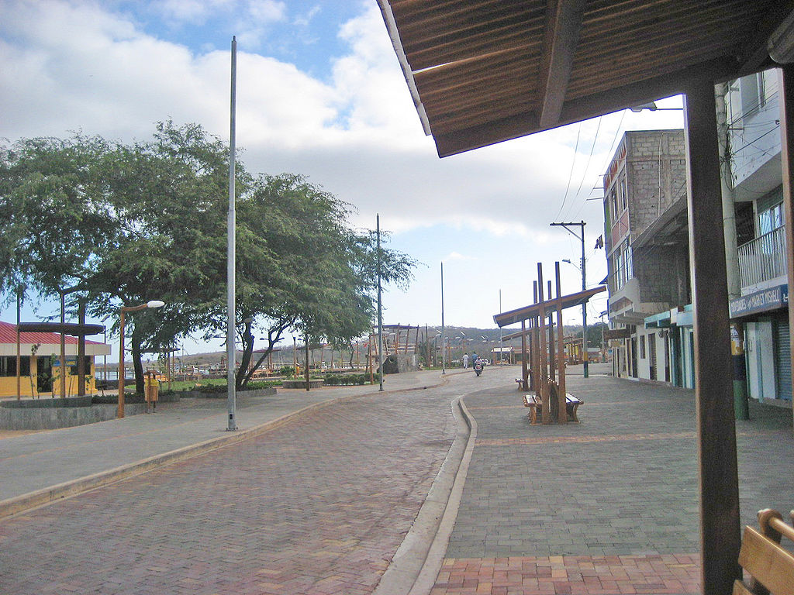
Main Street on San Cristóbal Island.

Slide 13
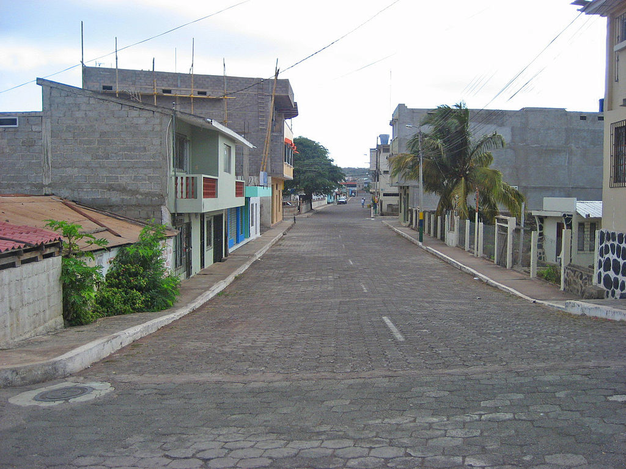
Puerto Baquerizo, San Cristóbal Island,

Slide 14
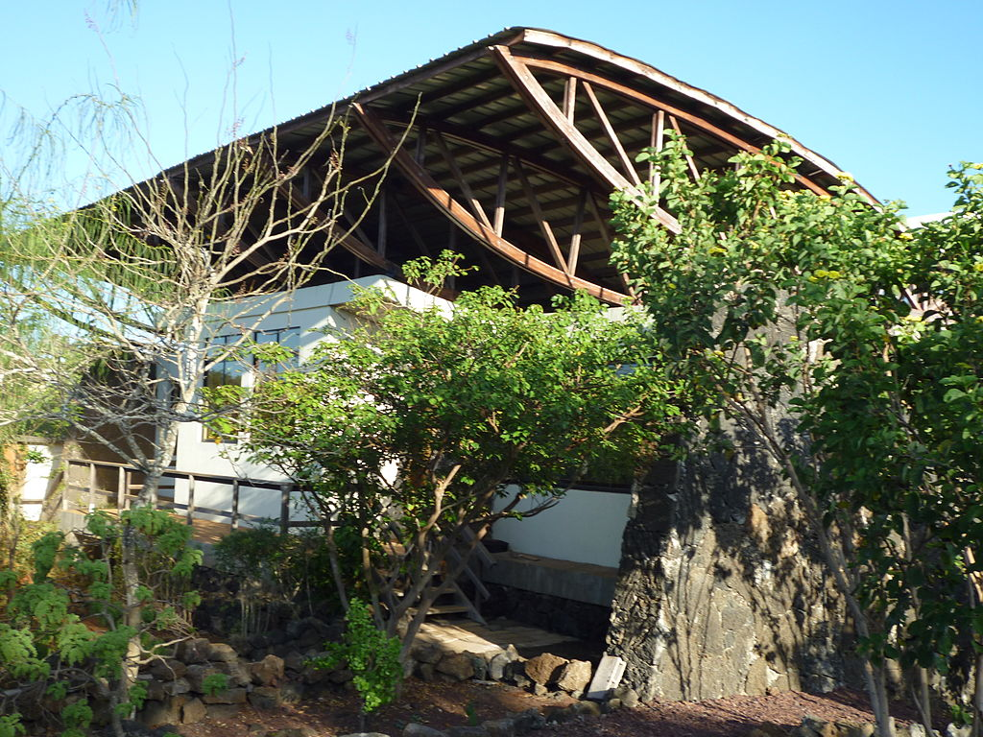
Charles Darwin Research Station, Galapagos

Slide 15
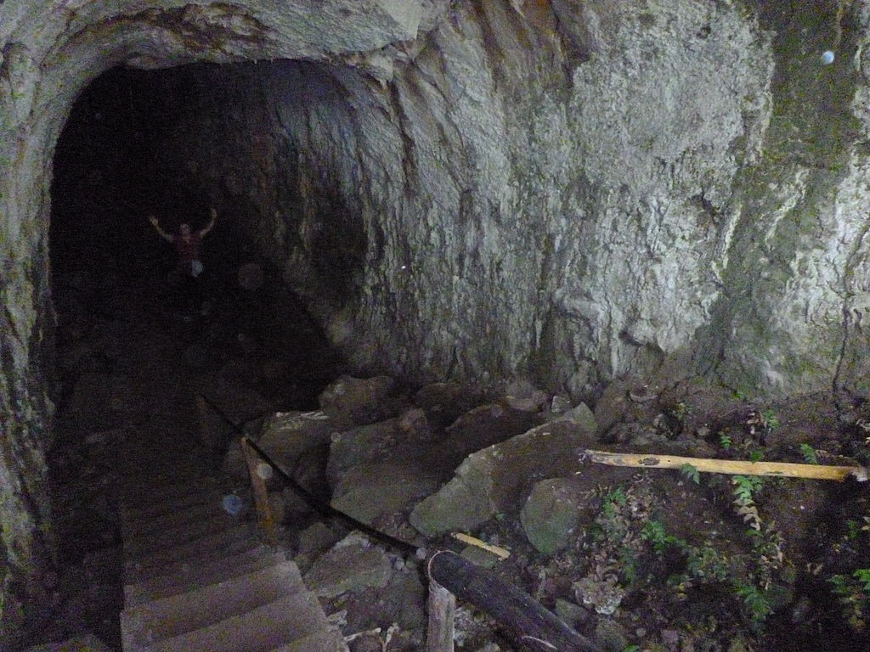
Entrance of Lava tunnel - Island of Santa Cruz

Slide 16
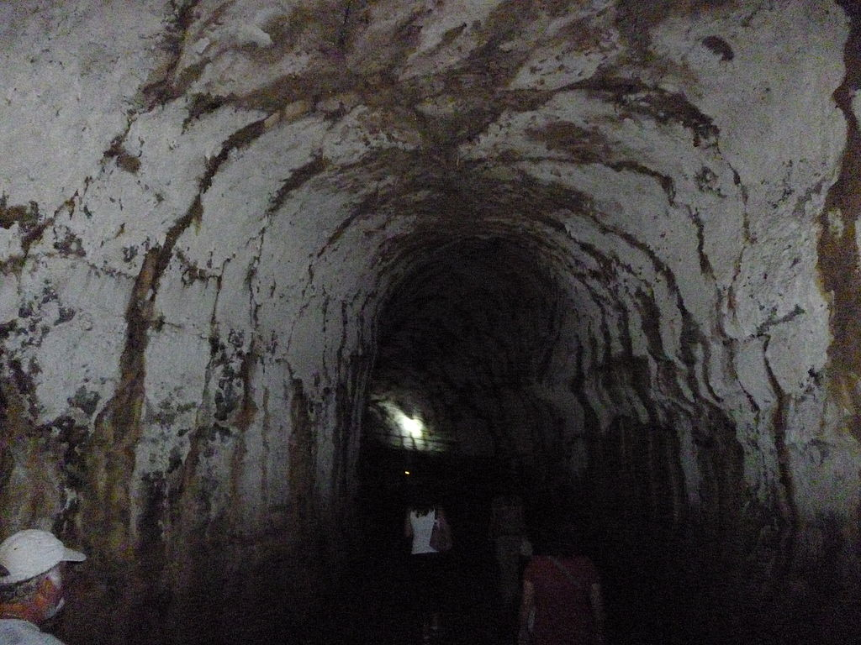

Slide 17
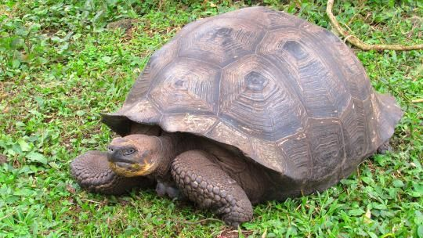
3. Spend time with the tortoises.
The Galapagos Islands are one of two places on Earth where you can see giant land tortoises. (The other is in the Seychelles, also islands.) There are various places to see them, but two of the most popular ways to visit are on Santa Cruz

Slide 18
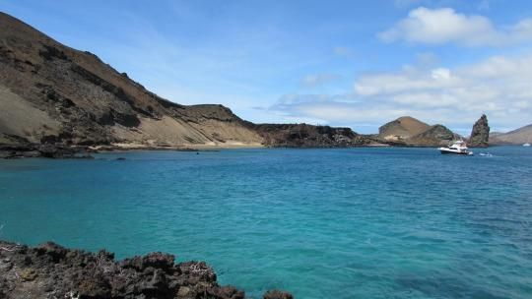
3. Book day trips to the various islands.
Isla Bartolome, with Pinnacle Rock in the distance. These boat trips range from one-and-a-half to four hours each way, depending on the route and the weather. You can book different day trips from San Cristobal, Santa Cruz, and Isabela. From San Cristobal, you can explore Punta Pitt (on the north side of the island), Isla Lobos, and the famous Kicker Rock there.

Slide 19
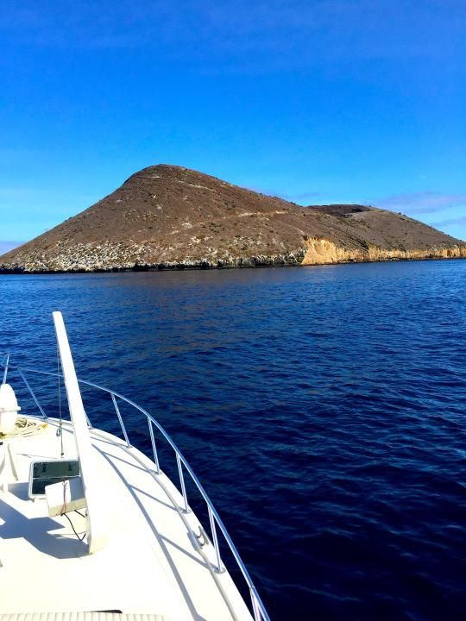
4. Go when the seas are calmer.
Though low season is a great time to see the Galapagos for several reasons (less crowds, cooler temperatures, lower prices), it also happens to overlap with part of the rough season at sea, which continues from May through October. If you don’t have your sea legs, you’ll want to pick a time when the ocean is calmer — January through March

Slide 20
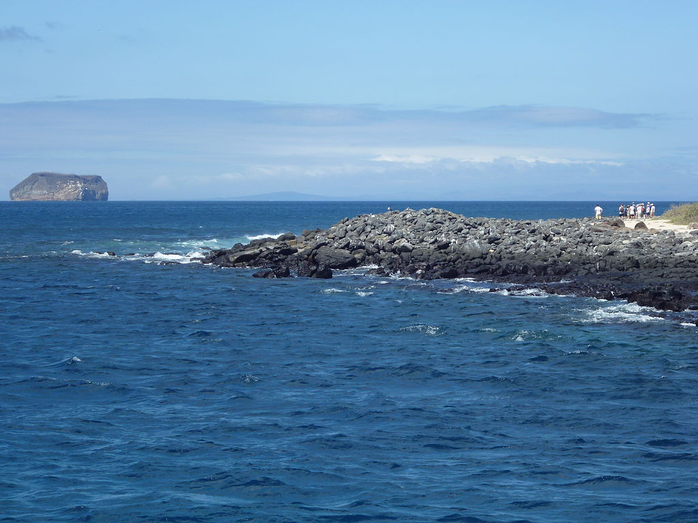
North Seymour Island in the Galapagos, Daphne Island is in the distance.

Slide 21
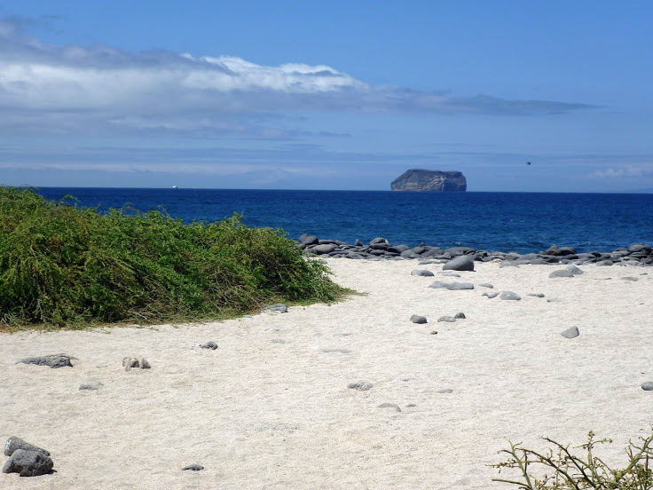
The beach at North Seymour Island

Slide 22
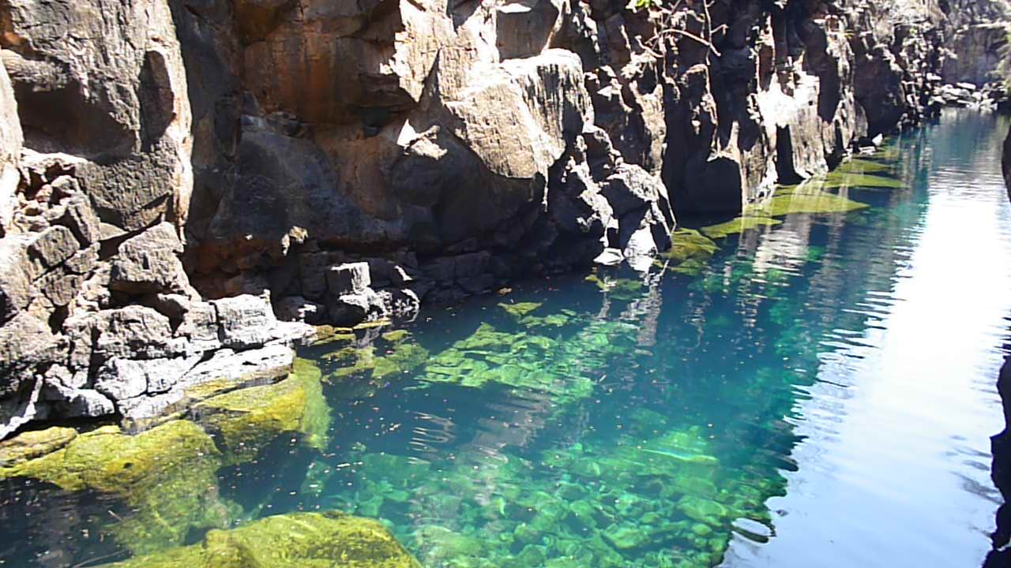
Fresh Water Swimming in the Galapagos on the Island of Santa, Galapagos

Slide 23
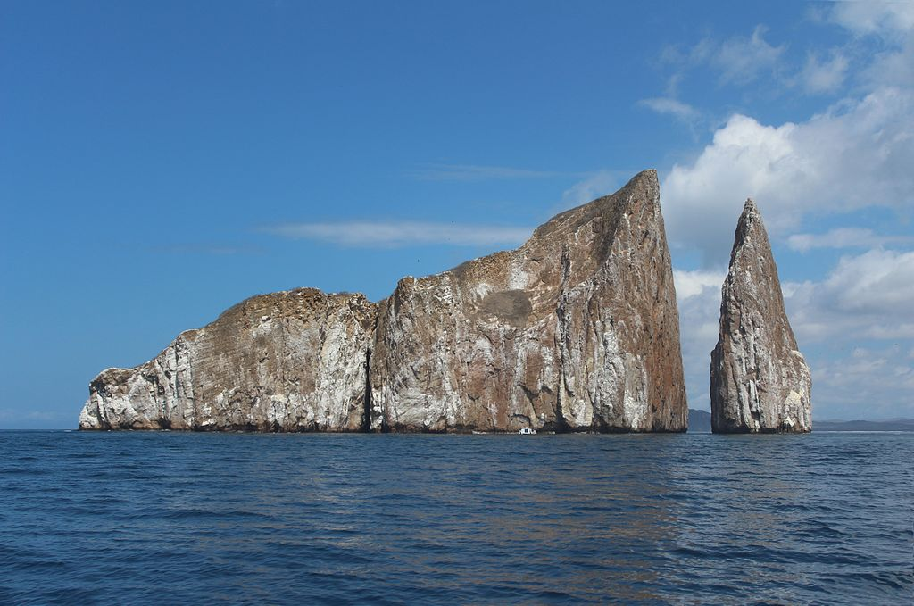
León Dormido (in English : Kicker Rock)

Slide 24
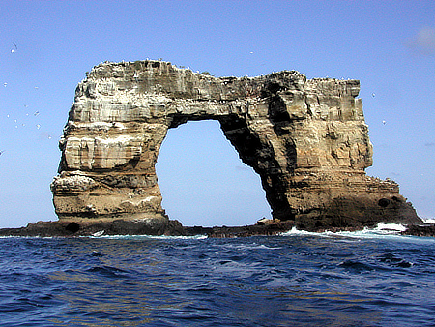
Darwin’s Arch

Slide 25
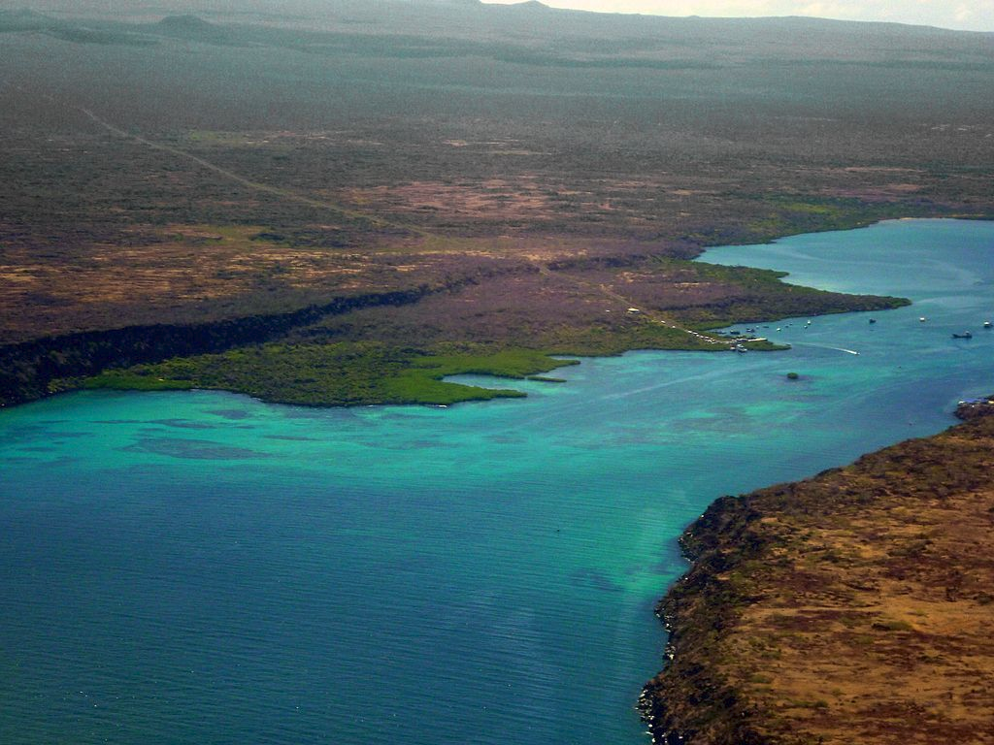
From an aircraft flying out of Baltra Island (on the right) and the Santa Cruz (on the left), the Itabaca Channel is the waterway between the islands.

Slide 26
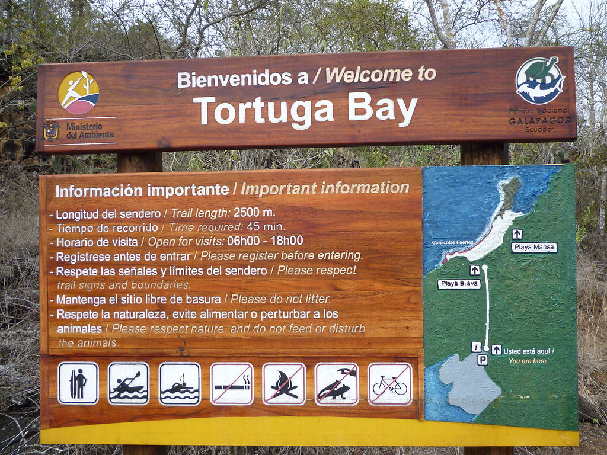

Slide 27
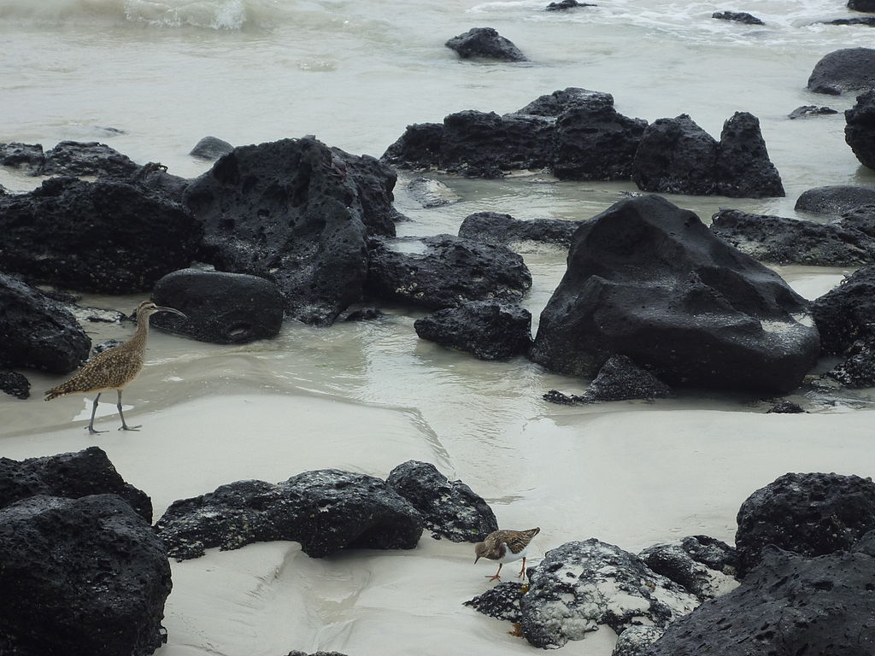
Tortuga Bay, Puerto Ayora on the Island of Santa Cruz.

Slide 28
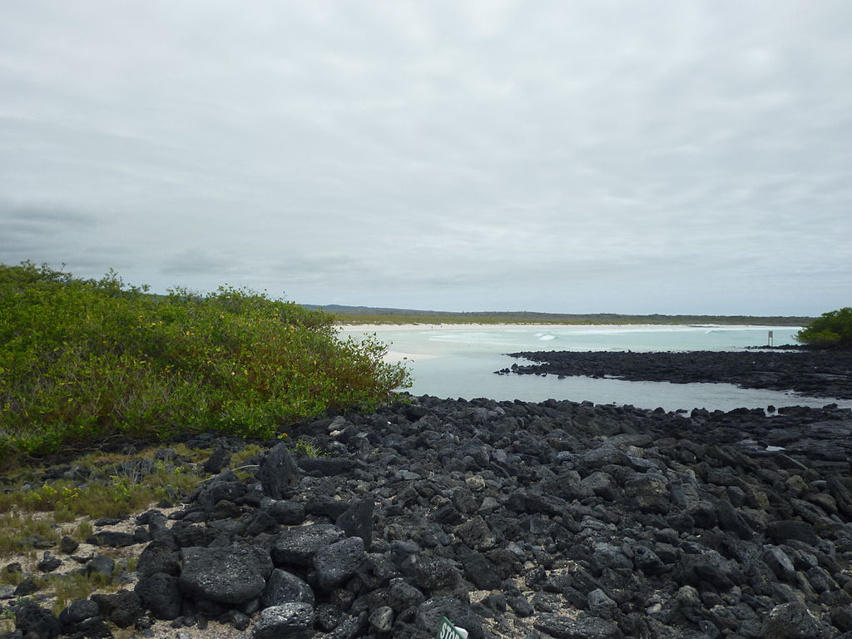
Volcanic rocks & the Pacific Ocean at Tortuga Bay.

Slide 29
Why go?
The islands became famous around the world after the survey ship HMS Beagle, arrived in the Galapagos on September 15, 1835. On board was a young naturalist named Charles Darwin. Darwin's subsequent studies of local wildlife noted that almost all of the animals and plants here were endemic to the islands, which of course contributed to his famous theory of natural selection, and put these special islands on the map for the rest of the world to experience.

Slide 30
The islands became Ecuador's first national park in 1959, and these now aggressively-protected islands and the surrounding marine reserve were both declared World Heritage sites. Travel to these islands is strictly controlled by Ecuador, and a visit to the home of the giant tortoise, marine iguanas, and Darwin's finches must (should) be done through a professional tour operator, of which there are many operating through Quito and Quayaquil.

Slide 31
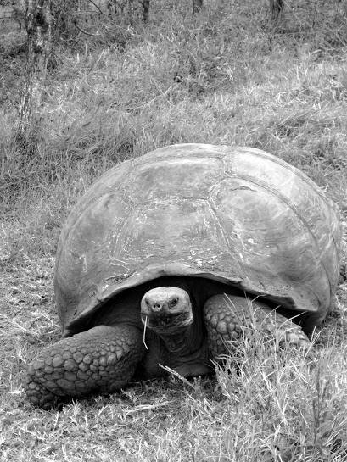

Slide 32
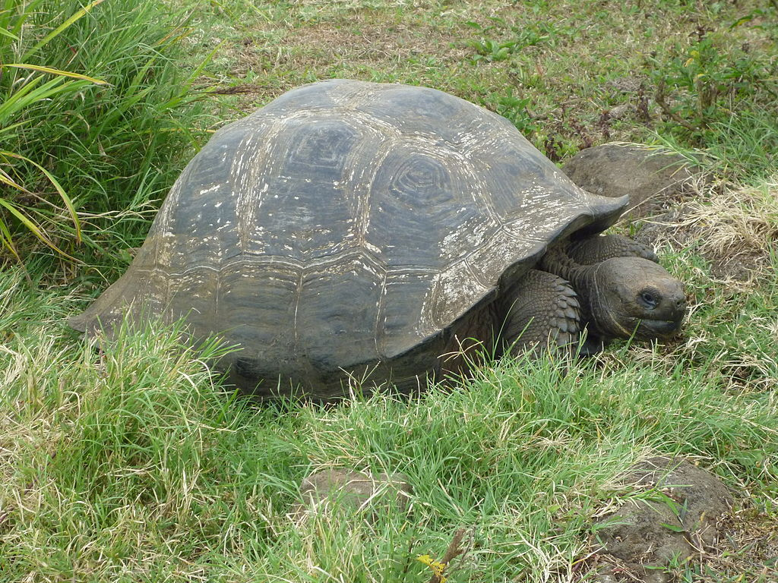

Slide 33
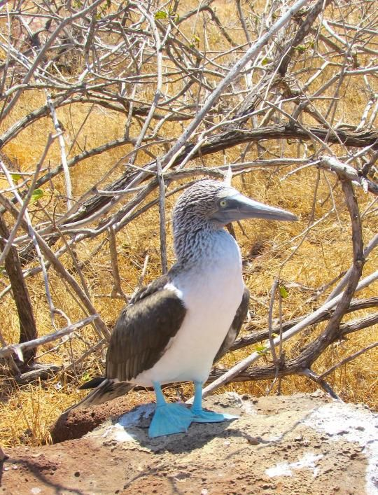
A blue-footed boobie

Slide 34
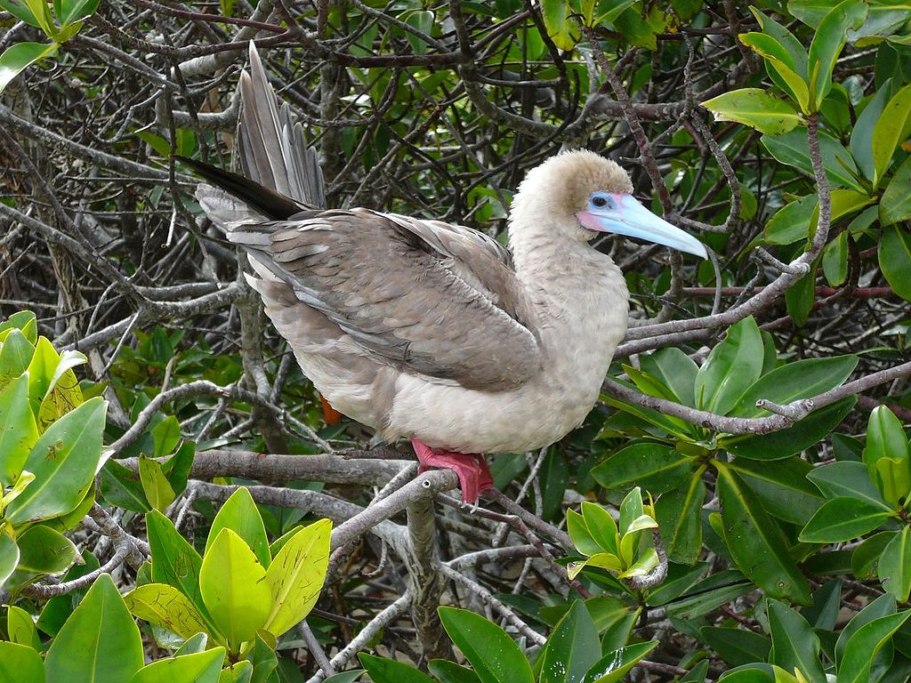
Red-footed Booby (Sula sula)

Slide 35
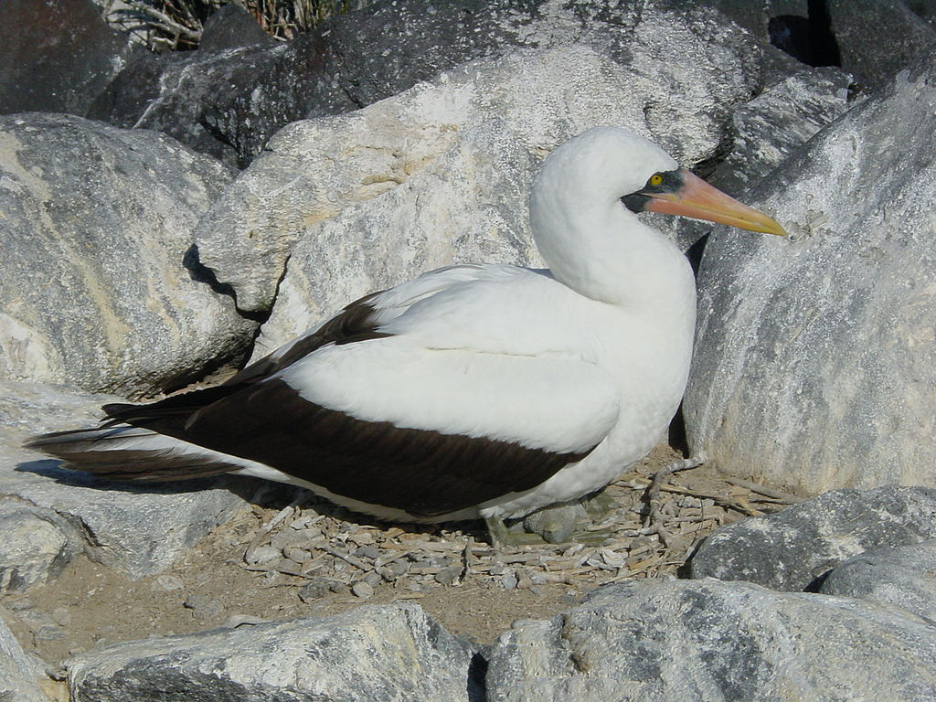
Nazca Booby (Sula granti)

Slide 36
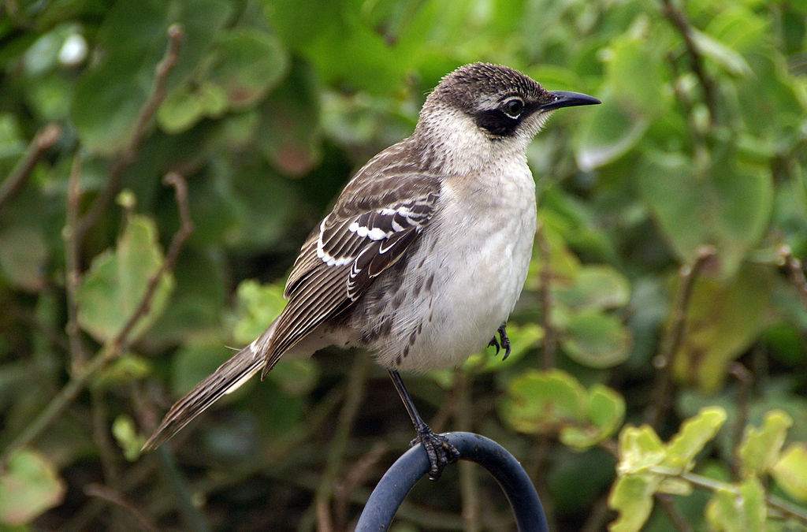
Nesomimus parvulus

Slide 37
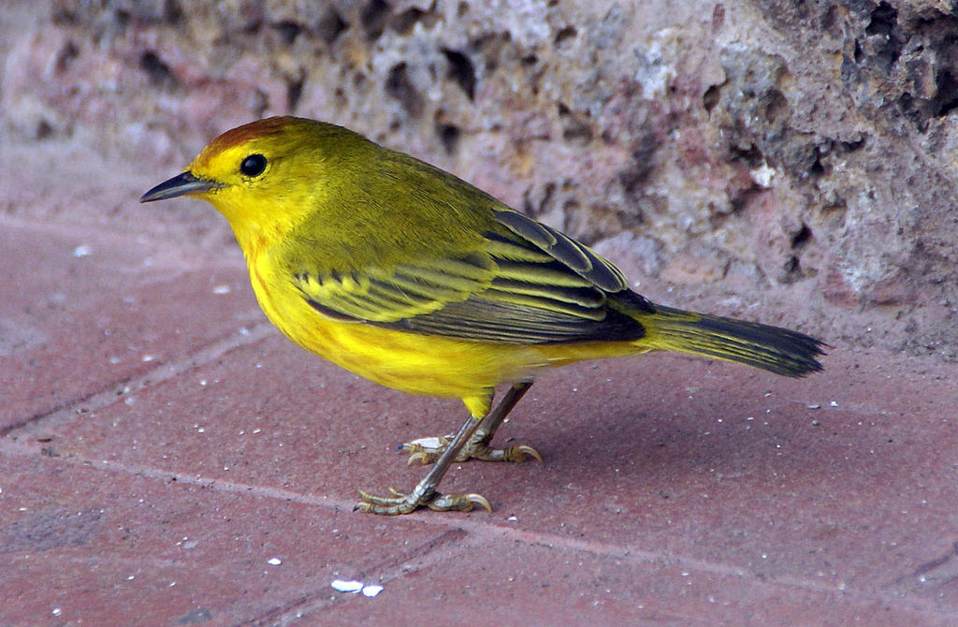
Dendroica petechia

Slide 38
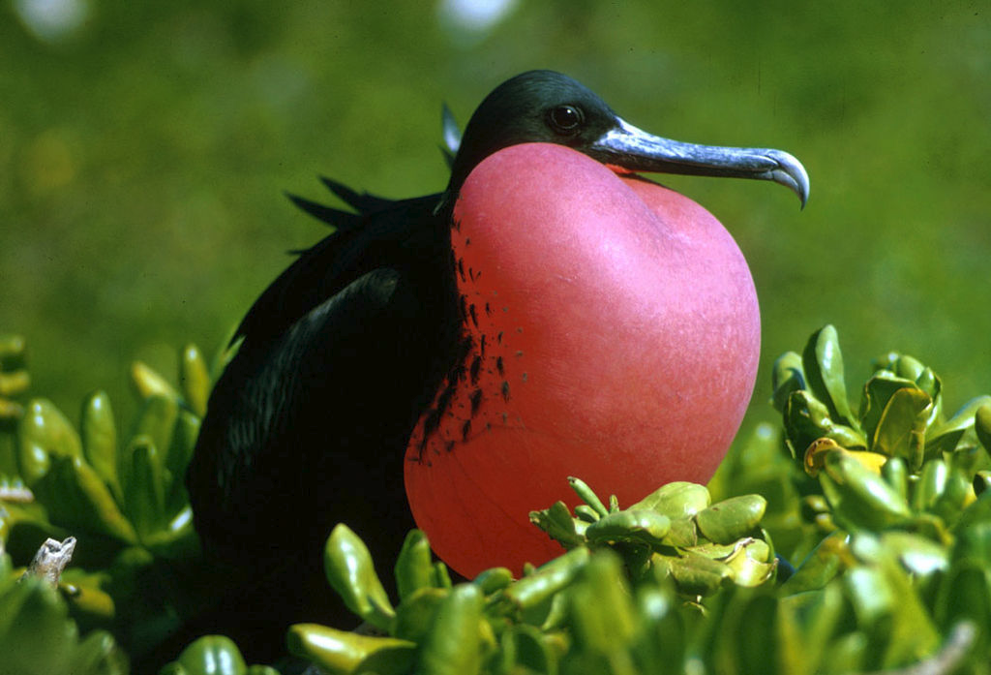
Magnificent Frigate Bird (Fregata magnificens)

Slide 39
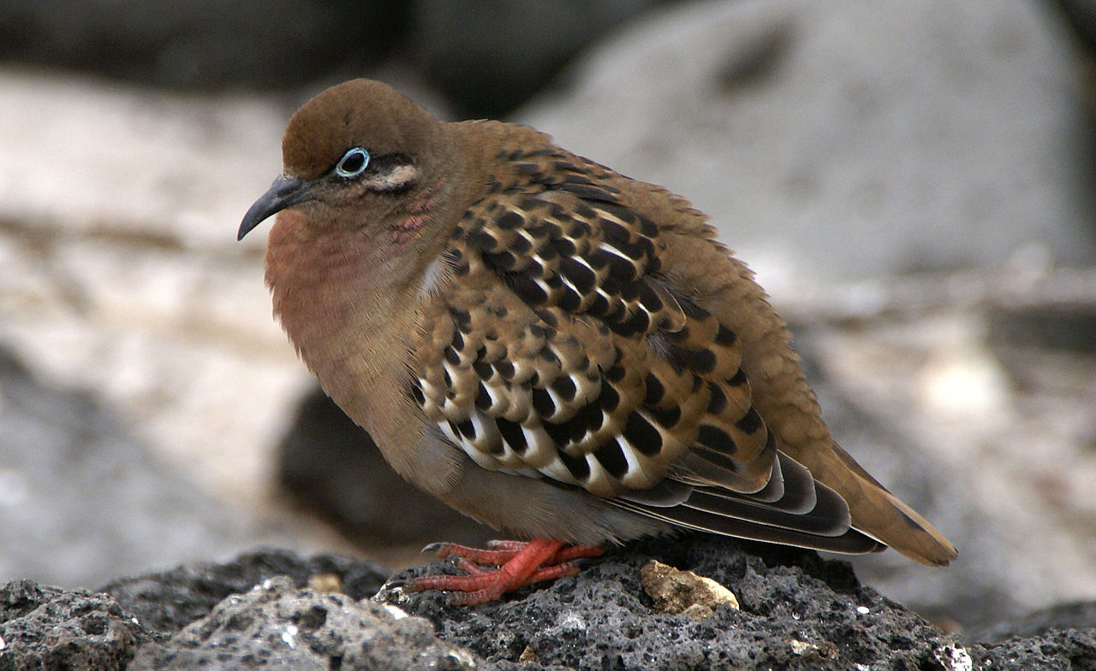
Zenaida galapagoensis

Slide 40
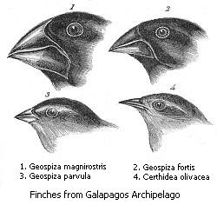
Darwin’s Finches

Slide 41
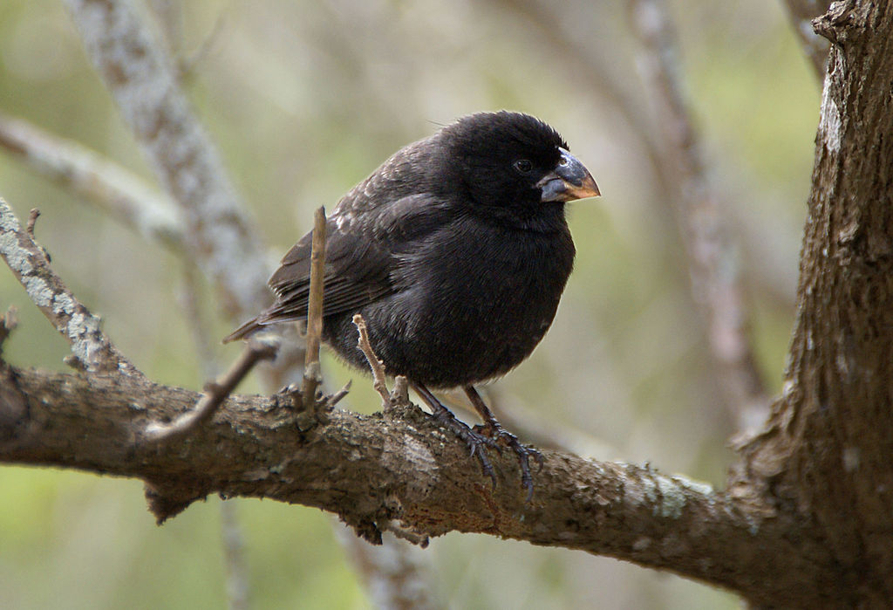
Medium Ground-finch (Geospiza fortis) endemic

Slide 42
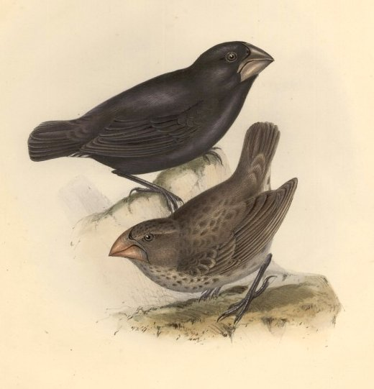
Large Ground-finch (Geospiza magnirostris) endemic

Slide 43
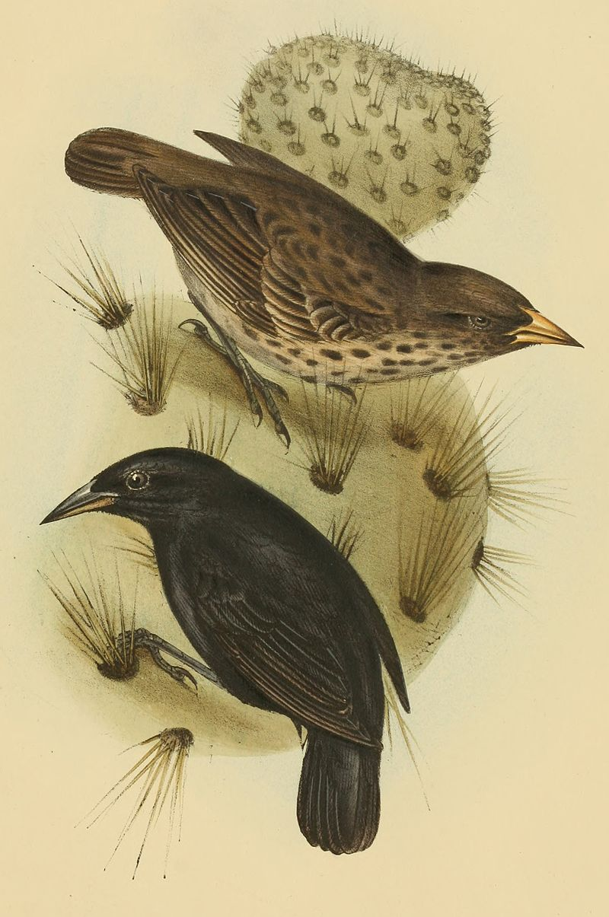
Common Cactus-finch (Geospiza scandens) endemic

Slide 44
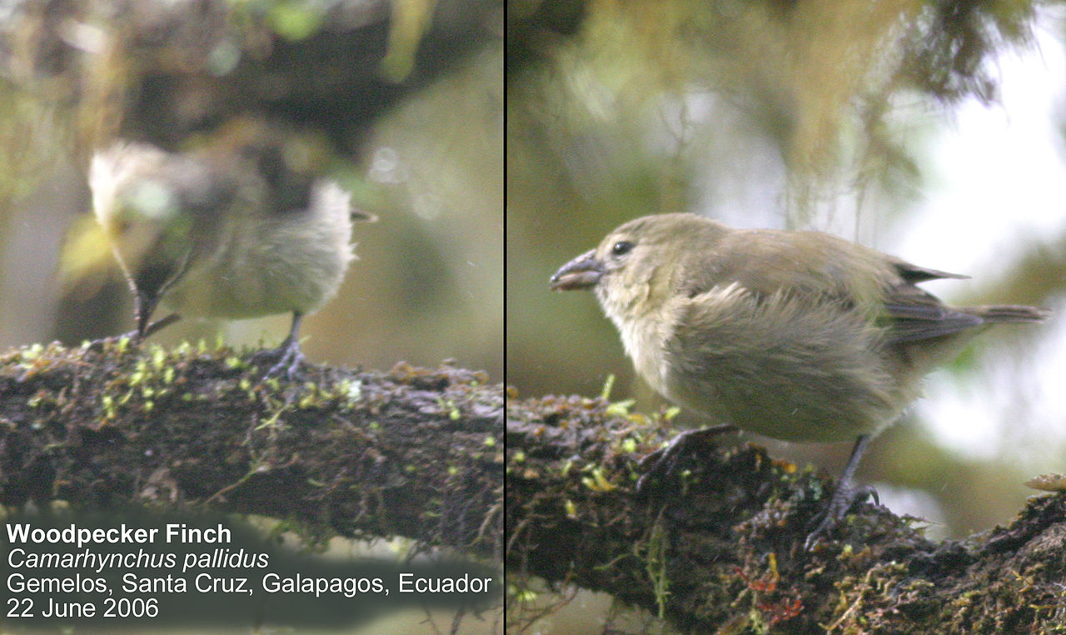

Slide 45
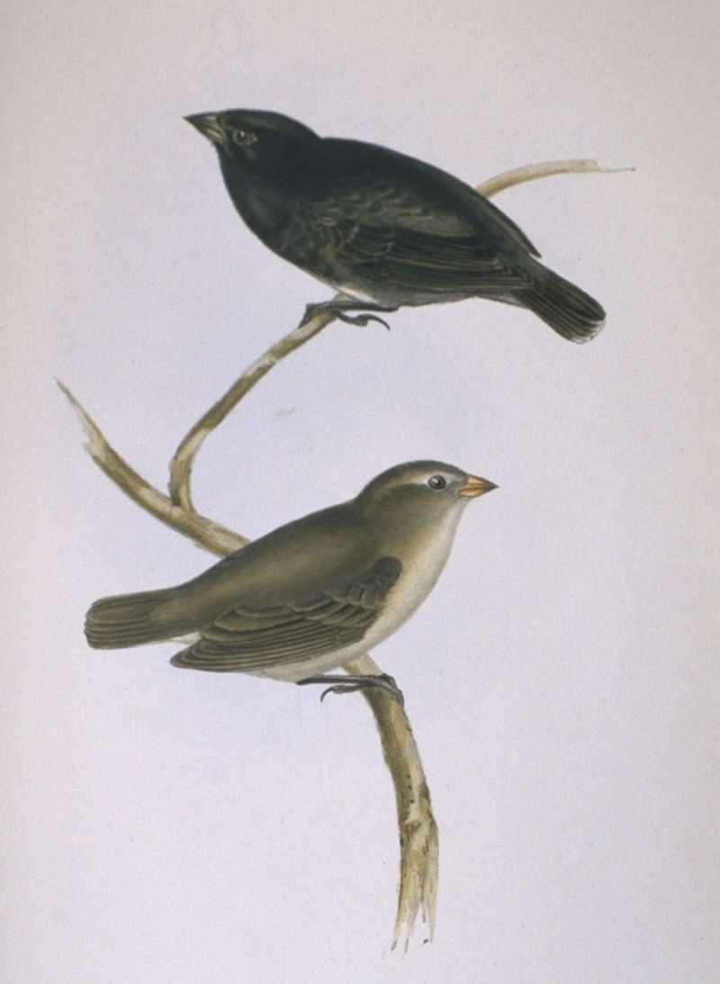
Small Tree-finch (Camarhynchus parvulus) endemic

Slide 46
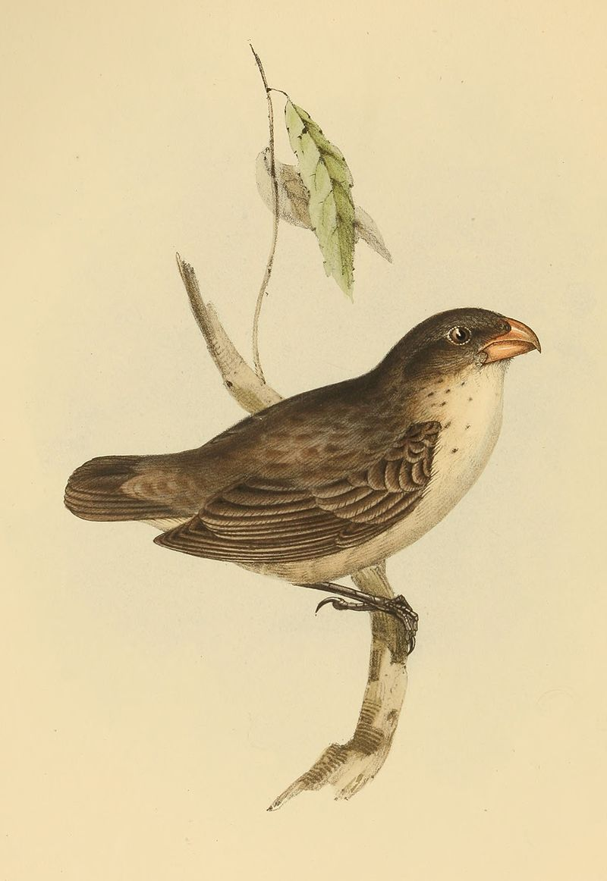
Large Tree-finch (Camarhynchus psittacula) endemic

Slide 47
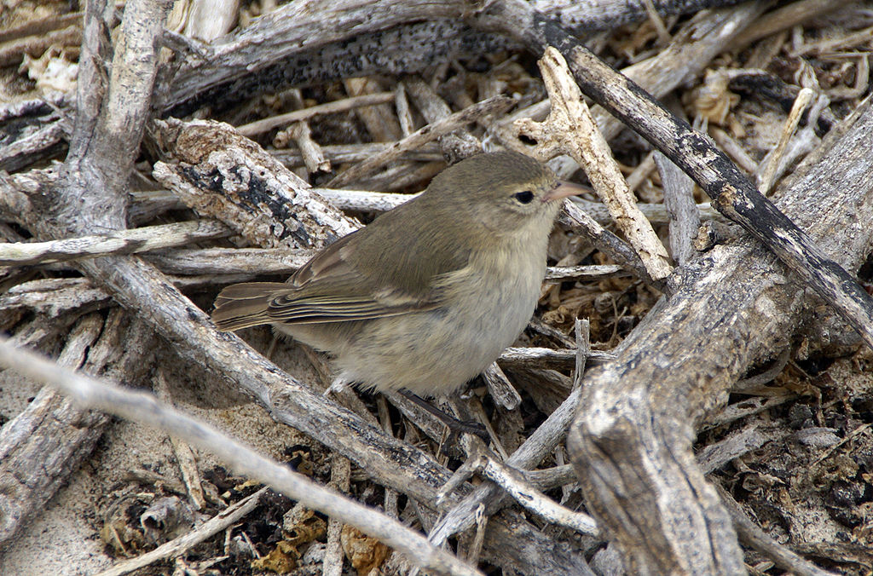
Warbler Finch (Certhidea olivacea) endemic

Slide 48
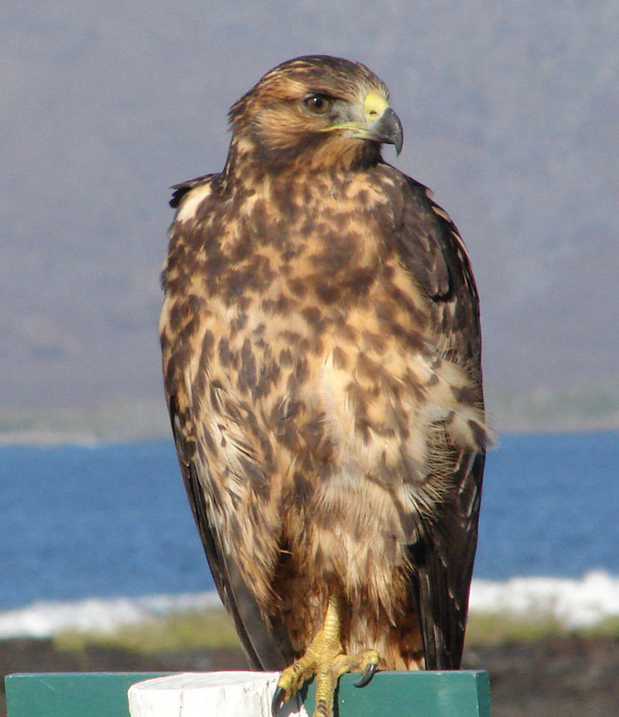
Galapagos hawk (Buteo galapagoensis) endemic

Slide 49
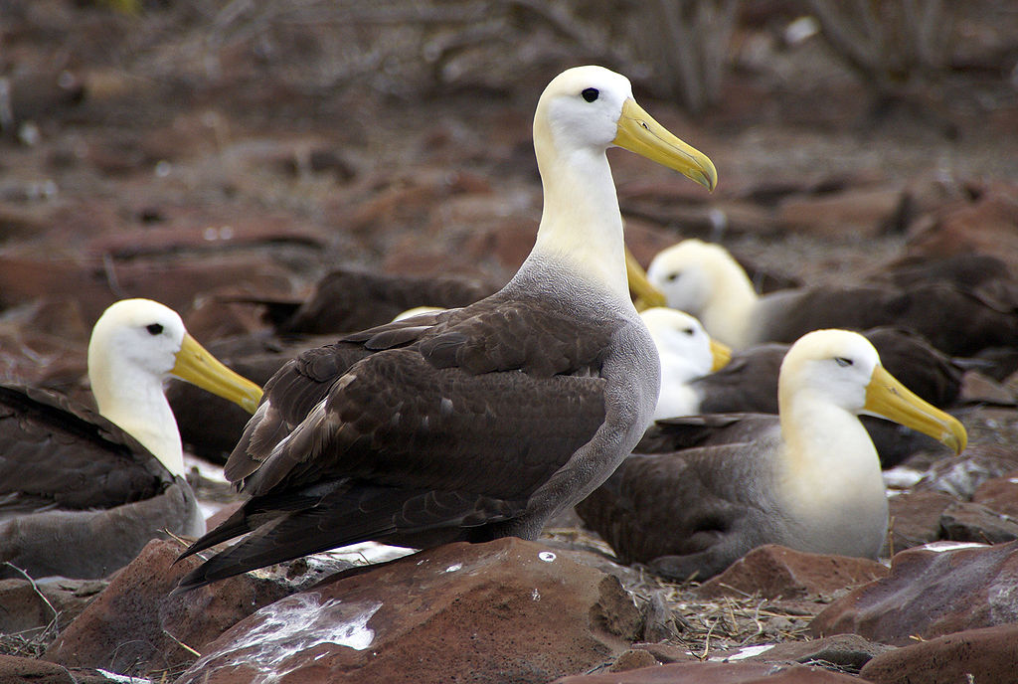
Waved albatrosses on Española

Slide 50
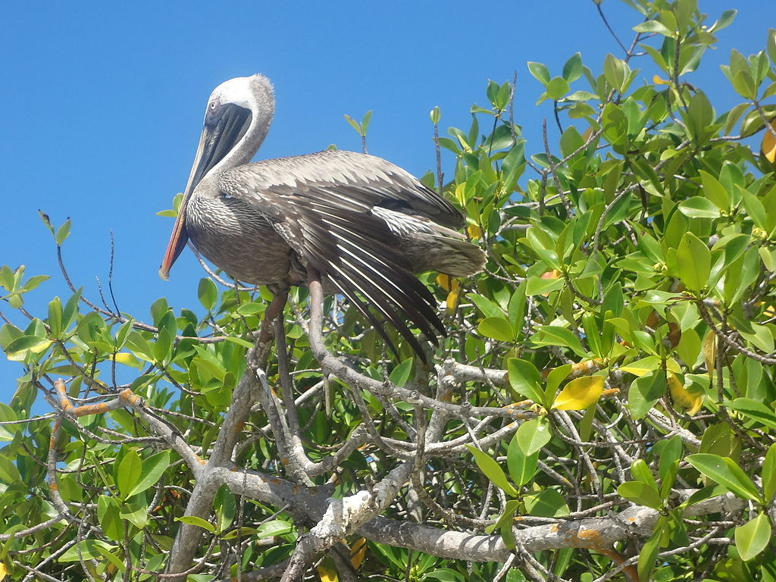
Pelecanus occidentalis, Tortuga Bay

Slide 51
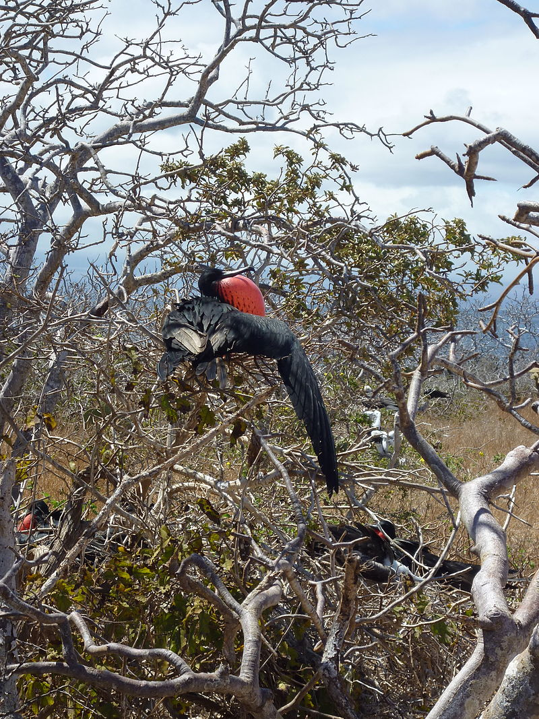

Slide 52
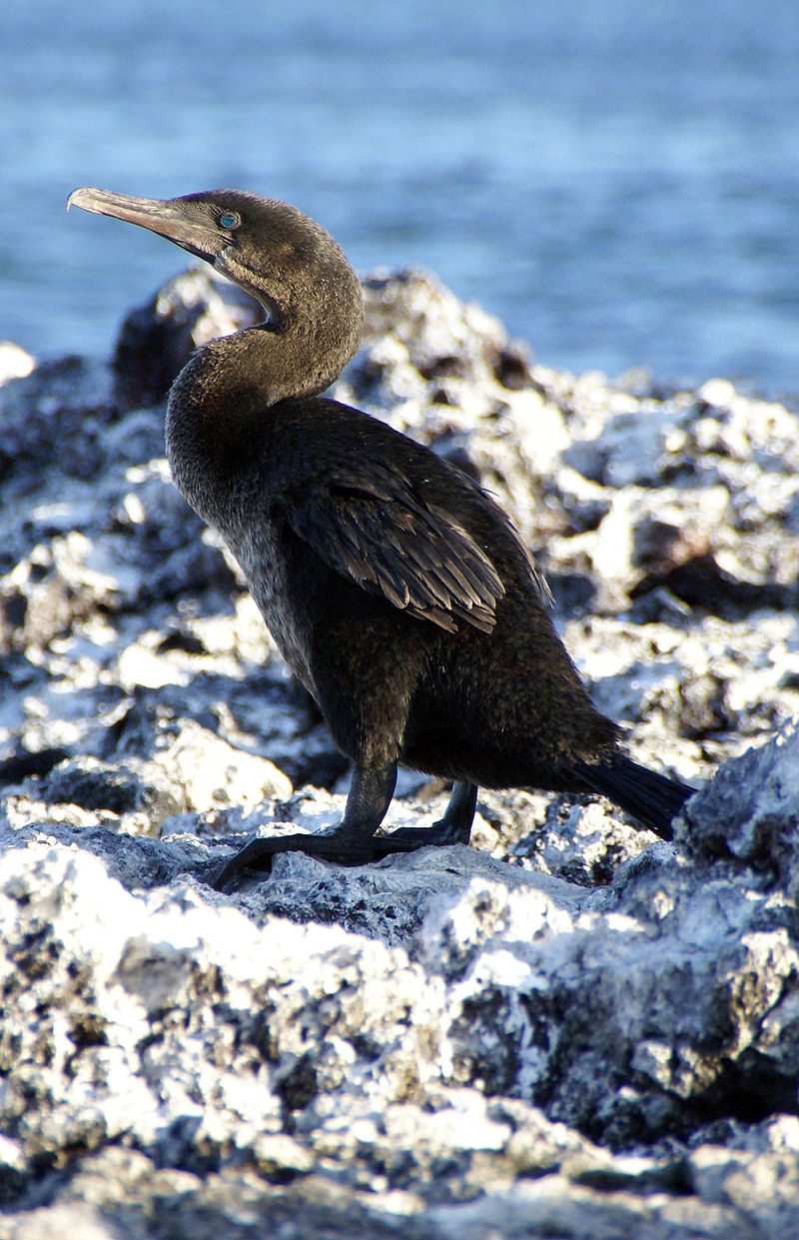
Flightless Cormorant (Phalacrocorax harrisi, (cat)) endemic

Slide 53
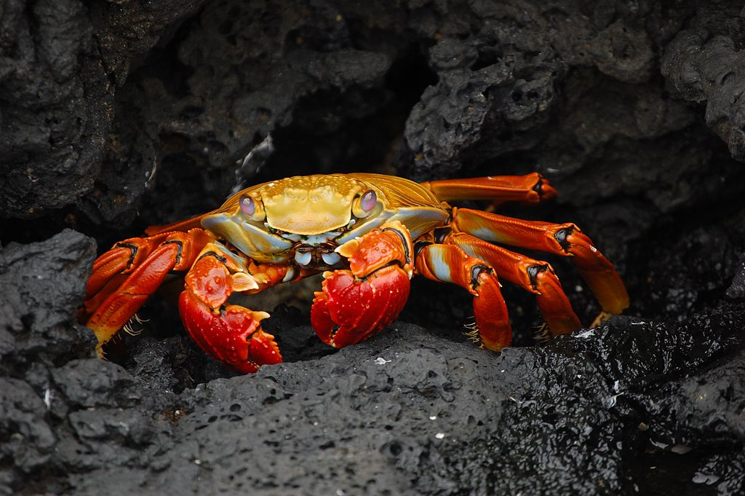
Grapsus grapsus in the Galapagos.

Slide 54
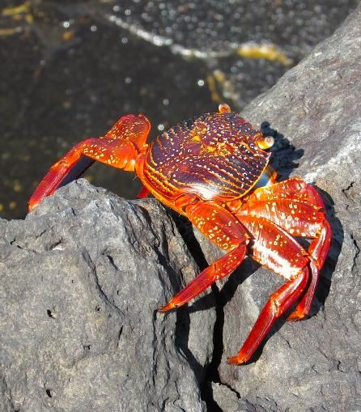
You’ll see crabs galore on many of the islands

Slide 55
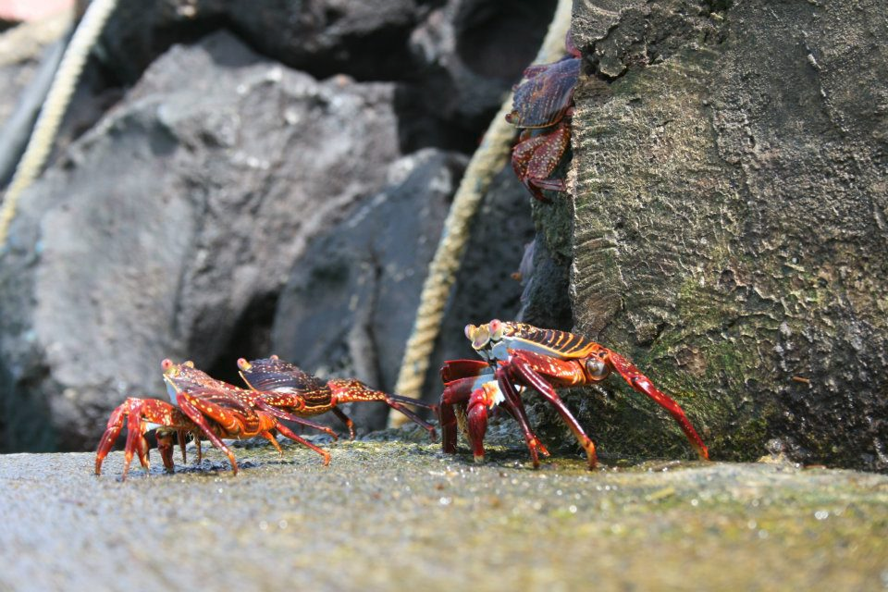

Slide 56

Galápagos marine iguana.

Slide 57


Slide 58

Marine Iguana, Amblyrhynchus cristatus venustissimus,

Slide 59


Slide 60

Marine Iguana

Slide 61

A breeding program in the Galapagos for Yellow Land Iguana living (pictured here living at the Charles Darwin Research Station, Puerto Ayora

Slide 62

A Galapagos Land Iguana on the North Seymour Island

Slide 63

Amblyrhynchus cristatus on the Volcanic rock, Tortuga Bay.

Slide 64

Lagarto de la familia Tropiduridae

Slide 65

Don’t forget the sea lions!

Slide 66

South American Sea Lion

Slide 67

Adult Galápagos sea lion resting on a park bench in Puerto Baquerizo Moreno .

Slide 68


Slide 69

Mother and baby seal

Slide 70

A juvenile Galápagos penguin before it has banding markings.

Slide 71

School of scalloped hammerheads, Wolf Island, Galapagos Islands

Slide 72

Sea Cucumber

Slide 73


Slide 74
Many of the plant species found in the Galapagos Islands are as interesting and unique as the islands’ renowned animal life. Still, many first-time visitors are surprised by the arid, almost lunar landscape that greets them as they step off of the plane. When compared to many parts of mainland South America or to other tropical island groups throughout the world, the Galapagos Islands are home to relatively few native plant species and are not particularly lush, except at higher elevations on the larger islands.

Slide 75

Tree cactus (Opuntia echios var. barringtonensis) on Santa Fe Island, Galapagos. The birds perched to the right of the cactus are Swallow-tailed Gulls (Creagrus furcatus)

Slide 76

Baumopuntie (Opuntia echios var. zacana)

Slide 77



Slide 78

Caesalpinia pulcherrima

Slide 79


Slide 80

Scalesia

Slide 81

Avicennia germinans

Slide 82

White Mangrove on Santa Cruz

Slide 83

Black Mangrove

Slide 84

Button Mangrove

Slide 85

Pink Passion Flower

Slide 86


Slide 87


Slide 88


Slide 89












