Slide 1
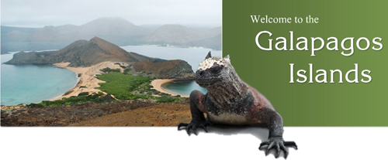
GALAPAGOS ISLANDS

Slide 2
What About Them?
The Galapagos Islands are an archipelago of volcanic islands that can be found on either side of the Equator in the Pacific Ocean, 926 km (500 nautical miles) west of continental Ecuador, of which they are a part.
The islands have a national park and a biological marine reserve. Although the islands have a scant human population of 25,000 people, the most interesting inhabitants are the many and varied animals that call these islands home, and which famously attracted the attention of Charles Darwin. Part of the islands are opened to travelers so there is the opportunity for outsiders to visit one of the true marvels of our world.

Slide 3
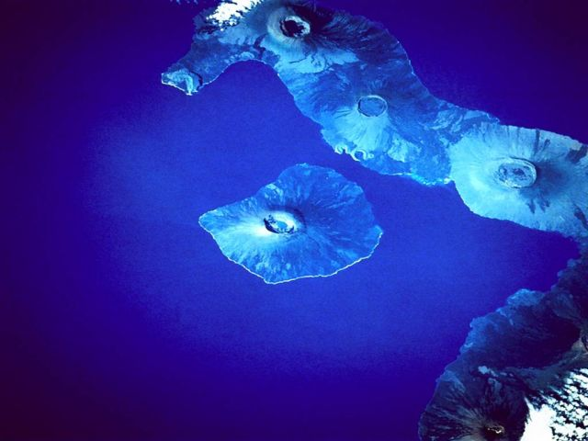
Volcanic Islands

Slide 4
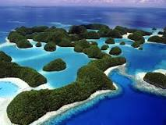
The Galápagos Islands is a volcanic archipelago in the Pacific Ocean. It's considered one of the world's foremost destinations for wildlife-viewing. A province of Ecuador, it lies about 1,000km off its coast. Its isolated terrain shelters a diversity of plant and animal species, many found nowhere else. Charles Darwin visited in 1835, and his observation of Galápagos' species later inspired his theory of evolution.

Slide 5
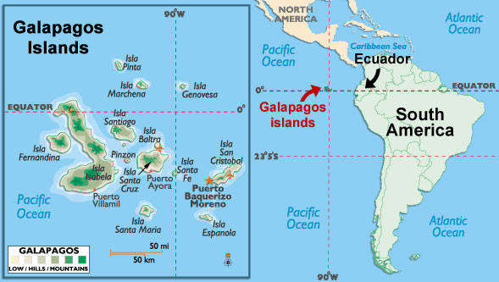

Slide 6
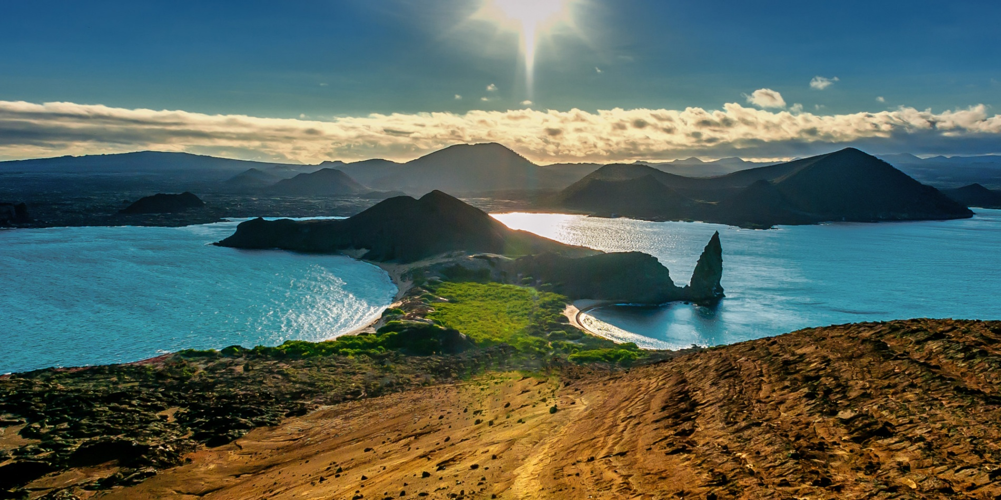
The Land

Slide 7
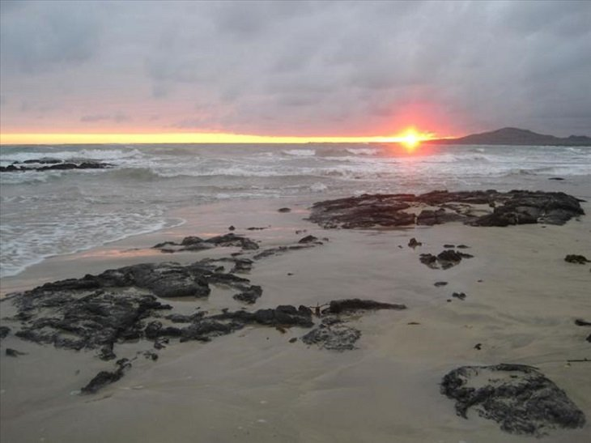

Slide 8
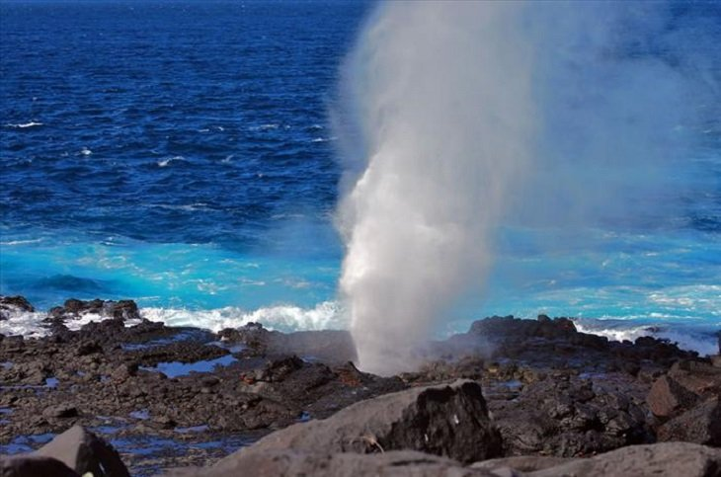

Slide 9
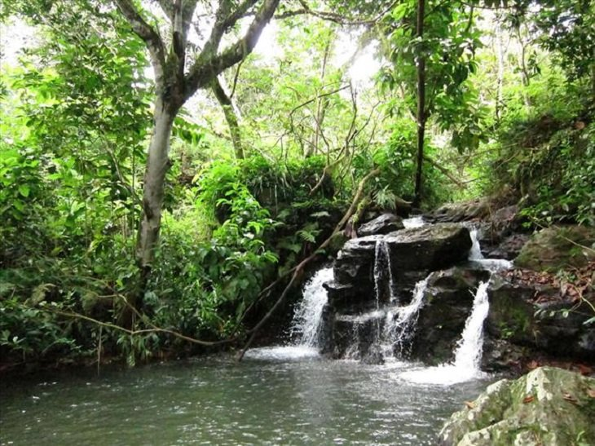

Slide 10
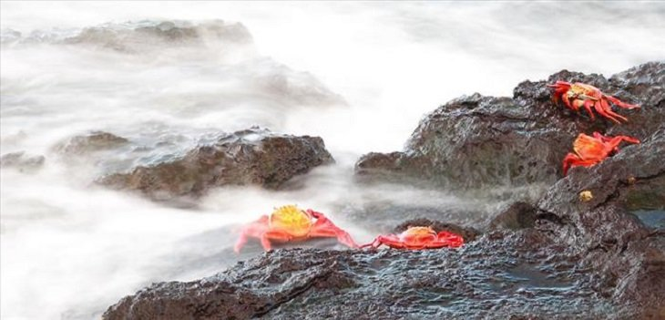

Slide 11
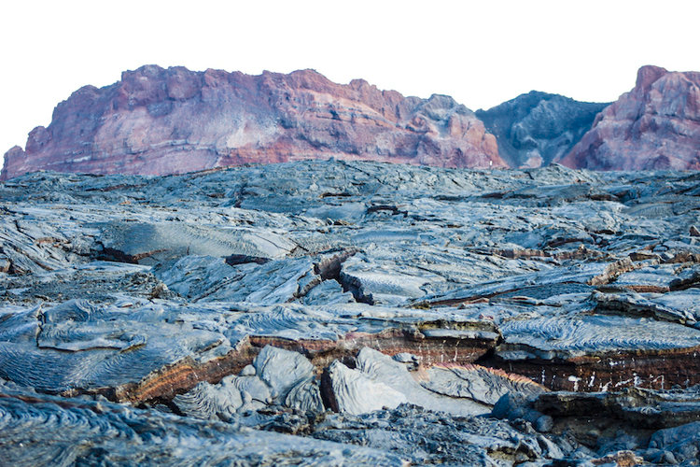

Slide 12
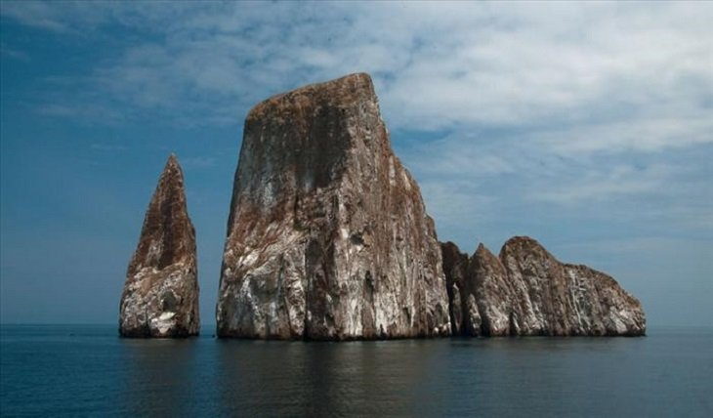

Slide 13
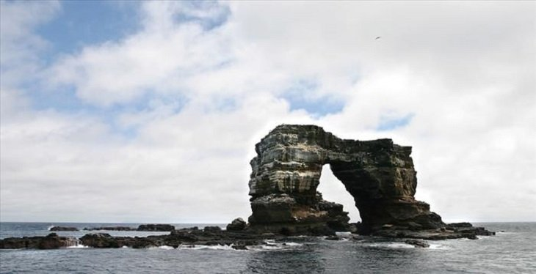

Slide 14
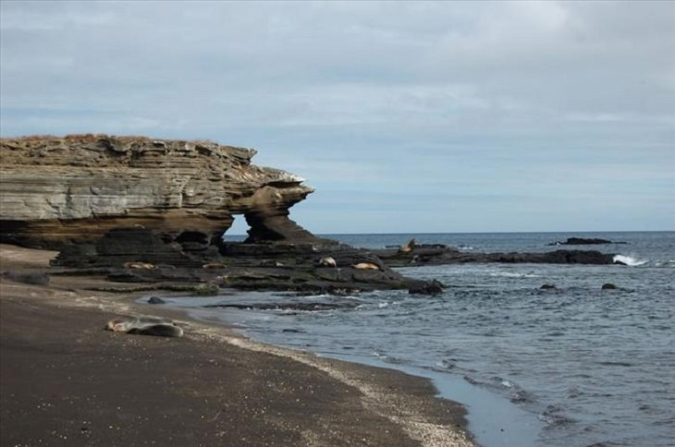

Slide 15
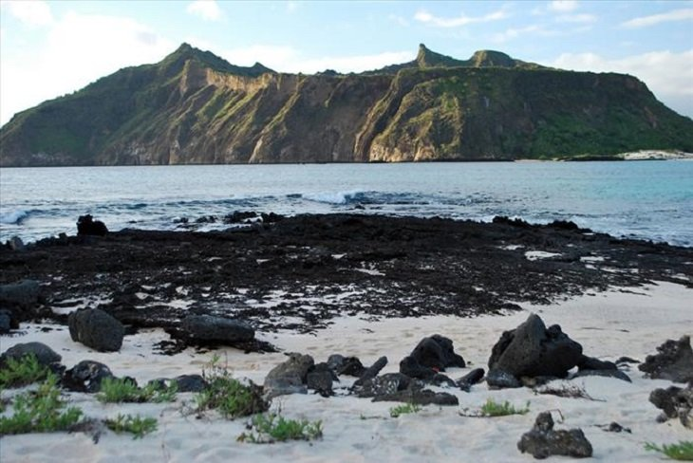

Slide 16
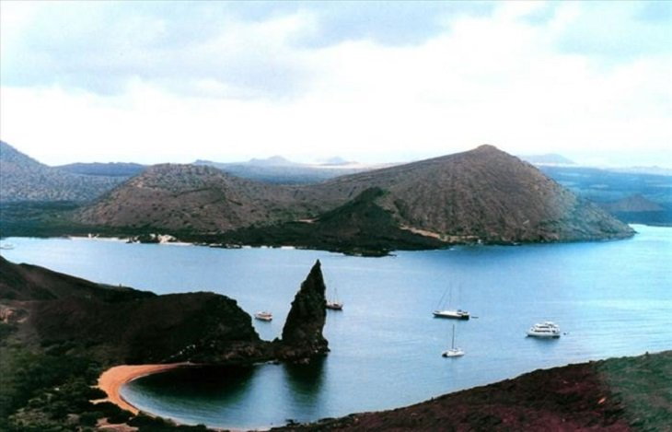

Slide 17
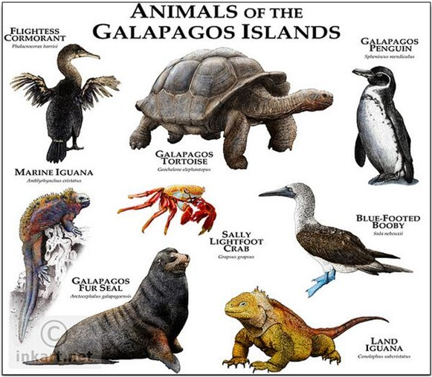
The Animal Life
Living in and on the land, the air, and the nearby water

Slide 18
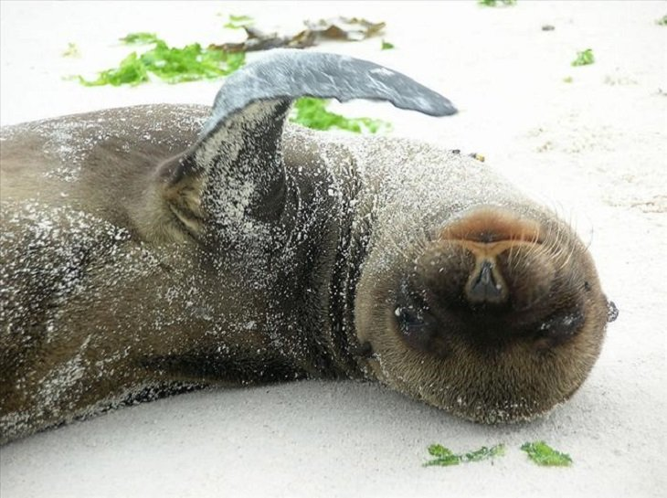

Slide 19
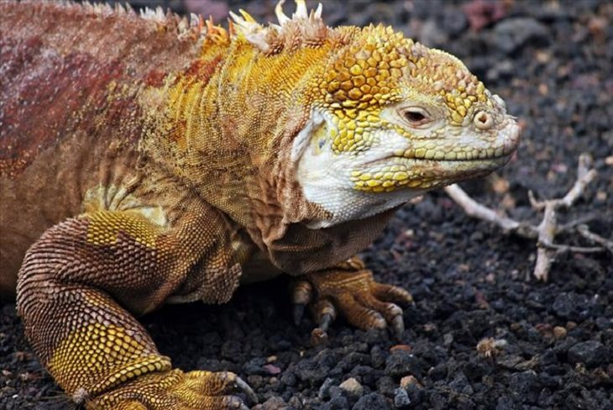

Slide 20
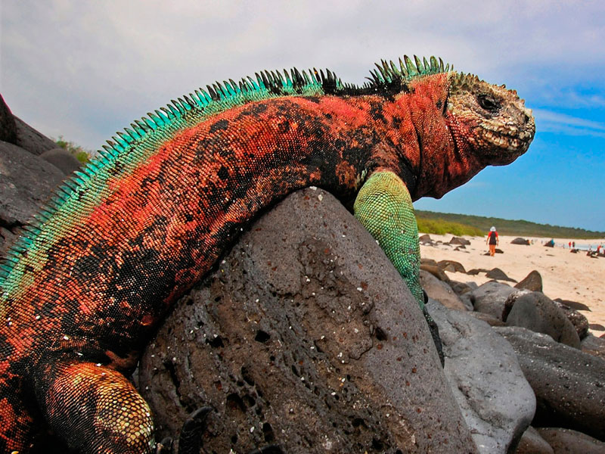

Slide 21
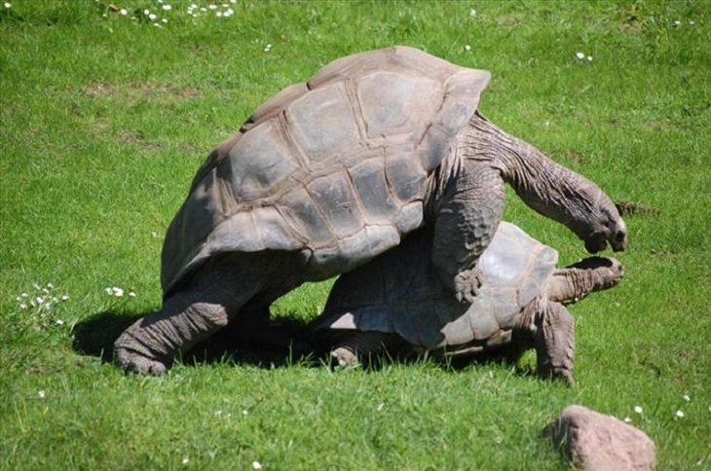

Slide 22
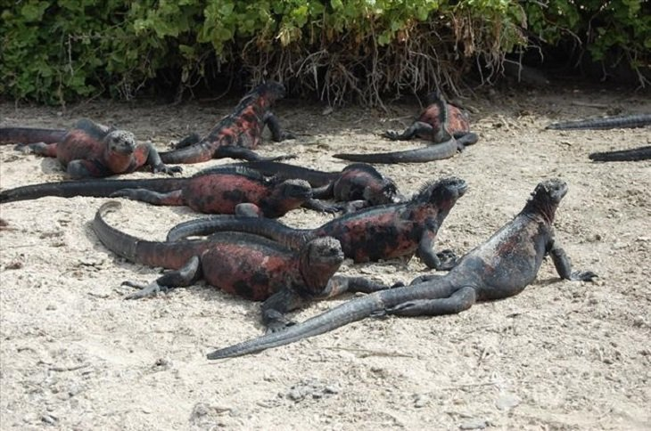

Slide 23
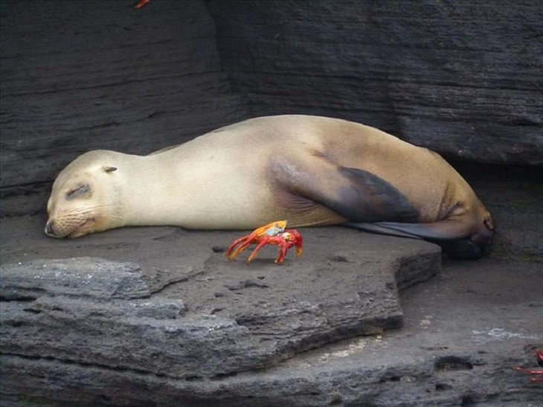

Slide 24
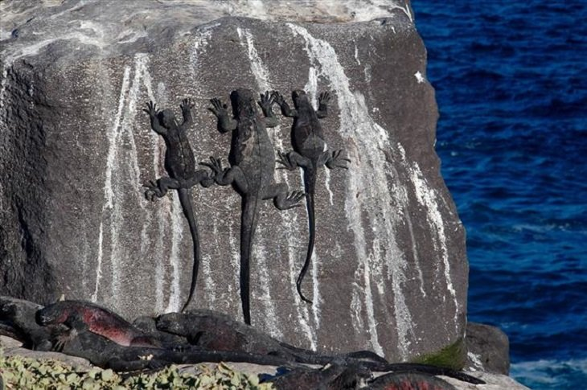

Slide 25
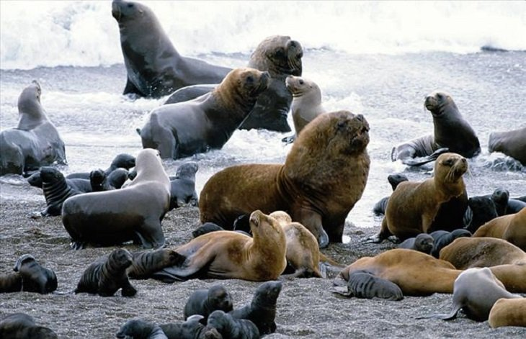

Slide 26
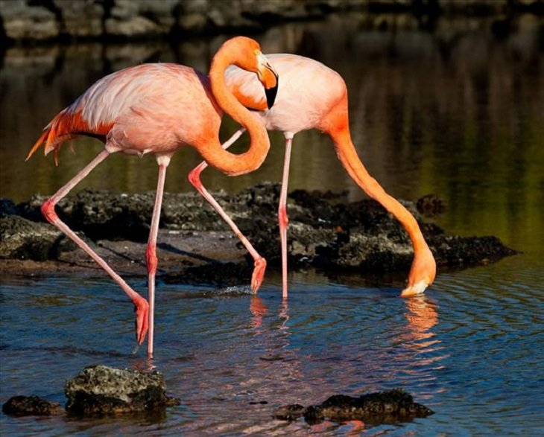

Slide 27
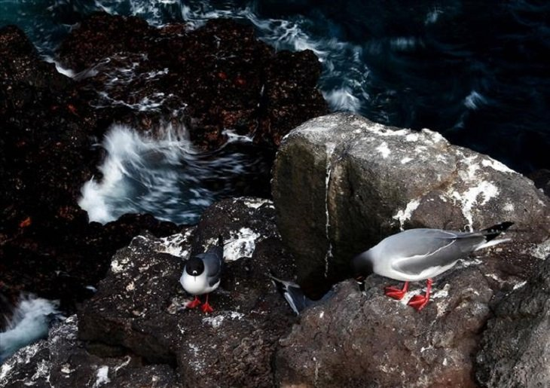

Slide 28
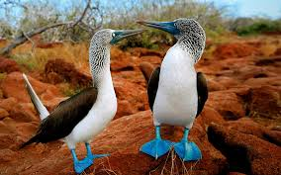

Slide 29
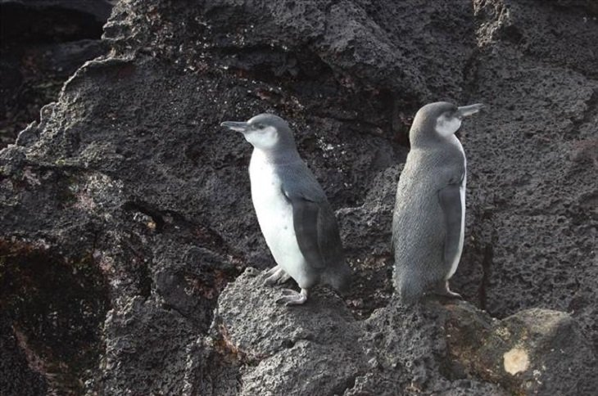

Slide 30
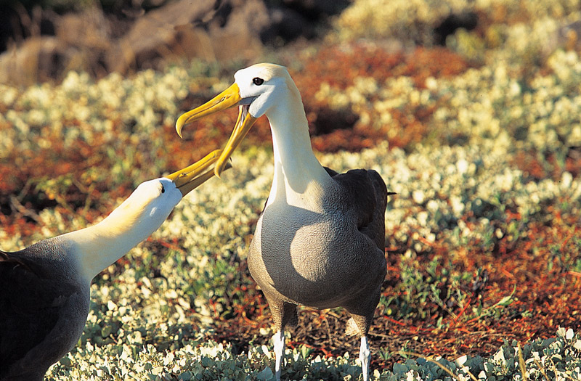

Slide 31
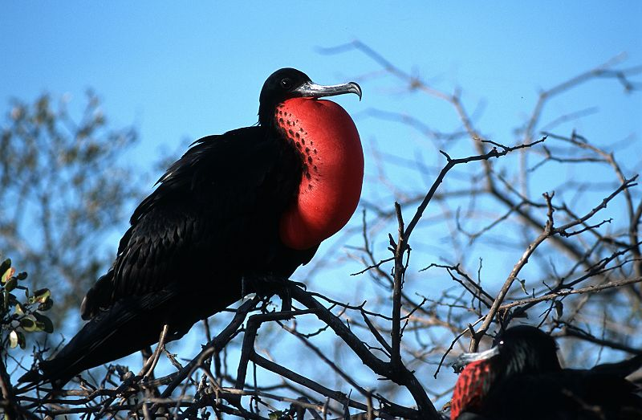

Slide 32
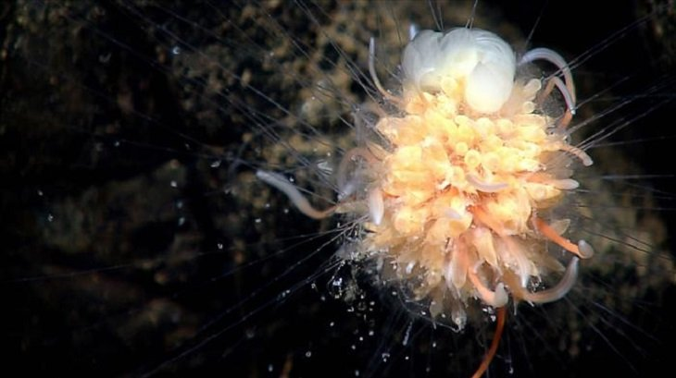

Slide 33
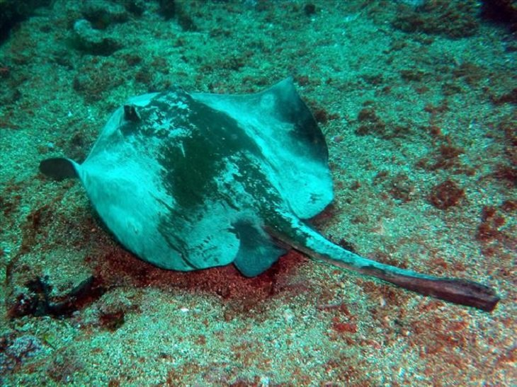

Slide 34
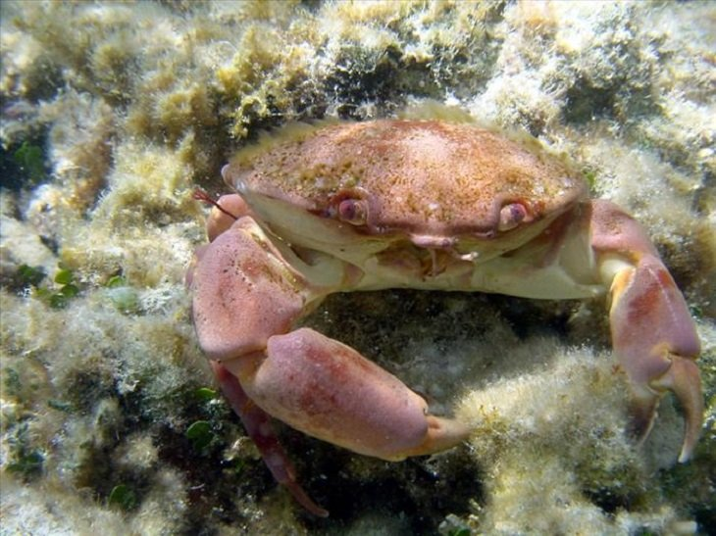

Slide 35
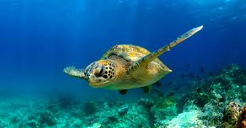

Slide 36
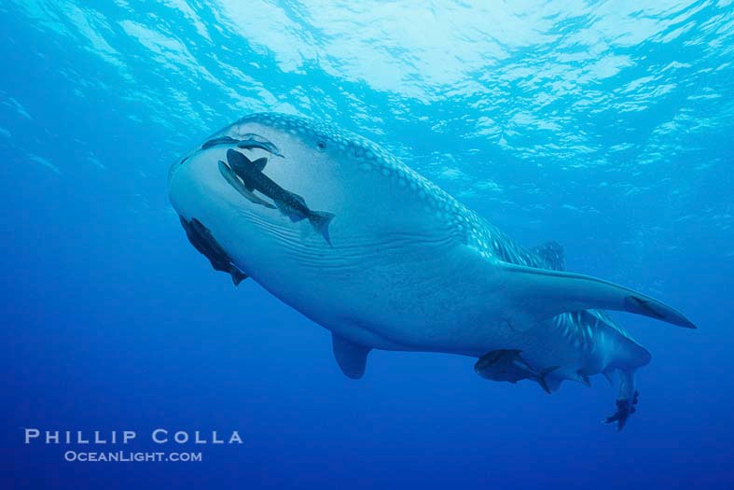

Slide 37
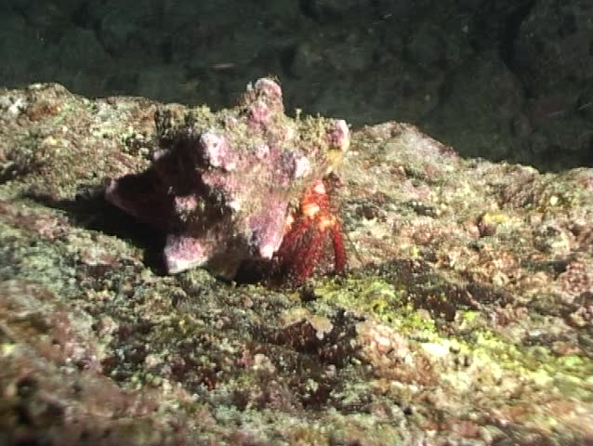
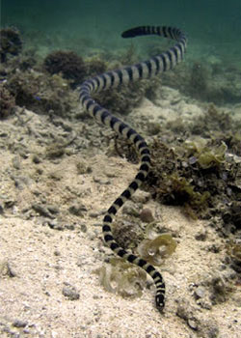

Slide 38
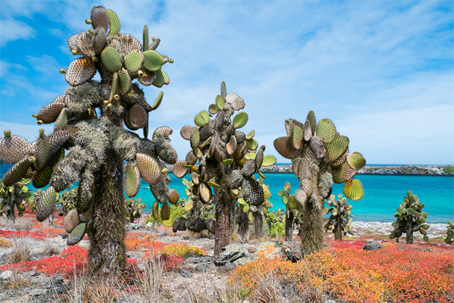
Vegetation

Slide 39
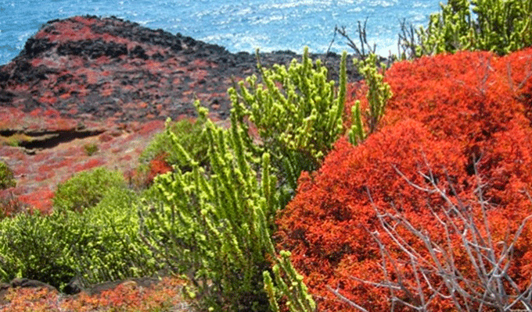

Slide 40


Slide 41
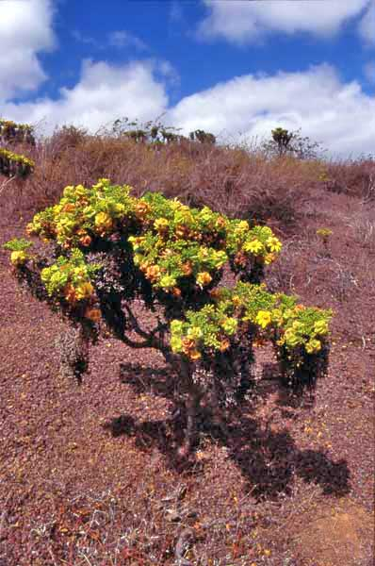
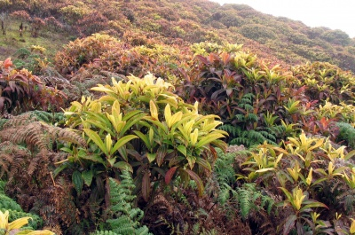


Slide 42


Slide 43
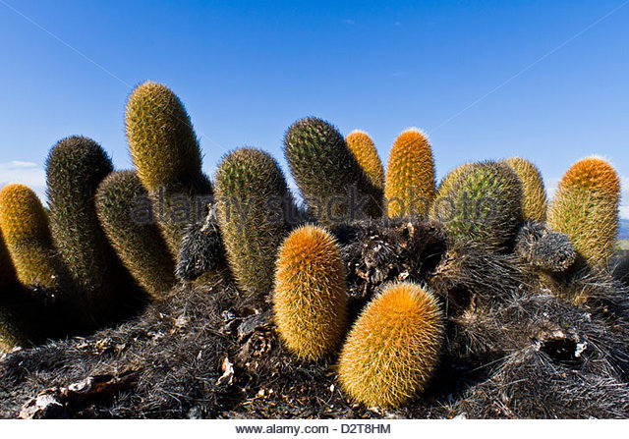

Slide 44
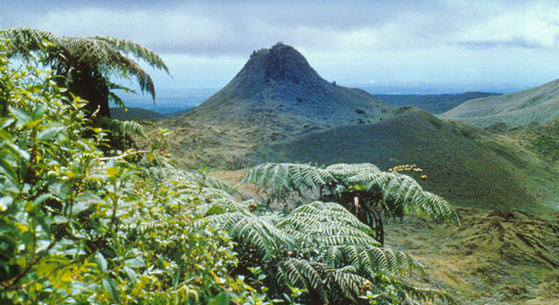

Slide 45
