Slide 1
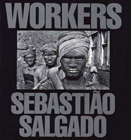
BRAZIL - Serra Pelada gold mine, 1985
Thousands scratch in the dirt for a flake of treasure

Slide 2
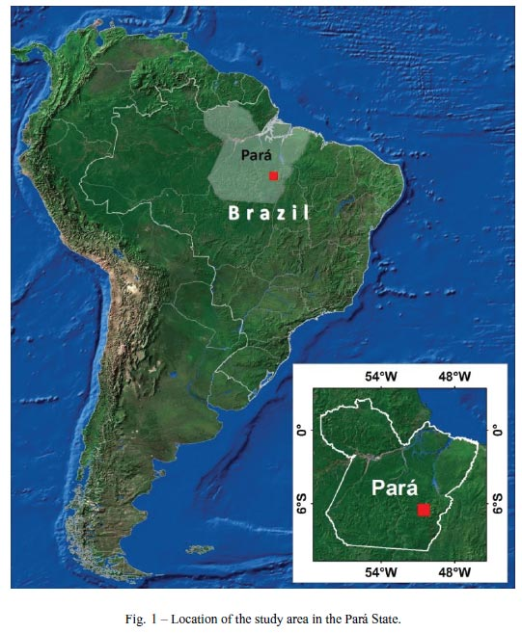
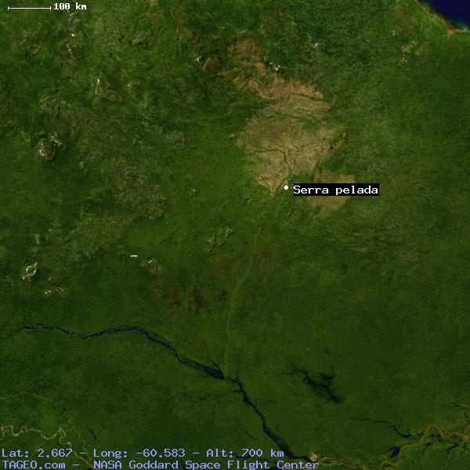
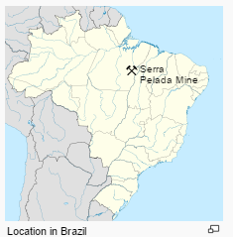

Slide 3
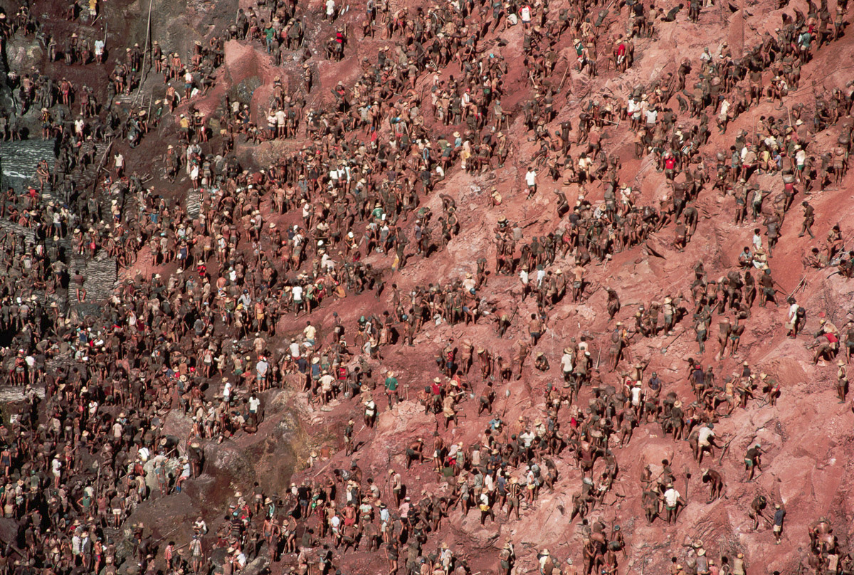

Slide 4
In 1979, Genésio Ferreira da Silva, a farmer in the remote interior of Brazil, discovered a nugget of gold on his property and hired a geologist to see whether there was more to find.
Within days, word had spread and a gold rush had begun. After five weeks, 10,000 speculators were scratching through the soil and finding nuggets as large as 13 pounds.
By May 1980, 4,000 miners had laid claim to two-by-three-meter plots in the rapidly deepening and expanding hole in the ground. Workers known as garimpeiros collected the muddy soil into 40-pound sacks, which they then carried up hundreds of feet of rickety wood and rope ladders to the lip of the mine for sifting.

Slide 5
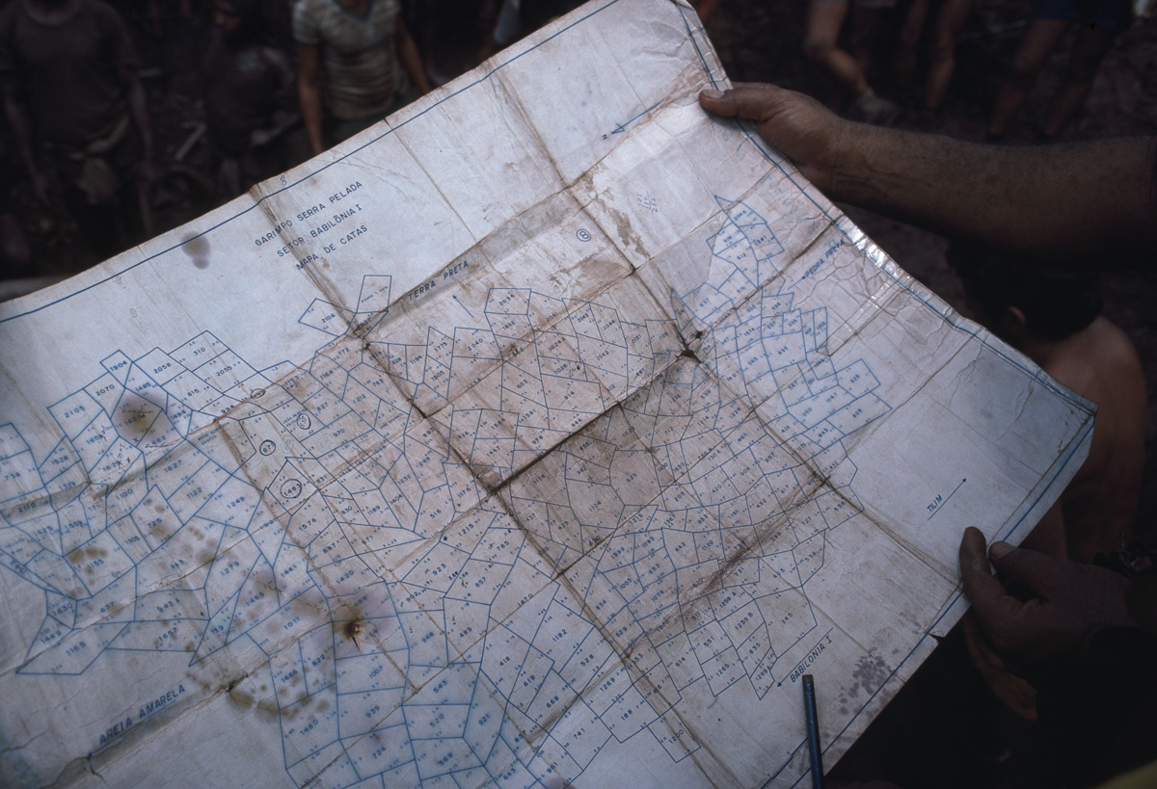
Mine surveyors consult a map of plots in the mine.

Slide 6
At its peak, an estimated 100,000 garimpeiros worked in the yawning mine. A shantytown sprung up near the chasm, where some 60 to 80 murders went unsolved every single month.
In 1986, flooding forced mining operations to end. In six years, the officially recorded yield was 44.5 tons of gold — but it was estimated that as much as 90 percent of the gold found was smuggled out and sold on the black market.
Today, the mine is a small, polluted lake, which still sits on top of tons of undiscovered precious metal.

Slide 7
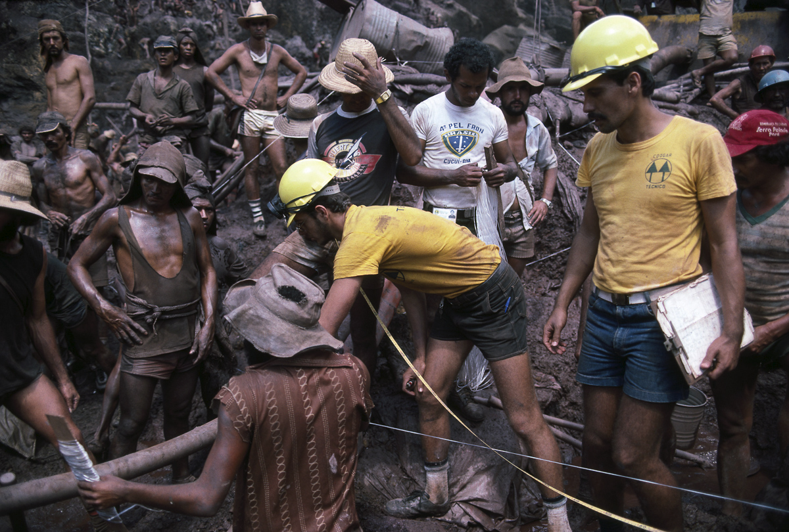
Mine surveyors measure off a single plot of two meters by three meters.

Slide 8
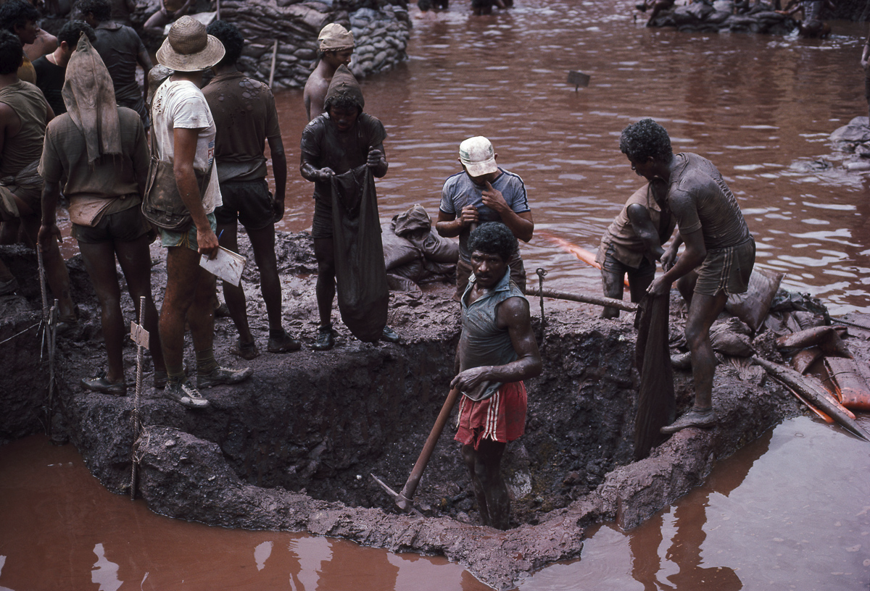
Garimpeiros dig ore from a plot at the bottom of the mine.

Slide 9
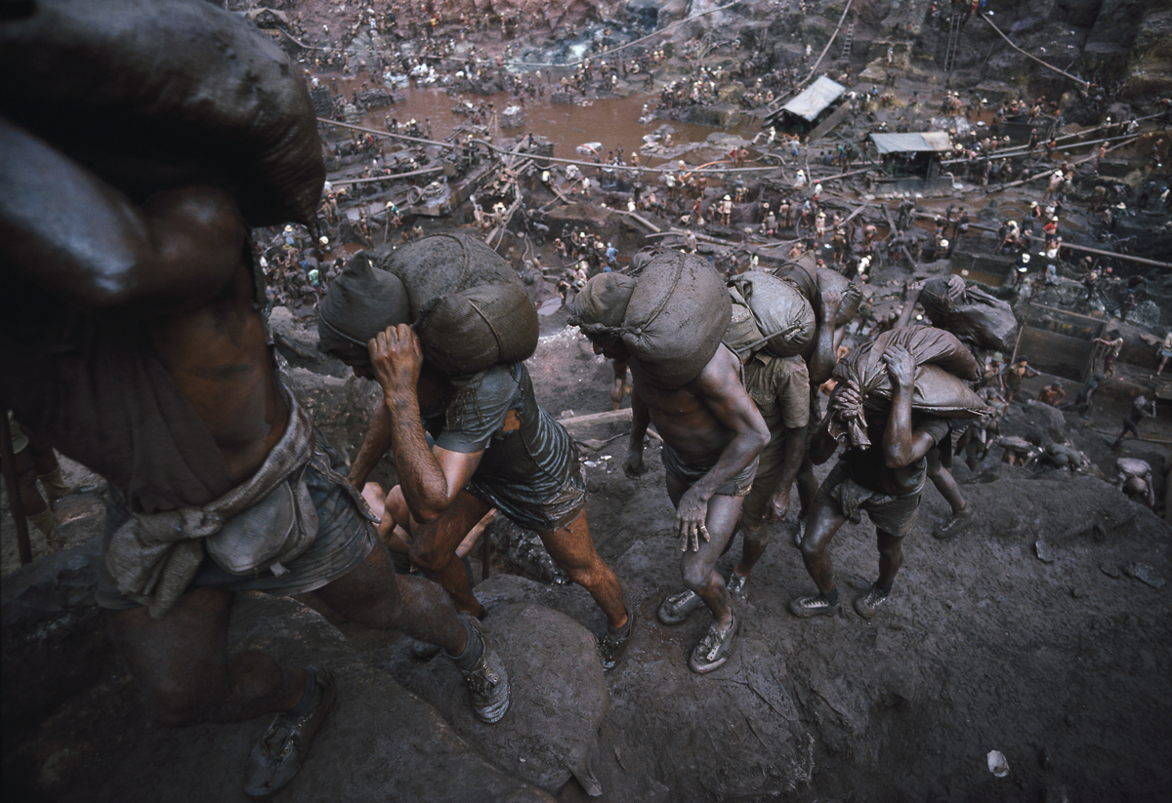
Workers carry out 40-pound bags of ore from the mine.

Slide 10
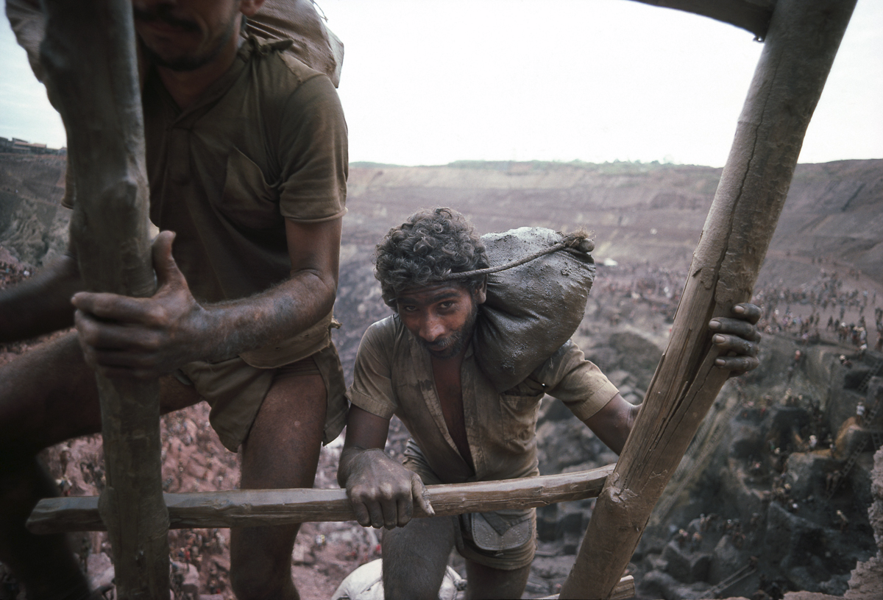

Slide 11
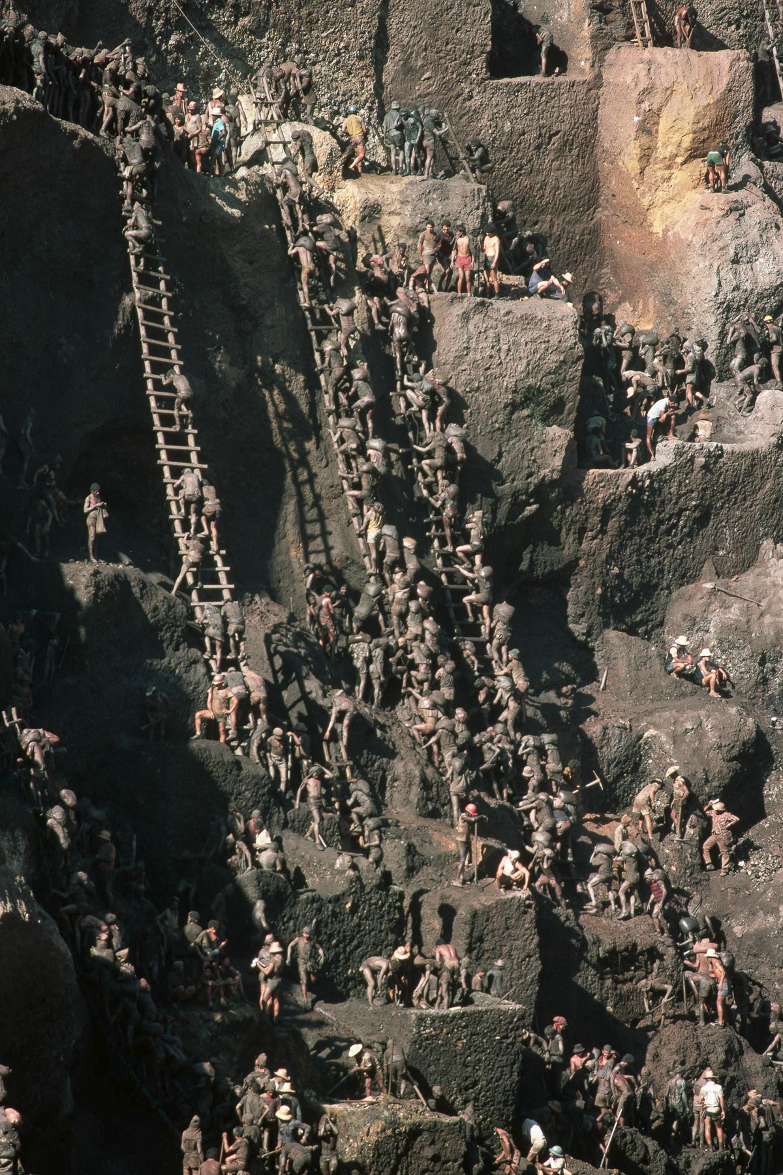
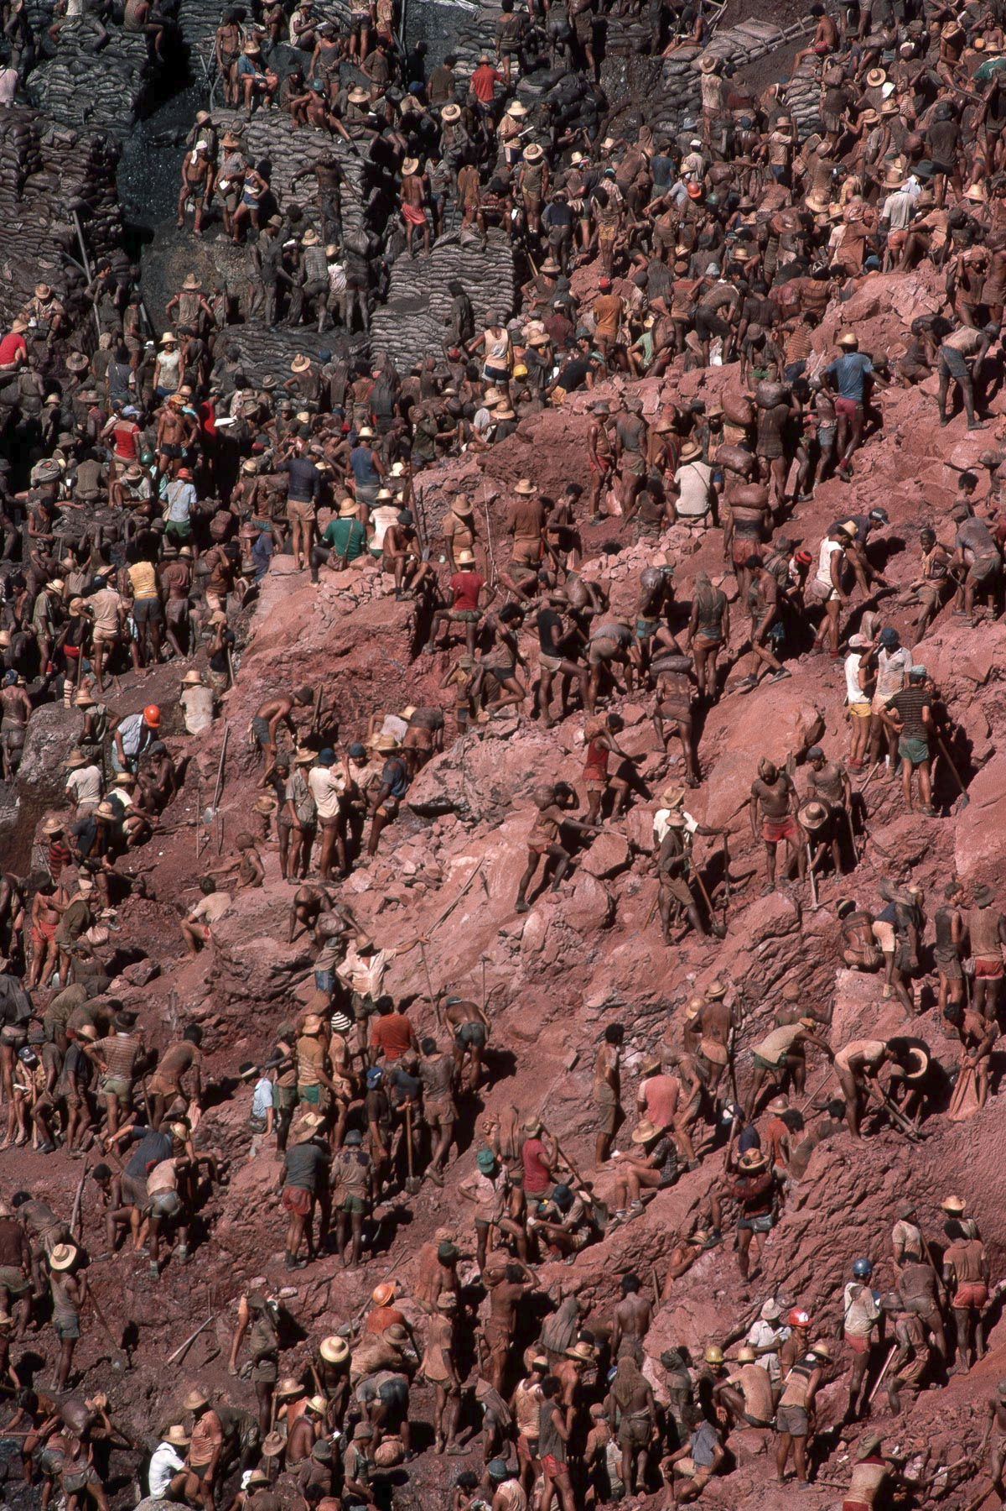

Slide 12
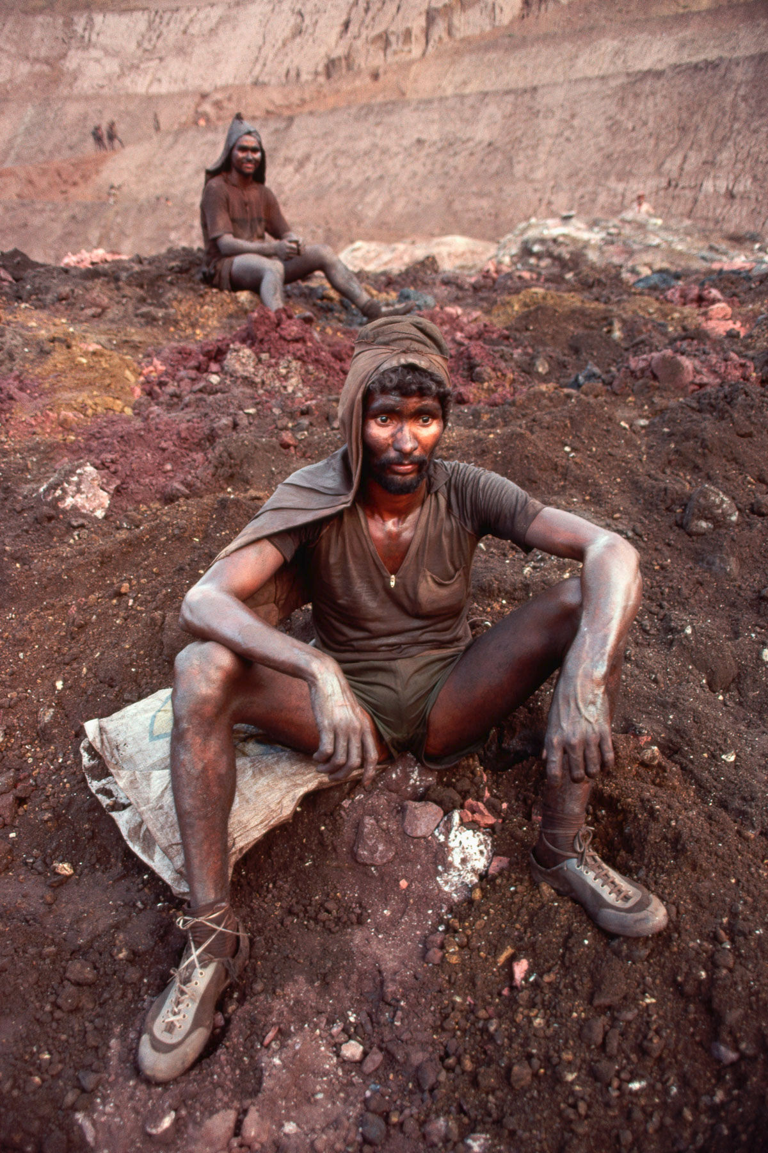
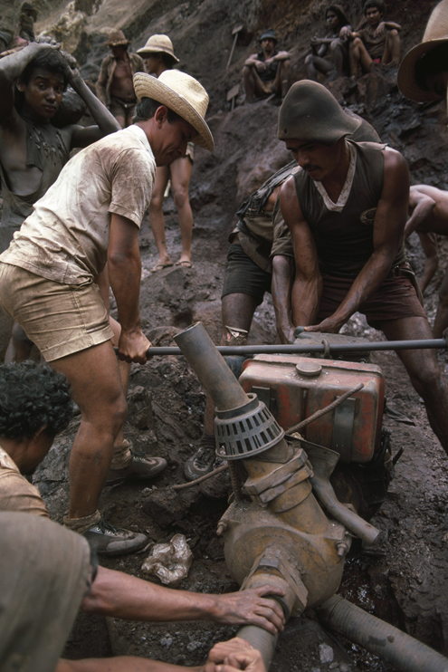
adjust a water pump

Slide 13
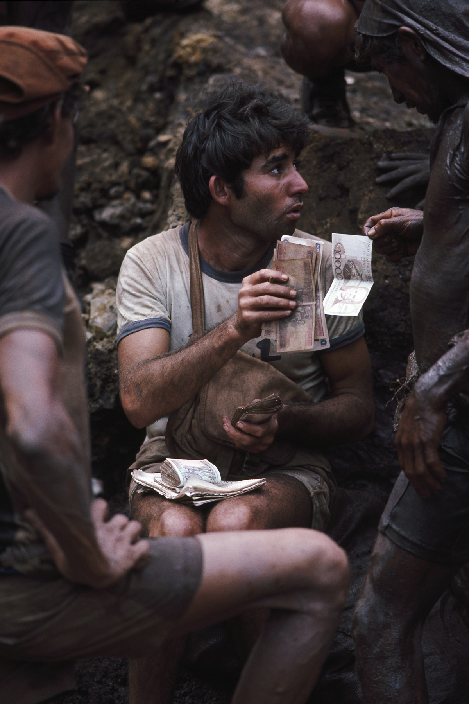
A paymaster distributes wages to garimpeiros, who are paid two to three U.S. dollars a day.

Slide 14
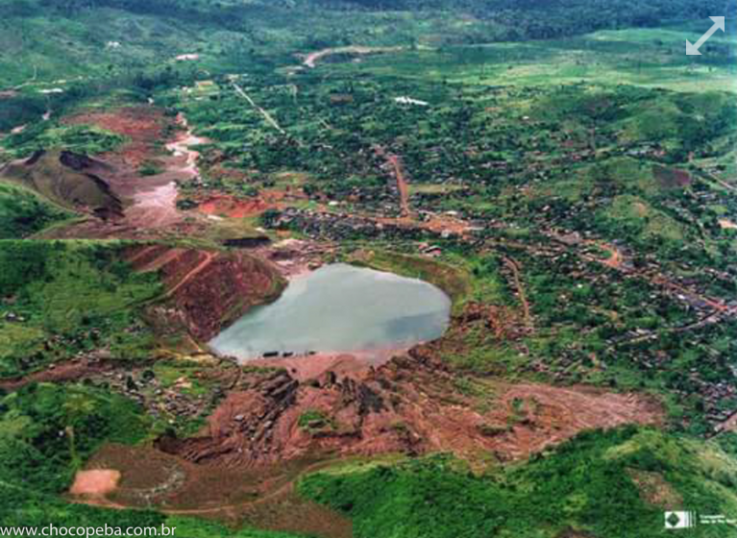
Today, the 300 feet-deep pit, once the largest open-air gold mine in the world, is a polluted lake

Slide 15
