Slide 1
Amazon Warriors turned Eco-Activists
Plus Wildlife of the Amazon

Slide 2
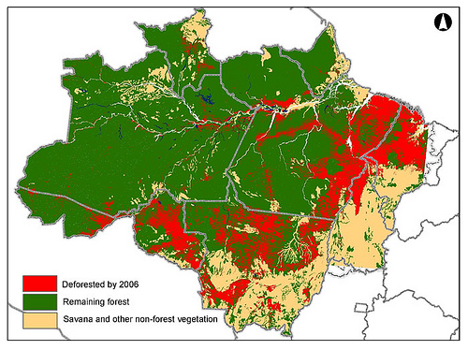
Amazon Basin

Slide 3
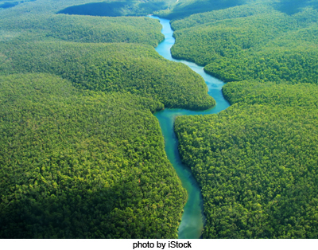

Slide 4
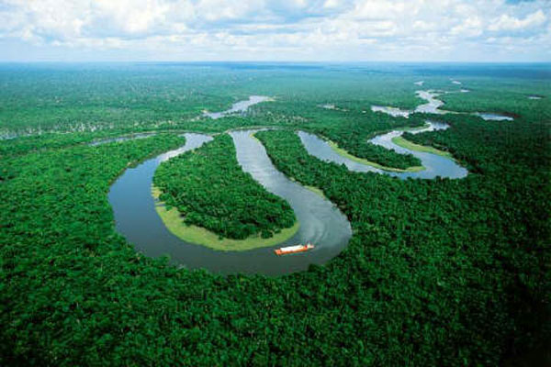

Slide 5
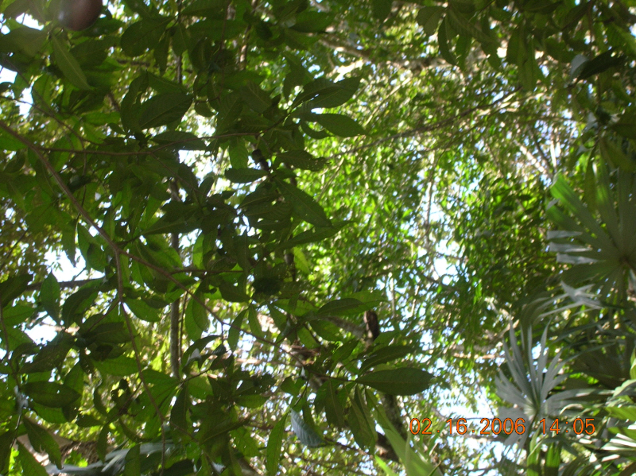
Rainforest Canopy in Belize

Slide 6
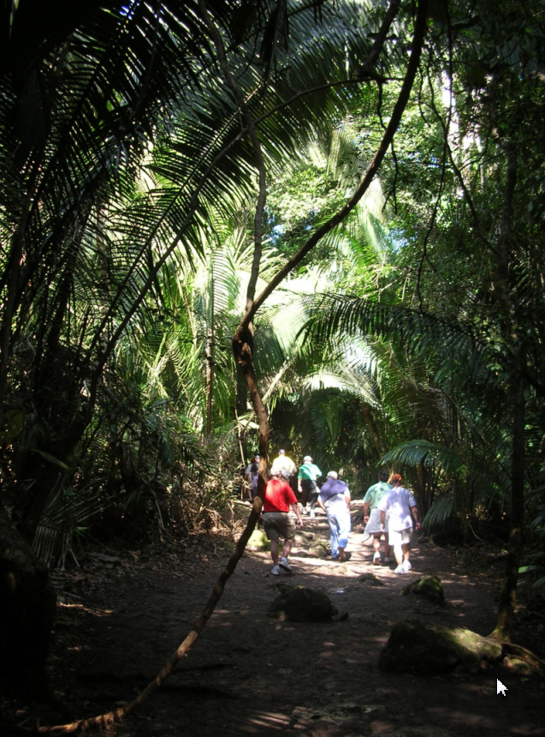
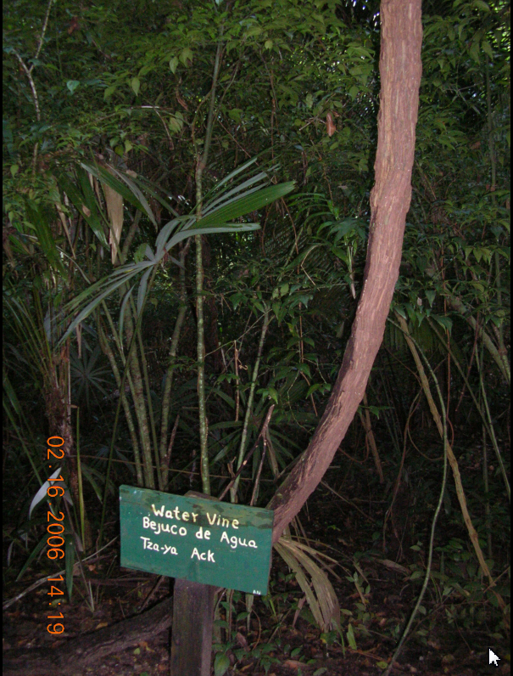
In Belize: Liana Vines

Slide 7
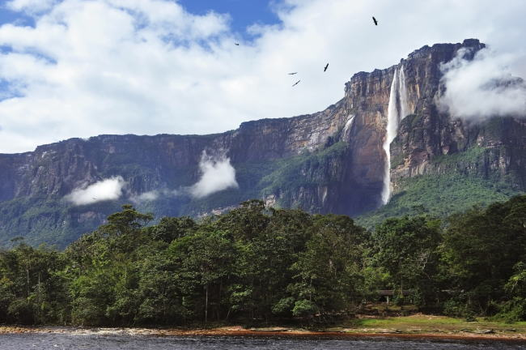
PreseThe lush Amazon Rainforest is home to nearly half of our planet's moist tropical forest, almost 400 indigenous groups, and over two-thirds of all Earth's fresh water.ntación

Slide 8
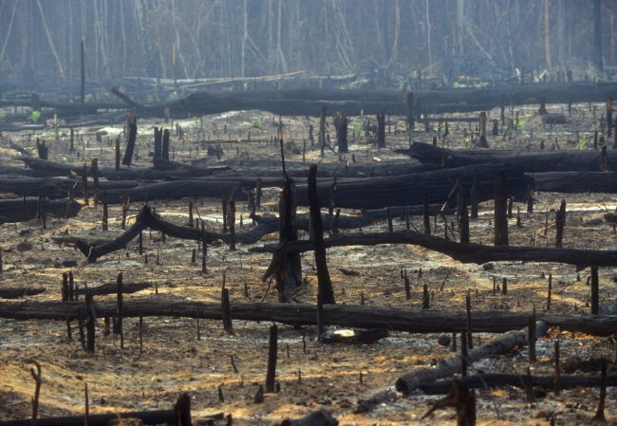
But tragically, today's forests are worth more dead than alive, due to the profitable industries of timber, charcoal, pasture and cropland. The destruction has a cost of its own—the cutting and burning of trees adds more global warming pollution to the atmosphere than all the cars and trucks in the world.

Slide 9
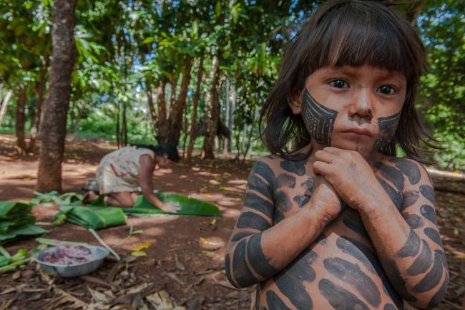
Deforestation affects each and every one of us—but not nearly as directly and disastrously as it affects the Amazon's indigenous people. It is their home that is suffering the consequences, and they're even seeing the impact in their day-to-day lives.

Slide 10
Indigenous Amazon tribes have always used controlled fires for landscape and resource management. But something has changed. "Fire is different now...Now, people set fire and it gets away and there's a big fire. Before it would burn the savanna but it didn't burn the forest. Now, we say, 'I think the weather changed.'" —Lahussia Juruna, Tuba-tuba village, Xingu Indigenous Park.

Slide 11
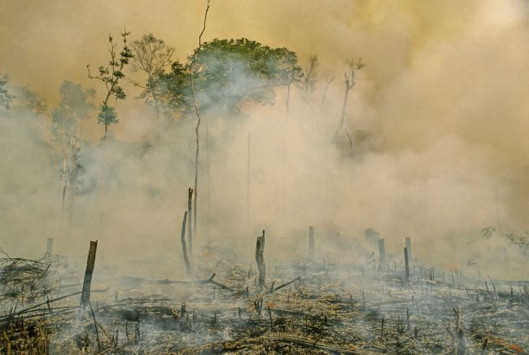

Slide 12
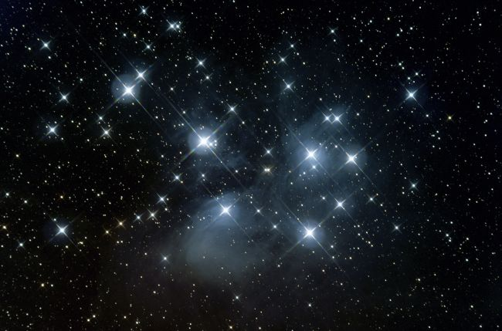
But that's not all. "We know when it is time to clear gardens when we see a star (the Pleiades) ... The star still comes out, but the rain is different. Last year we planted a community garden…and it didn't grow. The sun got very hot, because the rains were very late. The earth was very dry." —Sadea Juruna, traditional leader of the Yudja people.

Slide 13
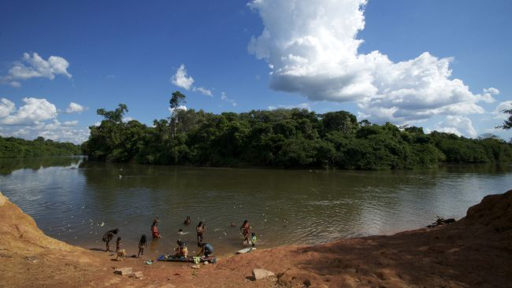
Scientific studies back-up these first-hand indigenous accounts. Their climate has changed, and today's Amazon is not the same as the rainforest their ancestors knew.

Slide 14
But the indigenous people haven't stood idly by. In the 1980s and 90s, the Kayapo tribe of Brazil used their warrior culture in a new way—grassroots advocacy.
Through organized protests and other efforts, they regained control of their borders. The Kayapo chiefs learned Portuguese and formed relationships with conservation organizations. In 1988, their hard work paid off and the Kayapo were instrumental in ensuring that indigenous rights were written into the Brazilian Constitution. Later, they even managed to have their territory legally recognized.

Slide 15
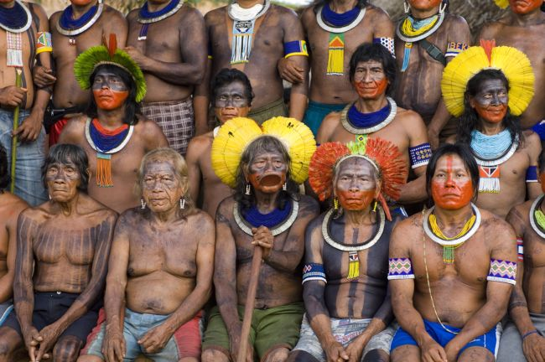

Slide 16
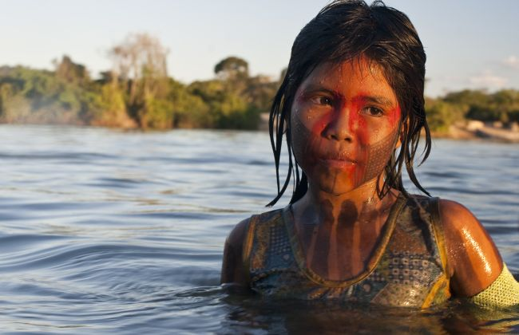
Their previous success makes it clear: Indigenous tribes like the Kayapo are a huge asset in our efforts to save the Amazon from the devastation of deforestation. That's why EDF is partnering with conservation and indigenous groups to empower tribes to take control of their own land.

Slide 17
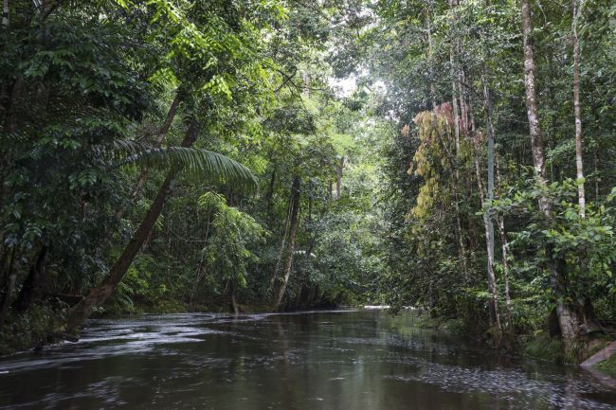
Enter EDF and the REDD (Reducing Emissions from Deforestation and Forest Degradation) program. It proposes to reward developing countries for participating in global emissions reductions—and it's extremely promising. Brazil—the world's fourth largest overall emitter—has already slowed deforestation by 40%.

Slide 18
How do indigenous tribes factor in? No one knows the Amazon as well as they do. After all, it's their home. That's why we're working with indigenous organizations, including Kayapo organizations, to help indigenous people protect their lands, develop sustainable income alternatives, measure the carbon stored in their trees, and ultimately become eligible for carbon credit for protecting their forests.

Slide 19
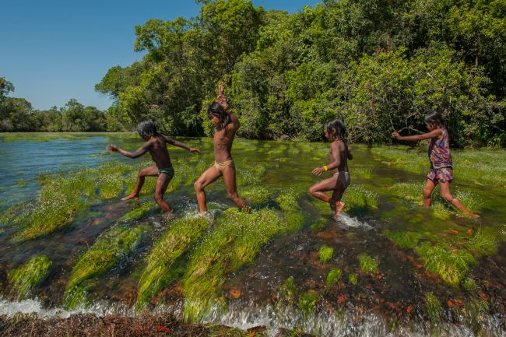

Slide 20
These children are from the Kayapo tribe. 26 of their elders recently met, and signed a letter making their hopes for the future clear. It stated, in part, "Our river does not have a price, our fish that we eat does not have a price, and the happiness of our grandchildren does not have a price. We will never stop fighting."
The Kayapo children—and all the children of the Amazon's indigenous tribes—deserve to experience the harmony with nature that their elders have fought so hard to protect.

Slide 21
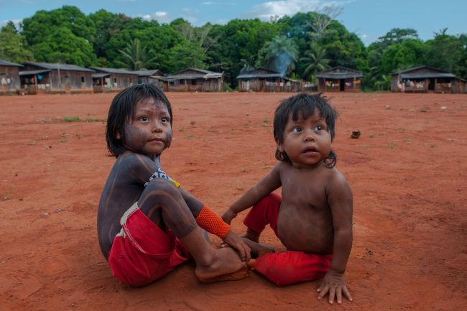

Slide 22
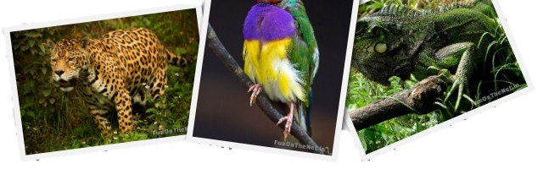
Animals of the Amazon

Slide 23
If you are thinking about Jaguars hunting in the dark, Iguanas sloppily moving up a tree trunk, or the Anacondas crunching the bones of its prey, it has to be the thick dense rainforests of The Amazon. One of the largest biodiversity hotspot in the world and home to over 2000 species which accounts to about a third of the entire world species. Some of which are found exclusively in the Amazonian rainforest. These jungles are deep and dense, partly impenetrable and cover almost half of the South America. No matter how dangerous the Amazon forests are to us, they are home to thousands of varied wildlife species, out of which some are yet to be discovered as they discreetly hide in the Amazon forests. Take a sneak peak at some of the Stars of this ‘tinseltown’.

Slide 24
Amazonian Mammals
The Amazon is home to more than 300 species of mammals some of which are endemic to the Amazon alone. Some are super-fast some are lazy and slow moving, some are harmless herbivores while some are carnivores. Some prefer trees and some prefer water. Whatever types they are, these beautiful creatures are rare and the Amazon extends to them a humble abode. Bats and Rodents are the most widespread species in the amazon and famous for attacking and killing the tribes in the forest. Cats like Jaguar, Jaguarundi, and ocelot are the famed habitants of the ostentatious jungles of the Amazon.

Slide 25
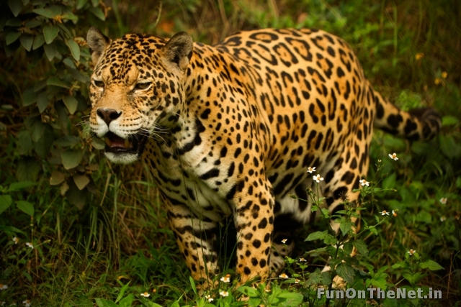
Jaguar- the star of amazon forest

Slide 26
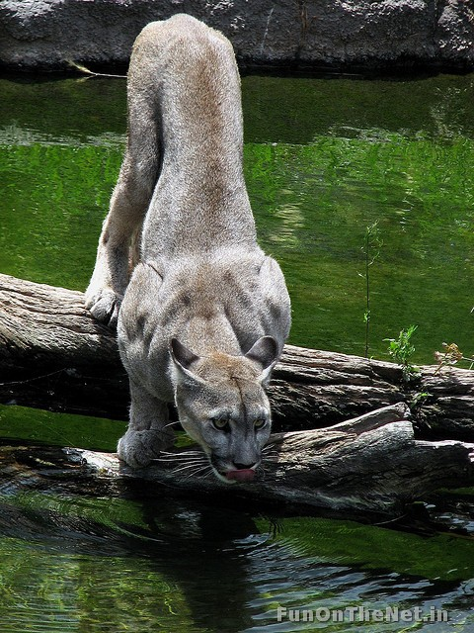
The endangered Puma

Slide 27
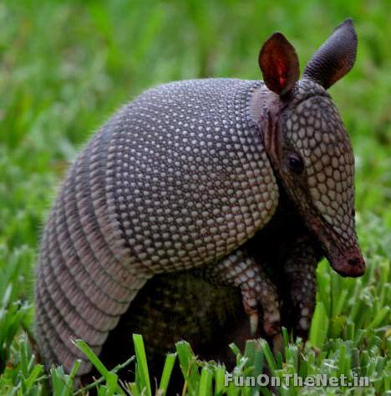
The Armadillo

Slide 28
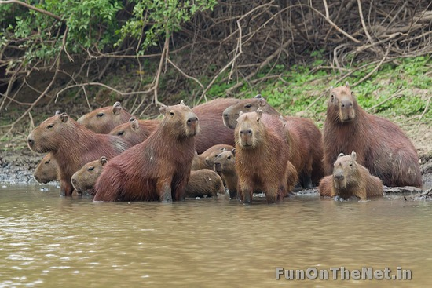
Family of Capybara

Slide 29
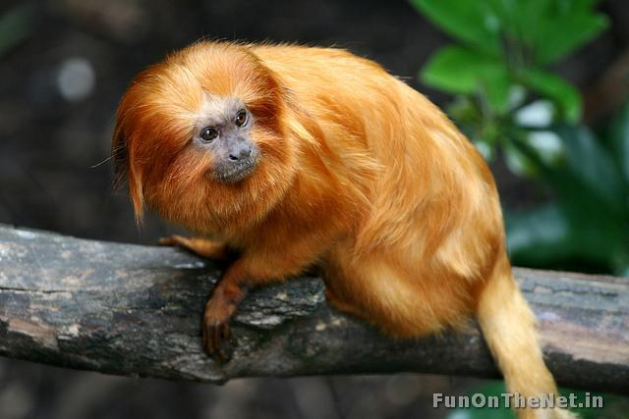
The ‘golden fur ball’ – Golden Lion Tamarin

Slide 30
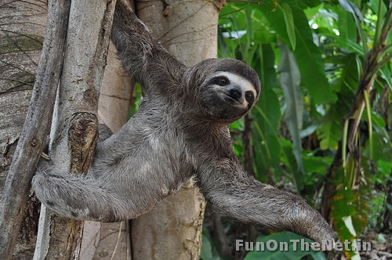
The sluggish Two Toed Sloth

Slide 31
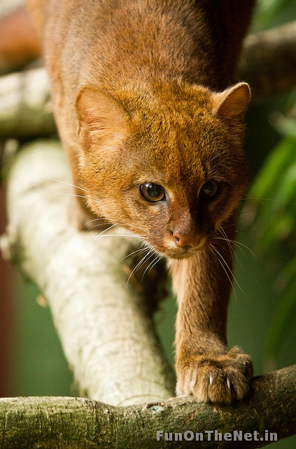
Small version of Jaguar- Jaguarundi

Slide 32
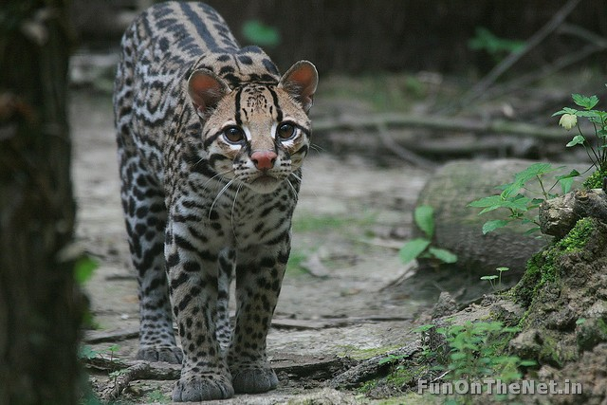
The feline terror – Ocelot

Slide 33
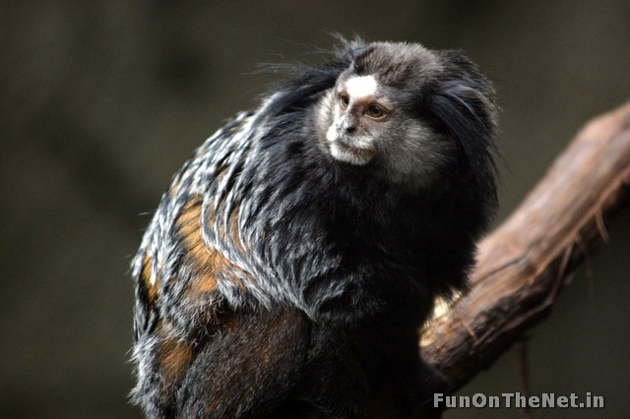
Uncle scrooge match – Rio acari Marmoset

Slide 34
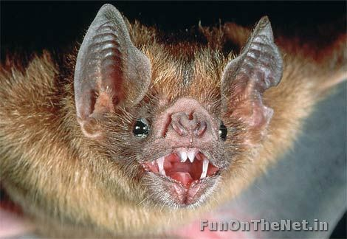
I will kill you!! – Vampire Bat

Slide 35
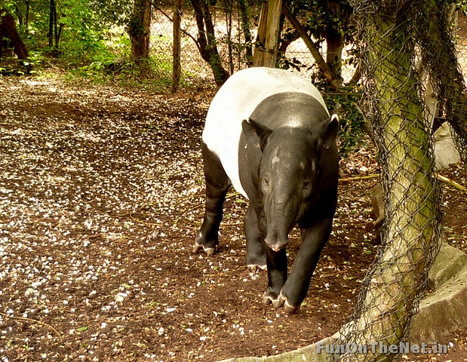
The long snout – Tapir

Slide 36
Amazonian Birds
You can find some of the most exotic species of birds in the Amazon. The jungles in this part of the world are home to some rare and colourful birds which are exclusive to Amazon. Believe it or not, the Amazon Basin is home to 1500 bird species, while South America houses roughly one third of the entire world’s bird population. Some of them gather in thousands, like the celebrated Macaws or the Toucans and it is indeed a spectacular and vibrant looking picture to see them in flocks. These birds nibble on seeds, fruits and minerals found typically in the Amazon to clean the toxins. They believe in healthy lifestyle!!

Slide 37
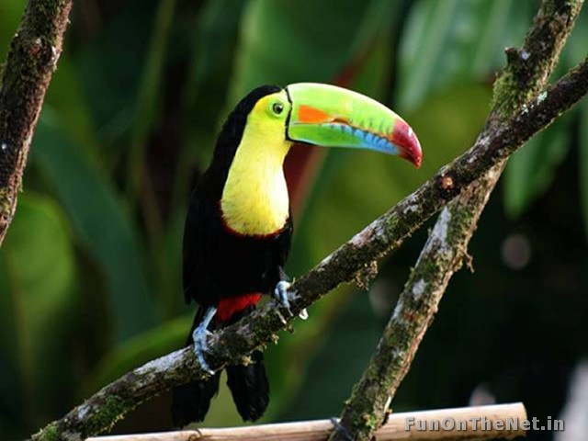
Long knife beak- Toucan

Slide 38
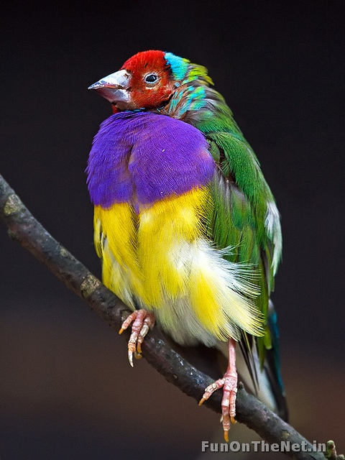
‘Ambassador for L’Oreal Hair Colour Range’ – the Gouldian Flinch

Slide 39
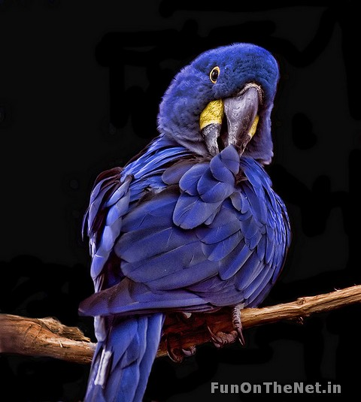
The Elite of Amazonian birds- the Blue Macaw

Slide 40
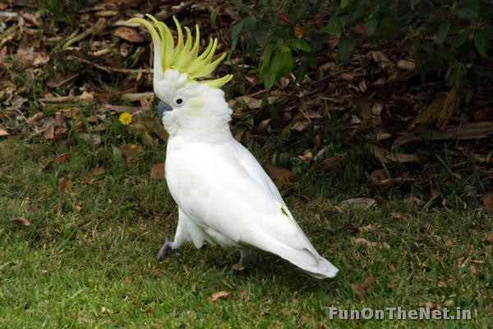
The very coy - Cockatoo

Slide 41
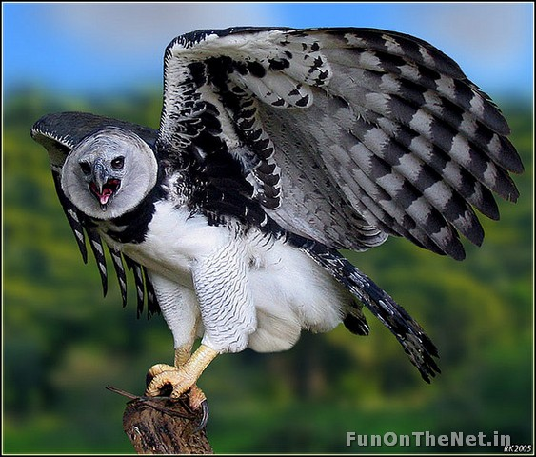
The daredevil - Harpy Eagle

Slide 42
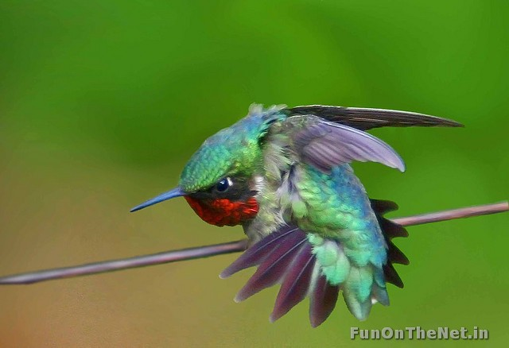
The Humming Bird – ‘needle beak’

Slide 43
Amazonian Amphibians
The damp climate of the forests in the Amazon breeds a variety of slimy and poisonous amphibians. You need to watch out for these vicious creatures because they may be small and camouflaged by nature but are poisonous enough to kill humans. They thrive in abundance in the marshy lowlands waiting to attack their prey. The Poison Dart Frog or ‘jumping marvels’ are the most colourful tiny frogs found here, but do not go by their appearance as some of them are potential enough to kill up to ten humans at once. The other amphibian exclusively found in the Amazon is the Horned Frog that has a peculiarly broad mouth and swallows anything that passes by, sluggish fella!!

Slide 44
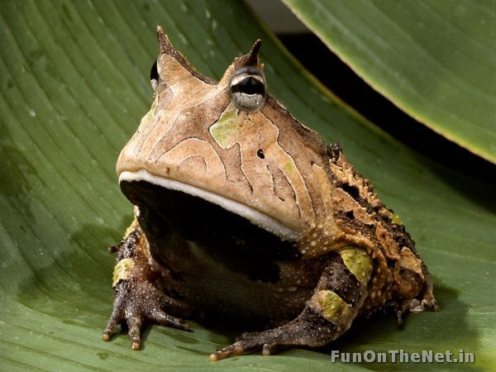
Big mouth – the Horned Frog

Slide 45
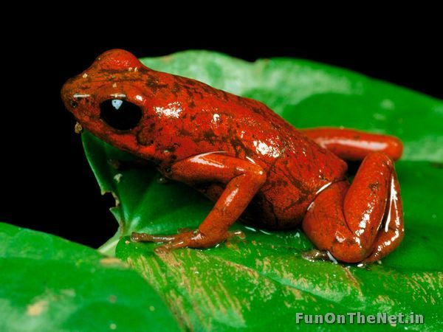
The colourful jumping jacks- Poison Dart Frogs

Slide 46
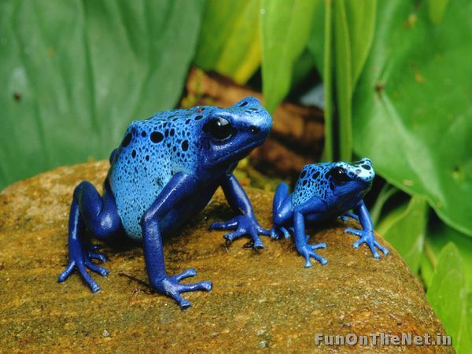

Slide 47
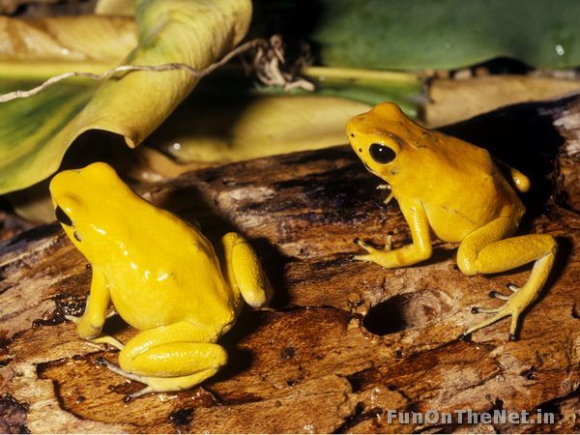

Slide 48
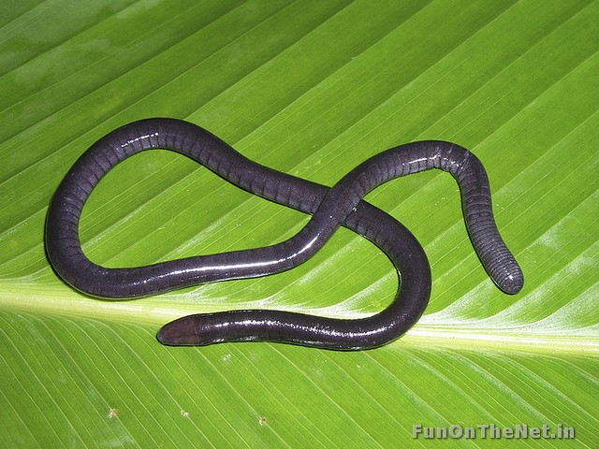
The Caecilians: This amphibian grows new skin every three days as it has a nutrient-rich skin and its little ones feed on it.

Slide 49
Amazonian Reptiles
The reptiles of the Amazon are the most dangerous species alive. They are colossal and hefty and take the life out of their prey within seconds. It is said there are many reptile species breathing in the Amazon but most of them are still undiscovered. The most common are the Boa, Anaconda, Green Iguana etc. while most of them are carnivores the Green Iguana is true blue Vegan!

Slide 50
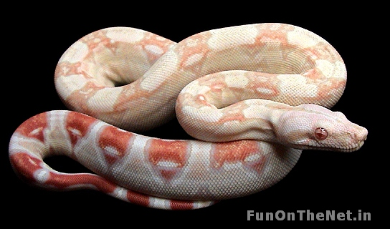
The Boa Constrictor

Slide 51
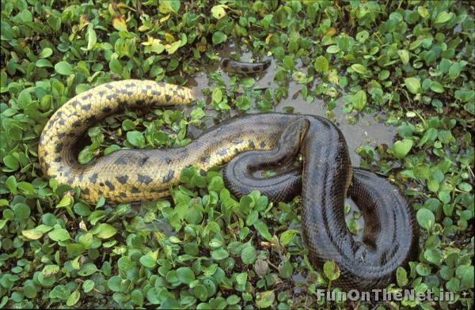
‘Mother of Snakes’- the Anaconda

Slide 52
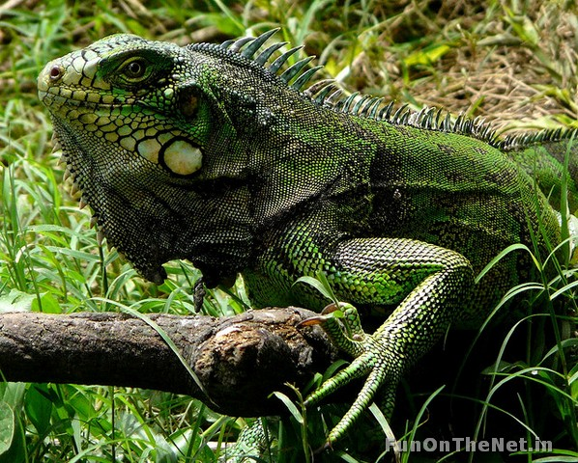
The Green Iguana- ‘Absolutely Vegan’

Slide 53
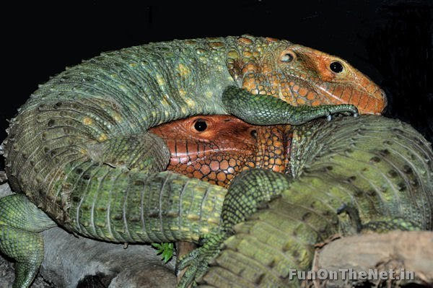
The Caiman Lizards

Slide 54
Amazon River Species

Slide 55
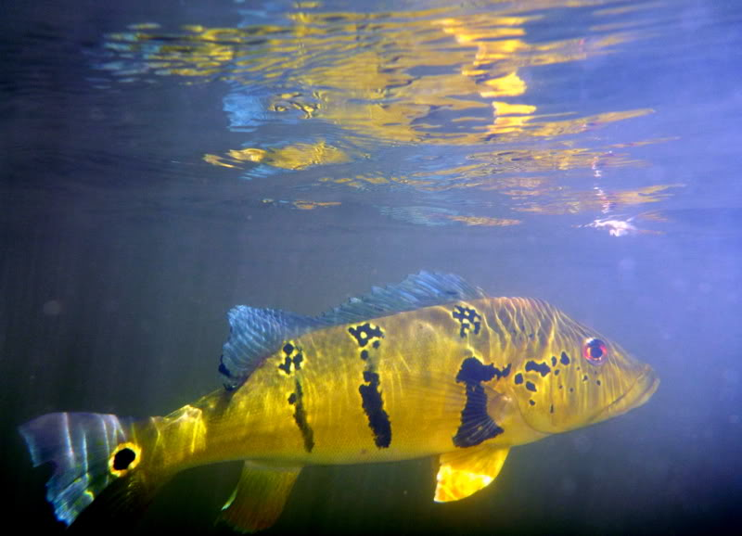
Peacock Bass

Slide 56
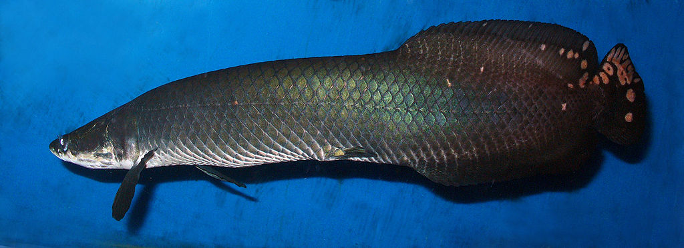
Arapaima

Slide 57
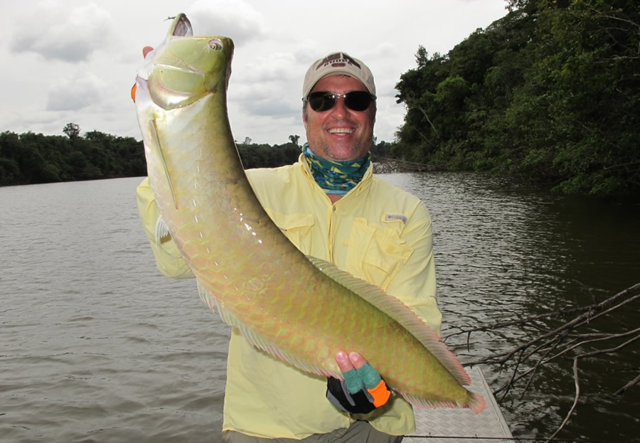
Aruana, Arawana

Slide 58
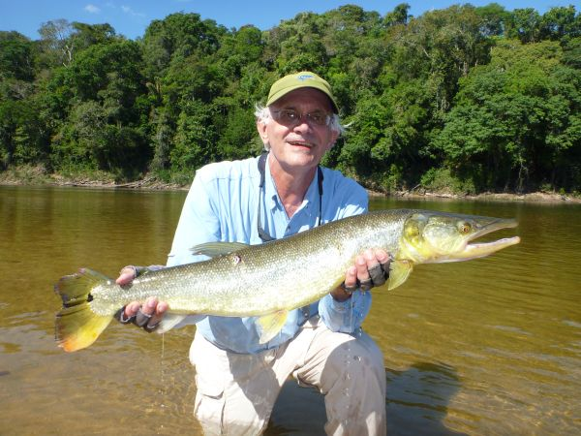
Bicuda

Slide 59
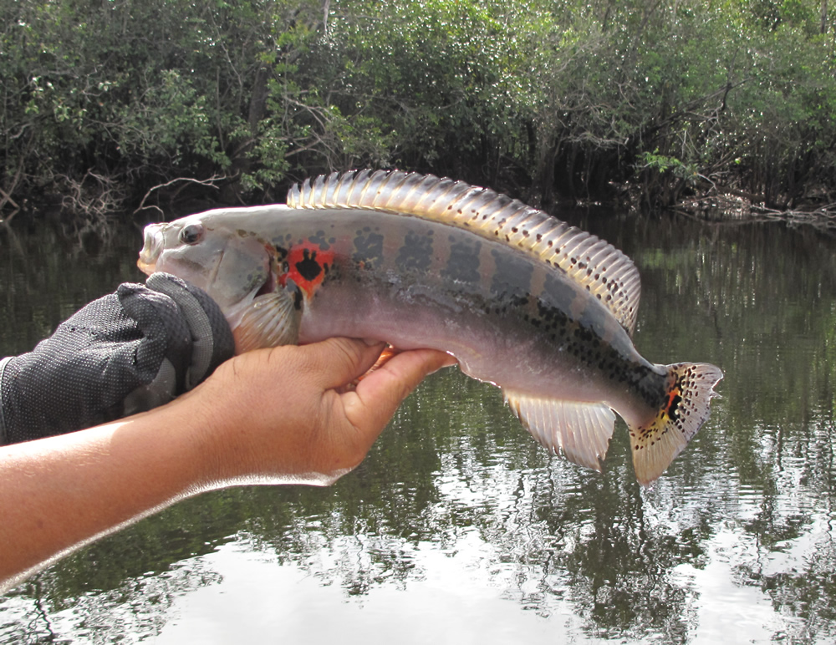
Jacunda

Slide 60
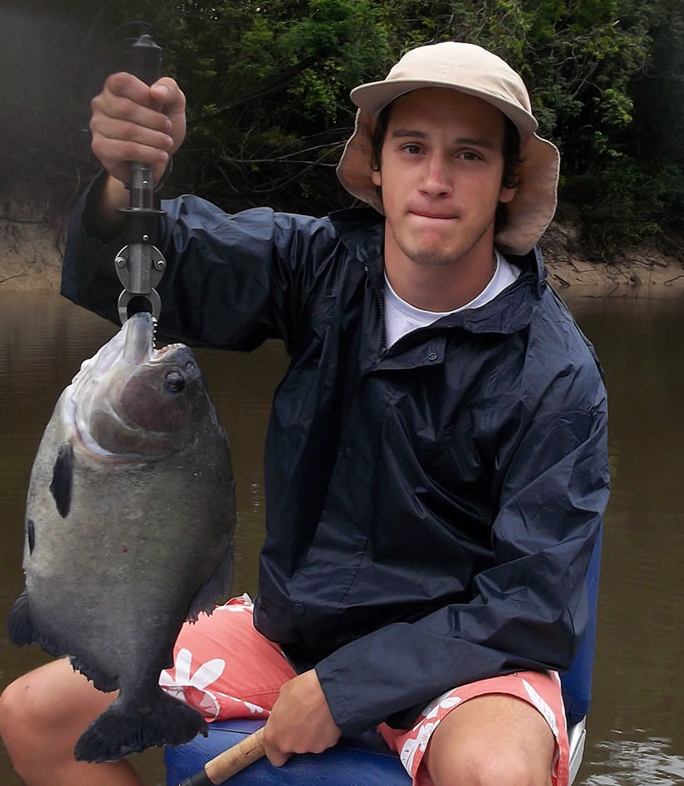
Piranha

