Slide 1
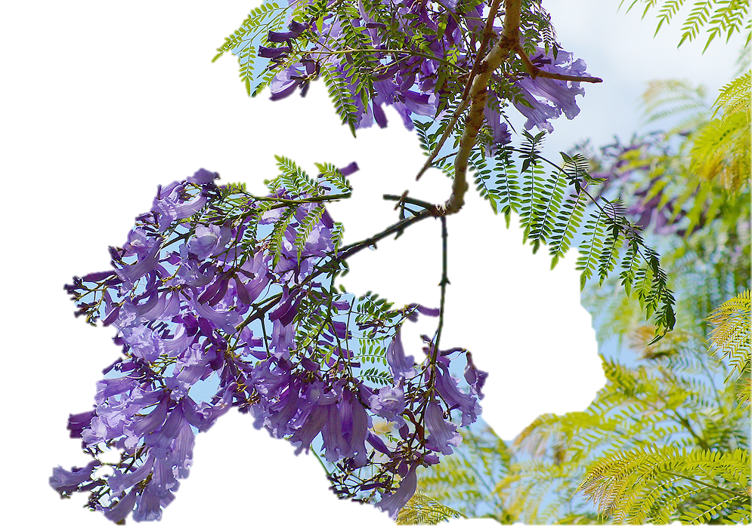
ARGENTINE: VIOLET WOOD (JACARANDA)

Slide 2
Jacaranda
Jacaranda is a genus of 49 species of flowering plants in the family Bignoniaceae, native to tropical and subtropical regions of Mexico, Central America, South America, Cuba, Hispaniola, Jamaica and the Bahamas.
It has been planted widely in Asia, especially in Nepal. Jacaranda mimosifolia is quite common in Zambia, South Africa, Zimbabwe and Australia, and has been introduced to most tropical and subtropical regions to the extent that it has entered the popular culture.

Slide 3
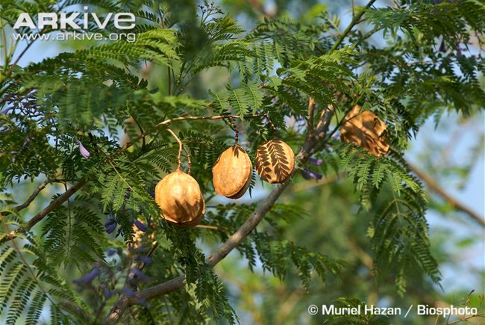
Jacaranda seed pods

Slide 4
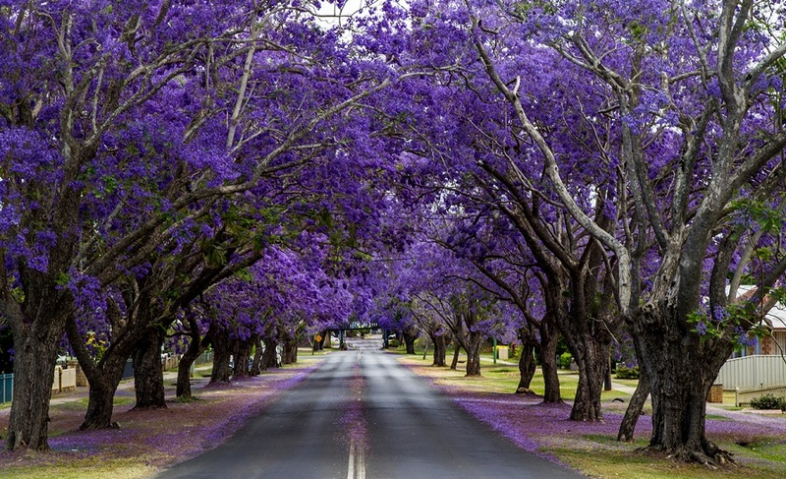

Slide 5
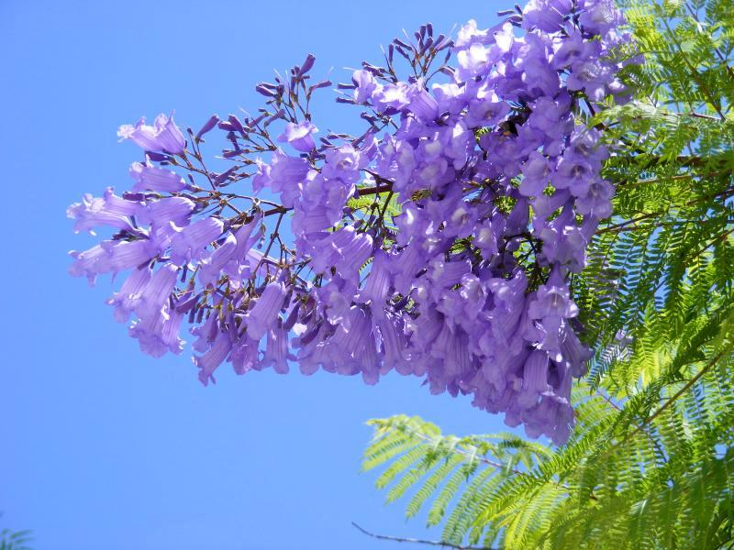

Slide 6
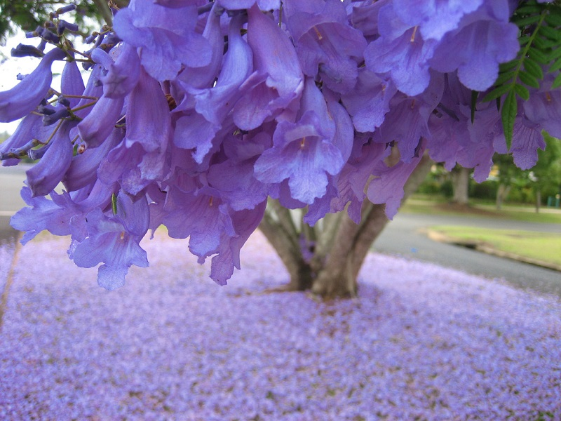

Slide 7
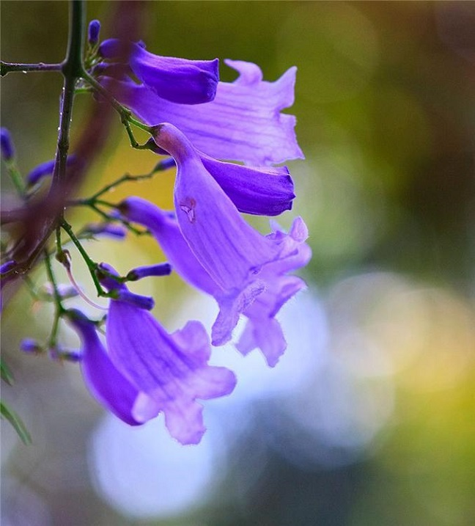

Slide 8


Slide 9
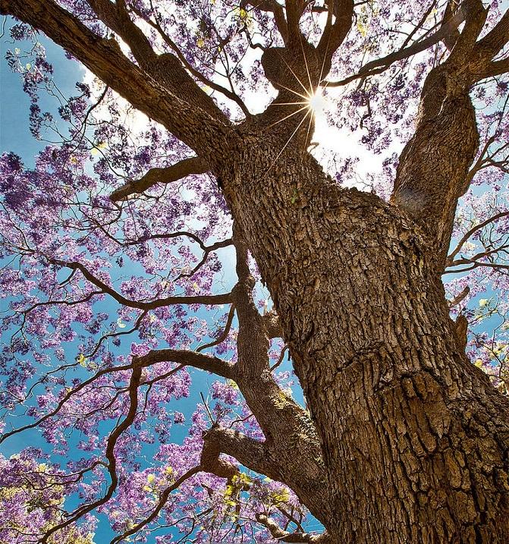

Slide 10
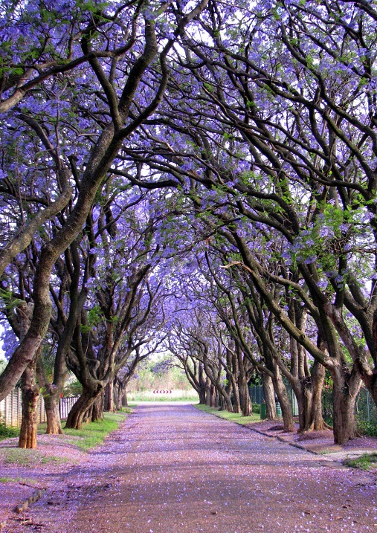

Slide 11


Slide 12


Slide 13
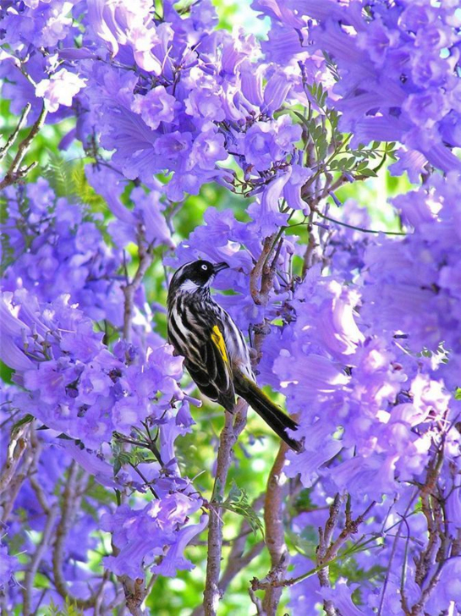

Slide 14
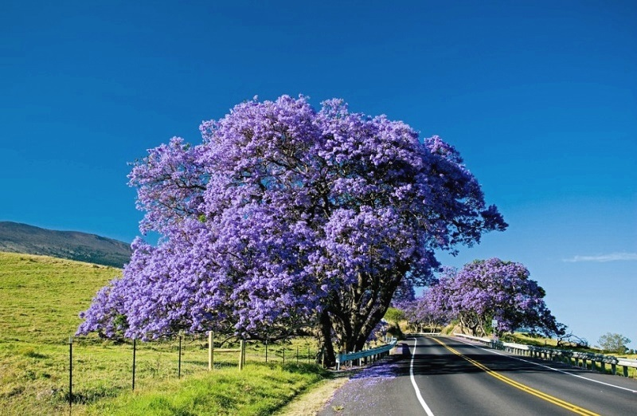

Slide 15
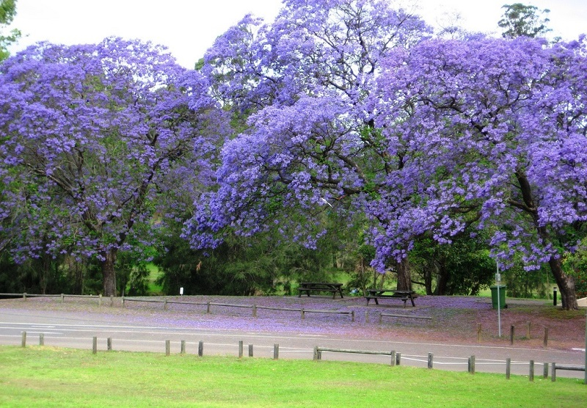

Slide 16
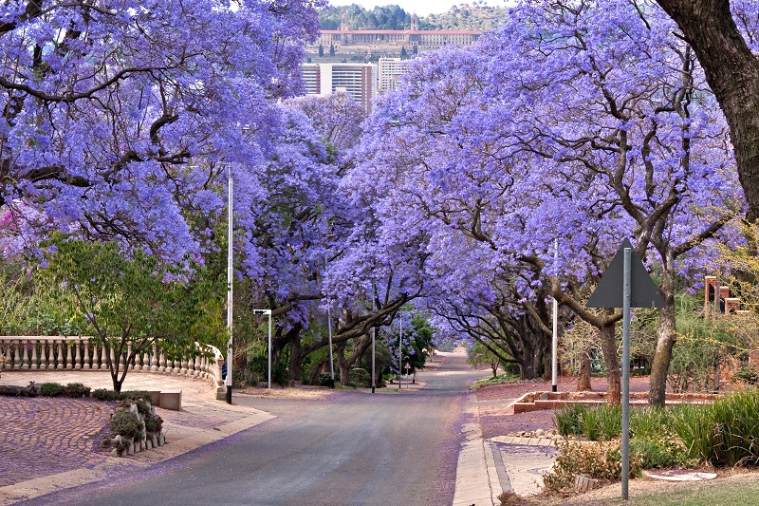

Slide 17
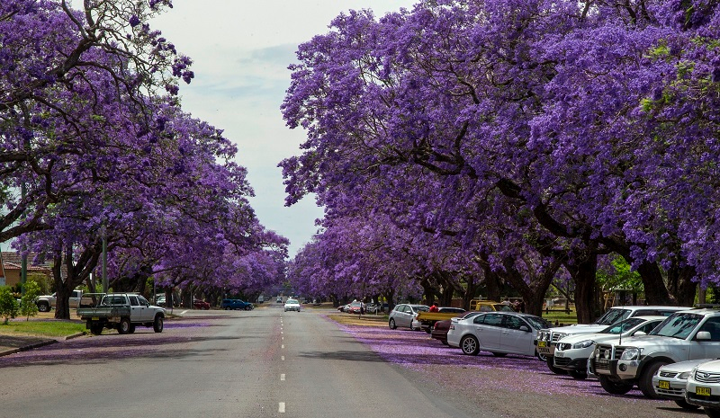

Slide 18
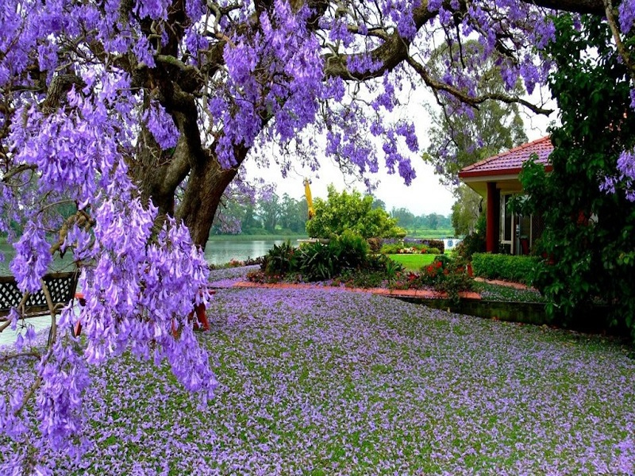

Slide 19
