Slide 1
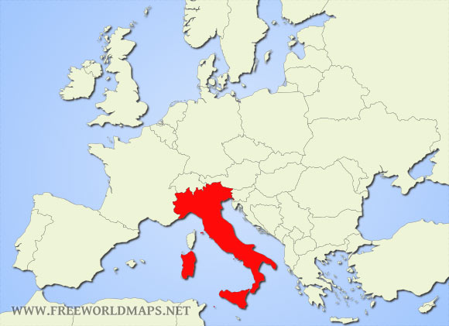
italy
John Deaux | Professor Naumann | Geography 1002

Slide 2
Where is Italy Located
Relative Location |  | Absolute Location
On which Continent | Europe (Eurasia) |  | Latitude | Longitude
Countries with which it shares a border | France, Austria, Switzerland, Slovenia | Center of the country? | 42⁰N | 13⁰E
In which ocean or sea | Peninsula in the Mediterranean | Northernmost point | 47⁰N | 12⁰E
Nearest countries (at least 3) | Tunisia, Libya, Albania | Southernmost point | 37⁰N | 15⁰E
 |  | Easternmost point | 40⁰N | 19⁰E
 |  | Westernmost point | 45⁰N | 7⁰E
Notes:
Insert a map of your country.

Slide 3
Geographic Features of Your Country (Physical Place)
Mountains: Alps & Apennine
Volcanoes: Mt. Vesuvius, Mt. Etna, & Stromboli
Rivers: Po & Tiber
Lowland: Po Valley & West Central Lowland
Lakes: Lake Maggiore & Lake Como
Seas (parts of the Mediterranean Sea): Adriatic Sea, Ionian Sea, Ligurian Sea, Tyrrhenian Sea, Strait of Sicily
Islands: Sicily & Sardinia
Notes:
Insert a picture of one of the geographic features of your country.

Slide 4
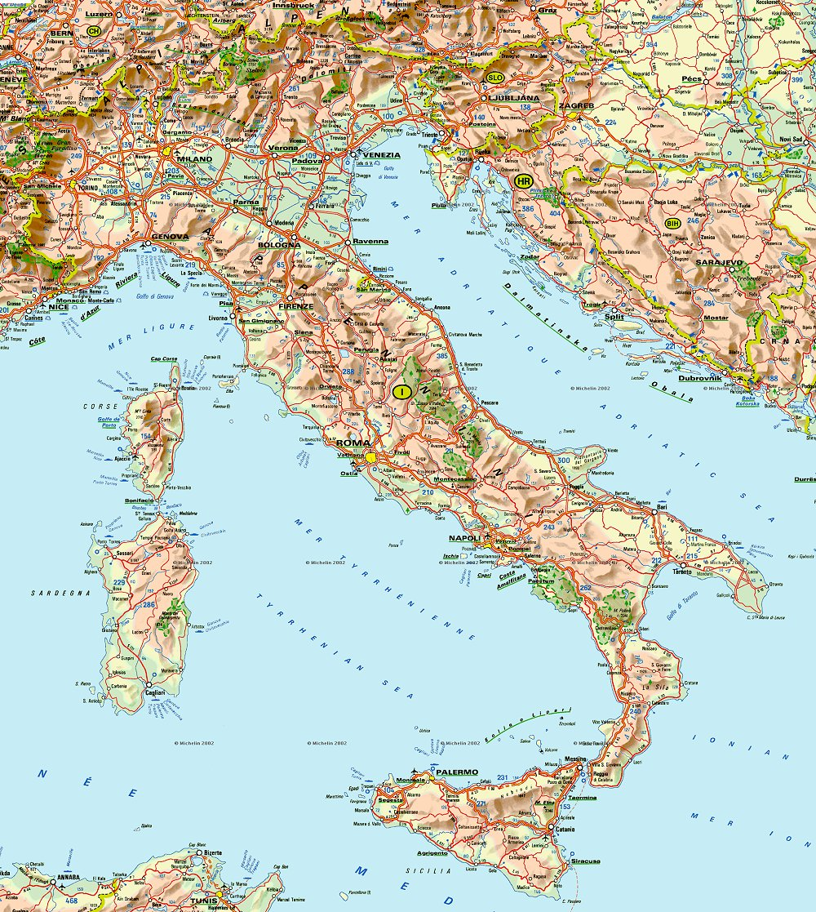

Slide 5
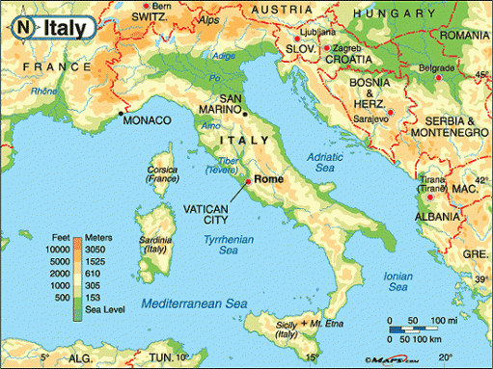

Slide 6
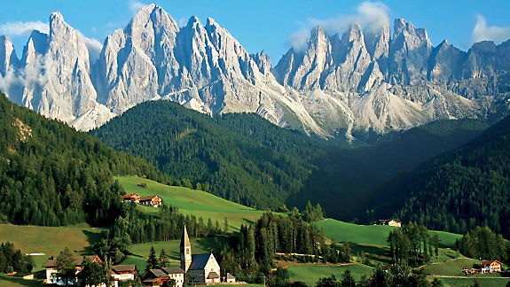
The Italian Alps

Slide 7
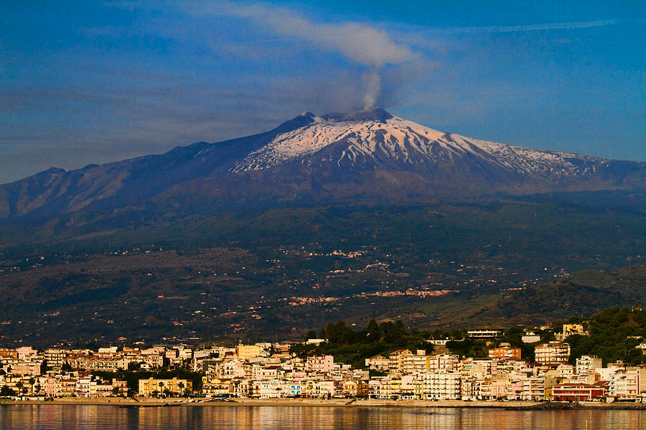
Mount Etna, Sicily

Slide 8
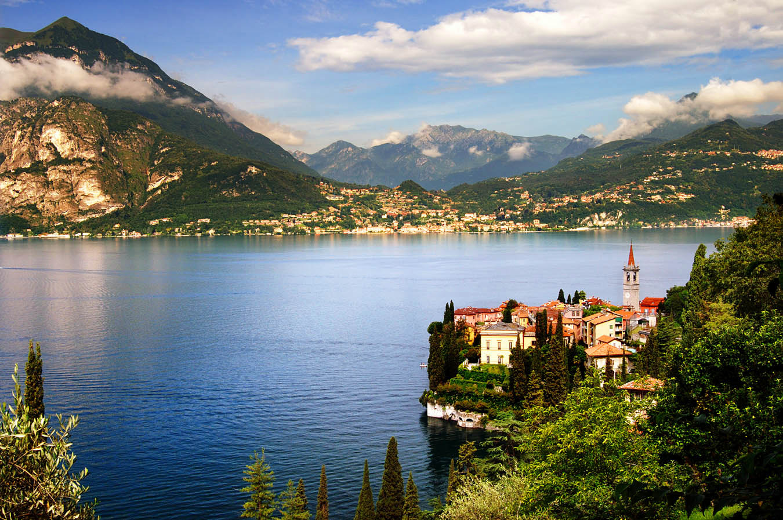
Lake como

Slide 9
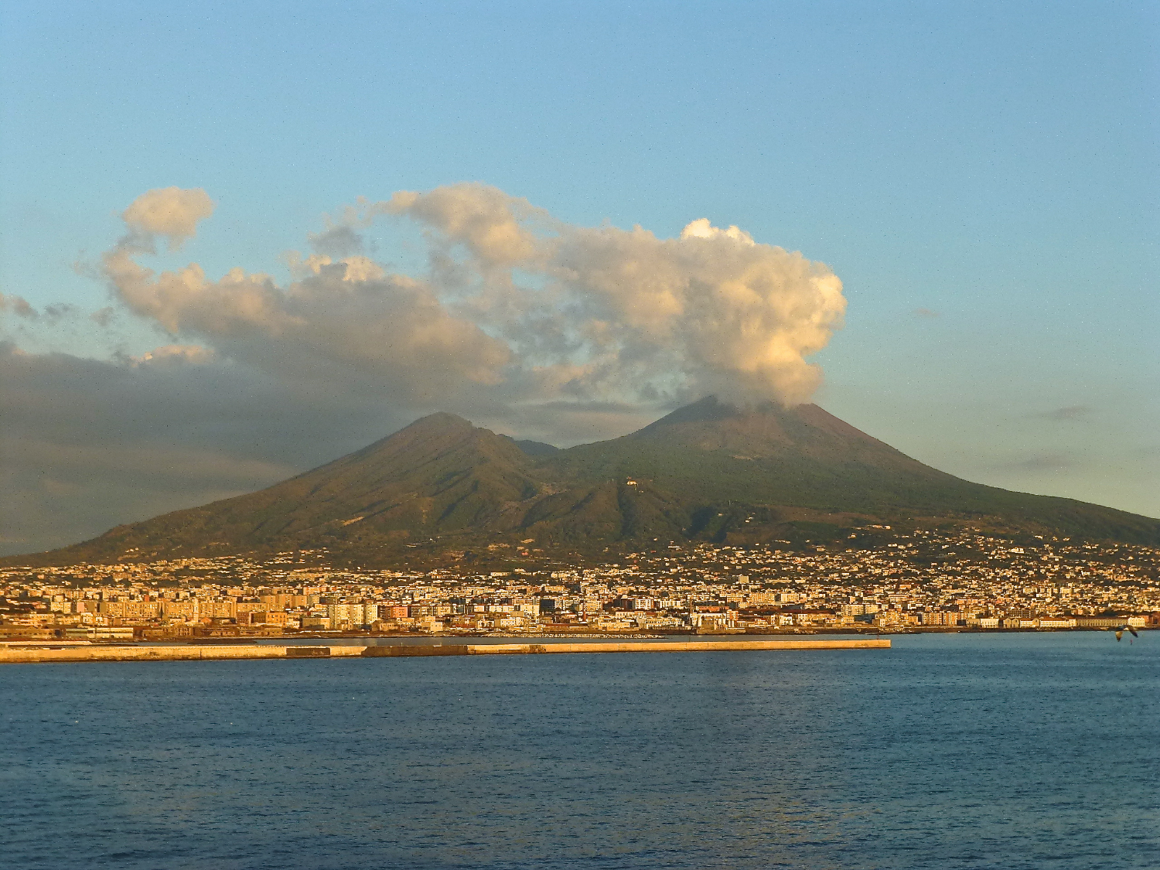
Mount Vesuvius

Slide 10
Climate (Physical Place)
Thanks to the great longitudinal extension of the peninsula and the mostly mountainous internal conformation, the climate of Italy is highly diverse. In most of the inland northern and central regions, the climate ranges from humid subtropical to humid continental and oceanic. In particular, the climate of the Po valley geographical region is mostly continental, with harsh winters and hot summers.
The coastal areas of Liguria, Tuscany and most of the South generally fit the Mediterranean climate stereotype (Köppen climate classification Csa). Conditions on peninsular coastal areas can be very different from the interior's higher ground and valleys, particularly during the winter months when the higher altitudes tend to be cold, wet, and often snowy. The coastal regions have mild winters and warm and generally dry summers, although lowland valleys can be quite hot in summer. Average winter temperatures vary from 0 °C (32 °F) on the Alps to 12 °C (54 °F) in Sicily, like so the average summer temperatures range from 20 °C (68 °F) to over 30 °C (86 °F).
Notes:
Insert a picture illustrating a season in your country.

Slide 11
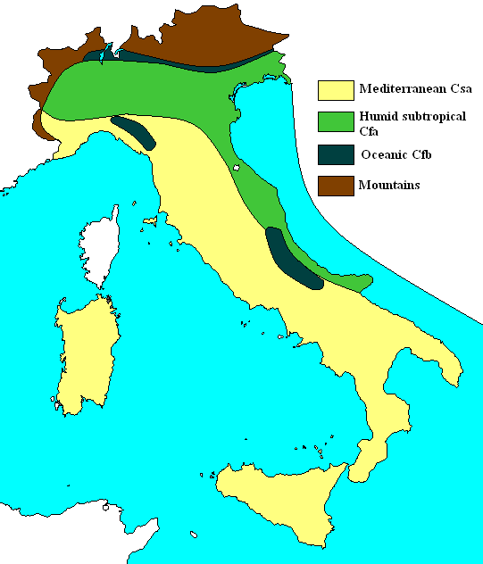
Climate map

Slide 12
Biological Environment
Plants |  | Animals
Grapes | Palm trees | Apennine shrew | Sicilian Wall Lizard
Prickly Pear Cactus | Cypress Trees | Italian Aesculapian Snake | Pond Turtle Emys Trinacris
Olive trees | Fig trees | Eurasian lynx | Italian wolf
Wheat | Orange trees | Marsican brown bear | Alpine ibex
Lemon trees | Sicilian Fir | mouflon | eagles
Cork oaks | Basil | Mountain goats | Mediterranean monk seal
Notes:
Insert a picture of an animal and/or plant found in your country.

Slide 13
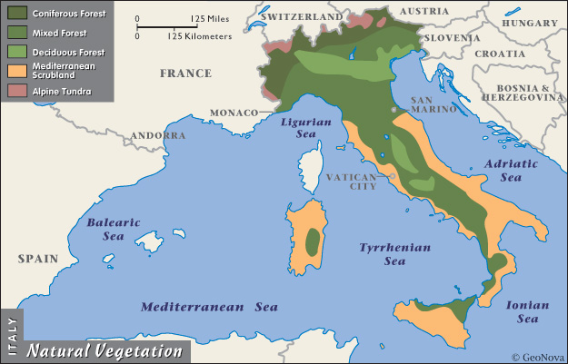
Biome or Vegetation map
.

Slide 14
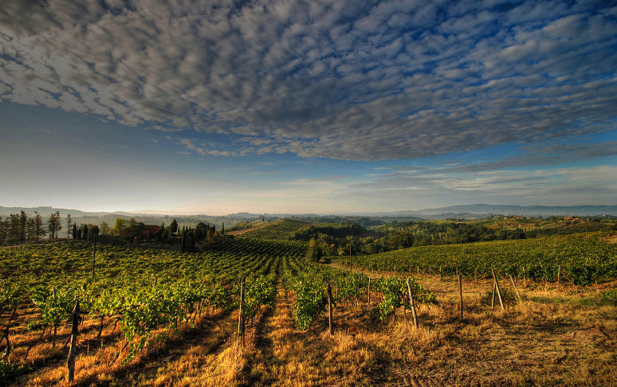
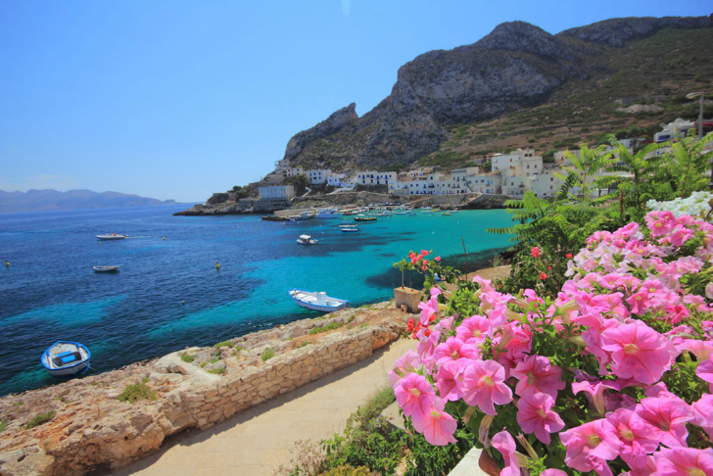
Grapes (for wine) & Palm trees

Slide 15
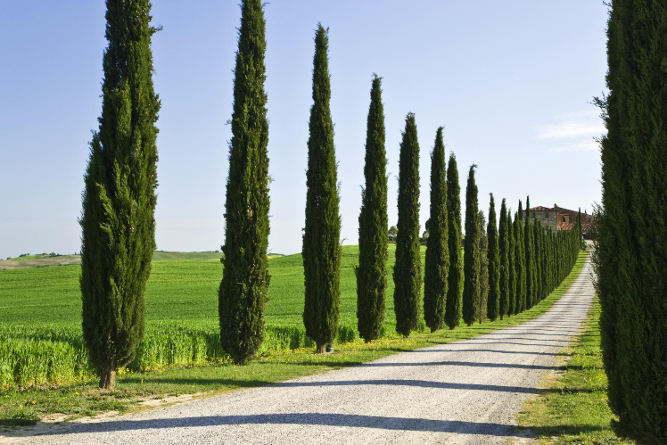
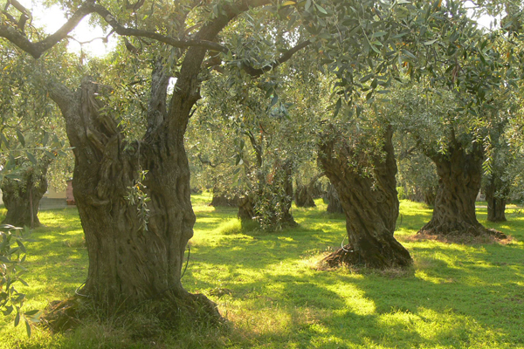
Cypress trees & Olive trees

Slide 16
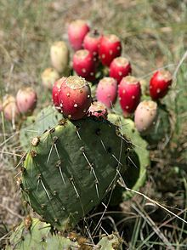
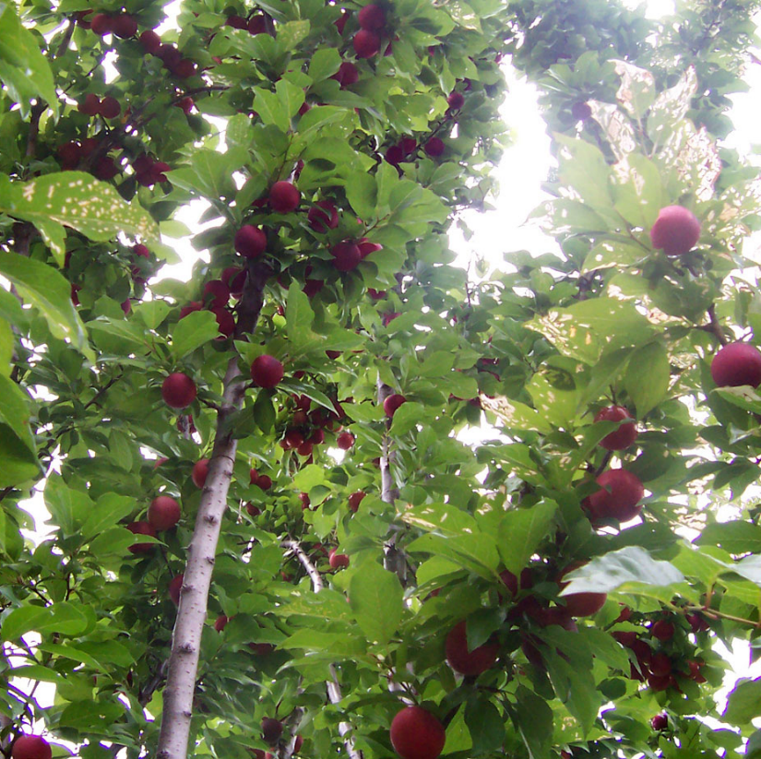
Prickly Pear Cactus & Figs (Invasive species)

Slide 17
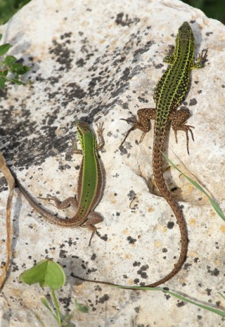
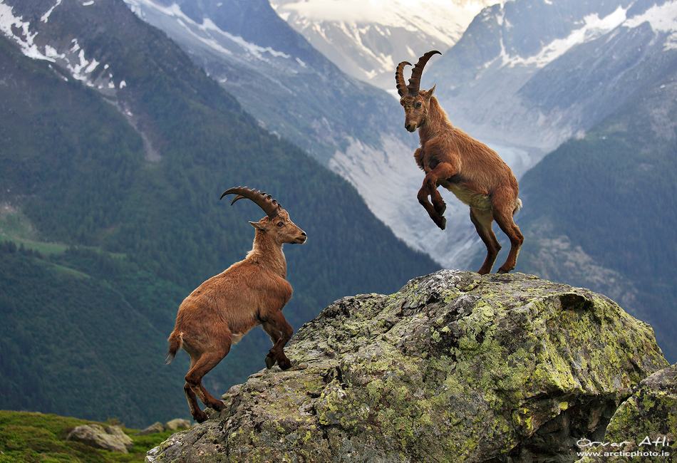
Sicilian wall lizard & Alpine Ibex

Slide 18
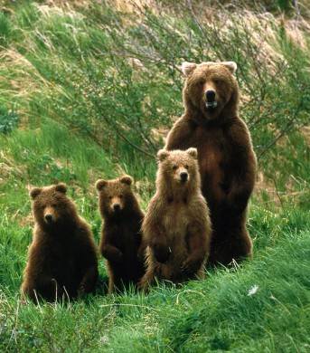
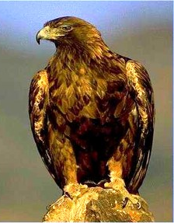
Marsican brown bear & Eagle

Slide 19
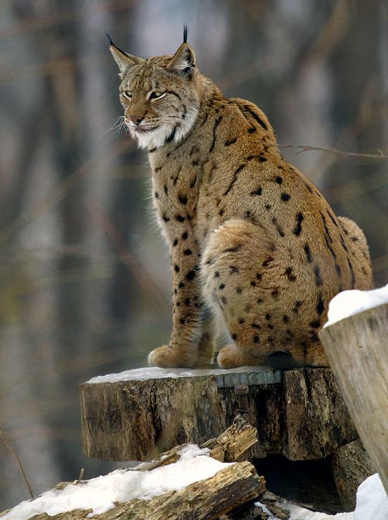
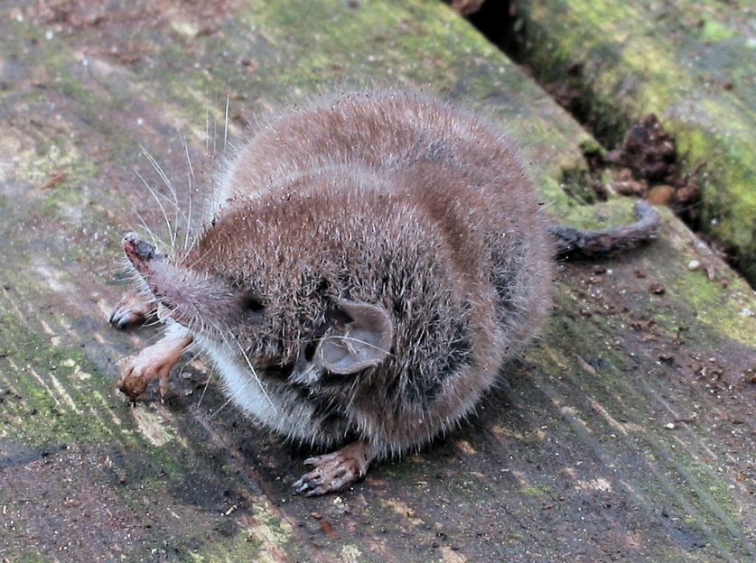
Apennine shrew & Eurasian lynx

Slide 20
Historic events (events that shaped and gave direction to italy)
Heart of the Roman Empire | Christianity became the official religion of the Roman Empire | Italy is united with Rome as its capital city. | Became a “charter member” of the Common Market
300 BCE – 476 CE | 312 – 316 CE | 1871 CE | March 25, 1957
The Latin Tribe (lived in Rome) conquered and ruled the Italian Peninsula and eventually all the lands around the Mediterranean Sea. | Many more people converted to Christianity now that the threat of persecution and possibly death was eliminated. The values and ethics taught by the Christian religion greatly affected how people lived and interacted. This also influenced the development of Roman law, which is at the root of the law systems of most European countries | Many separate states like Lombardy, Sardinia, Tuscany, Sicily, etc., became one country allowing for some coordinated development of the Italian Peninsula. The dialect of Florence (birthplace of the Renaissance) became the basis for the official, standard Italian language. | Italy was one of the founding members of the six-member Common Market which evovled into what is today the European Union which today has 27 member countries.
Notes:
Add key points in the history of your country to the timeline.

Slide 21
Customs and Traditions (Human Place)
"Children are reared to remain close to the family upon adulthood and incorporate their future family into the larger network,“
In Venice they celebrate Carnivale di Venezia, a two-week party in early spring
Scoppio del carro is an Easter festival held in Florence that marks the triumph of the First Crusade.
Italian families and friends usually kiss when they meet, irrespective of their sex.
the Palio bareback horse races in Sienna (held on 2nd July and 16th August)
Corpus Christi in Spello (Umbria) with its Le Infiorate flower festival in June
At Christmas, most churches are decorated with cribs or nativity scenes (presepi) and Epiphany (Epifania), celebrated on 6th January, is an important event, particularly for children, who are ‘visited at night by an old woman (La Befana) on a broomstick’ and left presents or coal according to whether they’ve been good or bad.
In Sicily, Passion plays are also popular.
Notes:
Insert a picture illustrating a custom or tradition.

Slide 22
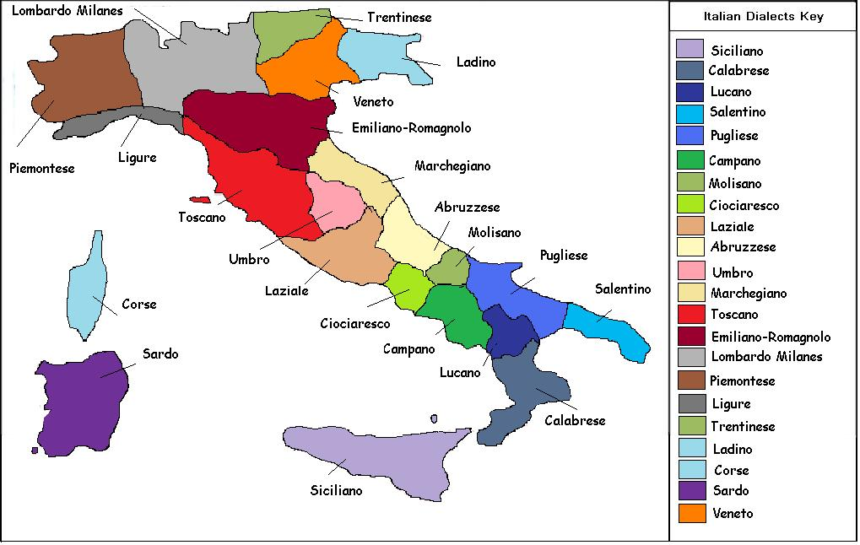

Slide 23

The Greeting Kiss

Slide 24
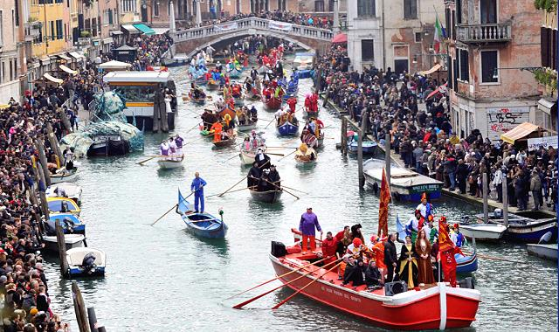
Carnivale di Venezia

Slide 25
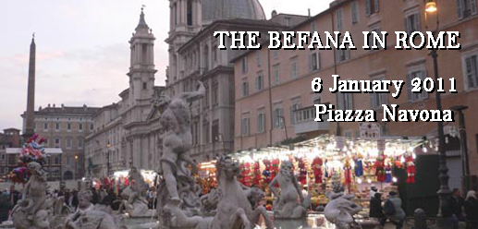
La Befana: Rome! Navona Square has been the best place for celebrating Epiphany

Slide 26
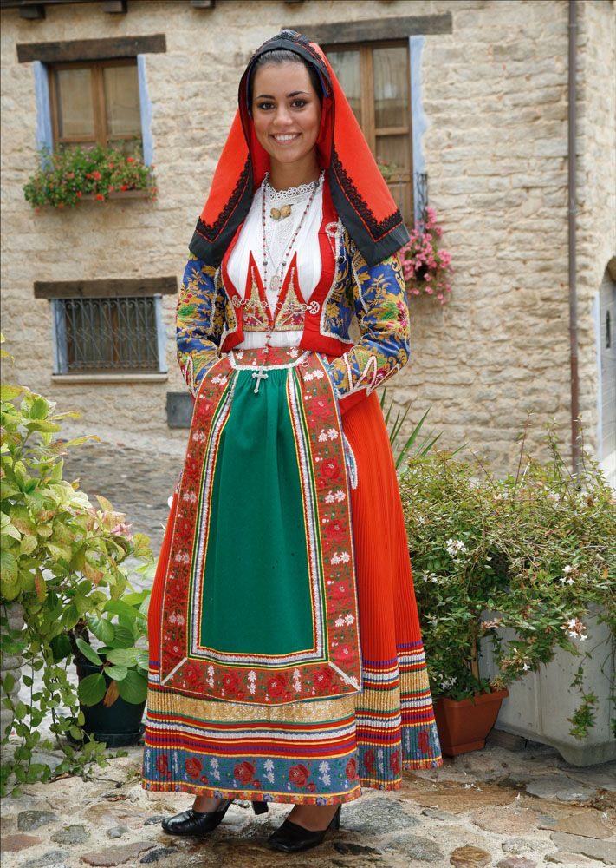
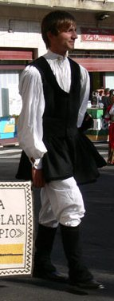
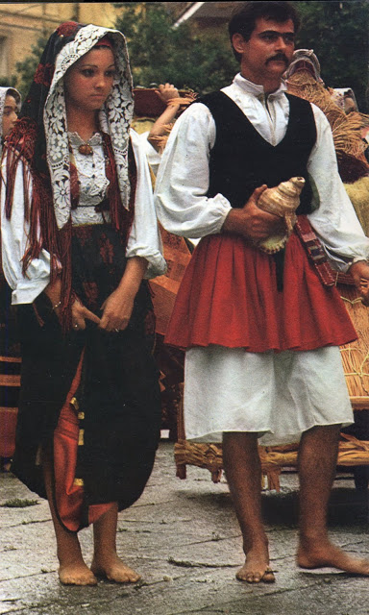
Traditional Dress (human place) Sardinia

Slide 27
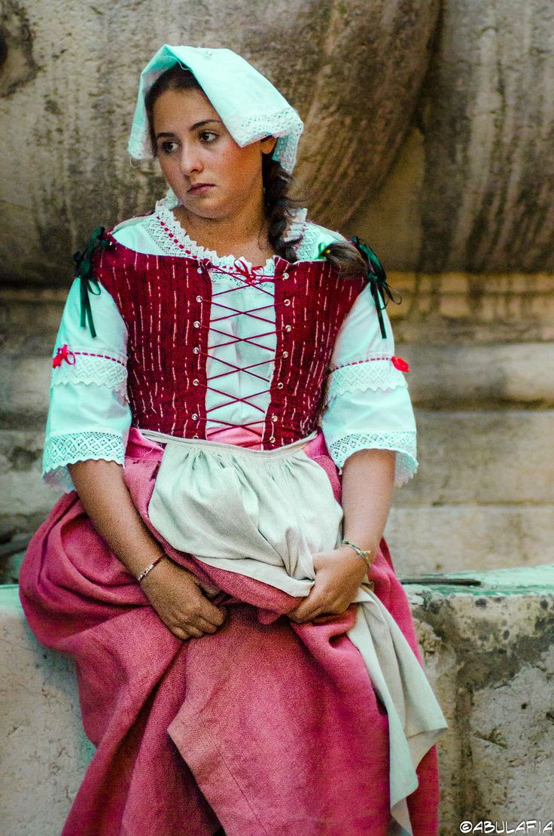
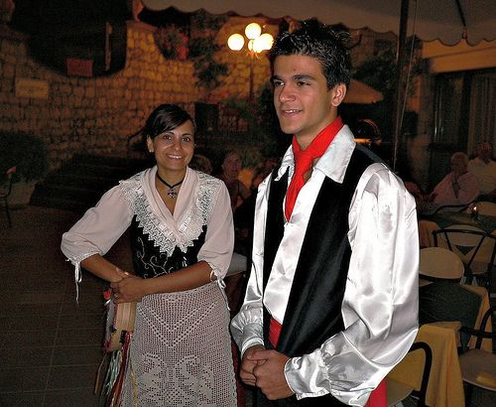
Traditional Dress (human place) Taormina, Sicily & Tuscany

Slide 28
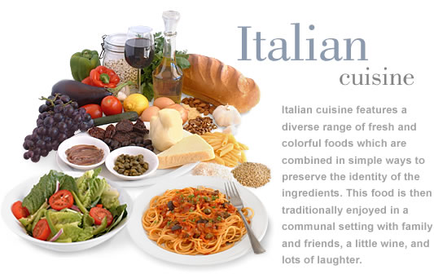

Slide 29
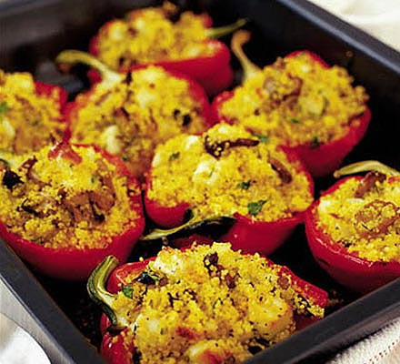
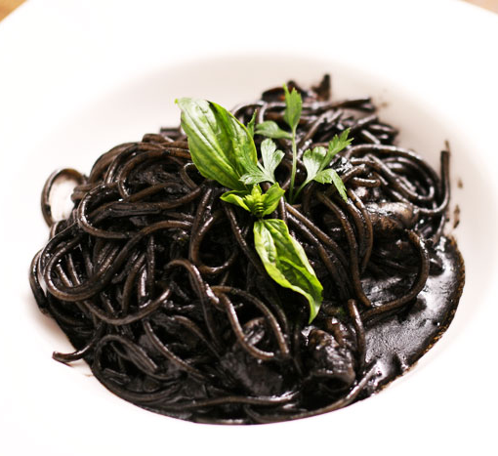
Cuisine: (human place)
Stuffed peppers
Black Pasta (Squid ink sauce)

Slide 30
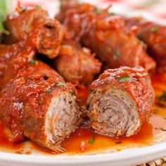
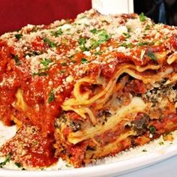
Cuisine: (human place)
Braciola, Italian Rolled Beef in Tomato Sauce
Lasagna

Slide 31
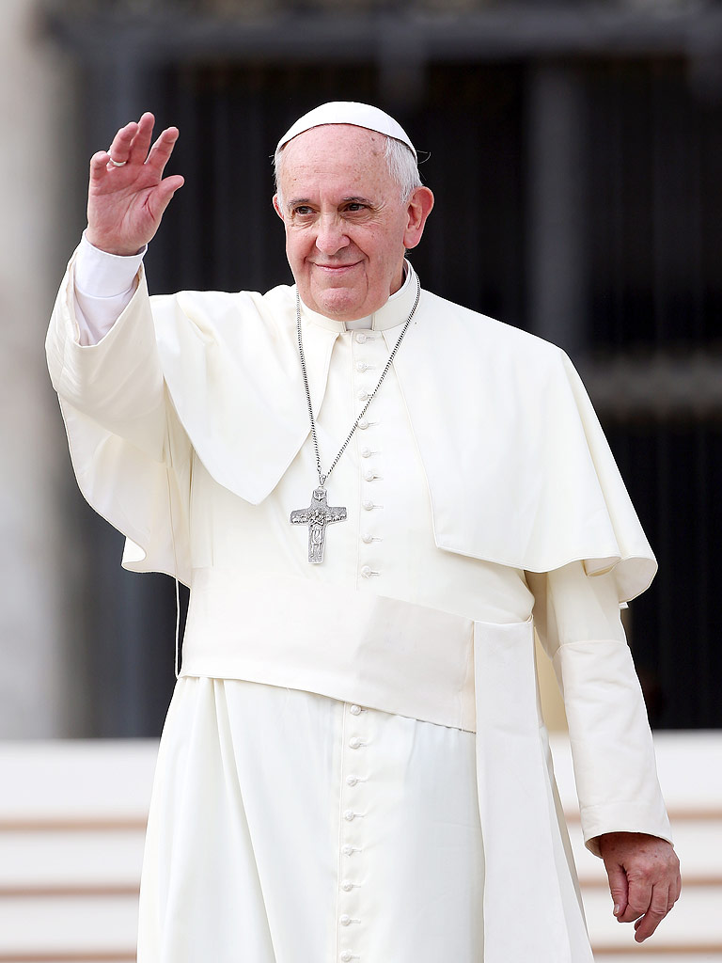
Religious composition of the population
Christian 80% (overwhelmingly Roman Catholic with very small groups of Jehovah's Witnesses and Protestants), Muslim (about 800,000 to 1 million), Atheist and Agnostic 20%

Slide 32
Government (Cultural or Human Place)
Politics of Italy is conducted through a constitutional republic with a multi-party system. Italy has been a democratic republic since 2 June 1946, when the monarchy was abolished by popular referendum and a constituent assembly was elected to draft a constitution, which was promulgated on 1 January 1948.
The executive power is exercised collectively by the Council of Ministers, which is led by the Prime Minister, officially referred to as President of the Council ("Presidente del Consiglio"). Legislative power is vested in the two houses of parliament primarily, and secondarily on the Council of Ministers, which can introduce bills and holds the majority in the parliament. The judiciary is independent of the executive and the legislative branches. It is headed by the High Council of the Judiciary. The president is the head of state, though his position is separate from all branches. The current President is Sergio Mattarella and the current Prime Minister of Italy is Matteo Renzi.
Notes:
Insert a picture of the head leader of your country.

Slide 33
International organizations to which this country belongs
European Union | NATO | United Nations
G7 | G8 | Eurozone
Organisation for Economic Co-operation and Development | General Agreement on Tariffs and Trade/World Trade Organization | Organization for Security and Co-operation in Europe
Council of Europe | Central European Initiative | European Parliament
UNESCO | Schengen Convention | WHO
United Nations High Commissioner for Refugees | Union Latina | World Trade Organization

Slide 34
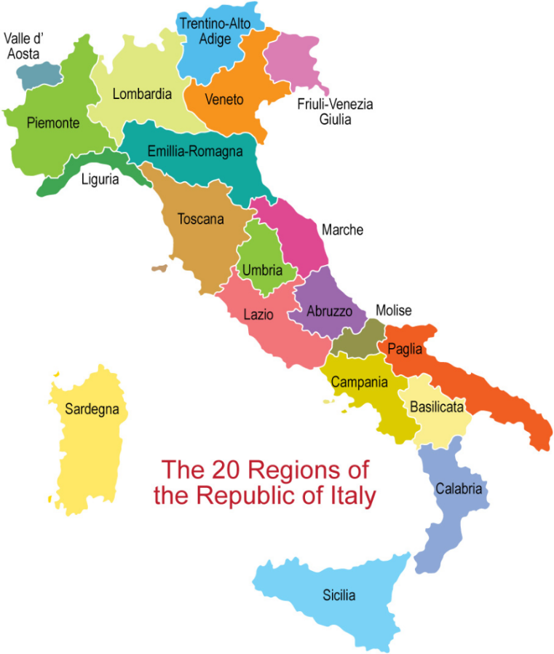
Political Divisions (Region)

Slide 35
Major cities (Interaction)
Rome | Milan
Metro Population: 4,321,244 | Metro Population: 3,204,601
Primary function: Capital of Italy and location of Vatican City – seat of the Roman Catholic church. | Primary function: Milan is the main industrial, commercial, and financial centre of Italy and a leading global city
Rome has the status of a global city. Rome ranked in 2014 as the 14th-most-visited city in the world, 3rd most visited in the European Union, and the most popular tourist attraction in Italy. Its historic centre is listed by UNESCO as a World Heritage Site. Monuments and museums such as the Vatican Museums and the Colosseum are among the world's most visited tourist destinations | The city hosts numerous cultural institutions and universities, with 185,000 students in 2011, i.e. 11 percent of the national total. It is the second Italian city - after Naples - with the highest number of accredited stars from the Michelin Guide. The city is also well known for several international events and fairs, including Milan Fashion Week and the Milan Furniture Fair, the largest of its kind in the world, and was the host for the second time of a Universal Exposition, 2015.

Slide 36
Major cities (Interaction)
Venice | Palermo
Population:264,579 | Metro Population:1,300,000
Primary function: a very important center of commerce (especially silk, grain, and spice) and art | Primary function: Palermo is Sicily's cultural, economic, political, and touristic capital.
Venice is one of the most important tourist destinations in the world for its celebrated art and architecture. The city has an average of 50,000 tourists a day (2007 estimate). In 2006, it was the world's 28th most internationally visited city, with 2.927 million international arrivals that year. It is regarded as one of the world's most beautiful cities. | Palermo is the main Sicilian industrial and commercial center: the main industrial sectors include tourism, services, commerce and agriculture. Palermo currently has an international airport, and a significant underground economy. In fact, for cultural, artistic and economic reasons, Palermo was one of the largest cities in the Mediterranean and is now among the top tourist destinations in both Italy and Europe.

Slide 37
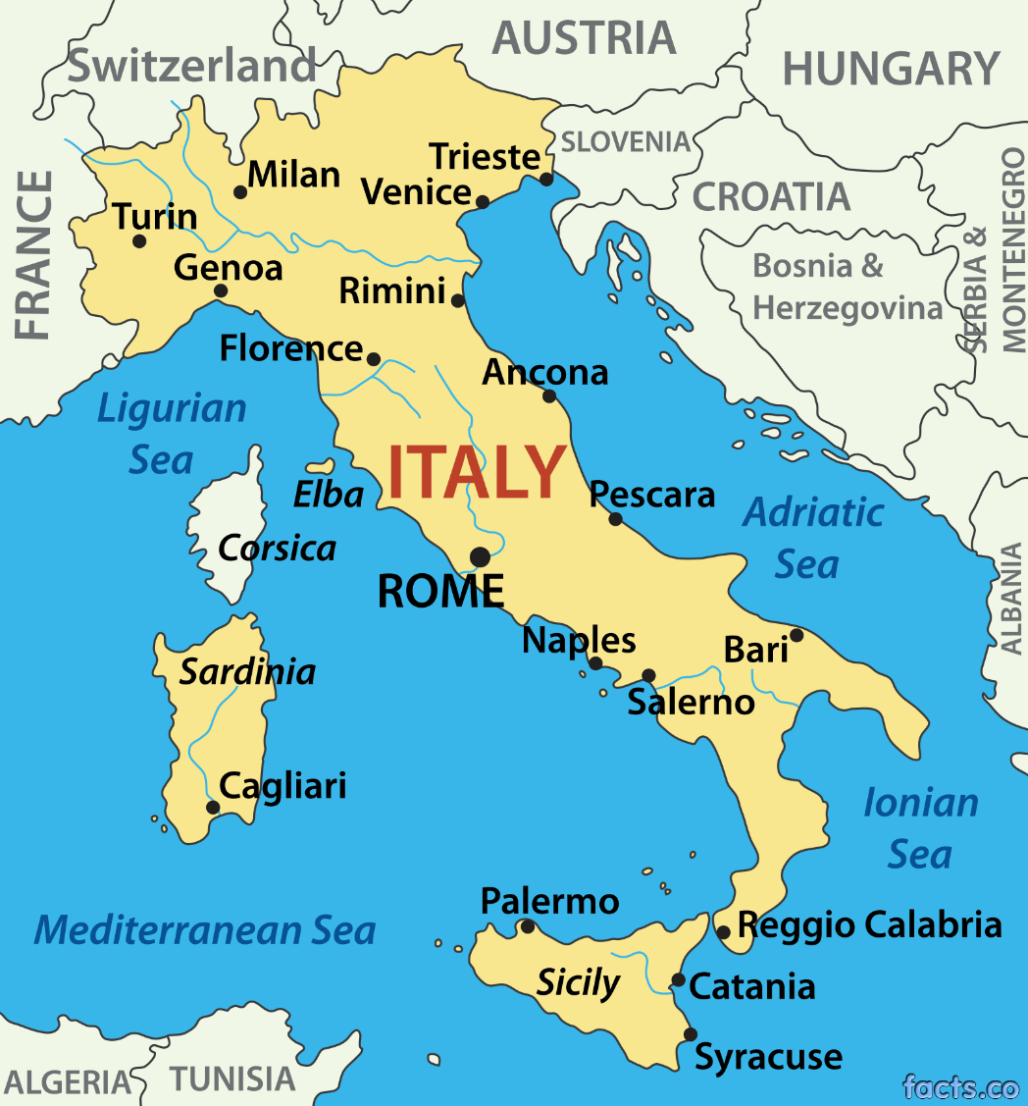

Slide 38
Economy (Cultural or Human Place)
Italy has a mainly market economy with a moderate amount of government supervision and/or regulation.
Italy is the 4th-largest national economy in Europe, the 8th-largest by nominal GDP in the world, and the 12th-largest by GDP (PPP). The country is a founding member of the European Union, the Eurozone, the OECD, the G7 and the G8. Italy is the eighth largest exporter in the world with $514 billion exported in 2015. Its closest trade ties are with the other countries of the European Union, with whom it conducts about 59% of its total trade. The largest trading partners, in order of market share, are Germany (12.6%), France (11.1%), United States (6.8%), Switzerland (5.7%), United Kingdom (4.7%), and Spain (4.4%).
Notes:
Insert a picture that illustrates some part of your country’s economy.

Slide 39
Economy Continued
the country enjoys a very high standard of living, and has the world's 8th highest quality of life according to The Economist. The country is well known for its influential and innovative business economic sector, an industrious (Italy is the second largest manufacturer in Europe behind Germany) and competitive agricultural sector (Italy is the world's largest wine producer), and for its creative and high-quality automobile, naval, industrial, appliance and fashion design. Italy is the largest market for luxury goods in Europe (third in the world).

Slide 40
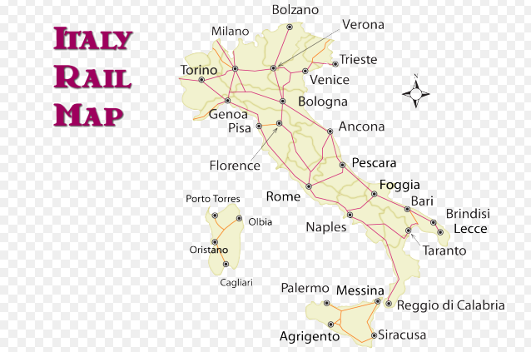
Movement (movement & interaction)

Slide 41
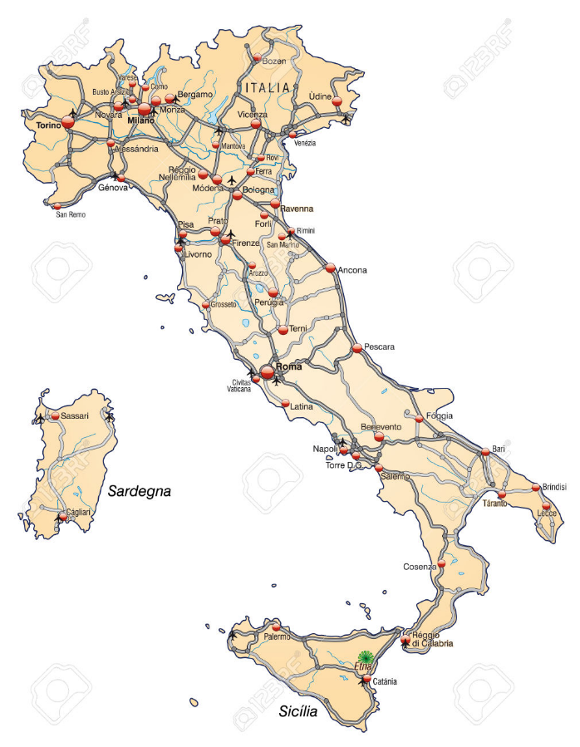
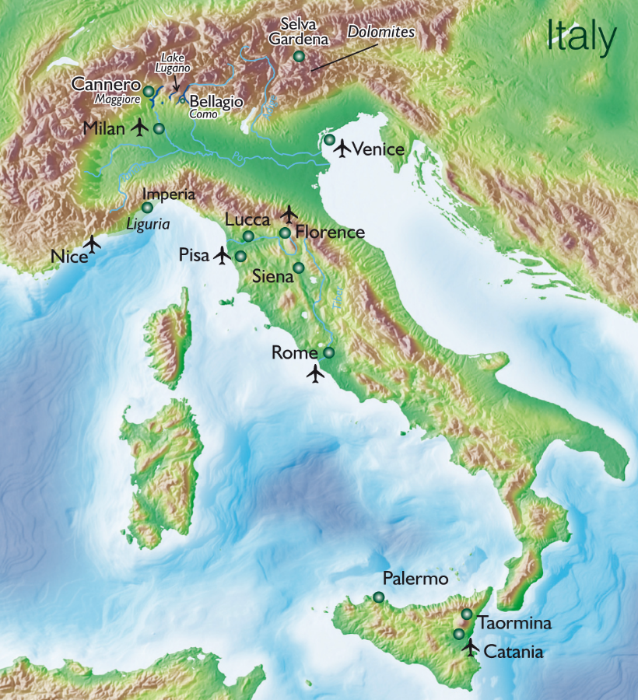
Highways & airports

Slide 42
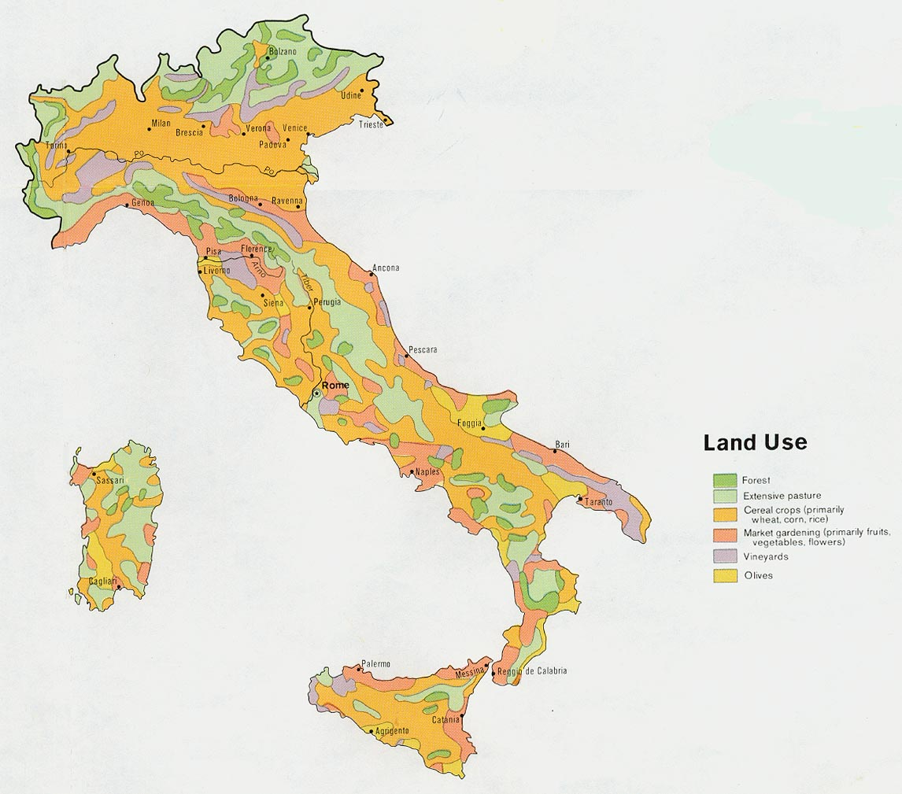
Agricultural Regions (& interaction)

Slide 43
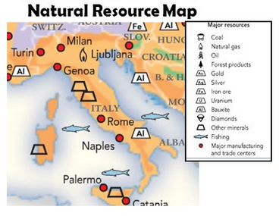
Resources

Slide 44
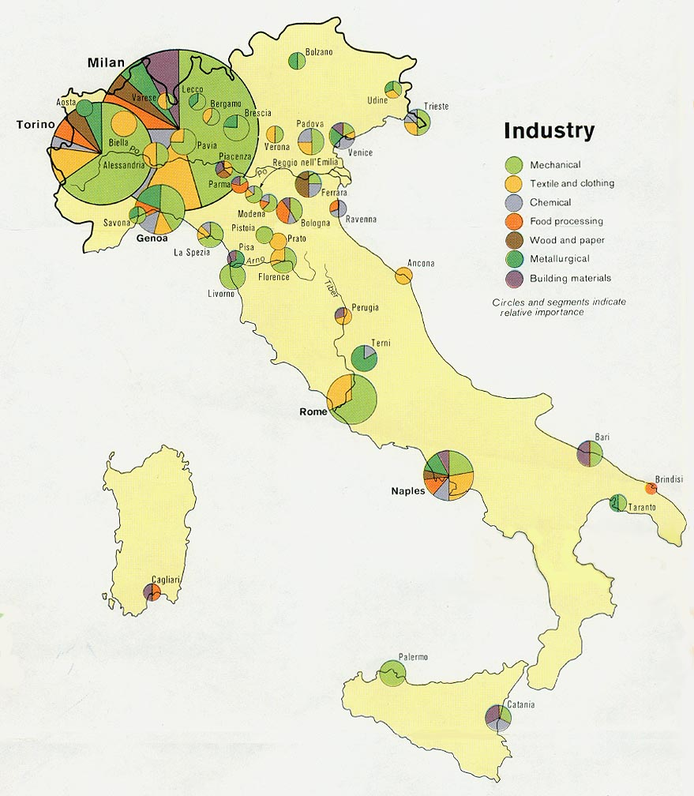
Industry

Slide 45
Statistics & demographics
Mostly Economic Related
GNP/GDP in $ | $2.174 trillion | GNP per capita ($) | $35,800
Import value in $ | $389.2 billion | Export Value in $ | $454.6 billion
GDP Growth | 0.8% (2015)
Major import | engineering products | Major export | engineering products
Unemployed % | 12.2% (2015 est.) | Inflation rate (%) | 0.3% (2015 est.)
National budget ($) | $930.5 billion | National debt ($) | $2.459 trillion
Poor people | 29.9% | Defense budget ($) | 1.1% of GDP
Demographics
Population | 61,855,120 | Growth rate | 0.27%
Infant mortality rate | 3.29 deaths/1,000 live births | Avg. life expectancy M/W | 79.48 yrs/ 84.92 yrs
% pop. under 15 | 13.73% | % pop. Over 65 | 21.2%
Total Fertility Rate (TFR) | 1.43 | # doctors per 1000 people | 3.76
% college degree | NA | % literate | 99.2%
Avg. calorie intake | NA | Poverty rate | 29.9%
Birth rate | 8.74 births/1,000 | Death rate | 10.19 deaths/1,000

Slide 46
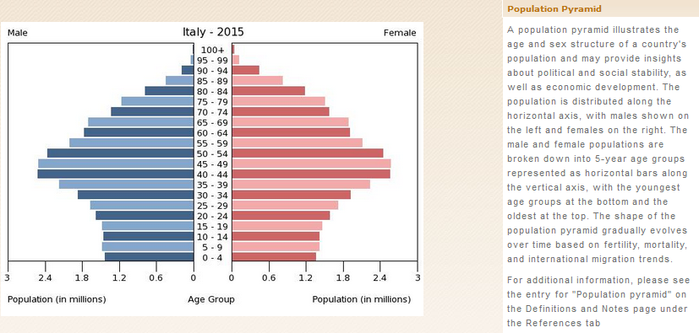
Population Pyramid

Slide 47
Tourism in Italy
With 48.6 million tourists a year (2014), Italy is the fifth most visited country in international tourism arrivals, behind France (83.7 million (2014)), the United States (74.8 million (2014)), Spain (65 million (2014)), and China (55.6 million (2014)). People mainly visit Italy for its rich art, cuisine, history, fashion and culture, its beautiful coastline and beaches, its mountains, and priceless ancient monuments. Italy also contains more World Heritage Sites than any other country in the world.
Tourism is one of Italy's fastest growing and most profitable industrial sectors, with an estimated revenue of €189.1 billion.
Notes:
Insert a picture of one of the points of interest for your country.

Slide 48
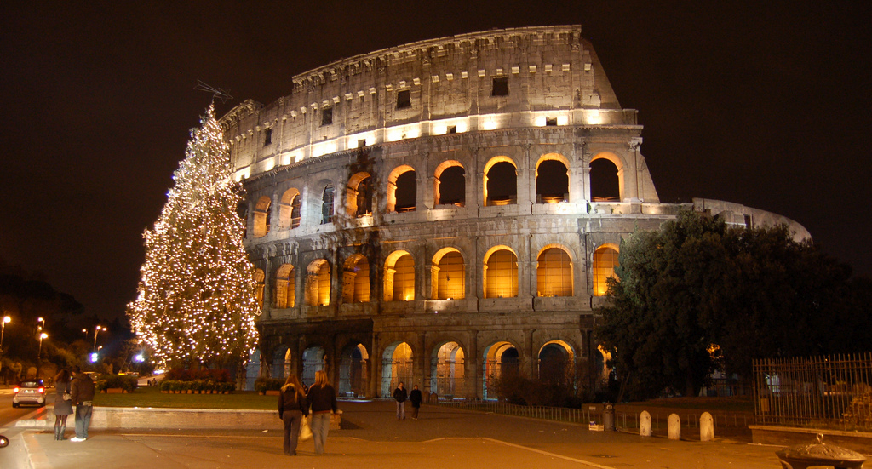
the Colosseum, Rome

Slide 49
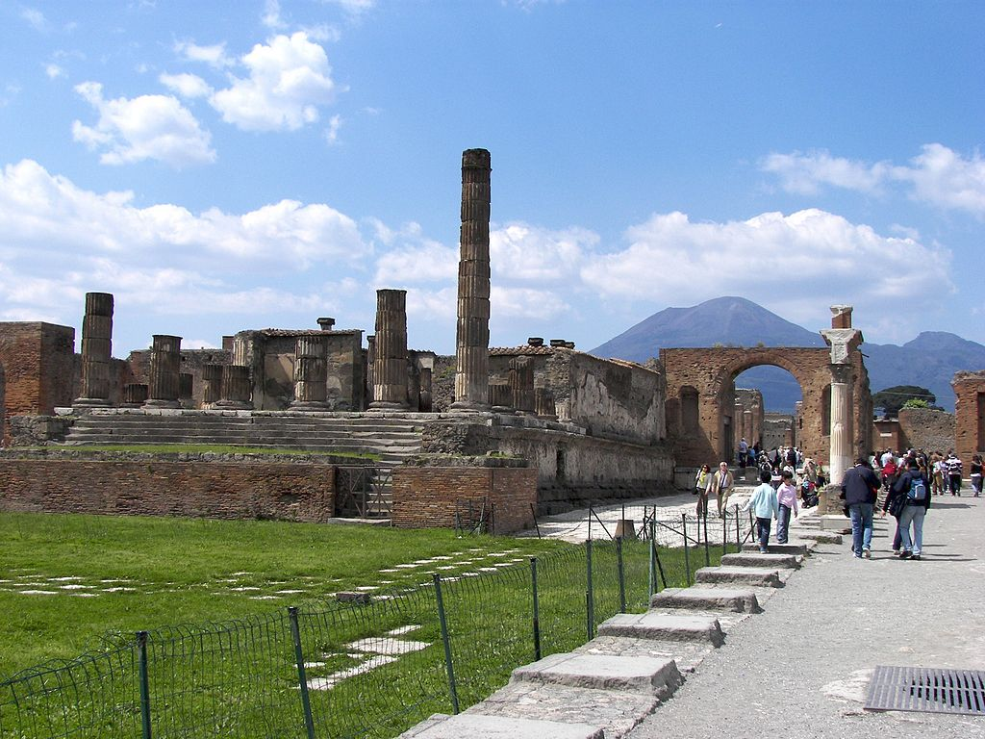
Pompeii with Vesuvius in the distance.

Slide 50
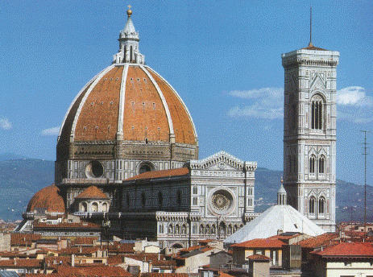
Florence

Slide 51
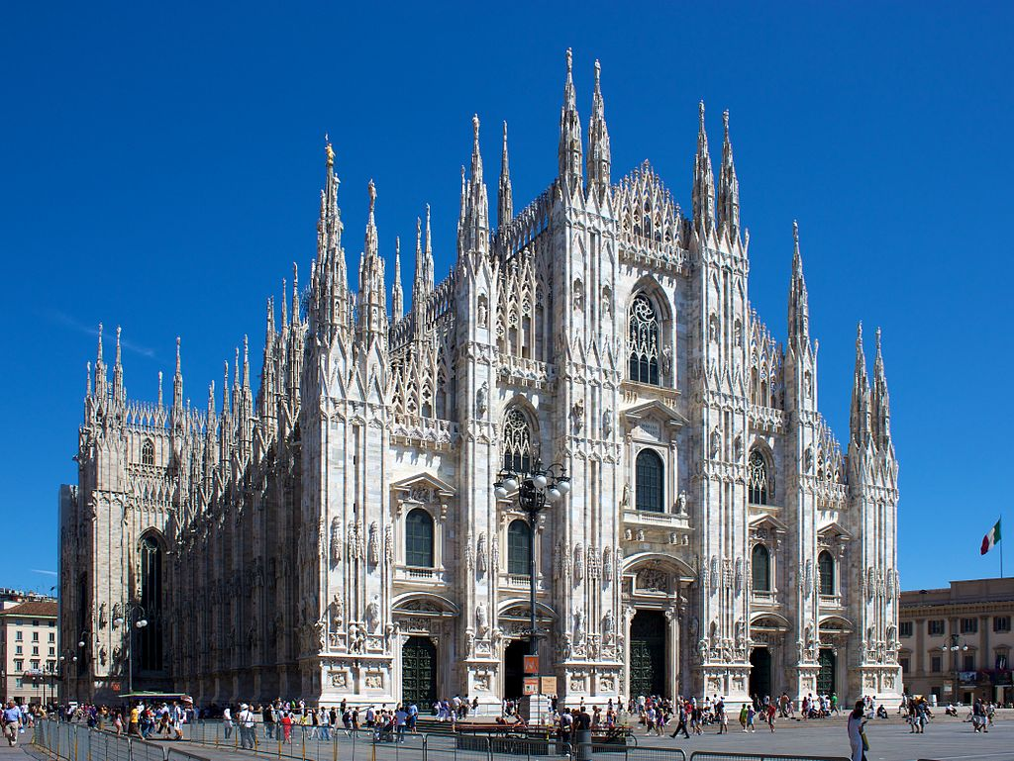
Milan Cathedral

Slide 52
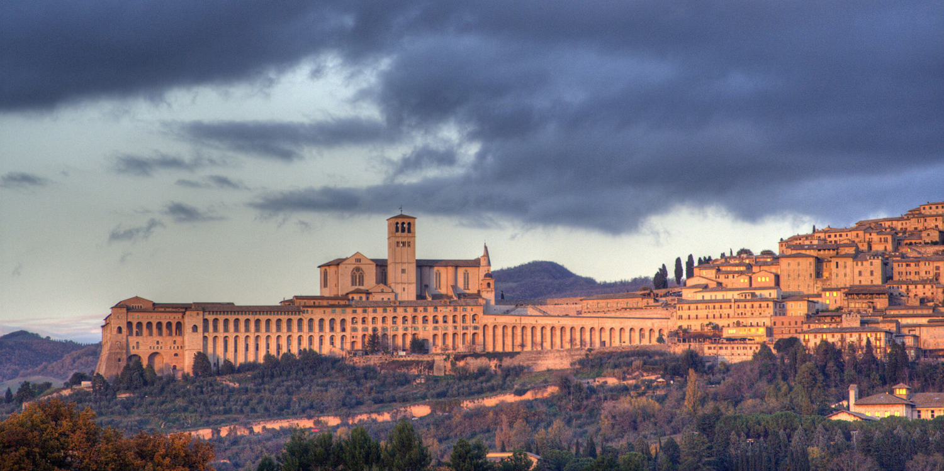
View of Assisi

Slide 53
Current major problem(s)
Massive public debt and the slow recovery from the 2008 “Recession.”
Refugees crossing the Mediterranean – Providing for the refugees, costly rescue operations, and fitting people with greatly different cultures into the Italian society.

Slide 54
Additional points of relevance
Italy has two sovereign countries within its borders: San Marino and Vatican City
Rome is the only city in the world that has a sovereign country within its boundaries – Vatican City.
Some of the best preserved Greek temples in the world are in Sicily.

