Slide 1
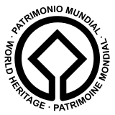
UN World Heritage Sites
A Bonus Point Project Opportunity

Slide 2
A UNESCO World Heritage Site is a place (such as a forest, mountain, lake, island, desert, monument, building, complex, or city) that is listed by the United Nations Educational, Scientific and Cultural Organization (UNESCO) as of special cultural or physical significance (see list of World Heritage Sites). The list is maintained by the international World Heritage Program administered by the UNESCO World Heritage Committee, composed of 21 UNESCO member states which are elected by the General Assembly.

Slide 3
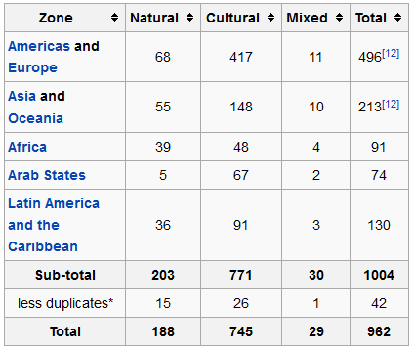

Slide 4
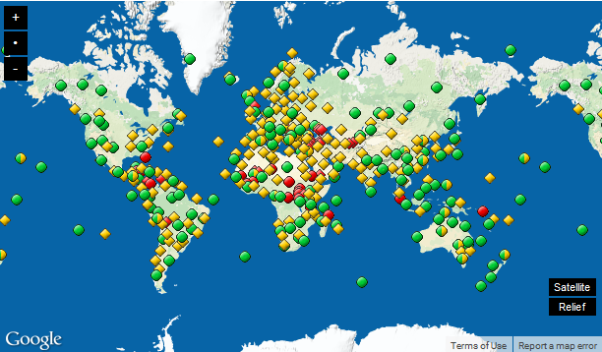

Slide 5
Russia

Slide 6
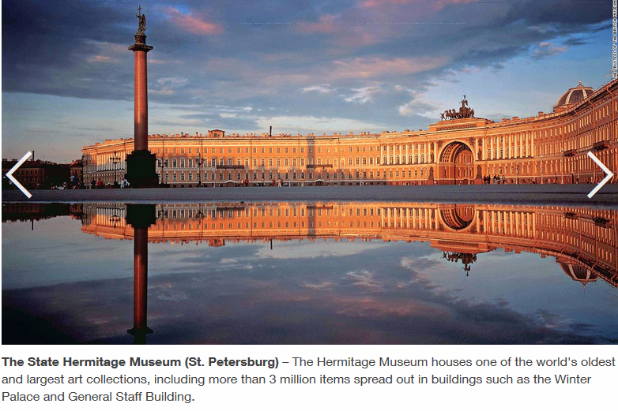

Slide 7
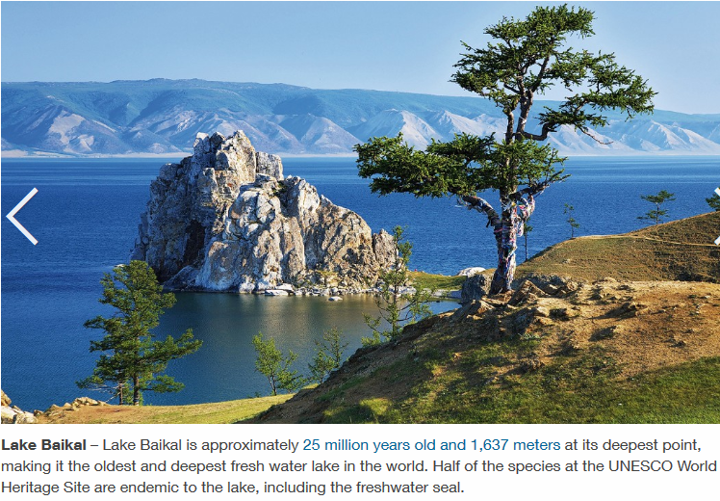

Slide 8
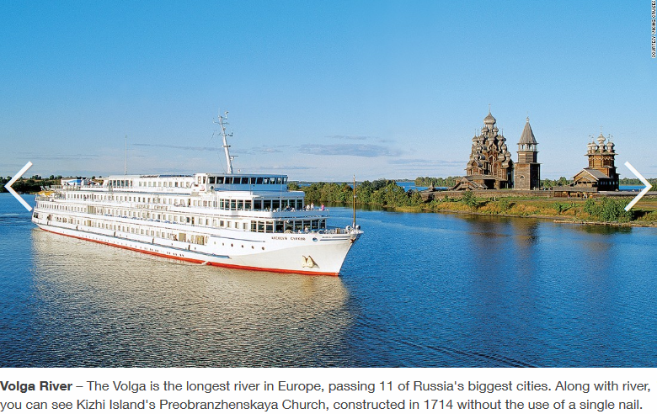

Slide 9
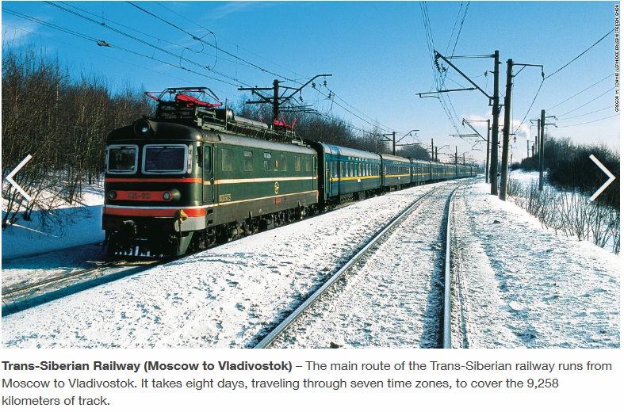

Slide 10
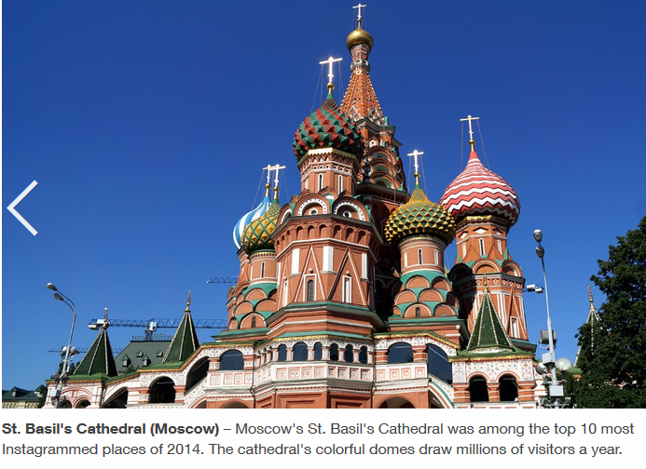

Slide 11
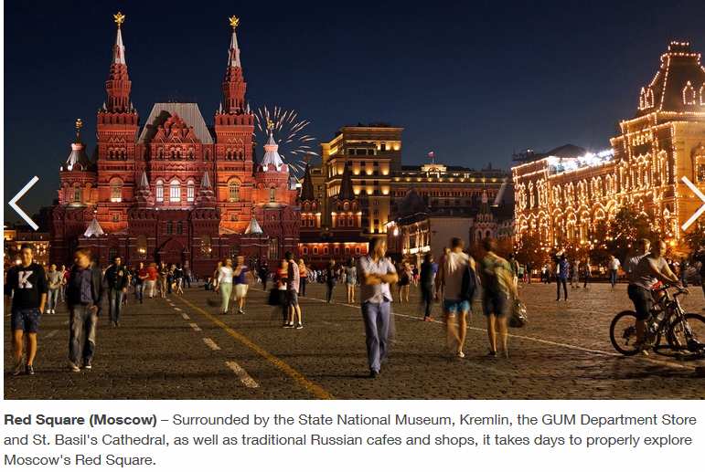

Slide 12
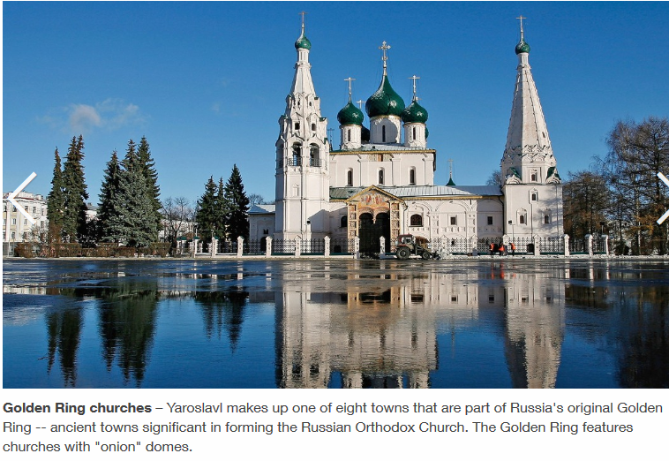

Slide 13
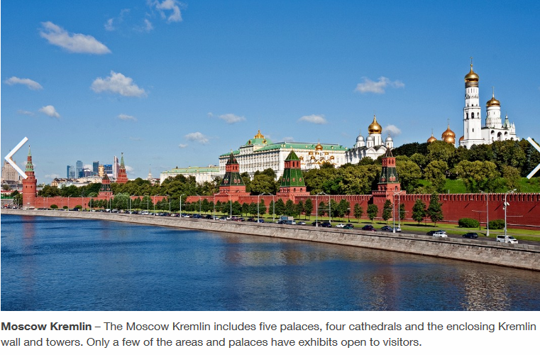

Slide 14
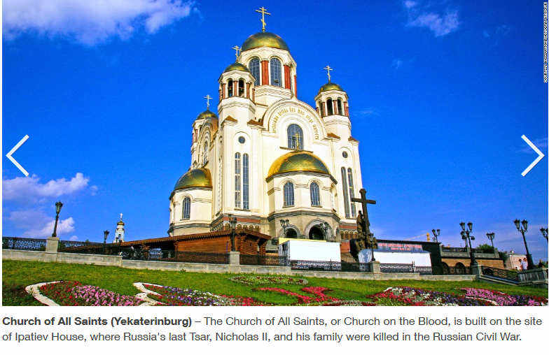

Slide 15
Okavango Delta
Boro - The Okavango Delta in Botswana is one of Africa's natural wonders, but the new Unesco World Heritage Site is facing a multitude of threats, which could lead to its ecological collapse.

Slide 16
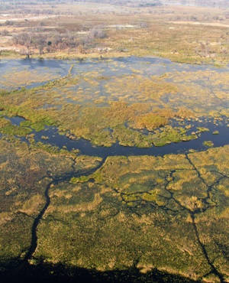

Slide 17
Moroccan Magic
This June 2013 photo shows a detail of a tower at Ait Ben Haddou in Moroccos Ouarzazate province. Ait Ben Haddou is a UNESCO World Heritage site, an example of the regions distinctive casbahs and ancient fortified villages built from a pressed mixture of clay and straw. (AP Photo/Giovanna DellOrto)

Slide 18
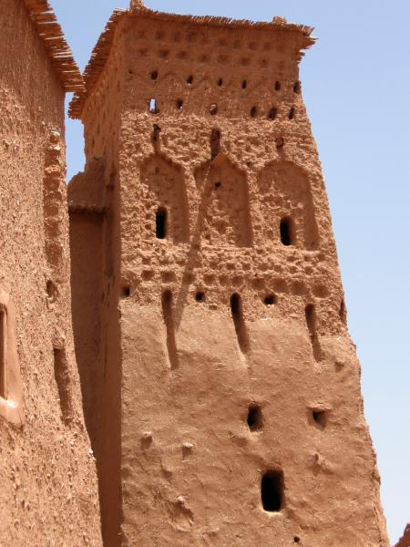

Slide 19
Basilicata rocks
As designer showers go, it was splendid: hot, strong and immaculately plumbed. What was odd was the setting: an immense cave, illuminated partly by candlelight. Home to Italian monks in the Middle Ages, and later to peasants, who shared the space with their animals (my oversized basin had once been a feeding trough), it’s now a seriously stylish boutique hotel. Welcome to Matera, where cave-dwelling can be surprisingly chic.

Slide 20
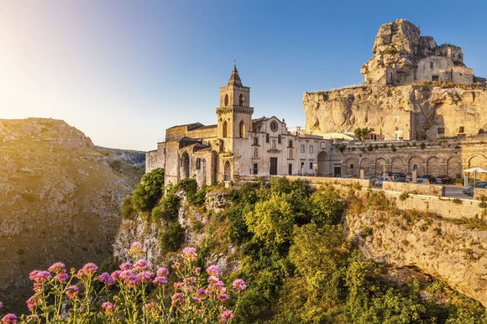
Cliff hanger: the Church of San Pietro Caveoso, in Matera

Slide 21
Barcelona's Sagrada Familia
Designed meticulously by the great architect Antoni Gaudi. This work of art has taken over 100 years to build and contains the finest architecture in the city. Construction continues and they estimate will come to full completion by 2026.
Construction of Sagrada Familia had commenced in 1882 and Gaudi became involved in 1883, taking over the project and transforming it with his architectural and engineering style, combining Gothic and curvilinear Art Nouveau forms. Gaudi devoted his last years to the project, and at the time of his death at age 73 in 1926 less than a quarter of the project was complete.

Slide 22
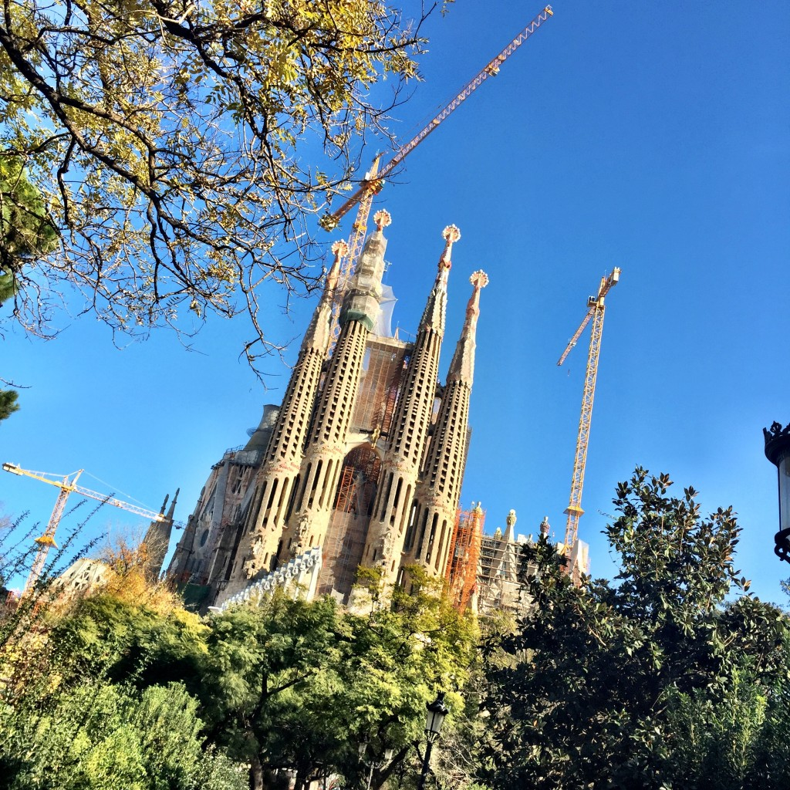

Slide 23
Project Requirements Section

Slide 24
Minimum Requirements for PowerPoint
Maps (4-6)
Location in the world and within a country
Map of the heritage site (if available)
Describe the site with words and pictures
One or two slides of text
5 (absolute minimum) pictures
What is the significance of the site (Why was it worth receiving the honor and the protection that such a site usually receives?)
Describe any visitors center or interpretive center (museum?) associated with the site
Any personal experience you might have had with this site.
Well done – 25 bonus points

Slide 25
EXAMPLE

Slide 26
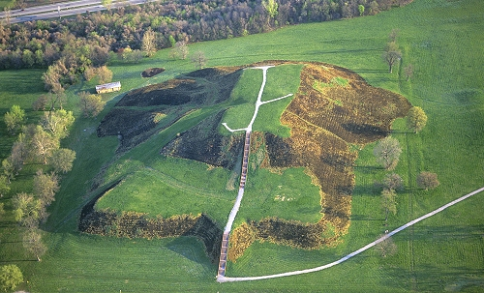
Cahokia Mounds, Illinois, USA

Slide 27
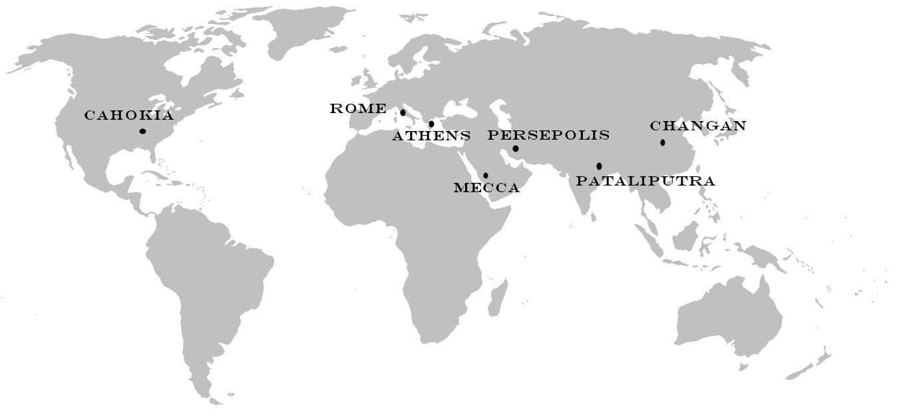
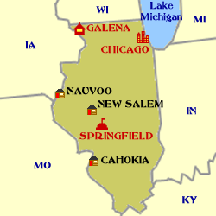
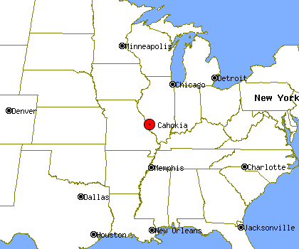

Slide 28
Cahokia Mounds State Historic Site is located on the site of a pre-Columbian Native American city (c. 600–1400 CE) situated directly across the Mississippi River from modern St. Louis, Missouri. This historic park lies in southern Illinois between East St. Louis and Collinsville. The park covers 2,200 acres, or about 3.5 square miles, and contains about 80 mounds, but the ancient city was actually much larger. In its heyday, Cahokia covered about six square miles and included about 120 human-made earthen mounds in a wide range of sizes, shapes, and functions.
Cahokia was the largest and most influential urban settlement in the Mississippian culture which developed advanced societies across much of what is now the central and southeastern United States, beginning more than 500 years before European contact. Cahokia's population at its peak in the 1200s would not be surpassed by any city in the United States until the late 18th century. Today, Cahokia Mounds is considered the largest and most complex archaeological site north of the great pre-Columbian cities in Mexico.

Slide 29
Cahokia Mounds is a National Historic Landmark and designated site for state protection. In addition, it is one of only 22 UNESCO World Heritage Sites within the United States. It is the largest prehistoric earthen construction in the Americas north of Mexico. The site is open to the public and administered by the Illinois Historic Preservation Agency, and is supported by the Cahokia Mounds Museum Society.
Cahokia Mounds was first protected by the State of Illinois in 1923 when its legislature authorized purchase of a state park. Later designation as a state historic site offered additional protection, but the site came under significant threat from the federal highway building program in the 1950s. The highway program reduced the site's integrity; on the other hand, it increased funding for emergency archeological investigations. These investigations became intensive, and today continue, and have led to the present understanding of the significance of the site. The site was designated a National Historic Landmark on July 19, 1964, and listed on the National Register of Historic Places on October 15, 1966. In 1982 UNESCO (the United Nations Educational, Scientific and Cultural Organization) designated Cahokia Mounds State Historic Site as a World Heritage Site.

Slide 30
Statement of Significance
Cahokia Mounds is the largest and earliest pre-Columbian settlement north of Mexico. It was occupied primarily during the Mississippian period (800-1350), when it covered over 1,600 hectares (3,950 acres) and included some 120 mounds. It is the pre-eminent example of a cultural, religious, and economic center of the Mississippian cultural tradition, which extended throughout the Mississippi Valley and the south-eastern United States. This agricultural society may have had a population of 10,000-20,000 at its peak between 1050 and 1150. Cahokia is an early and exceptional example of pre-urban structuring.

Slide 31
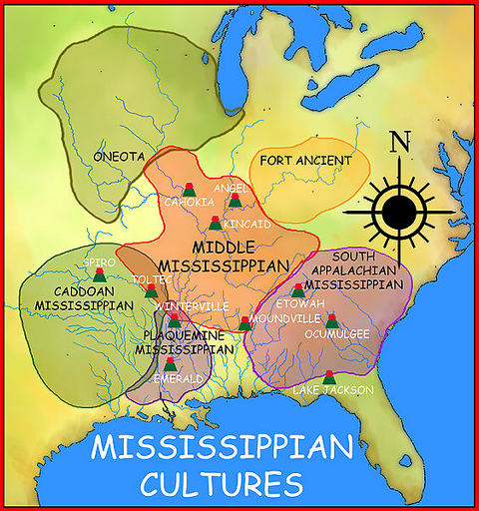

Slide 32
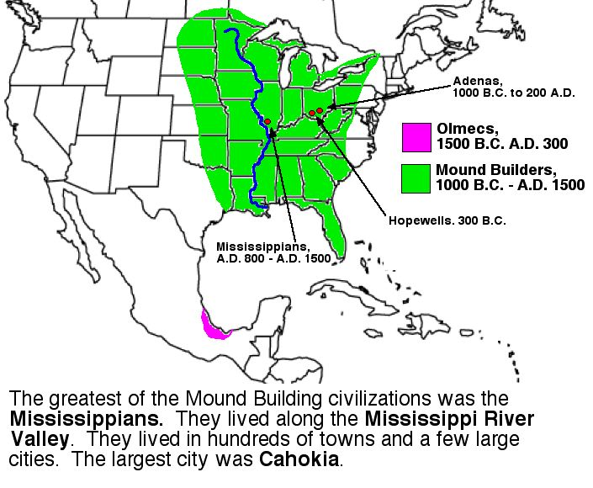

Slide 33
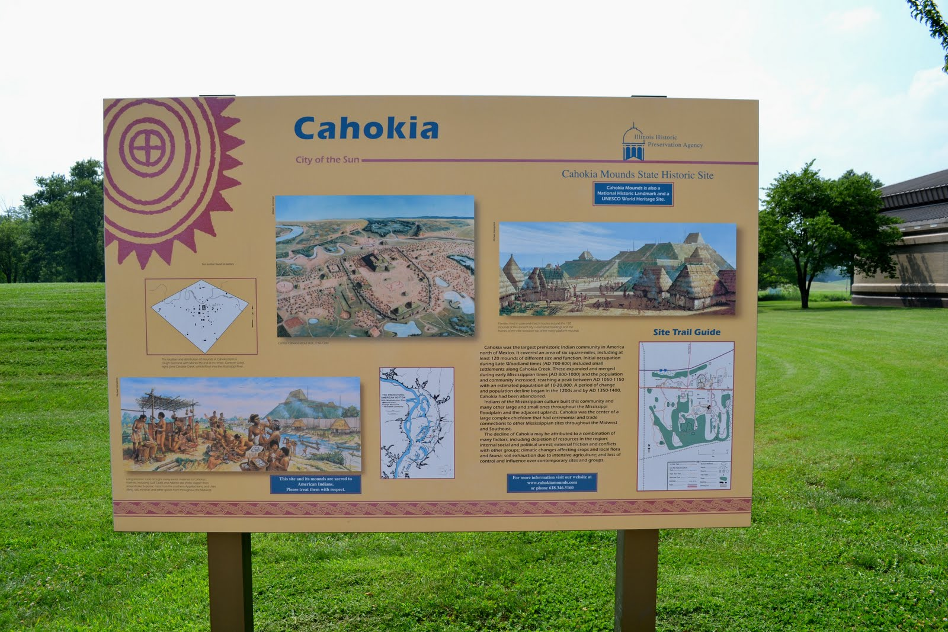

Slide 34
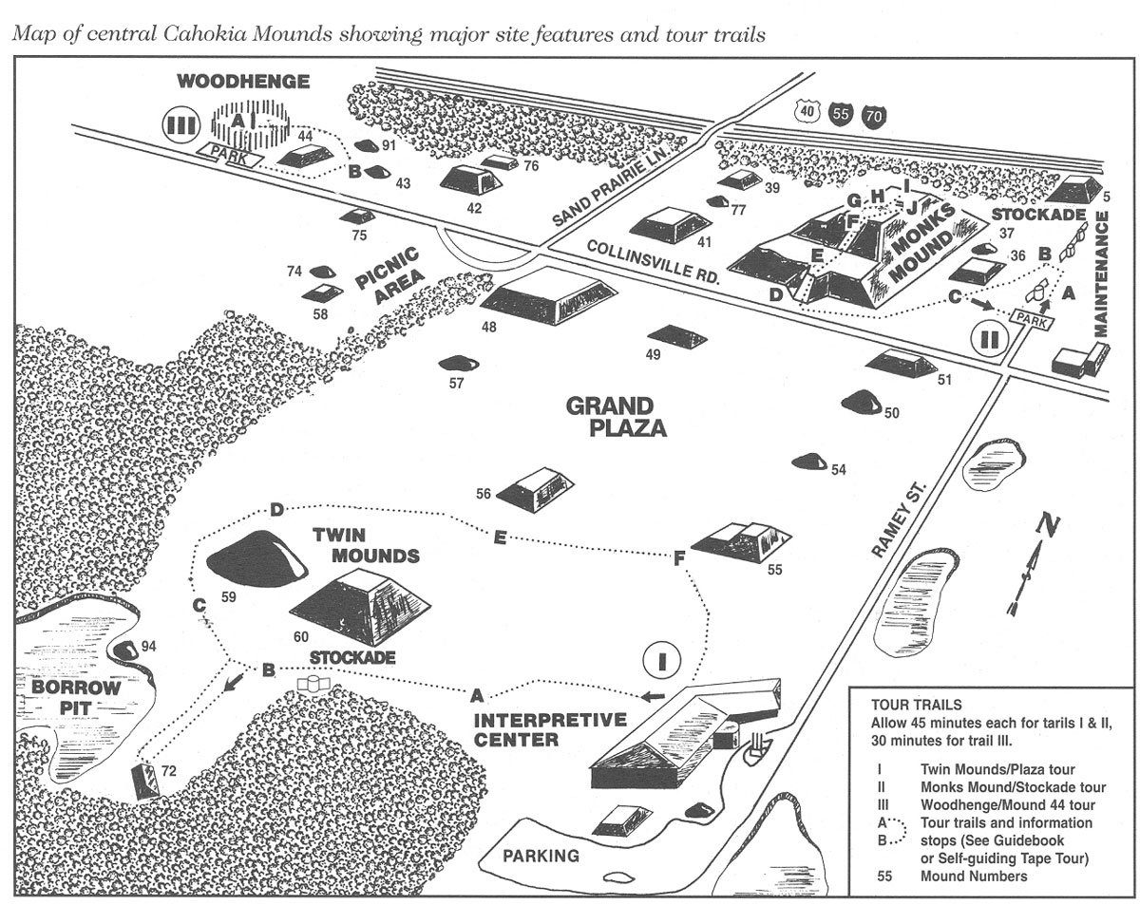

Slide 35
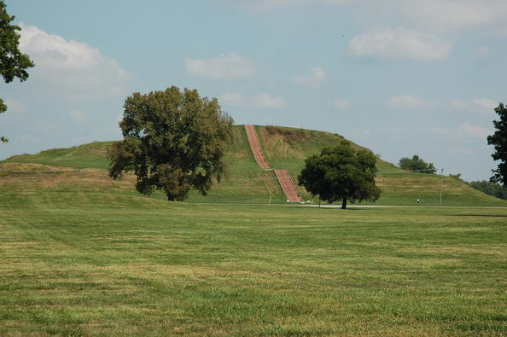
Monks Mound – the largest structure

Slide 36
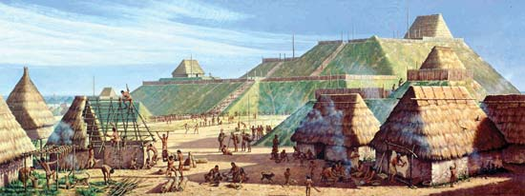
What the settlement probably looked like

Slide 37
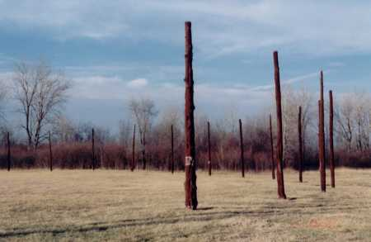
Woodhenge

Slide 38
Archeological excavations have revealed where a large solar calendar once stood. Because it was made of wood, the solar calendar is now called Woodhenge. The Woodhenge has been recreated by erecting representations of tree trunks at the locations where the excavations have revealed wooden markers had been placed by the original occupants. Alignments of the markers indicate important solar events, such as the solstices and equinoxes. There are four concentric circular rings of markers, respectively having 24, 36, 48, and 60 markers, and there is a fifth partial ring with markers along Eastern sunrise locations.

Slide 39
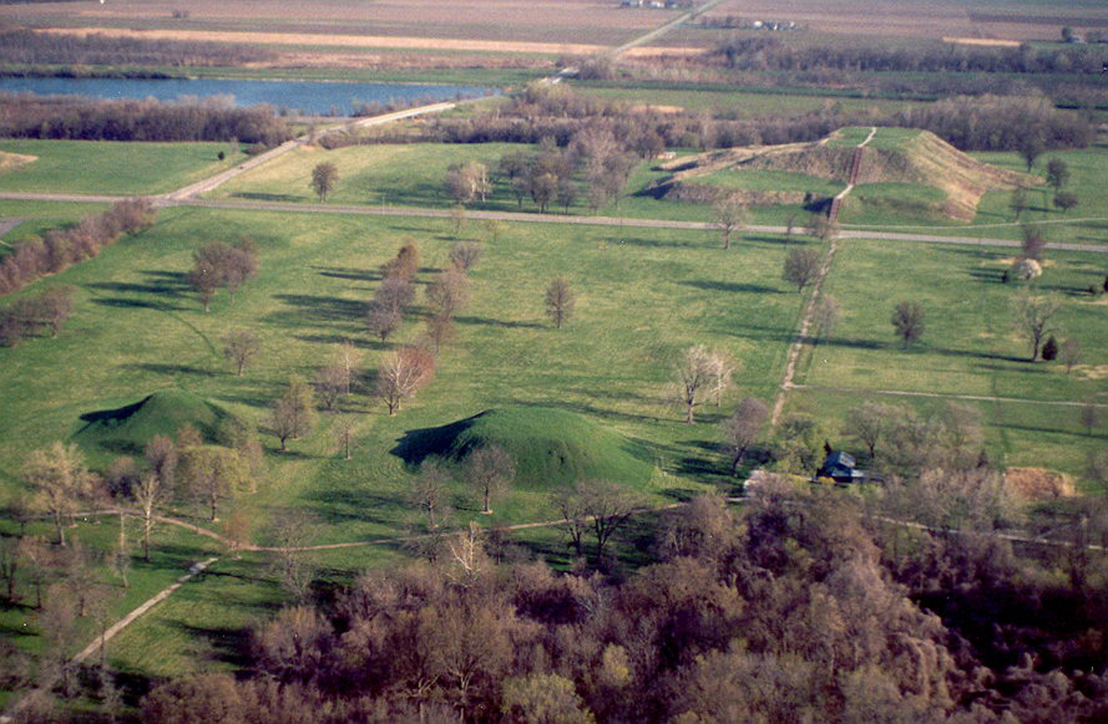

Slide 40
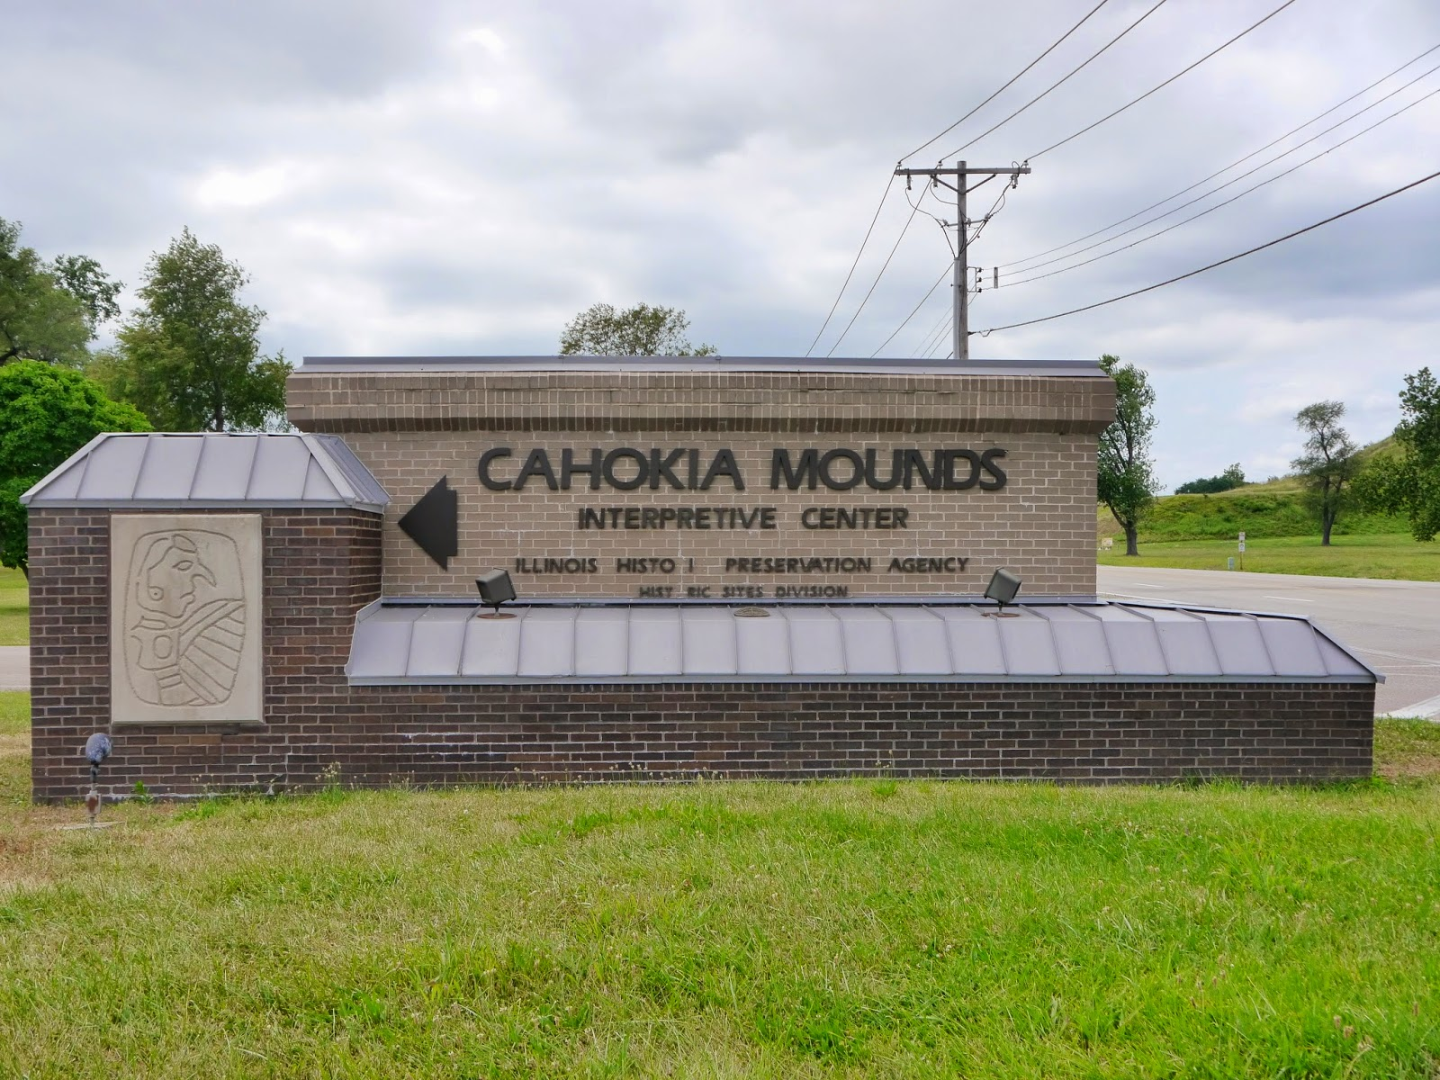

Slide 41
Outstanding Interpretive Center
The Cahokia Museum and Interpretive Center, which receives up to a million visitors a year, was designed by AAIC Inc. The building which opened in 1989 received the Thomas H. Madigan Award, the St. Louis Construction News & Reviews Readers Choice Award, the Merit Award from the Metal Construction Association and the Outstanding Achievement Award from the Brick Manufacturer Association.

Slide 42
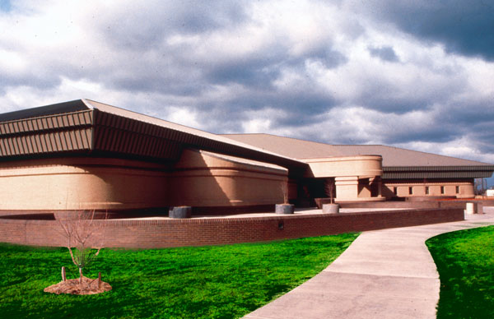

Slide 43
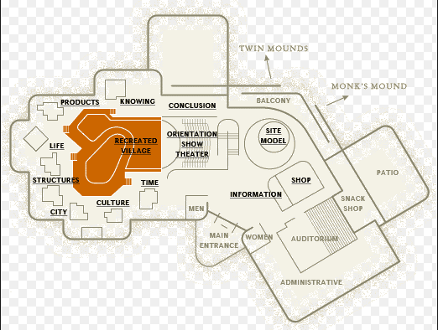

Slide 44
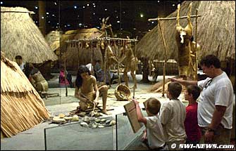
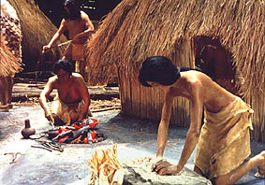
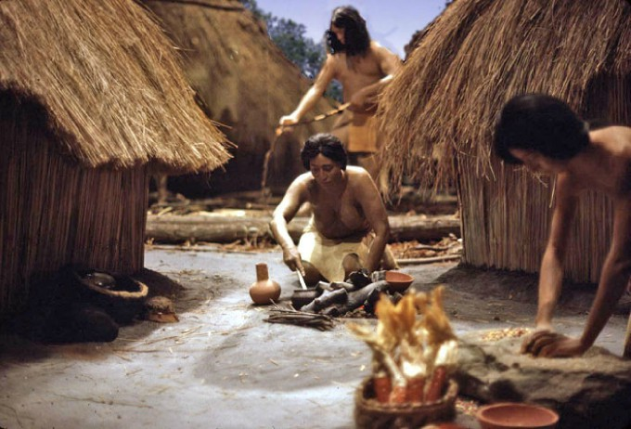
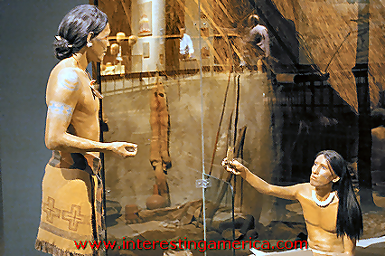
Life size dioramas

Slide 45
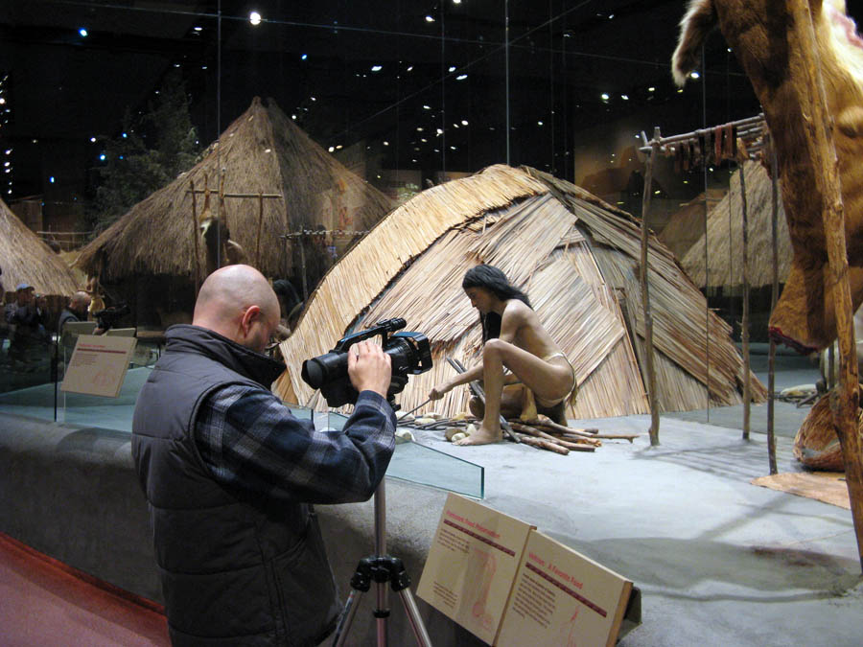

Slide 46
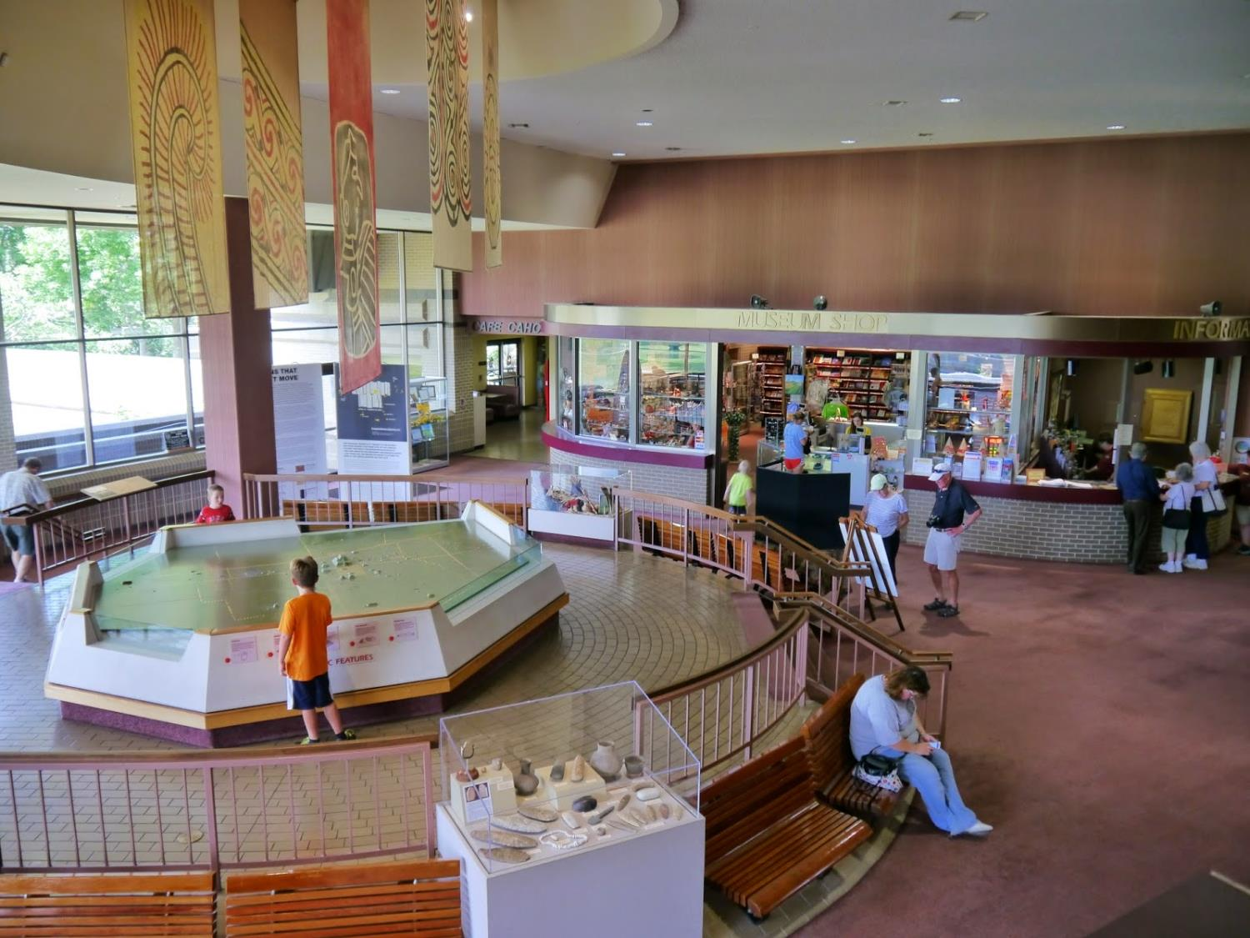

Slide 47
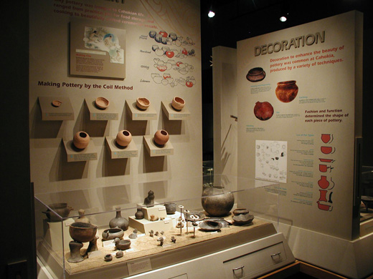

Slide 48
Personal Experiences
My family and I visited the site before the beautiful interpretive center was built. There was a small, old house near the road and in front of Monks Mound that served as a very limited interpretive center. We’ve been back several times since the new facility was completed. It is a fantastic experience – everything is so well done and the amount of information one can learn there is astounding. Anyone living within driving distance should visit this site. It is sad that so many people in this area are ignorant of this wonderful site.

