Slide 1
Metro St. Louis in the Penny Postcard Era
Approximately 1900-1940
http://www.usgwarchives.org/special/ppcs/ppcs.html

Slide 2
St. Louis Metropolitan Area
Historical geography:
  What was here then but not today
  How different some things were from what they are like today
A great way to step back into an earlier time and place.
One could mail a postcard with a one cent stamp until the mid-1940s

Slide 3
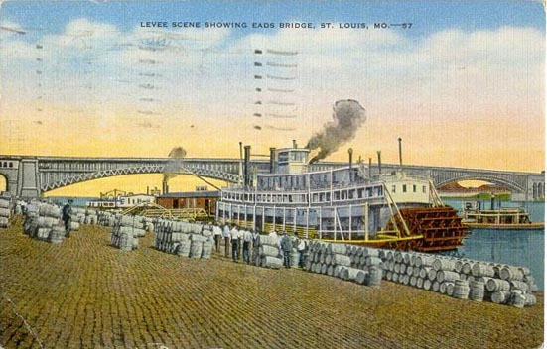

Slide 4
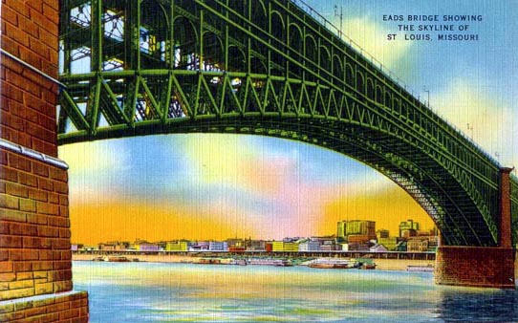

Slide 5
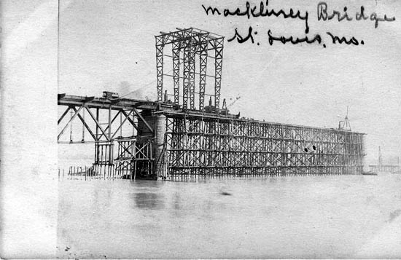
Building the McKinley Bridge

Slide 6
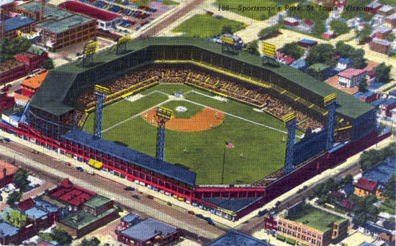
Sportsman Park on Grand Ave.

Slide 7
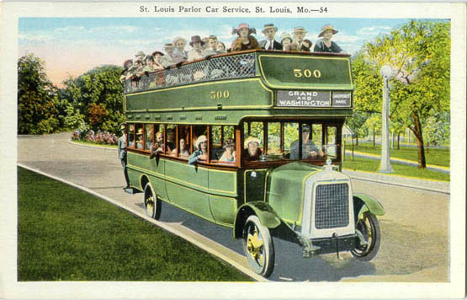

Slide 8
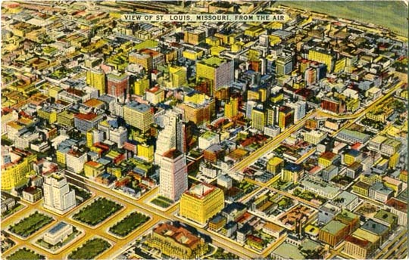

Slide 9
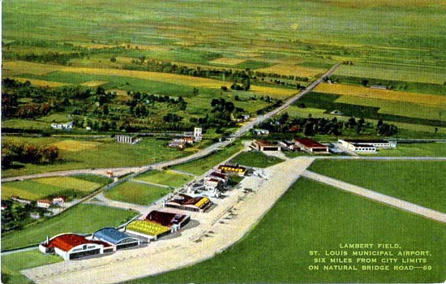

Slide 10
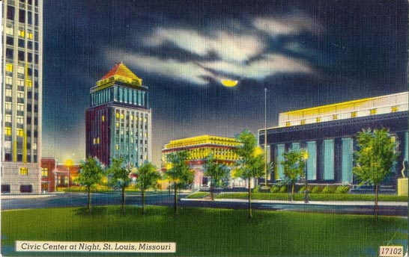

Slide 11
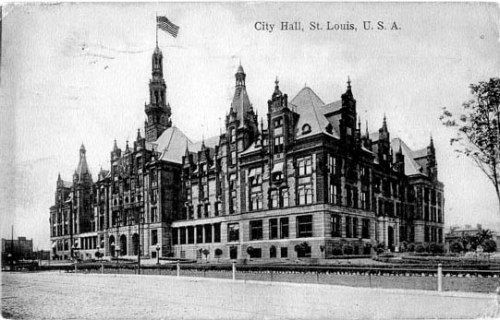
1908

Slide 12
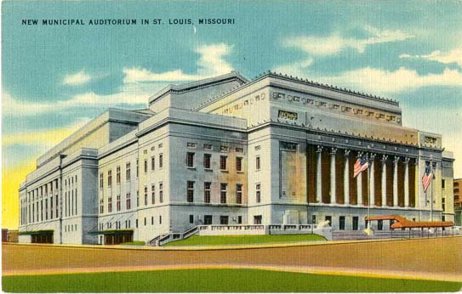
Restored 2011 – Peabody Auditorium

Slide 13
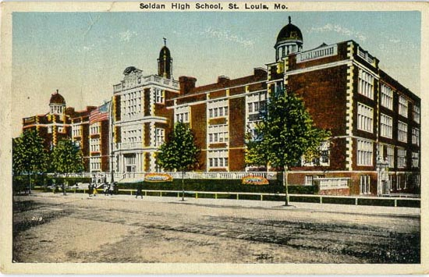

Slide 14
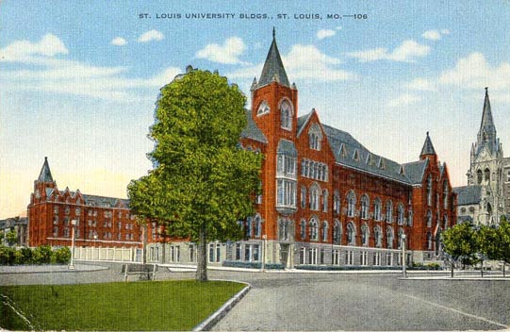

Slide 15
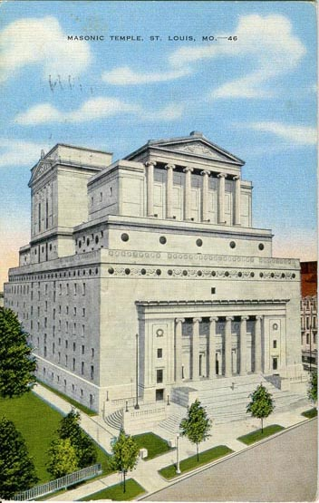
Masonic Temple on Lindell Blvd. west of Grand Avenue – Now part of St. Louis University

Slide 16
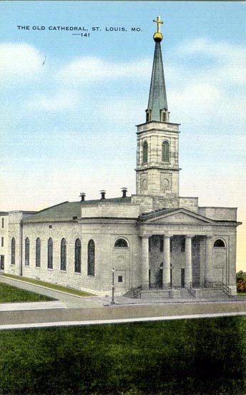
Now part of the “Arch” grounds

Slide 17
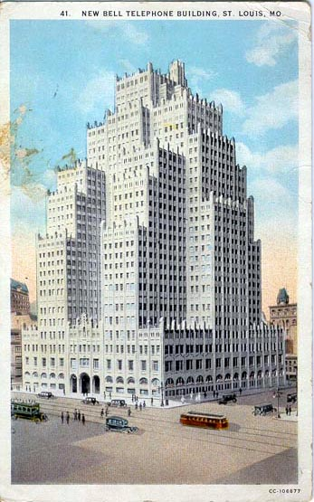
1010 Pine Street in downtown St. Louis

Slide 18
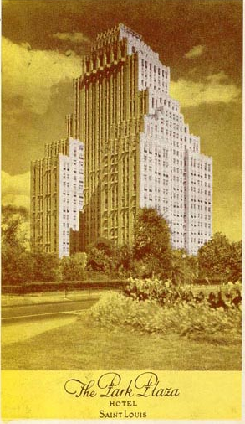
It and the Chase Hotel next to it were “premier” hotels up to the mid-20th Century

Slide 19
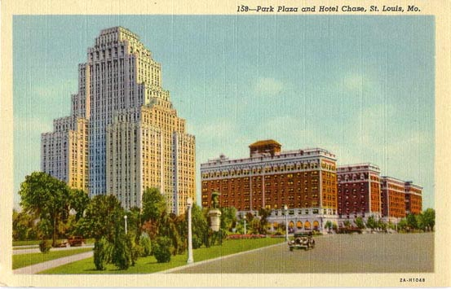

Slide 20
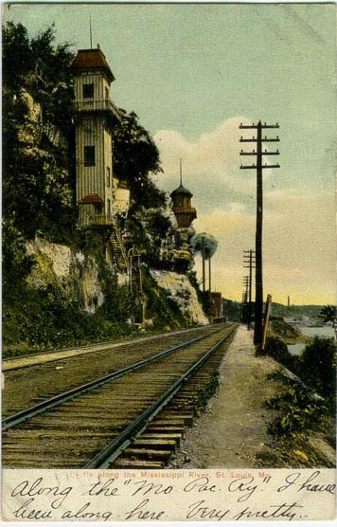
Limestone bluffs along the Missouri-Pacific Railroad

Slide 21
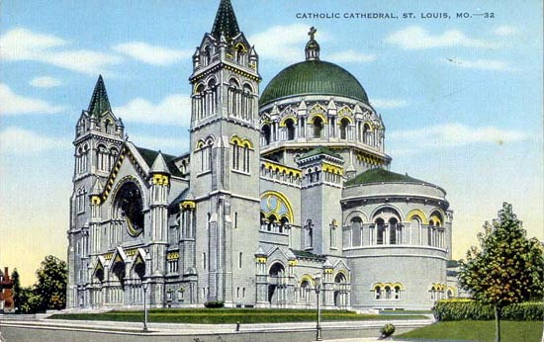

Slide 22
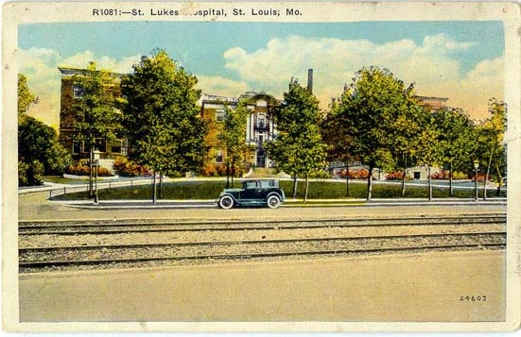
On Delmar west of Union Ave.

Slide 23
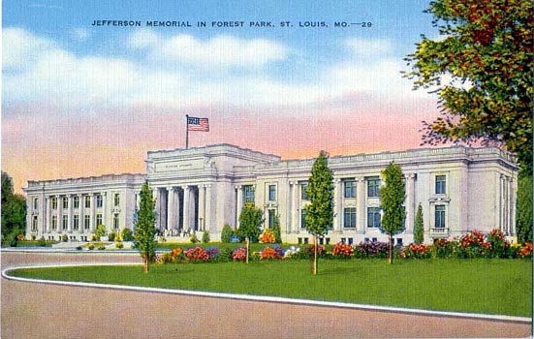

Slide 24
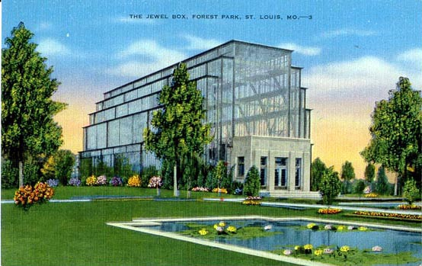

Slide 25
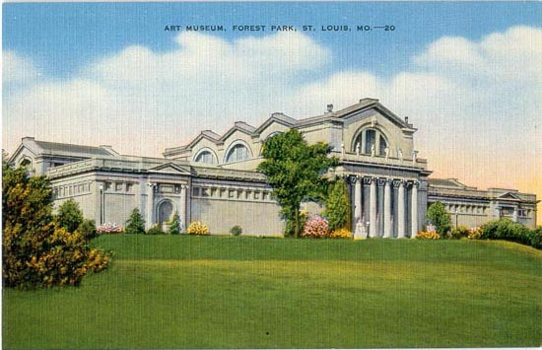

Slide 26
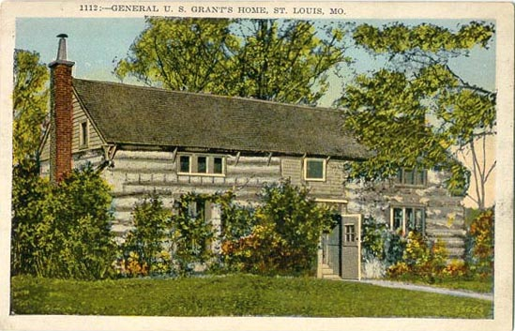

Slide 27
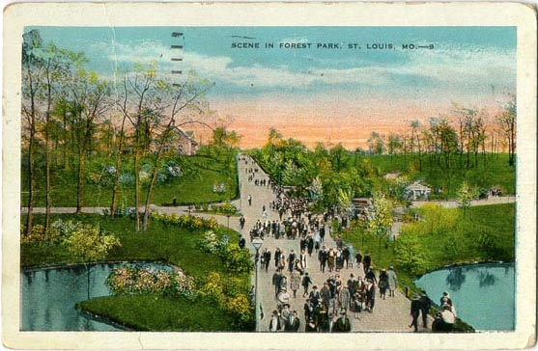

Slide 28
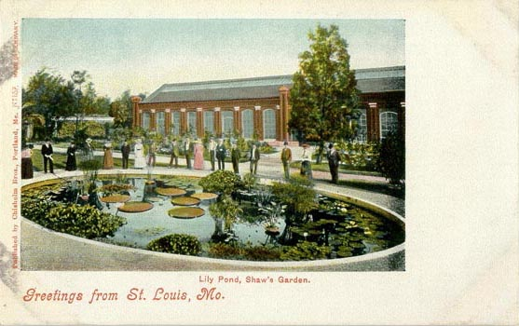

Slide 29
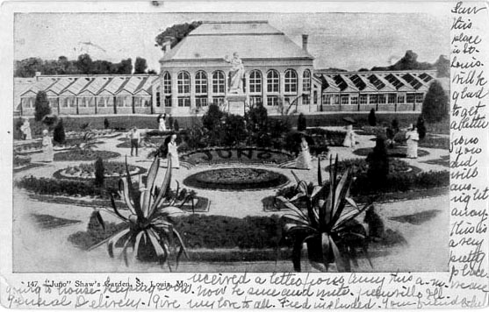
“Juno” Shaw’s Garden

Slide 30
Shaw’s Garden (Missouri Botanical Garden)
Founded in 1859, it is one of the oldest botanical institutions in the U.S. and a National Historic Landmark. It is a center for botanical research & science education of international repute, as well as an oasis in the city of St. Louis, with 79 acres of horticultural display. It includes a 14-acre Japanese strolling garden; the Climatron geodesic dome conservatory; a children's garden; a playground; a fountain area and a water locking system, somewhat similar to the locking system at the Panama Canal; an Osage camp; and Henry Shaw’s original 1850 estate home. It is adjacent to Tower Grove Park, a Shaw legacy.

Slide 31
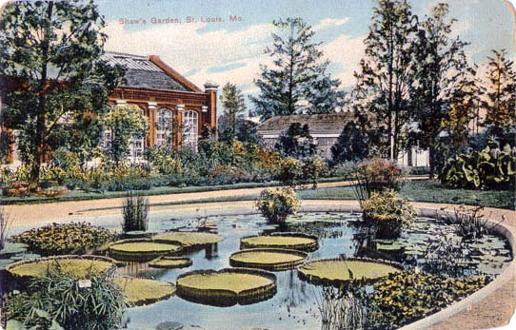
Shaw’s Garden 1909

Slide 32
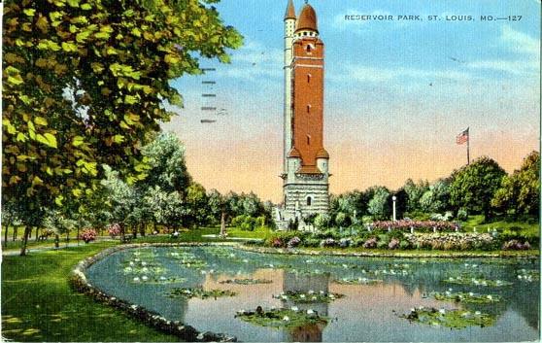

Slide 33
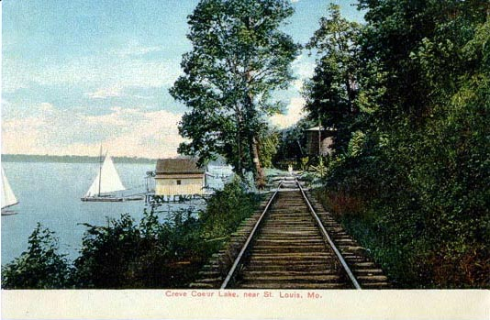
Creve Coeur Lake

Slide 34
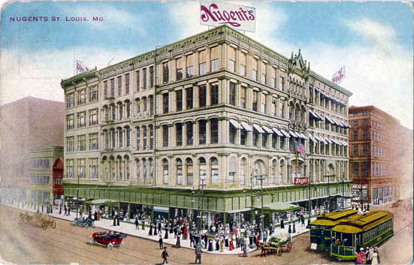
Nugents Dept. Store & Trolley Cars

Slide 35
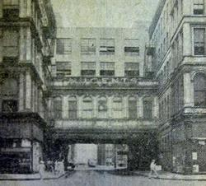
Nugents Department Store Building
Built in the mid-1850s
The department store went bankrupt during the Great Depression, though its legacy survived for years after that with its skybridge over St. Charles Ave. The bridge was removed in 1942.
Location: Washington & Broadway (downtown)

Slide 36
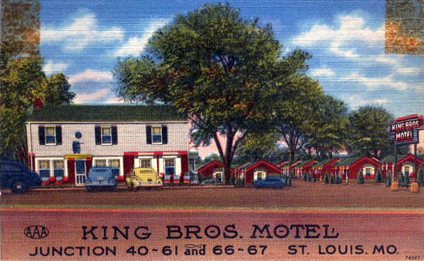

Slide 37
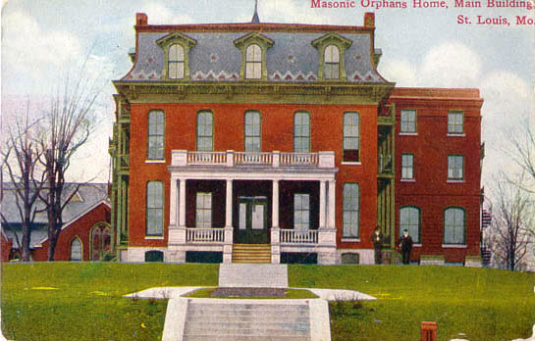

Slide 38
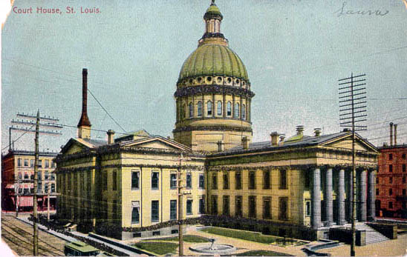
1907

Slide 39
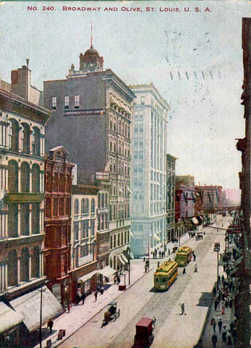
Downtown 1907

Slide 40
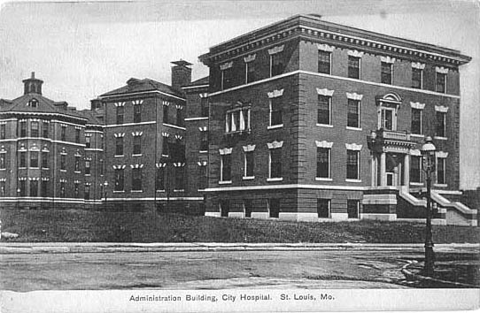
1913

Slide 41
St. Louis City Hospital
The St. Louis City Hospital was founded on July 10, 1845 to serve the indigent of a cholera-infested city. Located at the head of Soulard St., now the infamous corner of 14th St. and Lafayette Ave., the first building was partly finished by June, 1846, when patients started to move in. It didn't close until June 1985. In 2004 the developers reopened the Administration Building as condominium units. It’s ironic that City Hospital, created to serve the poor, became housing for people who could afford to buy condominiums. What a strange reversal, one that mirrors the devastating transformation of the St. Louis inner city.

Slide 42
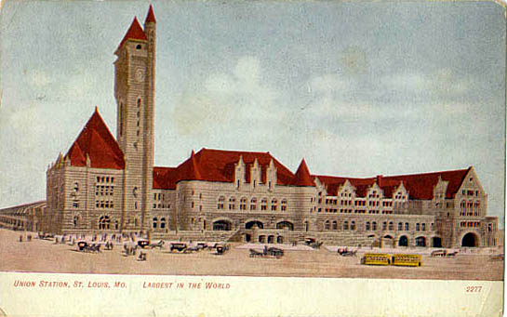
1909

Slide 43
Union Station
The station opened on September 1, 1894, and was owned by the Terminal Railroad Association of St. Louis. Designed by Theodore Link, it included three main areas: the Headhouse, the Midway and the 11.5-acre Train Shed. The headhouse originally housed a hotel, a restaurant, passenger waiting rooms and railroad ticketing offices. It featured a gold-leafed Grand Hall, Romanesque arches, a 65-foot barrel-vaulted ceiling and stained-glass windows. The clock tower is 280 feet high. At its height, the station served 22 railroads, the most of any single terminal in the world. In 1894, it was the world's largest and busiest railroad station. In the 1960s it became obsolete and too expensive to maintain. In August 1985, after a $150 million renovation, Union Station was reopened with a 539-room hotel, shopping mall, restaurants and food court.

Slide 44
Flood after 1903

Slide 45
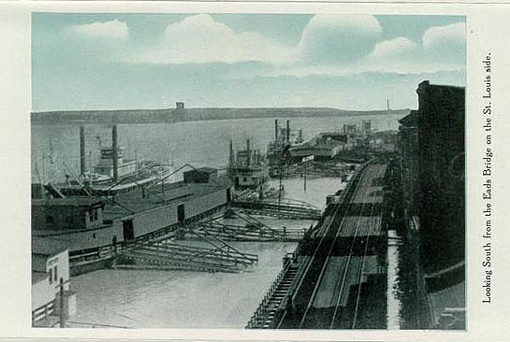

Slide 46
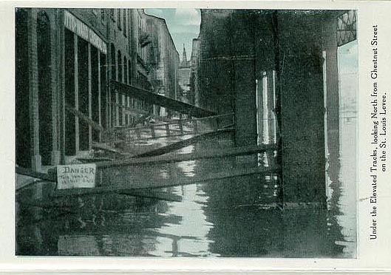

Slide 47
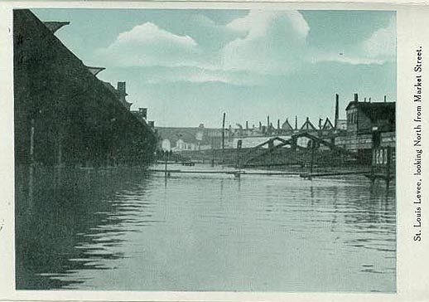

Slide 48
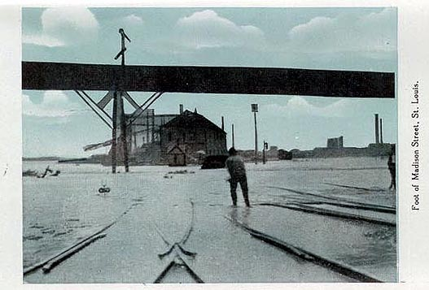

Slide 49
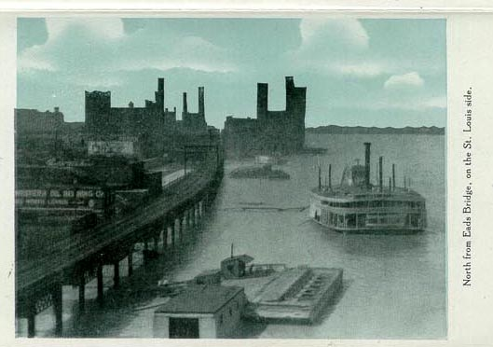

Slide 50
1904 World’s fair

Slide 51
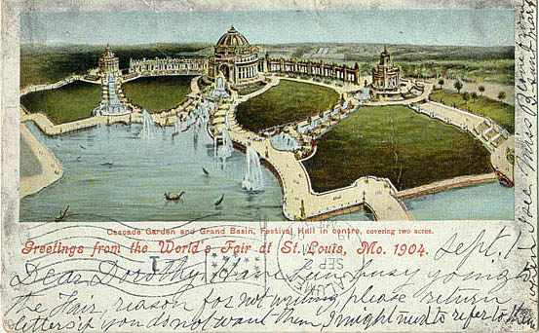

Slide 52
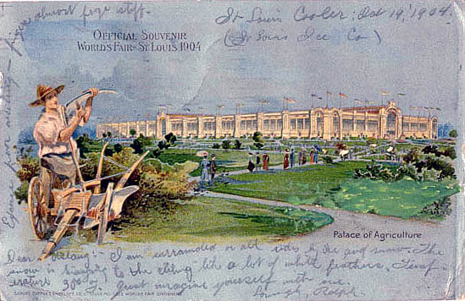

Slide 53
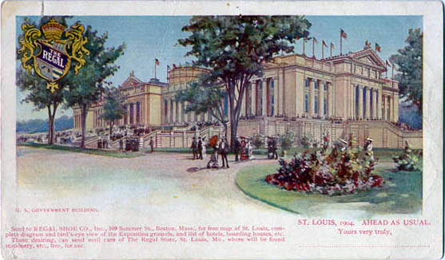
U.S. Government Building

Slide 54
East St. Louis, Illinois

Slide 55
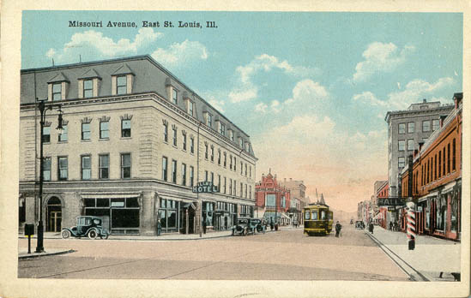

Slide 56
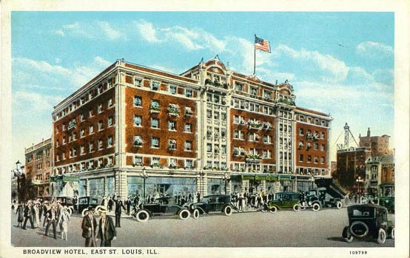

Slide 57
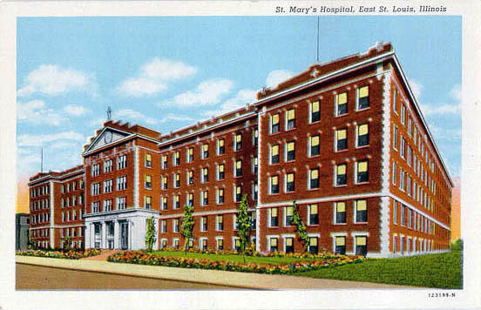

Slide 58
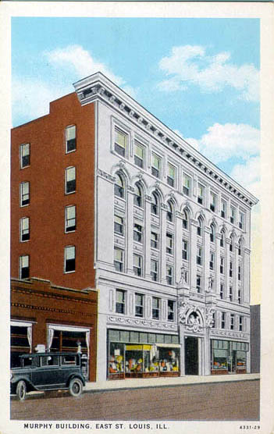

Slide 59


Slide 60


