Slide 1
Major Nor'easter Blankets East Coast in Possible Historic Snowfall
01/22/2016

Slide 2
Snow Expectations as of 12:30 p.m. Saturday - In New York City, the snowfall expectation is up to 20 to 25 inches -- which could mean a top 5 snowstorm ever in the city.
These are the top NYC snowstorms on record:
5. 20.2 inches in 1996
4. 20.9 inches in 2010
3. 21.0 inches in 1888
2. 25.8 inches in 1947
1. 26.9 inches in 2006

Slide 3
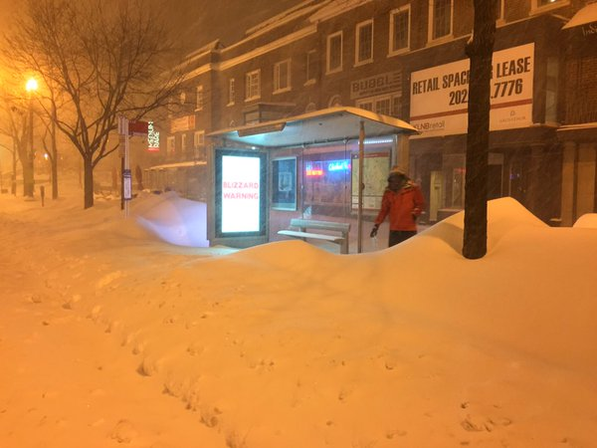

Slide 4
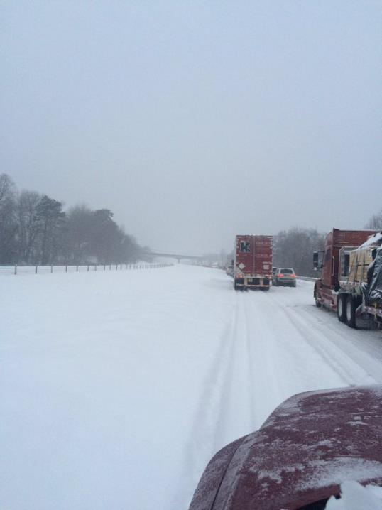

Slide 5
Snow Accumulations as of 2 p.m. Saturday – and it was still snowing heavily – won’t know the final total until the snow stops
Pennsylvania
East Coventry: 18.0 inches
Spring: 16.0 inches
Glen Mills: 17.5 inches
Norristown: 21.2 inches
Philadelphia: 17.7 inches
Maryland
Ridgeley: 26.0 inches
Jacksonville: 24.5 inches
Frederick: 32.5 inches
Philomont: 31.0 inches
Dulles International Airport: 23.5 inches
Redhouse: 38.0 inches

Slide 6
West Virginia
Jones Springs: 33.0 inches
Martinsburg: 31.9 inches
Hancock: 35.5 inches
New Jersey
Newark Airport: 16.5 in
Egg Harbor: 11.0 in.
Mount Holly: 17.0 in.
Trenton: 15.0 inches
Woodbridge: 16.0 in.
Jackson: 16.0 inches
Somerville: 17.0 in.
New York
LaGuardia Airport: 16.2 inches
Islip: 15.4 inches
Connecticut
Darien: 6.5 inches
Delaware
Dover: 12.1 inches

Slide 7
Peak Wind Gusts as of 11 a.m. Saturday
Ocean City, Maryland: 62 mph
Langley Air Force Base: 75 mph
Dewey Beach, Delaware: 75 mph
Atlantic City, N.J.: 58 mph
Tuckerton, N.J.: 68 mph

Slide 8
Power Outages as of 9:30 a.m. – there would certainly be more (probably thousands) by nightfall
New Jersey: 3,625 customers
North Carolina: 147,980 customers
Philadelphia: 59 customers
Virginia: 3,176 customers
Maryland: 4,586 customers

Slide 9
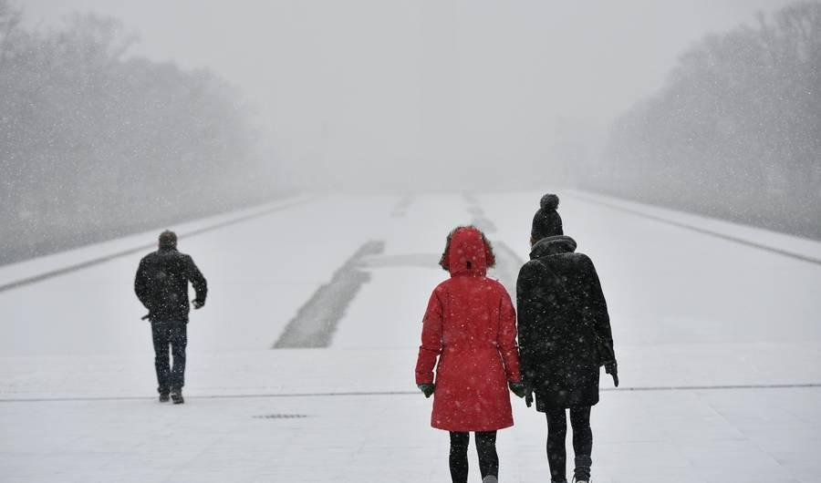

Slide 10
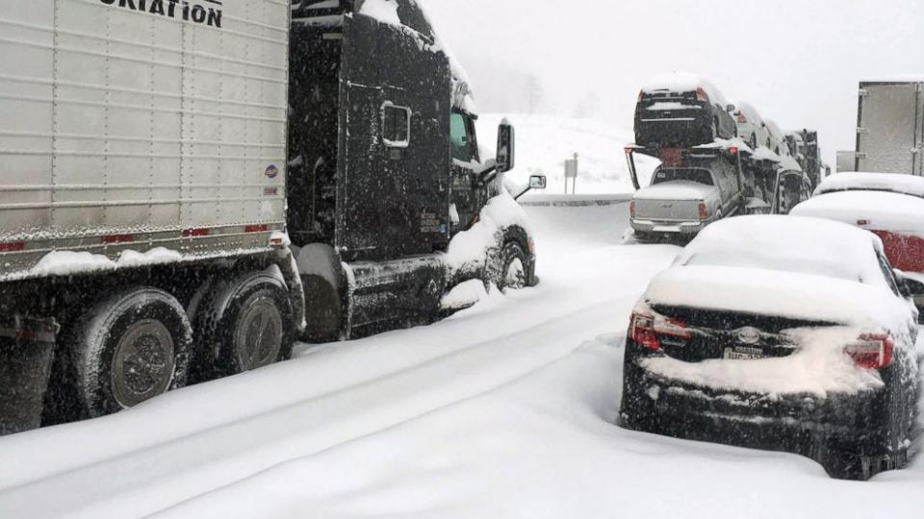

Slide 11
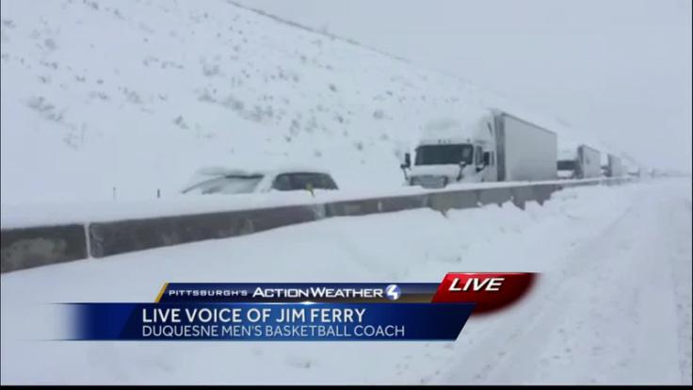

Slide 12
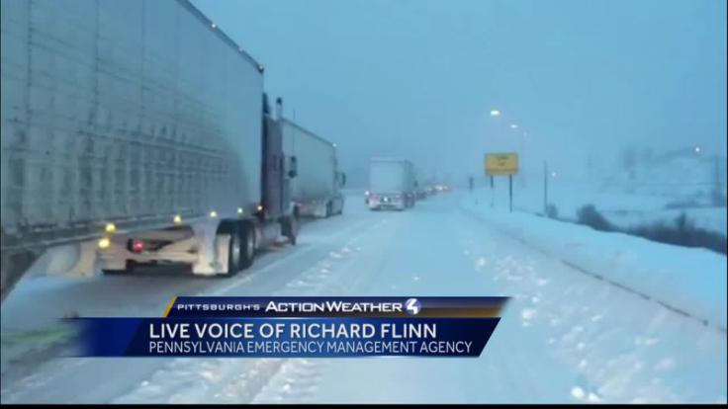

Slide 13
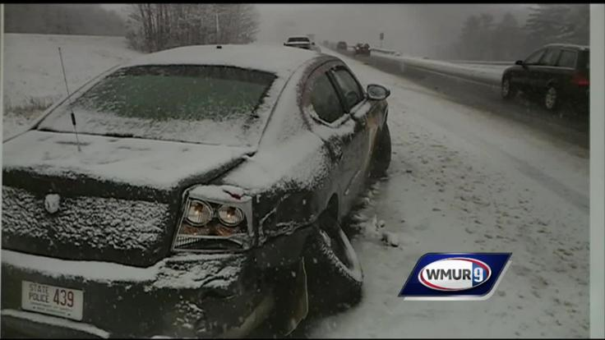

Slide 14
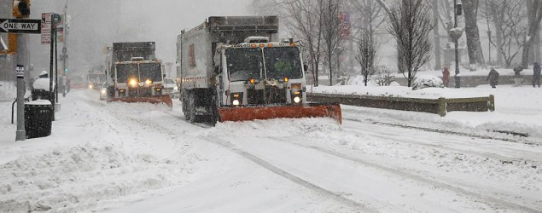

Slide 15
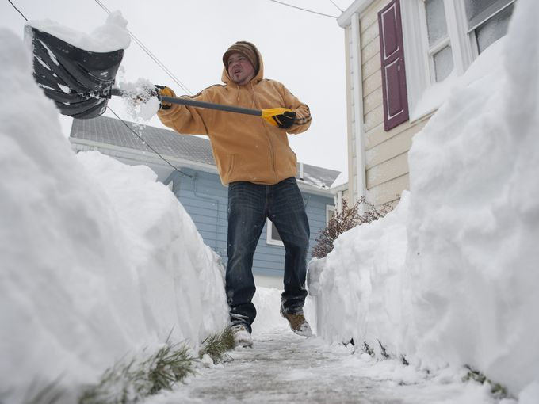

Slide 16
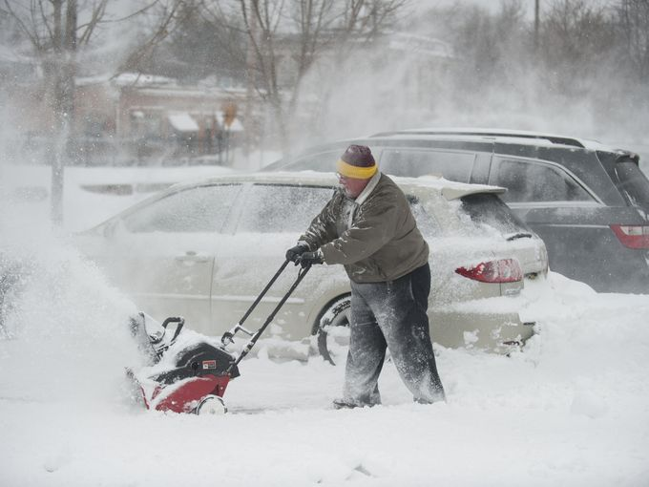

Slide 17
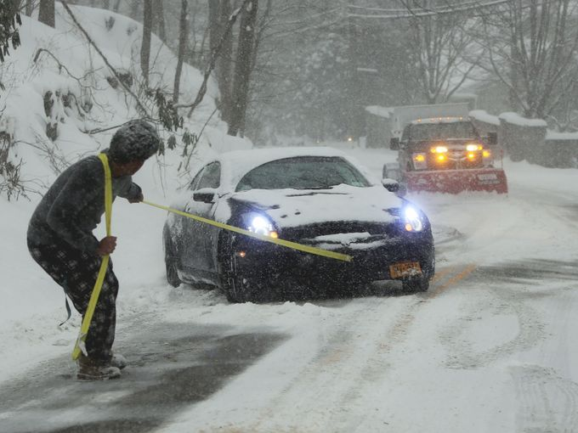

Slide 18
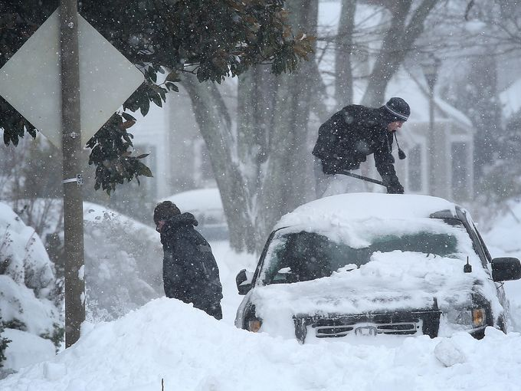

Slide 19
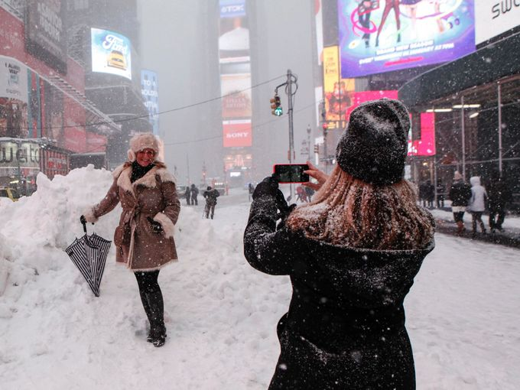

Slide 20
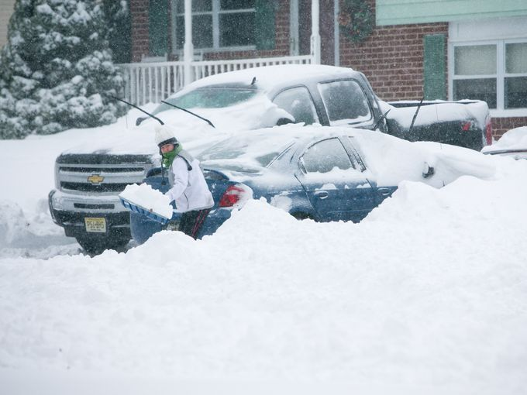

Slide 21
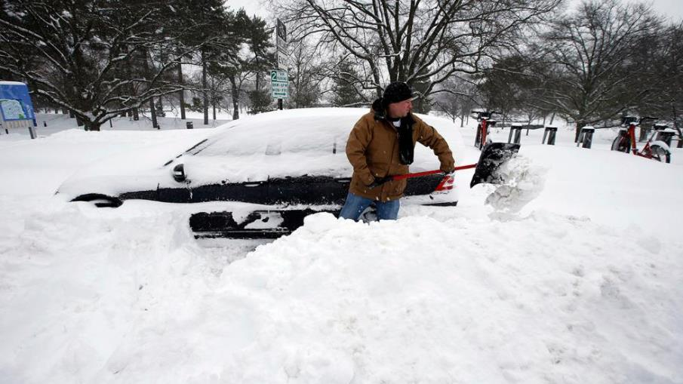

Slide 22
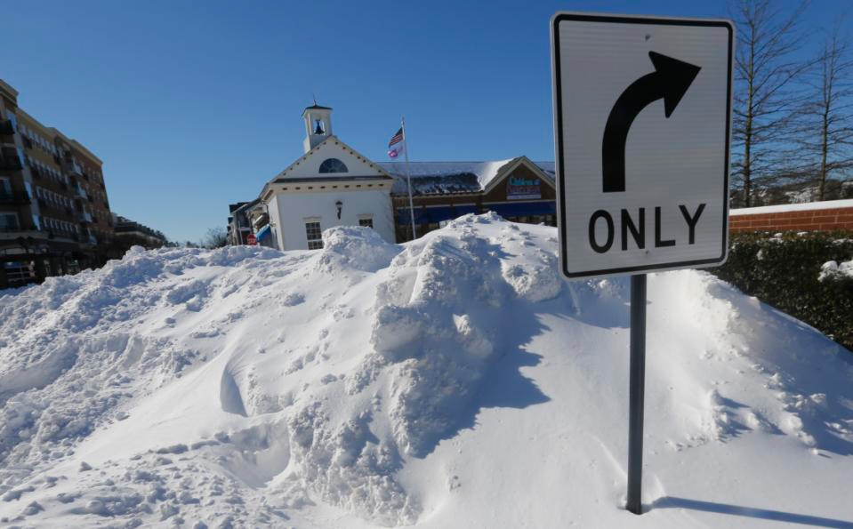
Richmond, Virginia

Slide 23
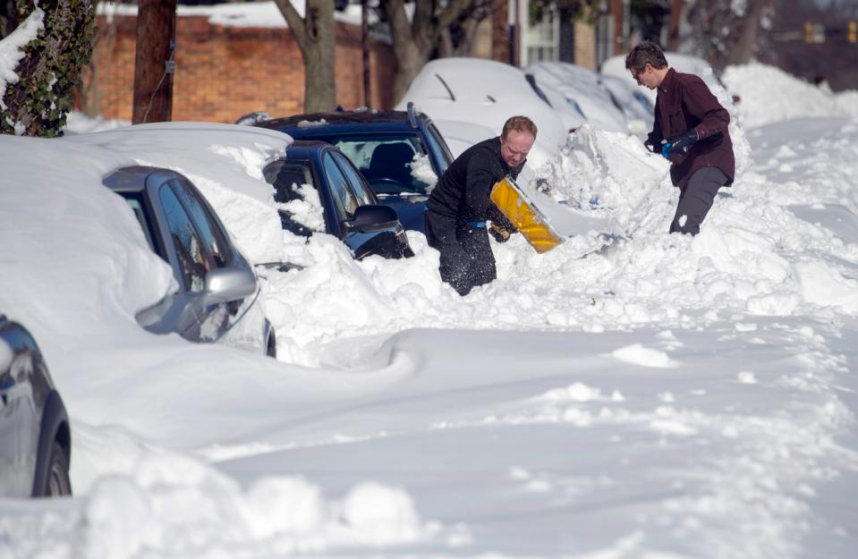
Alexandria, Virginia

Slide 24

Atlantic City Boardwalk

Slide 25
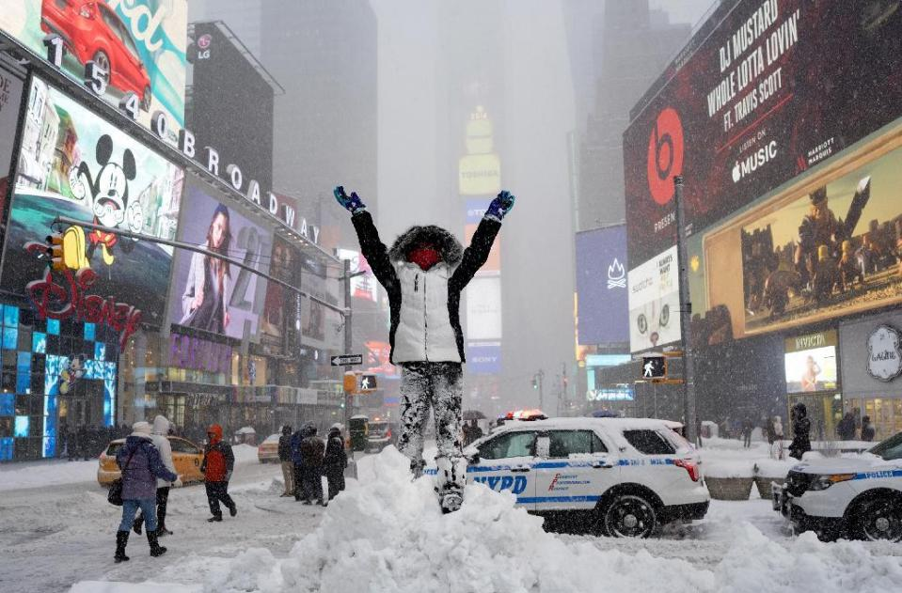
Times Square, NY

Slide 26
Final Report
The deepest snowfall from the blizzard paralyzing the U.S. East Coast has been recorded at 40 inches (102 cm) in Glengary, West Virginia, the National Weather Service said.

Slide 27
What about global warming?
Global warming is causing climate change where there will be greater extremes in temperature and precipitation and storms
Warmer ocean water plus warmer air =
More moisture evaporates into the air =
Higher humidity and more precipitation in some places
Look back at New York’s 5 heaviest snows
3 out of 5 have been since 1947
The current storm is expected to make the top five and then it will be 4 out of 5.

Slide 28
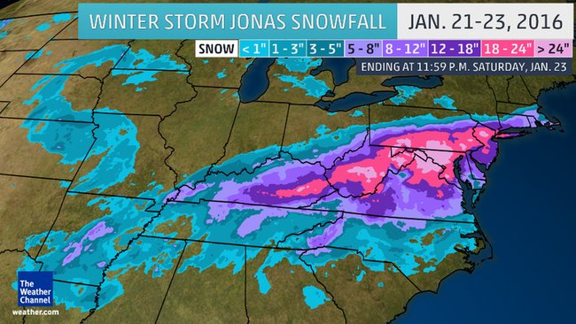
Snow totals

Slide 29
top snow and ice totals by state as of 2:14 a.m. Sunday,
West Virginia: 40 inches of snow in Glengary, in the eastern panhandle of West Virginia.
Virginia: 39 inches in Philomont, about 25 miles northwest of Washington, D.C.
Maryland: 38 inches in Redhouse, in western Maryland. Redhouse is 150 miles west of Baltimore.
New York: 30.5 inches at JFK Airport in New York City.
Pennsylvania: 35.5 inches at Somerset, about 25 miles southwest of Altoona.
New Jersey: 29.6 inches at Whitehouse, in Readington Township in the northern part of the state.
Connecticut: 16 inches at Greenwich, near the New York border in far southwestern Connecticut.
Delaware: 15.5 inches at Woodside in Kent County.
Rhode Island: 15.5 inches at Westerly, in the southwestern corner of the state.
Massachusetts: 14.5 inches at West Harwich on Cape Cod.

Slide 30
Heavy snow fall and high winds
The east coast is bracing for flooding
High winds plus high tides (full moon) mean higher storm surges along the coast
Snow melt will also increase river and stream levels

Slide 31
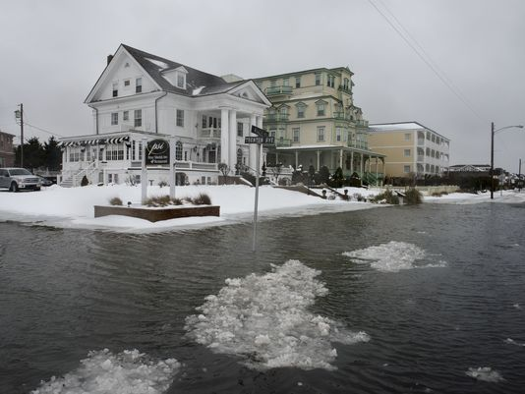

Slide 32
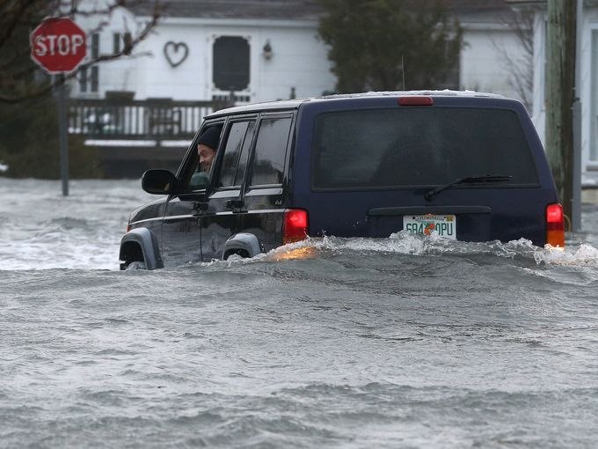

Slide 33
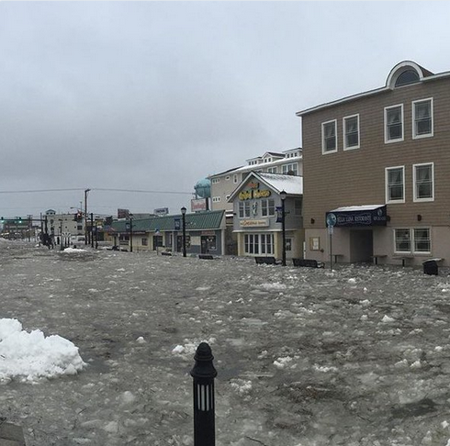

Slide 34


Slide 35
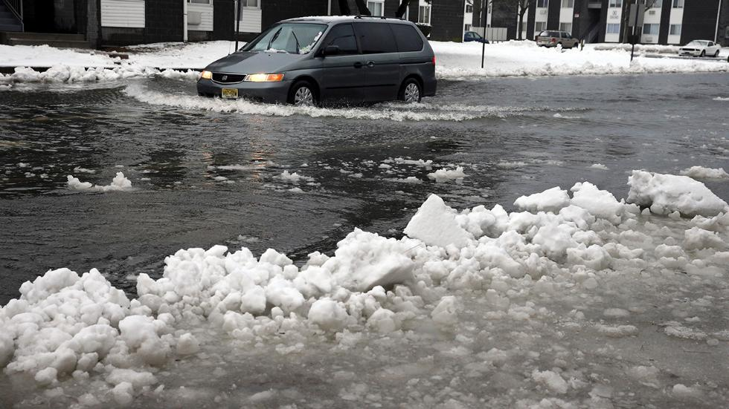

Slide 36
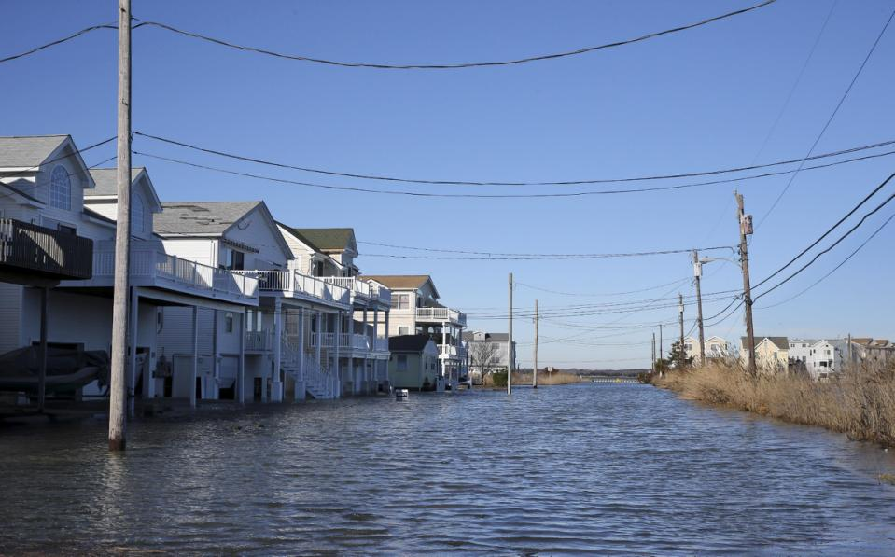
Sea Isle City, N.J.

Slide 37
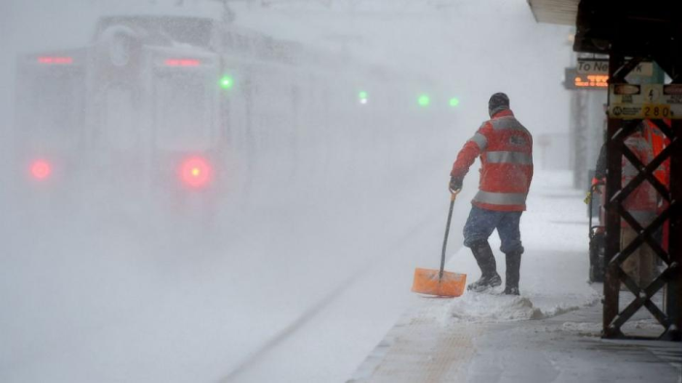
Digging out or cleaning up

Slide 38
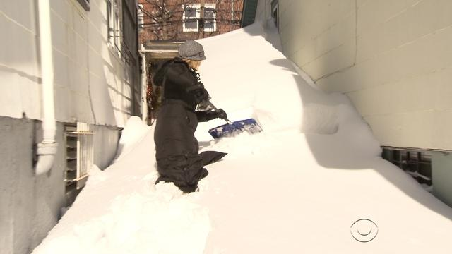

Slide 39
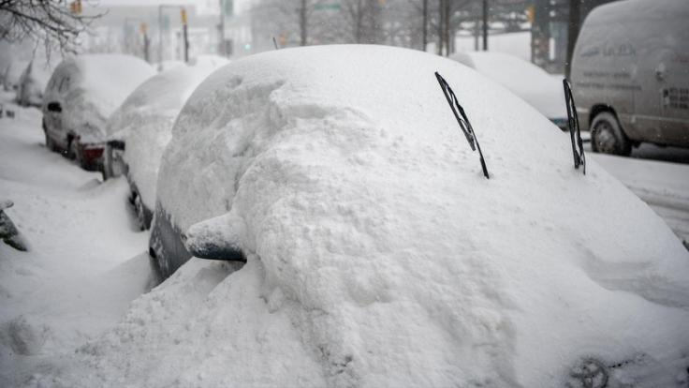

Slide 40


Slide 41
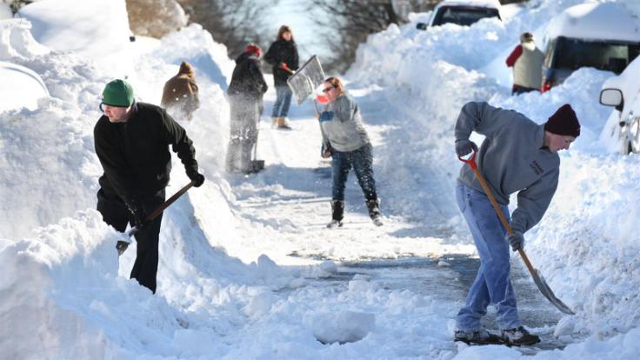

Slide 42
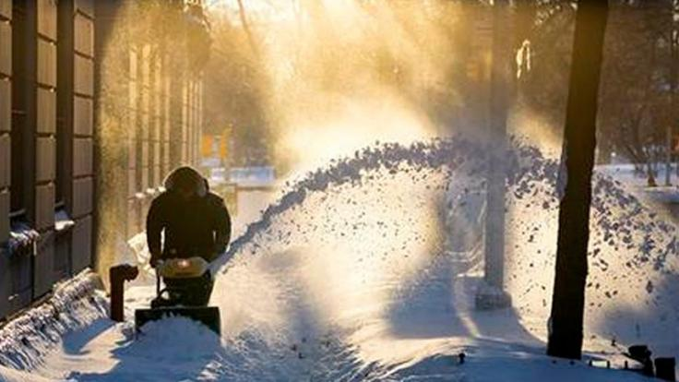

Slide 43
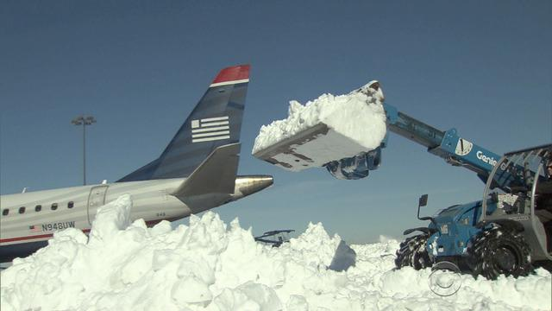

Slide 44
