Slide 1
What The World's Greatest Cities Will Look Like if We Do Nothing About Climate Change

Slide 2
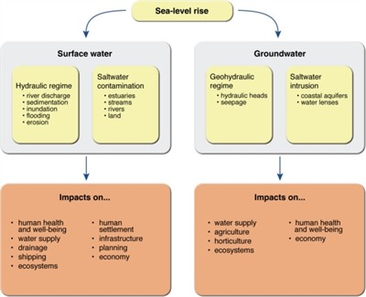

Slide 3
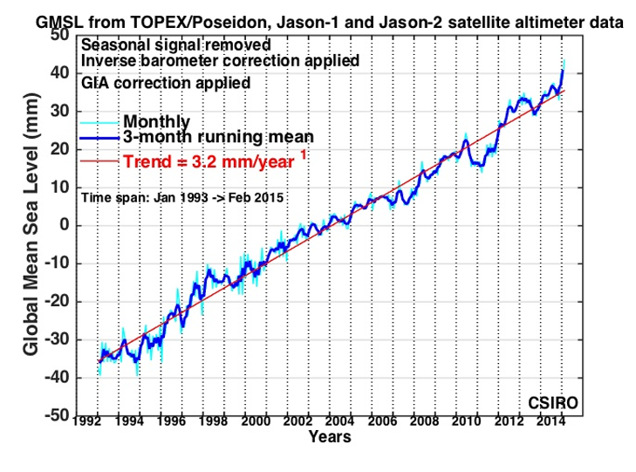

Slide 4
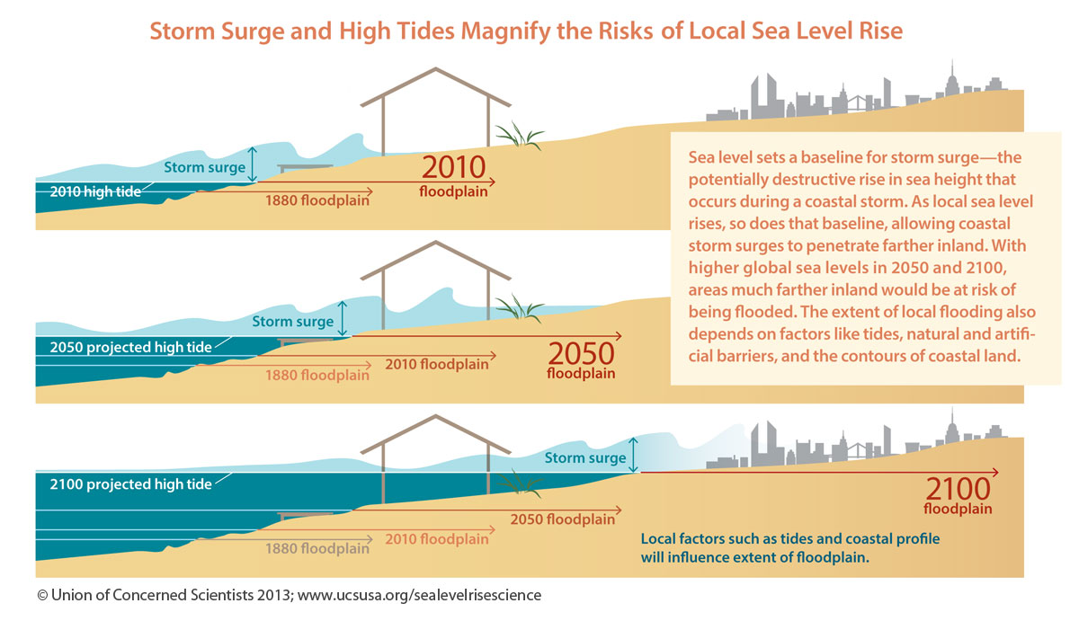

Slide 5
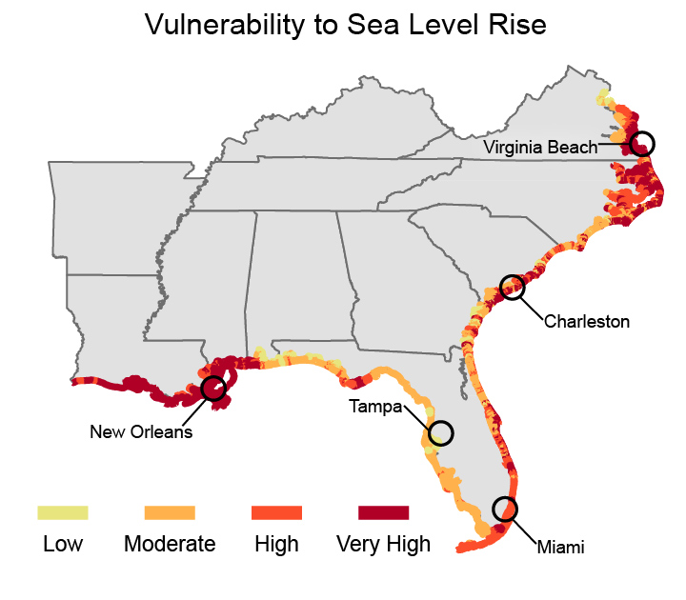

Slide 6
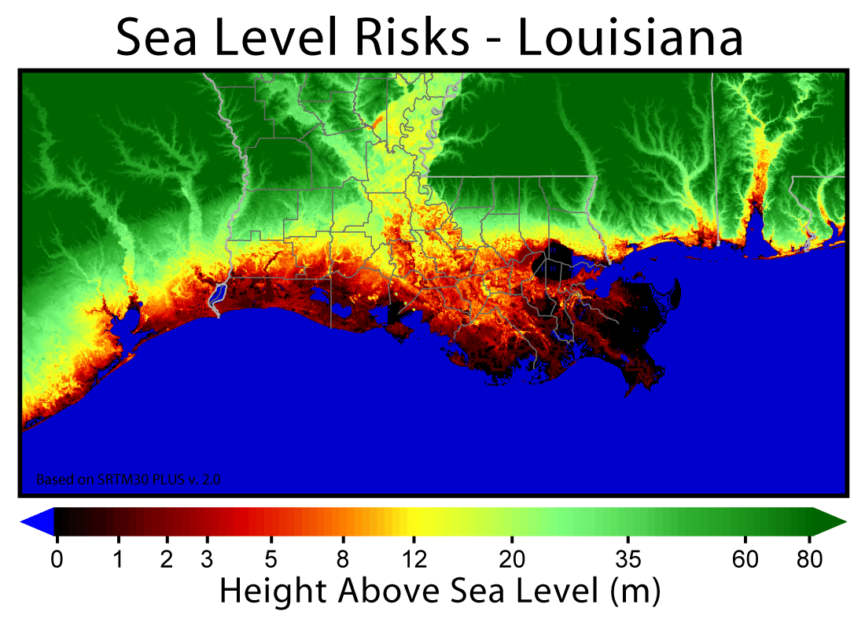

Slide 7
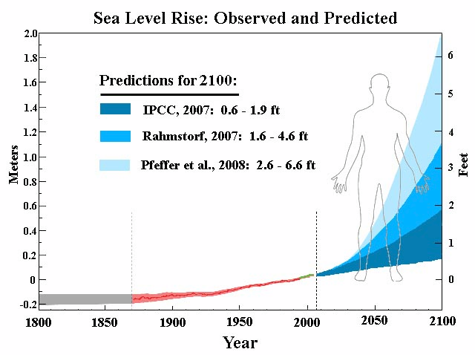

Slide 8
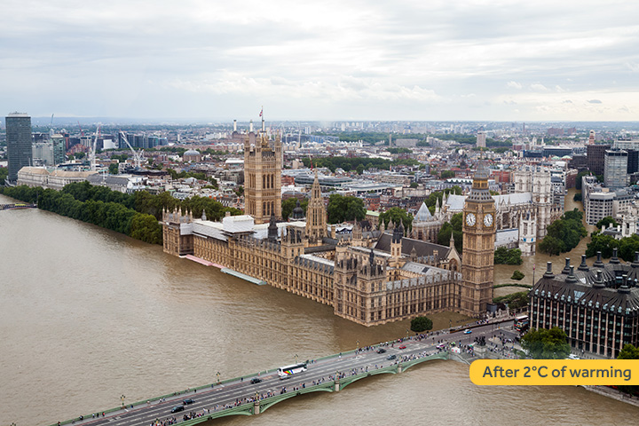
LONDON

Slide 9
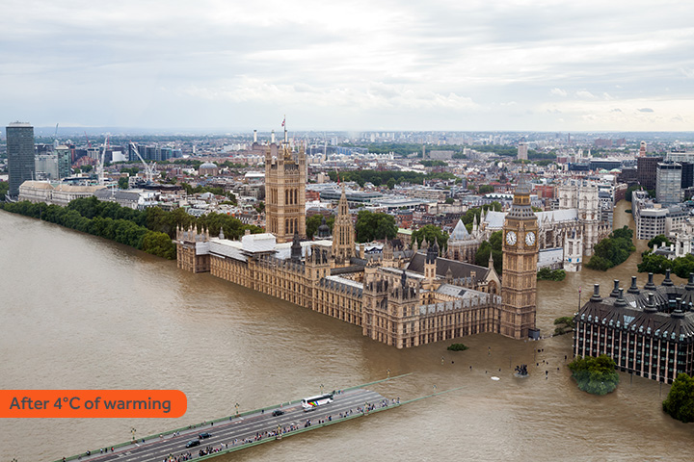

Slide 10
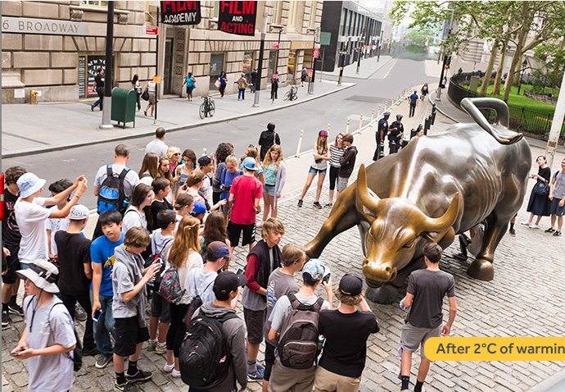
NEW YORK CITY

Slide 11
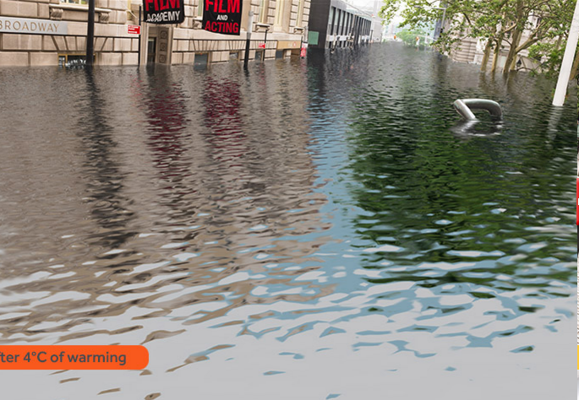

Slide 12
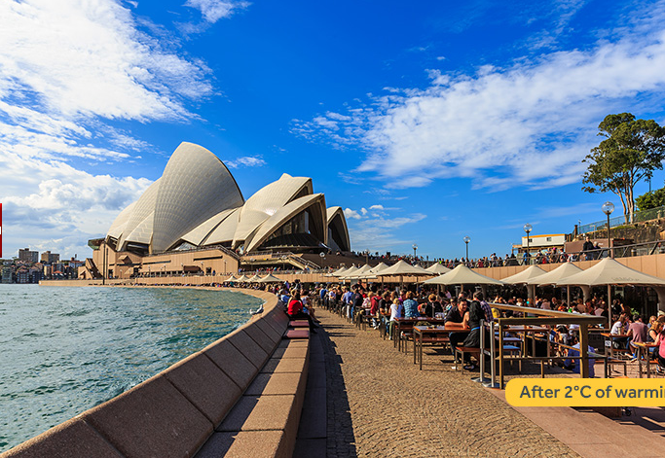
SYDNEY

Slide 13
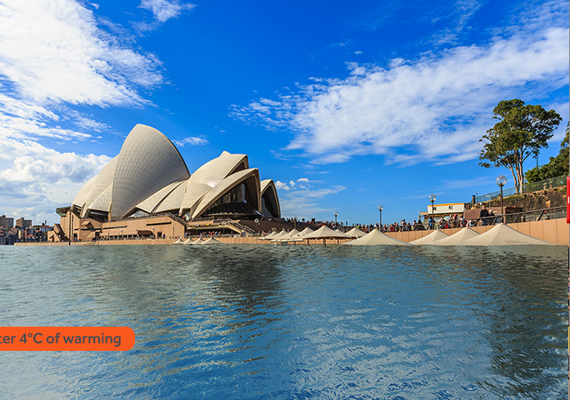

Slide 14
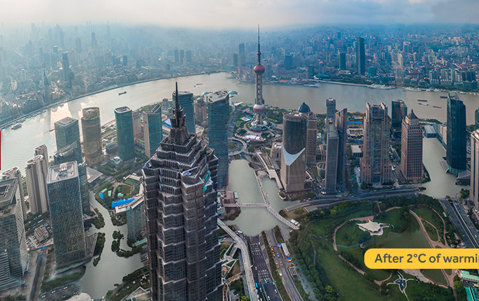
SHANGHAI

Slide 15
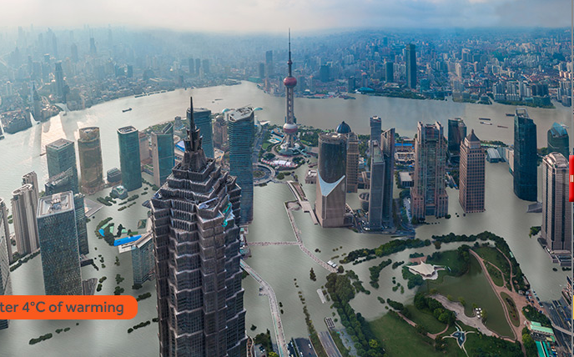

Slide 16
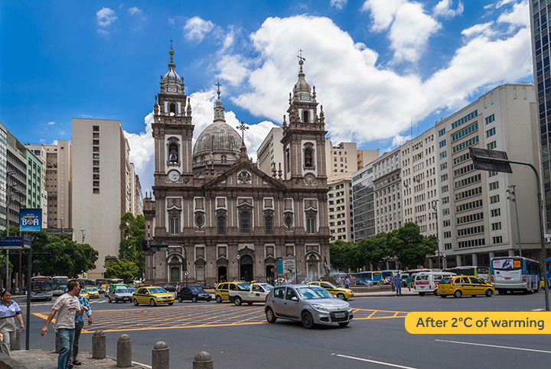
RIO

Slide 17
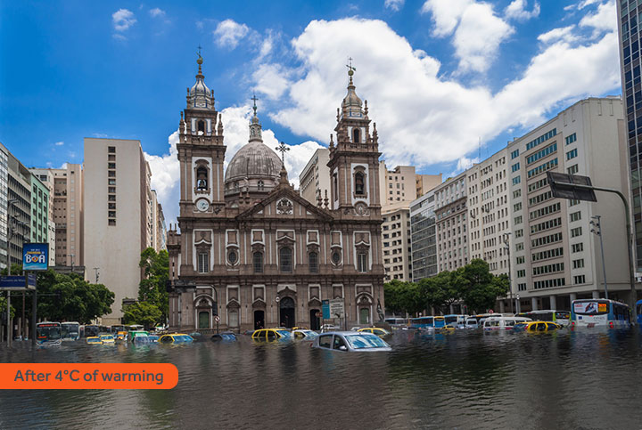

Slide 18
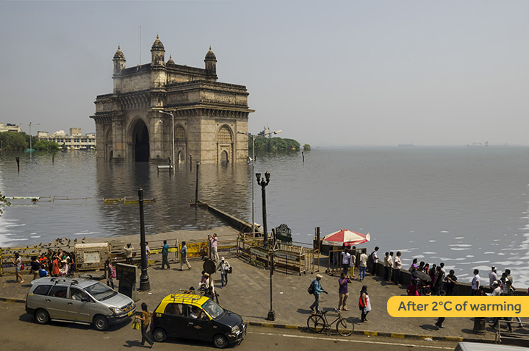
MUMBAI

Slide 19
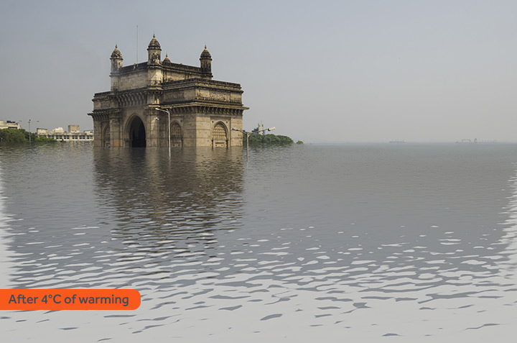

Slide 20
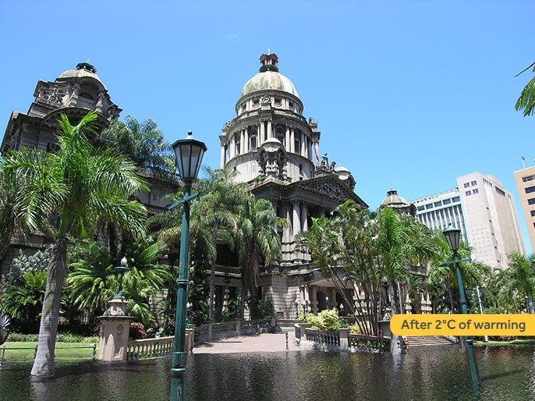
DURBAN

Slide 21
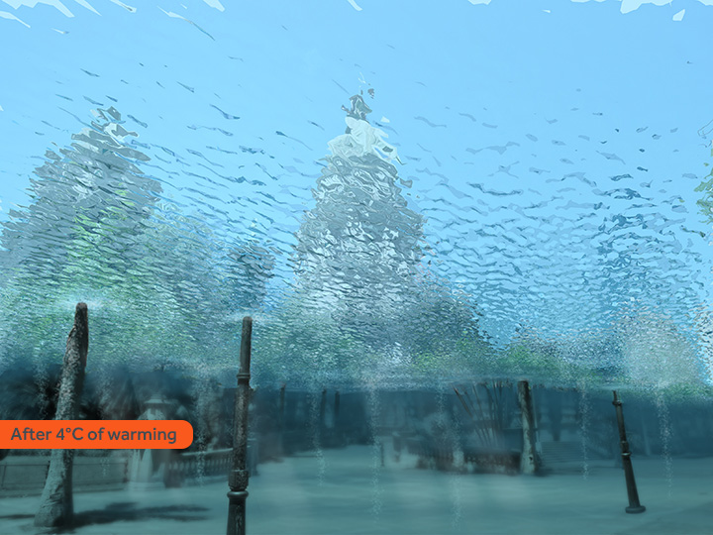

Slide 22
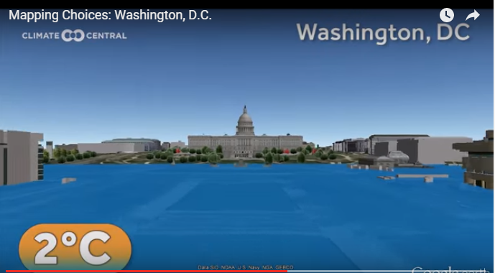

Slide 23
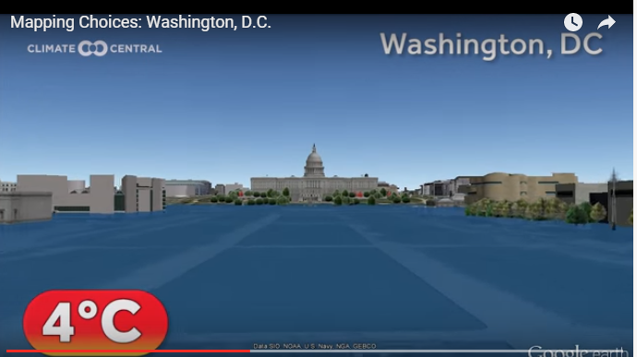

Slide 24
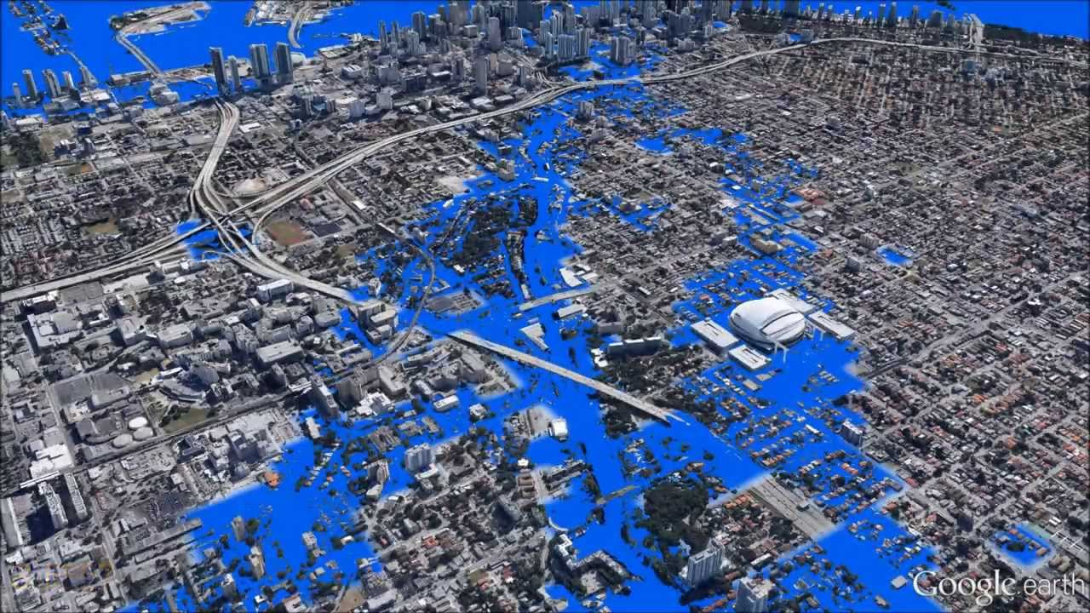
Threat to Miami

Slide 25
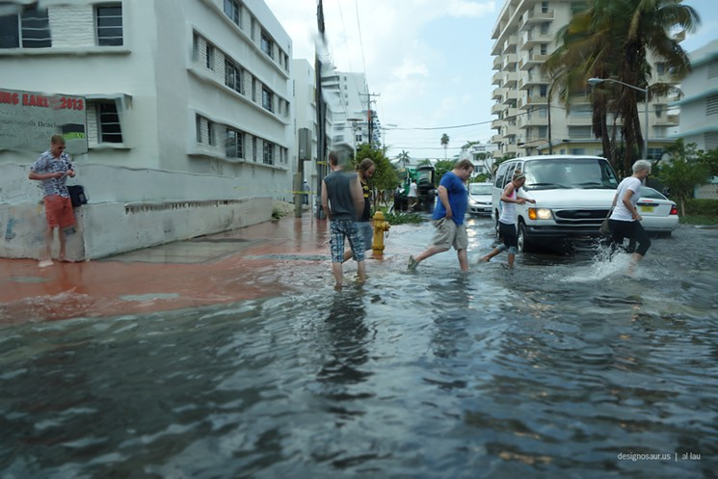
Miami already has problems with storm surges.

Slide 26
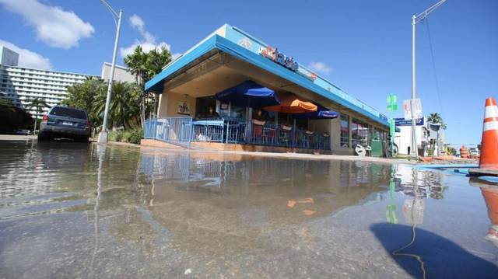
Miami Beach routinely floods during high tides.

Slide 27
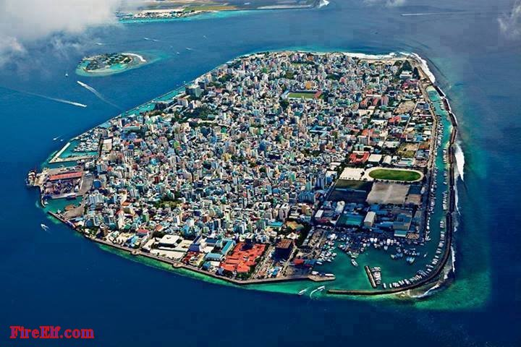
Malé Is The Capital And Most Populous City In The Republic Of Maldives. It wouldn’t take too great of a rise in sea level to flood every building on the island/city. They are experiencing problems already.

Slide 28
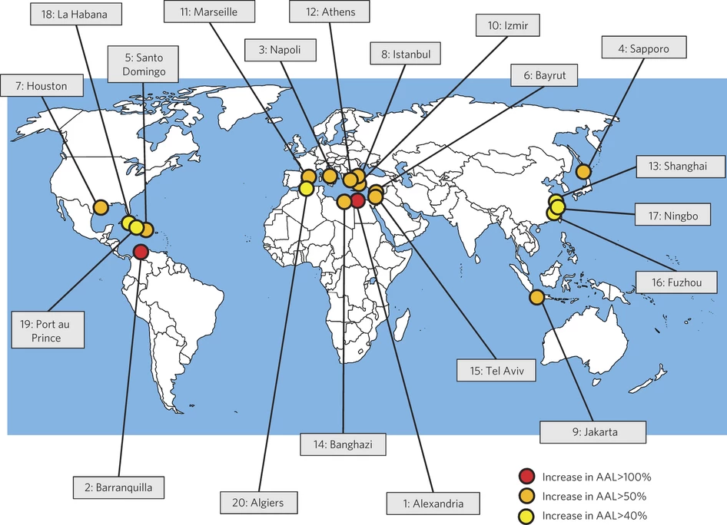

Slide 29
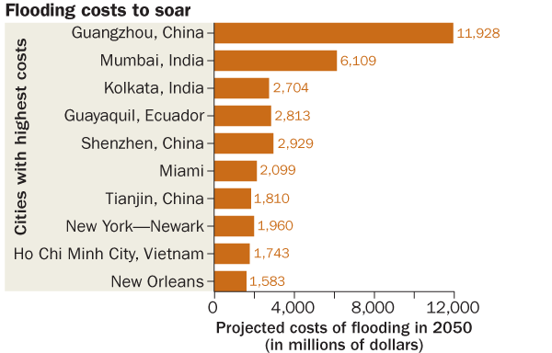
20 cities with the most to lose
I wonder why Venice, Italy isn’t on the list????????

Slide 30
What would you rather do?
Make the effort and spend the money needed to try to keep temperatures from rising above 2 decrees C.
Make no effort and save the money and wait to see what happens?

