Slide 1
The Changing Climate
A natural process? Yes!
Exacerbated by human actions? Yes!

Slide 2
Causation?
Increase in “greenhouse gases” in the atmosphere, producing global warming.
Global warming and its effects:
More extreme weather conditions
Colder winters with more snow possible
Hotter summers with more droughts and forest fires
Increasing violent storms – more violent and more frequent
Rising sea levels and flooding of coastal lands
Melting polar continental glaciers
Agriculture and health
Longer growing seasons at higher latitudes and altitudes
Expansion of some desert areas

Slide 3
Consequences of climate change on habitats
Some vegetation will “migrate” as the zone of ideal conditions shifts (changes in latitude & altitude)
Animal will have to adjust to changed conditions or relocate where the conditions that favor them have moved.
Already observable changes:
The range of the Tsetse fly (carrier of sleeping sickness which affects livestock and humans) has extended to higher elevations in East Africa.
Most polar bear used to hibernate in dens on the polar ice. Now many more are hibernating in dens on land because the area of polar ice has been greatly reduced in area. More bears on land means greater chances of bear and human interaction in the spring when the bears emerge with their new cubs.

Slide 4
Here are some conditions related to climate change

Slide 5
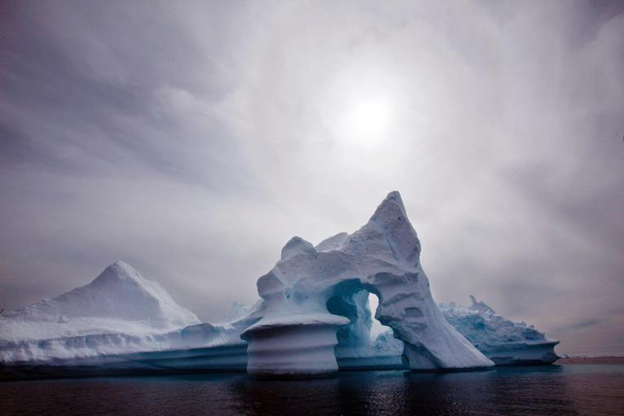
Glacial melting increased: An iceberg melts off Ammassalik Island in Eastern Greenland in 2007.

Slide 6
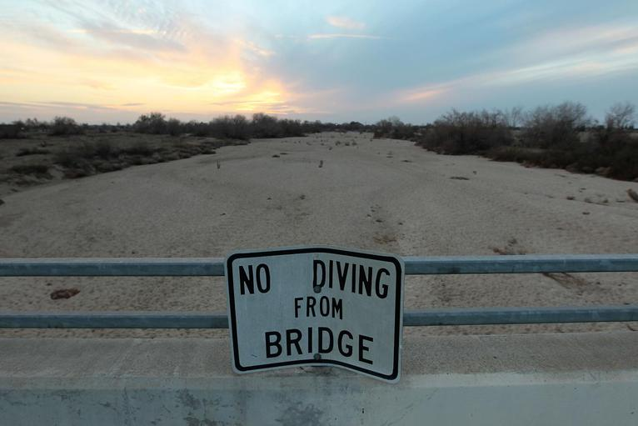
A sign from wetter times warns people not to dive from a bridge over the Kern River, which has been dried up by water diversion projects and little rain, in Bakersfield, California in 2014.

Slide 7
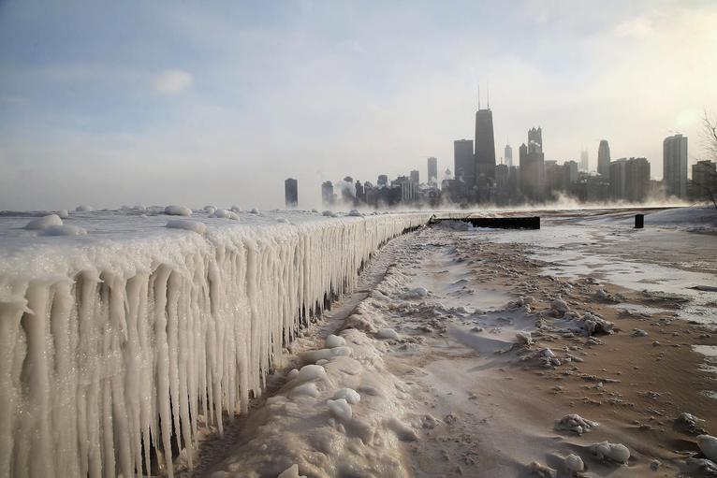
Extremes: Ice built up along Lake Michigan in Chicago as some of the coldest temperatures in two decades hit the city in 2014.

Slide 8
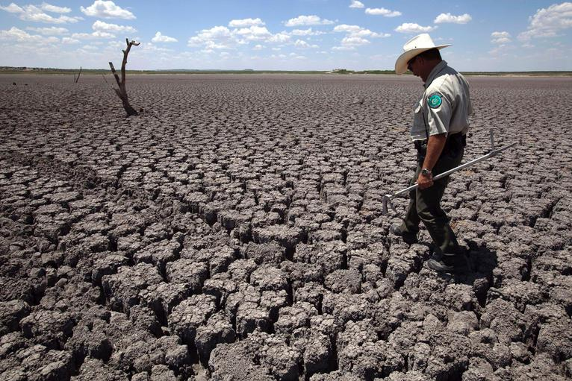
The cracked lake bed of O.C. Fisher Lake in San Angelo, Texas in 2011. A combination of the long periods of 100-plus degree days and the lack of rain in the drought-stricken region has dried up the lake that once spanned over 5400 acres

Slide 9
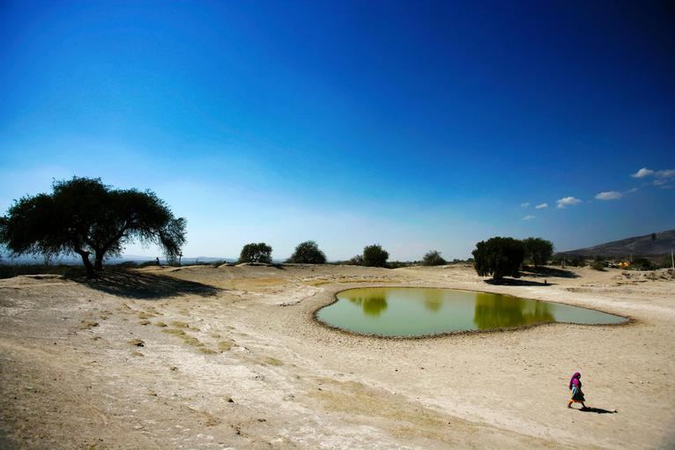
A Mexican woman skirts a water hole, near San Marcos Tlacoyalco, Mexico in 2006. Mexico City has long experienced severe water shortages which have been exacerbated by drought.

Slide 10
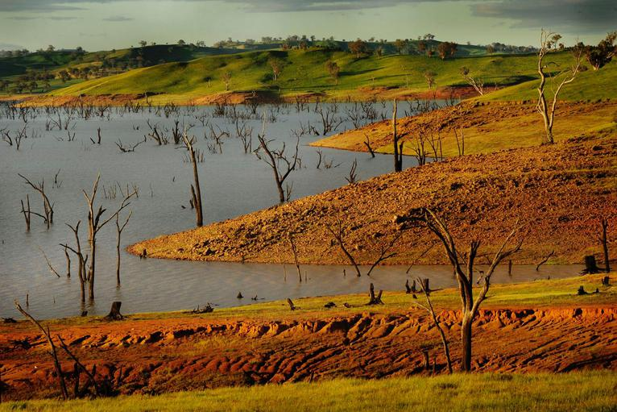
Eucalyptus tree trunks, once covered by lake waters, dot the lakebed in Lake Hume in New South Wales, Australia in 2009. Research shows that climate change intensifies both drought and heat.

Slide 11
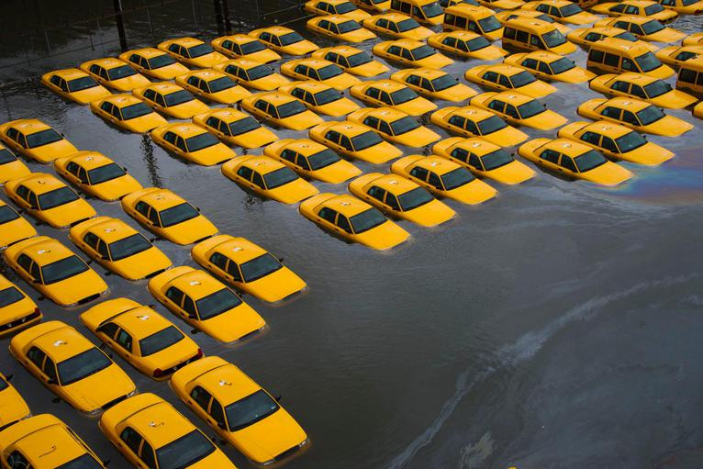
Super-storm induced sea surge: A parking lot full of yellow cabs is flooded as a result of Superstorm Sandy in Hoboken, New Jersey in 2012

Slide 12
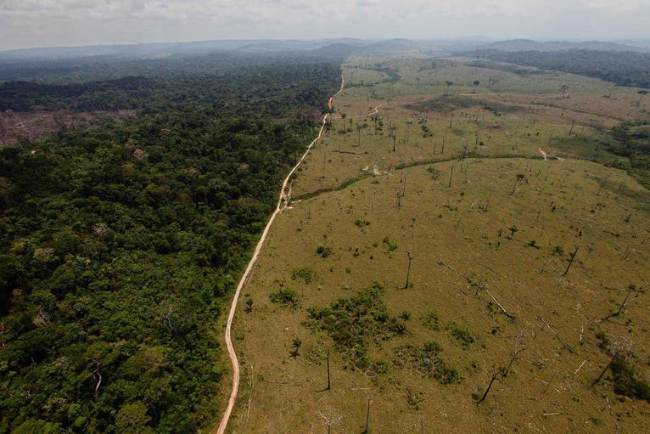
Human-created habitat change: In this 2009 photo, a deforested area is seen near Novo Progresso in Brazil's northern state of Para

Slide 13
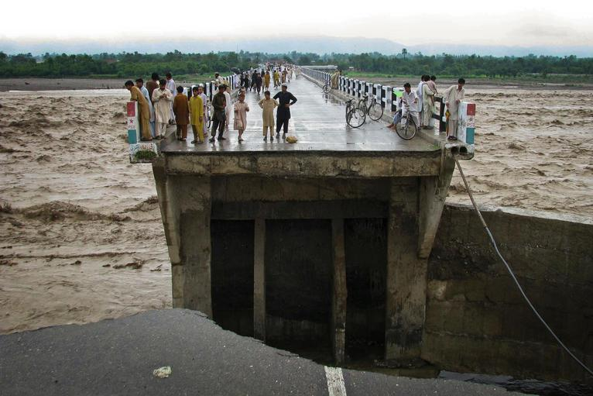
Greater extremes: The remnants of a bridge washed away by heavy flooding in Bannu in northwest Pakistan, in 2010.

Slide 14
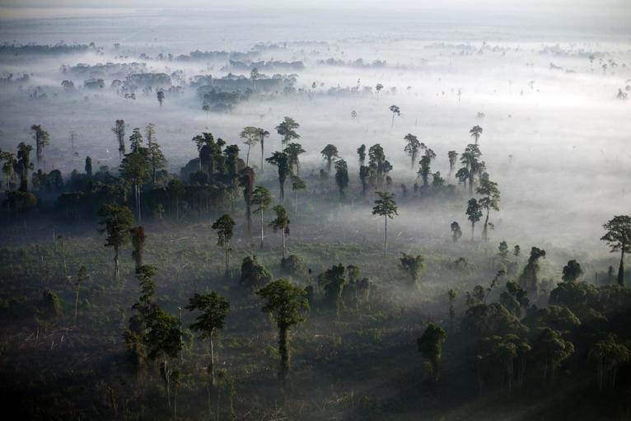
Fires burn virgin rainforests to make way for oil palm trees. Deforestation is a major source of carbon dioxide emissions across the world.

Slide 15
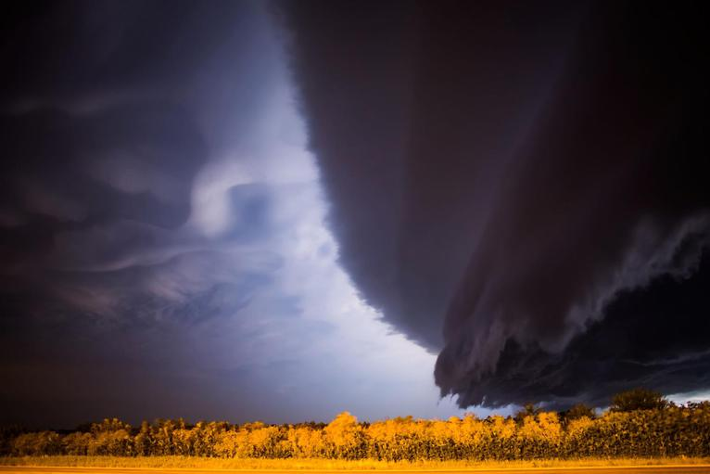
A supercell storm sweeps across Nebraska in 2015. Scientists expect climate change to increase the frequency of extreme weather events.

Slide 16
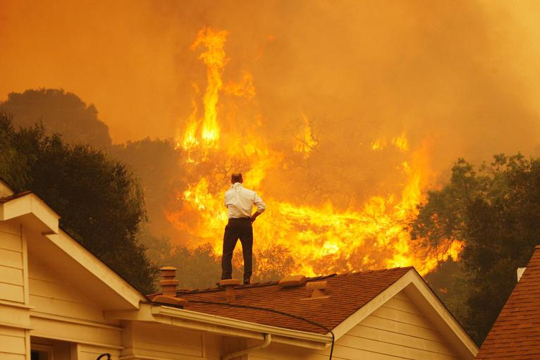
A man on a rooftop looks at approaching flames from the 2013 wildfire near Camarillo, California. Since 1983, there have been an average of 72,000 wildfires per year in the United States.

Slide 17
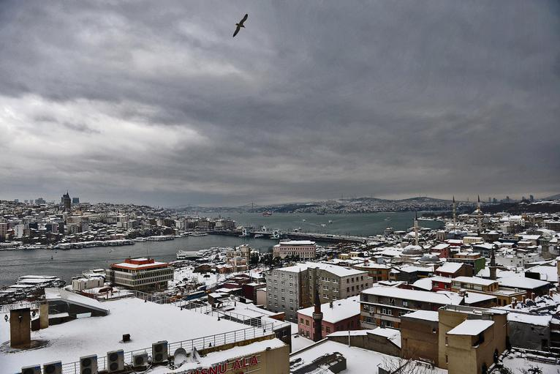
Snow-covered rooftops in Istanbul in 2015, after a heavy storm broke a 28-year snowfall record.

Slide 18
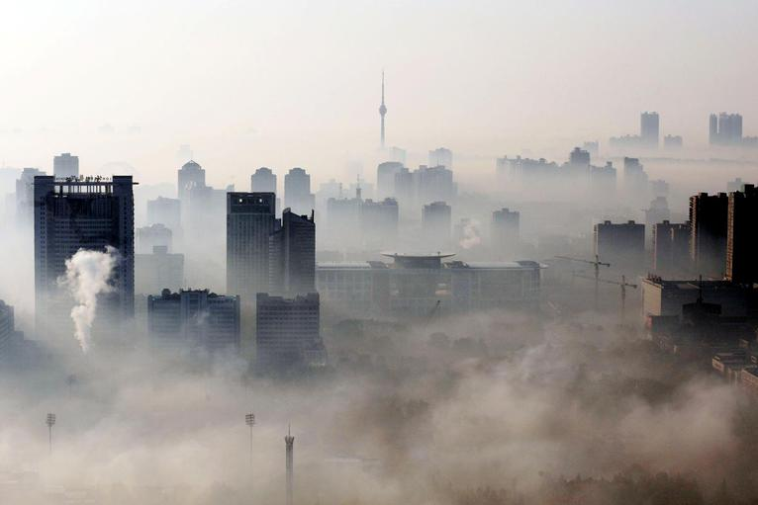
An aerial view of buildings amid haze in Wuhan, central China's Hubei province in 2009. In 2011, China was responsible for 28 percent of the world's carbon dioxide emissions from fossil fuel combustion, cement manufacturing and gas flaring.

Slide 19
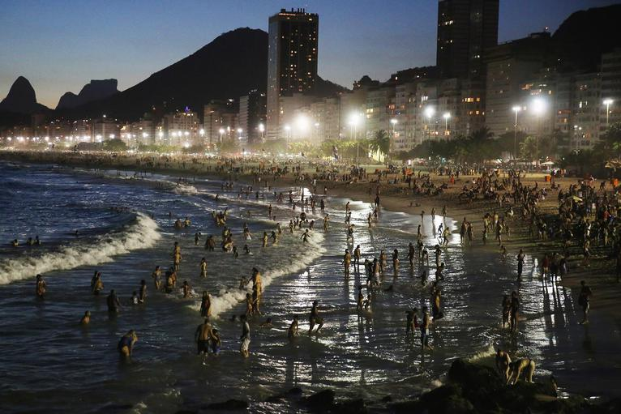
People gather on Copacabana beach in Rio de Janeiro, Brazil in 2015. Brazilians normally don't bathe at nightfall in Rio but the summer heat wave allowed people to enjoy the ocean at night. U.S. government scientists reported that 2014 was the hottest year on record.

Slide 20
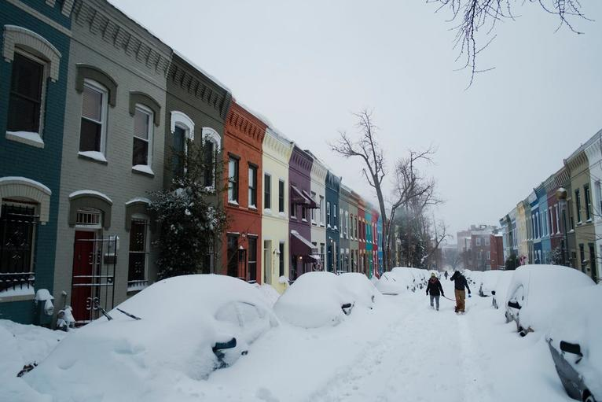
Northwest Washington D.C. during Winter Storm Jonas in January 2016

Slide 21
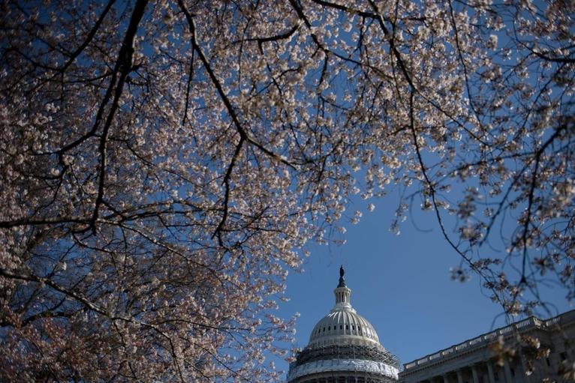
Blossoms near the U.S. Capitol on March 18, 2016 (a little early).

