Slide 1
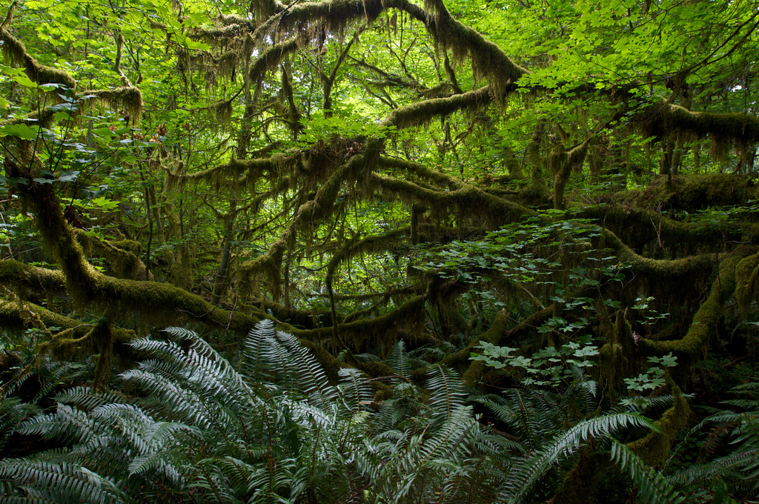
Climate Change

Slide 2
Some are finally waking up . . .
At least 20 years ago, I read an article by a meteorologist/climatologist who was explaining that global warming wasn’t just going to make things a little bit warmer. He was saying that the effects would be:
  Greater extremes in weather conditions (hotter and colder than normal and wetter and drier than normal)
  Less predictability of meteorological conditions
Anyone who has followed the news for the past 20 years will probably agree that he knew what he was talking about 20 years ago when few people were paying attention to people like him.

Slide 3
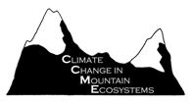
  In 1997, the U.S. Geological Survey embarked on the Repeat Photography Project, a systematic method of studying climate change and global warming based on glacier retreat in Glacier National Park, Montana. Computer models predict that all the glaciers in the Park will melt by 2030 under current warming trends.

Slide 4
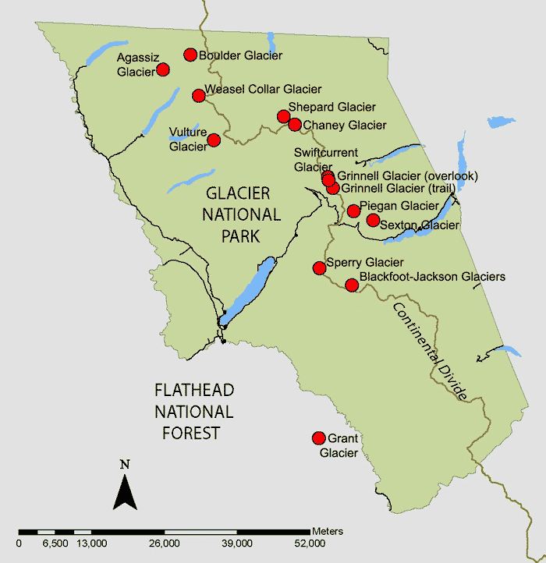
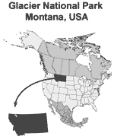
The red dots on this map represent selected repeat photographs of glaciers taken throughout Glacier National Park, Montana.

Slide 5
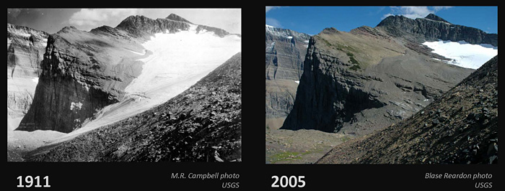
Glaciers: Going, Going, Gone?

Slide 6
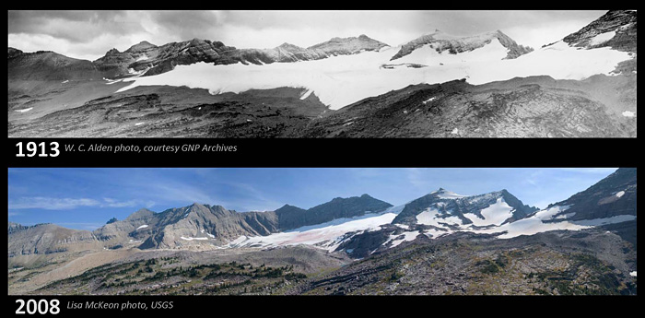
Sperry Glacier Panorama
In 1913, Sperry Glacier's mass spanned across the entire basin and the glacier's terminus (the end or bottom part of a glacier at any given point in time) was recorded at over 150 feet tall. Contemporary images show how the glacier has receded and separated into fragments.

Slide 7
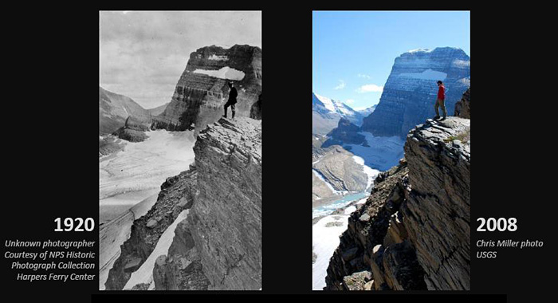
Grinnell Glacier Overlook

Slide 8
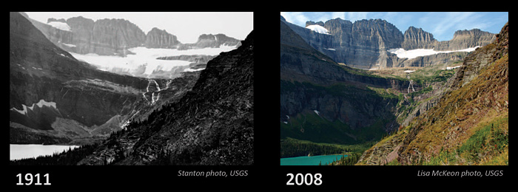
Grinnell Glacier
Nearly a century after Stanton's photograph was taken, Grinnell Glacier has receded into its cirque basin and is no longer visible from the trail above Grinnell Lake.

Slide 9
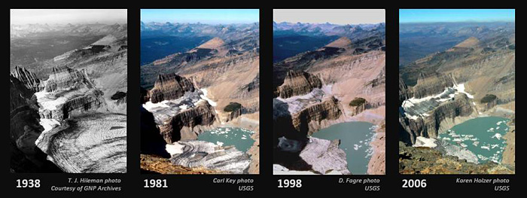
Grinnell Glacier, from Mt. Gould
Oblique view of Grinnell Glacier taken from the summit of Mount Gould. The relative sensitivity of glaciers to climate change is illustrated by the dramatic recession of Grinnell Glacier while surrounding vegetation patterns remain stable.

Slide 10
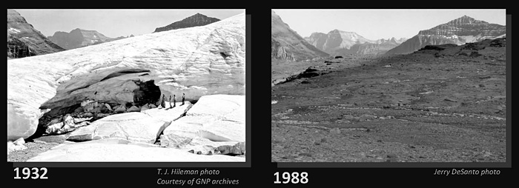
Boulder Glacier Cave

Slide 11
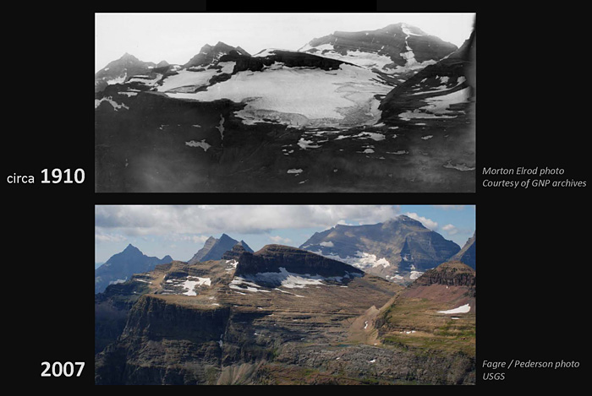
Boulder Glacier

Slide 12
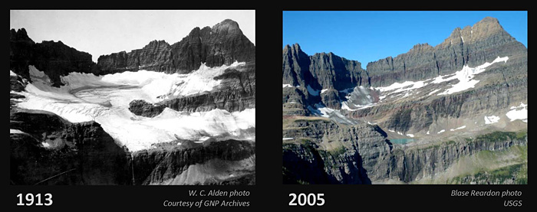
Shepard Glacier

Slide 13
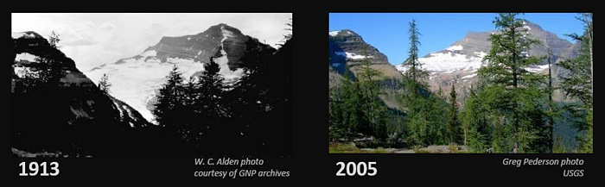
Agassiz Glacier

Slide 14
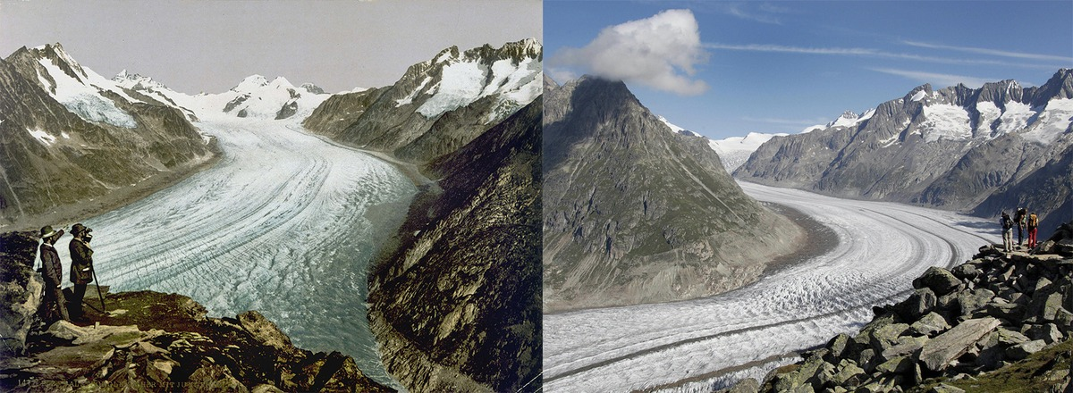
Alps Glacier
The Aletsch Glacier, the largest glacier in the Alps, in 1890 and 2003. Like all glaciers on earth, is retreating, at an average rate of 3% per year. Between 1850 and 2005, the Aletsch Glacier's surface area shrank 40%, and the volume shrank by 60%, according to the Swiss Academy of Sciences.

Slide 15
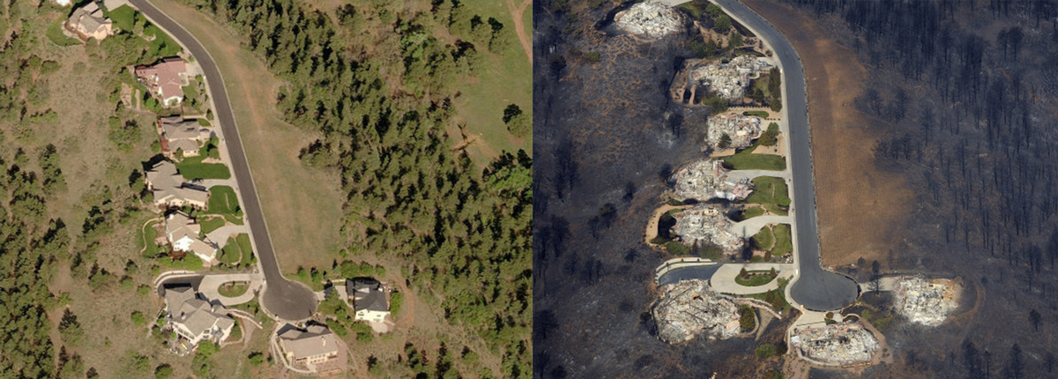
Colorado wildfire
Trevor Lane in Colorado Springs, Colorado, before and after the Waldo Canyon fire ripped through the area in 2012. Climate change means wildfire seasons are longer, conditions are drier and there's an increased frequency of lightning.

Slide 16
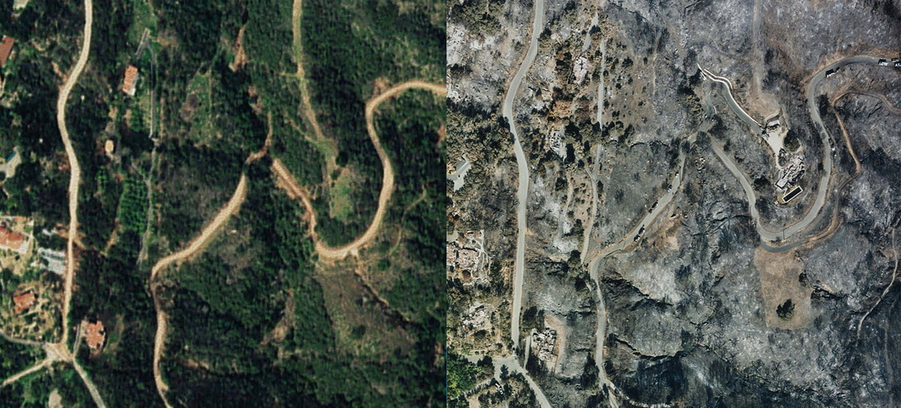
Santa Barbara wildfire
Mountain Drive in Santa Barbara, CA, in 1995 (left) and in 2008 (right) show devastation caused by the 2008 Montecito Tea Fire. The first image shows the area several years before the fire, while the second image was taken just days after the fire was contained.

Slide 17
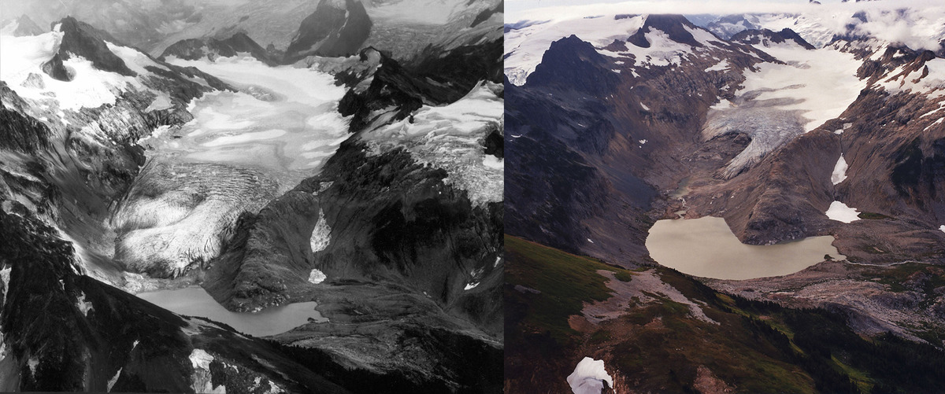
Washington glacier melts
The South Cascades Glacier in 1979 and 2003. Glaciers in the North Cascades of Washington have shrunk by 40% in the last 150 years.

Slide 18
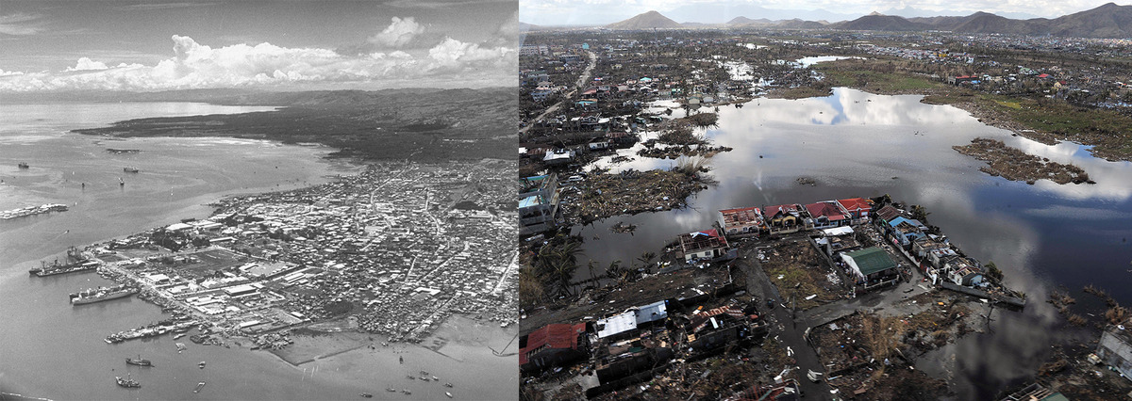
Visayas sea levels rise
Visayan Islands cities of Cebu and Tacloban in 1949 and 2013. The Philippines were devastated by super typhoon Haiyan on November 8, 2013, and left many parts of the country under water.

Slide 19
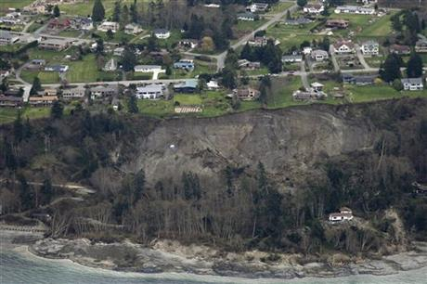
Washington landslide
A satellite image of Whidbey Island, Washington, after a landslide hit the area on March 27, 2013, after several days of heavy rain.

Slide 20
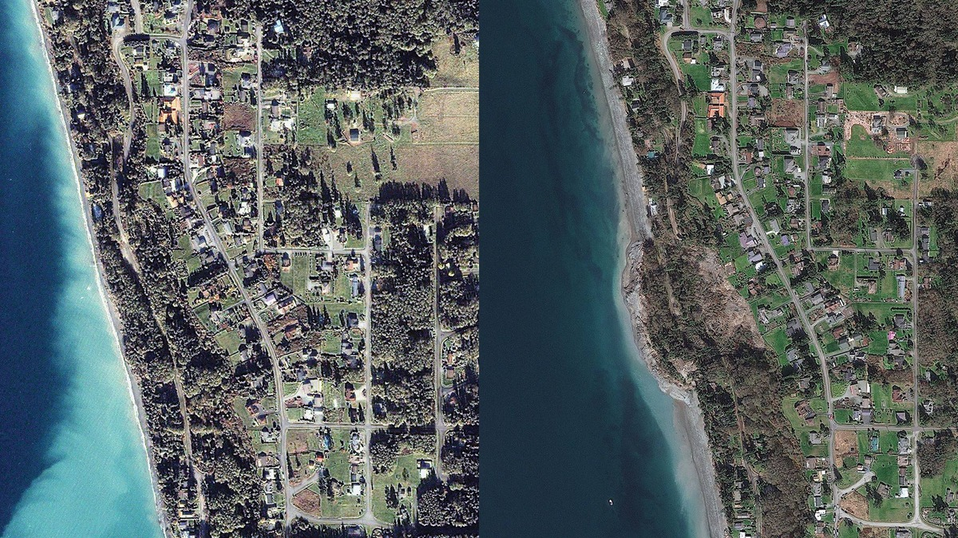
Washington landslide
A satellite image of Whidbey Island, Washington, before (left) and after (right) after a landslide hit the area on March 27, 2013, after several days of heavy rain.

Slide 21
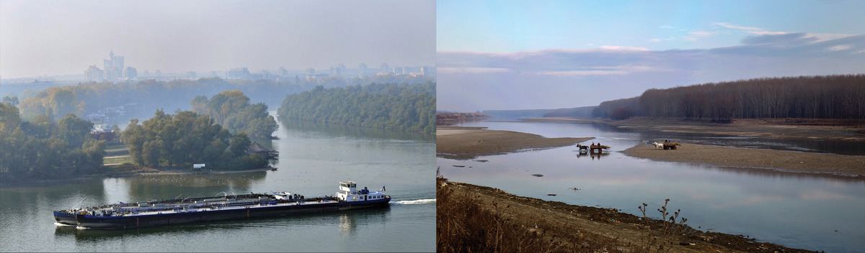
Drought in Romania
The Danube river in 2009 (left) and in 2011 (right) in Calarasi, in southern Romania. The waters of the Danube were so low due to drought that dozens of cargo ships were getting stuck in mud.

Slide 22
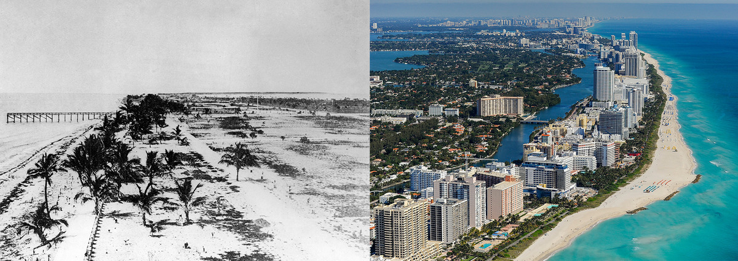
South Beach in Miami
South Beach in Miami in the early 1900s and 2014. Since the 1920s, the global average sea level has risen about nine inches and, because Miami sits at sea level, it is very vulnerable to storm-related flooding and sea-level rise.

Slide 23
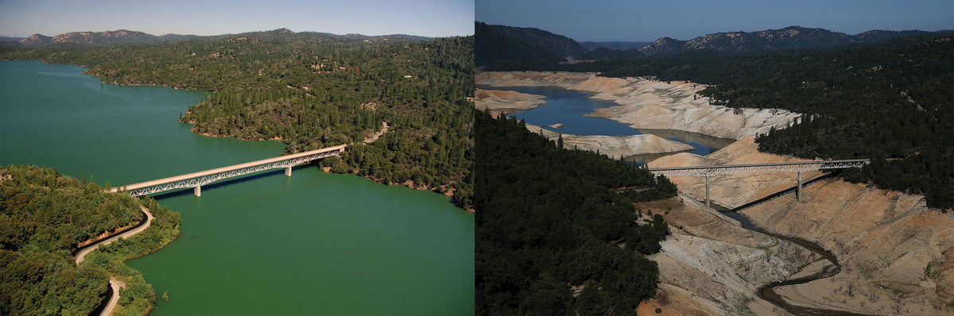
Drought in California
The Enterprise Bridge passes over a section of Lake Oroville in 2011 (left) and 2014 (right) in Oroville, California, which is experiencing "exceptional" drought.

Slide 24
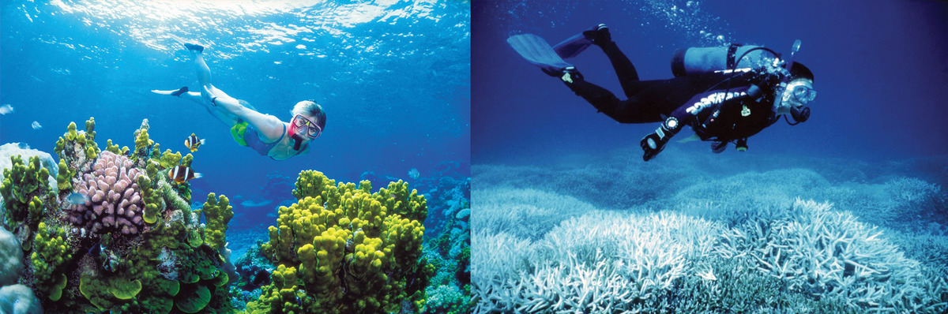
Coral reef bleaching
A photo of a woman snorkeling around the Great Barrier Reef in Australia in 2002 (left) and 2014 (right). When ocean water is too warm, coral will expel the algae living in its tissues, which blanches the appearance of the coral, according to NOAA.

Slide 25
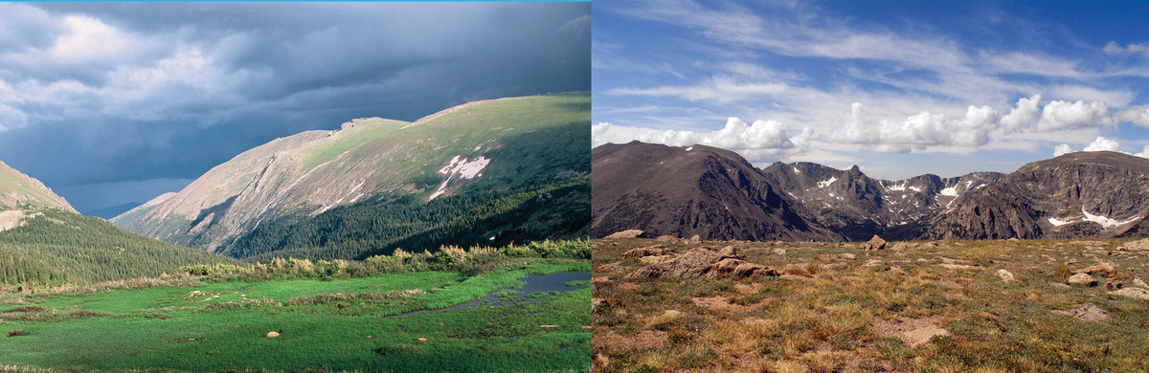
Colorado forests gone brown
The Rocky Mountain National Park in in 2001 (left) and in 2007 (right). The iconic pine and aspen forests of the Rocky Mountains are dying off at an alarming rate thanks to conditions exacerbated by climate change — drought, insect infestations and wildfires.

Slide 26
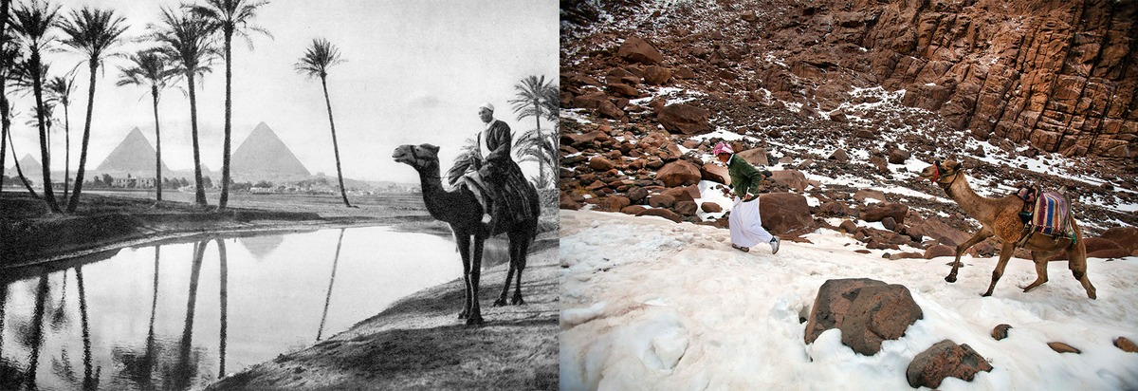
Snow falls in Egypt
Cairo, Egypt in 1920 and 2013. Normally-arid Egypt experienced the first snowfall in 112 years in December 2013, as a part of the Middle East cold snap.

Slide 27
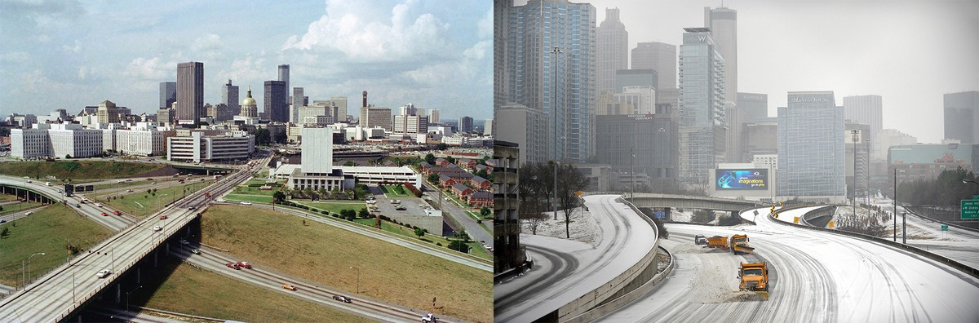
Snow falls in Atlanta
Atlanta, GA, in 1977 and during winter 2014, when three inches of snow prompted Georgia, Alabama, Mississippi, Louisiana, North Carolina and South Carolina to declare a state of emergency. The storm turned roads into parking lots and claimed 13 lives, according to USA Today.

Slide 28

WMO: Still Time to Act on Climate Change Need for Action on Greenhouse Gases Backed by Scientific Evidence
There is still a window of opportunity to prevent dangerous climate change and preserve the planet for future generations. But it is closing fast, according to the World Meteorological Organization (WMO), which says that the urgent need to cut greenhouse gases is based on overwhelming scientific evidence.

Slide 29
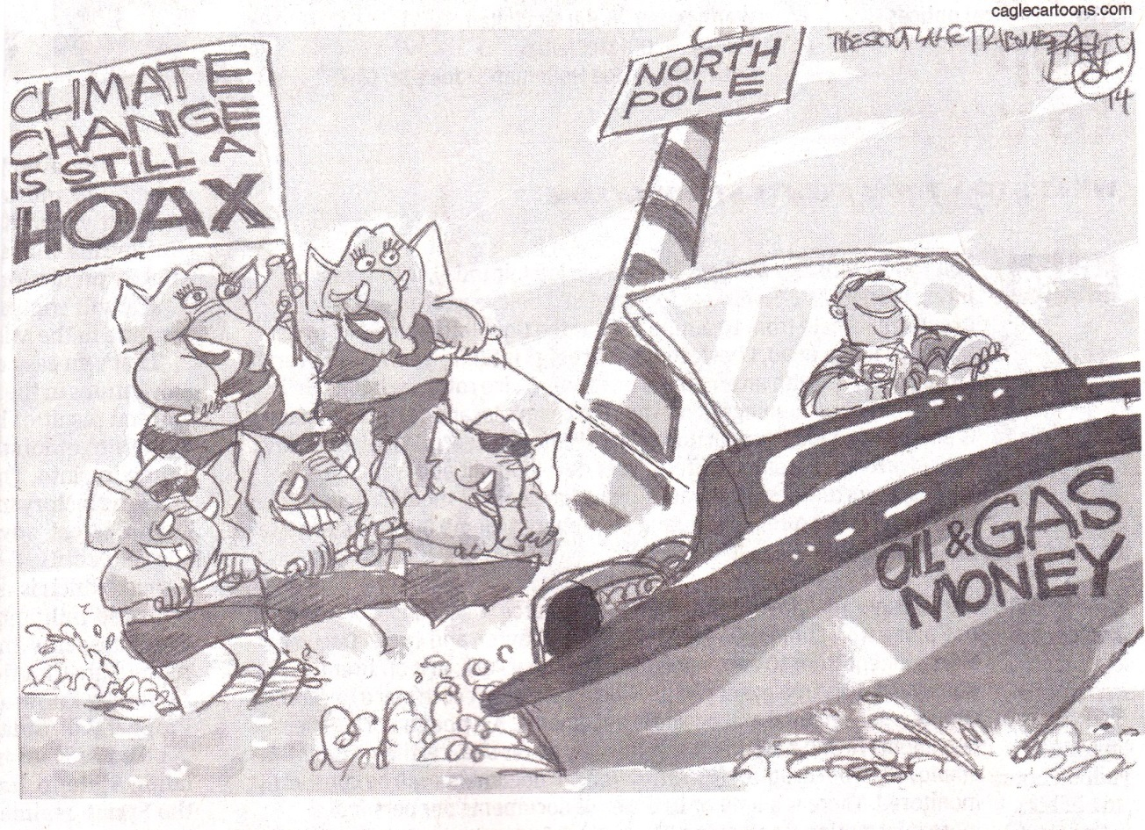
Some refuse to believe

