Slide 1
Midwest Tornado Day: Nov. 17, 2013

Slide 2
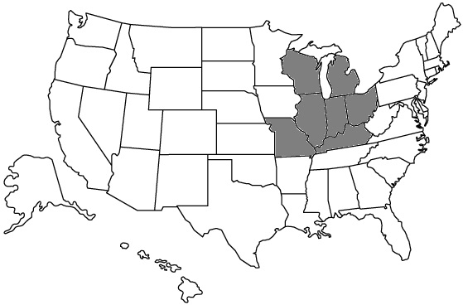

Slide 3
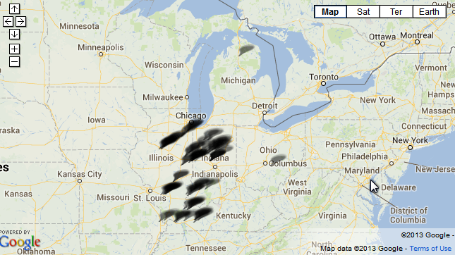

Slide 4
Touchdowns in seven states
As a powerful tornado bore down on their Illinois farmhouse, Curt Zehr's wife and adult son didn't have time to do anything but scramble down the stairs into their basement. Uninjured, the pair looked out moments later to find the house gone and the sun out and "right on top" of them, Zehr said. The home on the outskirts of Washington, Ill., was swept up and scattered over hundreds of yards by one of the dozens of tornadoes and intense thunderstorms that swept across the Midwest on Sunday, leaving at least six people dead and unleashing powerful winds that flattened entire neighborhoods, flipped over cars and uprooted trees.

Slide 5
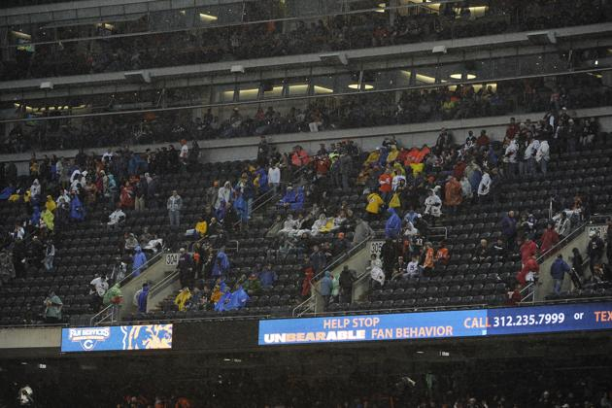
Fans evacuate the stadium because of weather after a game between the Chicago Bears and the Baltimore Ravens was delayed

Slide 6
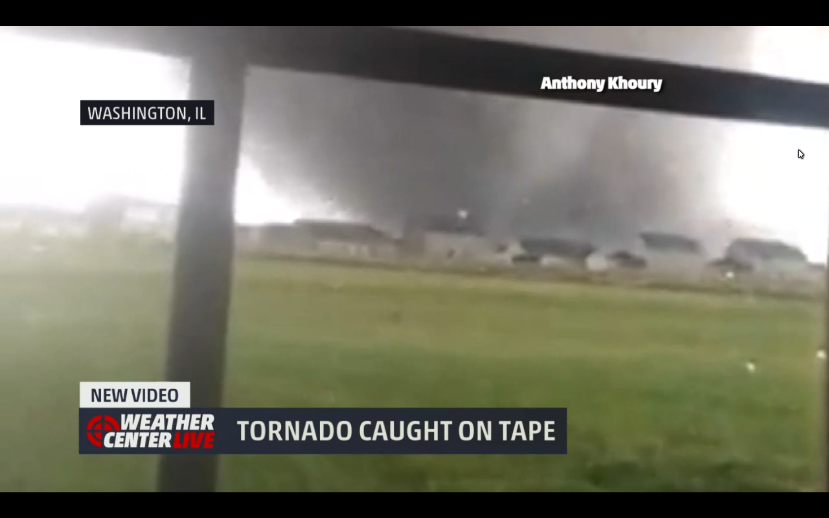

Slide 7
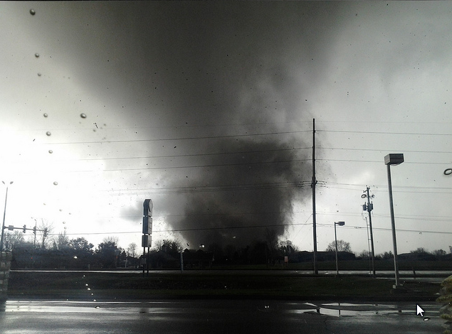

Slide 8
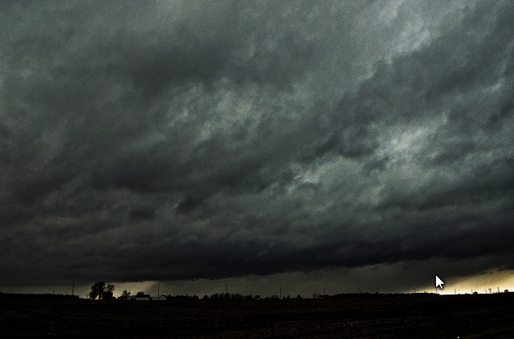

Slide 9
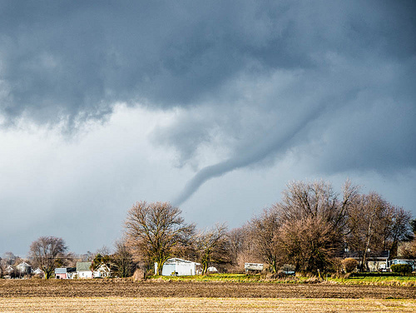

Slide 10
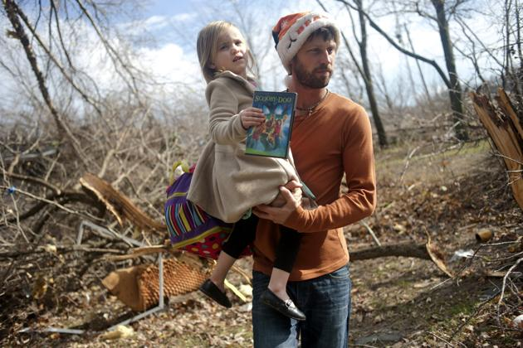
East Peoria resident Billy Vestal evacuates with his daughter,

Slide 11
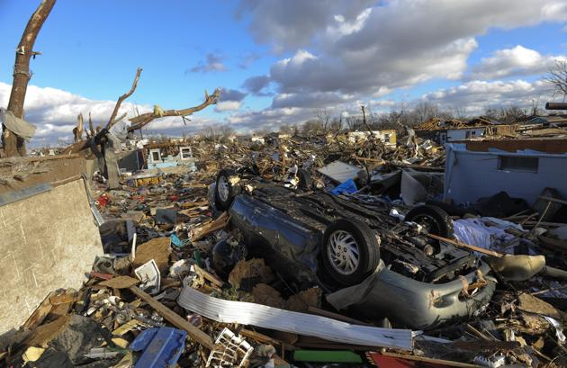
A neighborhood in Washington, Ill., is left in ruins after a tornado tore through the northern part of the town

Slide 12
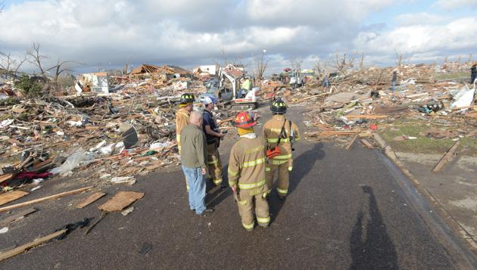
Washington, Ill., firefighters stand in the middle of Devonshire Street on the North side of Washington, Ill., after a tornado leveled at least fifty homes,

Slide 13
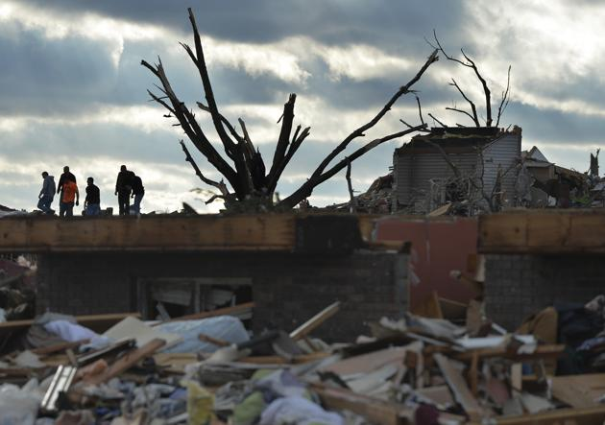

Slide 14
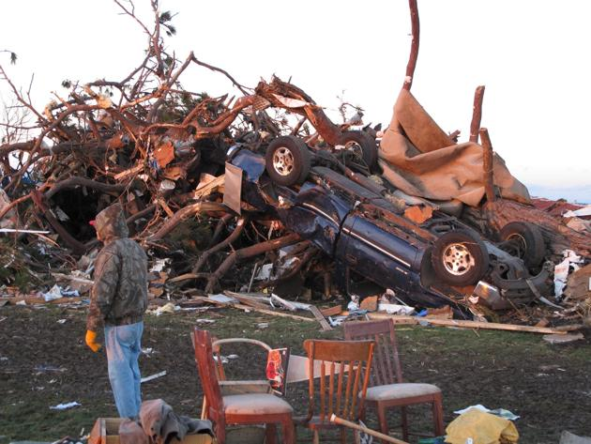

Slide 15
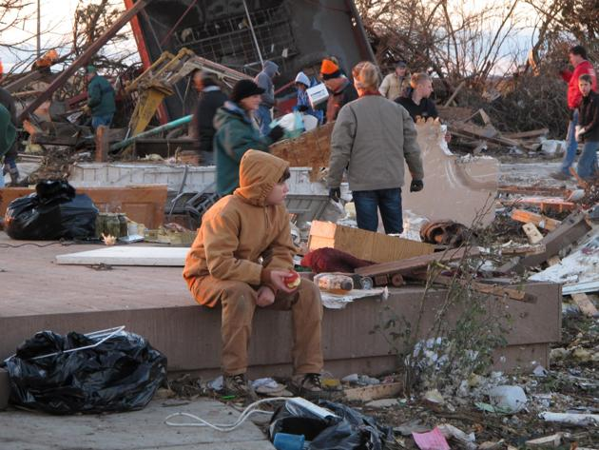

Slide 16
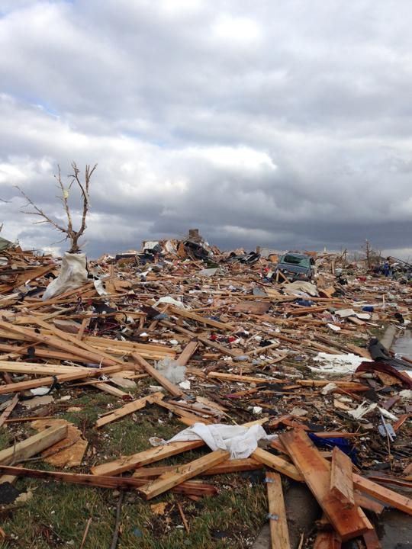
A view of part of Washington, Ill. is seen from Mackenzie Street in Washington, Sunday, Nov. 17, 2013 after a tornado moved through the area. Intense thunderstorms and tornadoes swept across the Midwest on Sunday, causing extensive damage in several central Illinois communities while sending people to their basements for shelter and even prompting officials at Soldier Field in Chicago to evacuate the stands and delay the Bears game.

Slide 17
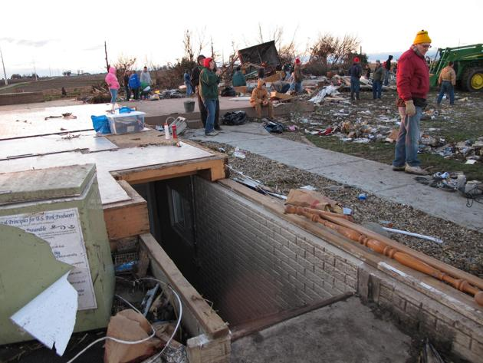

Slide 18
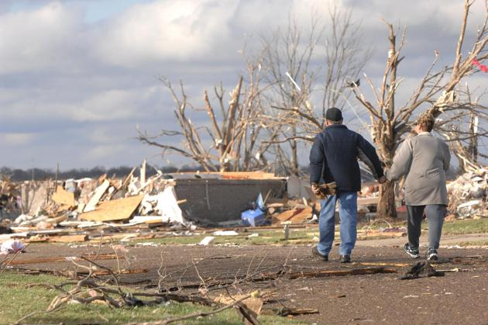

Slide 19
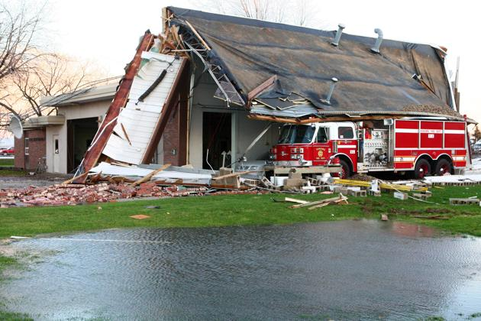
tornado damage to Fire Station in Kokomo

Slide 20
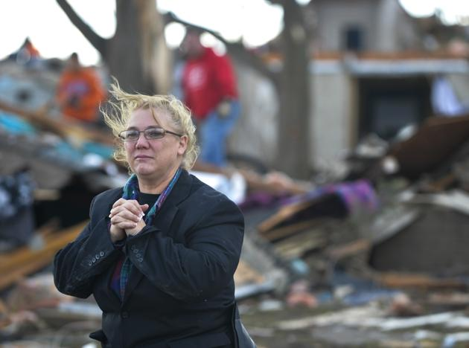

Slide 21
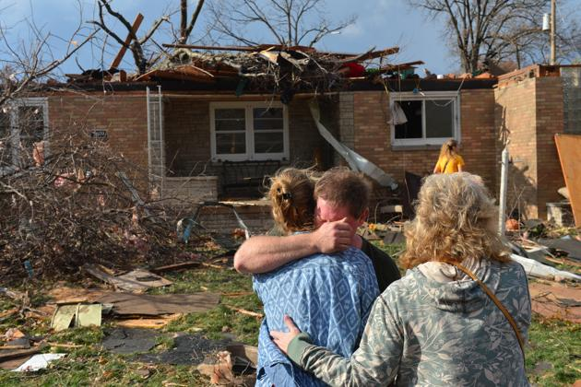
devastation through the north end of Pekin, Il.

Slide 22
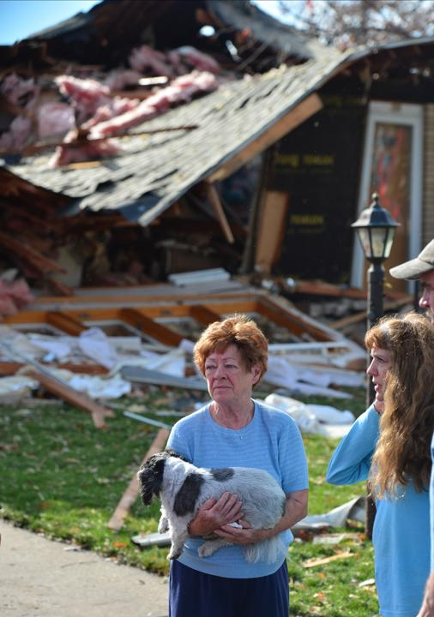
Shirley Wolf says she hung on to her dog Sammy for dear life as a tornado destroyed her home at 306 Delshire in Pekin, Il.,Sunday, Nov. 17, 2013. Intense thunderstorms and tornadoes swept across the Midwest on Sunday, causing extensive damage in several central Illinois communities while sending people to their basements for shelter.

Slide 23
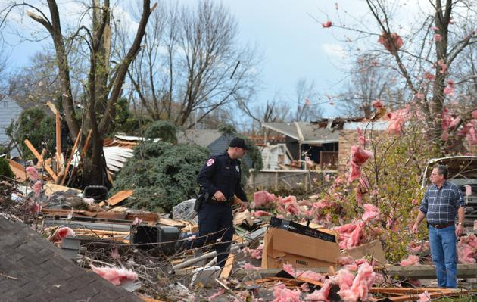
Pekin

Slide 24
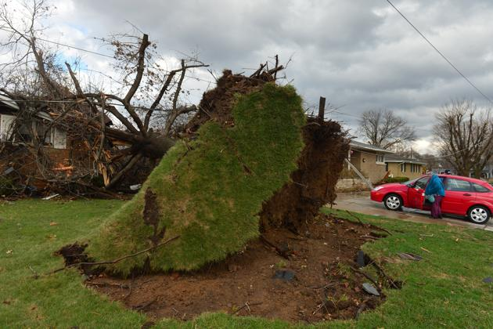
Pekin

Slide 25
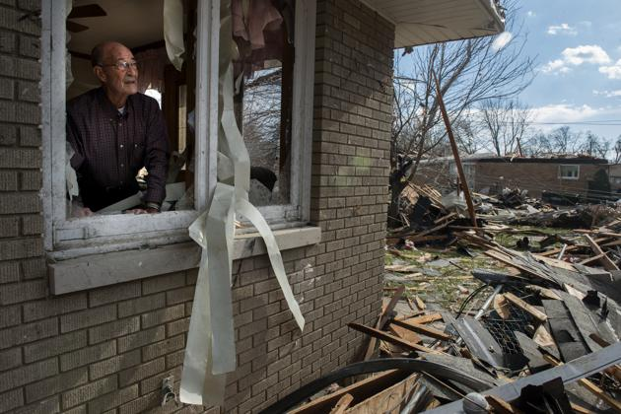
Pekin

Slide 26
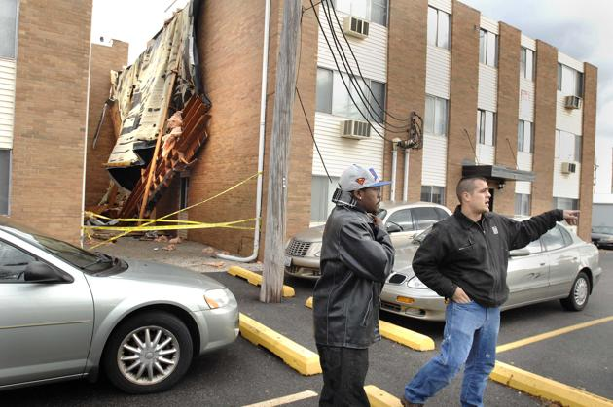
in Normal, Ill. The apartment was damaged

Slide 27
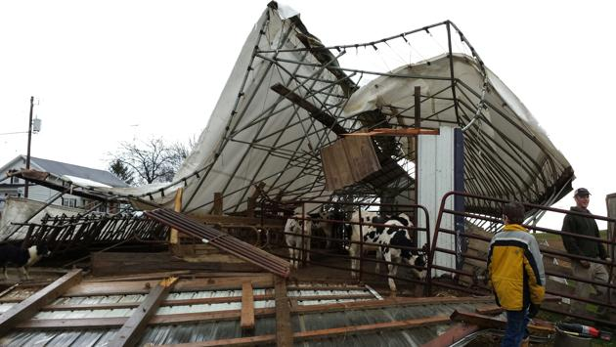
A cattle shed in the Town of Hustisford, Wis.

Slide 28
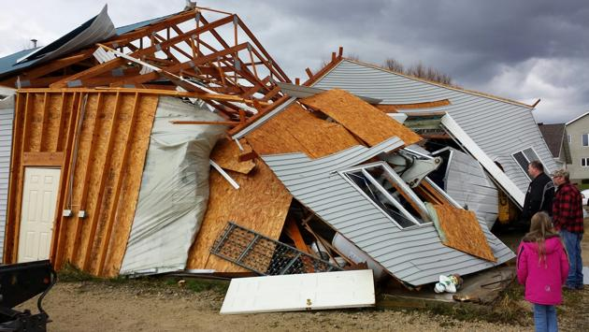
A garage in the Town of Hustisford

Slide 29
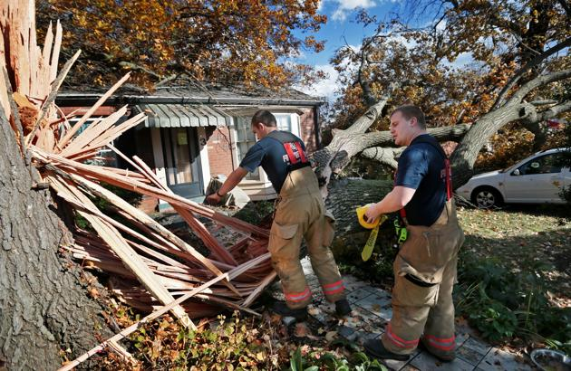
Webster Groves, Mo.

Slide 30
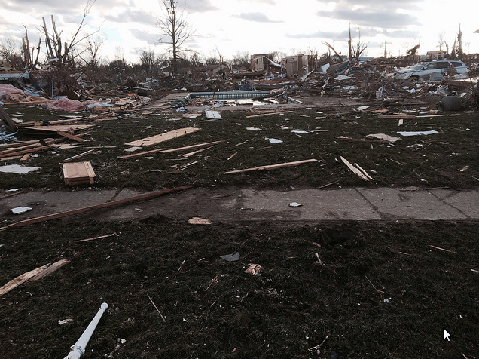
An estimated 14 tornadoes touched down & 8 people died

