Slide 1

2014 Rough Winter Start
January & February
Powerpoint Templates

Slide 2
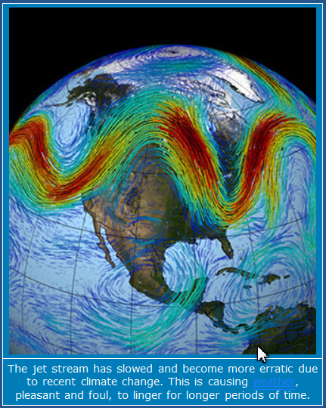
Climate change is bringing the polar vortex farther south as the jet stream moves.

Slide 3
Deadly storm slams South
The second wintry storm in two weeks to hit the Deep South encrusted highways, trees and power lines in ice knocking out electricity to nearly a half-million homes and businesses.
But it didn't wreak the highway havoc in Atlanta that the previous bout of heavy weather did — largely because people learned their lesson the last time and stayed off the roads.
At least nine traffic deaths across the region were blamed on the treacherous weather, and nearly 3,300 airline flights nationwide were canceled. (AP)

Slide 4
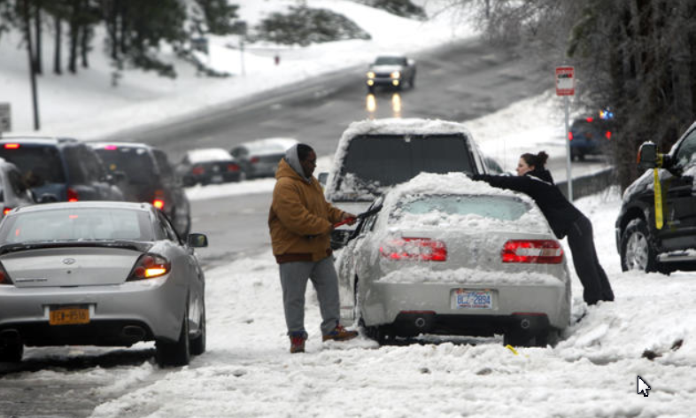

Slide 5
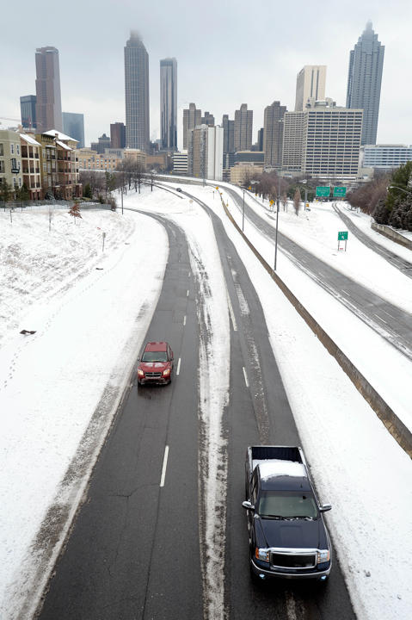
Atlanta, Georgia

Slide 6
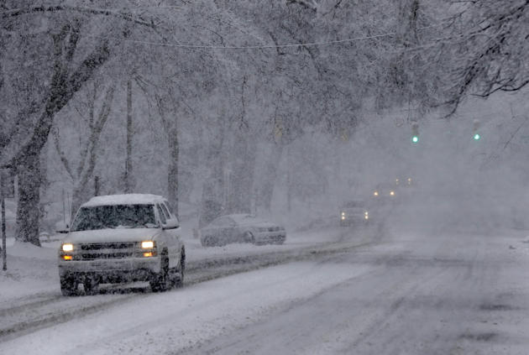
Chapel Hill, N.C.

Slide 7
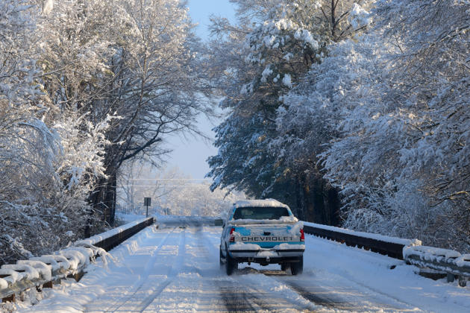
South of Hartselle, Alabama

Slide 8
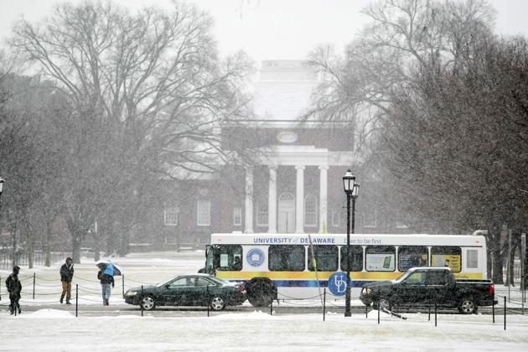
University of Delaware

Slide 9
Snow days in New York City
A winter storm packing snow and Arctic cold slammed the northeastern United States on Tuesday, grounding 3,000 flights, shutting down government offices and schools and making travel a potential nightmare for millions. States across the northeast declared emergencies and warned residents not to travel during the fast-moving storm, which packed a potentially lethal combination of snow and wind, backed by temperatures up to 30 degrees Fahrenheit below normal. This storm presented an opportunity for many, including Yahoo News photographer Gordon Donovan, to capture moments shared among people trying to get to work -- and those who wanted to enjoy the snow despite the freezing cold. (Yahoo News)

Slide 10
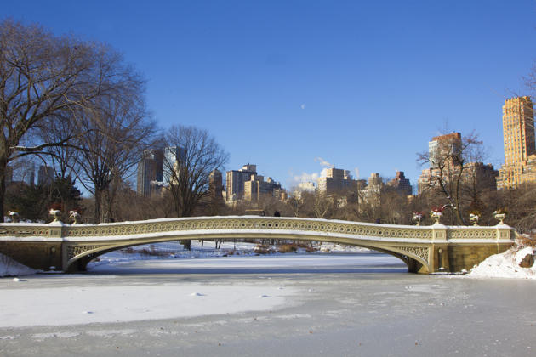
Central Park

Slide 11
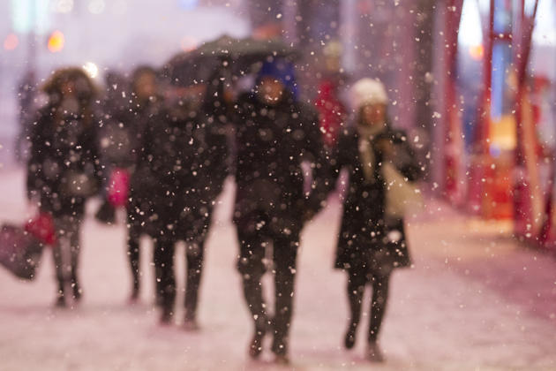
Large snowflakes

Slide 12
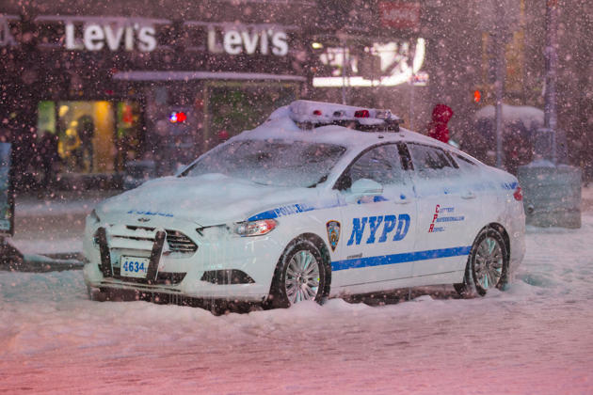

Slide 13
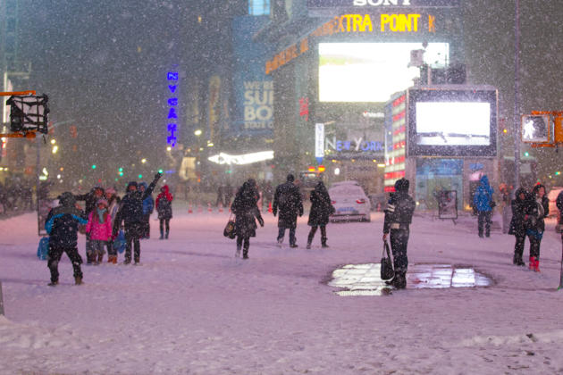
Times Square

Slide 14
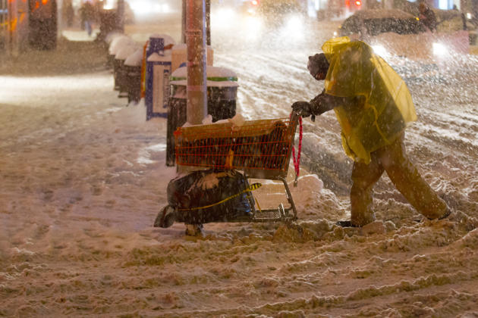

Slide 15
Winter storm hits the northeastern U.S.
Before the end of Tuesday, parts of Pennsylvania and New Jersey had seen about 15 inches of snow, said Stephen Corfidi with the National Weather Service. (Reuters)

Slide 16
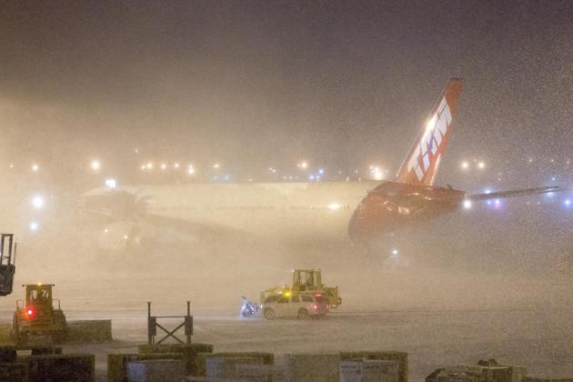
John F. Kennedy International Airport in New York

Slide 17
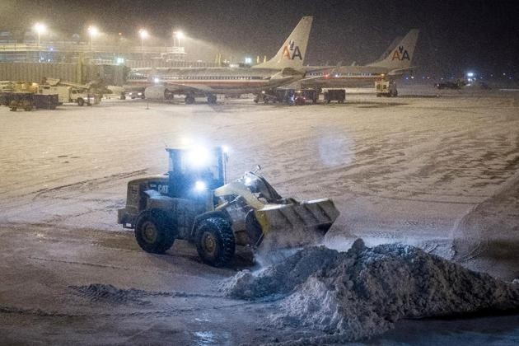
Reagan National Airport in Washington

Slide 18
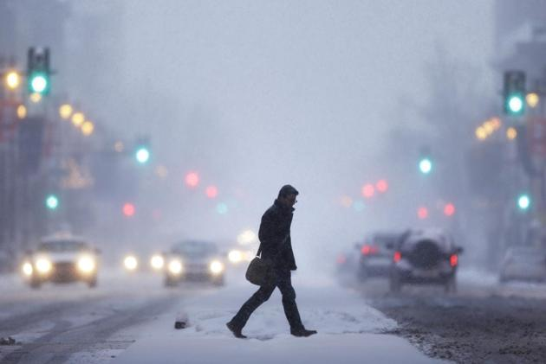
Philadelphia

Slide 19
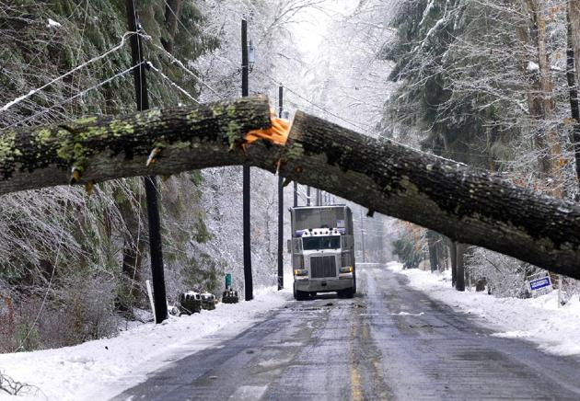
Fayetteville, Pa

Slide 20
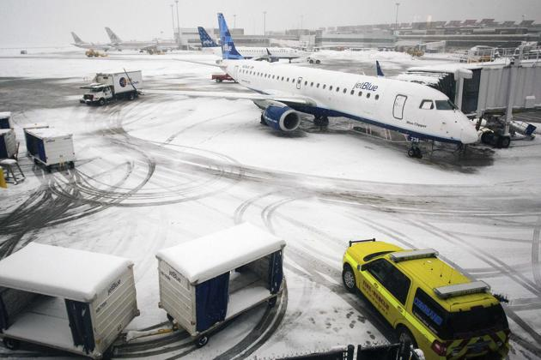
Boston, Massachusetts,

Slide 21
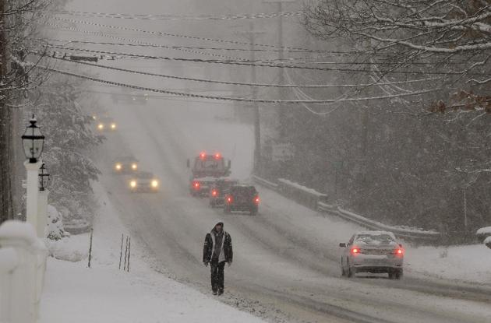
Pembroke, Mass.

Slide 22
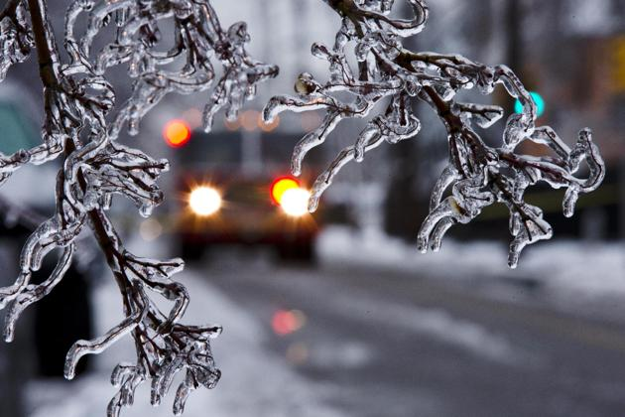
Pennsylvania

Slide 23
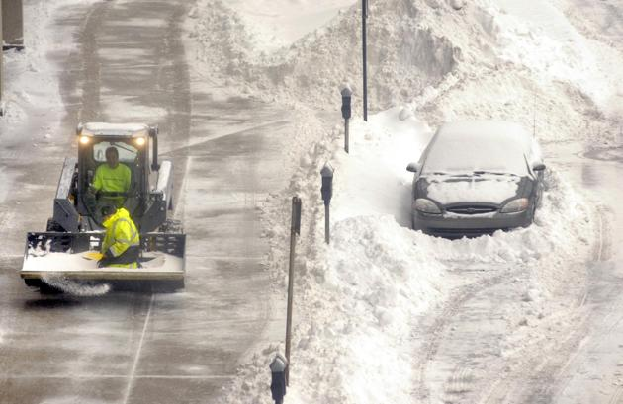
Worcester, Mass.

Slide 24
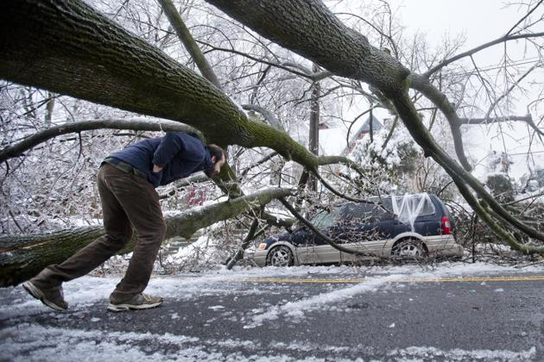
Philadelphia

Slide 25
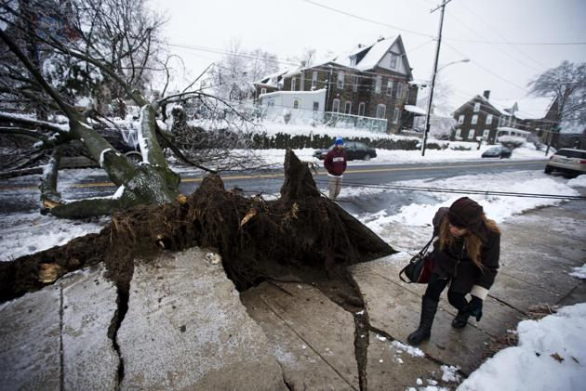
Philadelphia ice victim

Slide 26
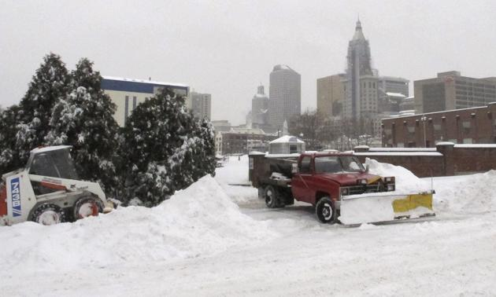
Hartford, Conn

Slide 27
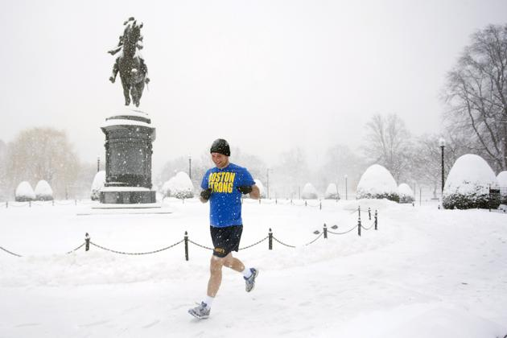
Crazy in Boston, Mass.?

Slide 28
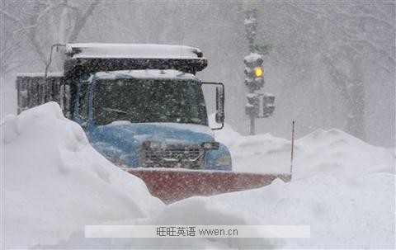
Washington, D.C.

Slide 29
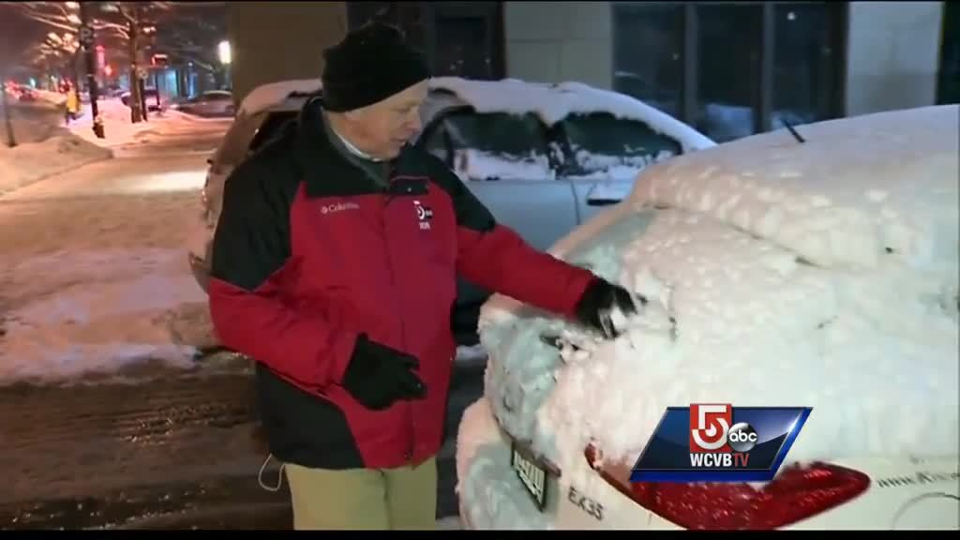
Boston

Slide 30
Other Areas

Slide 31
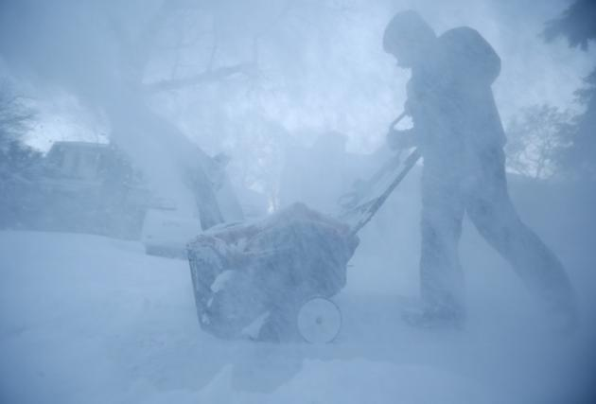
Wilmette, Illinois,

Slide 32
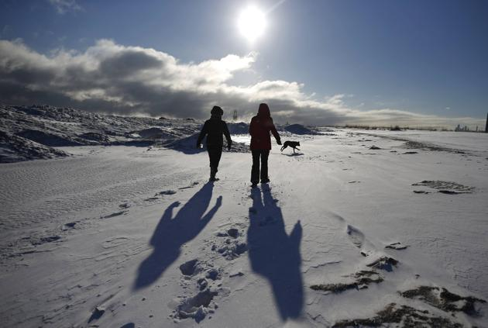
Chicago
Wilmette, Illinois,

Slide 33
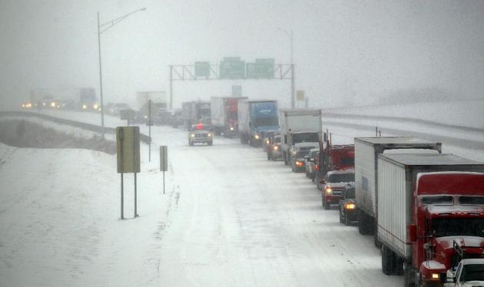
St. Joseph, Mo

Slide 34
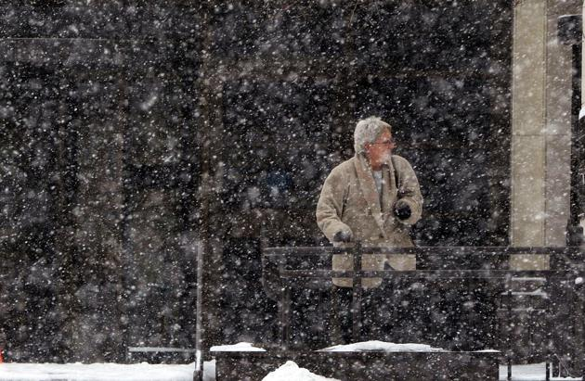
St. Joseph, MO.

Slide 35
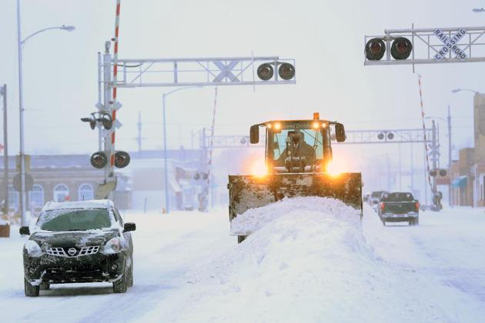
Hutchison, Kan

Slide 36
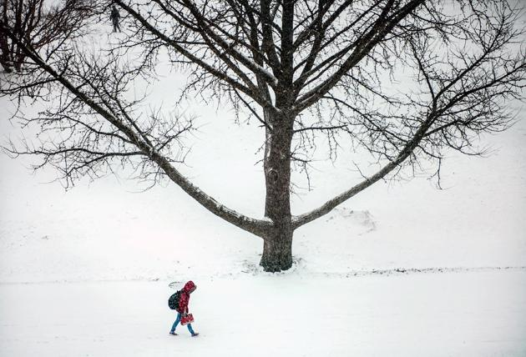
Urbana, Ill

Slide 37
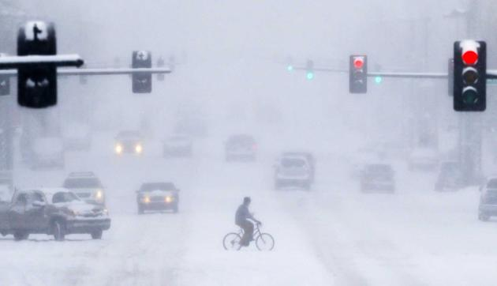
Wichita, Kan.

Slide 38
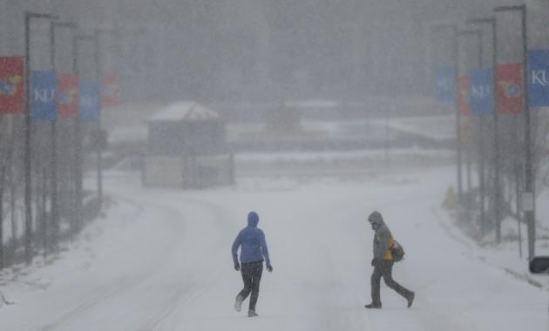
Lawrence, Kansas

Slide 39
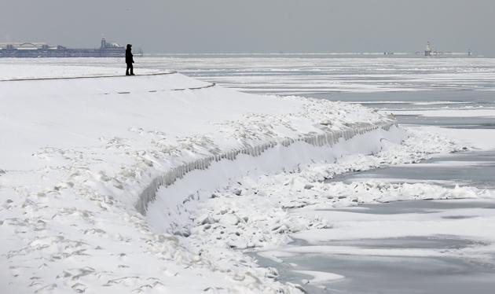
Lake Michigan at the 39th Street Harbor in Chicago,

Slide 40
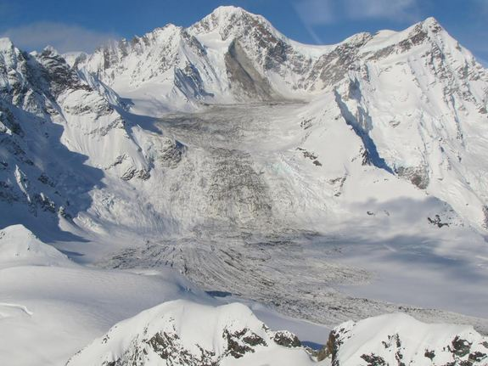
Alaska: An image of the landslide taken on Friday (Feb. 21).

Slide 41
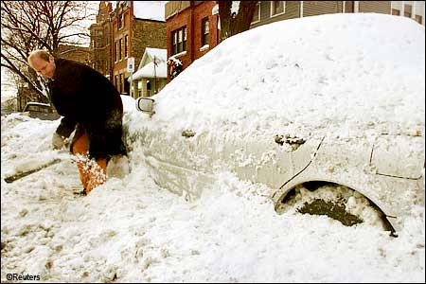
Florida

Slide 42
beyond North america

Slide 43
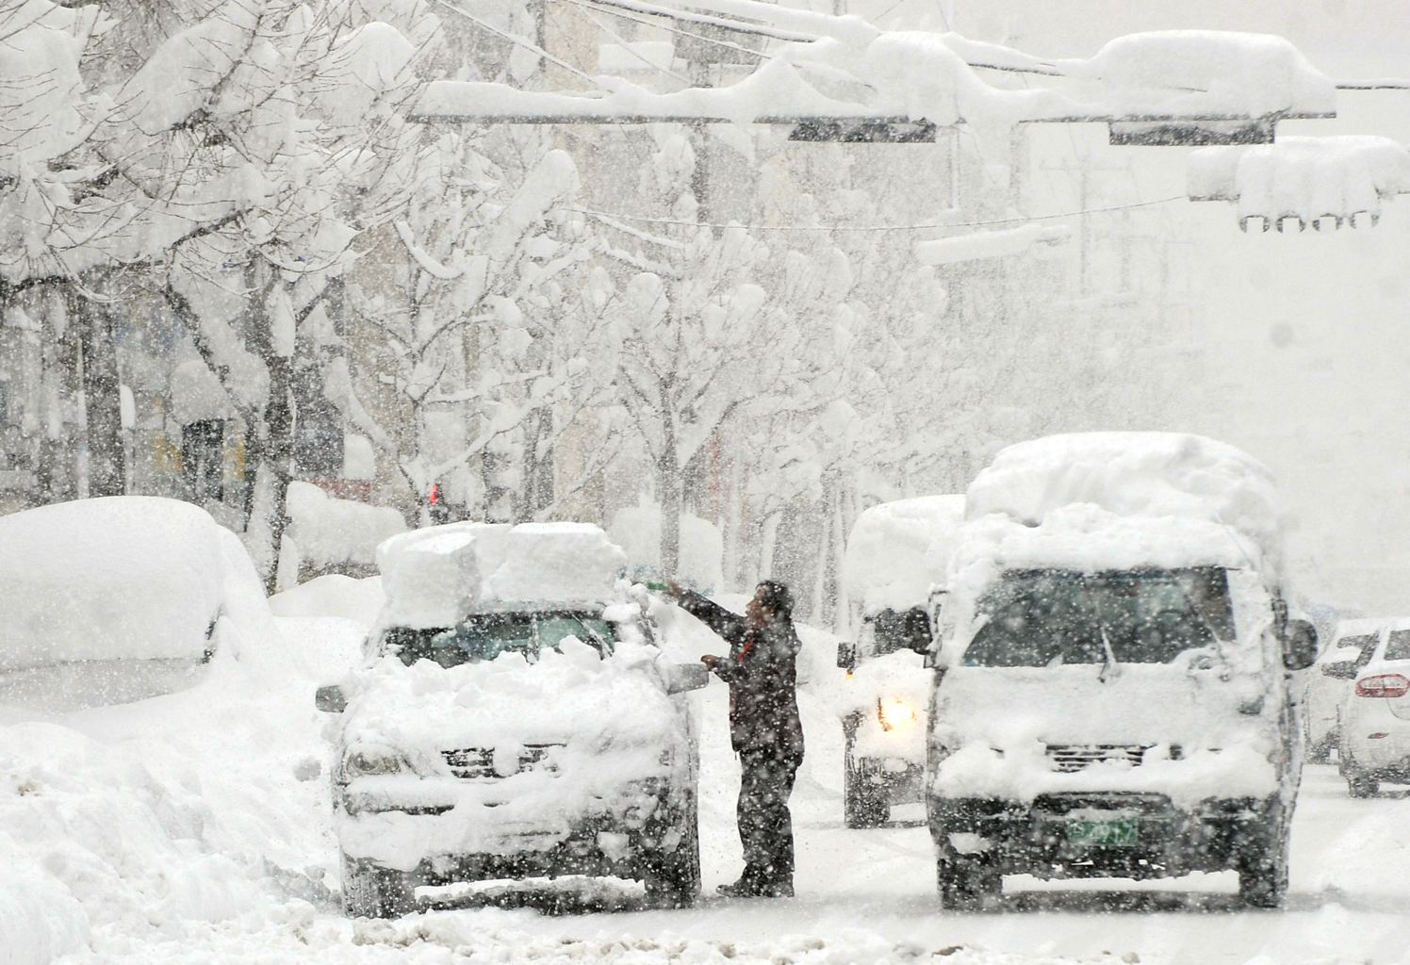
A resident removes snow form his car in Gangneung, South Korea, Monday, Feb. 10, 2014. More than one meter (3.3 feet) of snow fell last week

Slide 44
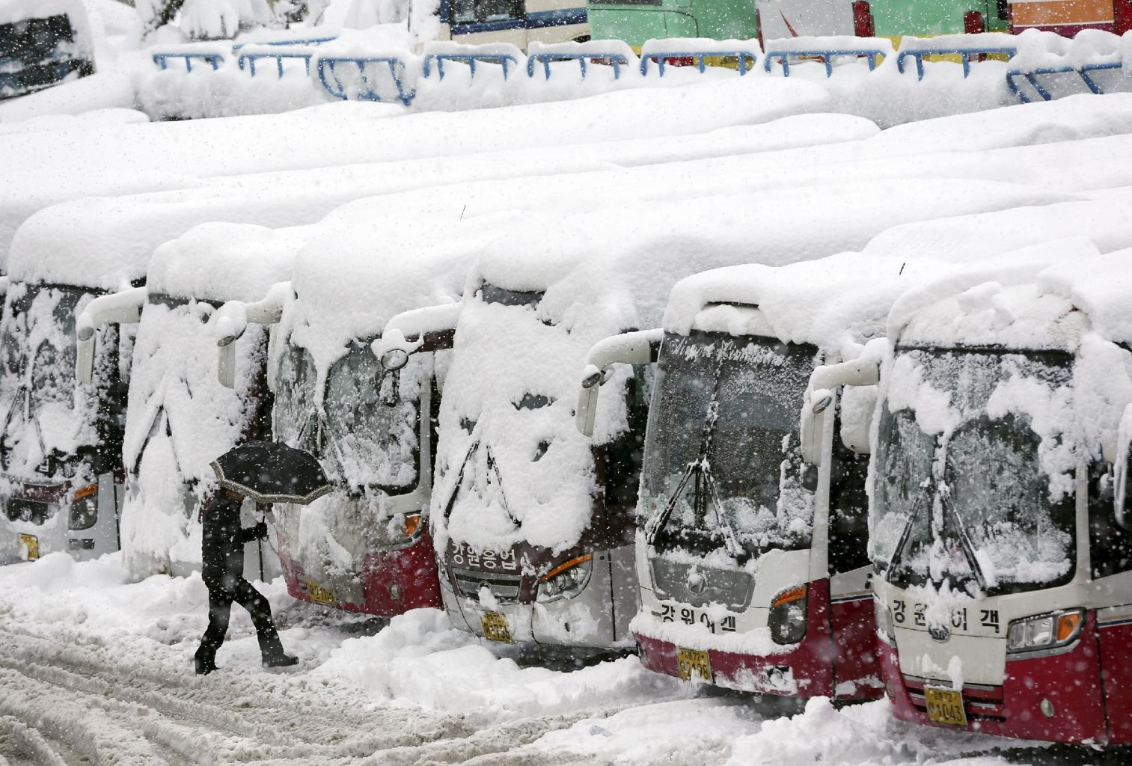
Gangneung, South Korea

Slide 45
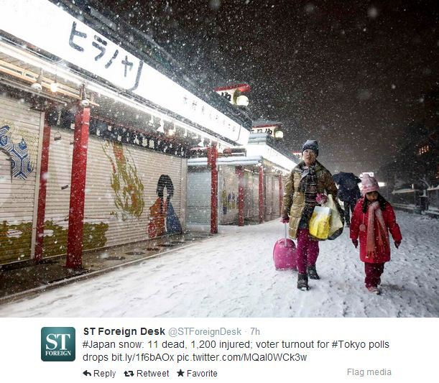
Japan

Slide 46
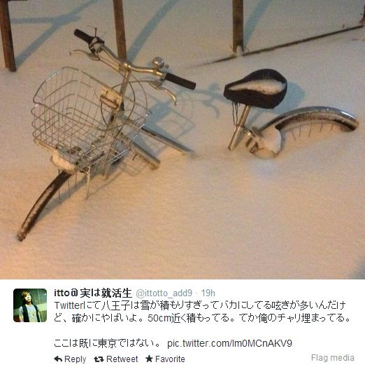

Slide 47
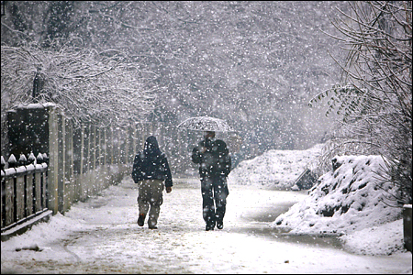
Jammu & Kashmir

Slide 48
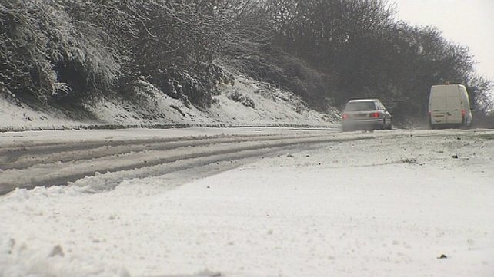
Northern Ireland

Slide 49
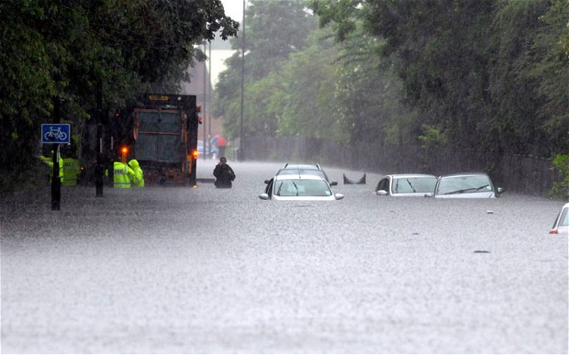
Severe flooding in Great Britain

Slide 50
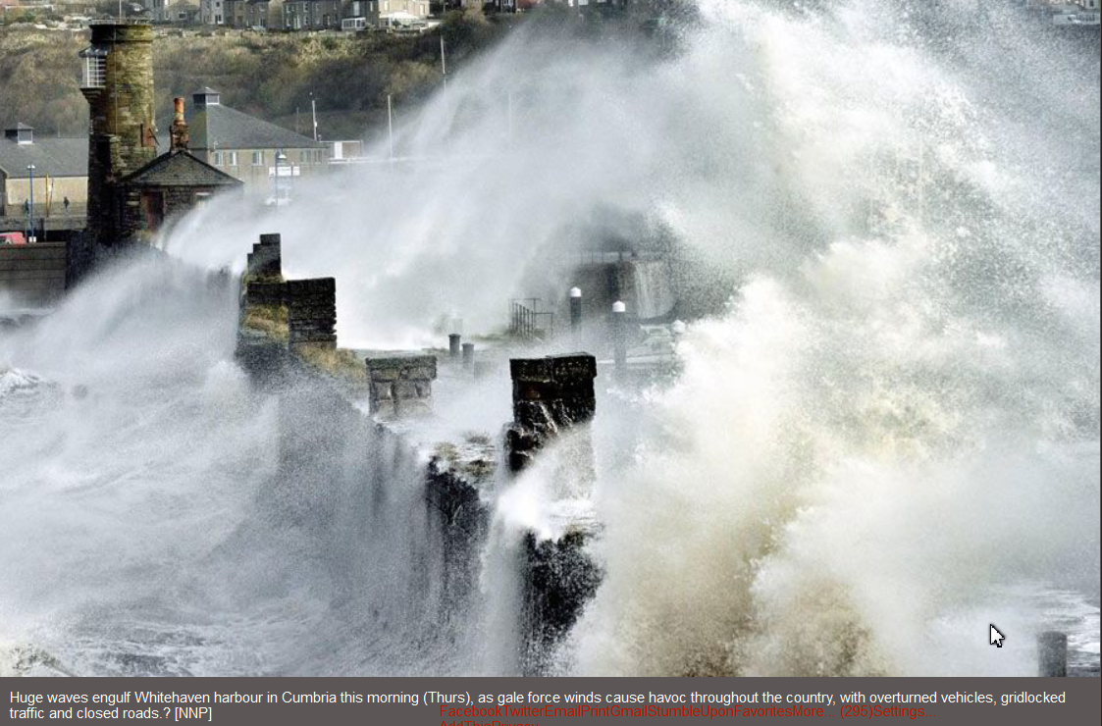

Slide 51
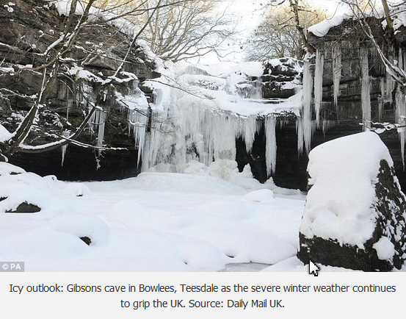

Slide 52
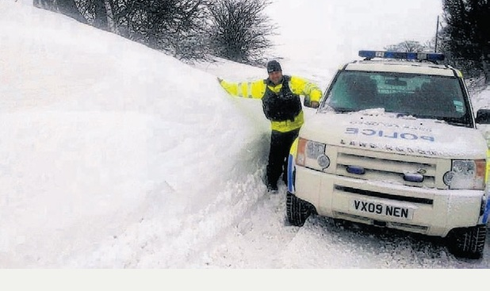
The Staffordshire Moorlands, U.K. during the recent bad weather

Slide 53
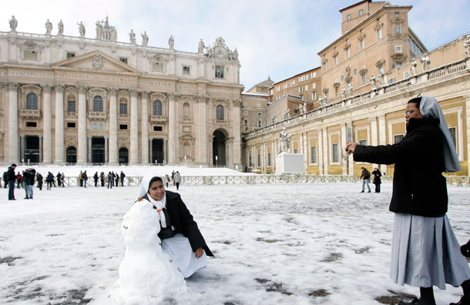
Vatican City

Slide 54
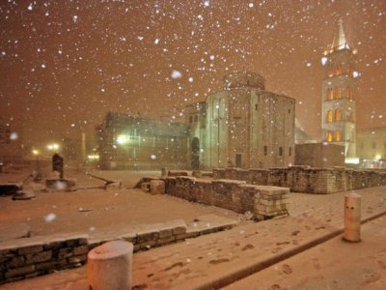
Three Die In Serbia In Severe Balkan Weather

Slide 55
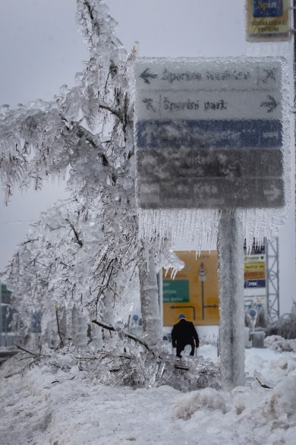
Slovevenia

Slide 56
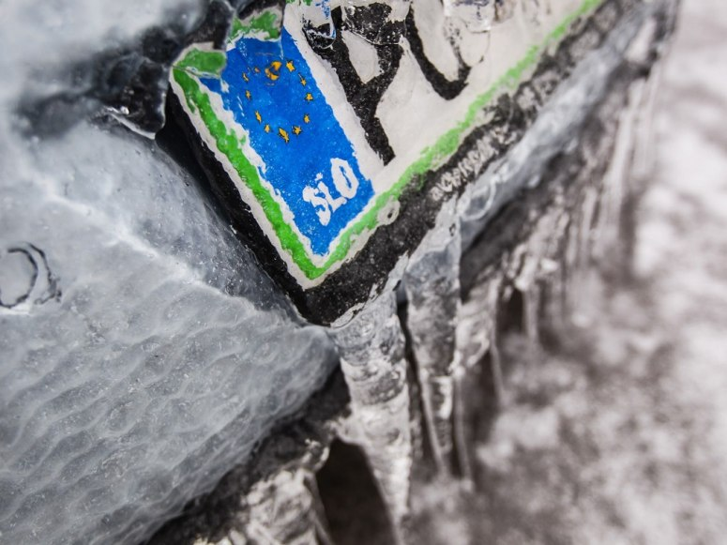
Slovenia

Slide 57

Wales, UK

Slide 58

Belfast, Northern Ireland

Slide 59


Slide 60

Xuchang, China

Slide 61

Copenhagen, Denmark

Slide 62


Slide 63

Germany

Slide 64

Berlin, Germany

Slide 65
Polar Vortex to Bring More Snow on Return to U.S. This Week: February 24, 2014

Slide 66
“Arctic air looks to make a return to the Northeast and Midwest this week following some of the warmest weather the regions have had so far this year,” AccuWeather Inc. said on its website.

