Slide 1

H 2O to YOU!
Notes:
This week we are going to look at water and how important it is.

Slide 2
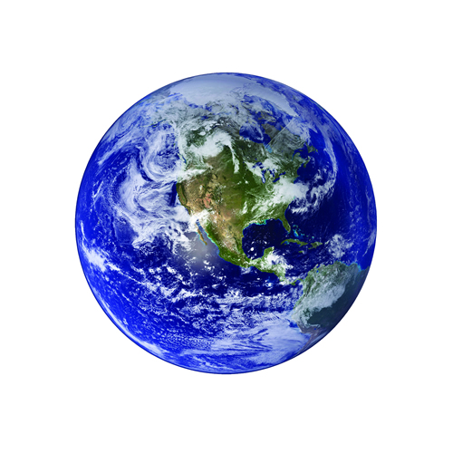
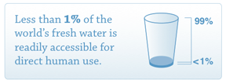
Notes:
If you look at the world- how much of it is water? ¾
How much of it is clean?

Slide 3
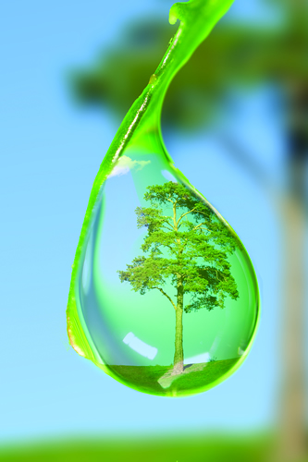
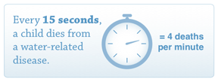

Slide 4

Most of our water is in the ocean.
The largest animals live in the ocean
Smaller animals provide food for larger animals!

Slide 5
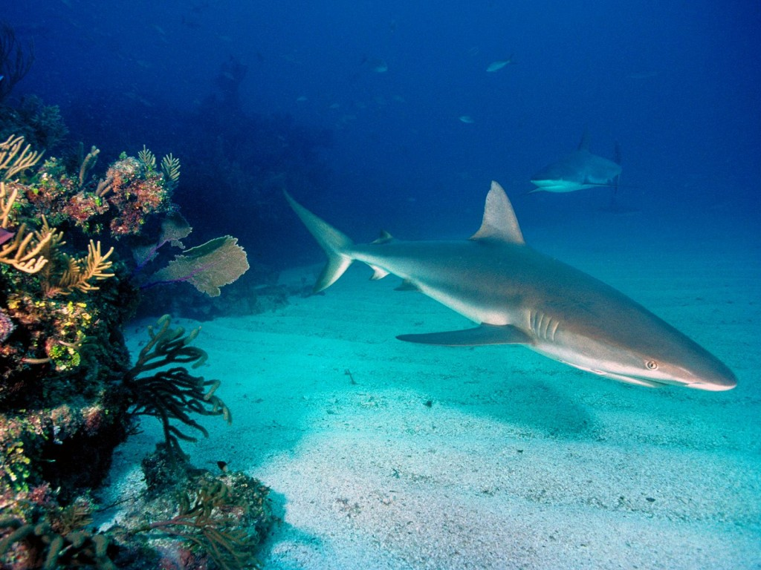
Salt water accounts for
more than 97 percent of
the water on Earth.

Slide 6
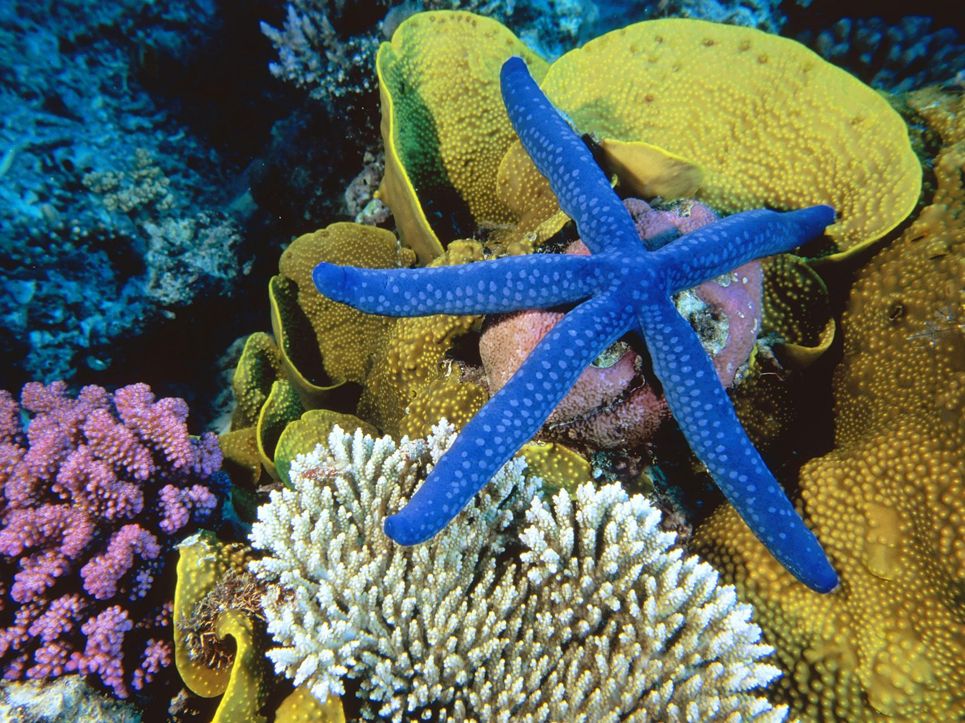
This is a coral reef and it provides a home for millions of animals like this sea star!

Slide 7
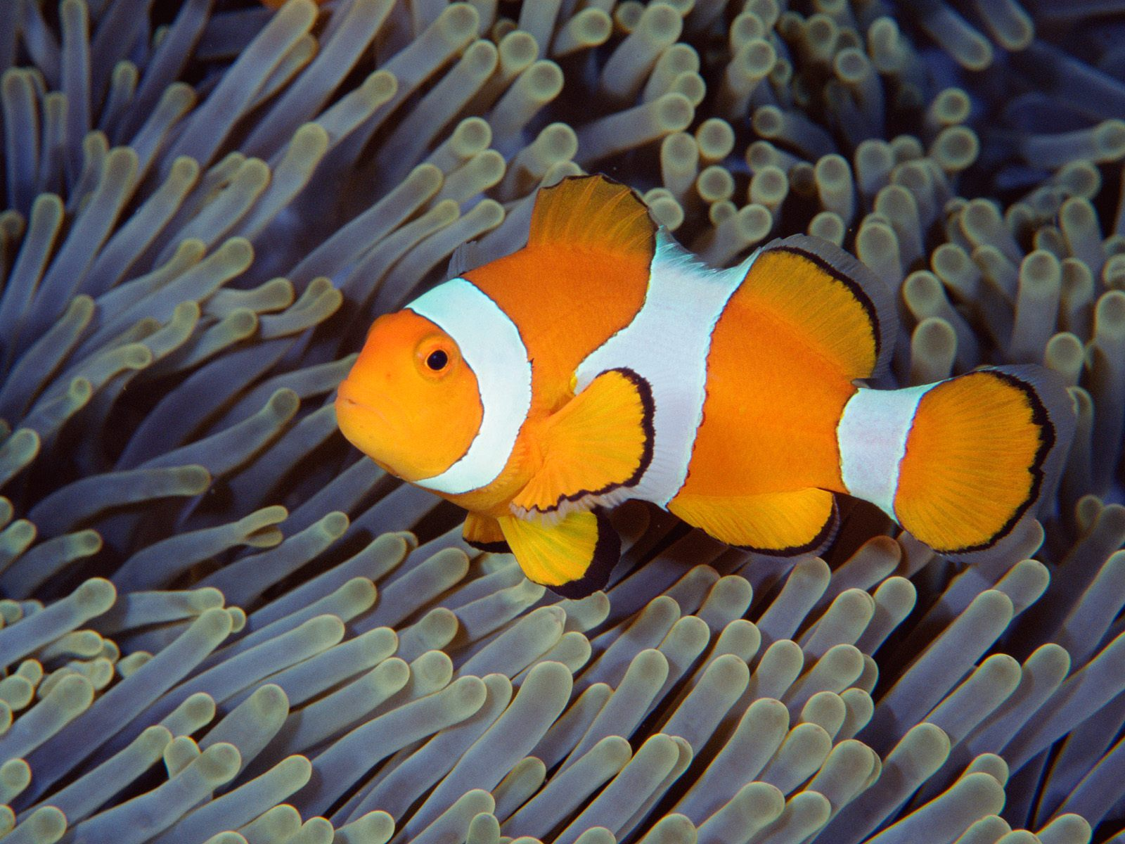
…and this clown fish.

Slide 8
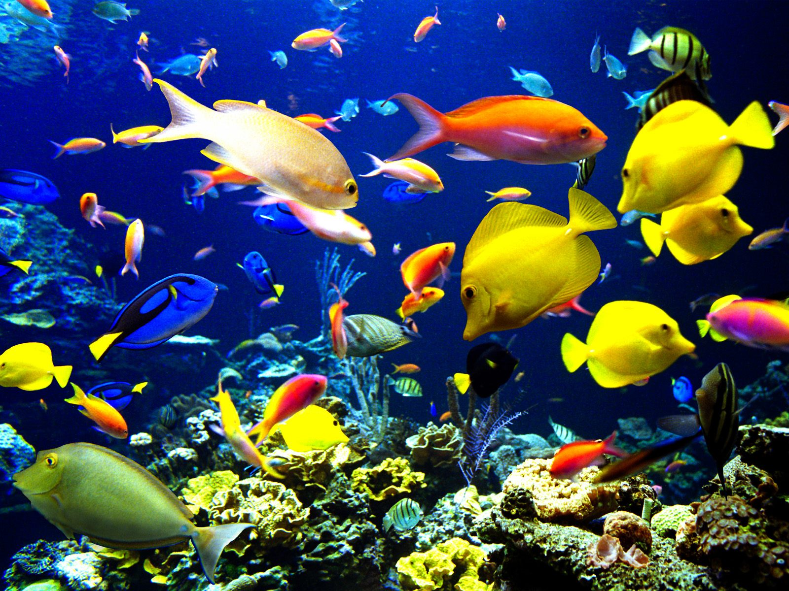
All living things,
including humans, need
water to survive!

Slide 9
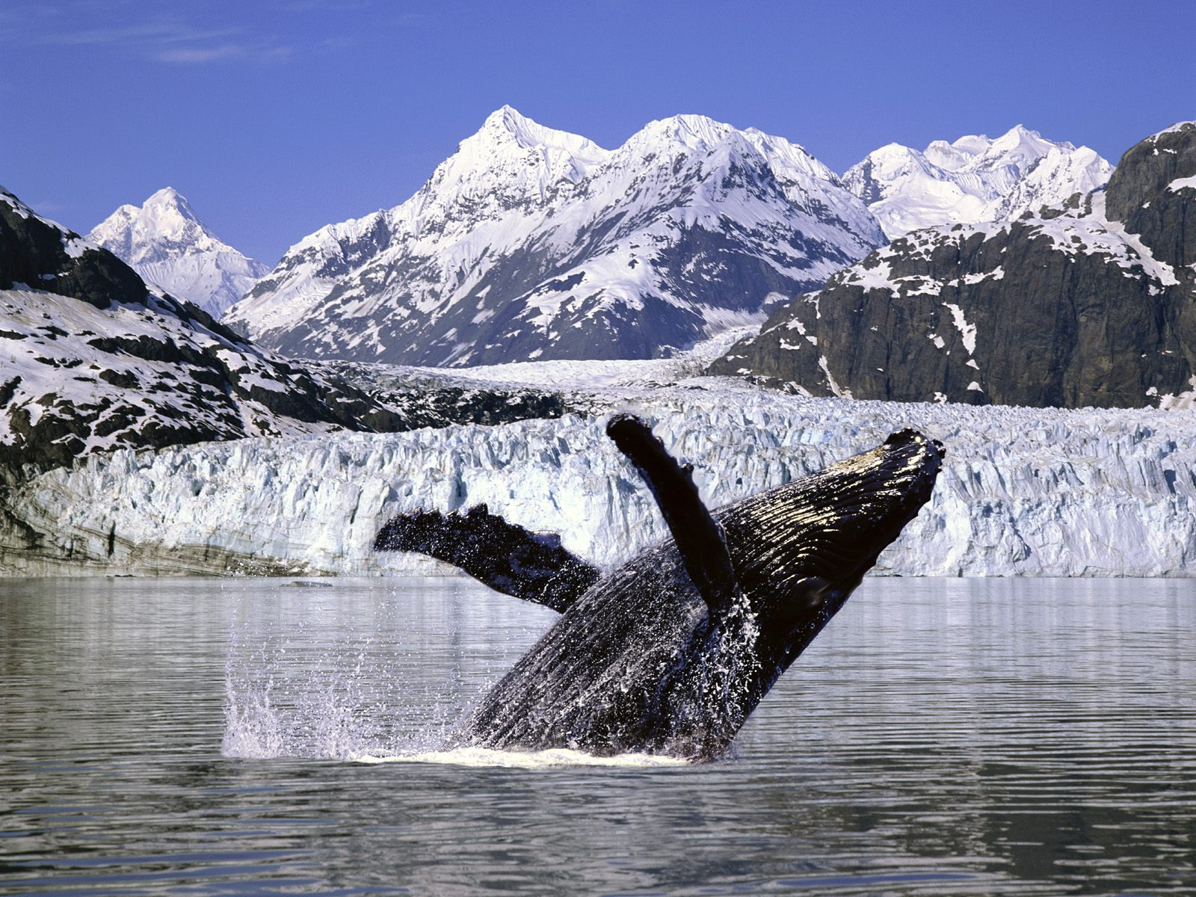

Slide 10
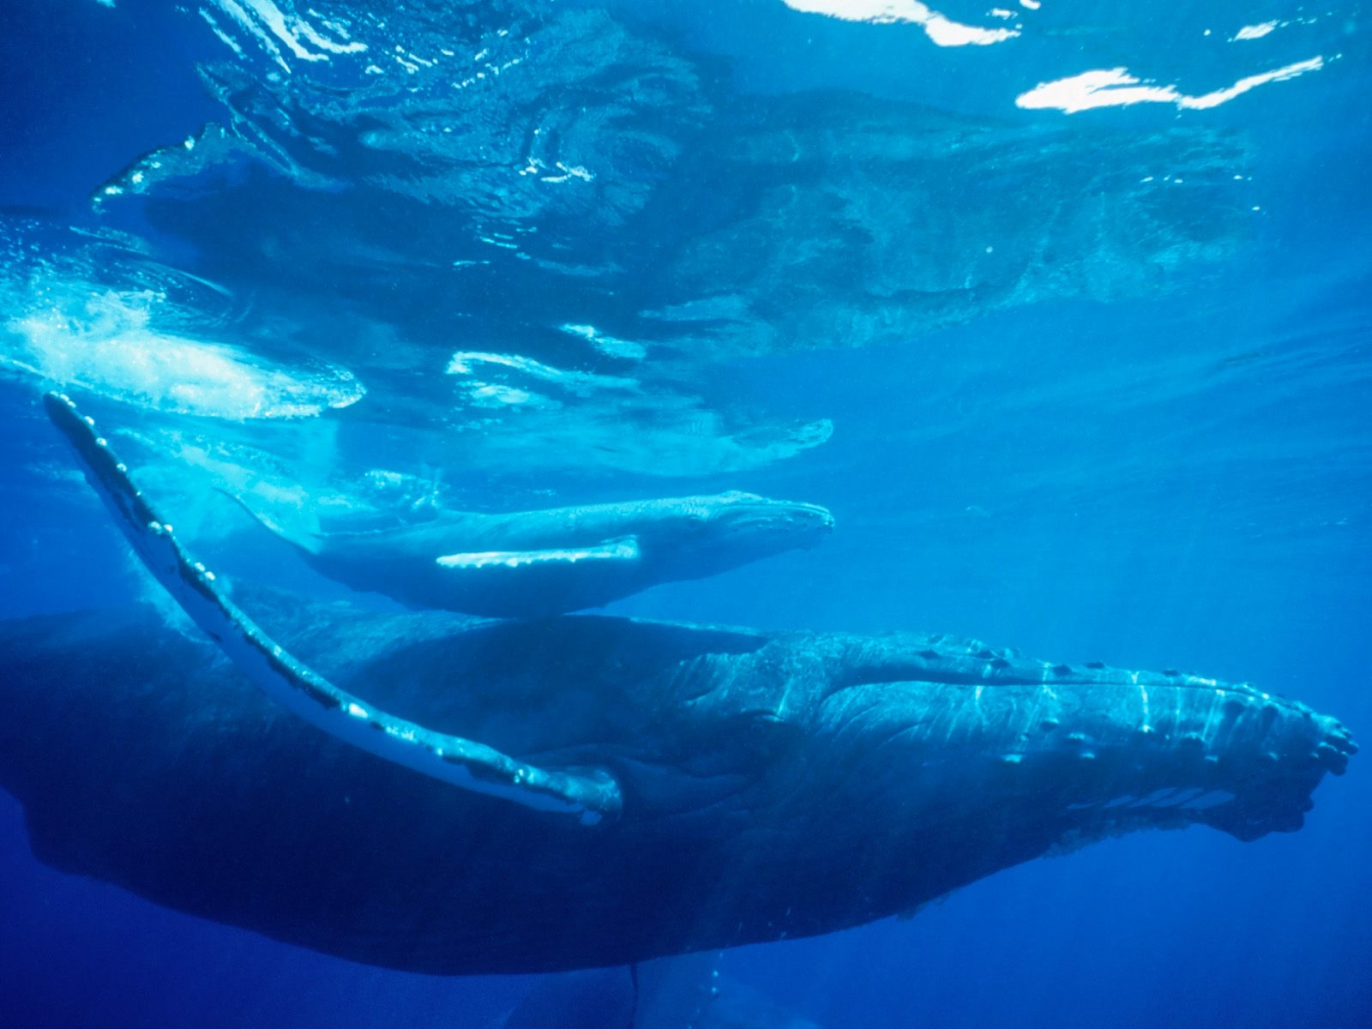

Slide 11
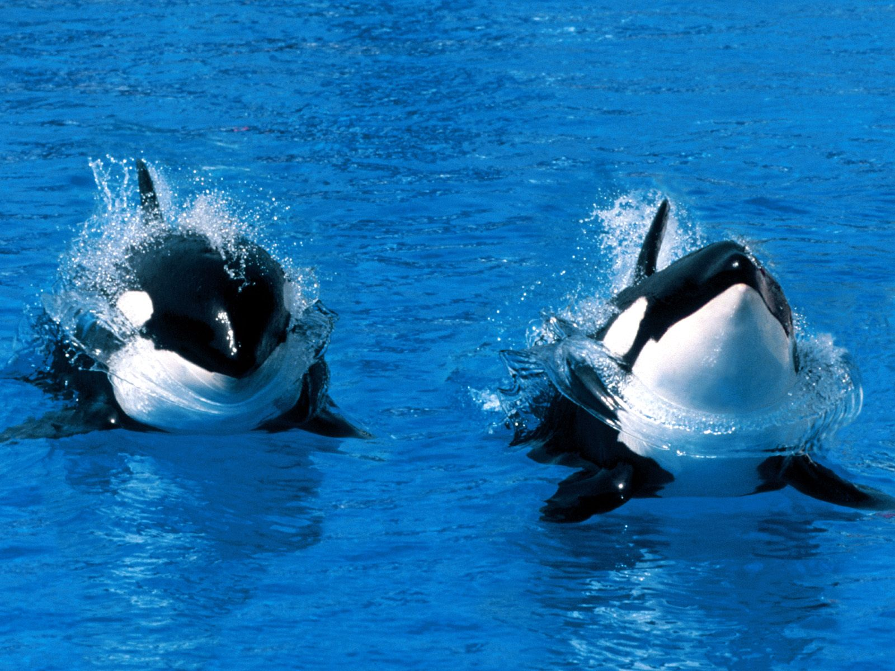

Slide 12
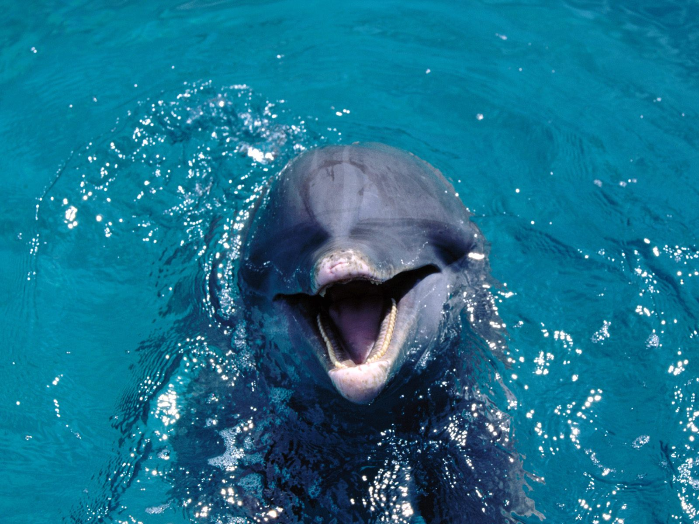

Slide 13
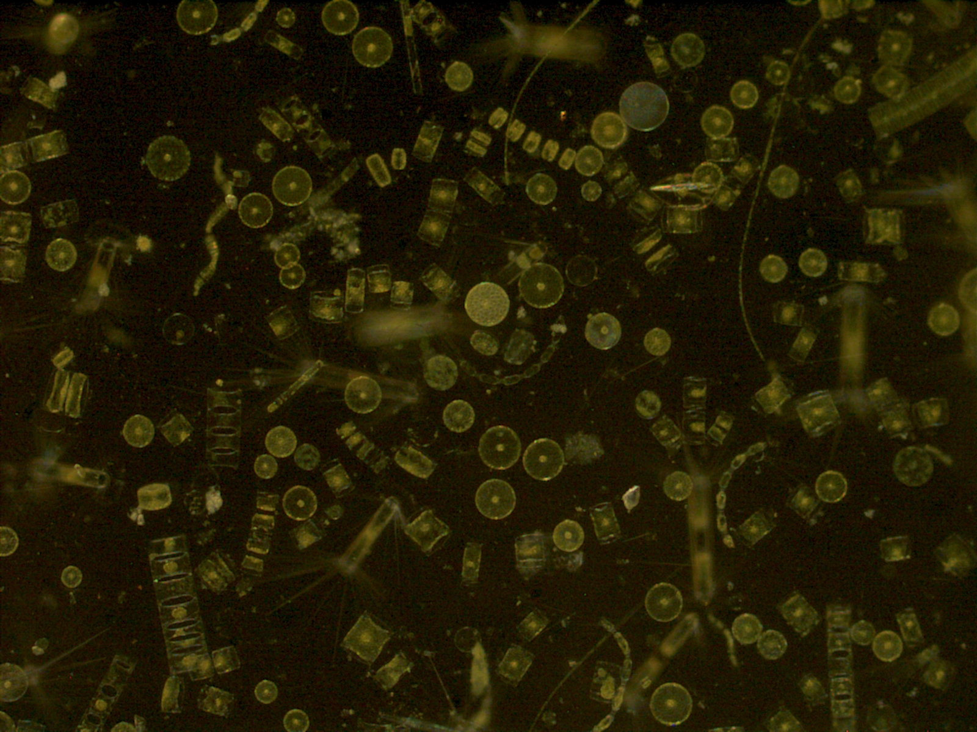
Do you know what this is?

Slide 14
Plankton provides food for a number of animals.

Slide 15
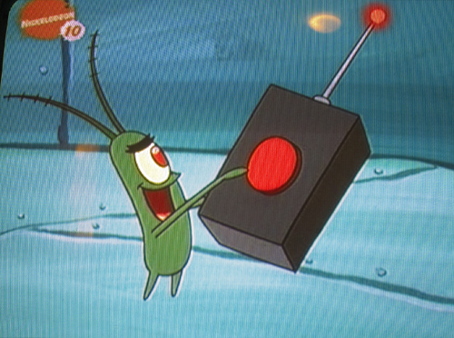
Do you know who this is?

Slide 16
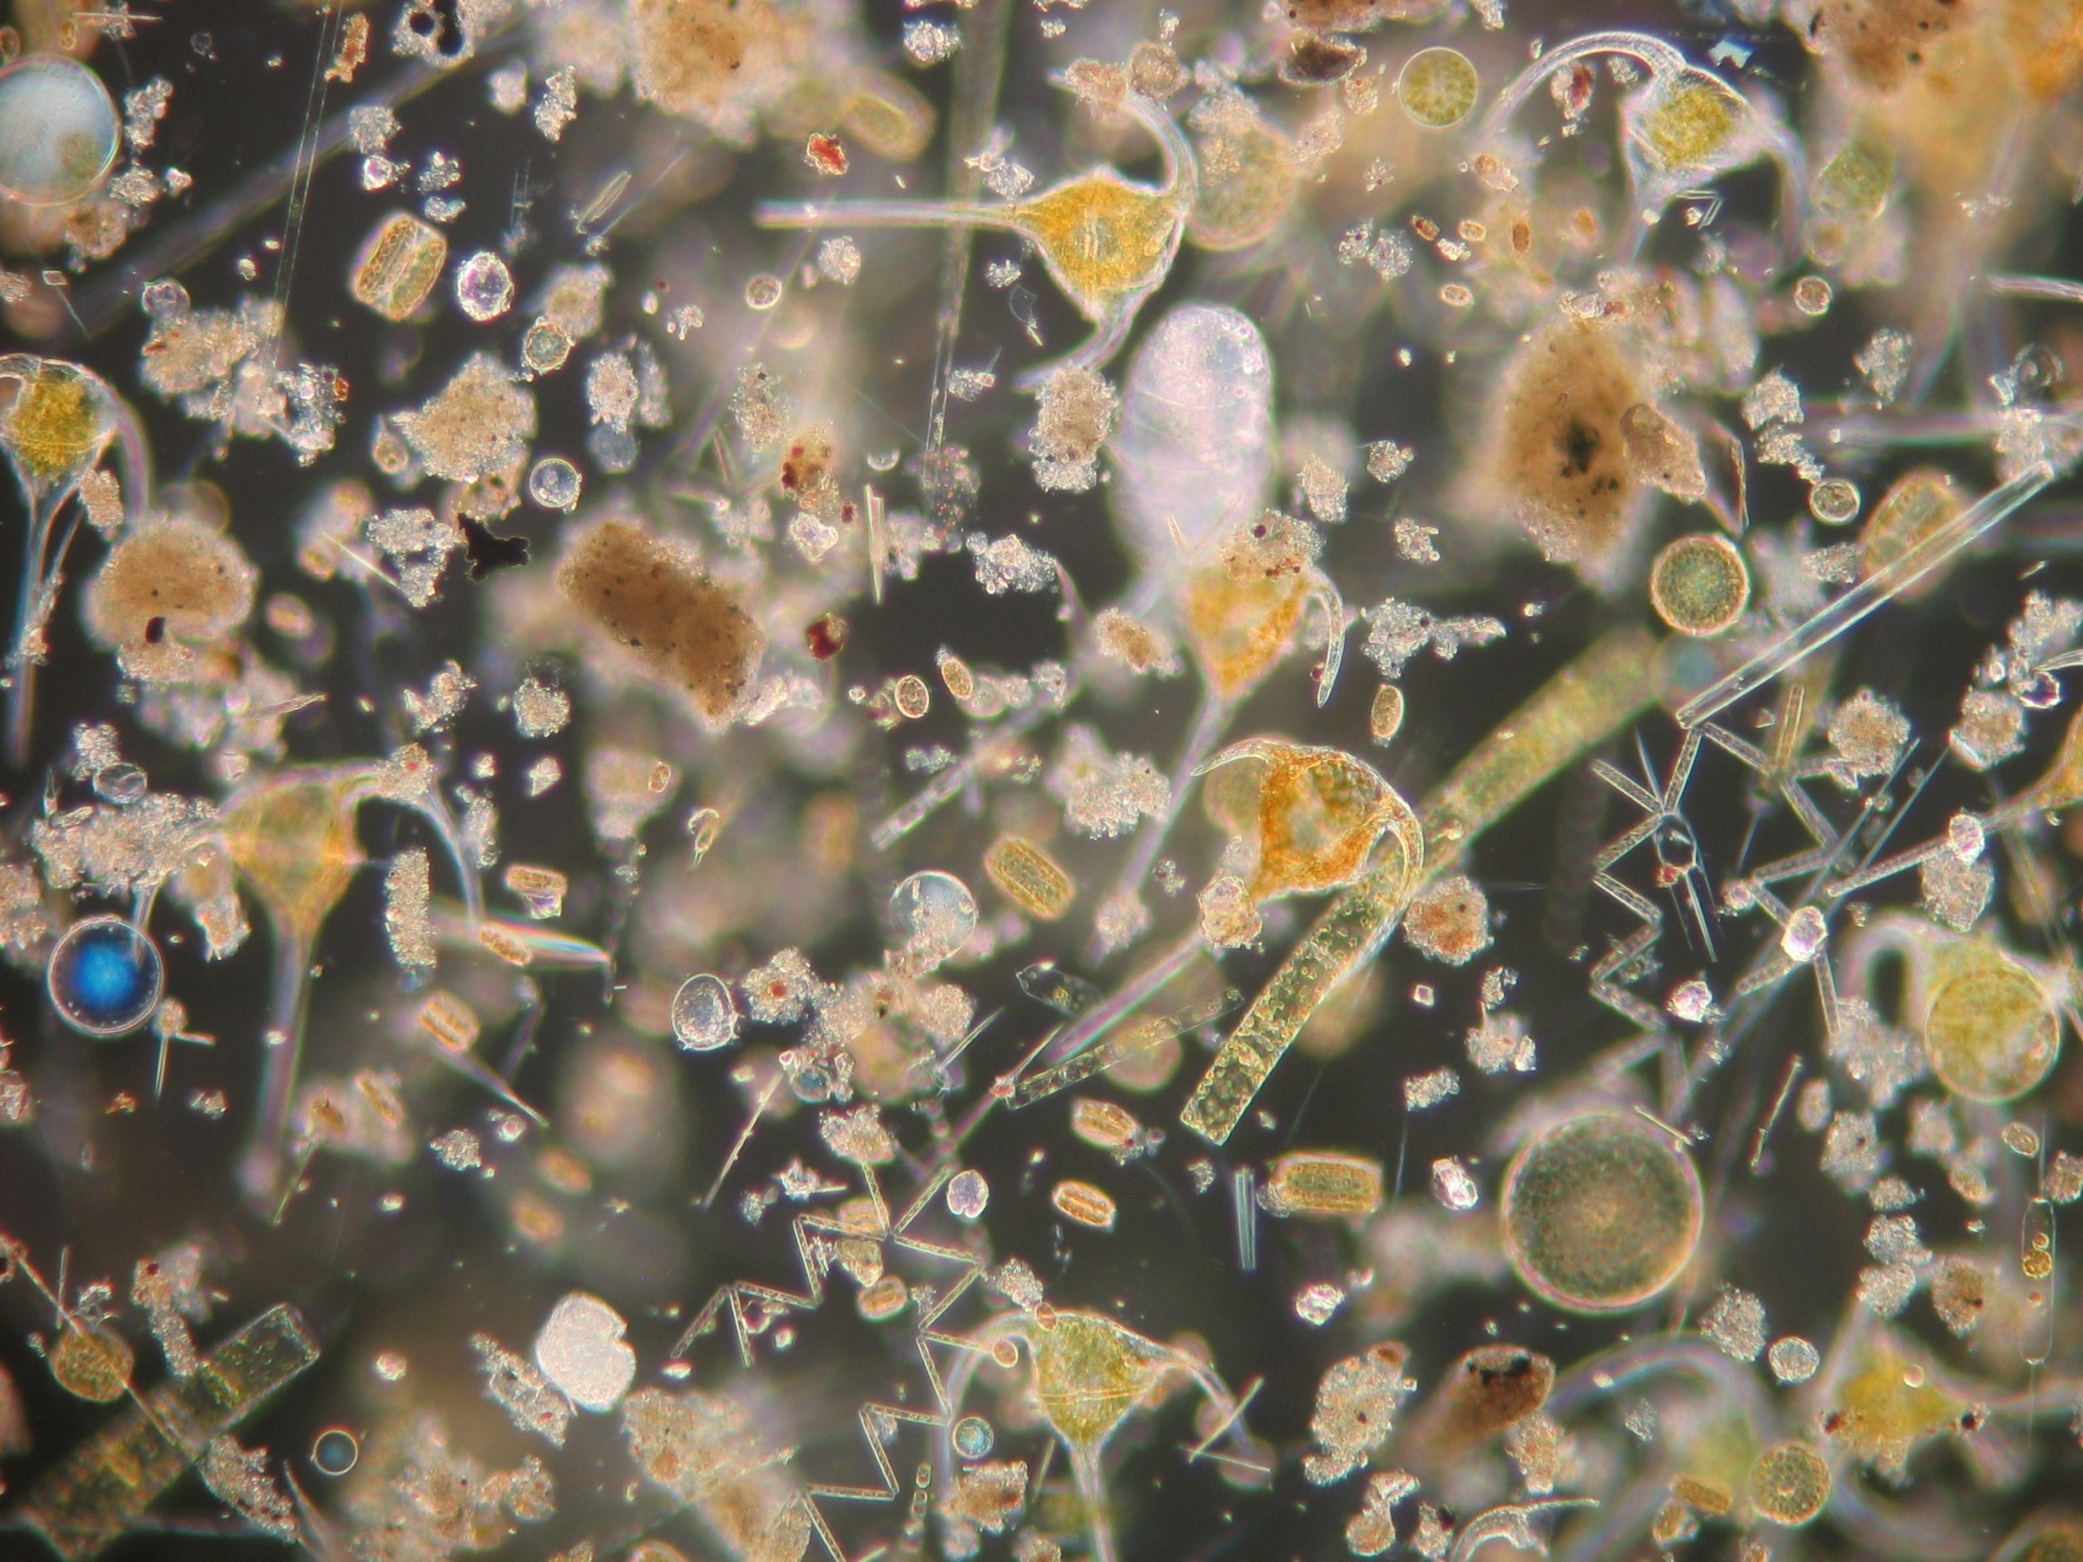
More plankton under a microscope!

Slide 17
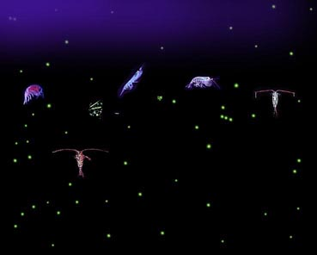
Salt water accounts for
more than 97 percent of
the water on Earth.

Slide 18
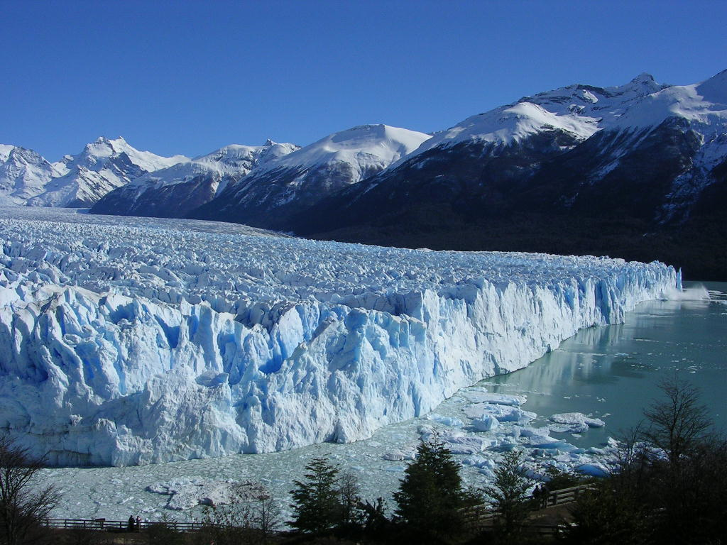
This- is our fresh water supply

Slide 19
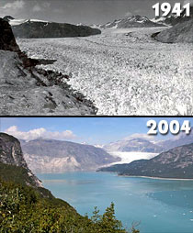
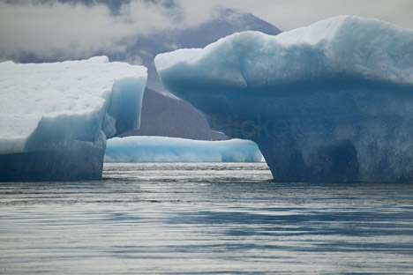
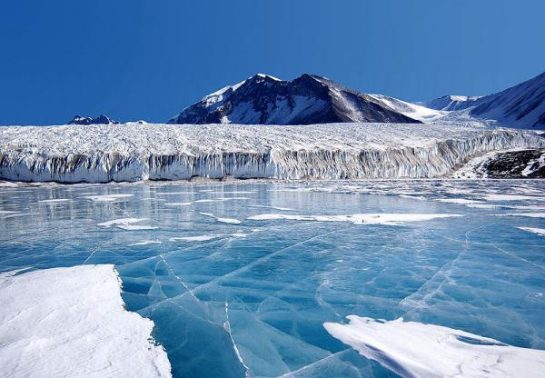
Human activities affect
water quality all over
the world

Slide 20
Do you see the problem?
Some places have a lot of water and some places don’t!

Slide 21
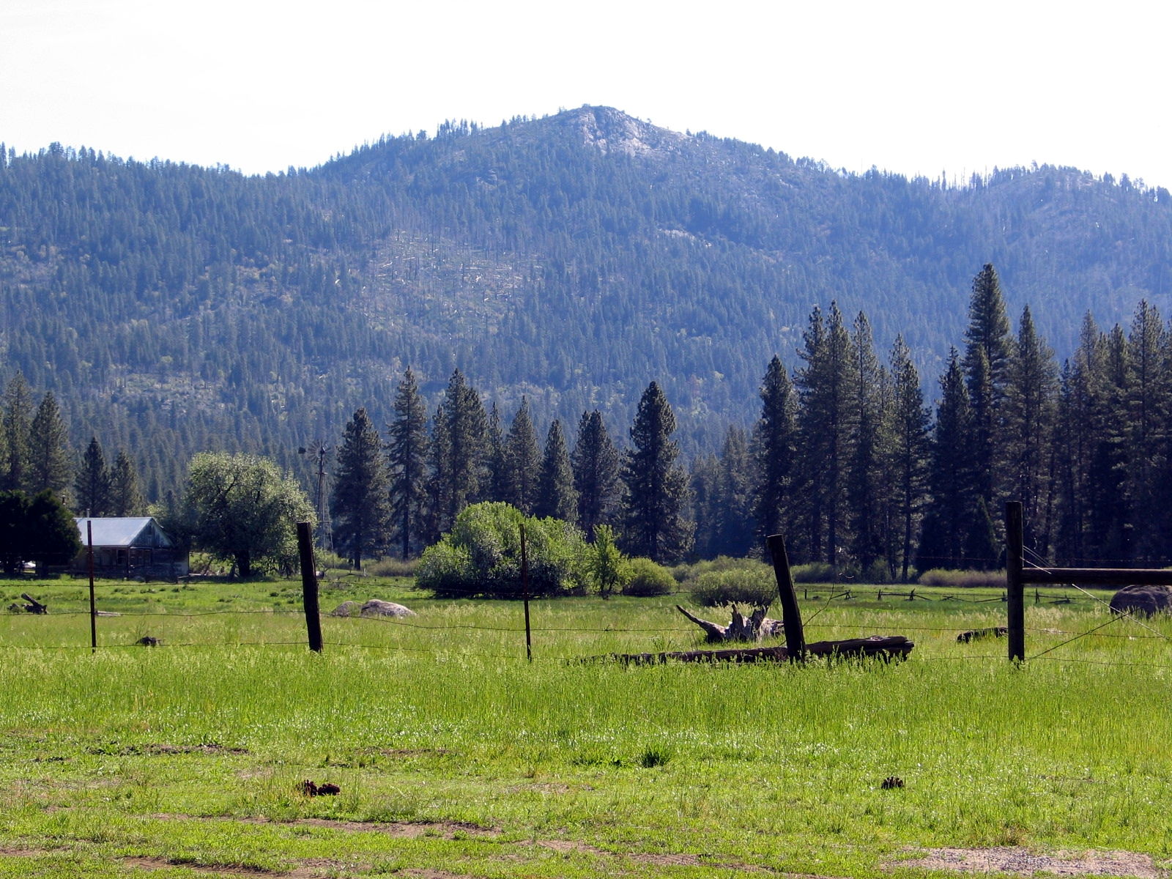

Slide 22
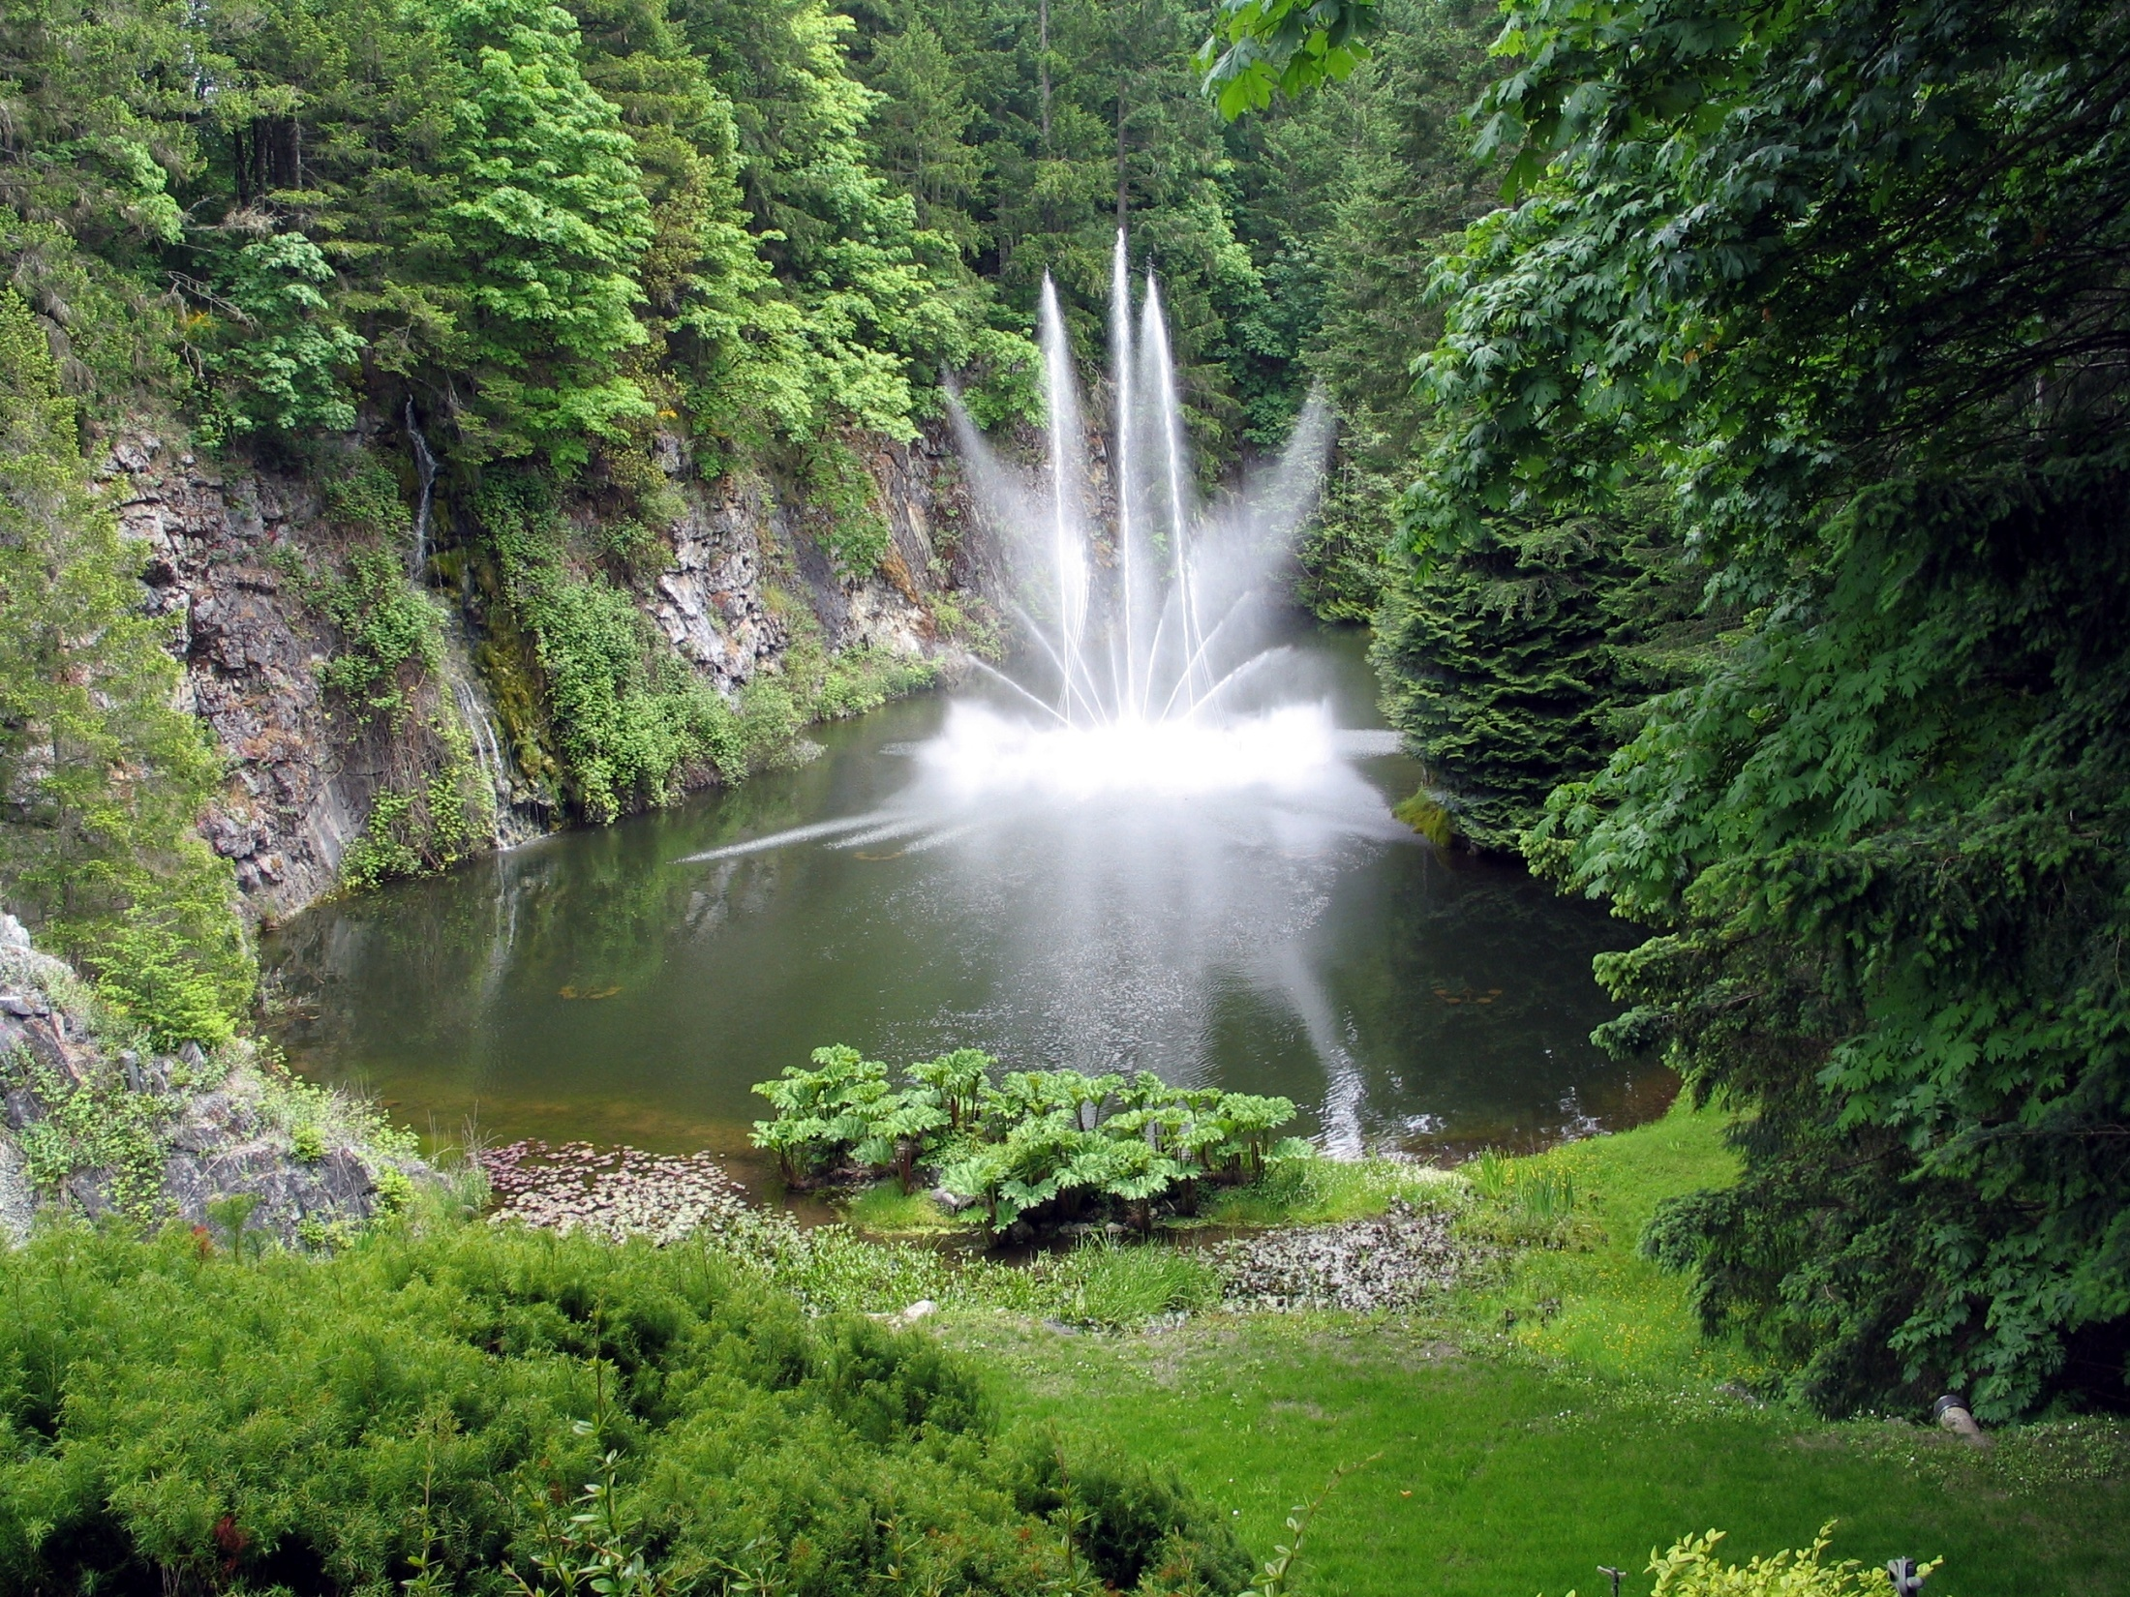

Slide 23
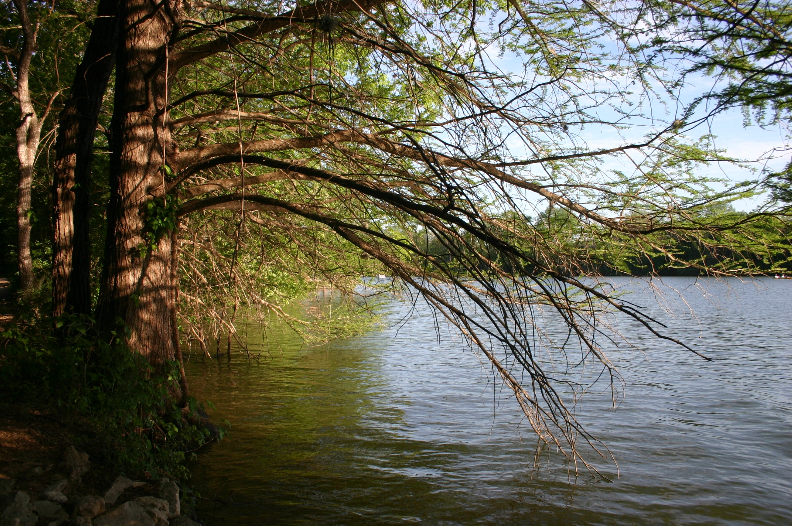
Conserving water helps to preserve the planet’s
natural resources

Slide 24
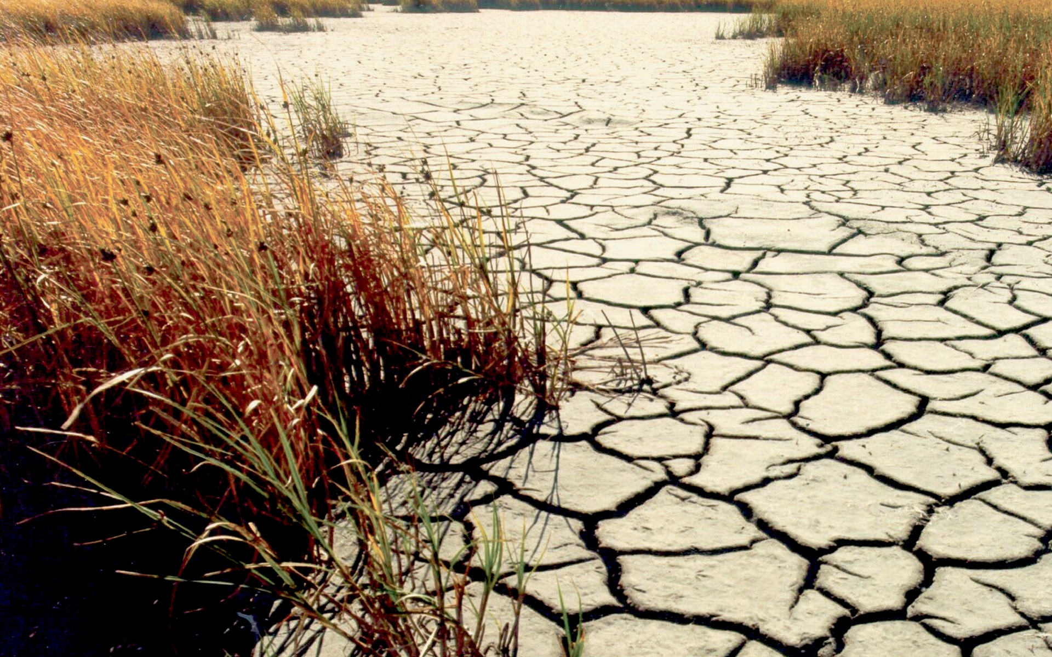

Slide 25
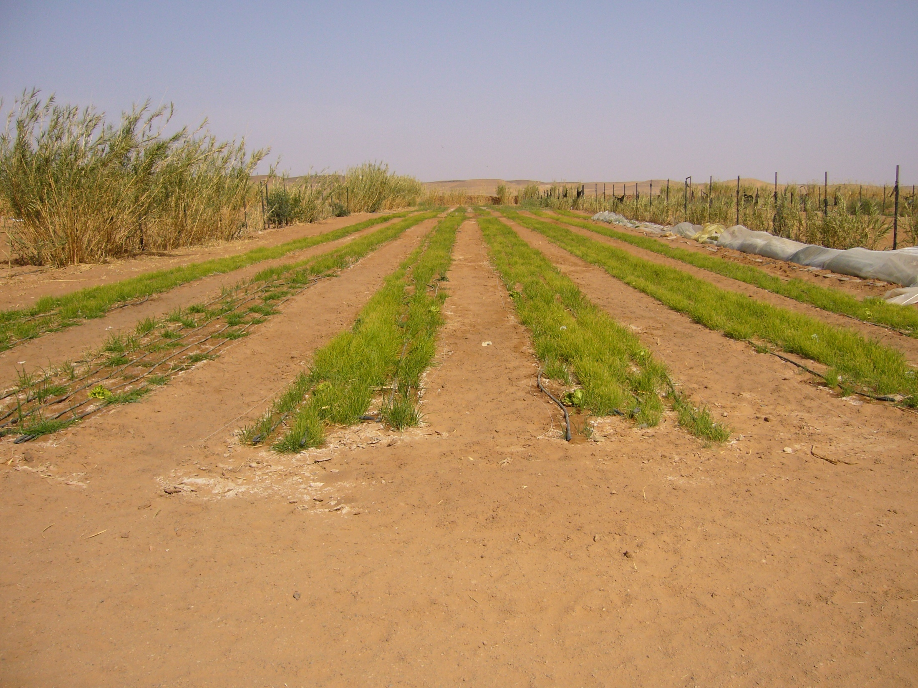

Slide 26
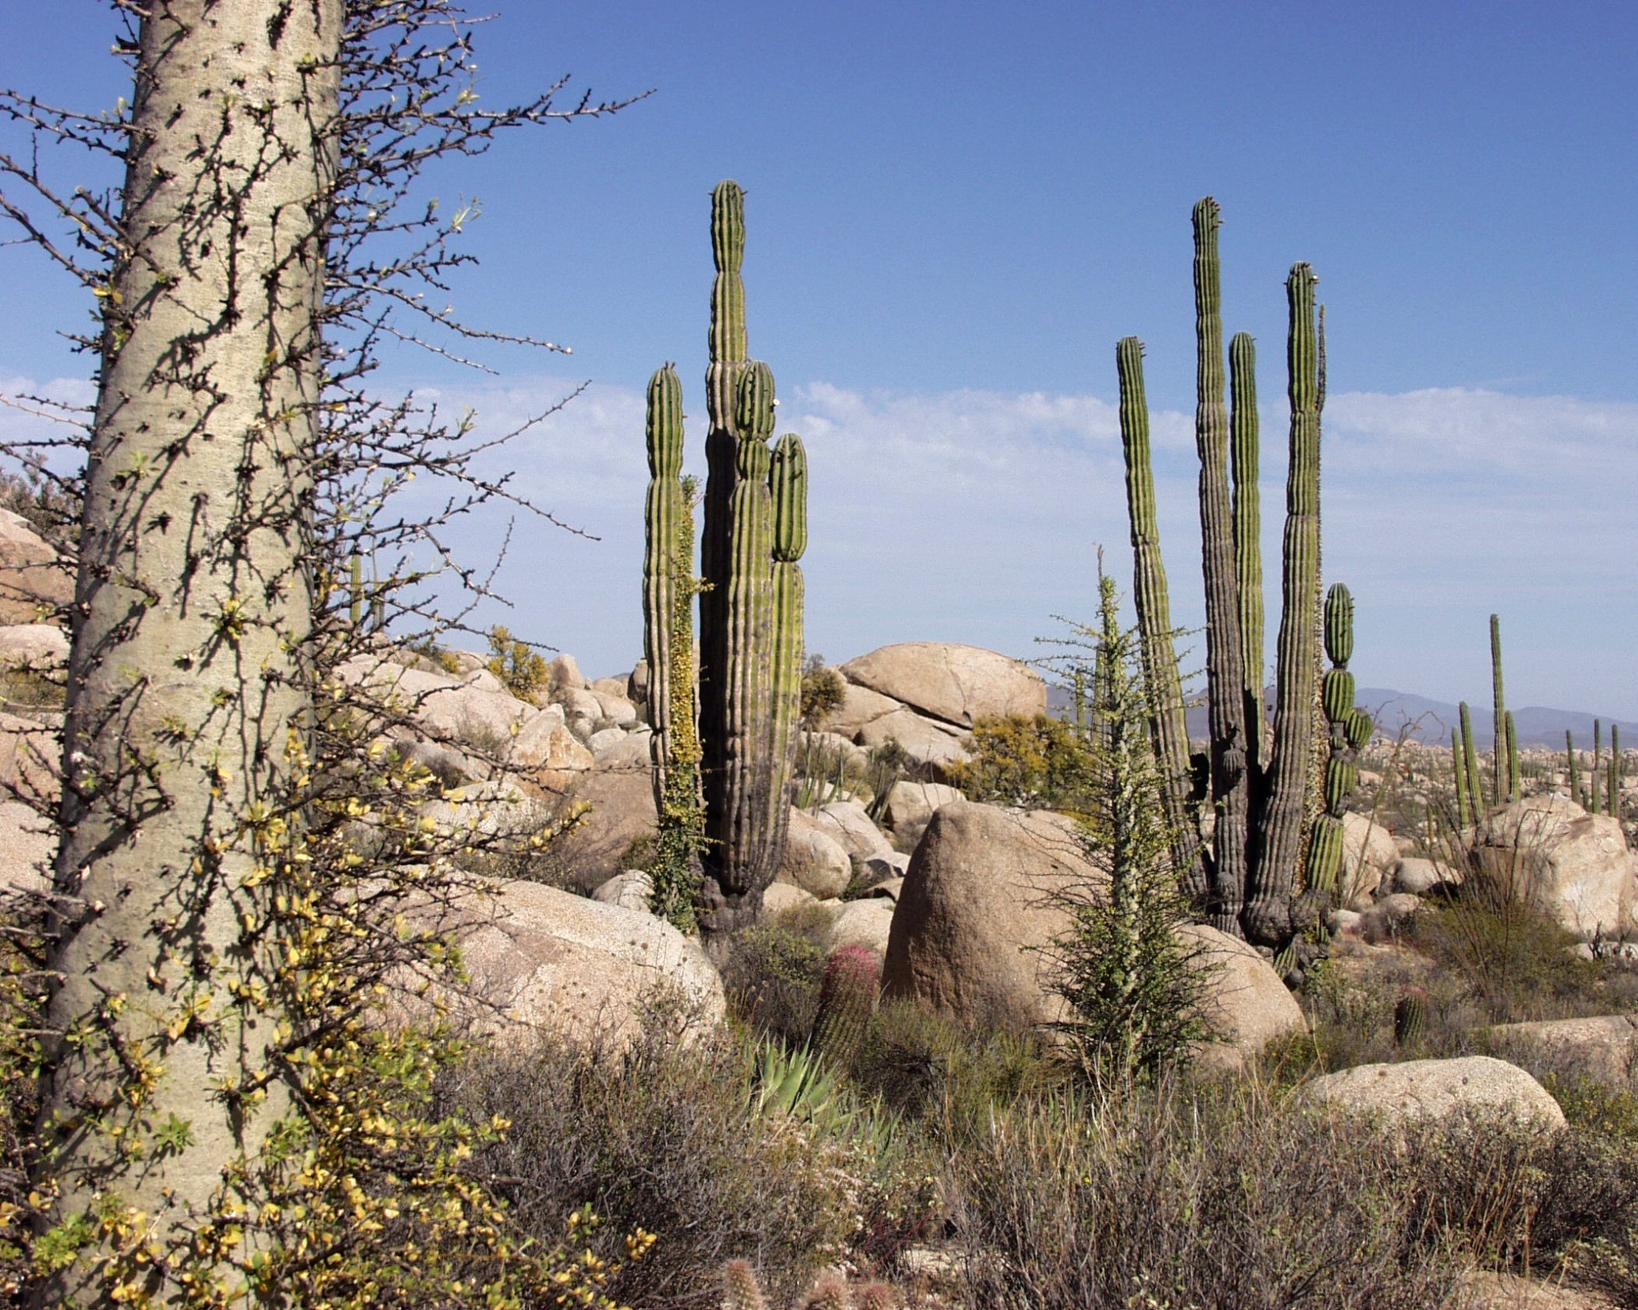
A person can live weeks without food, but only about three days without water!

Slide 27
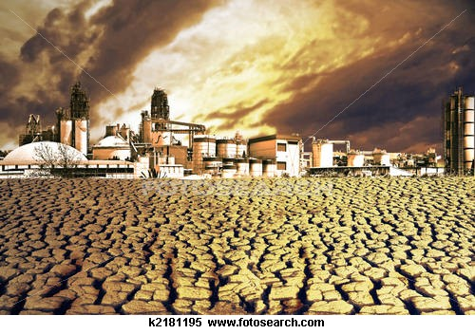
The earth has a limited amount of water. The same water keeps going
around and around the planet in a process called the water cycle.

Slide 28
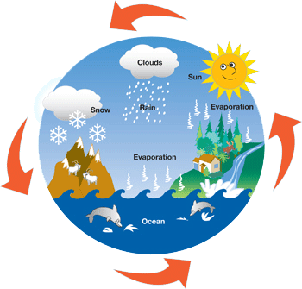
We are using the same water the dinosaurs used!
COOL OR EWWW?

Slide 29
What do we know?

Slide 30
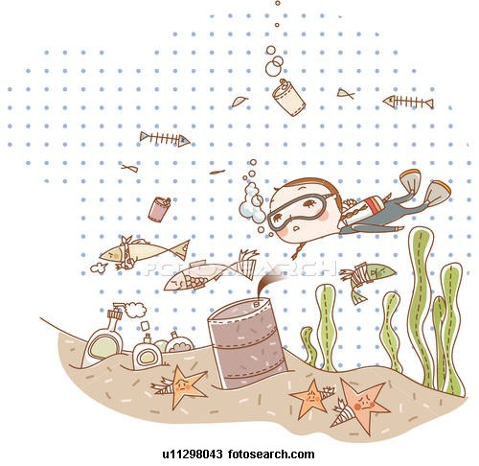
Our oceans are sick!

Slide 31
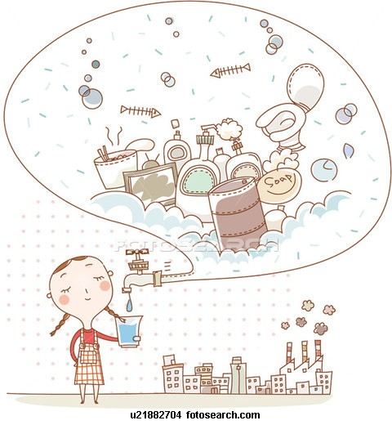
Our water is not clean!

Slide 32

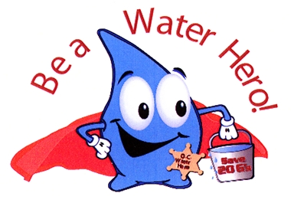
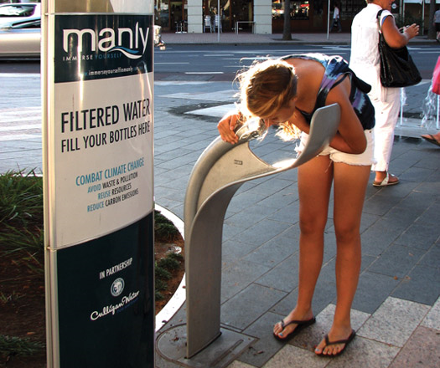
WE NEED WATER!

Slide 33
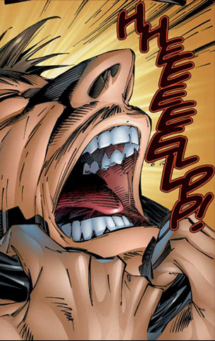
HOW CAN WE HELP?

Slide 34
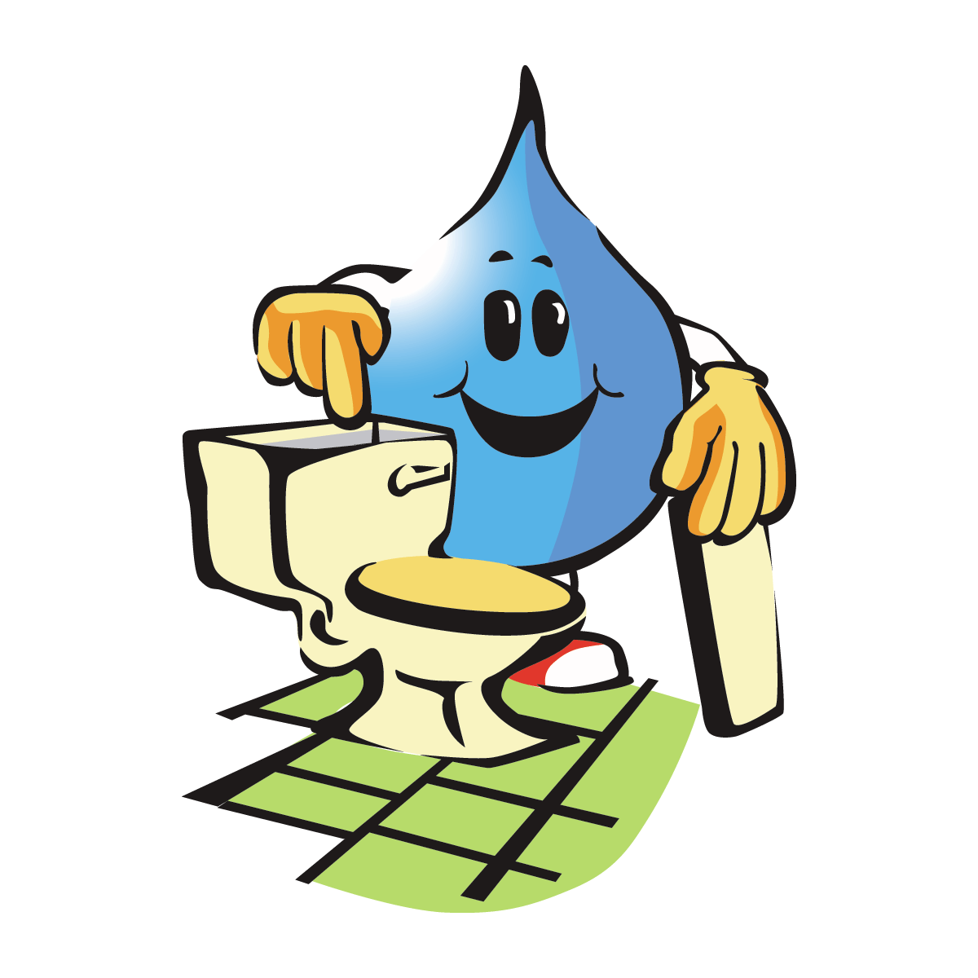
Check for toilet leaks.

Slide 35

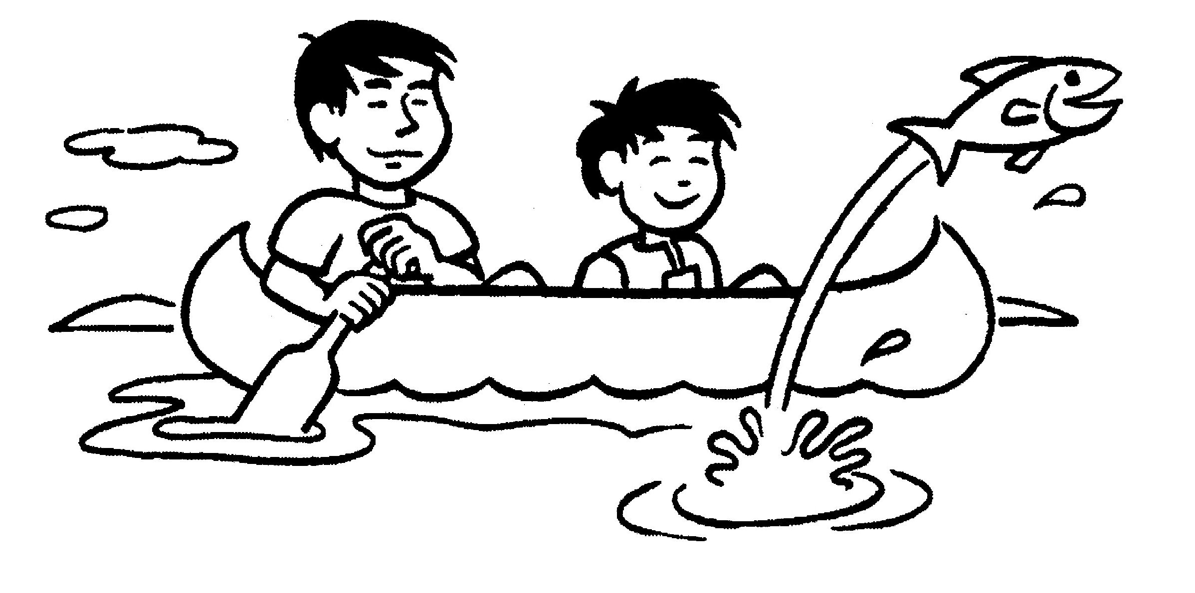
Take lots of pictures and leave only footprints behind!

Slide 36
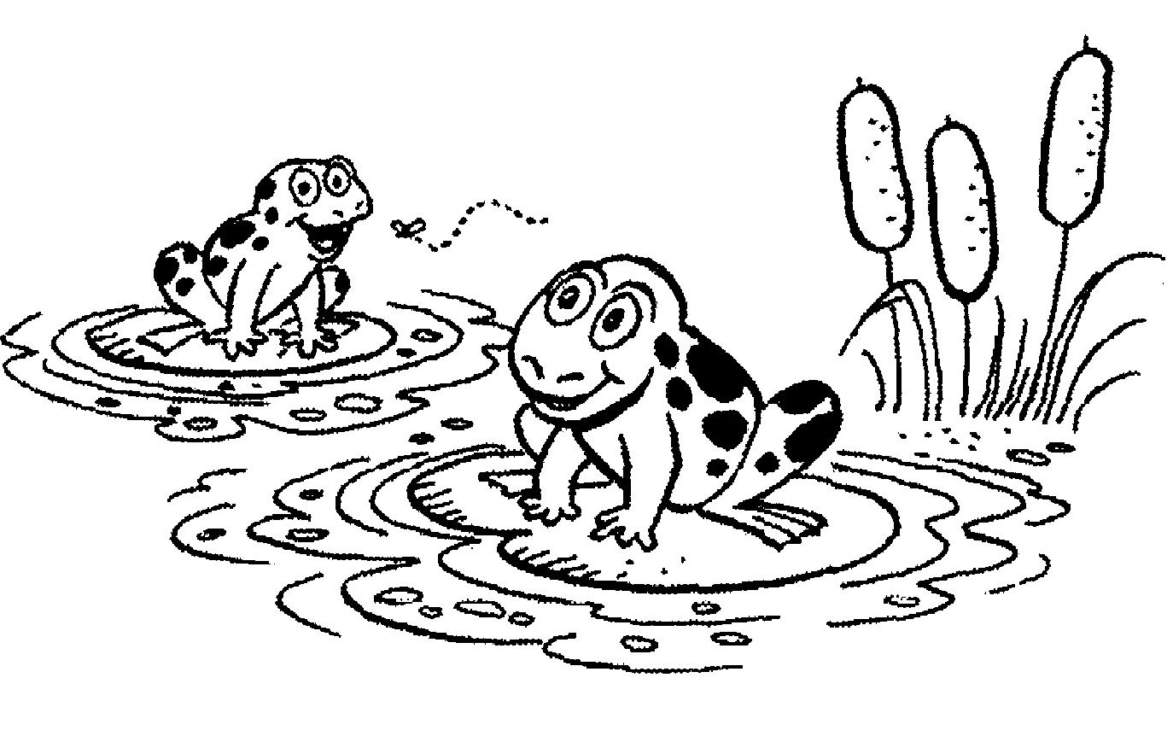
Everything has its place.

Slide 37
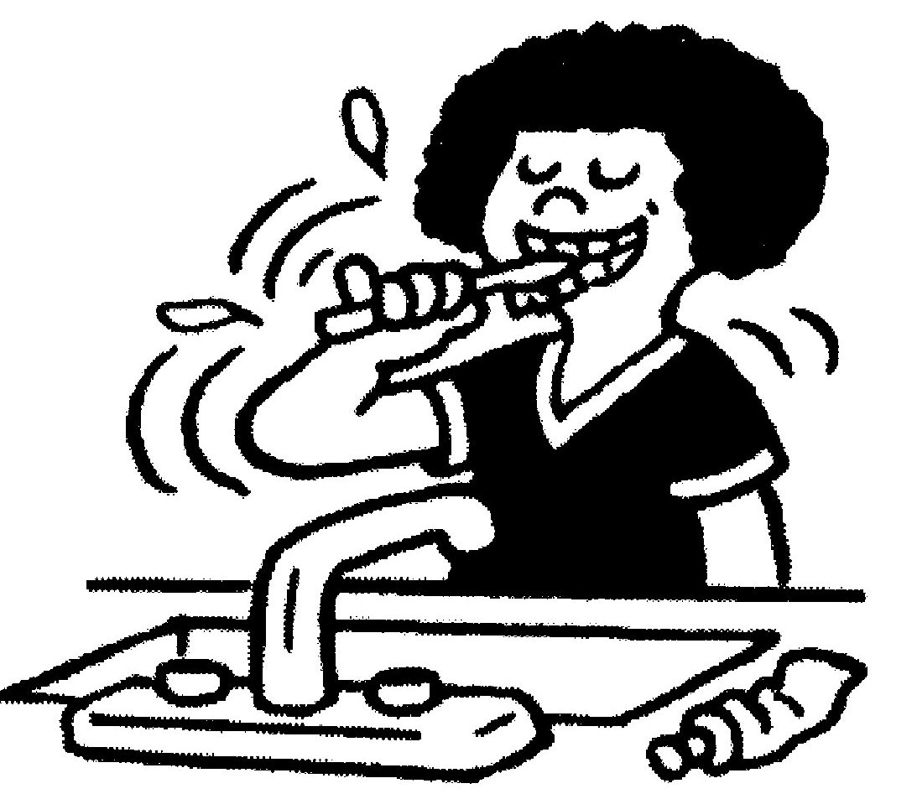
Turn off the tap when brushing your teeth.

Slide 38
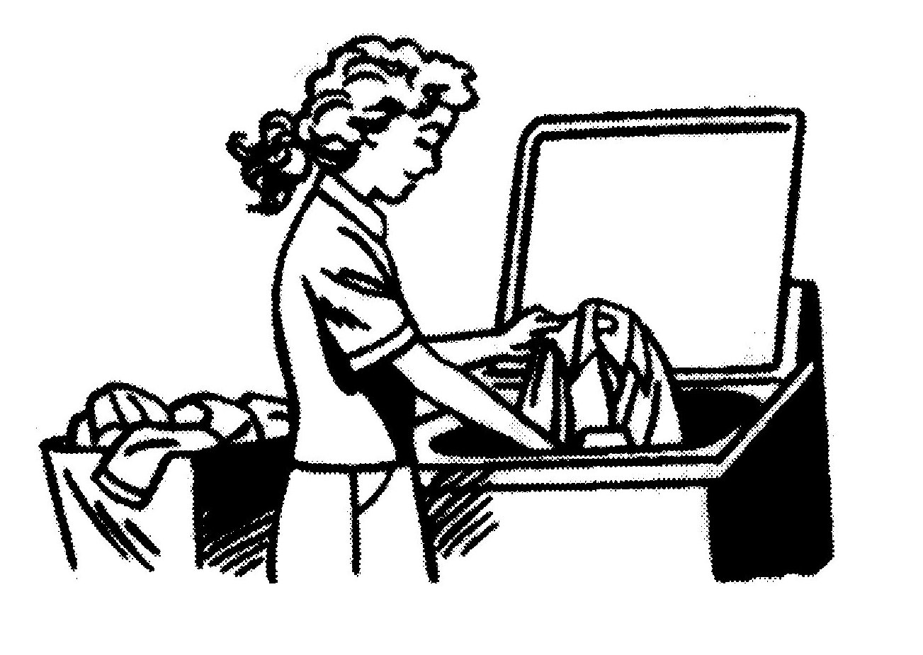
Fill the washing machine.

Slide 39
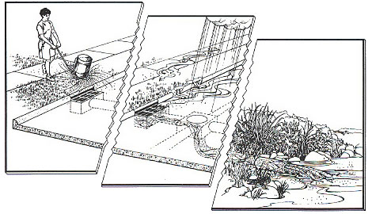
Remember that what you throw down the drain , comes back in the rain!

Slide 40
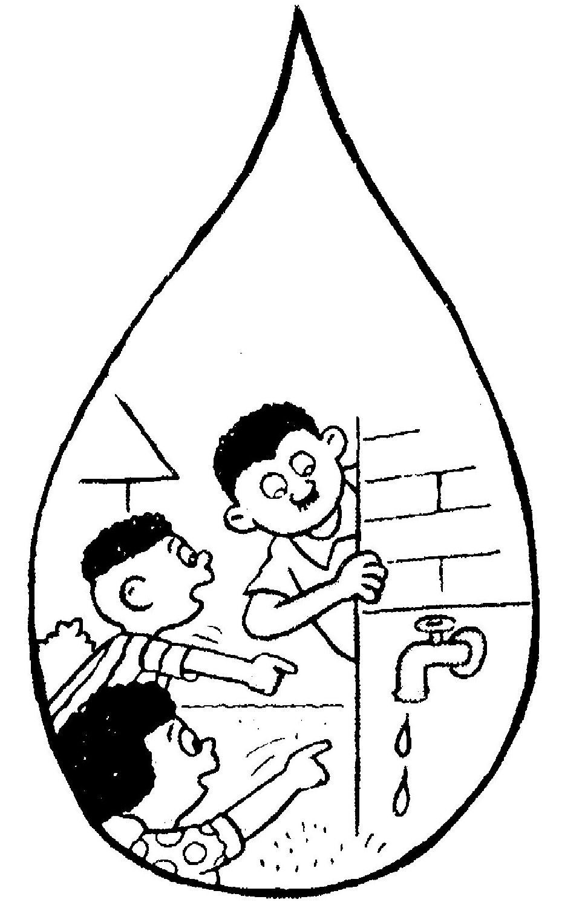
Check for leaks and turn off taps.

Slide 41
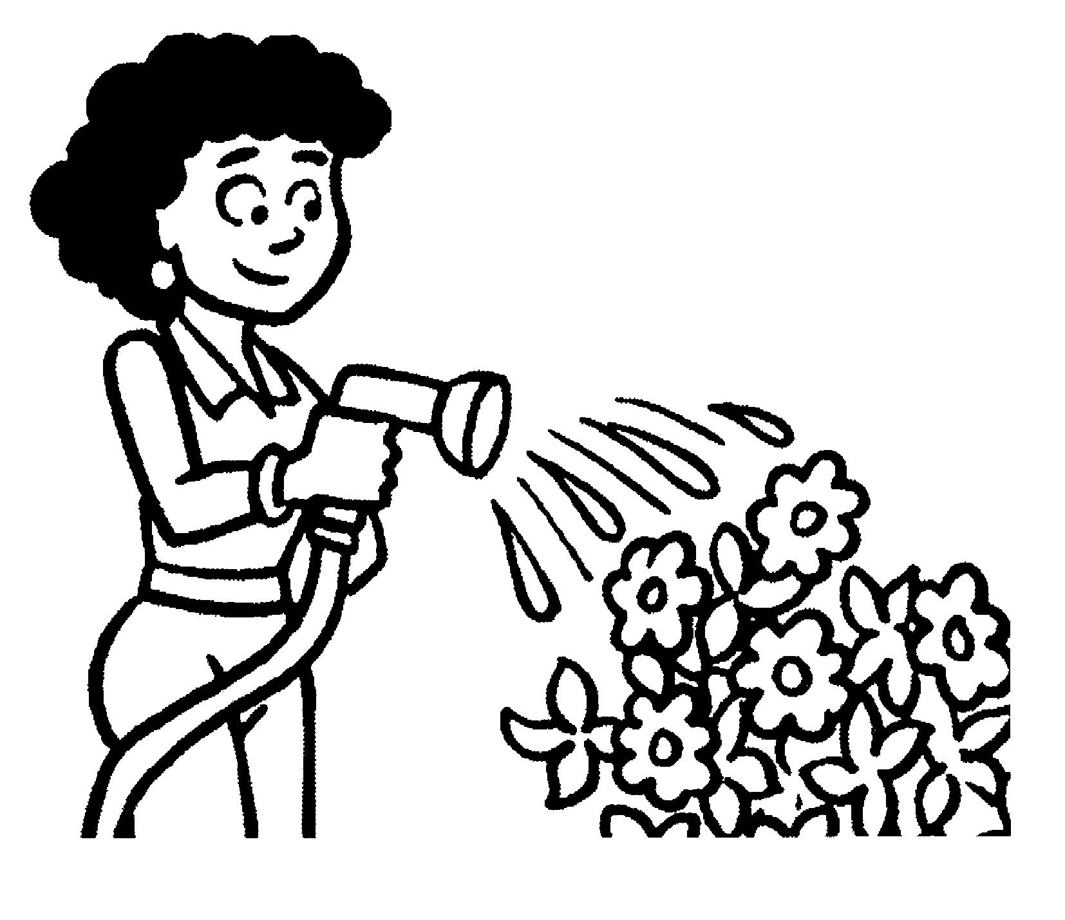
Water your garden using bath water or dish water.

Slide 42
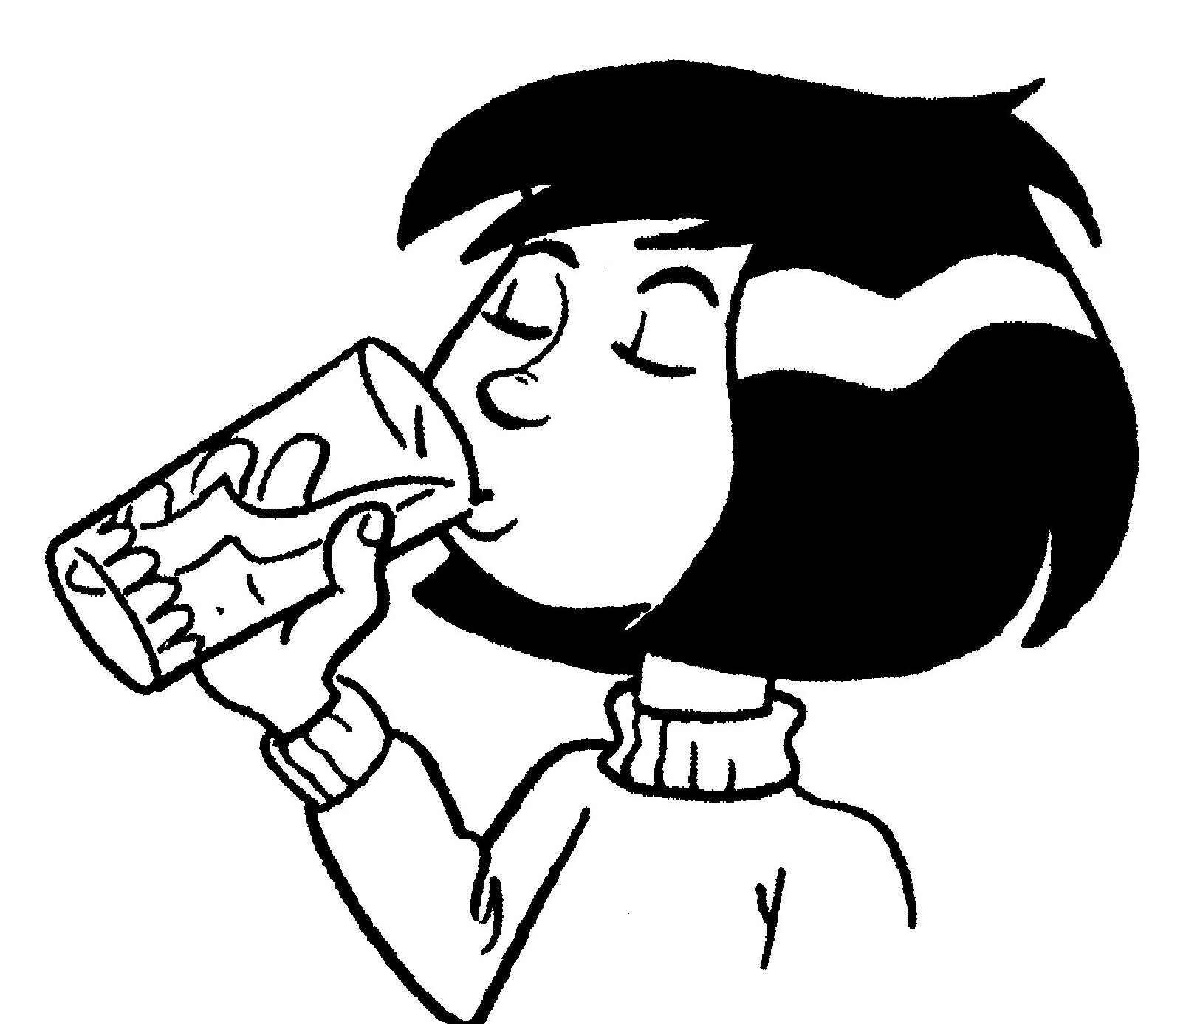
Be aware and take care!

Slide 43
REMEMBER THAT…

Slide 44


