Slide 1
Volcanic Ash covered landscape.

Slide 2
Puyehue volcano in southern Chile has spread volcanic ash far and wide since it erupted in early June. On Monday, Argentina's president announced that economic relief would be provided to residents affected by the ash in the southwestern region of Patagonia. And as recent as July 1 ash in the atmosphere was disrupting flights at the Buenos Aires airport. These images show how the earth's landscape has been affected.

Slide 3
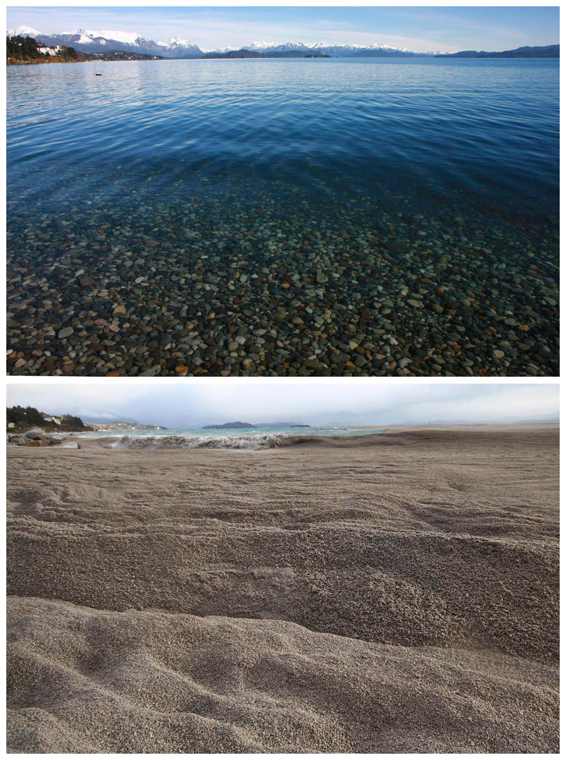

Slide 4
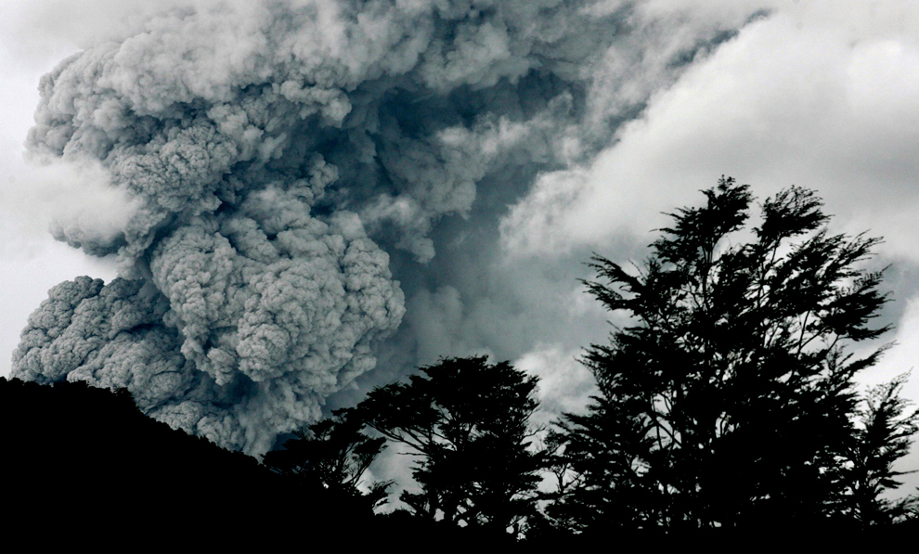

Slide 5
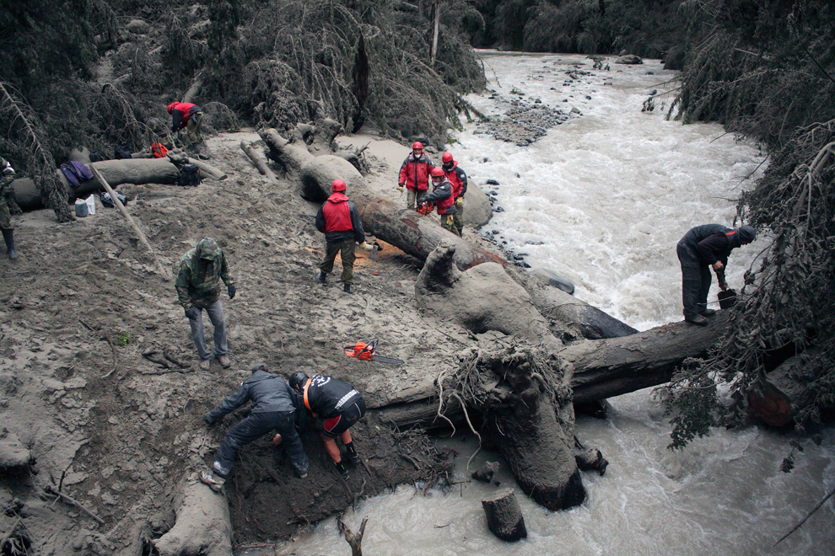

Slide 6
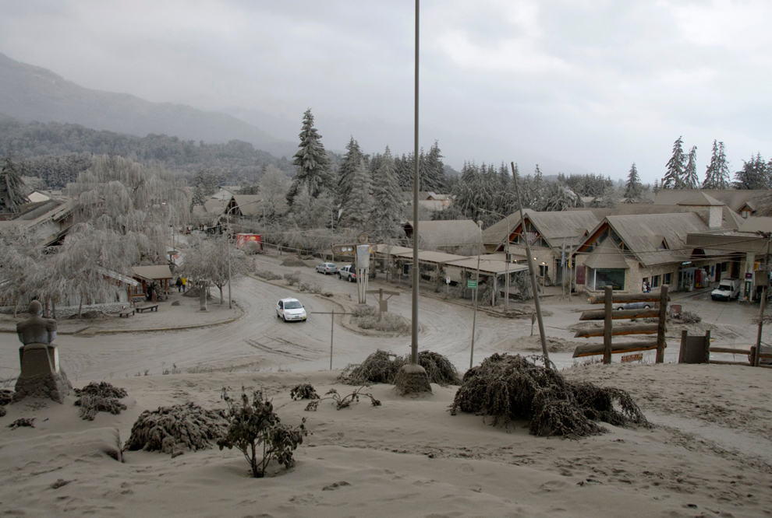

Slide 7
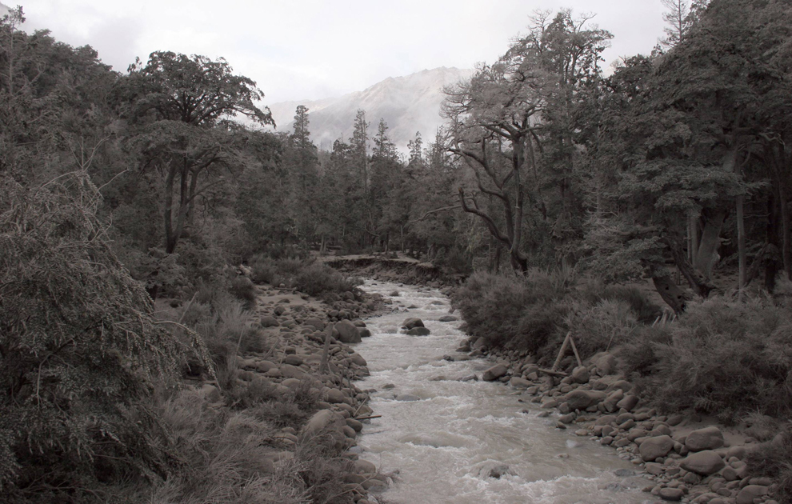

Slide 8
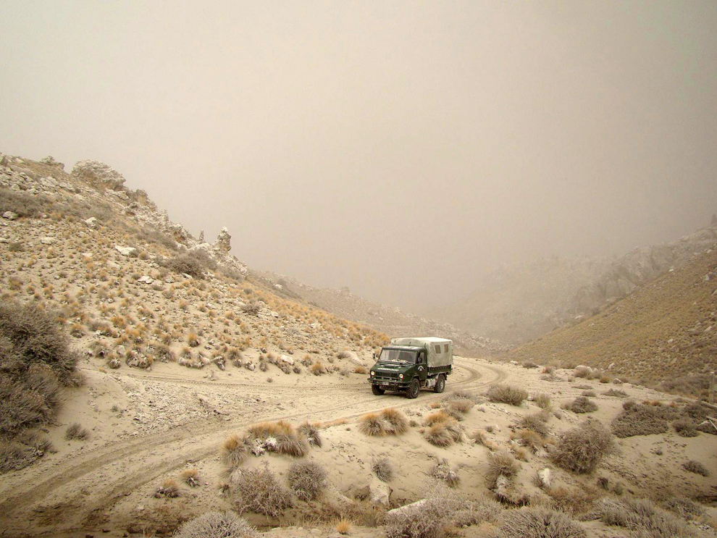

Slide 9
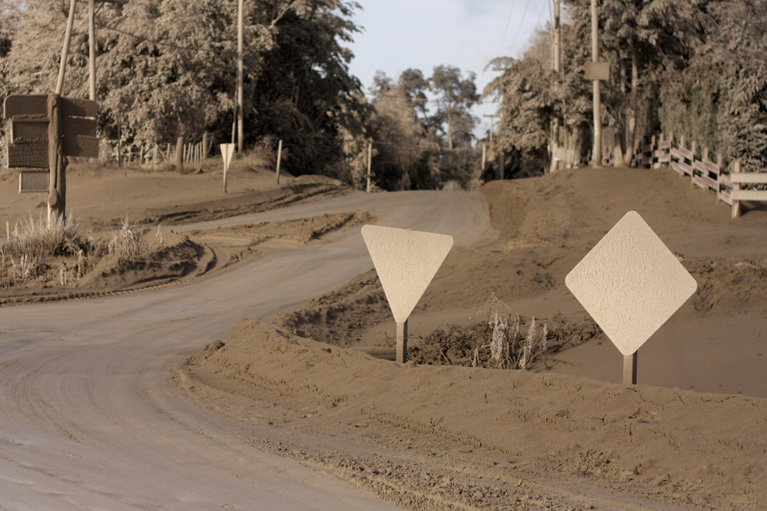

Slide 10
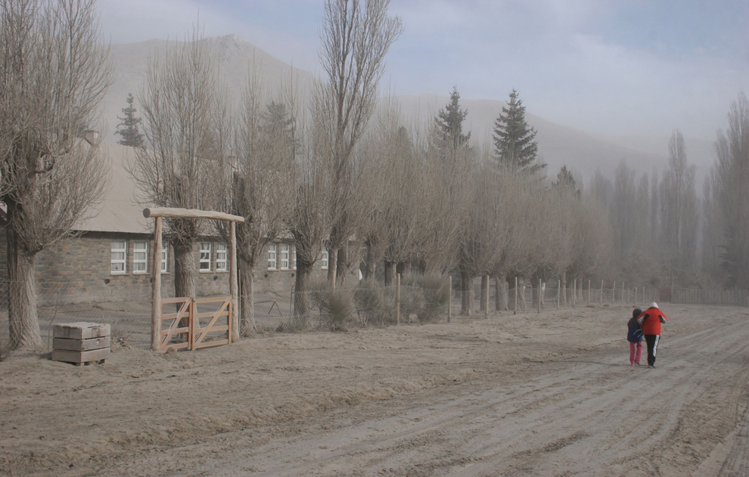

Slide 11
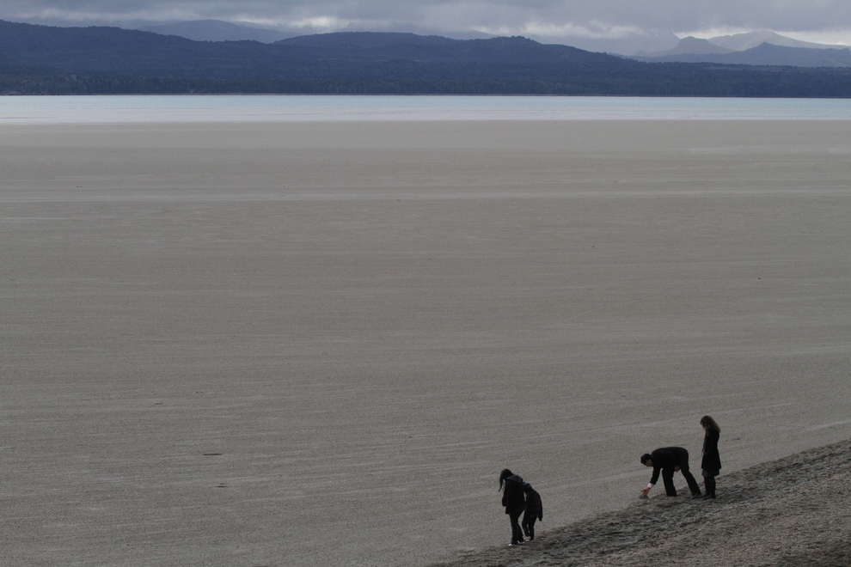

Slide 12
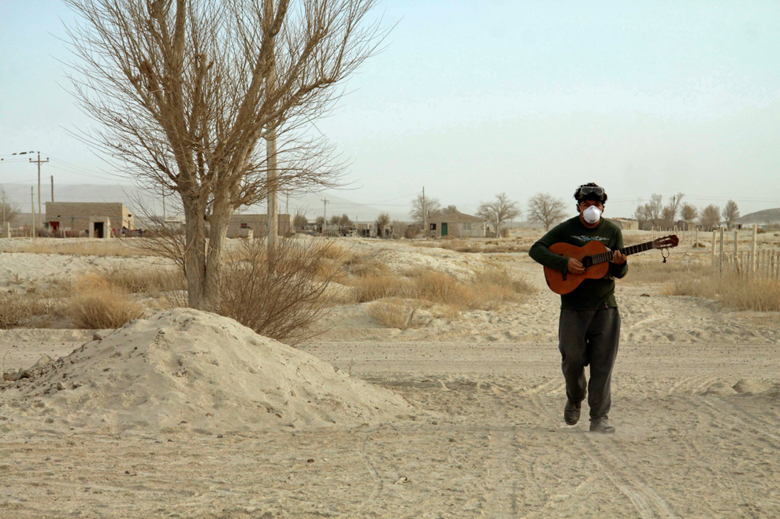

Slide 13
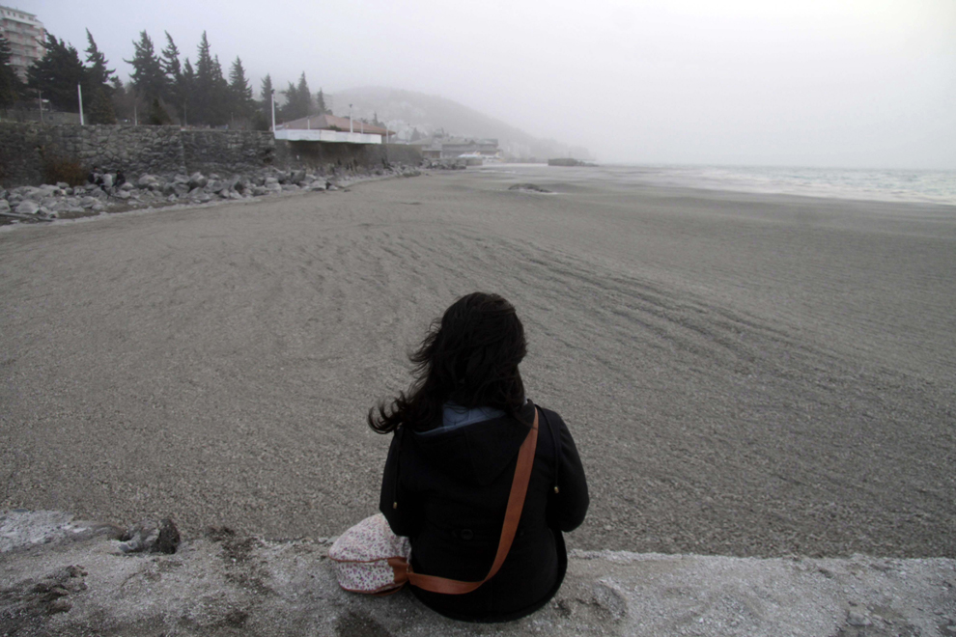

Slide 14
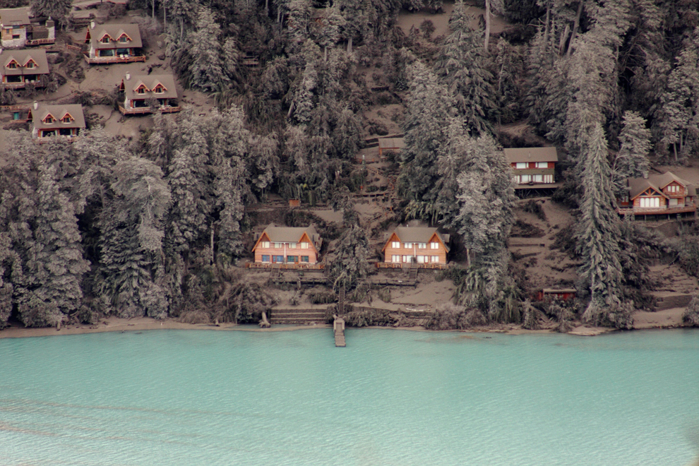

Slide 15
