Slide 1
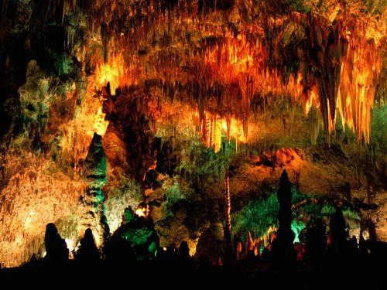
Underwater wonderland: Divers take the plunge to reveal stunning images of beautiful crystal cave in depths of Russia

Slide 2
The Orda Cave in the western Urals region is three miles of eerily dramatic natural channels created by water so clear divers can see over 50 yards ahead of them.
'This cave is unique - it is real wonder of nature,' explained Mr Lyagushkin. 'But if you want to see Orda cave for yourself, you must be experienced cave diver.
'For the millions of years this amazing place has existed water has formed it into a palace while no human was here. 'To visit this cave gives you a special feeling - I think the same feeling cosmonauts on the Moon have. 'You are hanging with no gravity in the strange unusual world. You fly like a bird over its landscapes.'

Slide 3

Location

Slide 4
Gypsum is a mineral that can form crystals and are responsible for the transparency of mineral water. Gypsum is also unusual rock formations can form in the sea.
Orda gypsum cave in the Western Ural region located three miles from a natural tunnel that looks terrible to be explored. The tunnel is the result of the creation of the flow of sea water so that divers can clearly see more than 50 meters underwater scenery in front of them.

Slide 5
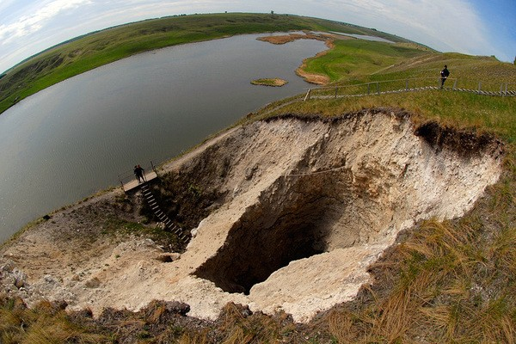
An Entrance

Slide 6
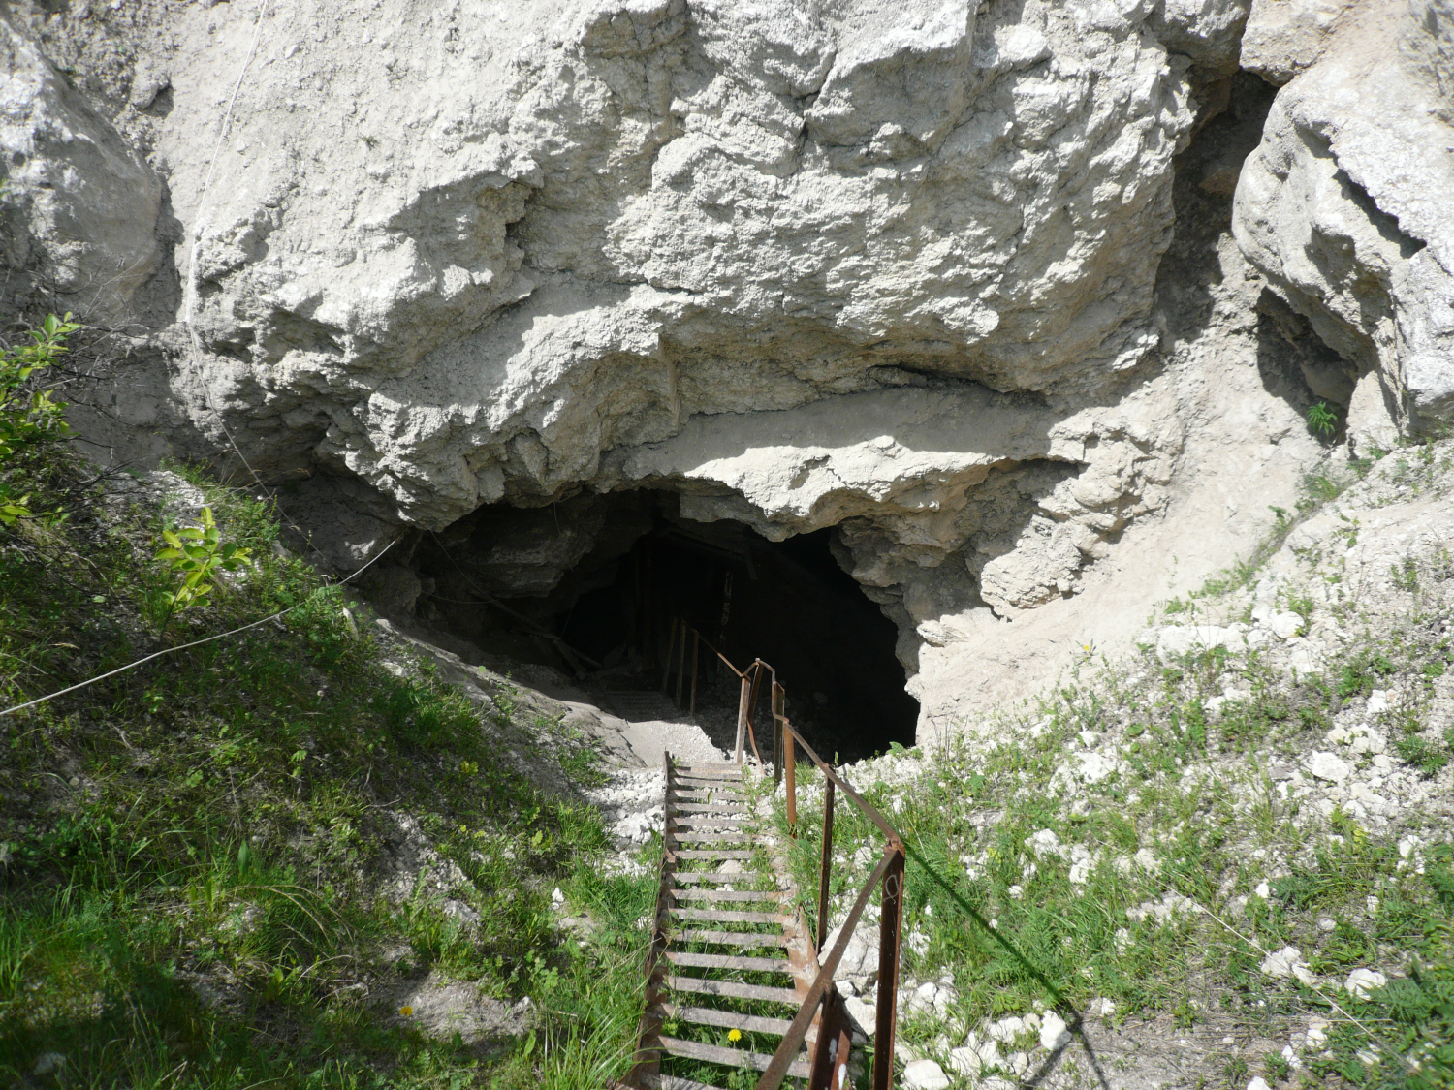
An Entrance

Slide 7
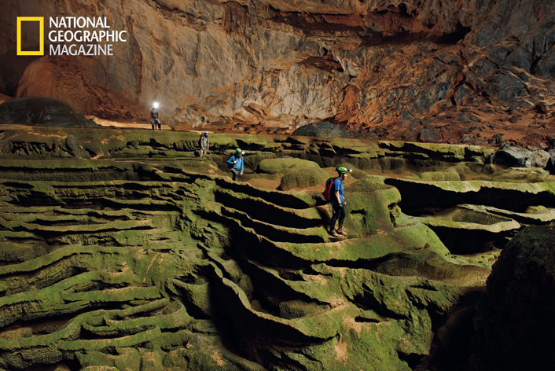

Slide 8
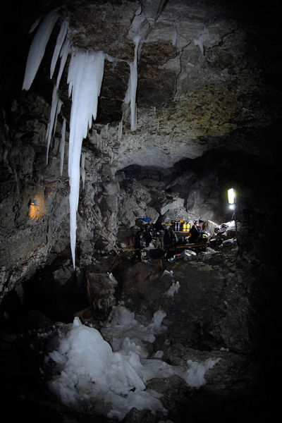

Slide 9
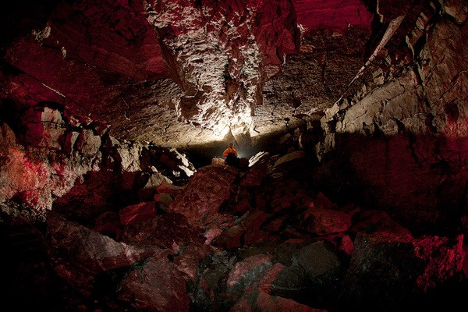
The Upper, Dry Part of the Cave

Slide 10
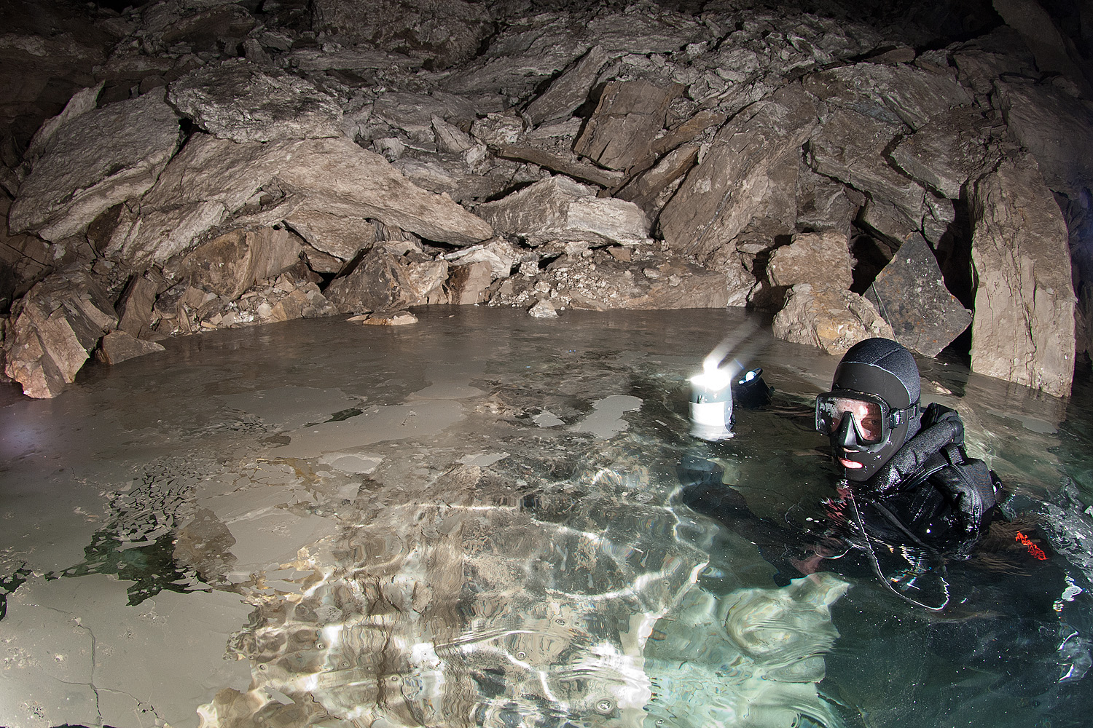

Slide 11
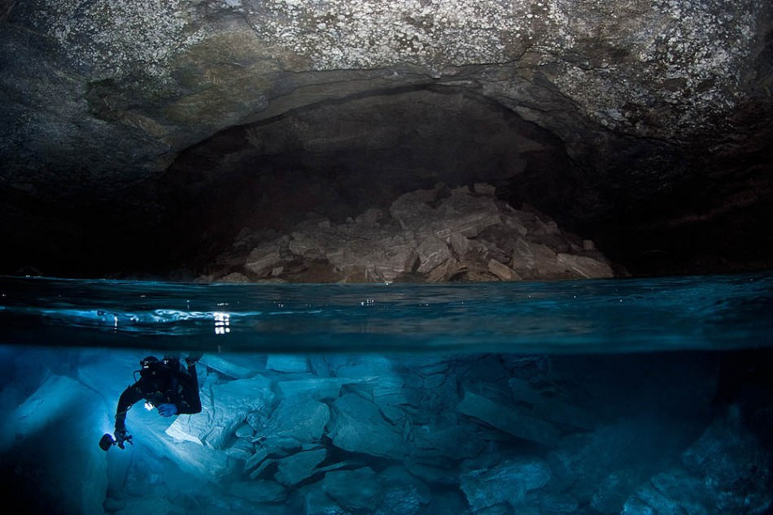
Entering the water-filled passages

Slide 12
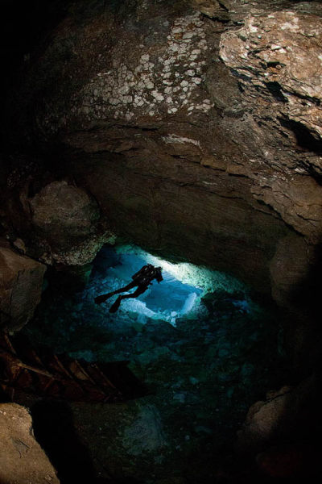

Slide 13
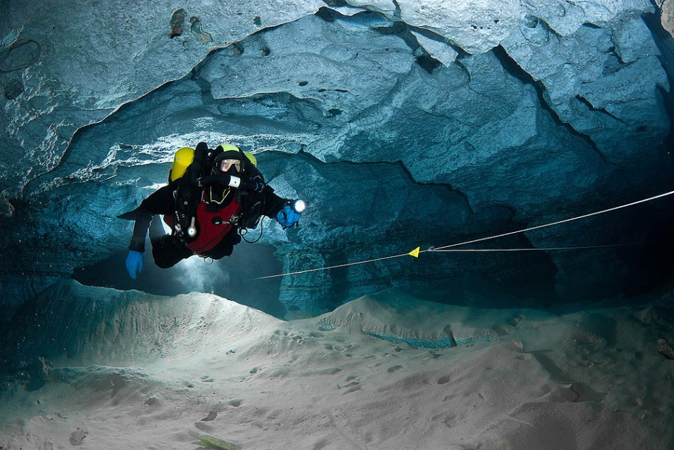

Slide 14
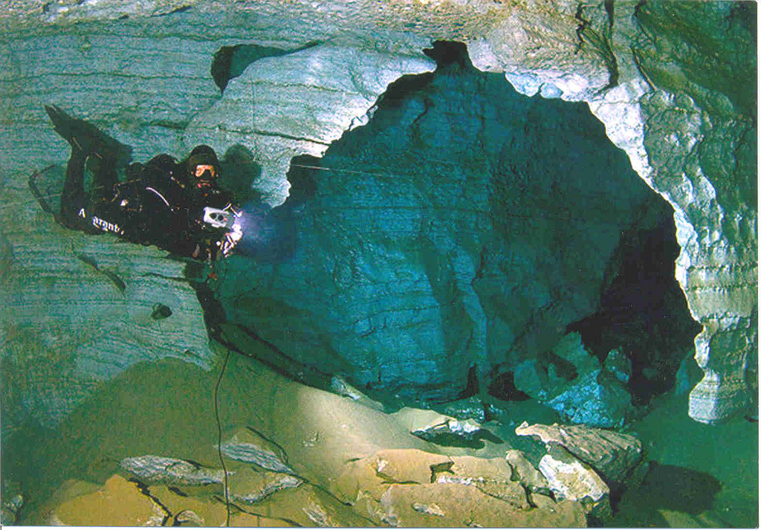

Slide 15
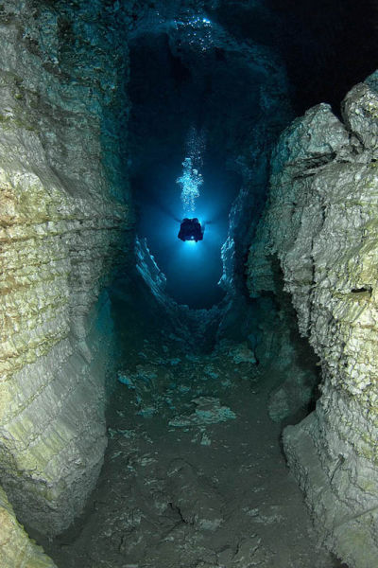

Slide 16
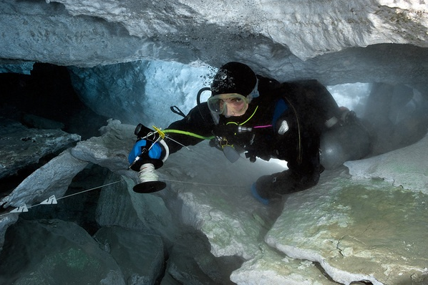

Slide 17
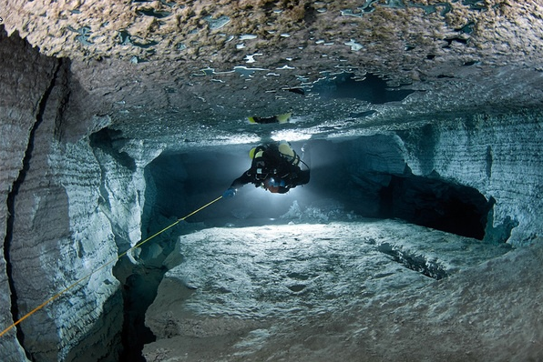

Slide 18
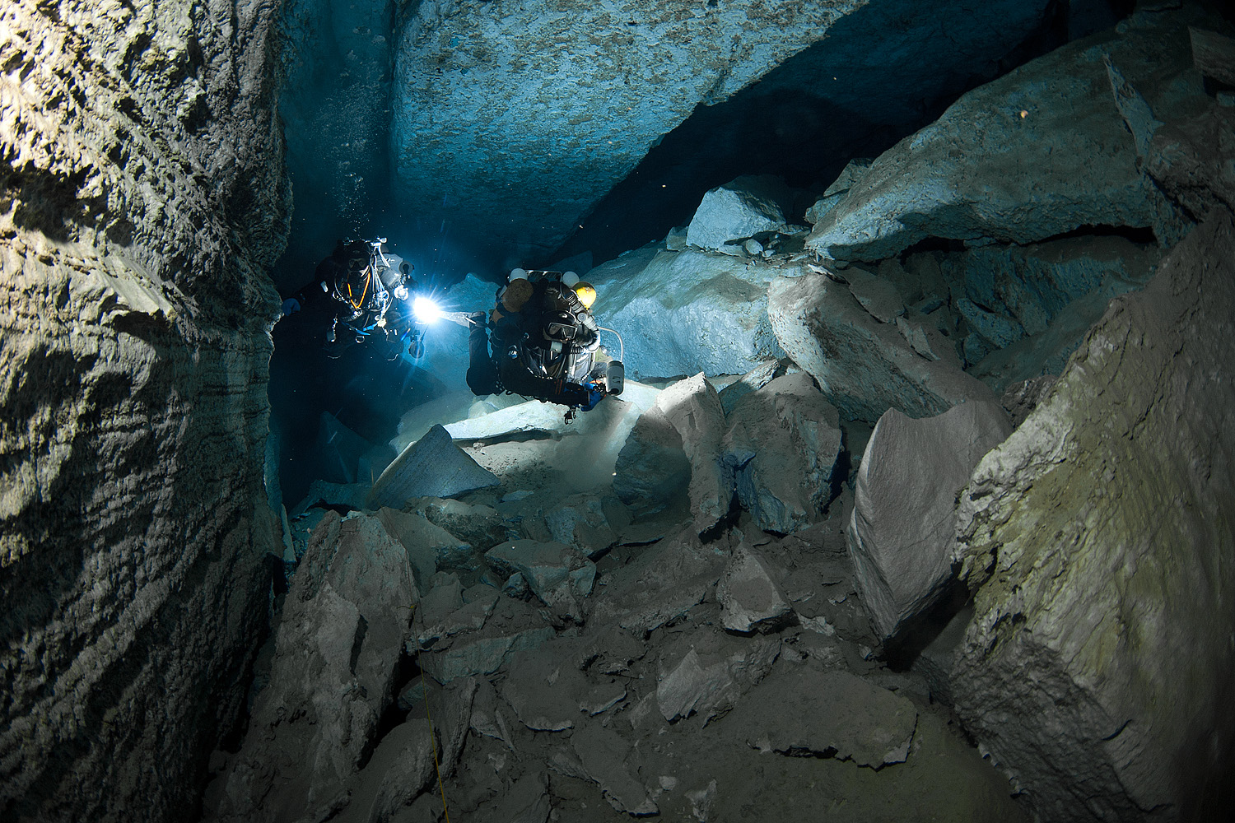

Slide 19
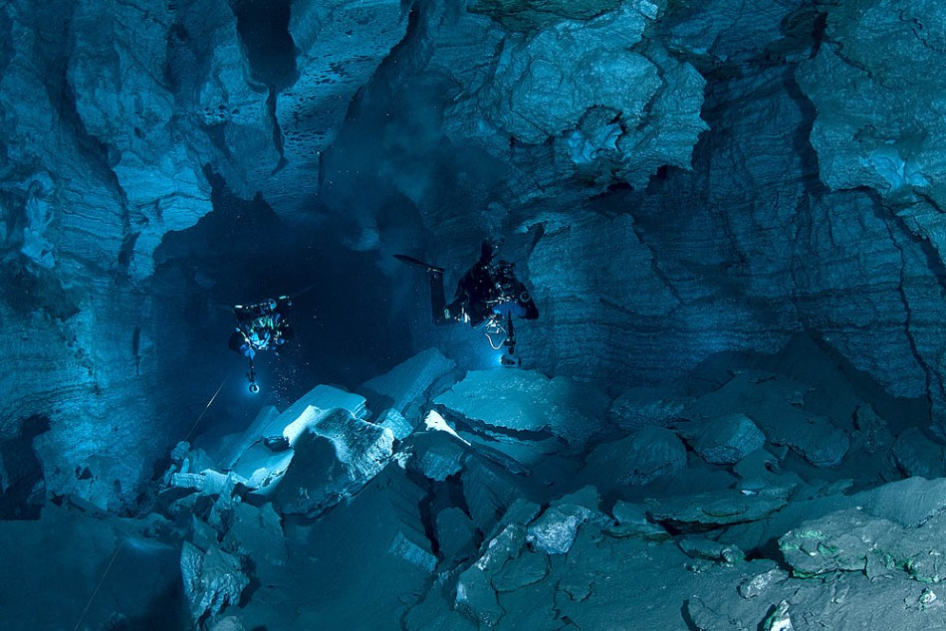

Slide 20
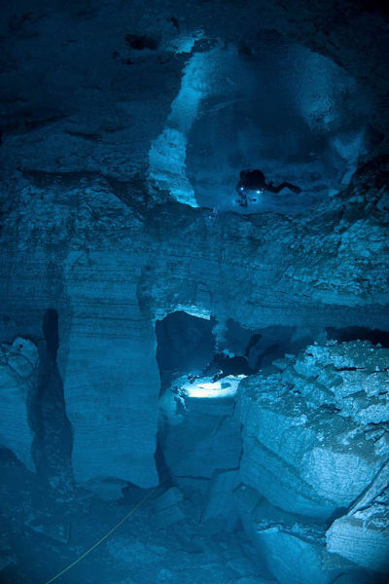

Slide 21
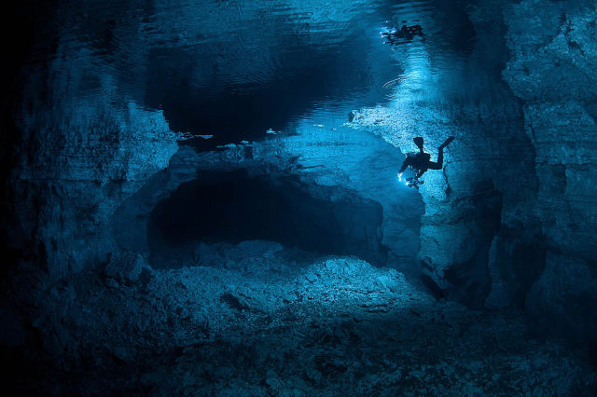

Slide 22
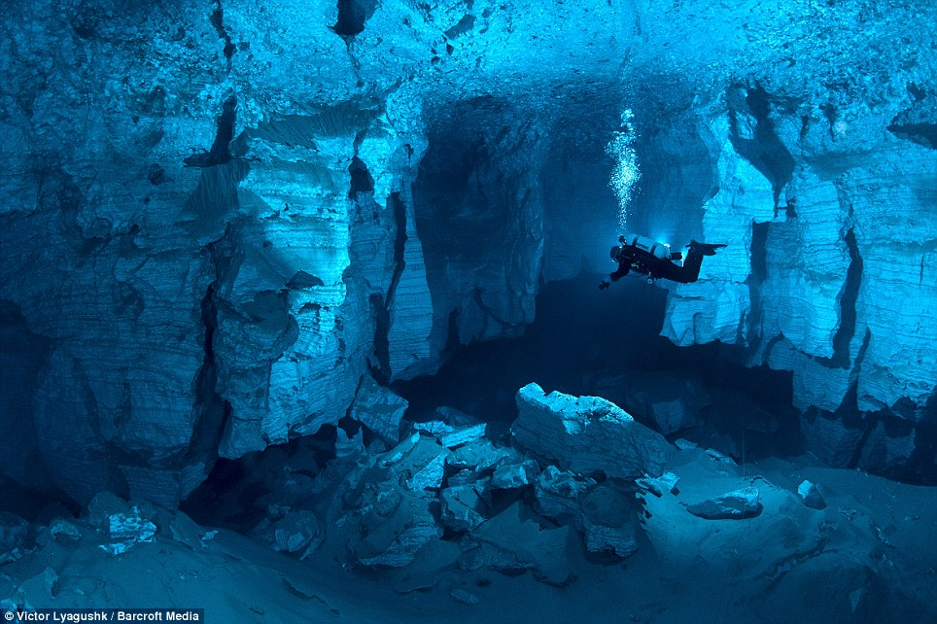

Slide 23
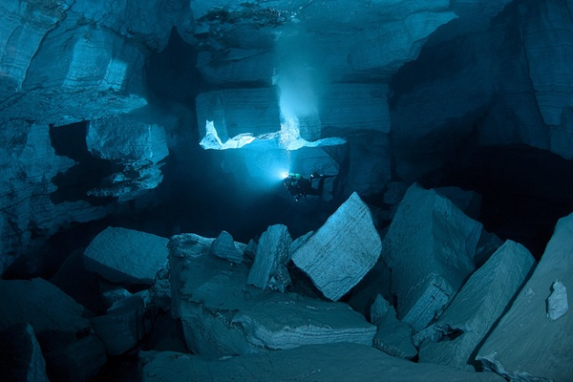

Slide 24
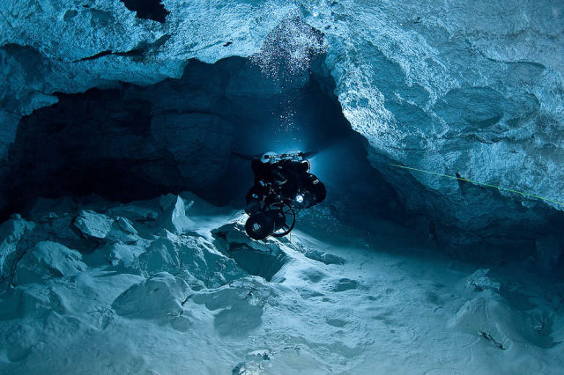

Slide 25
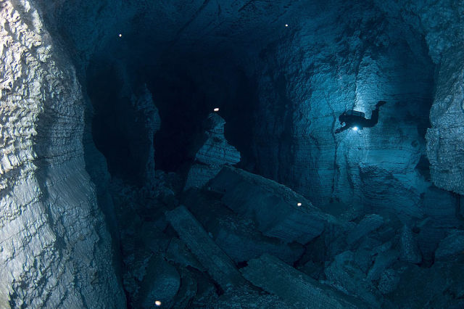

Slide 26
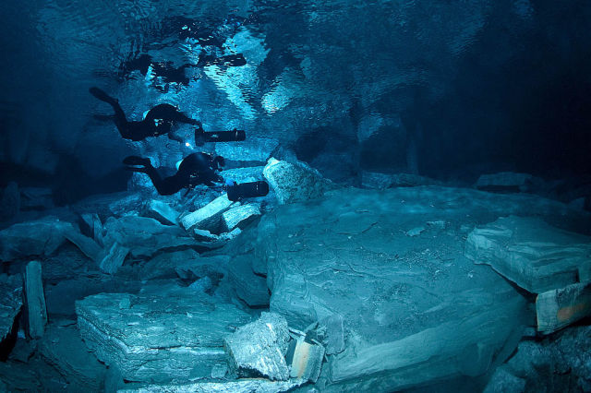

Slide 27
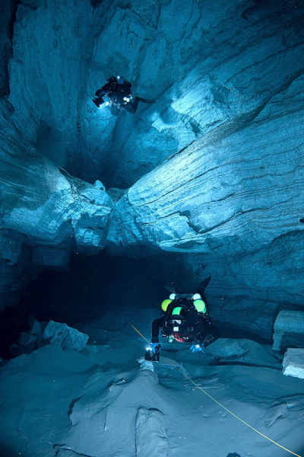

Slide 28
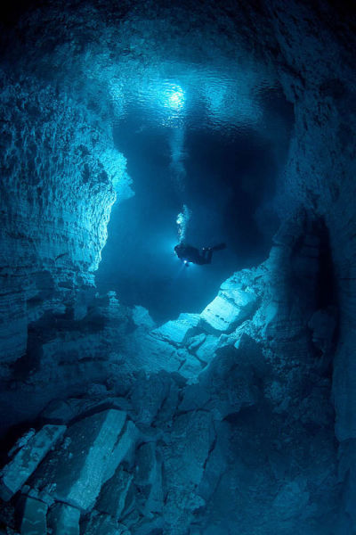

Slide 29
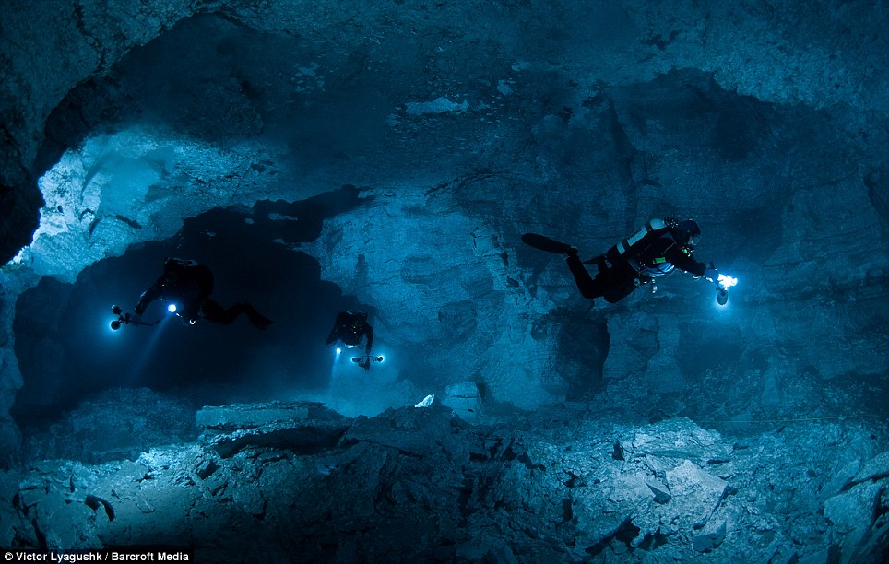

Slide 30
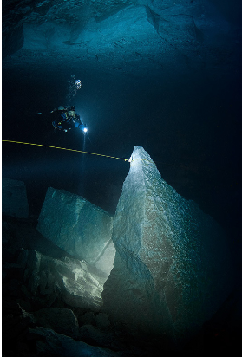

Slide 31
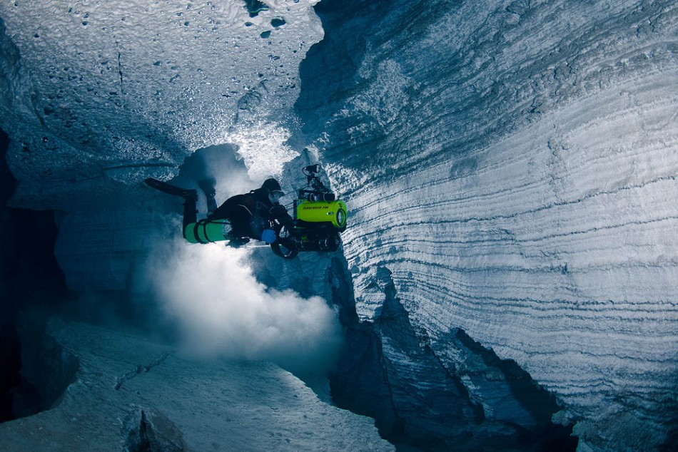

Slide 32
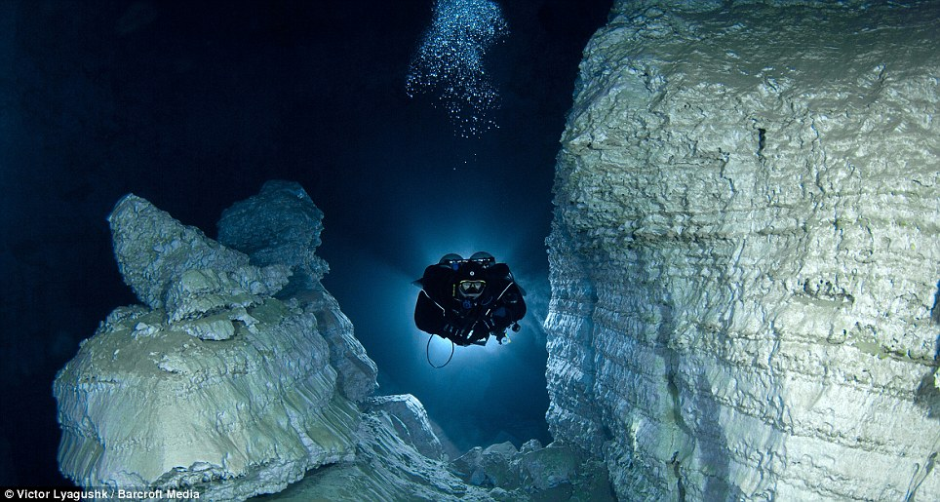

Slide 33
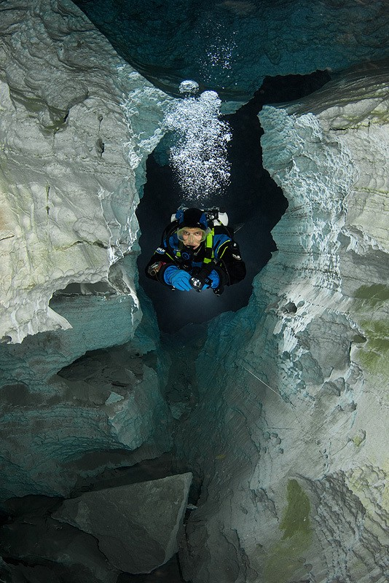

Slide 34
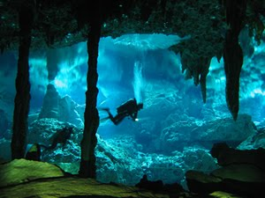

Slide 35
