Slide 1
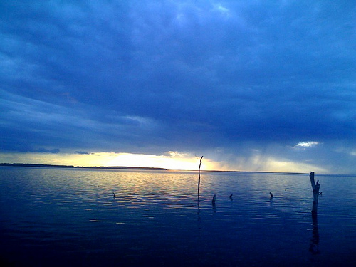
North Dakota's Expanding Devils Lake
Lake swallows land and buildings
From an Associated Press Story

Slide 2
It's been called a slow-growing monster: a huge lake that has steadily expanded over the last 20 years, swallowing up thousands of acres, hundreds of buildings and at least two towns in its rising waters.
Devils Lake keeps getting larger because it has no natural river or stream to carry away excess rain and snowmelt. Now it has climbed within 6 feet of overflowing, raising fears that some downstream communities could be washed away if the water level isn't reduced.

Slide 3
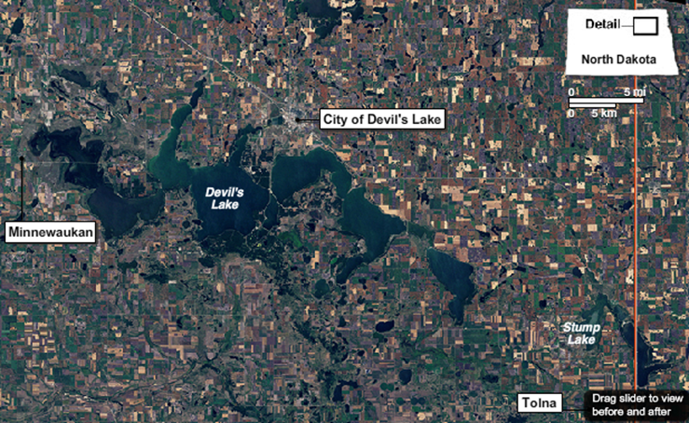
August 11, 1984

Slide 4
And those worries are compounded by another problem: Scientists believe the pattern of heavy rain and snow that filled the basin is likely to continue for at least another decade.
No other place in America has faced such a dilemma. The nation's only other significant "closed-basin" lake is the Great Salt Lake, which was in danger of flooding housing developments in the mid-1980s. But shortly after the state spent $70 million on huge pumps, a dry spell began. Those pumps now stand idle.
"We're unfortunately or fortunately — I don't know what it is — pretty unique," said Dick Johnson, mayor of Devils Lake, which has nearly 7,000 residents. The constant flooding "doesn't have the immediate impact that a hurricane or typhoon might have, but it's devastating.“ Since the water began rising in the early 1990s, more than 400 homes around the lake have been relocated or destroyed.

Slide 5
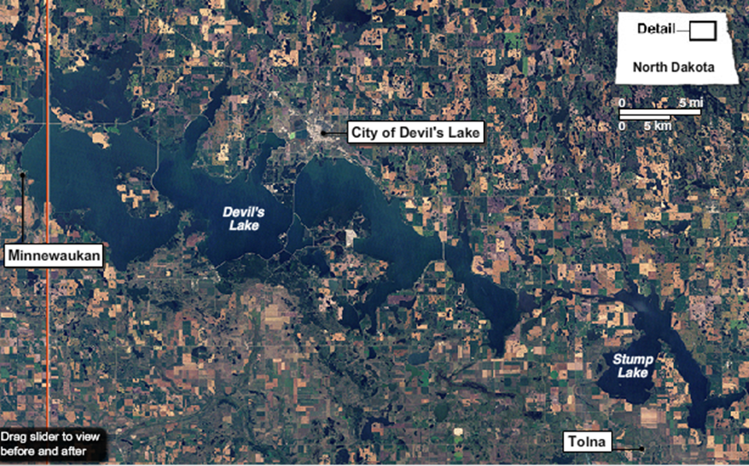
September 1, 2009

Slide 6
By the end of 2010, the federal government will have spent more than $1 billion to ease the threat, buying flooded property, building dikes and making other improvements. That figure does not include a $27 million floodwater-diversion channel built by the state on the west end of the lake. It also costs $330,000 a month for the electricity for pumps to take 1 inch off the lake. All of those measures are considered temporary. The final solution — and its cost — is not known.
Scientists with the U.S. Geological Survey say there's no way to predict exactly when a normal weather cycle will return. But the agency's models show a 72 percent chance that the current pattern will continue for at least 10 years.

Slide 8
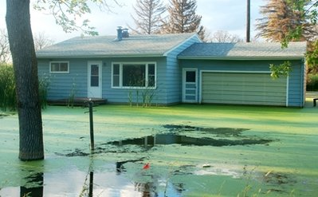
This Aug. 24, 2010, photo shows an unoccupied house that is surrounded by the green algae from Devils Lake which flooded the southeast side of town of Devils Lake, N.D., about a year ago. The house is scheduled to be burned.

Slide 9
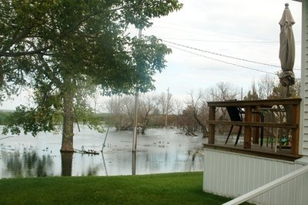
In this Aug. 24, 2010, photo is a view looking east about a block from the tiny town of Minnewaukan, N.D.'s only school. Devils Lake, which was once 8 miles away, today is lapping at the community from three sides

Slide 10
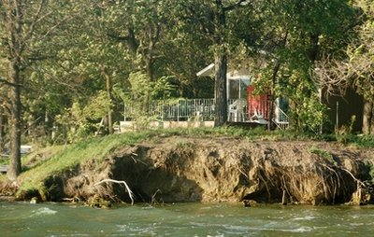
In this Aug. 24, 2010, photo is a house on the southeast side of Devils Lake in North Dakota, threatened by high waters and erosion. The house is expected to be bought out by the federal government in the next month. About 400 homes around Devils Lake have been relocated or destroyed flood waters

Slide 11
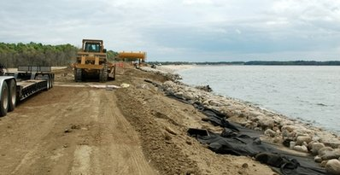
In this Aug. 24, 2010, photo State Highway 20 is expanded, in preparation for the road to be built up again if needed, in the Spring Lake area south of Devils Lake in North Dakota. Spring Lake, which was once its own lake, is now part of Devils Lake which has nearly quadrupled in size since the early 1990s, flooding nearly 150,000 acres of land.

Slide 12
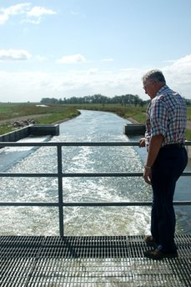
n this Aug. 24, 2010, photo Joe Belford, 72, a lifelong Devils Lake resident and county commissioner who spends most of his time lobbying for money and overseeing ways to control the flooding, watches water flow from an outlet on the west end of Devils Lake. The North Dakota lake has been called a slow-growing monster: a huge lake that has steadily expanded over the last 20 years, swallowing up thousands of acres, hundreds of buildings and at least two towns in its rising waters

Slide 13
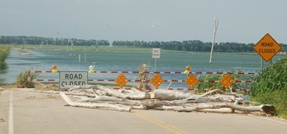
n this Aug. 24, 2010, photo is what used to be U.S. Highway 281 on the north end of Minnewaukan, ND. The road has since been moved because of approaching waters from Devils Lake. Residents from Minnewaukan are scrambling to save their town from the lake, which is approaching from three sides.

Slide 14
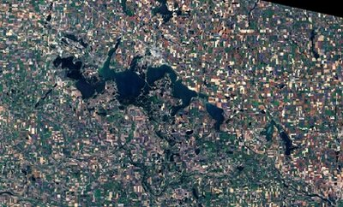
In this photo provided by NASA's Earth Observatory is a Sept. 1, 2009 view of the surface elevation of Devils Lake, N.D. The lake, about 160 miles northwest of Fargo, is the largest freshwater body in North Dakota. Since the water began rising in the early 1990s, more than 400 homes around the lake have been relocated or destroyed.

Slide 15
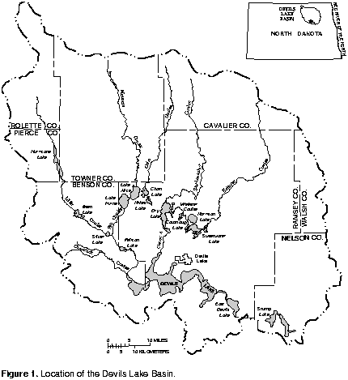
The Interior Drainage Basin

Slide 16
Devils Lake responds directly to climate variability across the region. This climate variability generally can be regarded as the movement of the jet stream from season to season and from year to year. The jet stream, which is a ribbon of high-velocity air located about 30,000 feet above the Earth's surface, exists because of temperature differences between air masses at the Earth's poles and at the equator. The movement of weather systems along the jet stream determines the distribution of precipitation about the globe. Climate variability results from a long-term shift in circulation patterns of the jet stream. As the circulation patterns shift, precipitation and temperature patterns also shift. Devils Lake has an enhanced sensitivity to long-term shifts in global circulation patterns as the level of the lake depends on many years of antecedent precipitation, runoff, and evaporation. If at any time precipitation, runoff, or evaporation is dominant, a corresponding dramatic response occurs in the lake level.

Slide 17
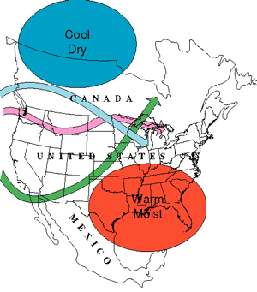
Jet Stream Factor in Climatic Variability

Slide 18
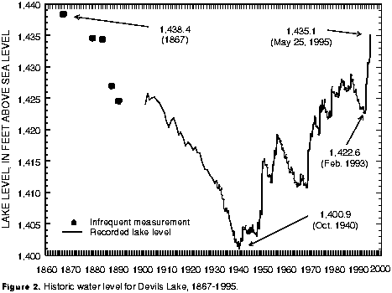
Fluctuations in Annual Precipitation Have Resulted in Varying Lake Levels

Slide 19
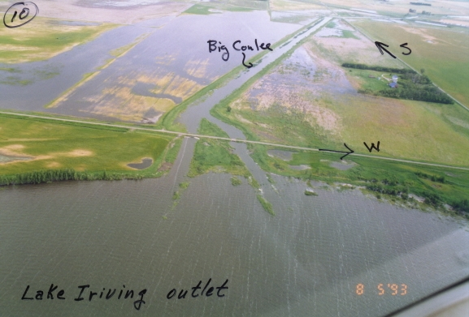
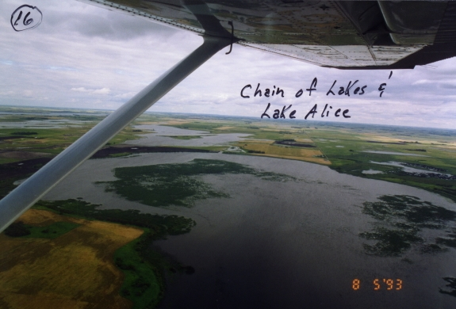
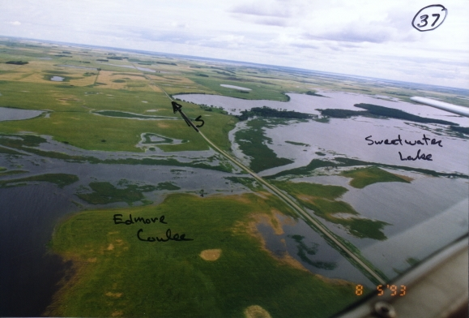
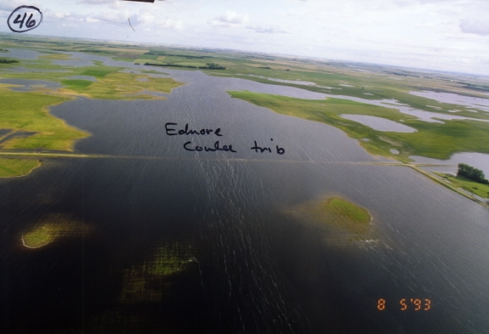
1993 Flood Pictures

Slide 20
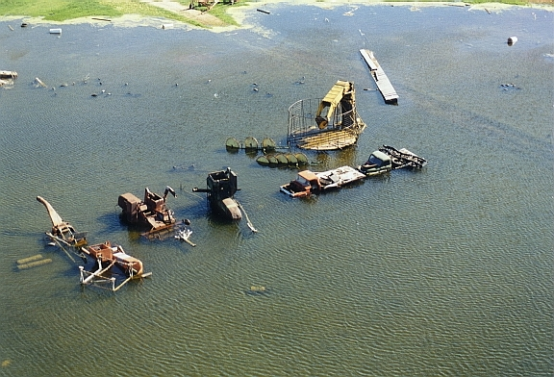
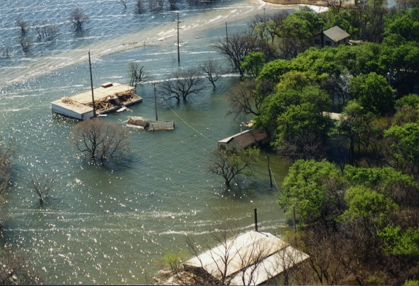
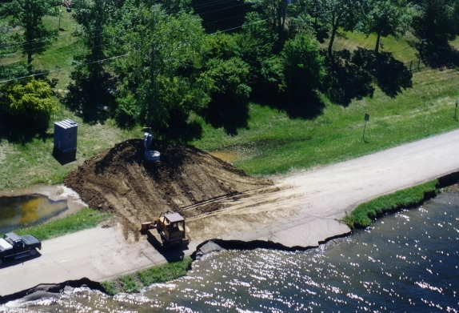
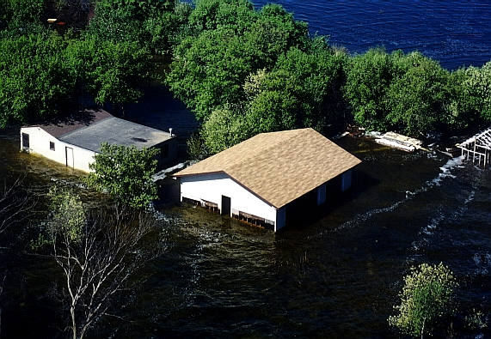
1997 Flood Pictures

Slide 21
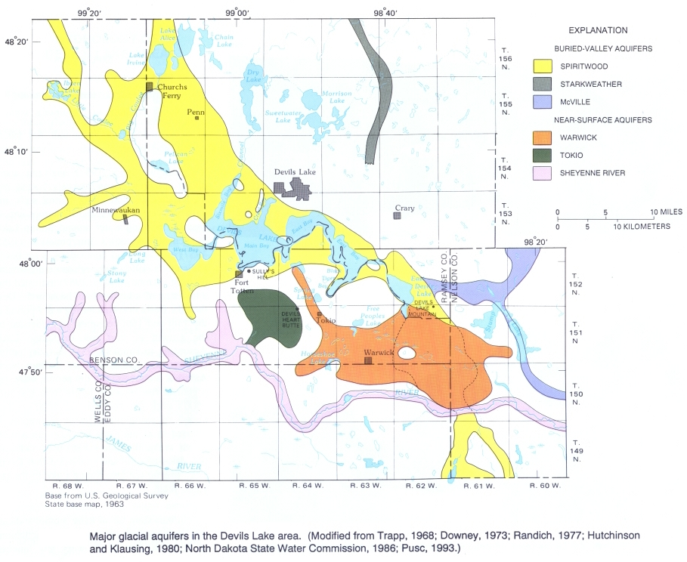

Slide 22
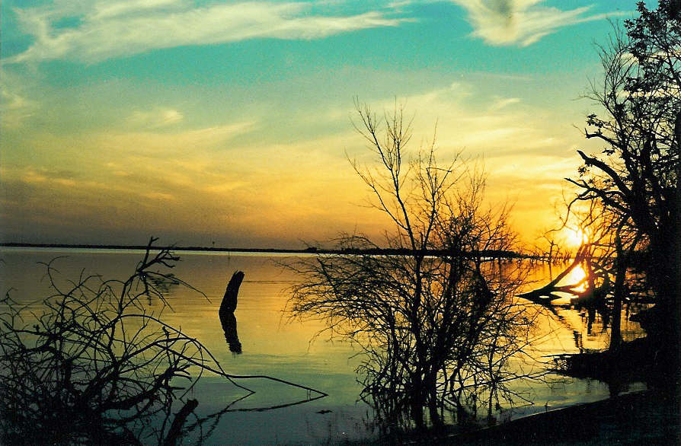
Devils Lake Sunset

