Slide 1

Interior Drainage Basins

Slide 2
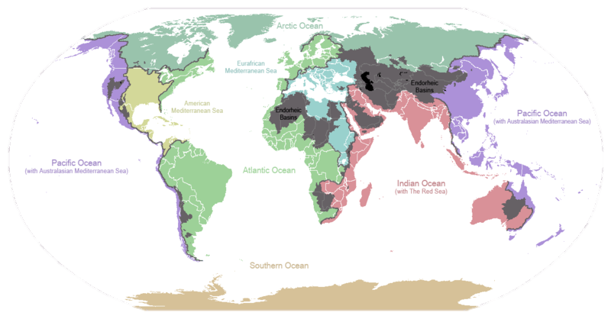
World Drainage Basins
Drainage basins of the principal oceans and seas of the world. Grey areas are endorheic (interior drainage) basins that do not drain to the ocean.

Slide 3
Interior Drainage (Endorheic) Basins
Endorheic drainage basins are inland basins that do not drain to an ocean. Around 18% of all land drains to endorheic lakes or seas or sinks. The largest of these consists of much of the interior of Asia, and drains into the Caspian Sea and the Aral Sea. Other endorheic regions include the Great Basin in the United States, much of the Sahara Desert, the watershed of the Okavango River (Kalahari Basin), highlands near the African Great Lakes, the interiors of Australia and the Arabian Peninsula, and parts in Mexico and the Andes. Some of these, such as the Great Basin, are not single drainage basins but collections of separate, adjacent closed basins.
In endorheic bodies of standing water where evaporation is the primary means of water loss, the water is typically more saline than the oceans. An extreme example is the Dead Sea.

Slide 4
Dry Lakebeds
Playas (salt flats) and Salars are interior drainage basins where there is insufficient to maintain a permanent body of water due to evaporation in excess of precipitation and/or from humans diverting water from the streams that flow into the basin in quantities great enough to prevent the maintenance of a permanent water body in the basin.

Slide 5
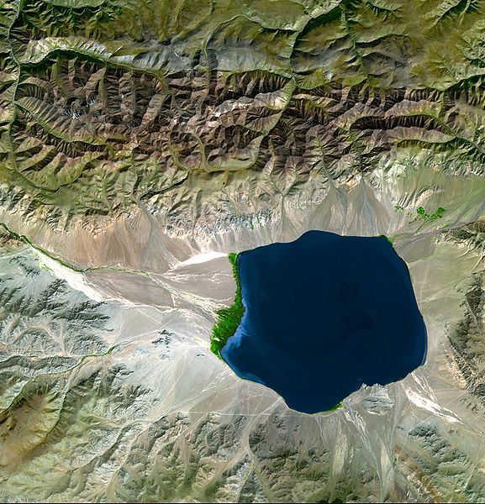
Visualization: Interior drainage basin in Central Asia

Slide 6
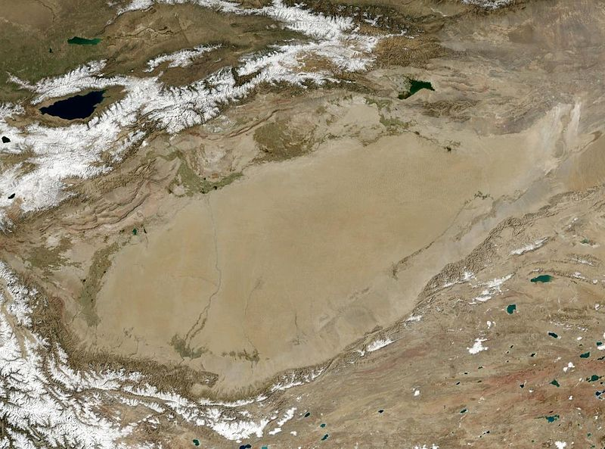
Tarim Basin, western China

Slide 7
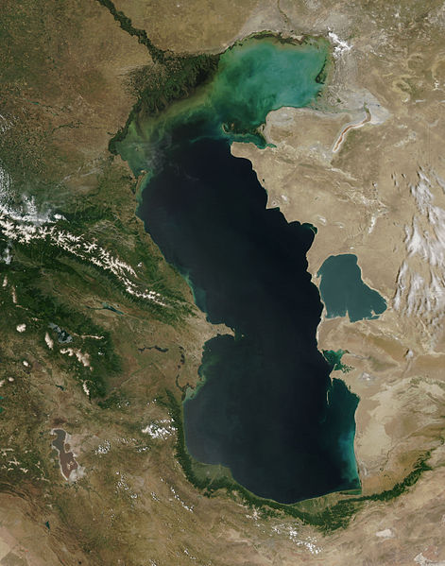
Caspaian Sea – the world’s largest endorheic water body.

Slide 8
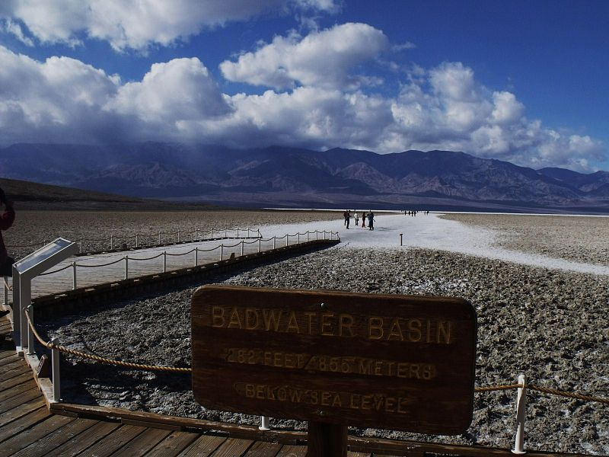
Badwater Basin (Death Valley, CA) – dry lakebed (no continuous body of water)

Slide 9
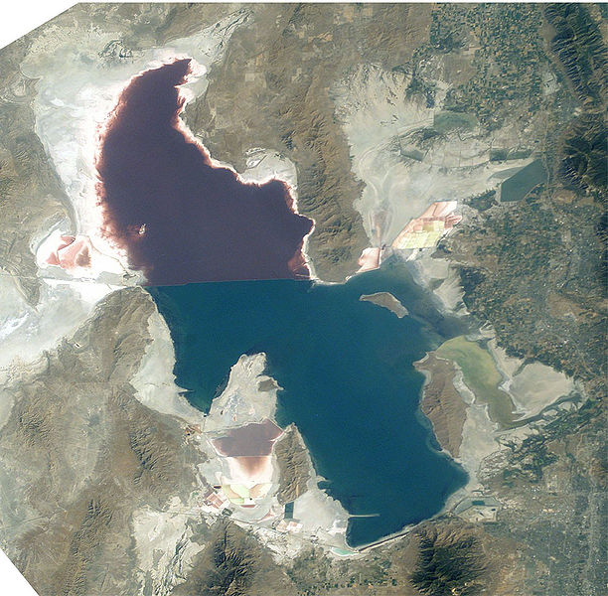
Great Salt Lake in Utah is shrinking and will become a dry lakebed eventually.

Slide 10
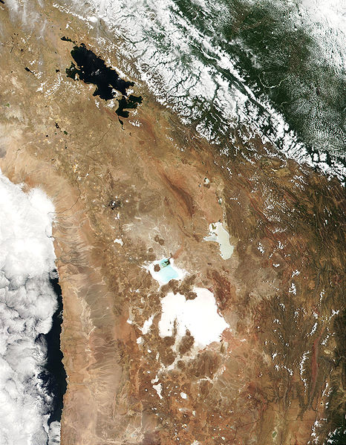
Lake Titicaca, the Salar de Uyuni, and the Salar de Coipasa (Salars are dry lakebeds). These are all parts of the Altiplano in Peru and Bolivia.
Lake Titicaca
Salars

