Slide 1
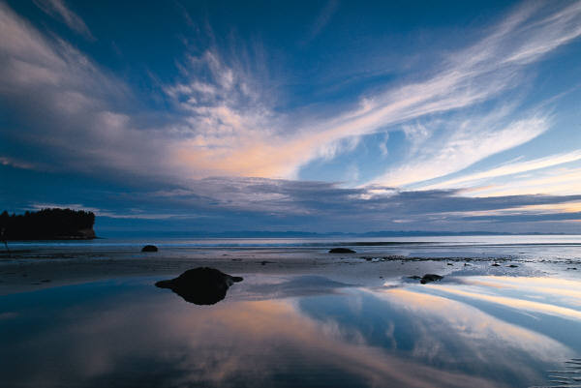
Interestingly Colored Beaches

Slide 2
Ever seen beaches with black, green, white, red or multicolored sand? See this amazing nature phenomenon in the following slides.
The colors of beaches are directly related to the sources of the sand. The darker sands contain more dark minerals, the very light, white sands are typically macerated calcareous material from reefs or shells..

Slide 3
Punalu'u Beach
Punalu'u Beach is the most visited of the few black sand beaches on Hawaii's Big Island and the stunningly black sand is actually volcanic rock, deposited as lava and subsequently cooled when met by the ocean. Apparently to take any of the sand home would result in you being cursed by a volcano goddess by the name of Pele.

Slide 4
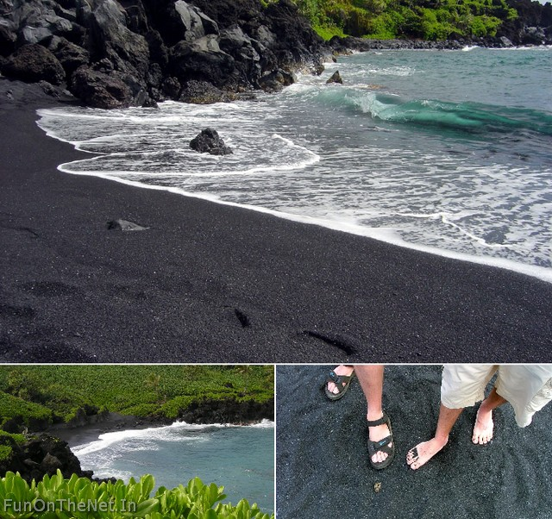

Slide 5
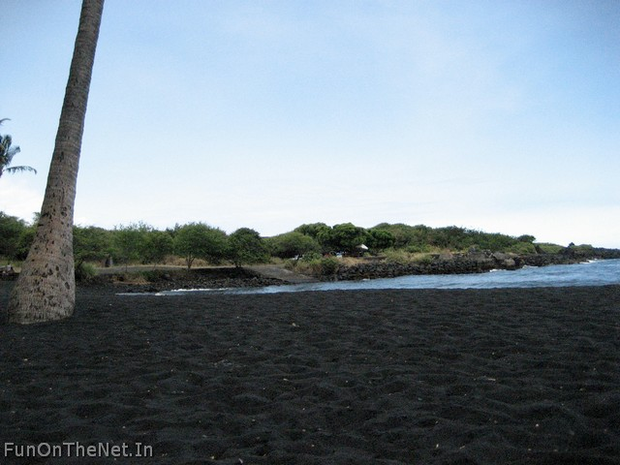

Slide 6
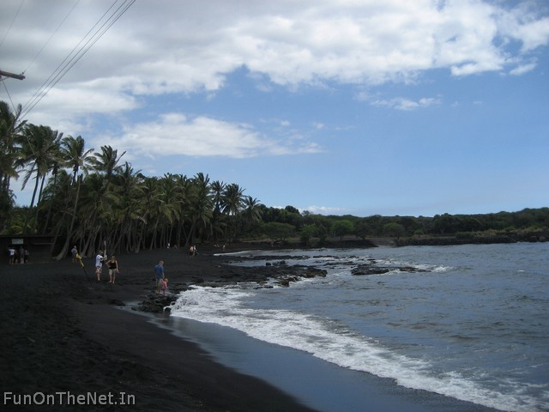

Slide 7
Papakolea Beach
One of 2 green sand beaches in the world, the truly magnificent sight of Papakolea Beach can be experienced in Hawaii's Ka'u district. Again, the unique color of its sand can be attributed to volcanic activity - the green hue belongs to the abundance of olivine crystals which have been produced as a result of a nearby cinder cone erupting and eroding.

Slide 8
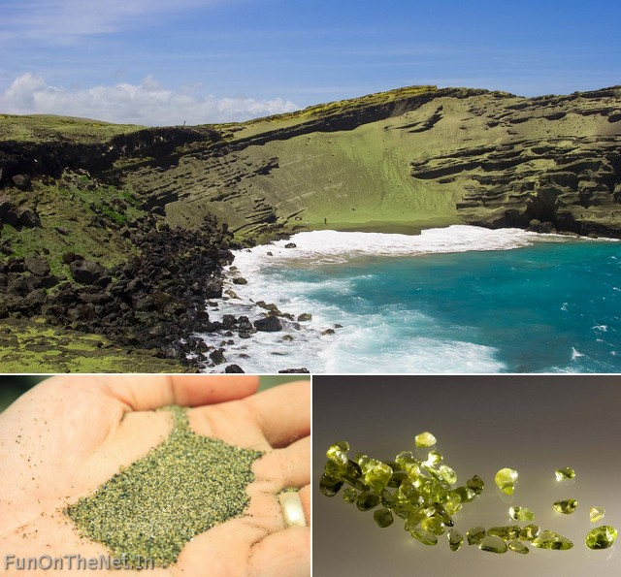

Slide 9
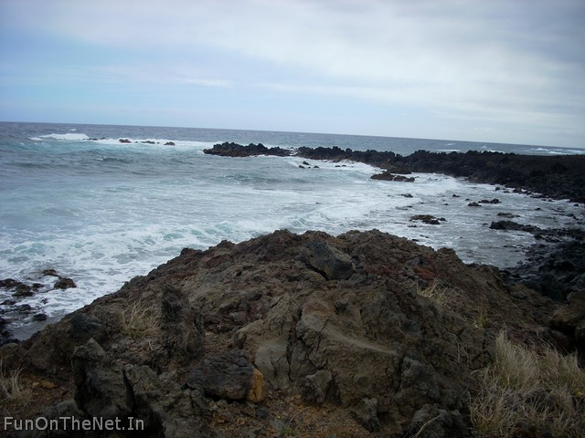

Slide 10
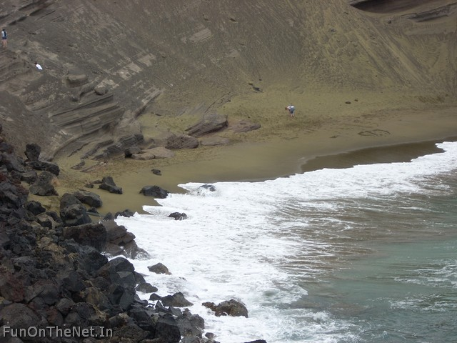

Slide 11
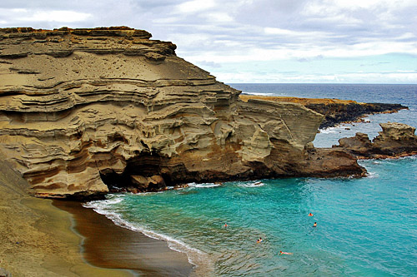

Slide 12
Hyams Beach
You may need to wear shades at Hyams Beach in New South Wales, Australia, but not just for the sun. It's not surprising after looking at photos but this sublime stretch of beach is home to the whitest sand in the world, an honor awarded by the Guinness Book of Records. white sands are typically macerated calcareous material from reefs or shells.

Slide 13
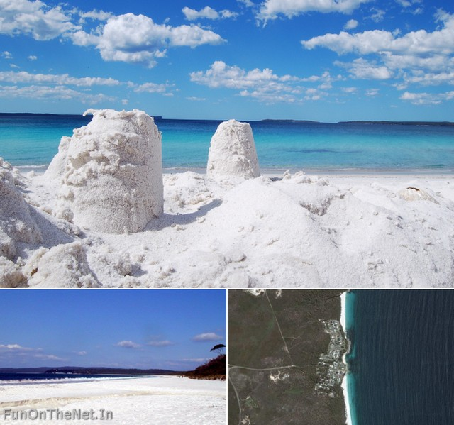

Slide 14
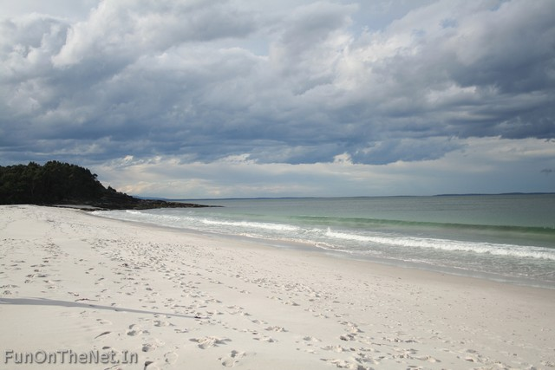

Slide 15
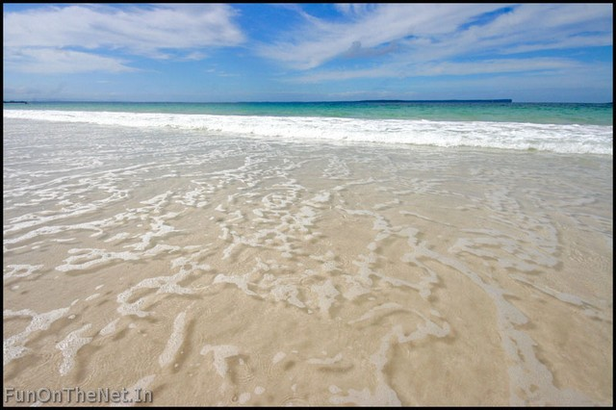

Slide 16
Pfeiffer Beach
The hills around Pfeiffer Beach in Big Sur, California, are rich in Manganese Garnet. A result of this being washed down onto the beach is the colour scheme you can see above - the entire stretch of sand has become a shifting, pink and purple canvas. Although it's probably inedible, I can't help picturing a bowl of Raspberry Ripple ice-cream every time I see it.

Slide 17
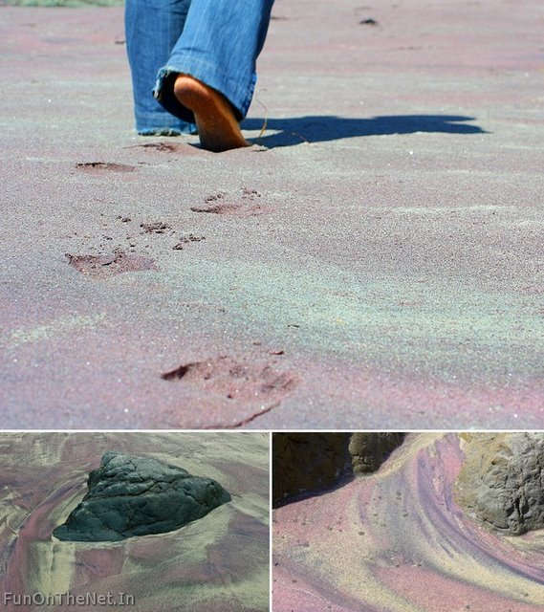

Slide 18
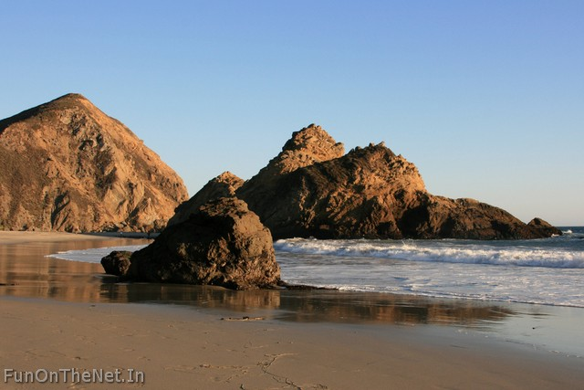

Slide 19
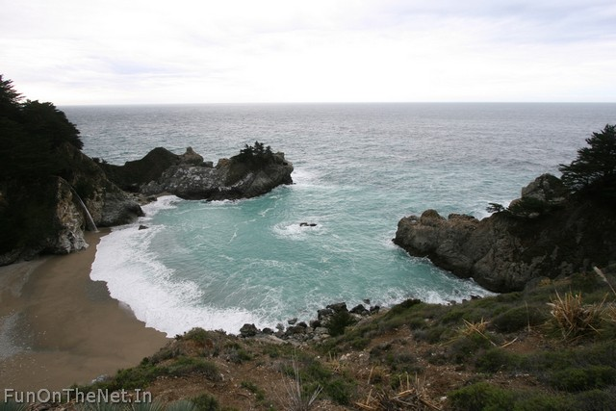

Slide 20
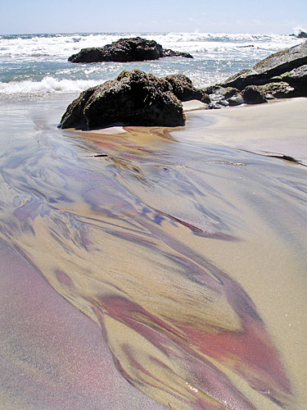

Slide 21
Kaihalulu
You won't find many beaches elsewhere in the world with sand as red as this one. Kaihalulu, or Red Sand Beach, is situated on the island of Maui and can thank the neighboring cinder cone hill for its intensely deep red appearance.

Slide 22
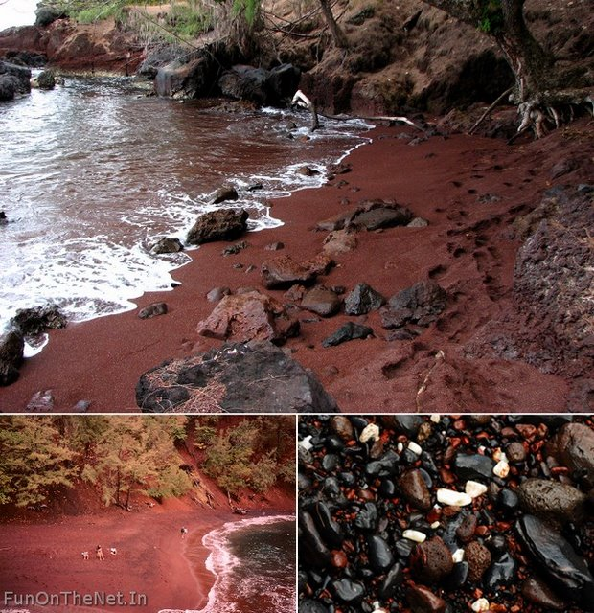

Slide 23
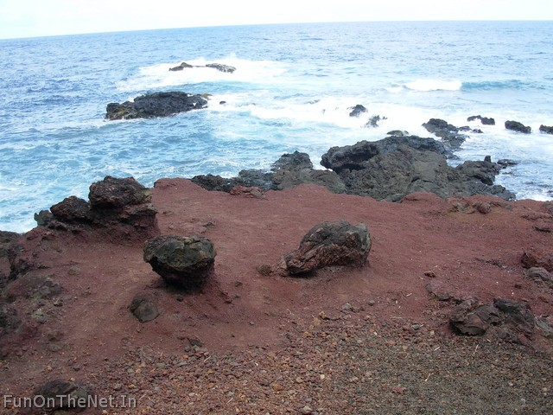

Slide 24
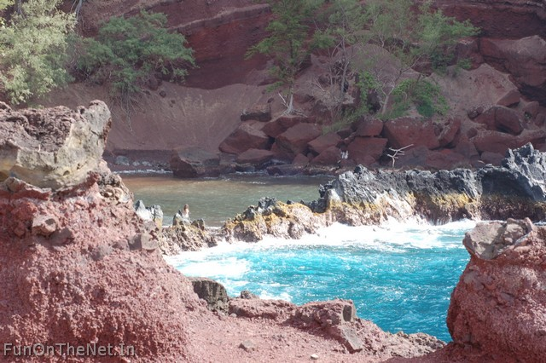

Slide 25
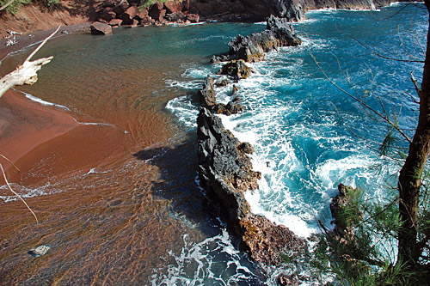

Slide 26
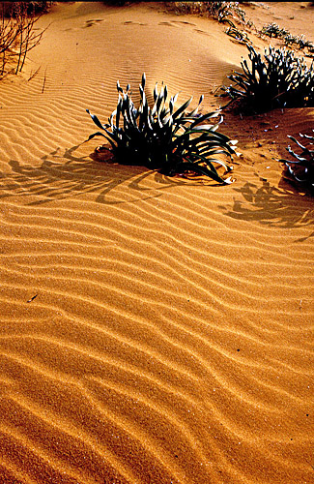
Ramla il-Hamra beach in Gozo, Maltese Islands
A golden sand dune at the beautiful Ramla il-Hamra beach in Gozo, Maltese Islands

Slide 27
Harbor Island, Eleuthera, Bahamas
Pink beaches are quite rare, occurring only in areas near a very large coral reef formations containing a tiny organism with a red skeleton. When they die, they fall to the ocean floor and are eroded to small particles that are carried to shore by the current, where they mix with the sand. The finest example may be the one at Harbor Island, Eleuthera in the Bahamas.

Slide 28
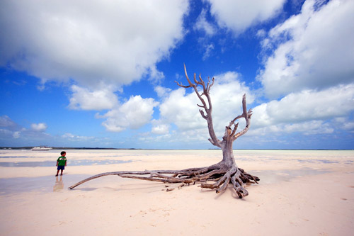

Slide 29
Fraizer Island, Australia
And then there’s Rainbow Beach on Fraser Island in Australia. Seemingly unable to make up its mind, Rainbow Beach displays more than 70 different colors whenever waves and winds shift and blow its sands around. Most of the colors can be clearly seen in the cliffs behind the beach, which formed during the last ice age and are so richly banded.

Slide 30
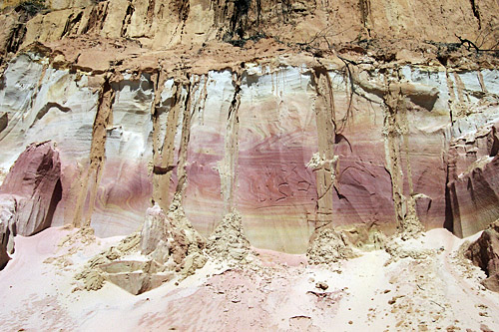
Rainbow Beach cliffs – color source

Slide 31
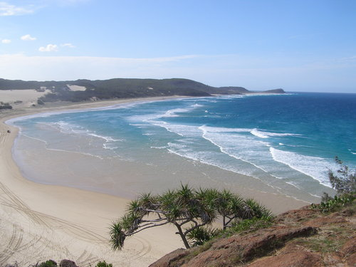

Slide 32
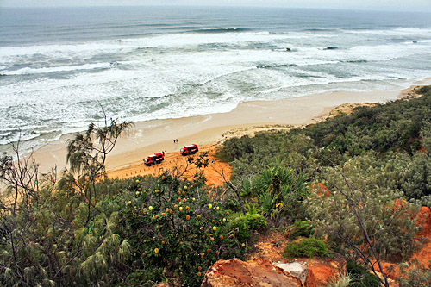

Slide 33
