Slide 1
Frozen Canadian Glacial Lake Has Rare Trapped Bubbles
In the Canadian Rockies

Slide 2
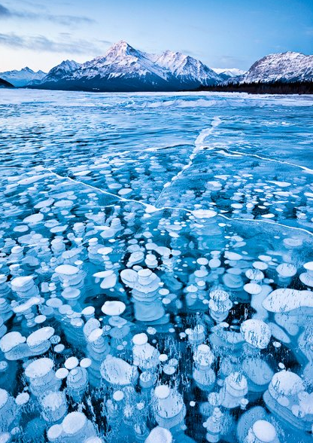
Photographer Emmanuel Coupe was a winner in the 2011 National Geographic Traveler Photo Contest for this photo of frozen lake in Canada. Check out the other pictures from his amazing shoot!

Slide 3
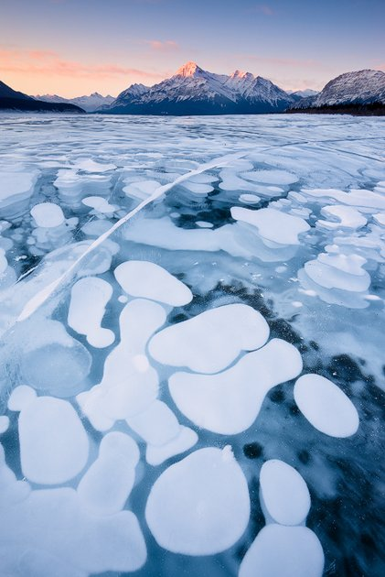
Here you can see frozen bubbles trapped beneath the surface. (Photo: Emmanuel Coupe)

Slide 4
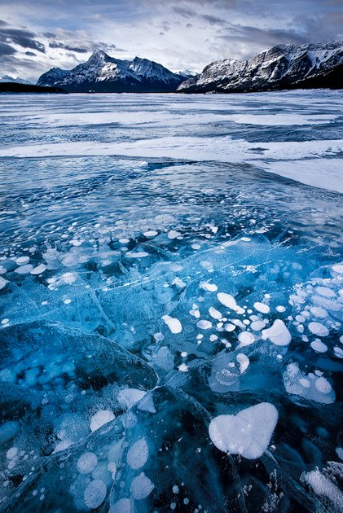
Spotting frozen bubbles on the lake is rare. They never appear in the same place twice. (Photo: Emmanuel Coupe)

Slide 5
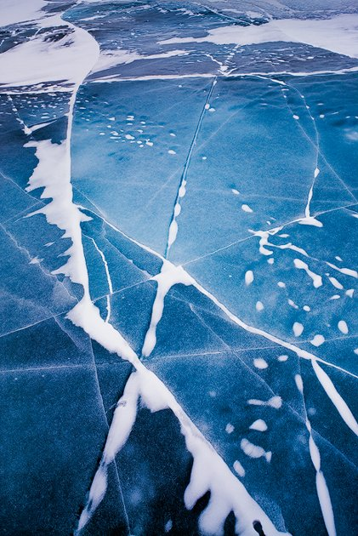
The brilliant blue color is a feature of glacial lakes. (Photo: Emmanuel Coupe)

Slide 6
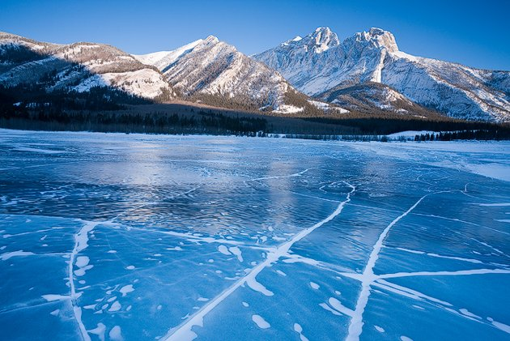
The subject is Abraham Lake situated in the Canadian Rockies in western Alberta, Canada. (Photo: Emmanuel Coupe)

Slide 7
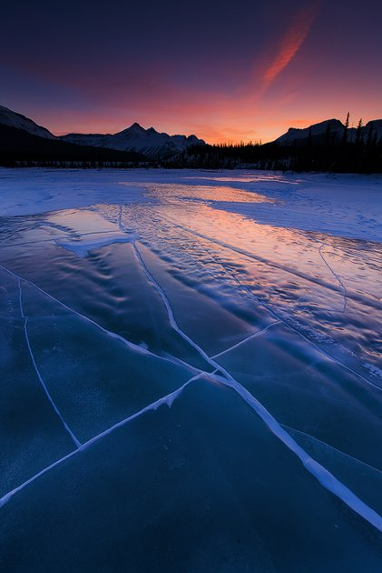
The photographer explained that seeing a frozen lake this spectacular is rare as they are usually covered in a thick blanket of snow. In this area, however, there is little precipitation which allows for stunning views of the frozen surface and beneath. (Photo: Emmanuel Coupe)

Slide 8
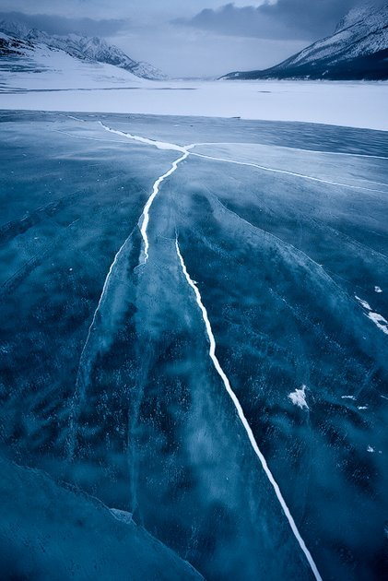
Conditions for the photographer were harsh - temperatures were as low as - 35 degrees F / - 31 degrees C! (Photo: Emmanuel Coupe)

Slide 9
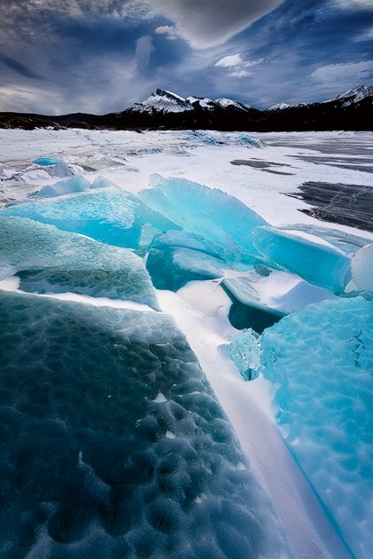
This section of Abraham Lake is known as Windy Point. Often the gusts here are strong enough to knock a person over. (Photo: Emmanuel Coupe)

Slide 10
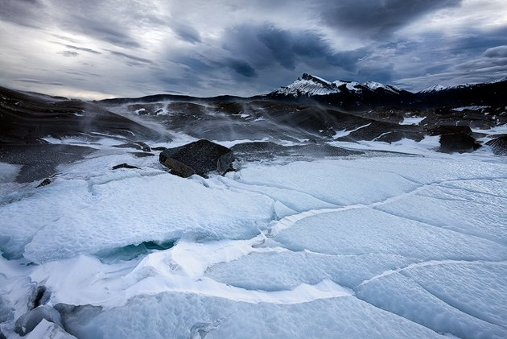
The lake is surrounded by the Rocky Mountains. (Photo: Emmanuel Coupe)

Slide 11
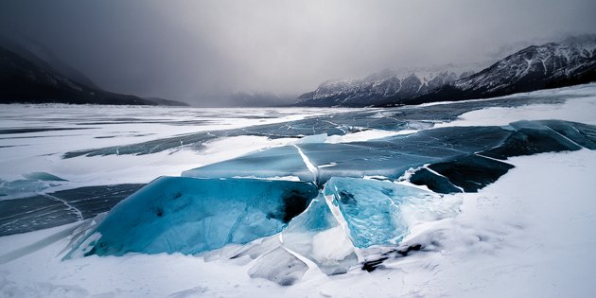
The lake is not naturally occurring. It was formed in 1972 with the construction of a nearby dam. (Photo: Emmanuel Coupe)

Slide 12
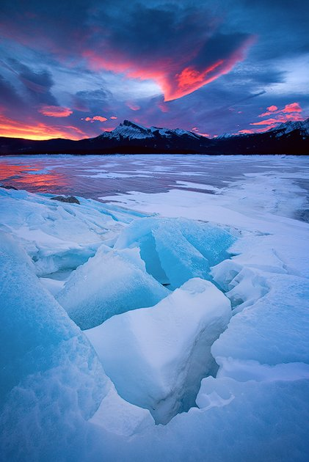
The Chinook winds are known to bring in below freezing temperatures in a short amount of time. They are seen here shaping the clouds. (Photo: Emmanuel Coupe)

Slide 13
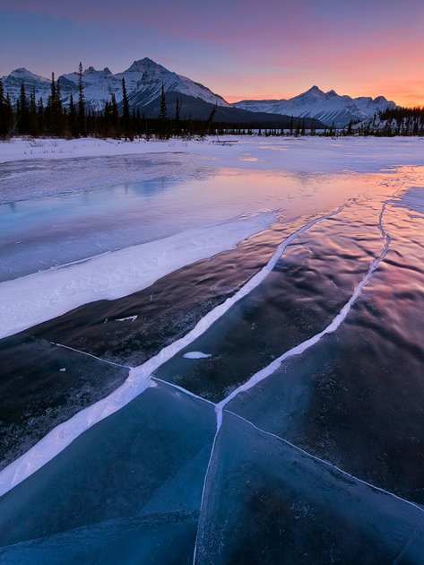
The lake is 20 miles long with a surface area of 20.7 square miles. See more at http://www.emmanuelcoupe.com. (Photo: Emmanuel Coupe)

