Slide 1
Human Migrations
Arial Font Family

Slide 2
Why Migrations Occur
When the reasons for leaving an area are greater than the reasons for remaining there.
Lee's laws divides factors causing migrations into two groups of factors: Push and pull factors. Push factors are things that are bad about the country that one lives in and pull factors are things that attract one to another area.

Slide 3
Push Factors
Not enough jobs
Few opportunities
Primitive conditions
Desertification
Famine or drought
Political fear or persecution
Slavery or forced labor
Poor medical care
Loss of wealth
Natural disasters
Death threats
Lack of political or religious freedom
Pollution
Poor housing
Landlord/tenant issues
Bullying
Discrimination
Poor chances of marrying
Condemned Housing (Radon Gas etc.)
War/Civil War

Slide 4
Pull Factors
Job opportunities
Better living conditions
Political and/or religious freedom
Enjoyment
Education
Better medical care
Attractive climates
Security
Family links
Industry
Better chances of marrying
Positive reports from family or neighbors who had previously migrated

Slide 5
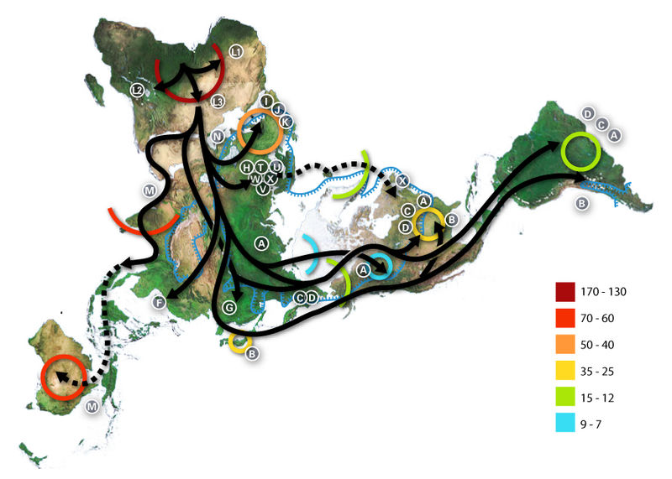
Migration from place of human origin

Slide 6
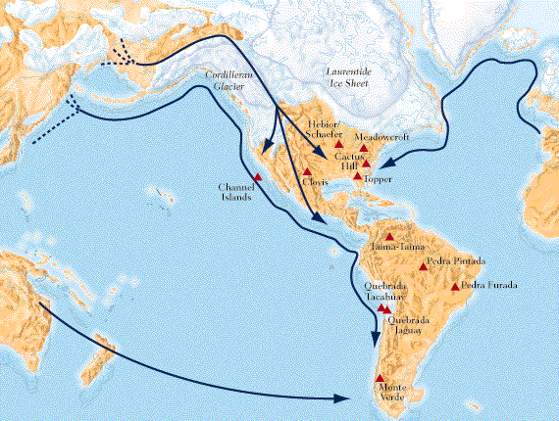
Pleistocene Migrations

Slide 7
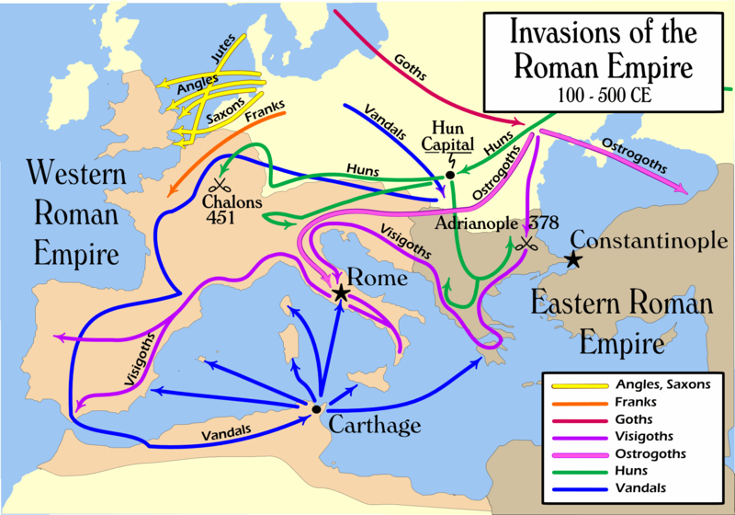
Migrations to Europe from the East

Slide 8
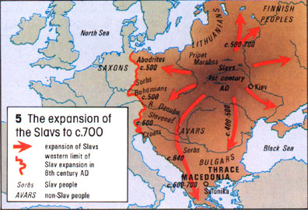

Slide 9
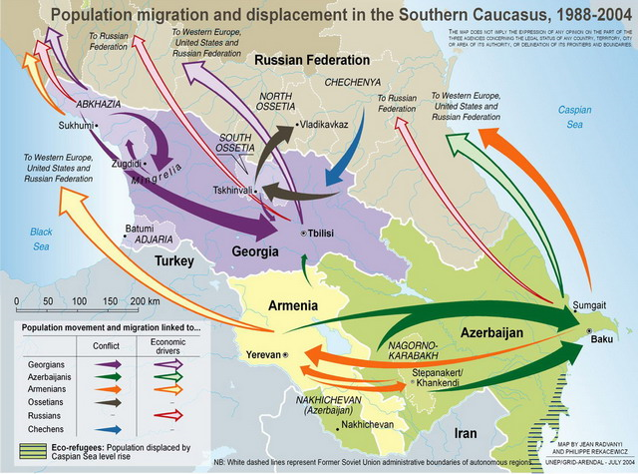

Slide 10
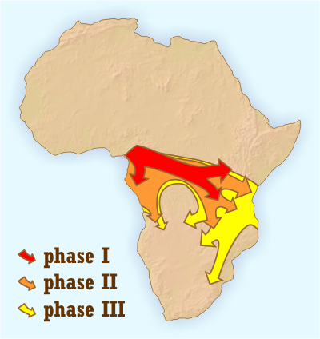
Bantu Migrations

Slide 11
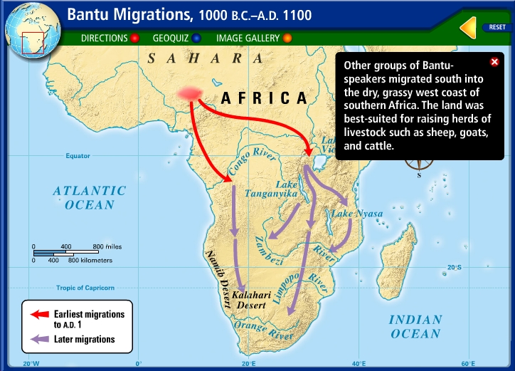

Slide 12
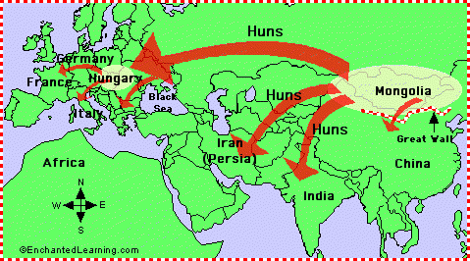
Mongol Migrations

Slide 13
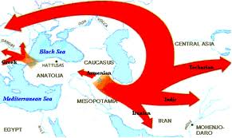
Migration of Indo-European Language Speakers

Slide 14
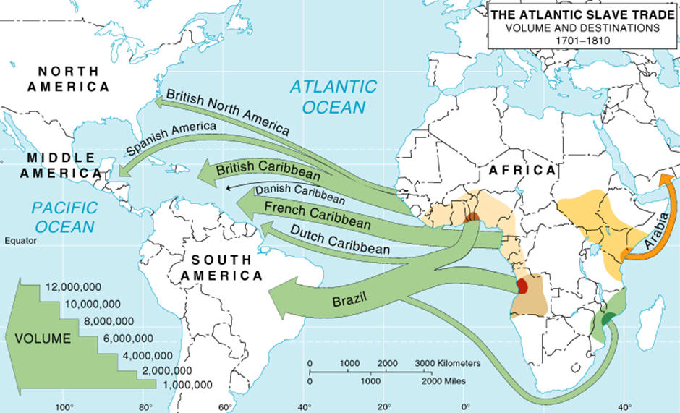
Forced Migration

Slide 15
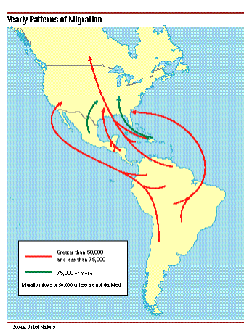

Slide 16
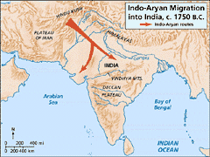

Slide 17
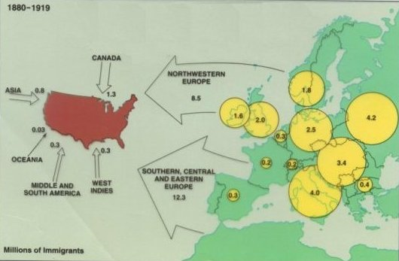

Slide 18
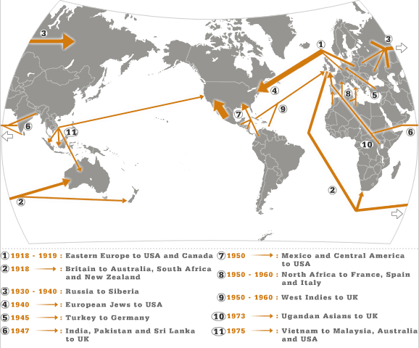

Slide 19
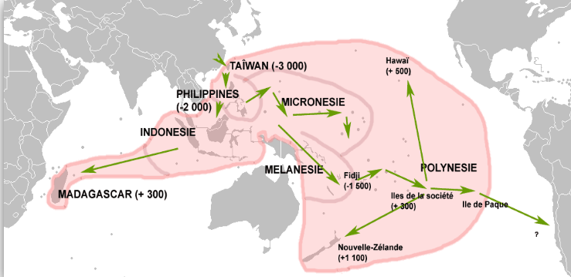
Migrations Autronesiennes

Slide 20
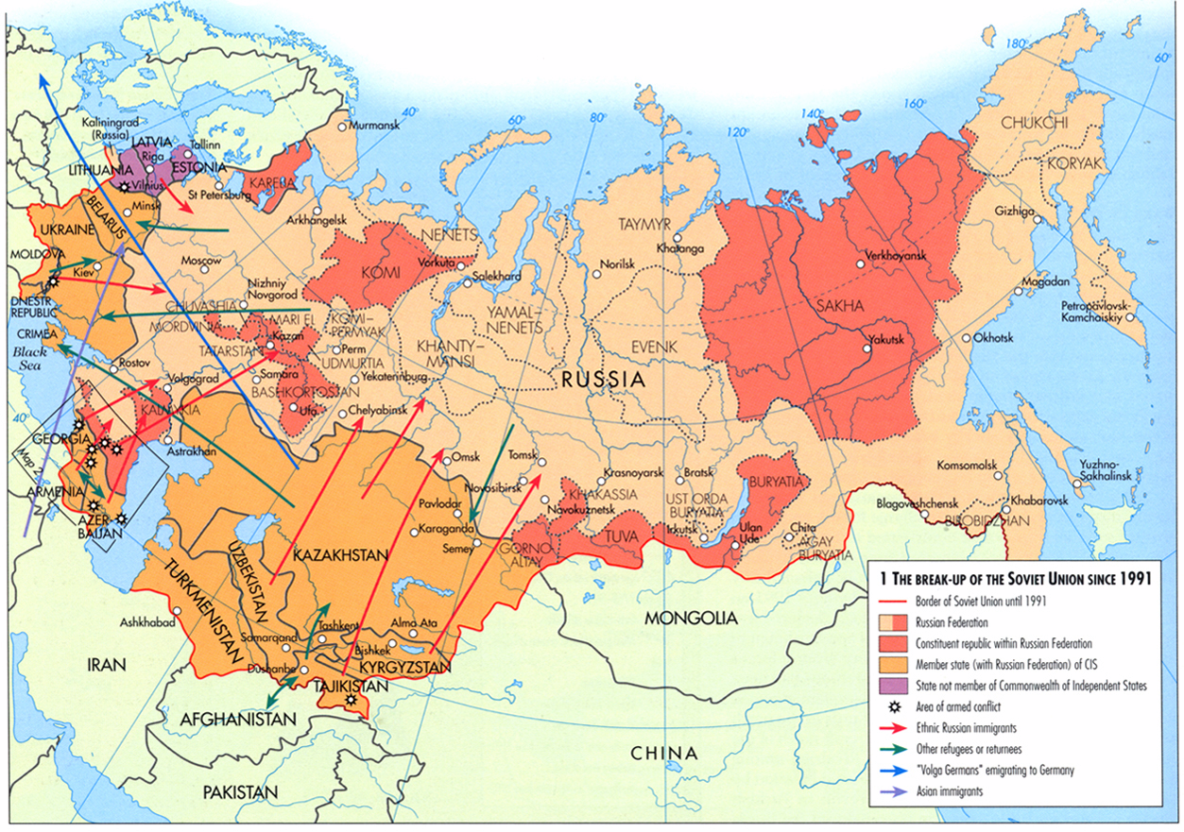

Slide 21
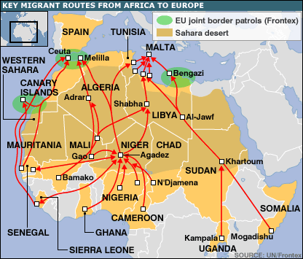

Slide 22
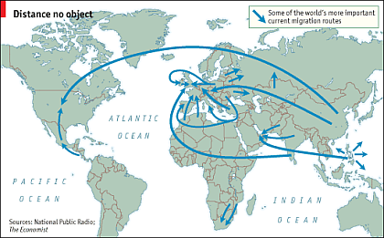
Current Migration Routes

Slide 23
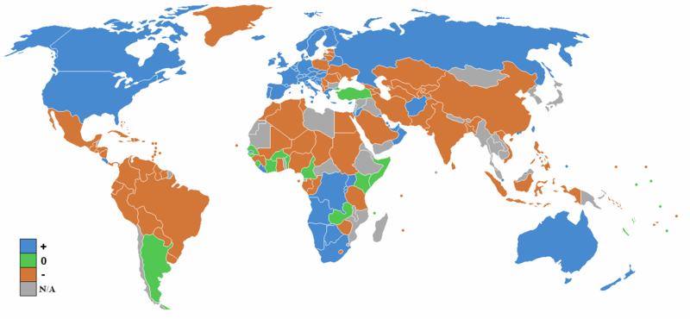
Net migration rates for 2008

