Slide 1
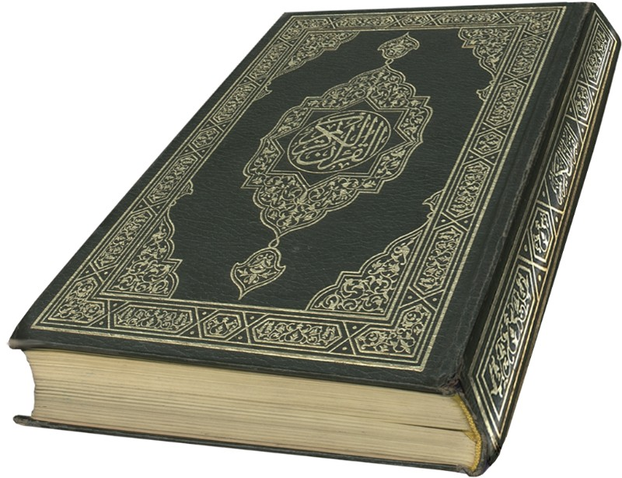
Influence of Islam
Terms- Islamic, Muslim, Moslem
Followers of Mohammed
Sphere of influence today?

Slide 2
Origins of the Arabs
Who are the Arabs- Semitic people like Phoenicians, Jews, Egyptians, Syrians
Tradition- son of Abraham through Ishmael
Roman times- many were Bedouin- lived in desert, usually tribal and polytheistic
revered Black meteor Ka’ba in Mecca

Slide 3
Founder Mohammed 570-632
married wealthy widow, managed trade
received a message from Gabriel (angel)
  with a new revelation to follow Judaism and Christianity
  spent time in desert contemplating
  returned to convert others- trouble
Hegira- 622 forced from Mecca First day of Muslim calendar

Slide 4
Beliefs of Islam
Qur’an (Koran)- basis sacred book, ethical guide
Five Pillars
  One God and his name is Allah(Mohammed is his prophet)
  Pray 5 x a day facing Mecca
  fast daylight during Ramadan
  Pilgrimage to Mecca- once in life time
  Give alms to the poor
laws- no alcohol, pork, dishonest
Believed in being hospitable

Slide 5
Spread of Islam- Jihad-Amazing Speed
overpopulation- division among Byzantines/ Persians/Christians
Abu Bakr- successor to Mohammed (caliph) instituted the jihad
key- convert or pay taxes, also promise of paradise and brilliant generals
treated those conquered with civility
Egypt- across North Africa- Berbers
  to Spain and Conquest Musa, Tarek, Roderick

Slide 6
Conflict within Islam
Abu Bakr elected- Omar followed, two others elected, killed
661- caliphate made hereditary in Damascus under Umayyads
Mohammed’s descendants Ali- Hussein disputed- called shi’at (partisans of Ali)
defeated 680, but split Islamic world into Sunni and Shiite
split lasts till today- revival among Shiites-
  Iran mostly Shiite/ Iraq Sunni SH attacks Shiites

Slide 7
Famous Islamic People
Abbasid dynasty 750-1258 Baghdad- control far reaching- probably too far
Fatimid- established in Egypt
Saladin- takes over Fatimids, becomes Sultan- time of Crusades
Moors in Spain- Battle of Tours stopped advance
dhimmis- “Peoples of the Book” not as much tax Jews, Christians, Zoroastrians

Slide 8
Achievements of the Islamic World
use Arabic numerals
Math and astronomy- borrowed zero from India, devel algebra
medicine- developed treatments later basis of European medicine and surgery
paved streets , libraries and education when Europe had none
art and arch- no statues or figures- beauty in buildings

Slide 9
Intellectual Life
Dove- Founding of Cairo-established university
Trade important- kept ideas going
preserved knowledge from Greeks
Founded universities (Islamic idea) and centers for learning
Built and rebuilt cities- art based on geometric figures, plants

Slide 10
Jihad 6th Pillar of Islam?
Inner spiritual journey
War on “infidels” ( anyone who is not Muslim)
Defend faith and way of life
Western Culture seen as threat
Crusades..why sensitive about this? Importance of Dome of the Rock.

Slide 11
Discovery BBC /Presentation
Perspective of some in ME
  Terrorism justified, ignored Palestinians, defile Islam (US troops in SA and elsewhere, shoot down pilgrims, let children of Iraq starve)
  Crusades- in Middle Ages Europe tried to take Holy Land
  20th cen- GB and France Suez Canal, drove out Turks, set up Protectorates, Israel established 1948, Six day War in 1967 Israel takes Palestine and Jerusalem. Millions become refugees, trained to hate supporters of Israel
  Culture conflict- Way of Western Civilization- too materialistic and secular, sexually immoral, movies, music, alcohol represent decadence. Role of women questioned– many Muslim nations have women leaders.
  Extremists do not want peace- death means reward from Allah

Slide 12
Turks and Mongols
Seljuks - mid 1000 capture Baghdad
Mongols 12th-13th Centuries

