Slide 1
Basics of Buddhism

Slide 2
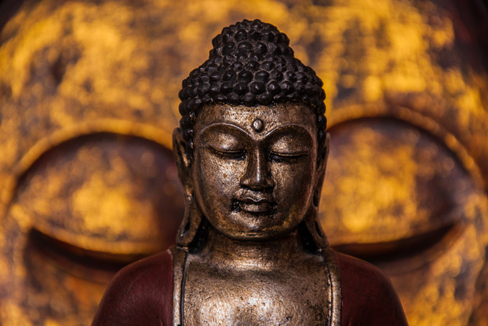
A simple introduction to the fundamental teachings of Buddhism and the core practices of this spiritual path.

Slide 3

Buddhism originated in northern India in the 5th century B.C.E. The tradition traces its origin to Siddhartha Gautama, who is referred to as the Buddha
(the "Awakened" or "Enlightened One").

Slide 4
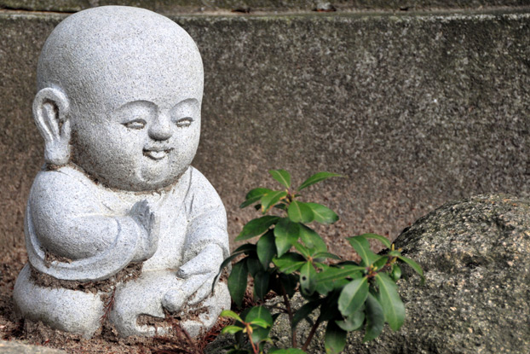
Born a wealthy prince, Gautama realized his material possessions and social
benefits provided only temporary happiness. He gave up riches and royalty to
take on a life of extreme deprivation as he wandered in search of the meaning
and purpose of human existence.

Slide 5
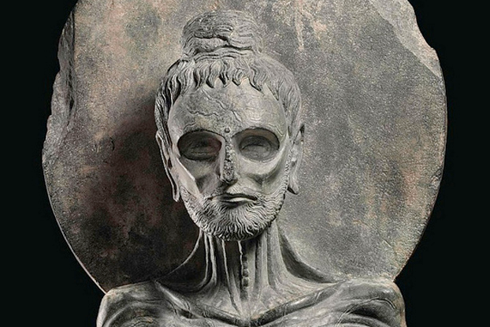
A life of scarcity (in which he almost fasted to starvation) didn’t lead him to
the answers he sought. He discovered what Buddhists call the Middle Way, a path of moderation between self indulgence and self-mortification. He
believed this was the path of wisdom.

Slide 6
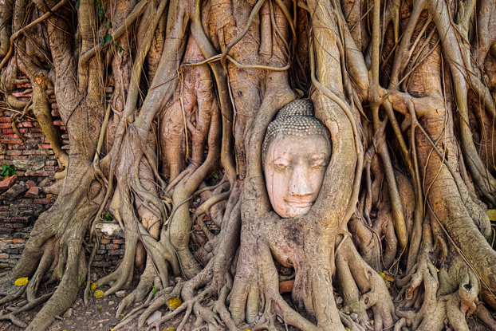
After a reputed 49 days of meditation under a Bodhi tree, at 35, Gautama attained Enlightenment and became the Buddha, realizing complete insight into the cause
of suffering and the steps necessary to eliminate it. Anyone can become a Buddha, but it's a difficult path.

Slide 7

The Buddha taught that people end their suffering through the elimination of
ignorance and craving, which is accomplished through the direct understanding
and perception of dependent origination and the Four Noble Truths.

Slide 8
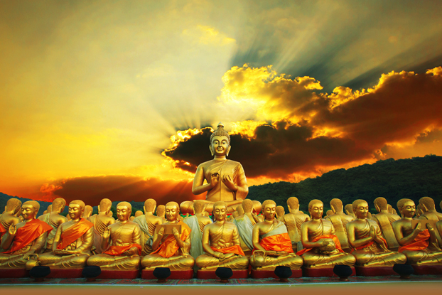
In his first sermon, he outlined the Four Noble Truths: 1) Suffering is characteristic of human existence; 2) Suffering is caused by longing for pleasure and avoidance
of pain; 3) It is not necessary to suffer; and 4) There is a path to end suffering.

Slide 9

In addition, the Buddha taught the Noble Eight Fold Path, which is seen as a set of guidelines for moral behavior that lead its practitioner toward self-awakening and liberation.

Slide 10

The law of dependent origination is another important teaching of the Buddha. Nothing exists in isolation, independent of other life. All things and individuals
are mutually supportive, related, and form a single living whole.

Slide 11

The Buddhist interpretation of karma does not refer to preordained fate. Rather, it refers to the good or bad actions a person makes during his or her lifetime and
how they bring on happiness or unhappiness in the long run.

Slide 12
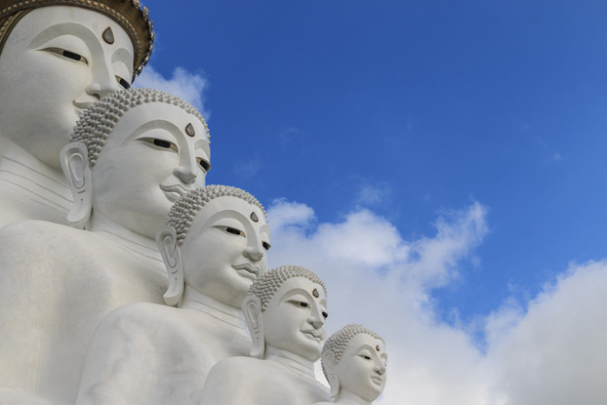
On a larger scale, karma determines where a person will be reborn and their status in their next life. Buddhists don’t believe in a permanent, intrinsically existing soul. Rebirth is an endless cycle involving the passing on of consciousness from one life to the next.

Slide 13

However, the aim of Buddhism is to eventually escape the cycle of rebirth
altogether by reaching Nirvana—the state one reaches after ridding themselves of all karma that constitutes who they are.

Slide 14

Buddhism's transformations and cultural interpretations have led to the emergence of different schools of thought. Three major sects are Mahayana ("great vehicle"),
Theravada ("school of the elder monks"), and Vajrayana (tantric Buddhism).

Slide 15
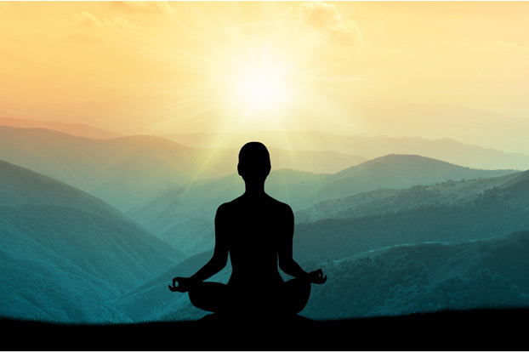
Meditation is important in nearly all forms of Buddhism, and it derives directly
from the Buddha's experiences and teachings. It's the central focus of Zen
Buddhism and the only way to liberation in Theravada Buddhism.

Slide 16

Chanting helps Buddhists learn texts, focus the mind, and internalize key Buddhist
ideas. Buddhism is unique in that it does not consider chanting to be prayer.

Slide 17

That said, Buddhists do pray. Instead of praying to a creator, as Buddhism doesn’t
recognize a God (not even the Buddha), Buddhists pray to cultivate loving-kindness and strengthen their desire to see beings flourish and be free from suffering.

Slide 18
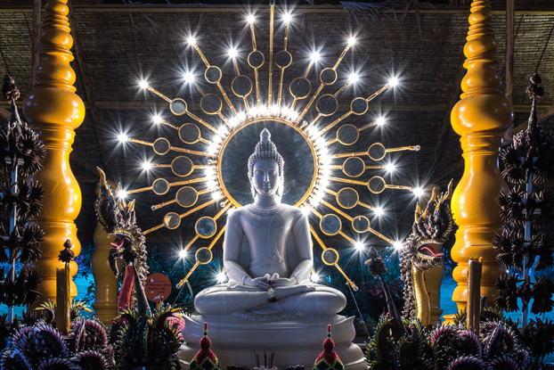
Buddhists pay respect to images of the Buddha, but not during worship or to ask for favors. A statue of the Buddha, with hands rested gently in his lap and a
compassionate smile, reminds us to strive to develop peace and love within
ourselves.

Slide 19
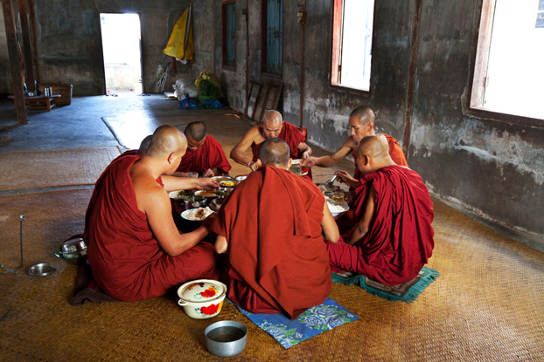
Some Buddhists are vegetarian, although the Theravada view is that the Buddha
did not prohibit eating meat. Mahayana schools generally believe Buddhists should not eat the flesh of any sentient being.

Slide 20
The minimum moral obligations of a practicing lay Buddhist are: 1) Not to take
the life of anything living, 2) Not to take anything not freely given, 3) Abstain from sexual misconduct and sensual overindulgence, 4) Refrain from untrue speech, 5)
Avoid intoxication.

Slide 21
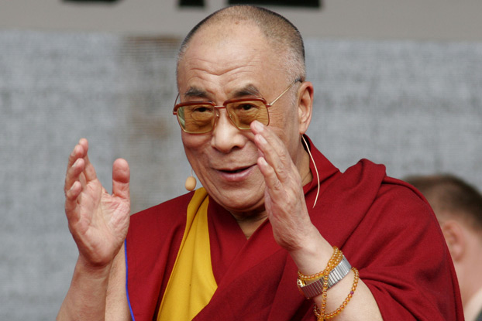
Monks and nuns are responsible for the preservation and sharing of the Buddha's
teaching. The Dalai Lama is the spiritual leader of the four major schools of Tibetan Buddhism, but not the many other schools.

Slide 22
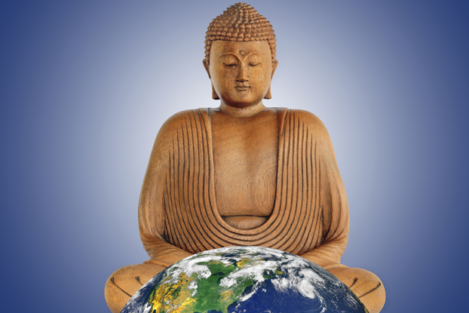
Buddhism has spread to every corner of the world, with 350 million followers. It's a distinct religious tradition, but many Westerners have adopted philosophical and
practical aspects of Buddhism—there are "Buddhist Christians," "Buddhist Jews,"
and "Buddhist Atheists."

