Slide 1
Buddhism – Wat Arun
Seashell Temple

Slide 2
Wat Arun Rajwararam
Wat Arun Rajwararam, "Temple of the Dawn") is a Buddhist temple (wat) in the Bangkok Yai district of Bangkok, Thailand, on the Thonburi west bank of the Chao Phraya River. The full name of the temple is Wat Arunratchawararam Ratchaworamahawihan. Named after Aruna, the Indian God of Dawn, the Wat Arun is considered one of the most well known of Thailand's many landmarks.

Slide 3
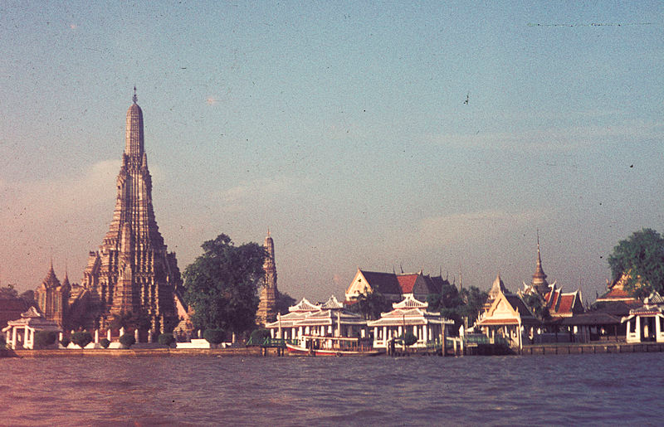

Slide 4
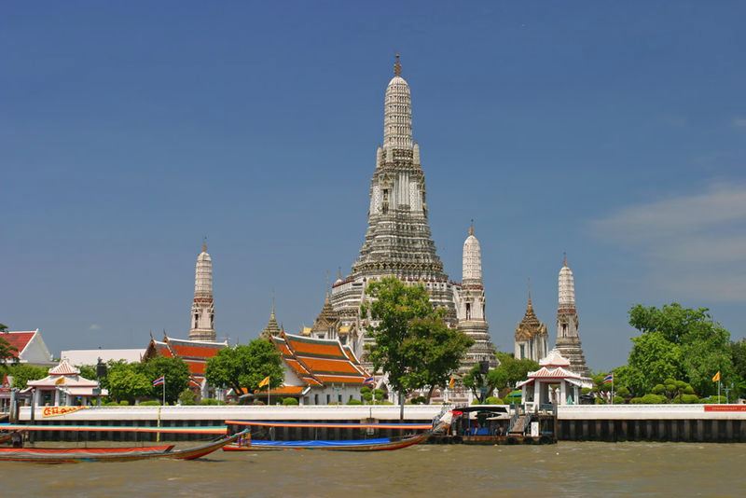

Slide 5
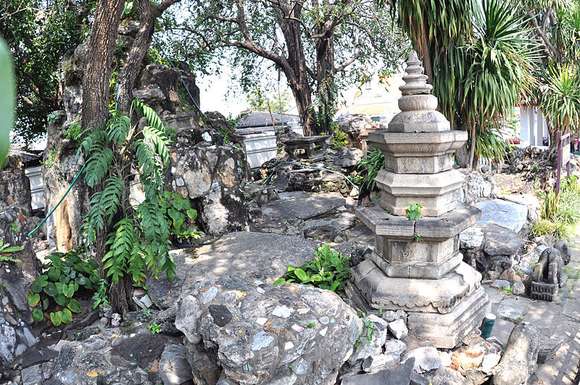
Entrance Garden

Slide 6
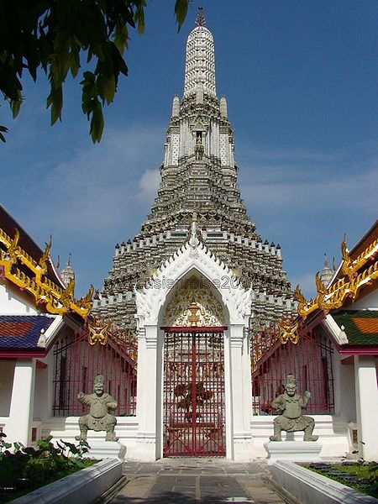

Slide 7
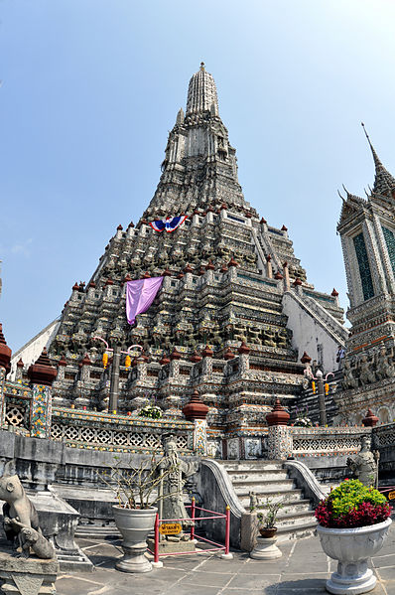
The outstanding feature of Wat Arun is its central prang (Khmer-style tower). Begun in 1809, it may have been named "Temple of the Dawn" because the first light of morning reflects off the surface of the temple with a pearly iridescence.

Slide 8
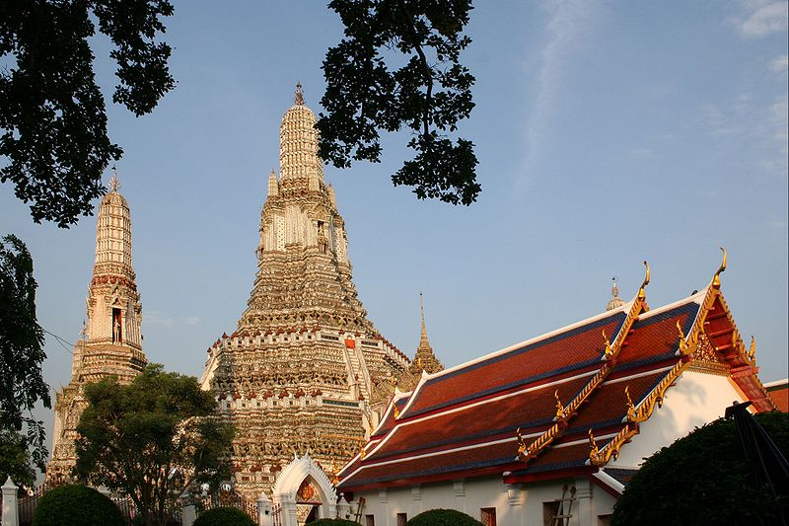

Slide 9
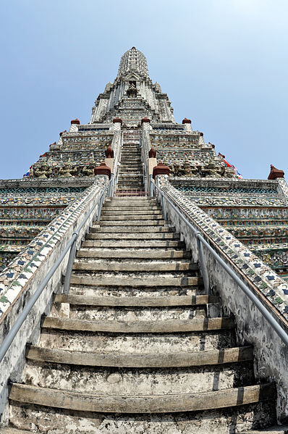

Slide 10
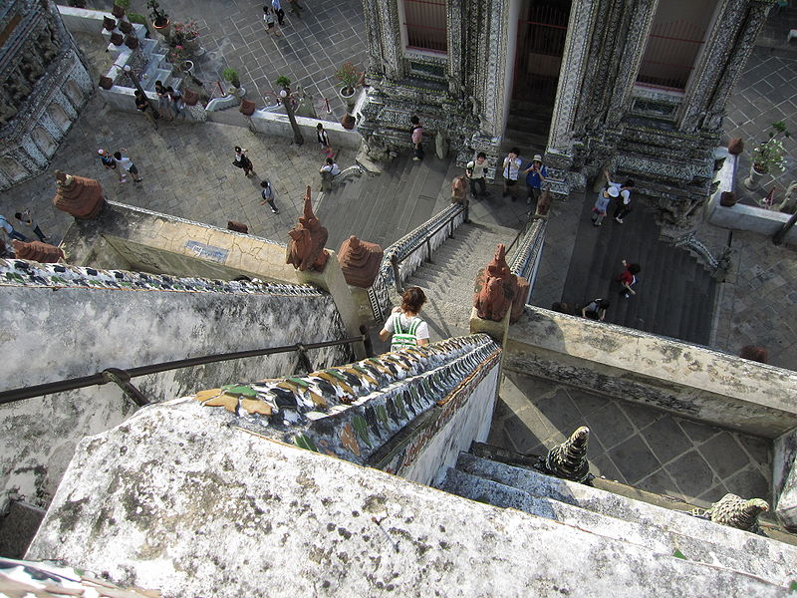
Stairway of Wat Arun

Slide 11
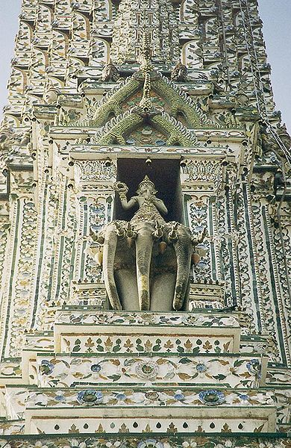
Detail of the Prangf

Slide 12
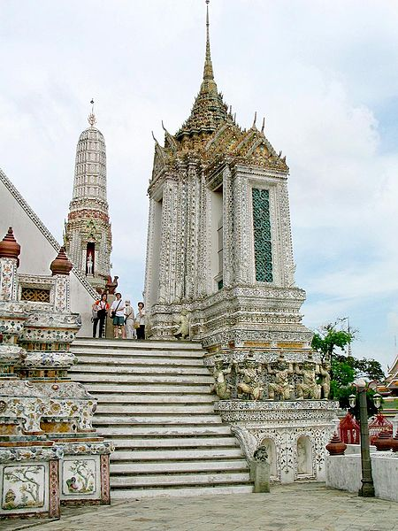

Slide 13
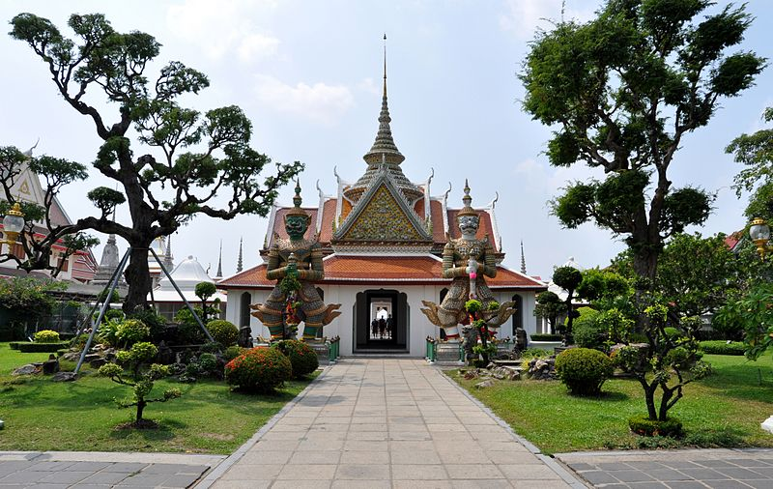
The front entrance of the Ordination Hall

Slide 14
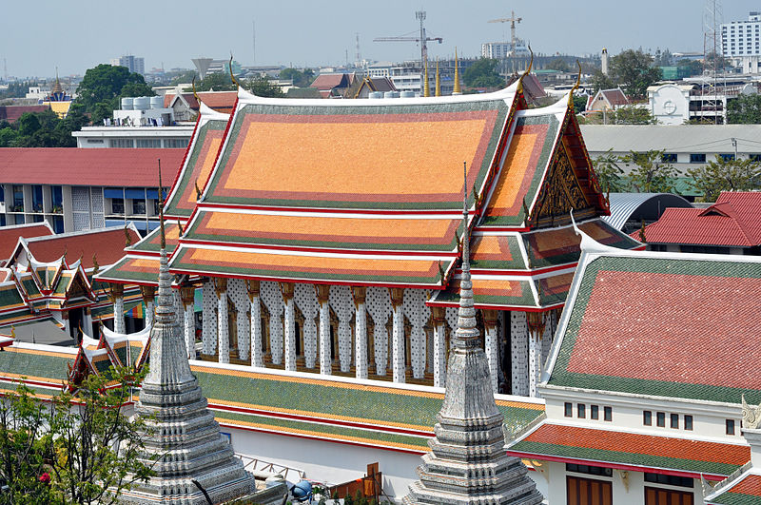

Slide 15
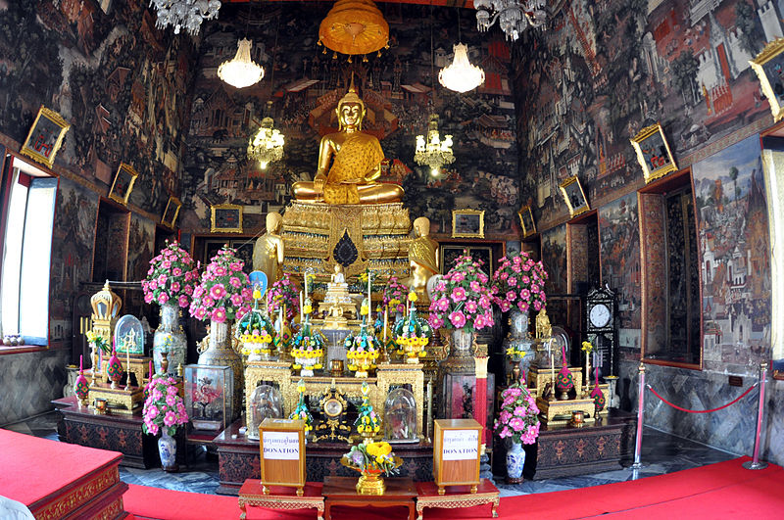
Inner Temple

Slide 16
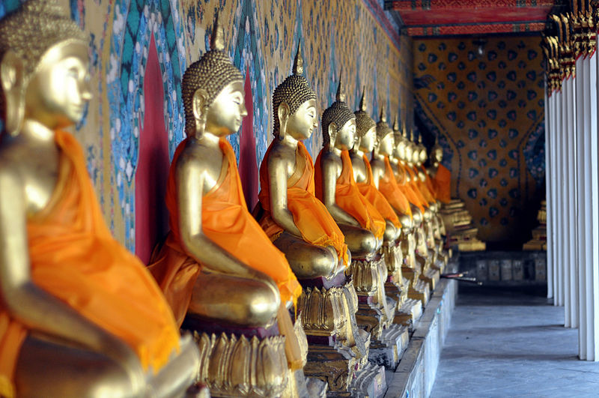
Buddha Images Inside

Slide 17
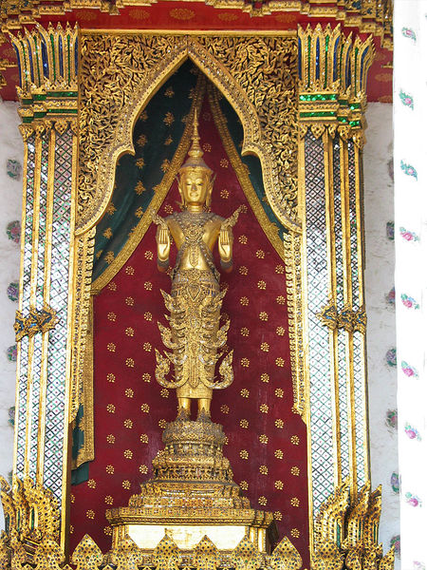
Standing Buddha, "Stopping the ocean", Rattanakosin style "in royal attire", Wat Arun, Bangkok, Thailand

Slide 18
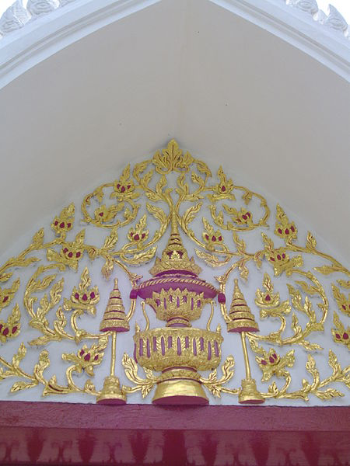

Slide 19
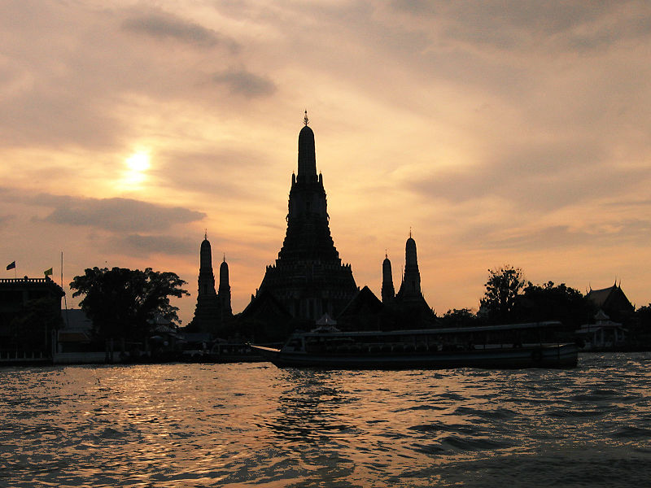

Slide 20
