Slide 1
Sacred Places - 9 Brilliant Pilgrimages
The pilgrimage allows for a physical expression of faith, tangible and visible—to deepen belief and connect us to history. Here we provide a selection of some of the most beautiful destinations for spiritual travelers.

Slide 2
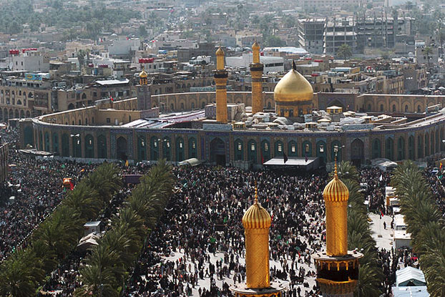
Arba'een: Islam — A Shia Muslim pilgrimage, Arba'een commemorates the end of the 40-day mourning period for the martyrdom of Husayn ibn Ali, Muhammad's grandson. For Arba'een, 31 million people travel to Karbala in Iraq making this one of the largest gatherings on Earth.

Slide 3
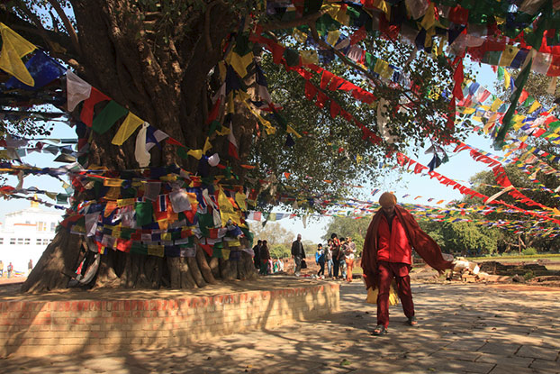
Lumbini: Buddha's Birthplace — Legend has it that Gautama Buddha was born here, and it was here that seven lotus flowers sprung up at his first seven steps. Today Lumbini has many temples and monasteries that pilgrims visit to honor the birth of Gautama Buddha.

Slide 4
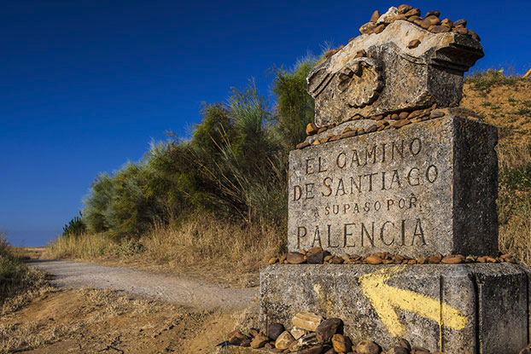
Way of St. James to Santiago de Compostela: Christianity — Also known as the Camino de Santiago this pilgrimage encompasses the many routs through Europe to reach the shrine of St. James in the Cathedral of Santiago de Compostela in Galicia, Spain.

Slide 5
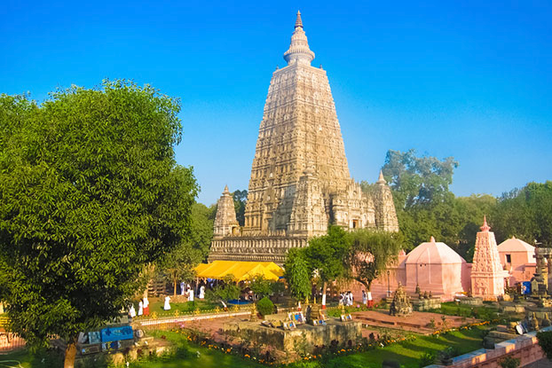
Bodh Gaya: Buddha's Place of Enlightenment — Famous as the place where Gautama Buddha obtained enlightenment under the famous Bodhi Tree and renouncing asceticism. Bodh Gaya is the most important of the Buddhist pilgrimages.

Slide 6
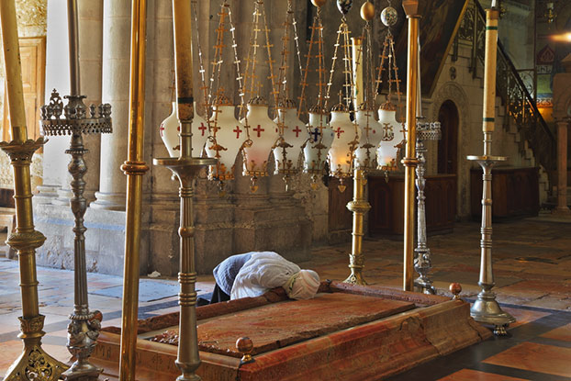
Christian Pilgrimages to the Holy Land — In both Israel and Jordan there are many sites connected to the ministry of Jesus and the formation of the early church. As the site of the Passion of Christ, Jerusalem acts as the crux of most Christian pilgrimages to the Holy Land.

Slide 7
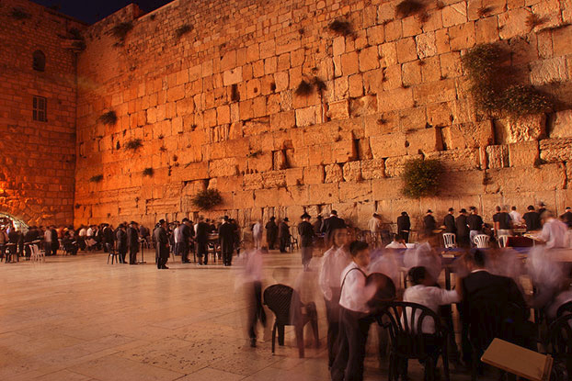
The Western Wall or Wailing Wall: Judaism — The last remnant of the great temple in Jerusalem, the Wailing Wall has become a place for both Jews and Christians to pray and connect with God.

Slide 8
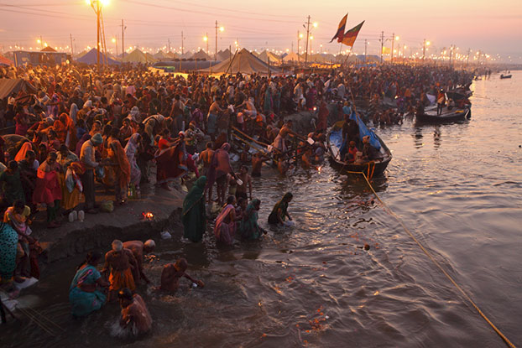
Kumbh Mela: Hinduism — A pilgrimage in which Hindus are to bathe in the sacred rivers of Hinduism, Kumbh Mela is held every third year at one of four rivers by rotation: the Ganges, Yamuna, Godwari, and Shirpa. 100 million visitors make it the largest peaceful gathering in the world.

Slide 9
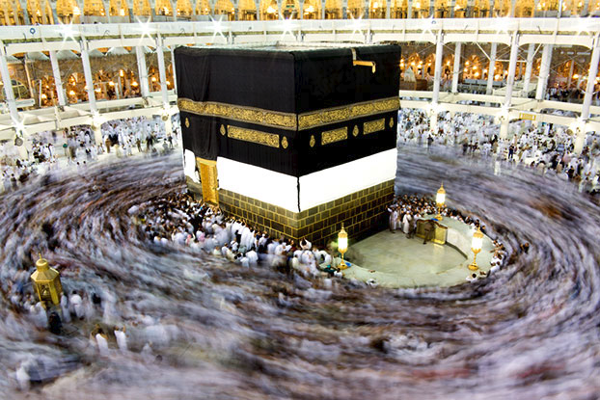
The Hajj: the Muslim Pilgrimage to Mecca — One of the four pillars of Islam, the Hajj (or the pilgrimage to Muhammad's birthplace in the city of Mecca, Saudi Arabia) is a mandatory religious duty all Muslims must perform at least once in their lifetime if they have the means.

Slide 10
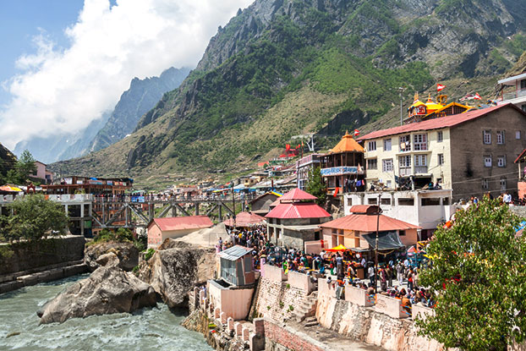
Char Dham: Hinduism — Char Dham is a pilgrimage to the four most sacred sites of Hinduism: Badrinath, Dwarka, Puri, and Rameswaram—representing the farthest north, east, west, and south points of India.

