Slide 1
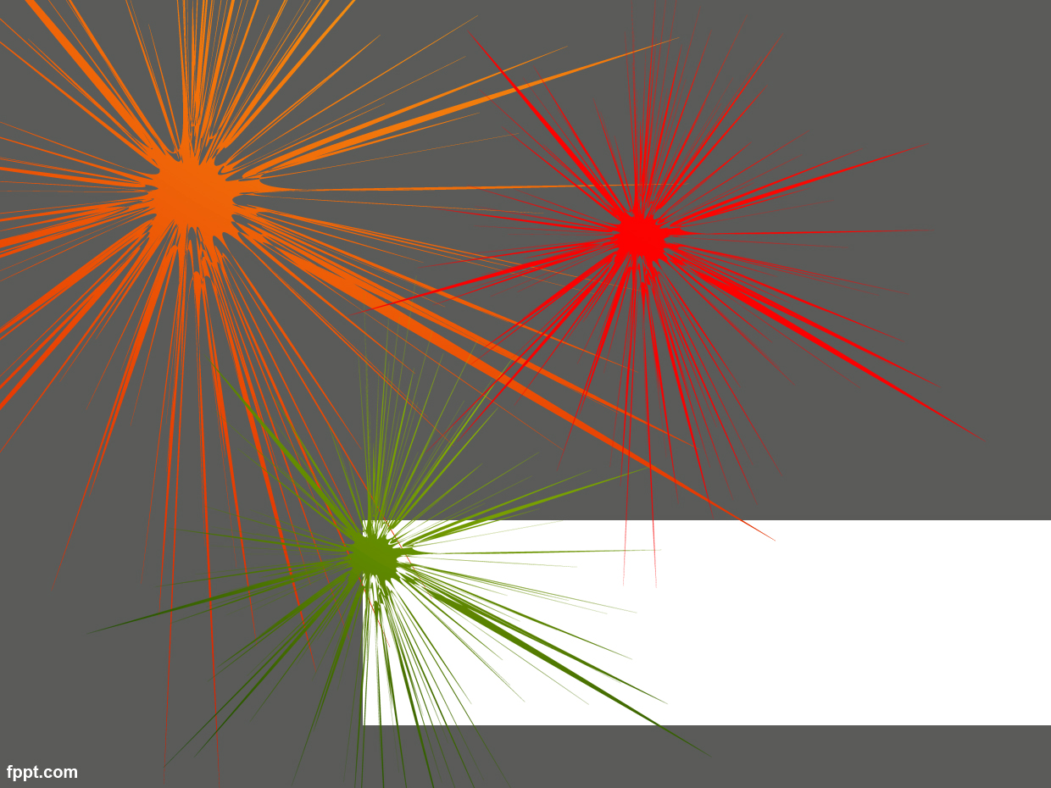
U.S. Intervention in Middle and South America

Slide 2
1846 to 1848, Mexico and the United States warred over Texas, California and what today is the American Southwest but was then part of Mexico. During this war, US. troops invaded and occupied parts of Mexico, including Veracruz and Mexico City. US took ½ of Mexico.
Roosevelt Corollary to the Monroe Doctrine. President William Howard Taft viewed "Dollar Diplomacy"
1898 Spanish-America War – US takes control of Cuba and Puerto Rico

Slide 3
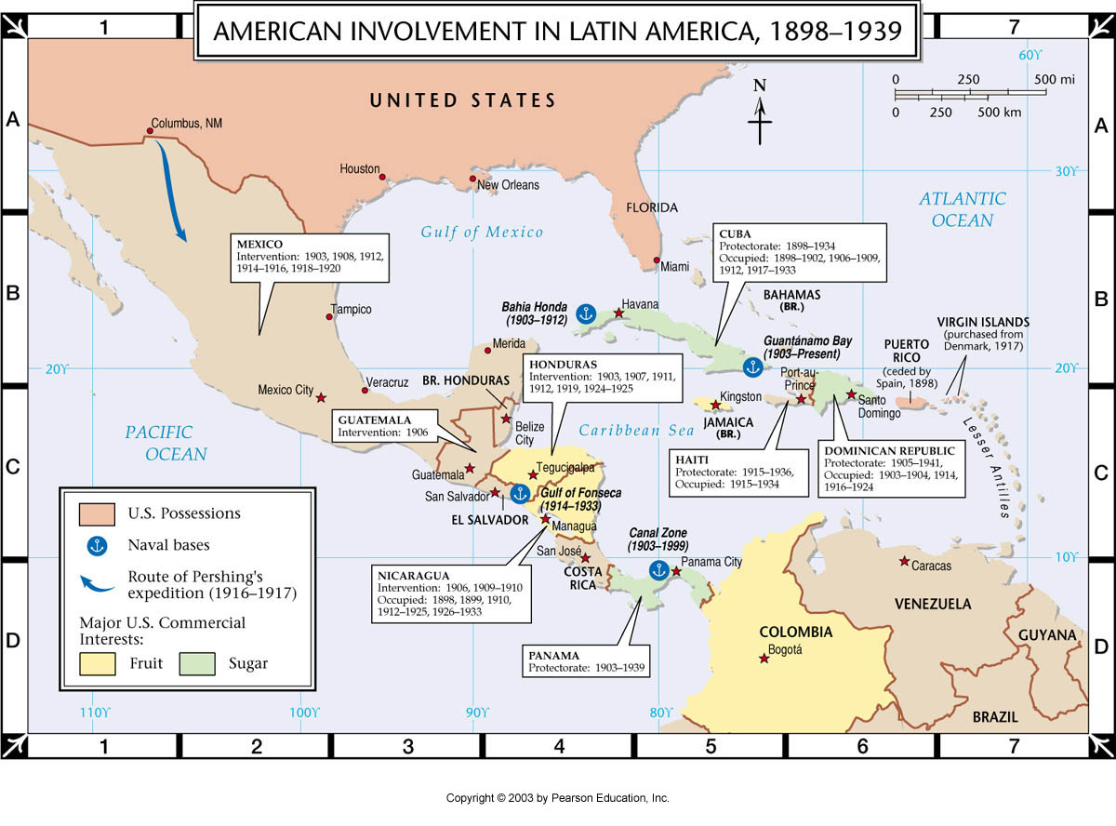

Slide 4
1901: The Platt Amendment amended a treaty between the US and Cuba after the Spanish–American War virtually made Cuba a U.S. protectorate. The amendment outlined conditions for the U.S. to intervene in Cuban affairs and permitted the United States to lease or buy lands for the purpose of the establishing naval bases, including Guantánamo Bay. In effect until 1935.
1903: U.S. backed independence of Panama from Colombia in order to build the Panama Canal; Hay–Bunau-Varilla Treaty

Slide 5
1904: When European governments began to use force to pressure Latin American countries to repay their debts, Theodore Roosevelt announced his "Corollary" to the Monroe Doctrine, stating that the United States would intervene in the Western Hemisphere should Latin American governments prove incapable or unstable.
1906 to 1909: U.S. governed Cuba under Governor Charles Magoon.
1909: U.S.-backed rebels in Nicaragua depose President José Santos Zelaya.

Slide 6
1912 to 1933 United States occupation of Nicaragua: Marines occupied main cities. Their purpose was to provide stabilization to the government. There was a period of a few months between 1925 and 1926 when the Marines left but were back for the same reason.[citation needed]
1914 to 1917: Mexico conflict and Pancho Villa Expedition, U.S. troops entering northern portion of Mexico.
1915 to 1934: United States occupation of Haiti

Slide 7
1916 to 1924: U.S. occupation of the (former Spanish colony) Dominican Republic
1954, the CIA launched Operation PBSUCCESS, which deposed the democratically elected Guatemalan President Jacobo Árbenz and ended the Guatemalan Revolution. The coup installed the military dictatorship of Carlos Castillo Armas
1961, the CIA attempted to depose Cuban president Fidel Castro through the Bay of Pigs Invasion.

Slide 8
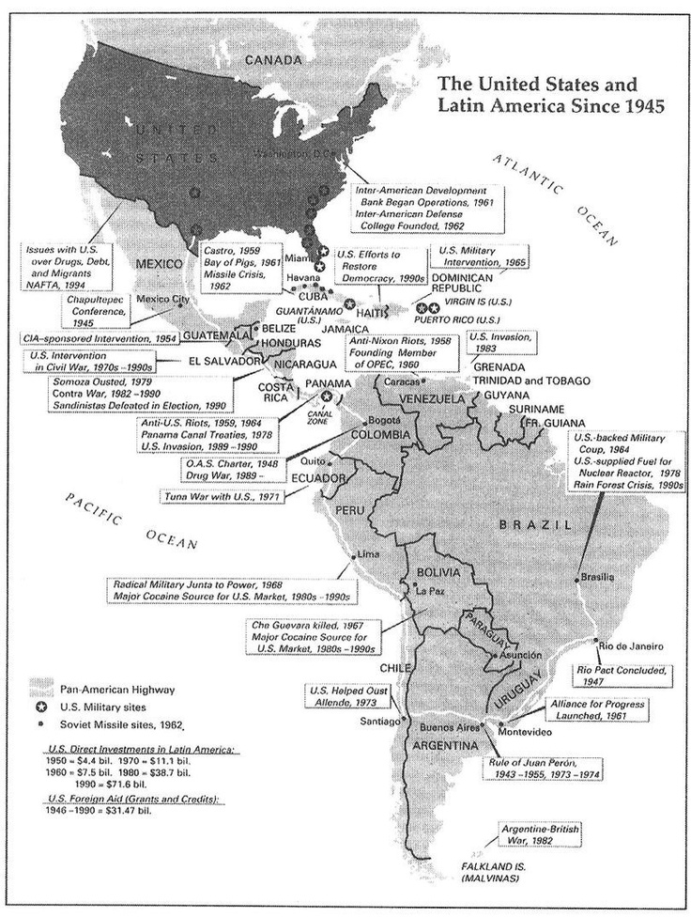

Slide 9
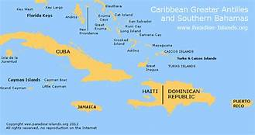
1961, the CIA supported the overthrow of Rafael Trujillo, dictator of the Dominican Republic After a period of instability, US troops invaded the Dominican Republic in Operation Power Pack, initially to evacuate US citizens on the island and ultimately to broker a cease-fire in the civil war.

Slide 10
In 1975 it was revealed by the Church Committee that the United States had covertly intervened in Chile from as early as 1962, and that from 1963 to 1973, covert involvement was "extensive and continuous In 1970, at the request of President Richard Nixon, the CIA planned a "constitutional coup" to prevent the election of Marxist leader Salvador Allende in Chile, while secretly encouraging Chilean generals to act against him. The CIA changed its approach after the murder of Chilean general René Schneider, offering aid to democratic protestors and other Chilean dissidents. Allende was accused of supporting armed groups, torturing detainees, conducting illegal arrests, and muzzling the press; historian Mark Falcoff therefore credits the CIA with preserving democratic opposition to Allende and preventing the "consolidation" of his supposed "totalitarian project". However, Peter Kornbluh asserts that the CIA destabilized Chile and helped create the conditions for the 1973 Chilean coup d'état, which led to years of dictatorship under Augusto Pinoche

Slide 11
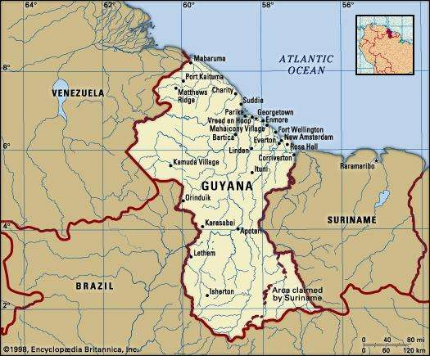
1964. The Johnson administration later helped Burnham fix the fraudulent election of 1968—the first election in Guyana after decolonization in 1966. To guarantee Burnham's victory, Johnson also approved a well-timed Food for Peace loan, announced some weeks before the election to influence the election but not to appear to be doing so

Slide 12
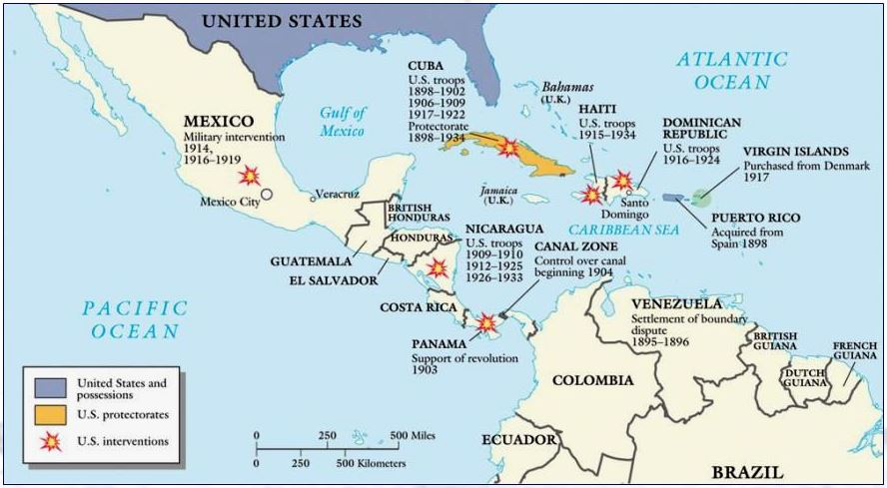

Slide 13
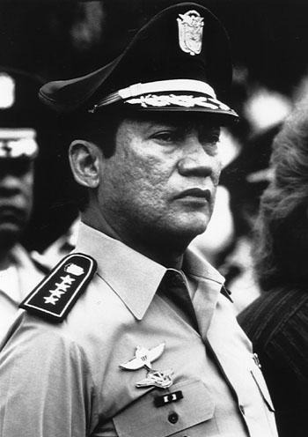
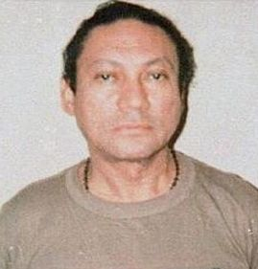
1980-88 , Reagan administration Iran/Contra illegal support of the Contra in Nicaragua .
Under Carter and Reagan, the CIA repeatedly intervened to prevent right-wing coups in El Salvador
US invaded Grenada in Operation Urgent Fury and held free elections. In 1986
invasion of Panama (Operation
Just Cause) in 1989 and deposed
dictator Manuel Noriega – Brought
him to the US, put him on trial, and
put him in prison

Slide 14
1995 Under President Bill Clinton, the US participated in Operation Uphold Democracy, a UN mission to reinstate the elected president of Haiti, Jean-Bertrand Aristide, after a military coup.
The US has used large amounts of aid and counter-insurgency training to enhance stability and reduce violence in war-ravaged Colombia, in what has been called "the most successful nation-building exercise by the United States in this century".

Slide 15
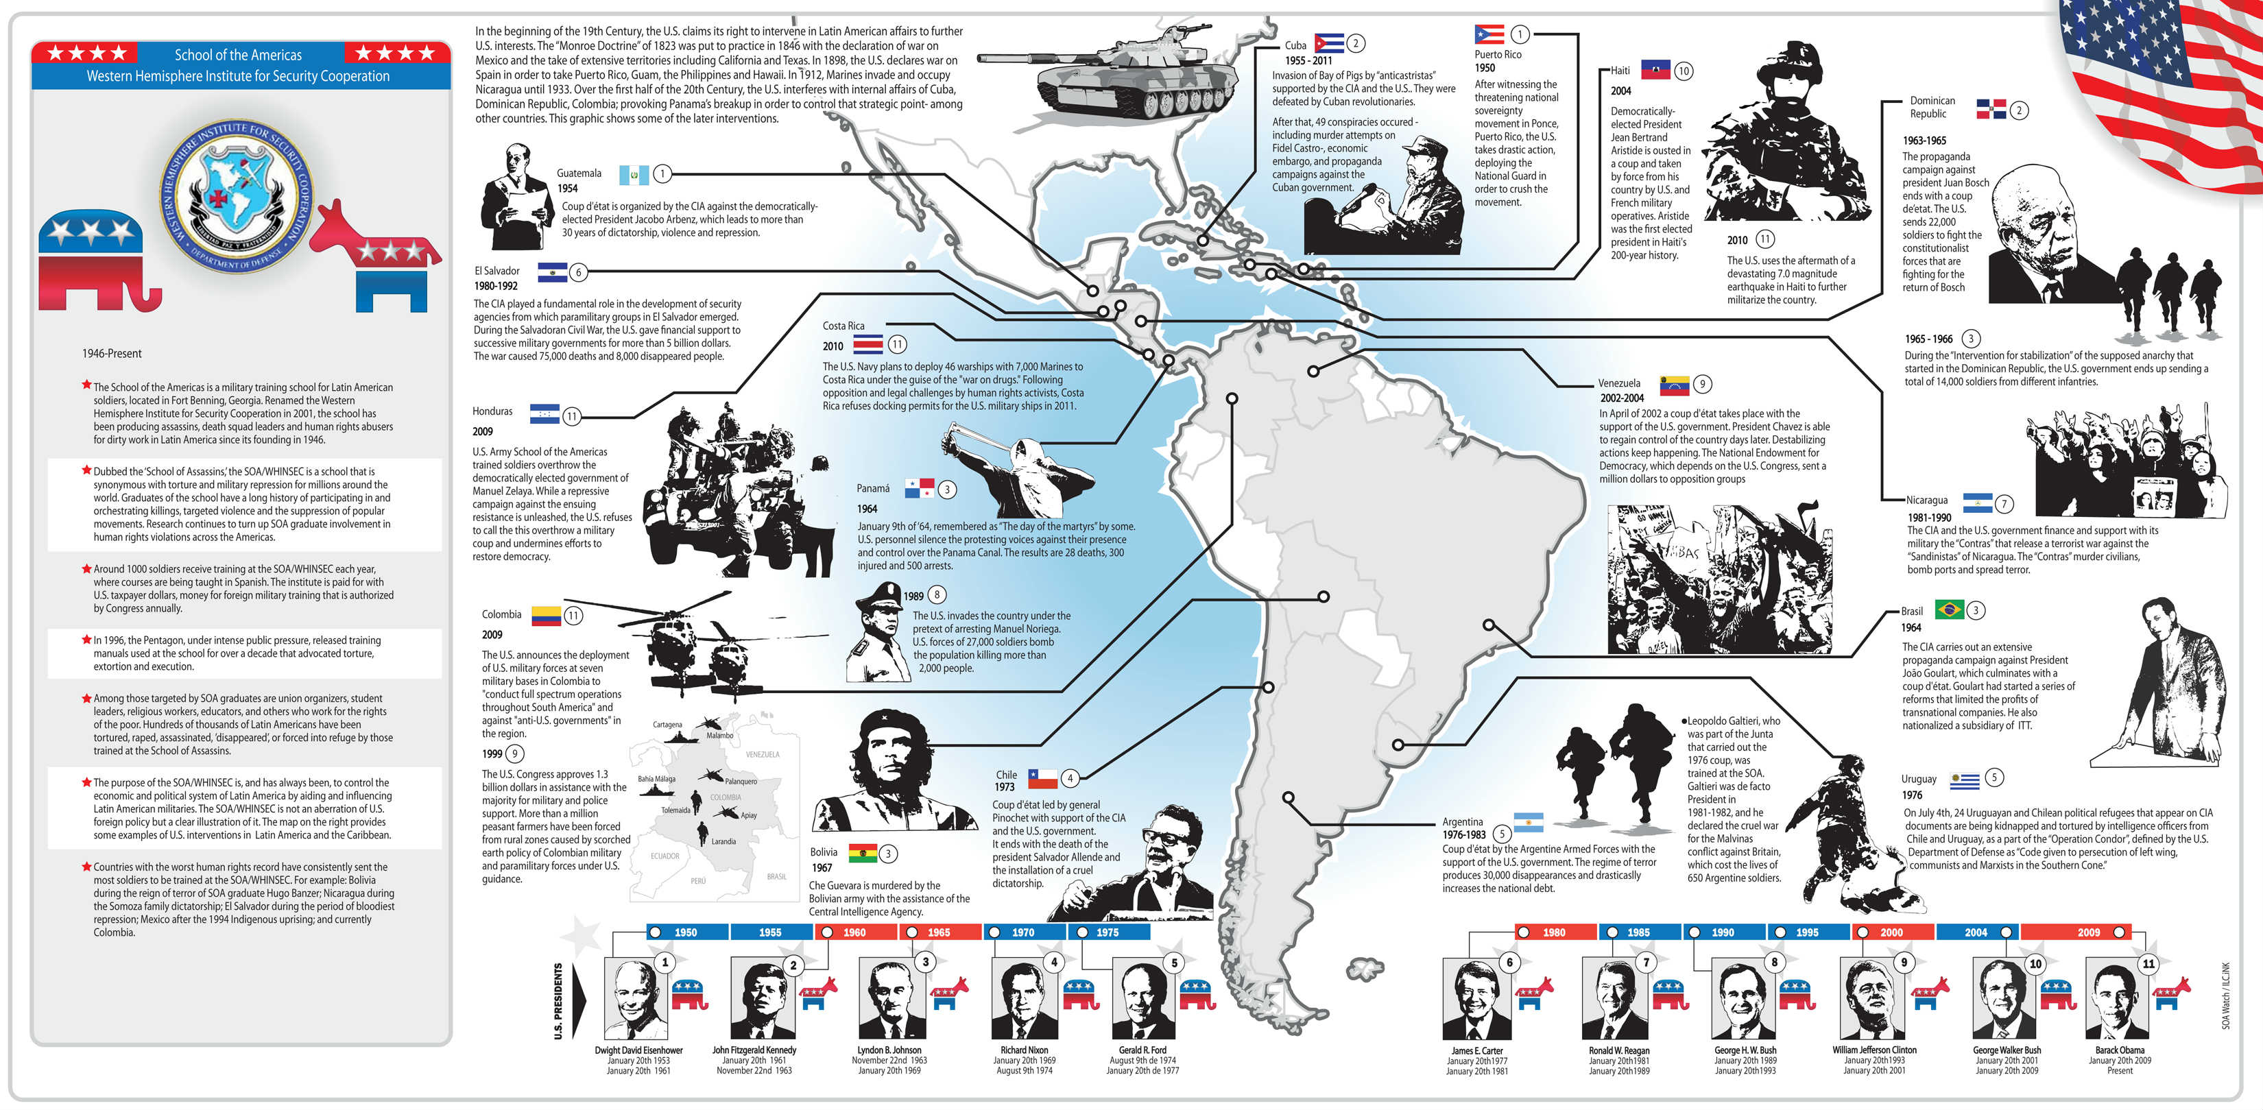

Slide 16
Trust?
Based on what you have seen in this presentation, if you were the leader of one of the Latin American countries, would you trust the US to respect your country and honor the results of elections held in your country?
Many of these countries would fall into the category of countries that President Trump publicly called, ”shithole countries.” Do you think that had an effect on how the leaders there think of the US? Explain.

