Slide 1
Life in North Korea
This article originally appeared on our sister site: domesticatedcompanion.com
Geographic information added by Joe Naumann, UMSL

Slide 2
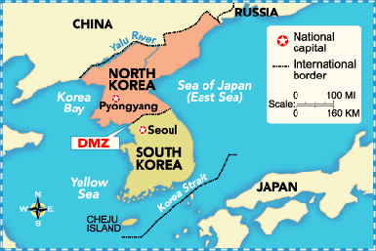
Korea has been divided since the end of World War II. It continued to be divided after the Korean War of the early 1950s.

Slide 3
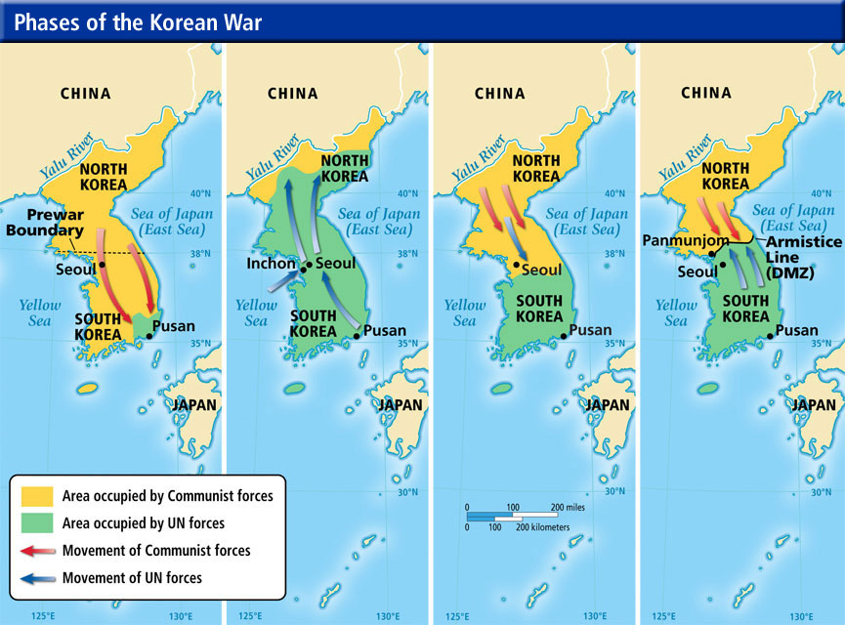
1950-1953
Chinese “volunteers” enter to help the North

Slide 4
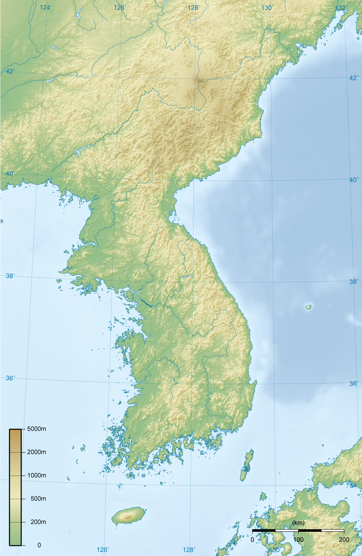
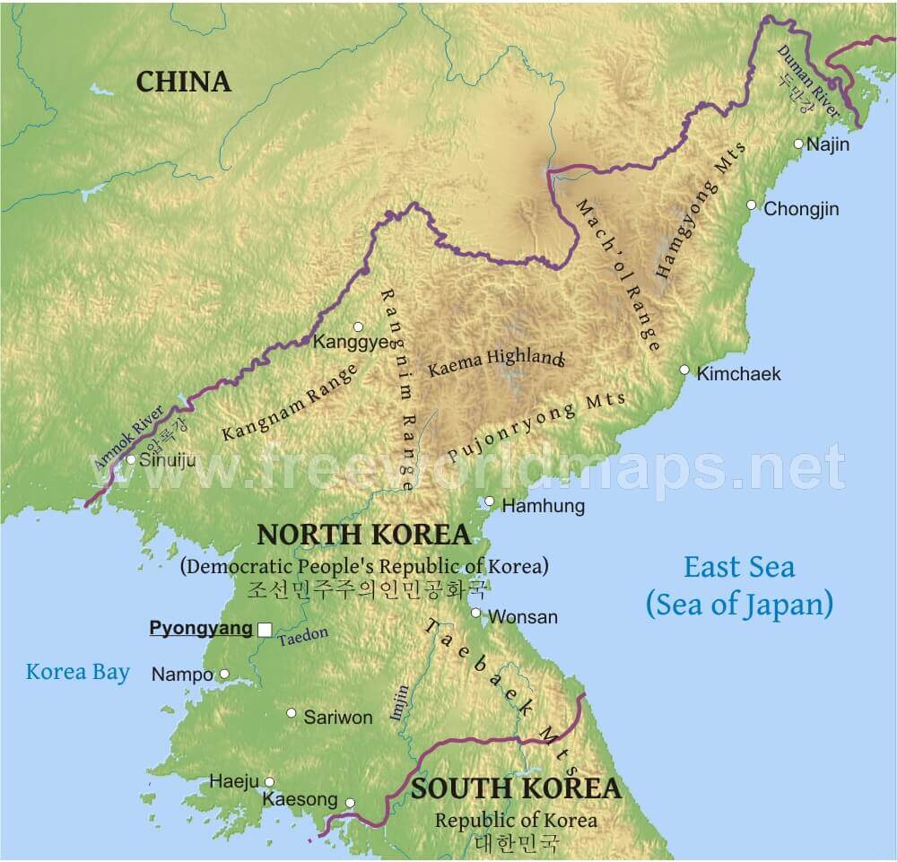
The North has a larger % of mountains and the South has a larger % of arable land.

Slide 5
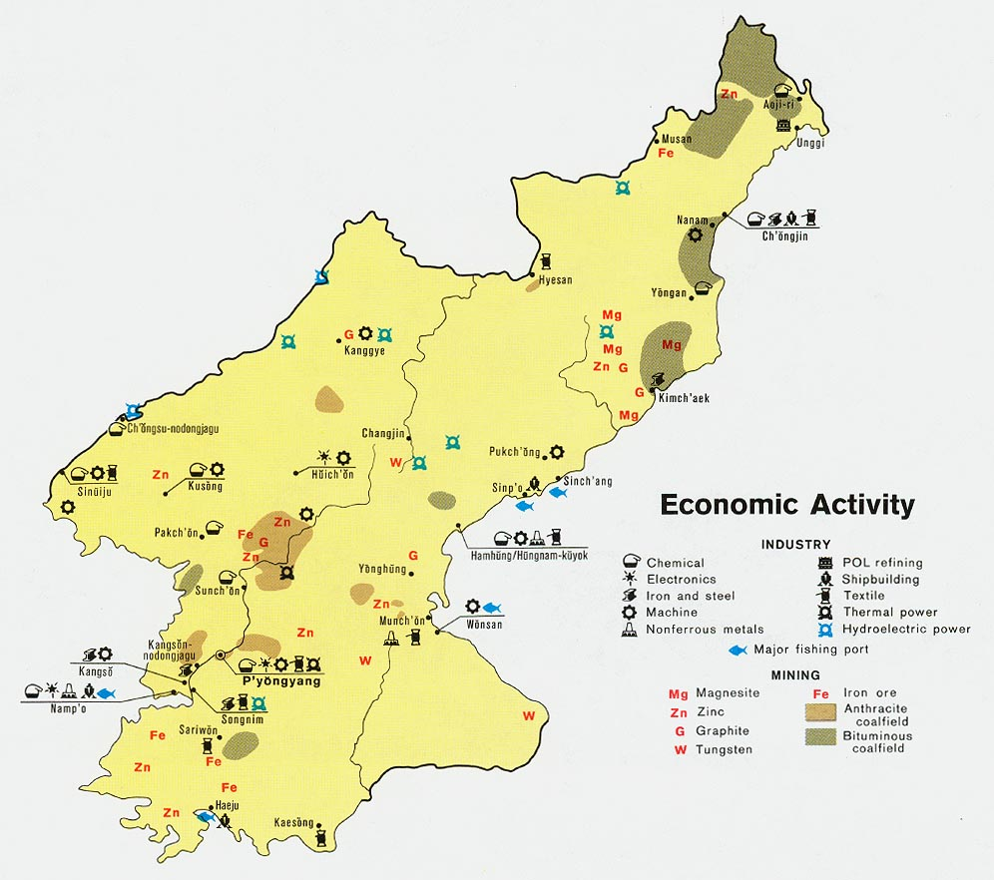

Slide 6
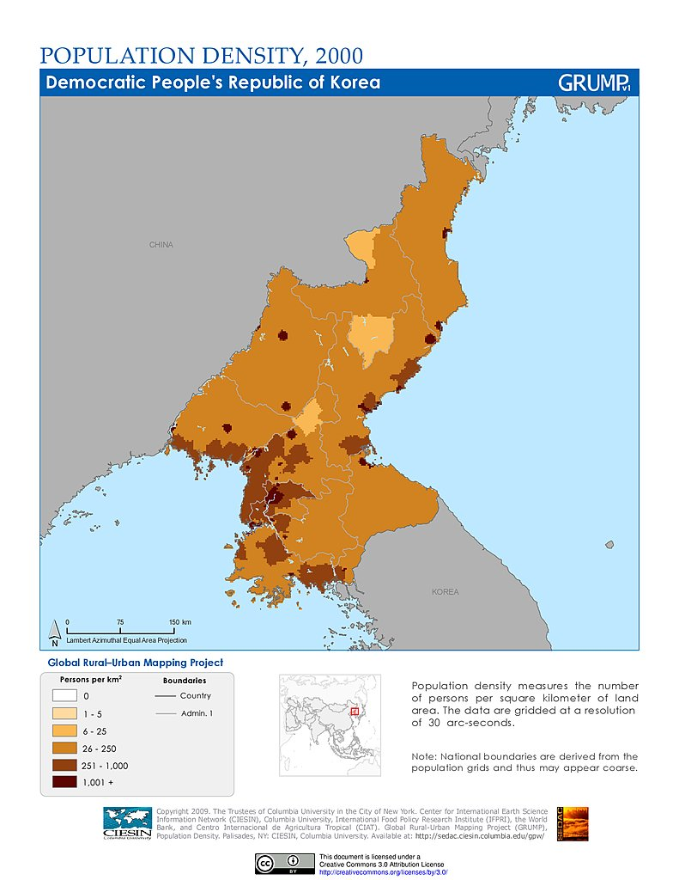
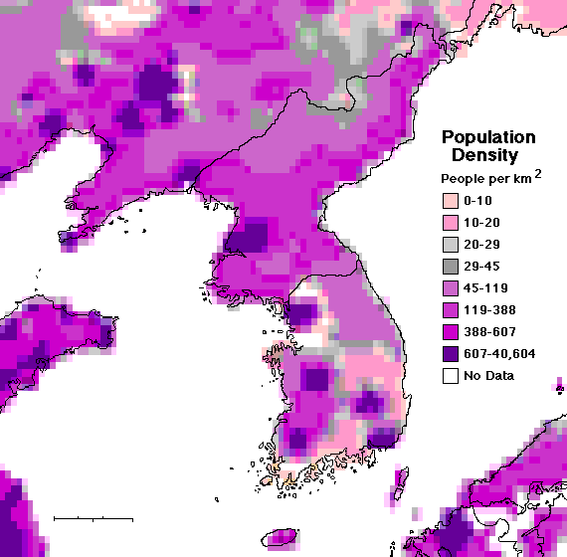

Slide 7
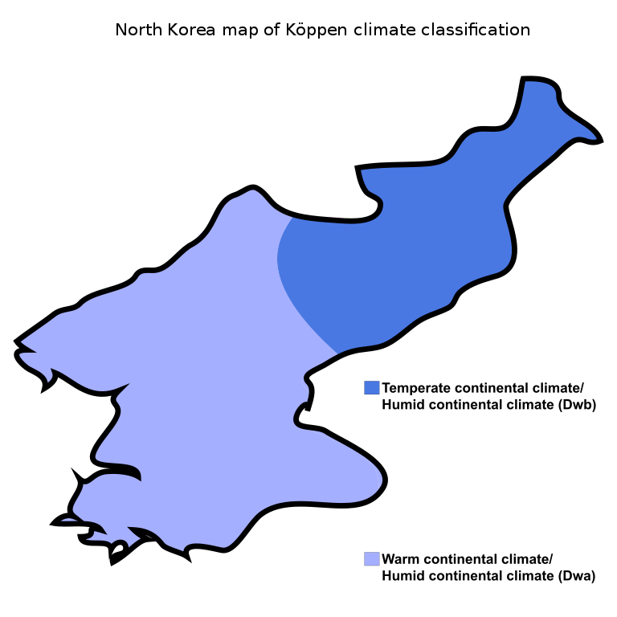

Slide 8
Far from happy
In government sanctioned propaganda, the people of North Korea appear happy, smiling and well fed. The people are often shown in spotless factories and laboratories, patriotic and fulfilled, but the following pictures will give you a glimpse of what their life is really like and it is nothing like what we are led to believe. A photographer used a hidden camera to shoot random people on their way to work. These people are not only unsmiling but seem bitter and angry about their lives and place in the world. These candid shots deliver a truth that is quite different than claims made by the North Korean regime.

Slide 9
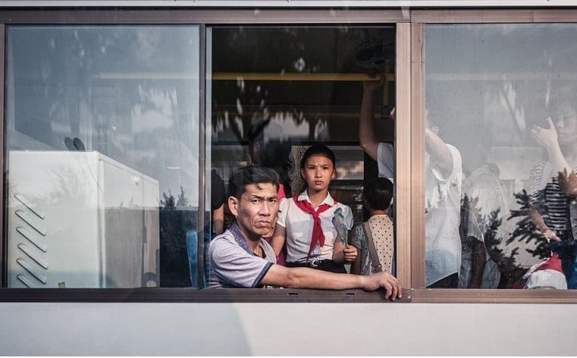

Slide 10
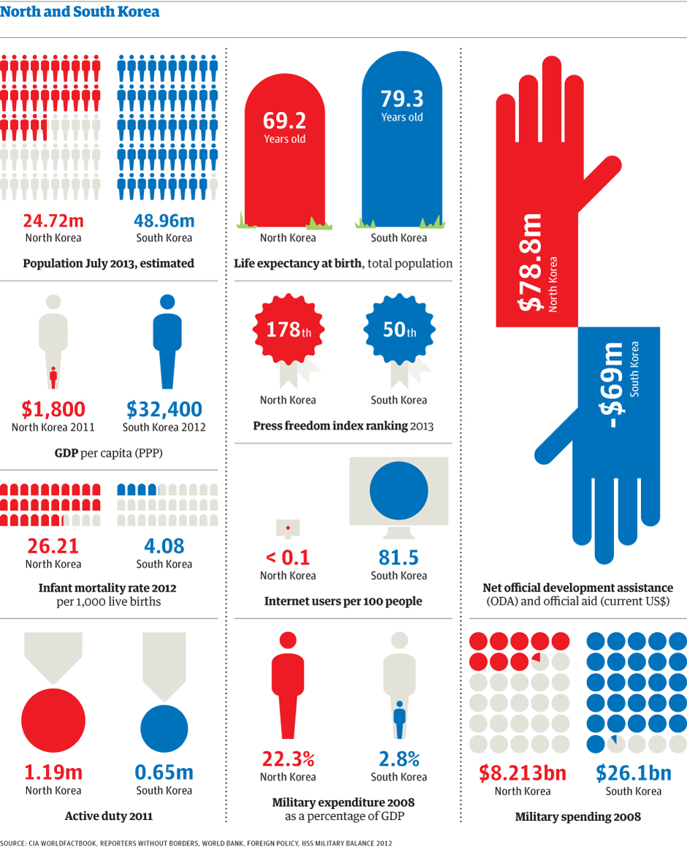

Slide 11
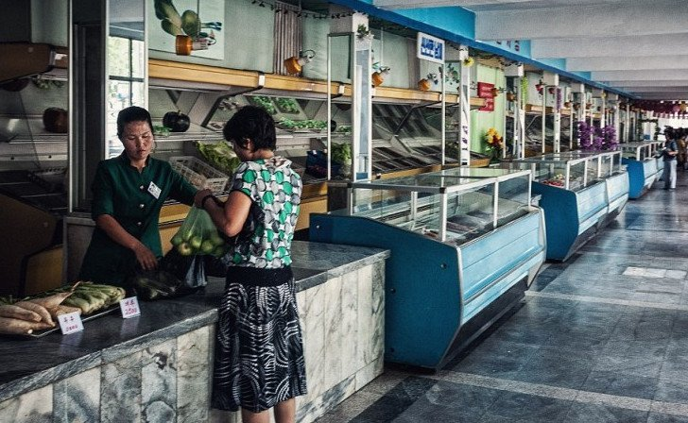
Empty grocery stores
Due to international trade sanctions, draught and corruption, North Korea is suffering from famine and the people are forced to live off food rations from the government. The government projects an image of providing their citizens with all that they need, but as this photo, which was secretly taken in a grocery store shows, that is not always the case. This supermarket in Pyongyang, which is for above average income families (although not for leadership) is full of empty shelves and offers meager choices. Shoppers can choose mainly between leeks, apples and turnips. Sounds delicious…

Slide 12
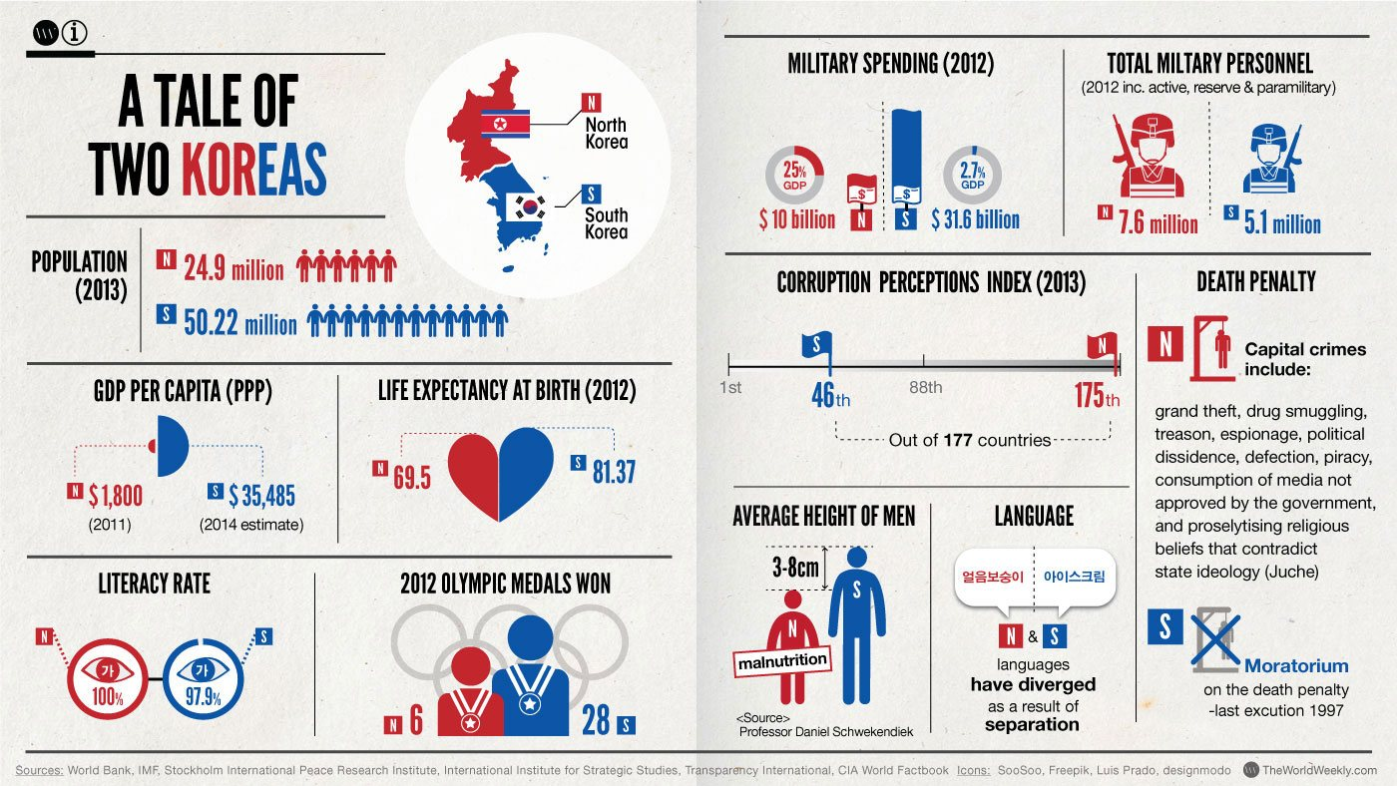

Slide 13
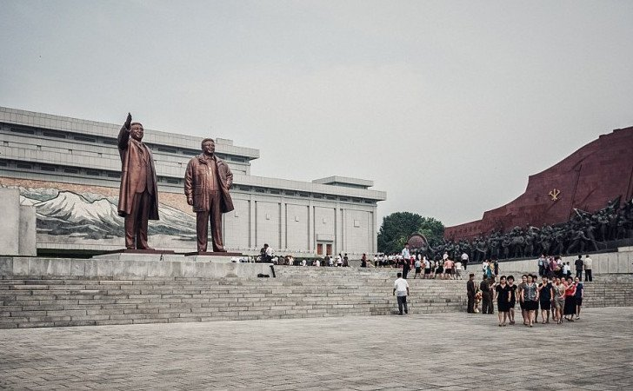
Welcome to North Korea!
North Korea is known as the Hermit Kingdom, due to the fact that it is so isolated and closed off. What we do know, is that much of the country’s resources are funneled into its own defense. This country is known for jealously guarding the secrecy surrounding the lives of its citizens military. All Korean men must serve at least two years in the military and women may volunteer. North Korea is also known for illegal nuclear testing, with an estimation of 60 nuclear weapons already in their arsenal. Another thing North Korea is famous for is concentration camps. There are many prison labor colonies that are cut off from the outside world and house roughly 150,000 people. But are they as secure as they seem? A brave photojournalist who was visiting the country took secret pictures of everyday life. This act could have cost him his freedom and gotten sentenced to a concentration camp as a spy.

Slide 14
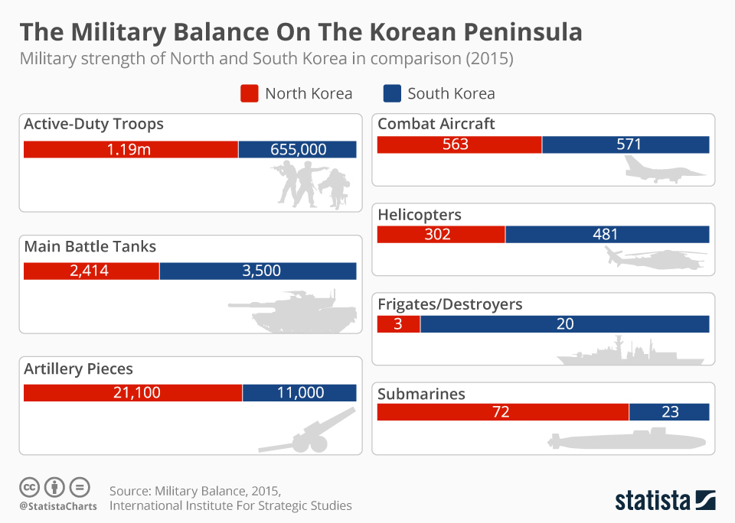

Slide 15
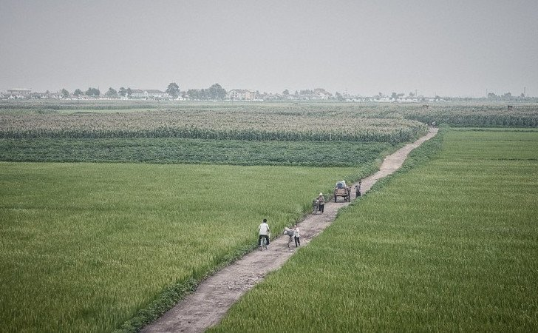
Hunger everywhere
North Korea is a starving country, with most of the population severely malnourished. The people survive on rats and squirrels and anything else they can get their hands on. In order to fix this problem, and feed the masses, the government is trying to increase the land available for farming. Unfortunately, these efforts have been mostly unsuccessful due to outdated farming techniques which are roughly 300 years old! Therefore, people all over the country are emaciated and weak. North Koreans who manage to make it to China are immediately spotted and are well known for being very thin and with an enormous appetite and willingness to eat anything.

Slide 16
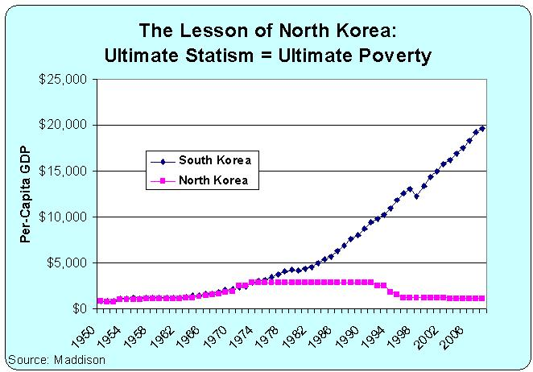

Slide 17
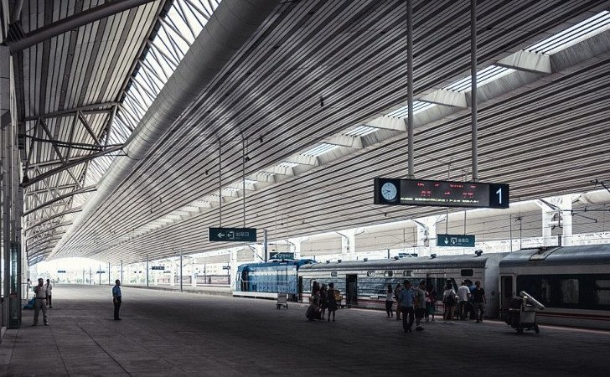
Empty trains
Empty trains run on time Foreigners who visit the Hermit Kingdom are heavily monitored, with only 4,000 to 6,000 western tourists being allowed access per year. They are taken on regulated, closely guarded tours, where taking photographs without permission could get them in serious trouble, thrown into jail or worse. This picture of an empty train station was taken at great peril to the photographer’s life. The lives of North Korean citizens are monitored closely, and they are not allowed to travel. The only way to leave your town or village is with the regime’s express written permission. The train in this picture is mainly for tourists and is also used a propaganda tool by North Korea’s leaders to show the country’s modern and convenient transportation.

Slide 18
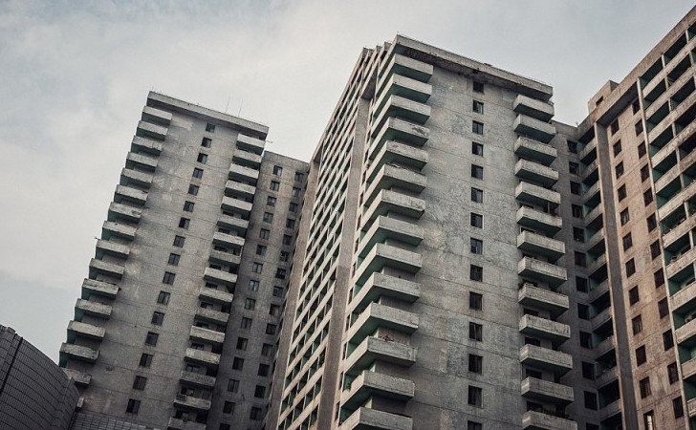
Rows of identical houses
Architecture in North Korea in general and in Pyongyang, in particular, is characterized by uniform gray cement, as used by the old Soviet Union. Since the country is technically, if not practically, a communist state, the message from the regime is that everyone is equal and therefore living arrangements should be equal as well. The reality is, that due to insufficient technical expertise and international sanctions, many of the buildings are not safe to inhabit and many others are empty and unused.

Slide 19
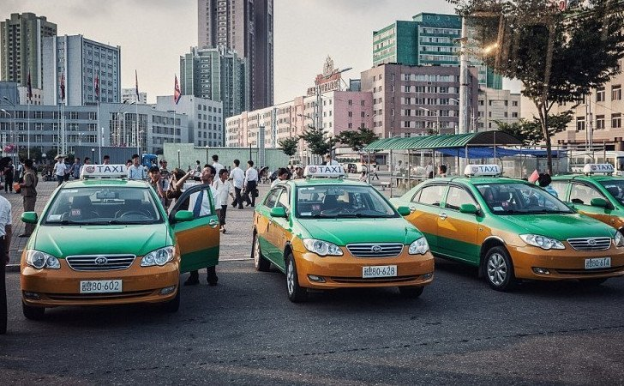
Taxis everywhere
North Korea has been flooded by taxis in recent years, but they are limited to the capital city of Pyongyang. Although most of the country’s residents live in poverty, the North Korean elite, some of which are even multi-millionaires, seem to be keeping this vast amount of cabs occupied and profitable. All the taxis in North Korea are part of state-run businesses and the competition is fierce. Taxi driving has become so lucrative that workers who want to become drivers must sometimes bribe their way into the business. All this probably means that you shouldn’t count on catching an Uber in Pyongyang, there is very little chance you could get one.

Slide 20
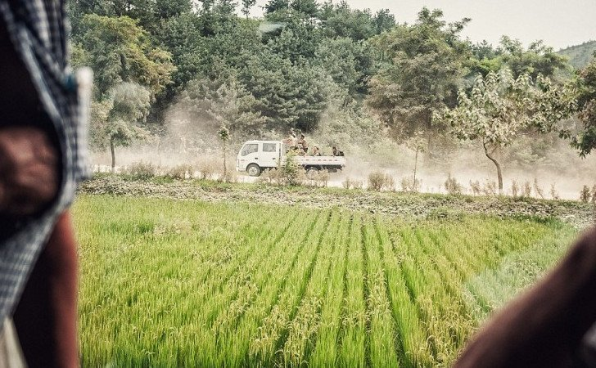
Ready to fight?
This photo, taken from a train, reveals a rural part of North Korea with what looks like a picturesque rice paddy in front of an old truck full of people driving down a dusty road. Interestingly enough, when you take a closer look, you can see that those are actually soldiers in the back of that beat up, relic of a truck that looks like it was made in the 1980’s. It seems strange that such a powerful and modern country, full of claims of military prowess, is transporting its troops in the back of an old pickup truck!

Slide 21
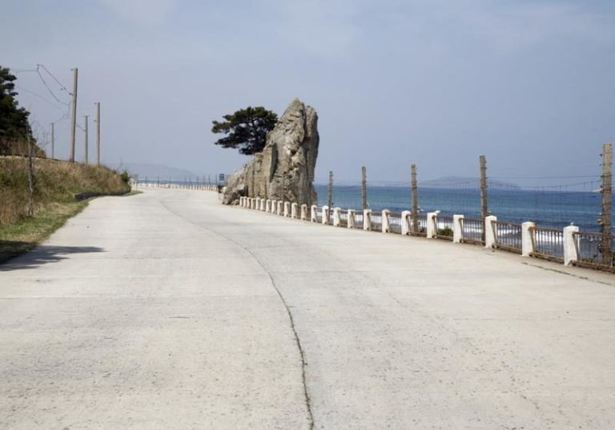
No beach access
This picture shows North Korea’s beautiful coastal road, with miles of beautiful views, coastlines and lovely beaches. However, upon taking a closer look, you can see a fence all along the coastal road. The fence is blocking access to the beach and is fully electrified. In a country that cannot afford to provide all its inhabitants with electricity, those resources are being used for an electrified fence which surrounds the country and keeps people in. Making sure the citizens can never leave.

Slide 22
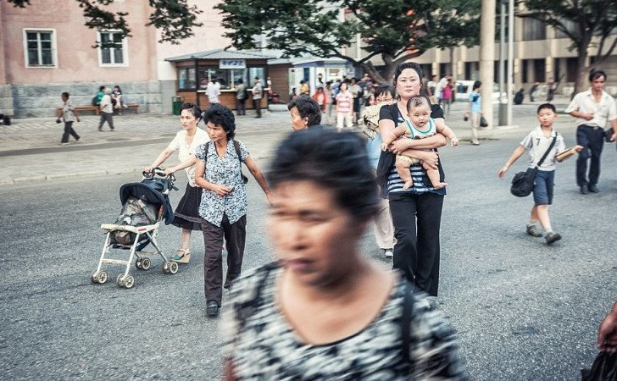
Street walking
In a country as big as North Korea it is important to have good roads so that people and goods can get from one place to another. Luckily, the North Koreans don’t have to worry about traffic. It is very rare for people to have their own car and the roads are often empty. So much so, that in Pyongyang and other cities around the country, you can see people walking in the street. Wide boulevards meant for car traffic have become pedestrian walkways because the people know there will never be any cars driving down them.

Slide 23
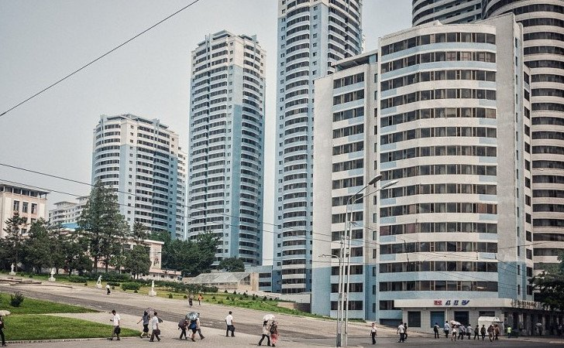
All for show
The North Korean tour guides love to show off the capital city of Pyongyang to visitors. The city looks modern and new and is full of shiny high-rise buildings that could fit in anywhere in the world, including Japan, China and even European capitals! Unfortunately, these buildings are mostly just for show. Many of them are unfinished inside or empty and unused. Even the finished buildings do not have electricity. I’m sure it’s not easy getting to the top floors of those towers without a working elevator.

Slide 24
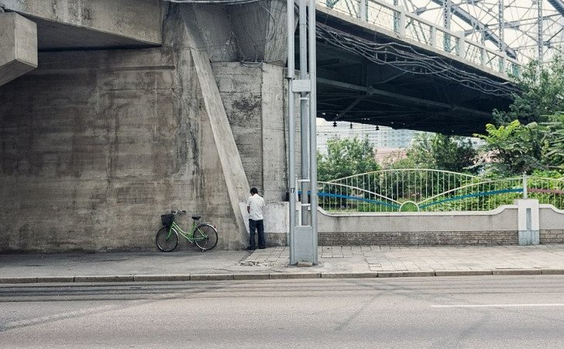
Under the bridge
As we all know, when you gotta go you gotta go, as illustrated in this picture taken by hidden camera of a man relieving himself by the side of the road. However, in North Korea, where the government regulates everything you do (and we mean EVERYTHING), public urination is quite risky. In America, if someone is stopped by a police officer for relieving themselves, that person would most likely get off with a warning or receive a ticket. In North Korea, if this man was caught, he would most likely be sent to a concentration camp.

Slide 25
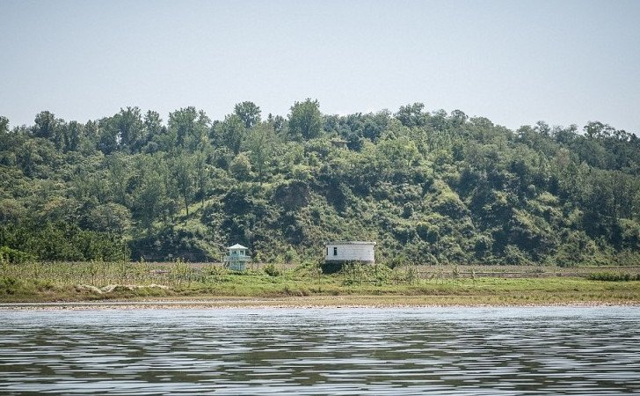
Eyes and ears everywhere
Just like in the famous book 1984 by Geroge Orwell, everything that is said or done by the people of North Korea is monitored by the government. No place in the country is free from surveillance. Hidden cameras and microphones are placed everywhere from people’s homes, work, parks and squares and even inside public transportation and cars! Just like in this picture, one can often see North Korean military watchtowers overlooking towns and villages, making sure that everyone is in line.

Slide 26
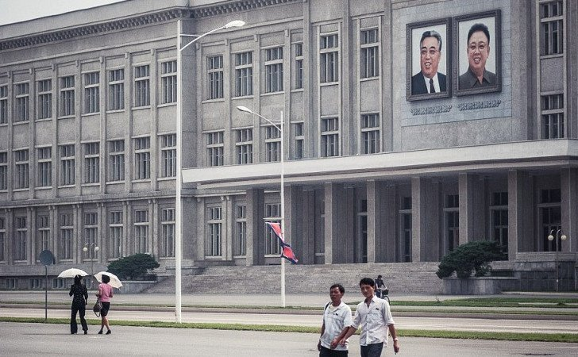
Central Government Building
This photo of the Central Government Building in Pyongyang reveals many interesting things about the country. First of all, it provides a glance of normal government bureaucrats walking around and going about their daily lives. Secondly, the roads are clearly empty of cars and the people are walking on them freely with no fear that they will face oncoming traffic. Thirdly, it is an act of bravery by the photographer as taking a picture of this building is a dangerous offense. One that can lead to arrest for espionage and possible execution.

Slide 27
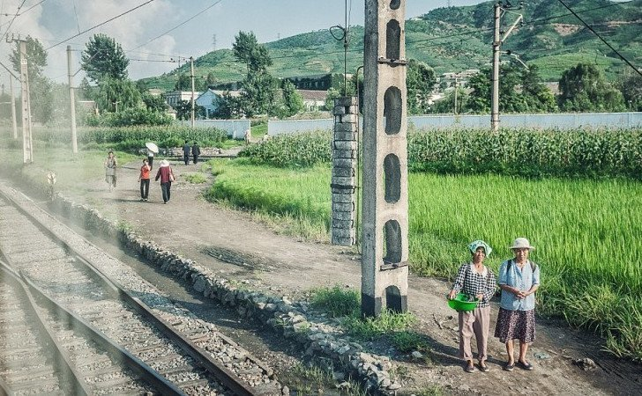
Rural train station
As you can see in this picture of villagers waiting by the side of the tracks, this is what a train station looks like in rural North Korea. Literally a post with holes and a dirt walkway leading to the tracks from the village. Since you need a hard to get government permit to travel, people rarely leave their own home villages Therefore, it is not unreasonable that not much in.frastructure for traveling outside the North Korean capital Pyongyang exists.

Slide 28
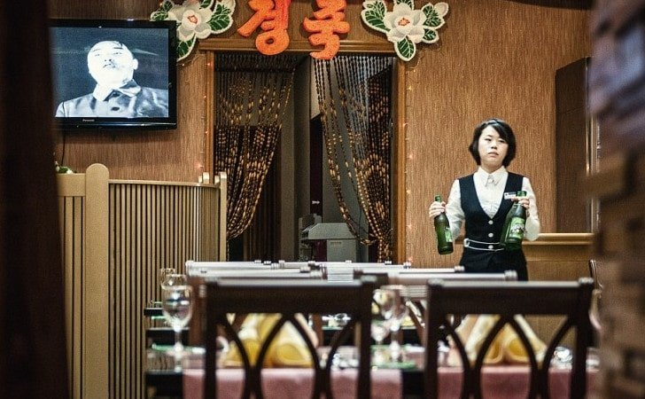
The propaganda machine
Imagine you only had one channel on television and one station on the radio and all they had on was the president talking all day long. Between his speeches you could enjoy patriotic country music videos and propagandist history shows. Not only is that the only thing on, but you aren’t even allowed to turn it off. This is the reality in North Korea. You are legally required to keep the television and radio in your home or business on at all times. If you do not keep your television or radio on in order to at least listen to the propaganda you can be incarcerated, or even worse.

Slide 29
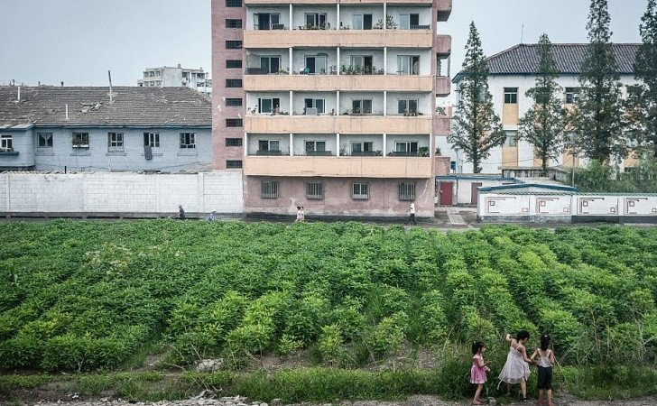
Empty places
The country of North Korea is filled with towns and cities. Unfortunately, not all these towns and cities are populated – at least not all of the time . In order to trick foreign satellites and spy planes and make empty cities look prosperous and alive, the Hermit Kingdom’s regime will periodically call on the entire population of a town to uproot and move to a different location. These shifts make it seem to observers from above that all is well in the pariah state.

Slide 30
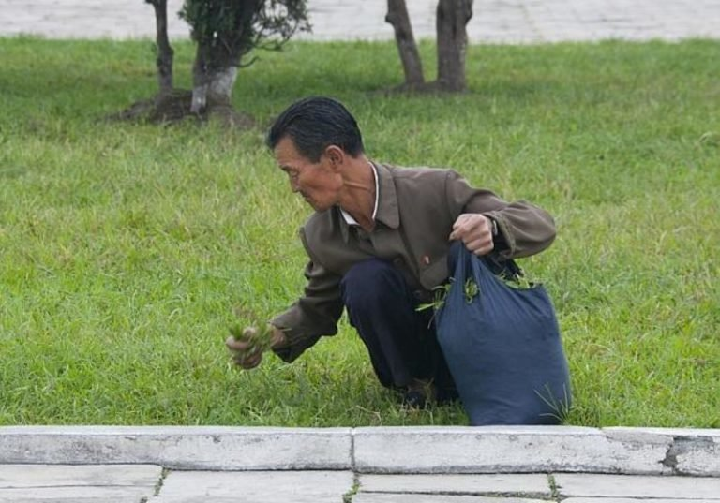
Modern gatherers
Due to the fact that 90% of North Koreans are too poor to go to the grocery store, many have resorted to eating anything they can find on the ground including scraps, rats, birds and even grass and leaves. This behavior is so widely spread that the North Korean government has actually put out a cookbook on what types of grasses and leaves are the tastiest, and how eating all of those greens all the time isn’t so bad and might even be healthy. Although admittedly, if you have gotten to the point that you are eating grass, things have probably gotten pretty bad.

Slide 31
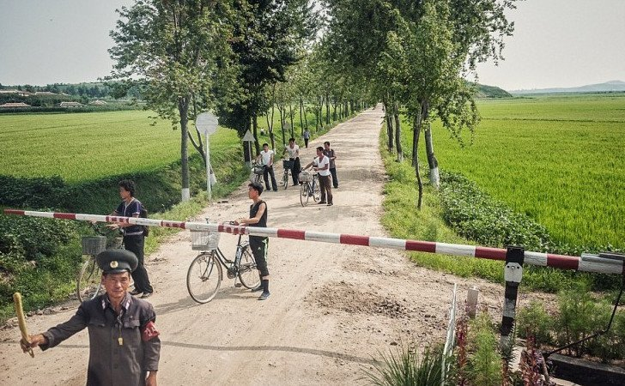
The train watcher
In order to keep the vast population in line, the North Korean government has a military presence everywhere, including every city, village and farm. That also applies to this soldier, whose only job in life is to tell people in this tiny little North Korean farming village when a train is coming and stopping them from getting on the tracks. Can you imagine posting a soldier to guard a track for a train that only goes by once each day?

Slide 32
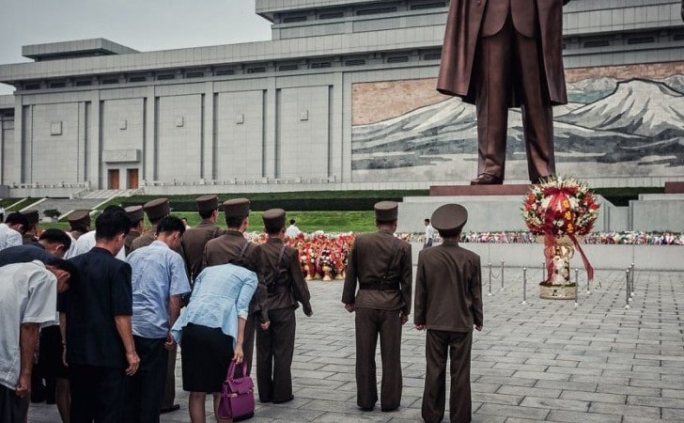
The eternal president
One of the craziest things about North Korea is that they consider their leaders to be divine and therefore their religion is actually their leaders. In fact, the eternal president of the republic is a man named Kim Il Sung, who has been dead for almost 25 years! Kim Jong Il and Kim Jong Un, the son and grandson of the “dear leader” Kim Il Sung are the country’s prophets. That is why the people in the picture are bowing to these giant statues – they are actually praying to them!

Slide 33
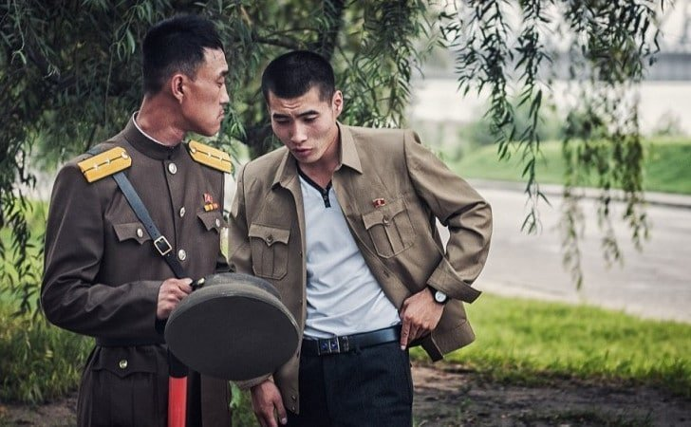
We want you!
Enlisting in the military is one of the only career paths that promises food on the table and a small chance of a decent life for you or your family. Getting in is not so easy, you must have the right connections, and a lot of luck. If the rights strings get pulled, you have a chance to become an officer and make sure that grass is not the main ingredient in the family dinner. The officers’ class is extremely secretive which is what makes this photo so rare.

Slide 34
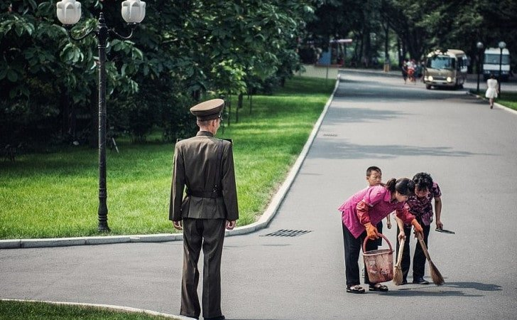
A soldier on every corner
Soldiers stand on every corner; their job is to make sure all citizens are doing what they are supposed to be doing. Under their watchful eyes, the activities of anyone and everyone are reported directly to state officials. In this photo, captured by hidden camera, we see this soldier whose only job is to guard women who are sweeping dust and dirt off the empty road. As you can see, there’s no need to fear oncoming traffic.

Slide 35
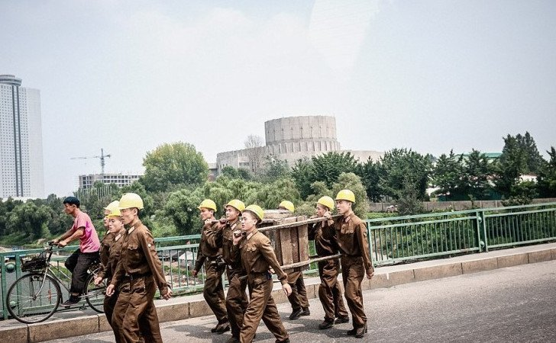
Construction junction
This photo shows a group of North Korean construction workers in Pyongyang on the way to their worksite. The North Korean leadership makes a point of broadcasting the modernity their country has achieved, with no outside help, and visitor tours focus on Pyongyang’s booming construction. However, not all is as it seems. North Korea has very few skilled architects qualified craftsman, and their work crews sandurvive mostly on grass. No wonder so few of the new buildings are suitable for habitation.

Slide 36
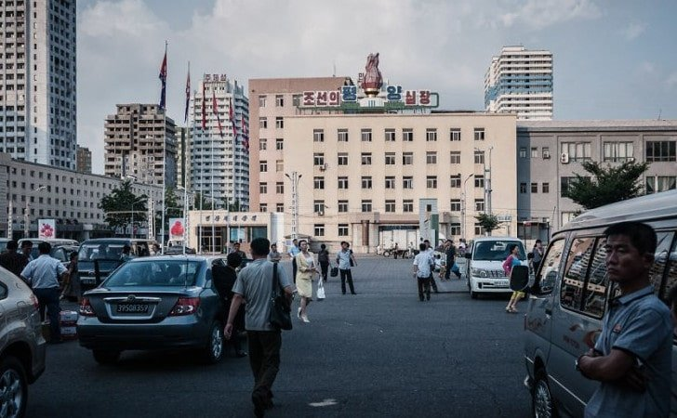
Tourism
Many cities offer guided tours to visitors, with explanations by the tour guide but also a chance to explore on your own. This is not the case in North Korea. All sightseeing tours are organized by the regime. Even the people you are allowed to meet have been vetted by the state. And if you have accidentally wandered off, get ready to get to know your tour guide much better. There is a good chance that you two will be cellmates because both wandering off and losing a tourist are punishable by a jail sentence!

Slide 37
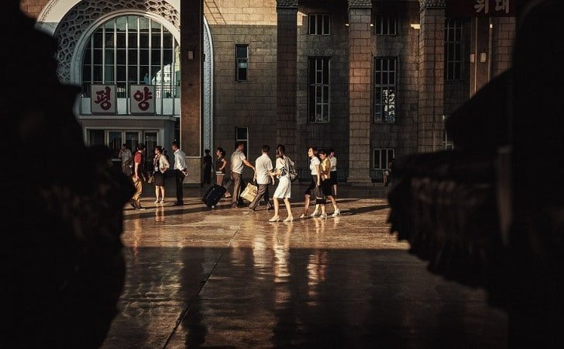
Late to nowhere
This photo of a train station in Pyongyang, North Korea which was taken by a tourist was sanctioned by the government. The photo seems unremarkable at first with many travelers on their way to various destinations. The funny thing is that all the people in this photo are paid actors. Due to the fact that trains are used mostly for tourism, train stations are only open for a few hours each day. At the time this photo was taken (showing people entering the station) the real trains had already stopped running!

Slide 38
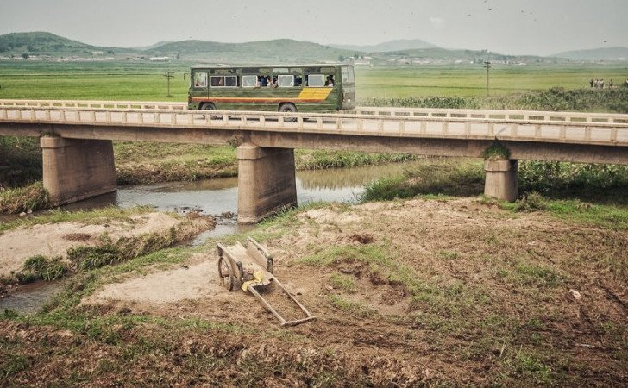
Just stay home
Traveling is not part of life in North Korea. Most people in the country do not leave the village they were born in their entire lives. There are military check points at the entrances to many towns and villages and it is very rare to get permission to leave. There is always the risk that even with special permission you will get arrested and charged with trumped up espionage charges. That is why this picture of a bus traveling the countryside is so rare. The bus looks at least 50 years old and probably doesn’t even have air conditioning. The bus looks at least 50 years old and probably doesn’t even have air conditioning. Talk about traveling in style. This 1960’s era bus traveling the countryside is a rare sight.

Slide 39
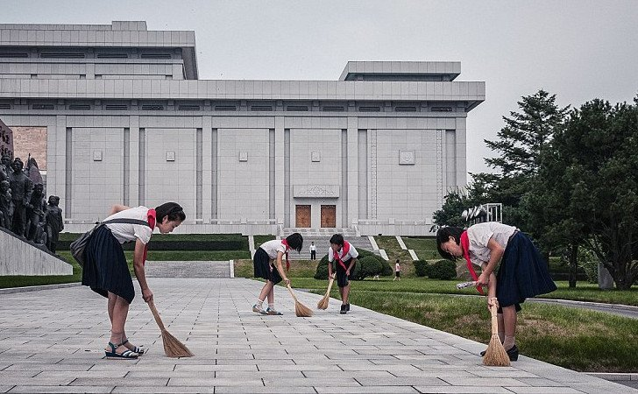
0 unemployment
What a marvelous country North Korea must be to have a 0% unemployment rate and a job for every worker. This is surely a sign of a strong economy. An economy so strong, that even the schoolgirls want to pitch in and clean the street from dust. Unfortunately, this doesn’t seem to be the whole truth, but with no access to unofficial numbers, we must trust in the government’s unemployment figures. Well, maybe with just the tiniest hint of skepticism.

Slide 40
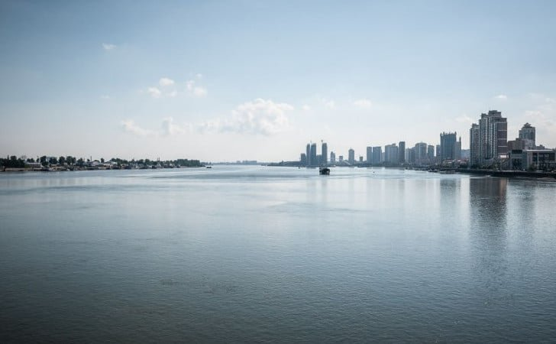
Across the water
In this photo the difference between North Korea and the rest of the world is plain to see. North Korea is impoverished and undeveloped while China is modern and booming. On the right side of the picture lies the Chinese town of Tumen, which sits on the Tumen river. On the left-hand side is a North Korean riverside village. In the winter, when the river freezes solid, many North Koreans try to flee into China over the ice. Soldiers chase them into China, grab them and bring them home. Sometimes, the military uses these excursions as an excuse to snatch random people and hold them for ransom!

Slide 41
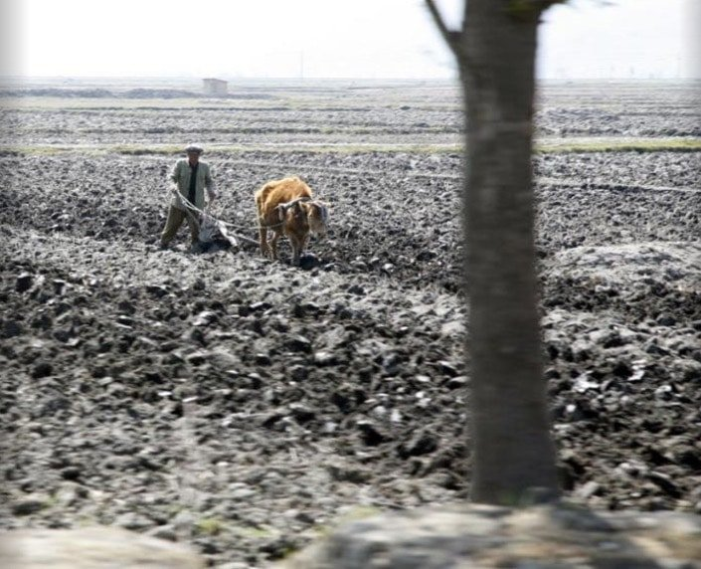
Rock farming
This picture was taken secretly from a passing bus and shows a man trying to plow his field with a steer and without modern farming tools. Unfortunately, when you look at the ground, it seems like there are more rocks than soil. This is not ideal for planting crops. Hopefully, the poor man will be able to plant some seeds that will help feed his family. Otherwise the leaders in Pyongyong may need to start working on a cookbook for rocks.

Slide 42
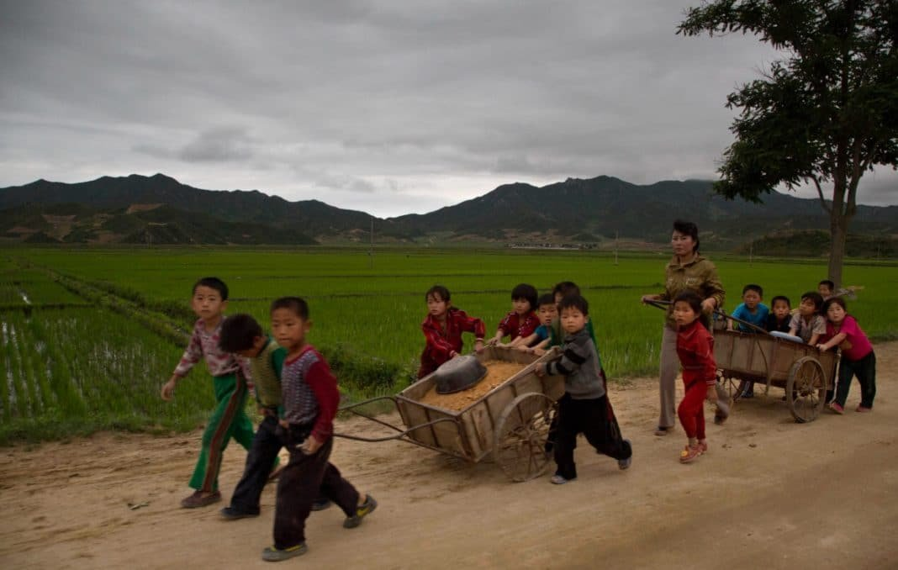
Child labor
This picture of the North Korean countryside was taken illegally and smuggled out of the country on a USB drive by the photographer. The picture features very young children, some looking no older than six years old, working hard in the communal farm fields. According to a state sanctioned tour guide, children are annually tasked with this work during the harvest season, when a severe economic downturn occurs. He claims that this downturn is cause by the America, but it is unclear why.

Slide 43
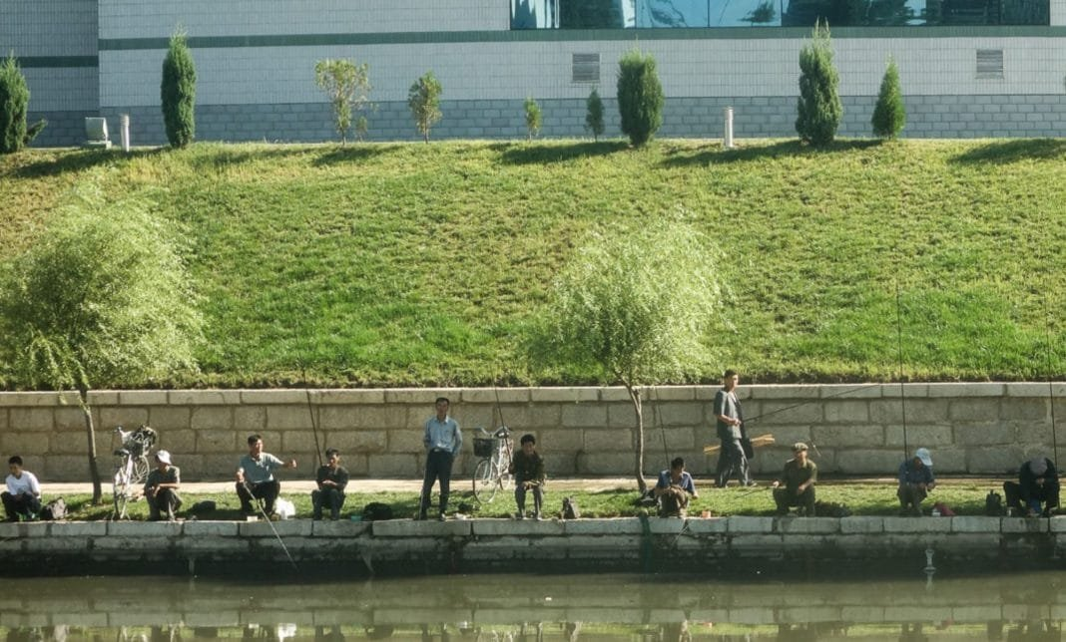
Fishing for food
Many men come to the Taedong River to try their luck at fishing for their supper. It may seem like this is a shot of rural life in an impoverished village, but it is actually from the North Korean Capital Pyongyang. The whole of North Korea is suffering from malnutrition and fresh fish and meat are almost impossible to find in supermarkets. Therefore, these men need to fish in the city’s river in order to secure the protein necessary for them and their families.

Slide 44
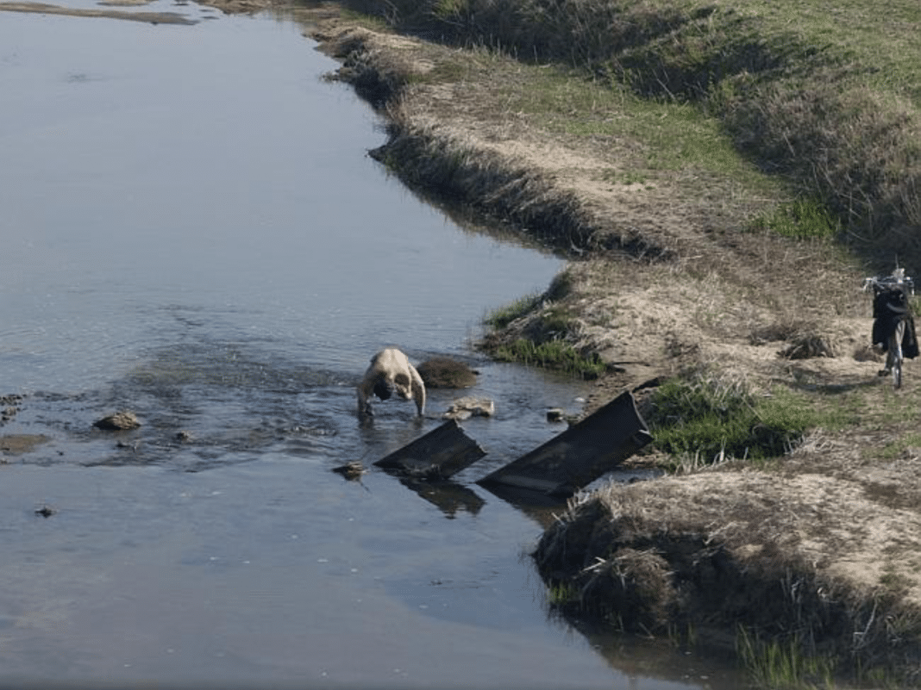
Public bathing
Due to the fact that running water is hard to come by across most of North Korea (even having a faucet is no guarantee because there is rarely water in the pipes), most people bathe outside in river. They go outside with some soap and let the current wash their dirt away. The North Korean government forbids taking pictures of people bathing in rivers because the censors believe it portrays the country in a negative light as an impoverished backwater.

Slide 45
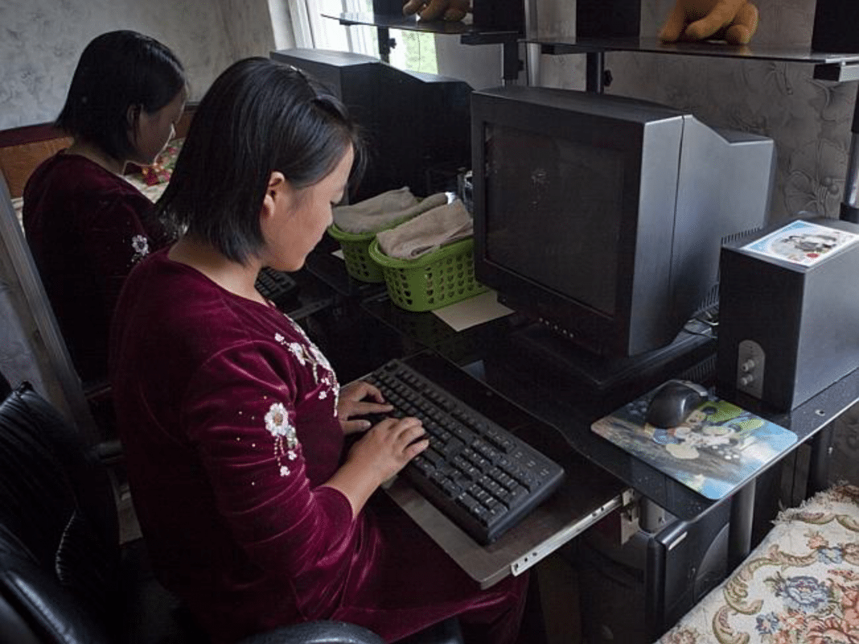
Computers with no electricity
To show off how modern their lives are, the North Korean government has their tour guides take visitors to an “average” North Korean family to show off the fact that they can afford computers and are connected to a special, North Korea only intranet! Although the screen didn’t work because there was no electricity when this photo was taken, the actress, or North Korean citizen, was still typing on the keyboard.

Slide 46
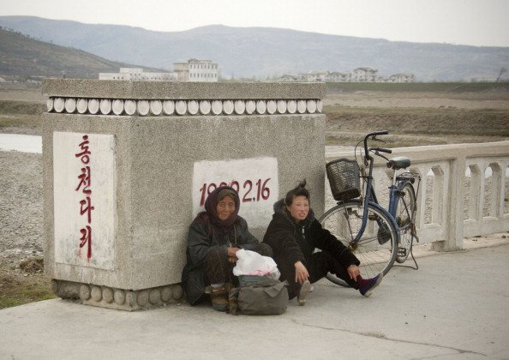
North Koreans are never tired
Very few North Koreans can afford private cars, therefore most of them walk or bike each way every day for many hours to reach their place of work. Even professional cyclists competing in the Tour de France would complain after that much riding! However, that didn’t stop the photographer who snapped this shot from allegedly getting yelled at by his chaperone, on the basis that it is a crime to show people being tired in North Korea.

Slide 47
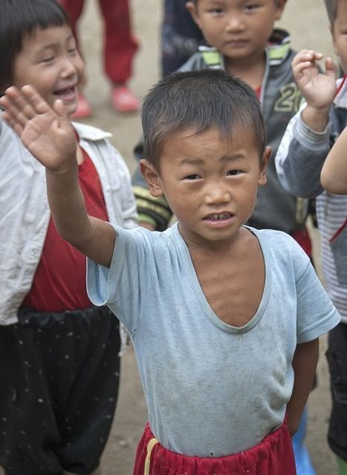
Hungry Children
Malnutrition affects millions of children all over North Korea, with tens of thousands enduring stunted growth and severe nutritional deficiencies. The food shortages are partly caused due to a 20% decrease in food production leaving many outside the main cities – particularly children – with insufficient food to eat. In Pyongyang the situation is quite different, the leadership which has close ties to the regime is well fed and satisfied. The taking of this photograph is against the law because it goes against the North Korean government claims that all the children in the country are well taken care of and none are underfed.

Slide 48
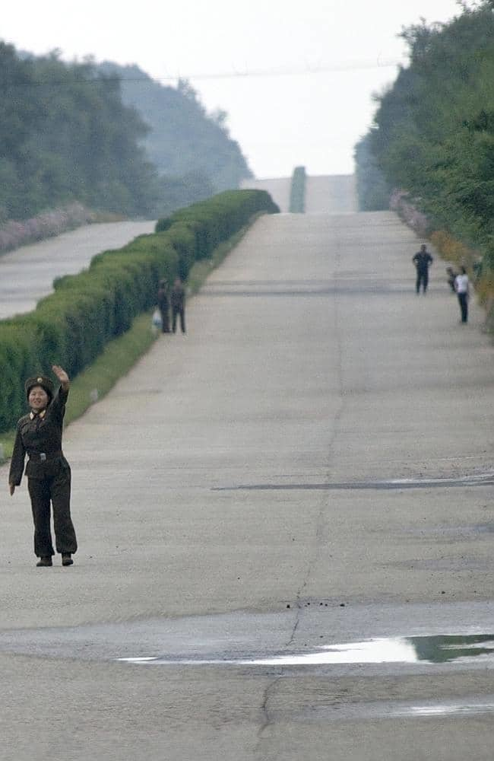
Need a lift soldier?
There are almost no cars traveling the roads of North Korea and the locals usually walk or bike everywhere. So, when a car does come along, people often try to catch a ride, and the first in line to hitchhike are obviously the soldiers. But soldiers are relatively well off, shouldn’t they just use a bus or a train? The truth is there is no public transportation between towns and people cannot leave their home villages without a special written permit from the government to travel. This picture shows a group of people taking advantage of the empty highway to walk between villages.

Slide 49
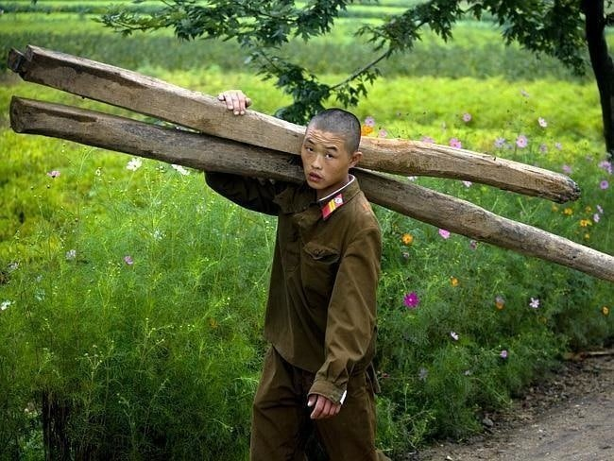
Soldiers on the farm
Farming is the most important national activity in North Korea and everyone must take part in one way or another. Since the North Korean government cannot afford to pay all its soldiers, new recruiters and lower rank soldiers often find time while not doing target practice and reciting military doctrine, to work on farms in order to make a living. It is common practice for conscripted soldiers, like the young man in the picture, to work on farms in exchange for food or money.

Slide 50
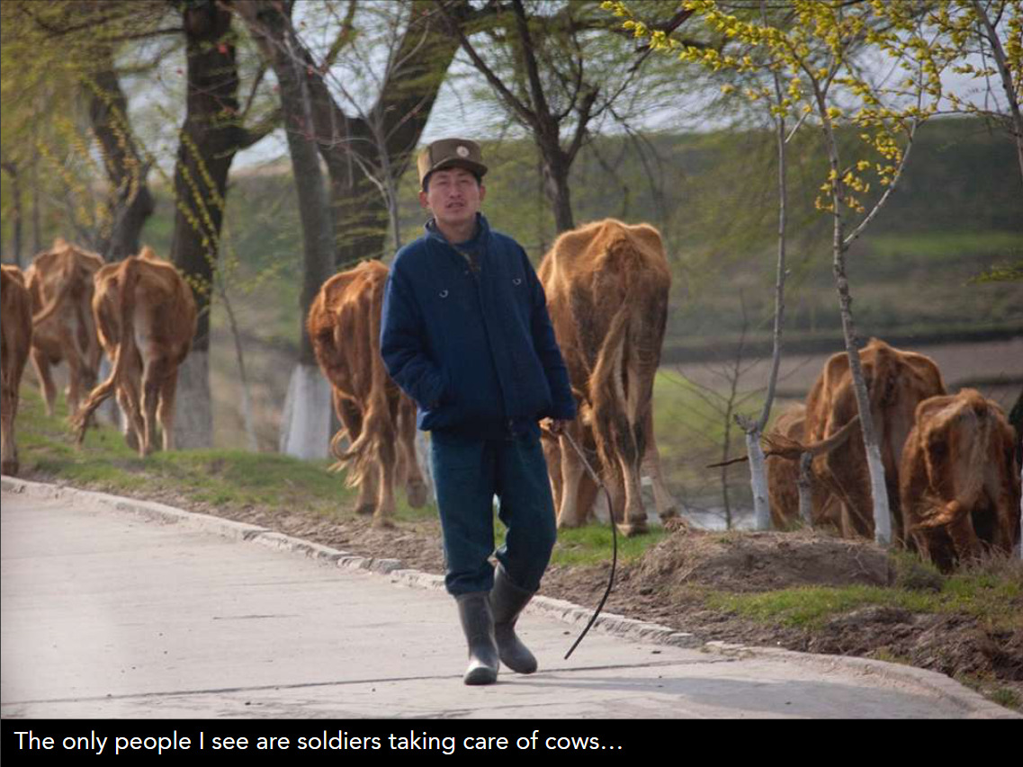

Slide 51

A real street
This picture was taken during a tour of the North Korean border town of Kaesong, located on the border with South Korea. The tour guide focused on the nicer area of the town near the hotel and gave assurances that the rest of the town looked the same. The photographer succeeded in sneaking a few shots of the rampant poverty which is rampant in all areas of North Korea outside the capital city of Pyongyang.

Slide 52

A tire boat
Similarly to the fishermen on the Taedong River, this villager from the countryside of North Korea is trying to catch fish for his family to eat, as there is no way they will get any in their government approved rations. In his desperation for sustenance, he has decided on an original way to improve his chances and is using an old tractor tire as a boat and paddling it to the middle of a small pond. Fingers crossed that the fish were biting that day.

Slide 53

The people are hungry
The North Korean propaganda machine is very sensitive about showing the world their poor and starving citizens. They try to maintain a façade of success, strength and happiness with carefully crafted publicity shots. This photographer managed to take a picture of a North Korean worker who is clearly malnourished and suffering from iron deficiency brought on by lack of food. This was a very dangerous photograph to take, if the photographer was caught, he could be put in a concentration camp for his “crime”.

Slide 54

Indoor plumbing?
This photo of a bathroom was tkaen inside an average North Korean home. The photographer managed to snap it while evading his official tour guide for a precious minute. The picture shows the bathroom’s plumbing system which as you can see does not exist. A hand pump for pumping underground water is clearly seen, with the water being pumped into a bathtub. However, this water is not used for bathing, it is drinking water and the bathtub is actually an in-house water storage tank!

Slide 55

Living in poverty
The North Korean message is that their country is like any other only better. They are a perfect communist state, with a crime rate of zero, fit and healthy people where no one lives in poverty. The true story is clearly seen in this photograph shot outside Pyongyang. It is immediately clear that there is immense poverty in every corner of North Korea, just like in the rural village shown. The photographer who shot this image risked his life smuggling it out of the country in order to get it seen by the outside world.

Slide 56

All is dark
Electricity shortages that cause blackouts are common all over North Korea and occur even in the capital of Pyongyang. In this photo, all the city lights are out due to no electricity being available at the time. However, one thing is still lit up – a picture of the beloved North Korean leader. A North Korean citizen may claim that this is proof of their leader’s divinity, while a skeptic may argue that all it takes to make this happen is a handy citizen with an electrical generator.

Slide 57

Hitching a ride
Since public transportation is not a real option in North Korea, locals must hitchhike in order to travel undetected. Drivers who are lucky enough to own a personal car or drive a company car, like in this photo, often use their vehicles to take hitchhikers where they need to go, for a small fee of course. These small “businesses” are quite dangerous since any kind of private enterprise is illegal in the Hermit Kingdom.

Slide 58

Lights out
Despite its reputation as a worker’s paradise, most of North Korea does not have reliable power, with rolling blackouts hitting the country on a regular basis. Things have become even worse since China refuses to import North Korean coal, meaning the Hermit Kingdom is having real trouble keeping the lights on. If you look at a satellite image of the world at night, you will see a giant dark spot where North Korea should be.

Slide 59

Electricity is often not available or reliable in the north. This night time aerial photo shows on the capital of North Korea using enough electricity to be seen at night; whereas, electricity is clearly used in abundance in South Korea.

Slide 60

Lines for the bus
Public transportation is in short supply just like everything else in this semi fascist country. The only place that even has public transportation is the capitol city of Pyongyang, and even there the buses are few and far between. That is the reason for the scene in this picture, with people in enormous lines, waiting sometime for hours, just to get to and from work. And here we are complaining about our daily commute, we’ll take out traffic jams any day.

Slide 61

This office is only for women
Sometimes it seems like North Korea is stuck in a 1950’s time warp with no natural progression. Furthermore, the societal norms even seem to be reverting to feudal times. Therefore, it not surprising that most jobs in the country are divided by gender, something that was popular in the US and most of the world 70 years ago! These women are most likely best friends who work in the same place, and in North Korean society, it is not considered strange or unusual for grown men or grown women to hold each other’s hands in public.

Slide 62

The rise of tourism
Not that long ago, even in 2012, it was extremely difficult for foreigners to be granted entrance into isolated North Korea. Actually, the only chance to get into the Hermit Kingdom was to travel to China, stay in a North Korean run hotel there, give your passport to the North Korean embassy (don’t forget the bribe please) and wait with your fingers crossed. Today, the process is much simpler, and locals are much more used to tourists. This shot was taken before foreigners were a regular sight.

Slide 63

Ryugyong hotel
This enormous pyramid shaped building in the middle of Pyongyang was supposed to be used as a hotel. The building is incredibly tall, with 105 stories, and is an amazing feat of North Korean engineering. Work was started in 1987 but stopped in 1992 because money stopped coming in from the fallen Soviet Union. The building stood empty and unfinished until 2011 when work on the exterior was completed. The interior is still not finished and with several opening dates cancelled, the hotel is known as the tallest unfinished building in the world.

Slide 64

Heroes on the wall
In every North Korean home there are pictures of the country’s three leaders: Kim Il Sung, Kim Jong Il, and Kim Jong Un. It is mandatory for every family to have these pictures prominently displayed in their homes and due to Kim’s cult of personality, they are also used as religious icons with prayers being offered to the images. In fact, the pictures are considered so important, that there is a famous story of a young girl who was swept away by a flood trying to save them. She is now considered a hero of the state.

Slide 65

The best defense
These massive stone blocks on the sides of the road are not decorative. In case of attack, the United States being the most likely invader, these blocks will be blown up to create tank traps. As these blocks fall, they will block the road making it impassable. Furthermore, the walls are made of rocks which are designed to form shrapnel, making sure any soldiers on the ground will be hurt or worse.

Slide 66

Time off
Even though it seems hard to believe, even North Koreans sometimes need a break to enjoy time off just like you or me. One of the preferred leisure activities for (well off) North Korean kids is to rollerblade. Even though they are about two decades behind in this trend, it is something they enjoy, and a small sign that North Korea may be slowly catching up with the rest of the world.

Slide 67

Thought of resistance?
The girl in this photo is holding something so dangerous it could get her, her family, her unborn children and her unborn grandchildren shipped off to a concentration camp. Weapons of any kind are completely illegal in North Korea due to fears of social unrest and revolution. Anyone found with a weapon will immediately be sent to a camp, and three generations of their family will also be imprisoned. This picture makes you think about how many people in North Korea are just like this girl, waiting for the world to come in and save them.

Slide 68

Local business
This woman has started her own little business in her small village, selling a few items to make some money to try and improve her and her children’s lives. Such businesses are illegal in North Korea, but most of the local authorities probably won’t make an issue out of it, as she is probably selling smuggled Chinese goods like candy and cigarettes to them as well. If she makes sure to sell to them at a good price or give them items as gifts, she should be all right.

Slide 69

Kids in the fields
In this photo we again see children being used as farm workers in the North Korean fields. It seems as if taking these kids out of school to work is the only way to keep food production on track. Otherwise, the famine in the country would be even worse. These children, especially in the poorer areas in the countryside, see this as a normal part of life and probably think children everywhere must work this hard too. They don’t know what a normal child’s life is like.

Slide 70

Big guns
North Korea has many tanks in its arsenal. However, in the past few years they have put their focus on Nuclear weapons, causing the tanks they have to be old and outed. Also, although the tanks in North Korea are big, they are not nearly the biggest out there. If war were to break out, the rest of the world would be more advanced in their tank capabilities.

Slide 71

The People’s Army
Most of the money in North Korea goes to its armed forces. The exact amount spent by Kim Jung Un on the Korean People’s Army is unknown but is rumored to be a massive fortune. The North Korean army uses lasers and missiles which have been banned all over the world and are known for their famous hacks, with an advanced cyberwarfare unit. Conscription occurs at the age of 17, with all males drafted for and many women as well. The North Korean Navy also has a surprising number of submarines – between 70 and 75, which is the same as the US Navy! However, like the tanks, their submarines are considered old and outdated and would probably be no match for the US in case of war.

Slide 72

School is hard work
In North Korea, students must work hard for their education. Even though schooling is mandatory and proclaimed as free, North Korean students need to pay for their own chairs, desks and heat for the winter. Also, almost half the school day is spent doing hard labor making items for the government. If parents decide they do no want their daughter spending so much time on hard labor, they must either bribe the school officials or stop her from attending school, essentially giving up on her only chance for any kind of education.

Slide 73

Road work
In North Korea, less than 3% of roads are paved. The government does not allocate much funding for this and so most roads are unpaved. Therefore, when you travel around North Korea the vast majority of roads will be unfinished. Out of 120,538 square kilometers of road, only roughly 289 square kilometers are paved. If all the roads in North Korea were paved, they could circle the planet of Pluto 3.5 times while the 450 miles of paved roads would barely cover the distance from New York to Cleveland.

Slide 74

Money
North Korea is not a rich country. Bill Gates’ net worth is much larger than all of North Korea’s yearly GDP (gross domestic product). As of 2016, Bill Gates has a net worth of about $78.2 billion, which is four and a half times larger than North Korea’s. According to the estimations, North Korea’s GDP is estimated to be about $17.4 billion, while United States is $16.77 trillion. It is hardly a surprise that poverty is so wide spread in North Korea!

Slide 75

Widespread corruption
North Korea won the dubious honor of being named the most corrupt country in the world. This is probably not a big shock, but as of last year according to the Corruption Perceptions Index, North Korea is tied as the most corrupt country in the world! The share this “honor” with the country of Somalia with a score of 8. The rating system is between 0 (rampant with corruption) and 100 (squeaky clean). The results as a whole are worrying, showing that almost 70% of all the countries in the world have a serious corruption problem. In case you were wondering, no perfect corruption free countries exist in our world so don’t pack your bags just yet.

Slide 76

Checking things out
Soldiers are a normal part of the landscape in North Korea and it is not uncommon to see them everywhere and in all aspects of life. In this photo, there are five officers checking up on something with a pair of binoculars. All things that happen in the country are strictly monitored. Due to military security, the photographer would have probably gotten in a lot of trouble if he was caught taking this picture!

Slide 77

No way out
There is no government sanctioned way of leaving North Korea and those caught trying to escape are severally punished. They only way to get out is to defect and that costs $8,000 and that only gets you into China. In realistic terms, $8,00 is an impossible sum of money to the majority of North Koreans to acquire. The fact is, it is almost impossible to leave the corrupt country.

Slide 78

Sins of the fathers
North Koreans have to live by many rules and breaking even one of them means being sent to a prison or a work camp, currently holding roughly 200,000 prisoners. However, you are not the only one being held accountable for your crimes under North Korea’s “three generations of punishment rule.” If a person with a family breaks the law, it is common for their entire family to be punished with them. Meaning both grandparents, the parents and the children of the offender are sent away too. Any other children born in the camps must also stay there for life.

Slide 79

Busy buses
The only form of public transportation available to North Koreans are buses and they are a common way for people to commute to work and home. Car ownership is almost non-existent, therefore even busy, full and slow buses are a good option. Even on the bus, a permit is still required to move between cities and towns. If you can manage to catch the bus, I’m sure it beats walking or biking.

Slide 80

The Sino-Korean Friendship Bridge
This beautiful bridge is called The Sino-Korean Friendship Bridge and it connects Dandong, China with the city of Sinuiju, North Korea. This bridge is one of the only ways to get and out of North Korea and pedestrians are not allowed to use it. For visitors, it is pretty much the last brightly colored lights they will see before entering the Hermit Kingdom.

Slide 81

Military Strength
North Korea shows off its military prowess to South Korea and the world by parading around these enormous Koksan Guns. These guns, which are placed along the South Korean border are 170 mm, self-propelled, and with an open turret. There are speculations that these guns will not be as effective in warfare as threatened by North Korea and that they are mainly a propaganda tool.

Slide 82

Stop please
This photo shows a rare example of an undisciplined North Korean boy. The bus was traveling the small roads of Samijyon in the north of the country when this child suddenly stood in front of the bus.

Slide 83

Don’t mess with perfection
This picture of an official painter working on a new mural in Chilbo caused an unexpected uproar. After the photographer took the picture everyone started yelling at him. Apparently, due to the fact that the painting was unfinished taking its picture was forbidden. It seems all the artwork in North Korea must be perfect before being fit to be seen,

Slide 84

A unified
Korea As seen on this map, the isolated country of North Korea believes it has rights over the entire Korean peninsula. That is the reason a huge military arsenal, with nuclear weapons, stands pointed at South Korea at all times.

Slide 85

A quick break
This picture of a soldier sleeping in a field played a big part in getting the photographer banned from North Korea for life. If you are wondering why, firstly, it is illegal to take pictures of soldiers due to military security and secondly this does not make North Korean soldiers seem very intimidating.

Slide 86

Pink among the green
It is also illegal for this picture to be taken because officials do not allow army pictures. It is unclear what the woman is doing there among all the soldiers, but the pink amongst all those green uniforms is quite beautiful.

Slide 87

Kids carrying water
In this picture two kids are carrying water home in plastic pails. The North Korean regime doesn’t allow these kinds of pictures. They contradict the stories of well fed and prosperous citizens. Even though the photographer explained that poverty exists in every country, his own included, they did not want him to take it.

Slide 88

Too wealthy?
Shots of poverty are not approved by the North Korean regime but surprisingly shots of wealth are not approved either and they did not want this photograph of a Mercedes taken. Such opulence does not fit in to their pseudo-socialist ideology.

Slide 89

No flash
This photo shows a local street vendor with nothing unusual going on. However, the picture may appear a bit dark, because the photographer was not asked not to use a flash to keep from scaring the citizens.

Slide 90

Hardhats please
These window washers are climbing the side of the building with no special equipment of protection. No one on the ground seems particularly concerned. It doesn’t seem like worker safety is the top most thing on their mind.

Slide 91

No crowds
This picture shows a dolphin amusement act for what seems like the military and the country’s elite and is surprisingly also officially not allowed. The North Korean government allow pictures of animals performing, however, they do not allow showing the crowd watching the performance.

Slide 92

Going shopping
Only the most elite citizens are allowed to go grocery shopping in this store. Here we see a woman in a fancy dress walking with a tiny cart in an empty store. There may not be much on the shelves, but they do carry Evian water.

Slide 93

Mother and son
While taking this picture of a mother and son relaxed on a park bench, the photographer thought it was a nice, charming moment. However, the government believed that people would think the two were homeless and asked him to delete the images.

Slide 94

Not from behind
This picture is not allowed because although it is ok to take pictures of statues, it is illegal to take pictures of statues from behind. Please look away from the back of the statue.

Slide 95

The Kimjongilia Festival
All North Koreans are required to attend the Kimjongilia Festival. This yearly event takes place on the birthday of their former leader Kim Jong Il with a special flower which was named after him. The festival includes flower shows, a military parade and a large dance party.

Slide 96

Rundown buildings
In North Korea, image is everything and therefore they focus their energies on maintaining the exterior of buildings. However, due to lack of resources and reliable contractors, some buildings begin to look rundown.

Slide 97

No brooms
This worker must have been extremely distracted because he left a broom next to this statue. This picture is banned because brooms are not allowed at the bottom of any statues.

Slide 98

Push the bus
Most of the buses in North Korea are old and outdated but I guess they never break down, or do they? This picture of soldiers pushing a broken down bus is not allowed, because the regime doesn’t approve pictures of anything broken. Wouldn’t it be nice to live in a world where everything worked all the time?

