Slide 1

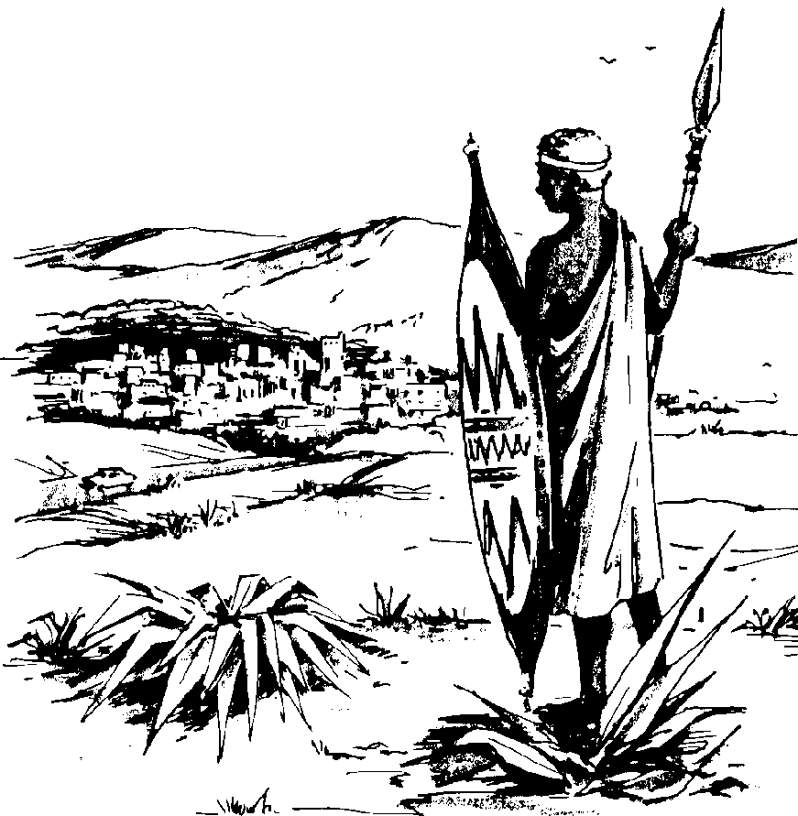



Ch. 7 – Sub-Saharan Africa
Modified by Joe Naumann, UMSL

Slide 2
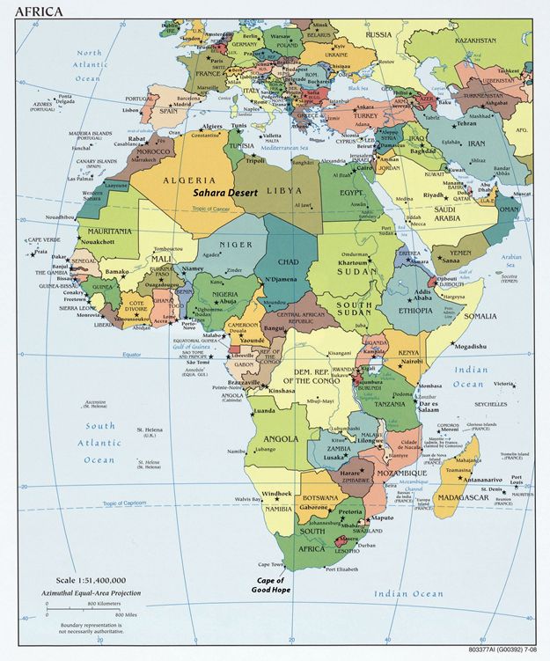
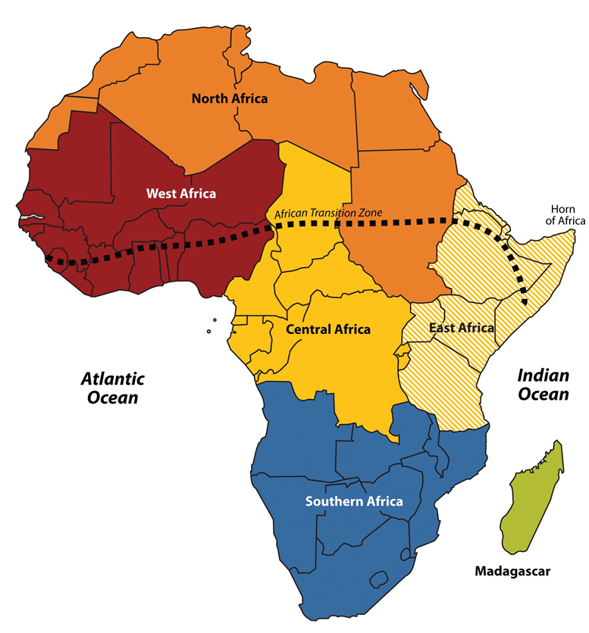
To help identify places discussed in this book, Africa has been divided into regions along traditional boundaries.

Slide 3
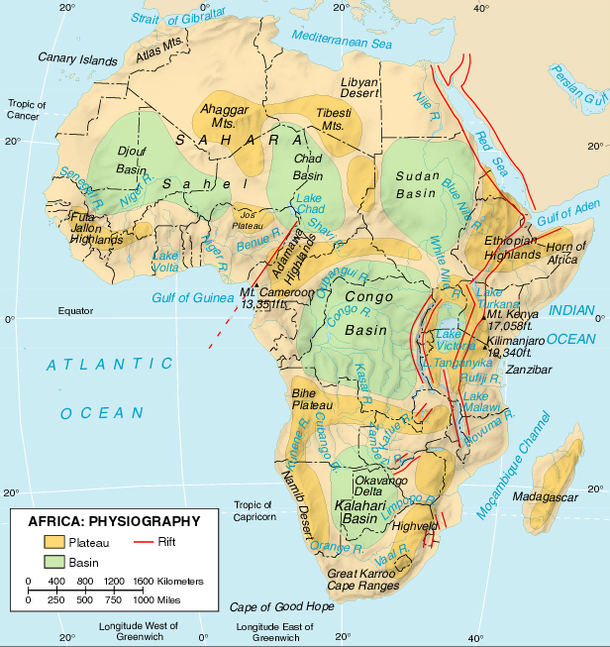
AFRICA’S PHYSIOGRAPHY
RIFT VALLEYS

Slide 4
Learning Objectives
Become familiar with the physical, demographic, cultural, political and economic aspects of Africa
Understand the roles of slavery, disease, and colonization in shaping Africa
You should understand the following concepts and models:
-Apartheid
-Berlin Conference
-Biofuels
-Horn of Africa
-Sahel
-Pastoralists
-Refugees
-Swidden
-Transhumance
-Kleptocracy

Slide 5
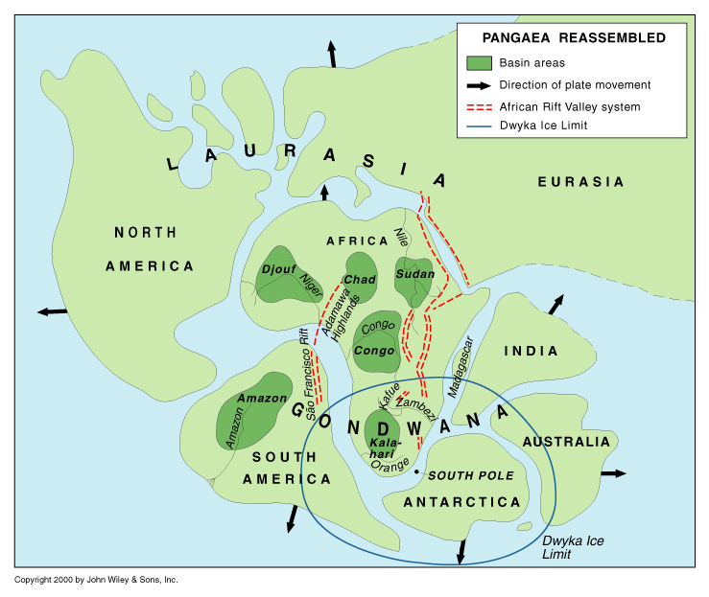

Slide 6
Continental Drift and Africa
Pangaea began breaking up more than 200 million years ago
The southern tip of Africa was near the South Pole
Has drifted northward
Direction of movement and short distance account for lack of major mountainous “spine”
Africa was affected more by divergent forces than convergent forces
Great Escarpment is remnant of gigantic fault

Slide 7
CONTINENT OF PLATEAUS
Least movement since break up of Pangaea
Plateau is the one term which best describes the whole continent.
Rift Valleys in East Africa separating

Slide 8
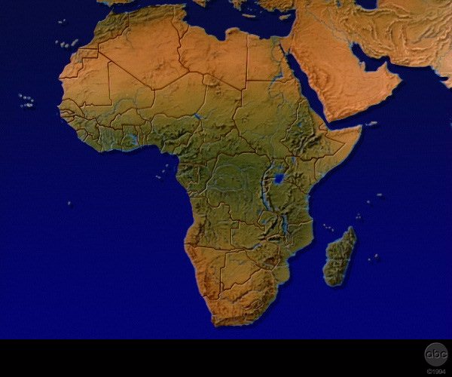

 


Atlas Mts

Mt Kenya


Mt Kilimanjaro
MOUNTAINS


Drakensberg

Cape Ranges




Slide 9
CHAD
B
A
S
I
N
S
DJOUF
SUDAN
CONGO
KALAHARI
ESCARPMENT

Slide 10
MAJOR
R
I
V
E
R
S
NIGER
SHAVI
NILE
CONGO
ZAMBEZI
BESET BY WATERFALLS

Slide 11
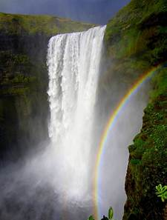
Unusual river systems
As part of Pangaea, there were several interior drainage basins (like around the Great Salt Lake, only bigger)
After drifting began, the interior drainage systems were altered and eventually found their way to the seacoast
mid course deltas (where the streams emptied into the former inland seas)
numerous cataracts or falls make the rivers less usable for transportation purposes
Rivers poor for transportation but good for hydroelectric power production

Slide 12
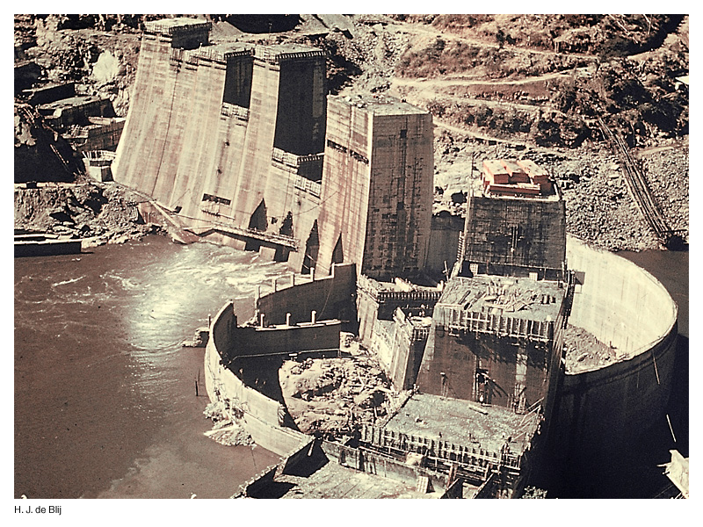
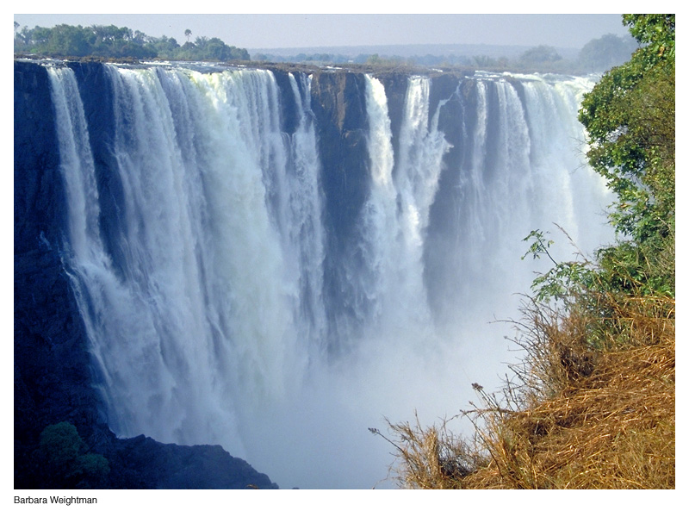
Double-edged Sword: Waterfalls and Power
Problem for transportation
Good for development

Slide 13
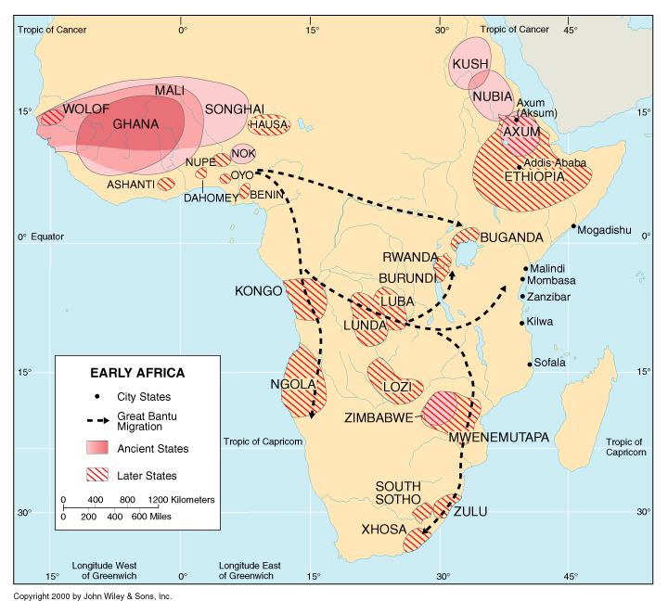
Historical Culture Hearths
Knowledge of Iron-working
Early Human Development

Slide 14
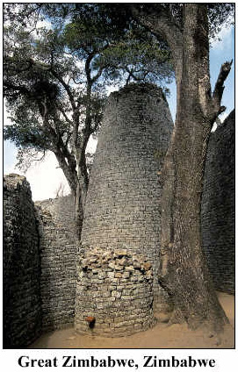
Great Zimbabwe
Zimbabwe building required sophisticated geometry in its construction (ellipse)
At first, European explorers refused to believe that Africans built these structures – credited the Greeks

Slide 15
Cultural Coherence and Diversity:
Globalization and African Culture
Role of slavery
Estimated 12 million were taken from Africa and sent to the Western Hemisphere from 1500-1870
Enslaved Africans sent to Europe, North Africa, Southwest Asia
African rhythms found in music around the world

Slide 16
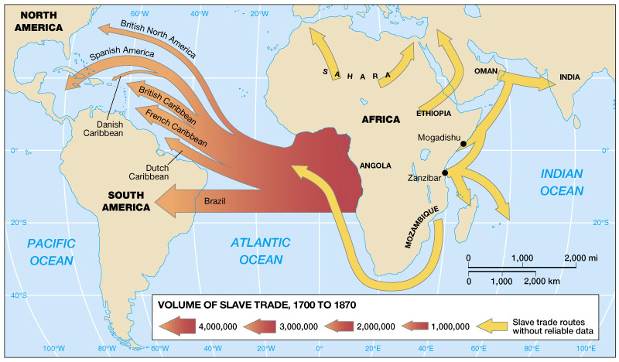
African Slave Trade (Fig. 6.27)

Slide 17
Legacies of Colonialism and Conflict
Before the arrival of Europeans, Sub-Saharan Africa had a complex pattern of kingdoms, states, and tribal societies
European Colonization
It took Europeans centuries to control this region
The Disease Factor
Malaria and other tropical diseases made it difficult for Europeans to establish colonies
Quinine made colonization possible
The wealth of the region made colonization desirable
The Scramble for Africa
Ethiopia remained unconquered

Slide 18
COLONIALISM
EUROPEAN COLONIAL OBJECTIVES
A port along the West African coast
A water route to South Asia and Southeast Asia
1500’s- looking for resources; Slaves
Europe 1850- industrial revolution occurs
Increased demand for mineral resources
Need to expand cash crop production
Need for markets for industrial products

Slide 19
BERLIN CONFERENCE 1884
13 States divided up Africa without consideration of cultures
Results of superimposed boundaries
-- African peoples were divided.
-- Unified regions were ripped apart.
-- Hostile societies were thrown together.
-- Hinterlands were disrupted.
-- Migration routes were closed off.
When independence returned after 1950, the realm had already acquired a legacy of political fragmentation – boundary change unrealistic.

Slide 20
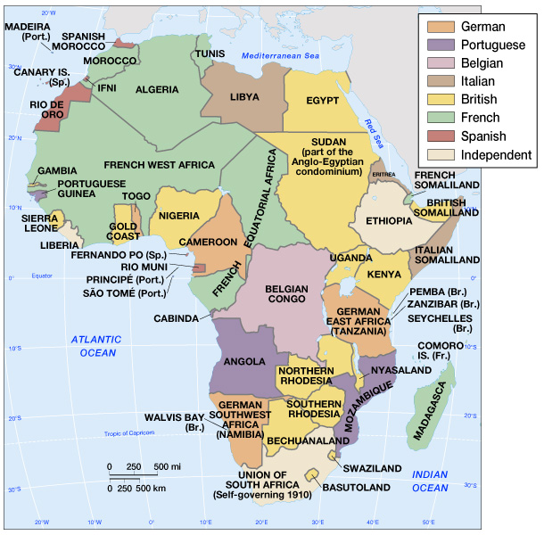
European Colonization in 1913 (Fig. 6.28)

Slide 21
COLONIAL POLICIES
Great Britain: “Indirect Rule” (Ghana, Nigeria, Kenya, Zimbabwe)
Indigenous power structures were left intact to some degree and local rulers were made representatives of the crown.
France: “Assimilationist” (Senegal, Mali, Ivory Coast, etc.)
Enforced a direct rule which propagated the French culture through language, laws, education and dress (acculturation)

Slide 22
COLONIAL POLICIES
Portugal: “Exploitation” (Guinea-Bissau, Angola, Mozambique)
First to enslave and colonize and one of the last to grant independence
Maintained rigid control; raw resource oriented
Belgium: “Paternalistic” (Rwanda, Zaire, Burundi)
Treated Africans as though they where children who needed to be tutored in western ways; did not try to make them Belgium
Raw resource oriented; ignored development of natives

Slide 23
THE COLONIAL LEGACY
Several hundred languages are spoken.
European language usually continues as the “official” language – language of government, business, & education.
Multilingualism
Powerful centrifugal force – reinforces tribalism
East Africa, Swahili serves as the lingua franca
Antagonism between tribes (e.g., Rwanda)
Politics often equates with TRIBALISM

Slide 24
THE COLONIAL LEGACY
Low level of development is linked to colonization
Transportation facilities - Movement of goods is from the interior to coastal outlets. No network was developed.
Communication within Africa is impeded by desert, dense forest, and lack of navigable rivers in certain regions.
Dual economy remains intact; most states rely on a single crop or mineral and are vulnerable to world markets. They often produce cash crops at expense of food crops.

Slide 25
Geopolitical Framework: Legacies of Colonialism and Conflict (cont.)
Establishment of South Africa (cont.)
Dutch (Boers) and British settlers conflicted
1948 Afrikaner’s (Dutch) National Party gained control of govt.
Instituted Apartheid: formalized racial segregation
Petite, meso-, and grand apartheid
Homelands – nominally independent states for blacks

Slide 26
Environmental Geography: The Plateau Continent
Largest landmass straddling the equator
A plateau continent -- extensive uplifted areas
Relatively poor soils and vulnerability to drought
Africa’s Environmental Issues
Desertification: the expansion of desert-like conditions as a result of human-induced degradation
The Sahel and Desertification
Sahel – zone of ecological transition between the Sahara to the north and wetter savannas and forests to the south
Life is dependent on reliability of rains
Transhumance: the movement of animals between wet-season and dry-season pasture

Slide 27
Environmental Geography
Deforestation
Extensive woodlands remain, but many forests have been replaced by grasslands or farms
Results in shortages of biofuels: wood and charcoal used for household energy needs, especially cooking
In some countries, women are organizing to plant trees
Wildlife Conservation
Wildlife survives because of historically low population density
Wildlife populations currently declining
Poaching a problem
Sale of ivory (elephant tusks) has been prohibited

Slide 28
Africa south of the Sahara Desert
A culturally diverse region
World’s fastest-growing region
> 670 million people; 48 states and one territory
Most countries, nearly 50% of population < 15
Relatively low economic output
In 1999, Sub-Saharan Africa’s economic output was just 1% of global output
S. Africa’s GNP was 44% of GNP of whole region, but Nigeria surpassed S, Africa a few years ago
Foreign aid helped improve agriculture, but led to large debt and corruption

Slide 29
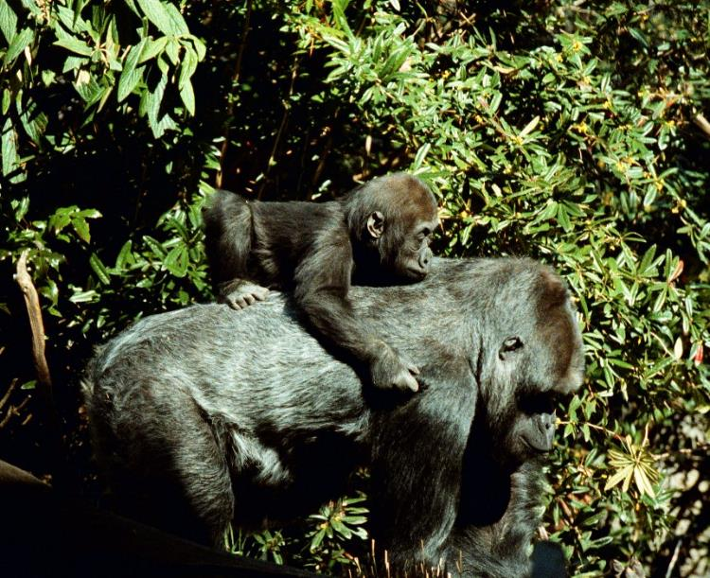
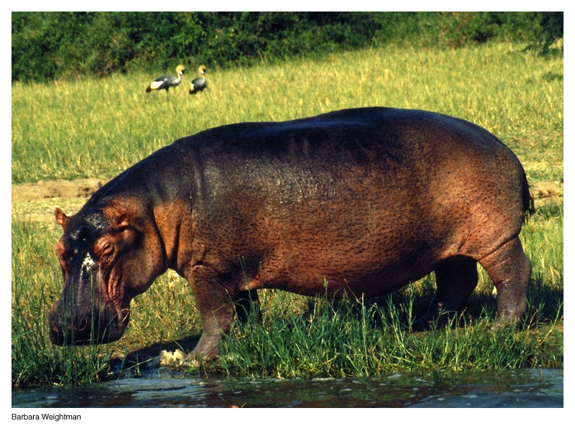
Environmental Problems
Deforestation
Endangered species

Slide 30
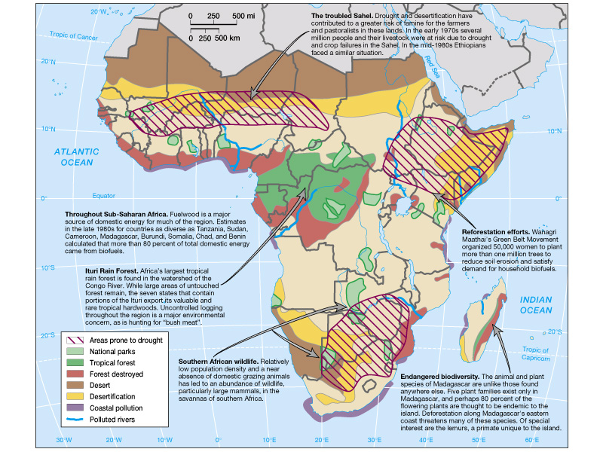
Envronmental Issues in Sub-Saharan Africa (Fig. 6.3)
Environmental Problems

Slide 31
Environmental Geography:
Plateaus and Basins
Elevated basins dominate the interior
Great Escarpment: landform rimming much of southern Africa, impeding coastal settlement
Watersheds
Major river systems: Congo, Nile, Niger, Zambezi
Soils
Relatively infertile because they are old
Most fertile soils located within Rift Valley
Highland Ethiopia, Lake Victoria lowlands, central highlands of Kenya also have productive agricultural bases

Slide 32
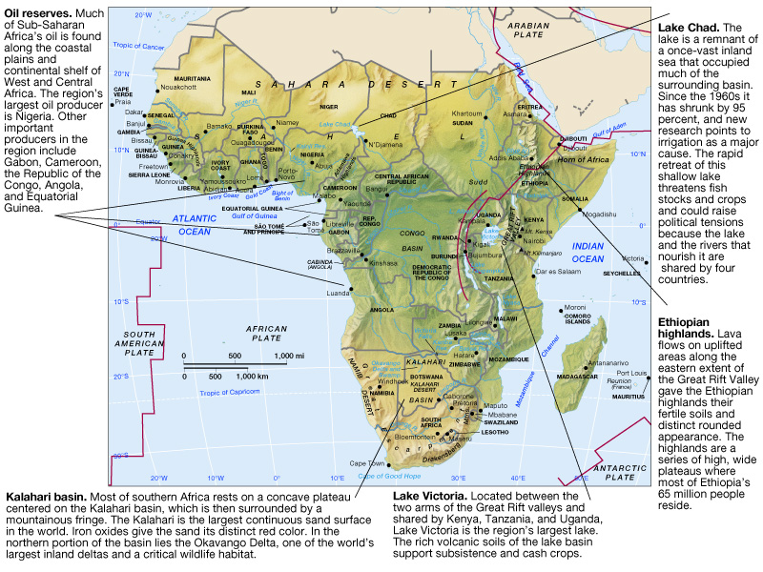
Physical Geography of Sub-Saharan Africa

Slide 33
Environmental Geography:
Climate and Vegetation
Warm year-round, while rainfall varies regionally
Tropical Forests
Congo Basin contains the second largest expanse of tropical rainforest in the world
Savannas
Wet and dry savannas surround central African rainforest belt
Deserts
Sahara, Namib, Kalahari
Horn of Africa – northeastern corner that includes Somalia, Ethiopia, Djibouti, and Eritrea

Slide 34
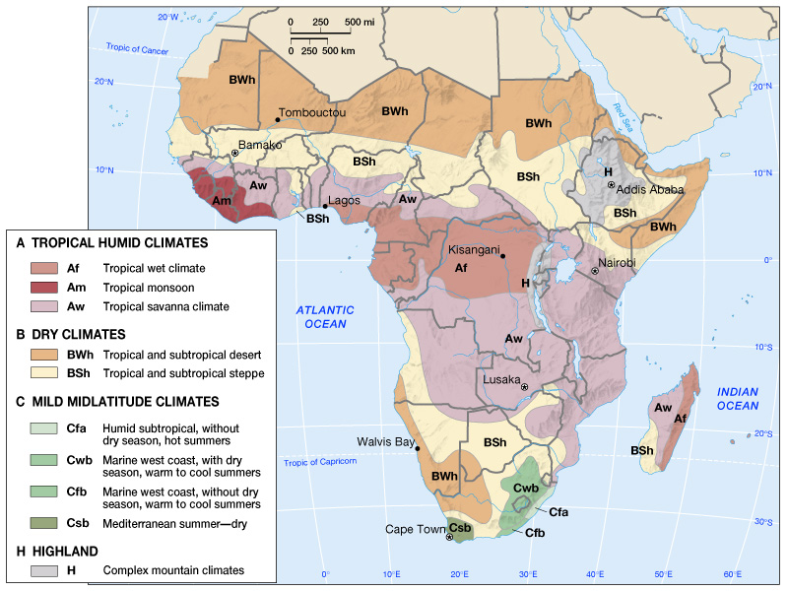
Climate Map of Sub-Saharan Africa (Fig. 6.11)

Slide 35
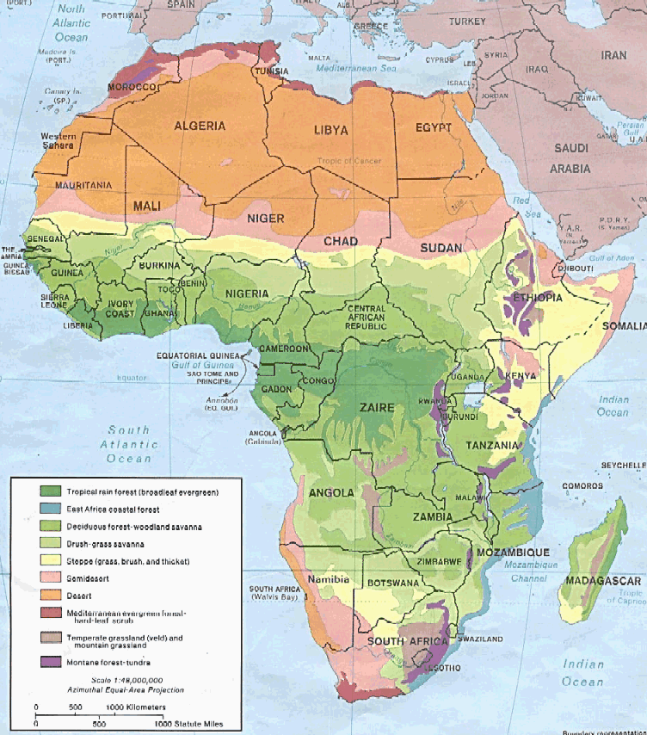
VEGETATION
MORE GRASSLAND THAN TROPICAL RAINFOREST
TROPICAL RAINFOREST (SELVA) IS DIFFERENT FROM JUNGLE – THERE IS VERY LITTLE JUNGLE

Slide 36
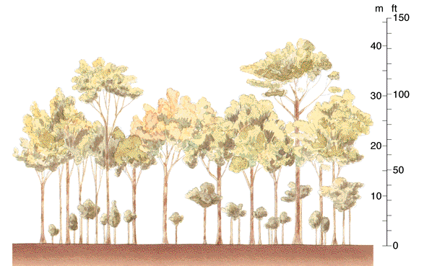
THREE-TIERED RAINFOREST
LITTLE OR NO UNDERBRUSH
EASY TO TRAVEL THROUGH
JUNGLE OCCURS WHEREVER SUNLIGHT CAN PIERCE THE TREE CANOPY AND REACH THE GROUND CAUSING UNDERBRUSH

Slide 37
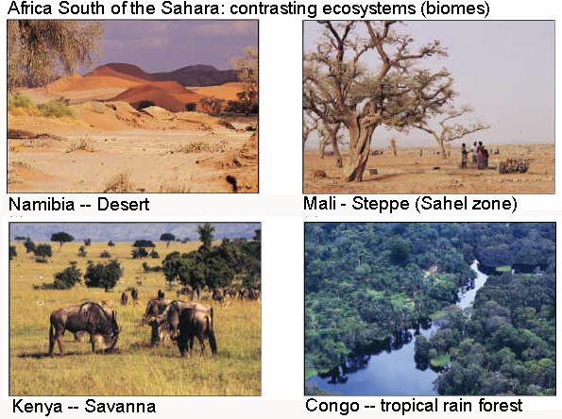
Different Biomes

Slide 38
Climate-Related Conditions
High temperature and high humidity create breeding ground for organisms
Tropical diseae vectors
Extremely rapid decomposition of humus in soil
Conditions also contribute to poor soil (low in humus)
Leaching of water soluble materials from upper soil zone
When farmed, soil is quickly depleted
Where precipitation is marginal (Sahel) conditions exist for desertification and soil erosion

Slide 39
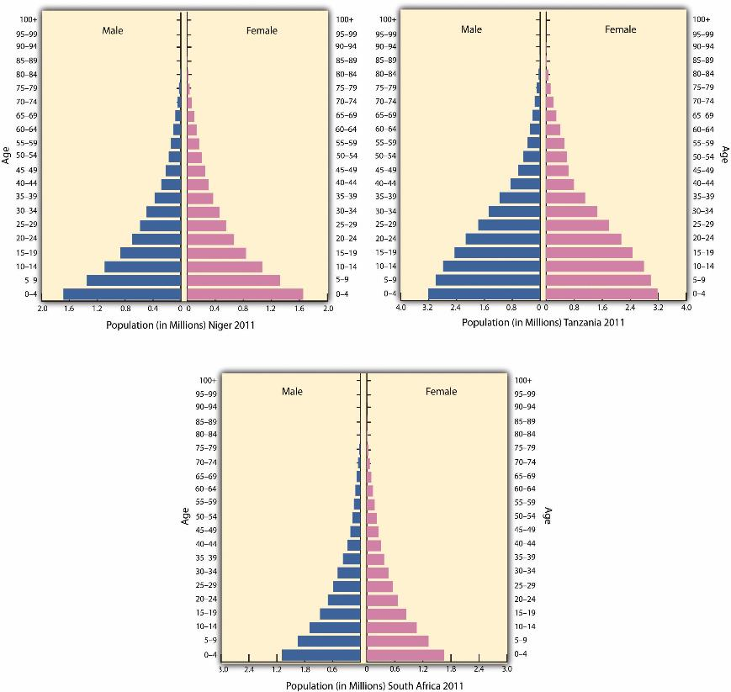
Population and Settlement: Young and Restless
Population projected increase by 130% by 2050
Population density is similar to that of the U.S.
Life expectancy short (<50 years), TFR high (5+)
Population Trends & Demographic Debates
How many people can Sub-Saharan Africa support?
Family size
Preference for large families
Guarantee lineage and status
Rural life makes children an asset

Slide 40
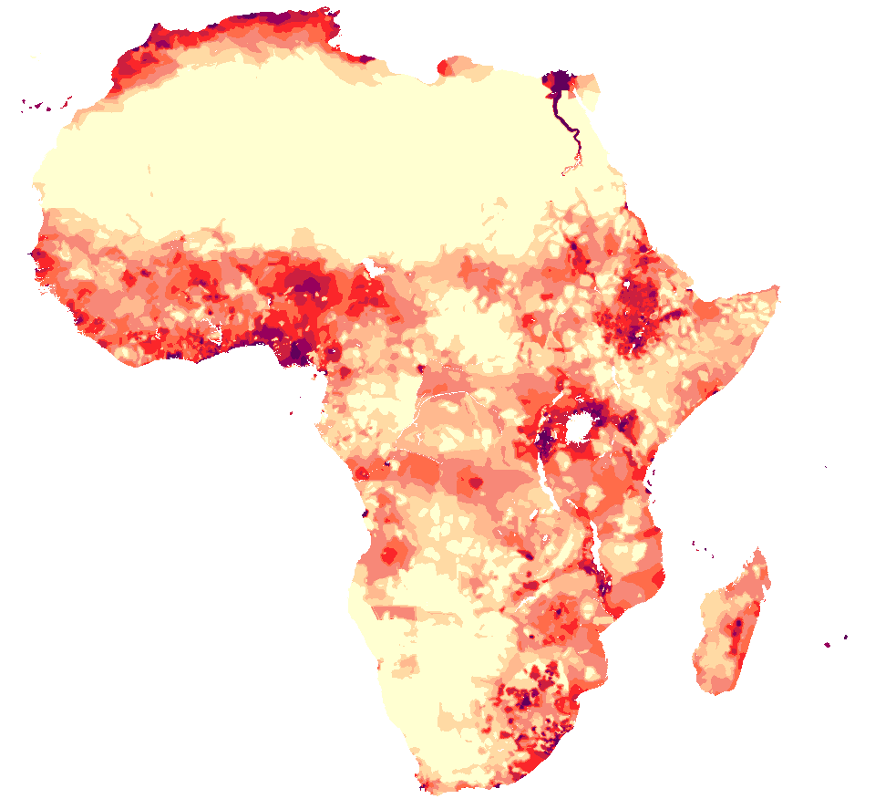
Populatiom Density

Slide 41
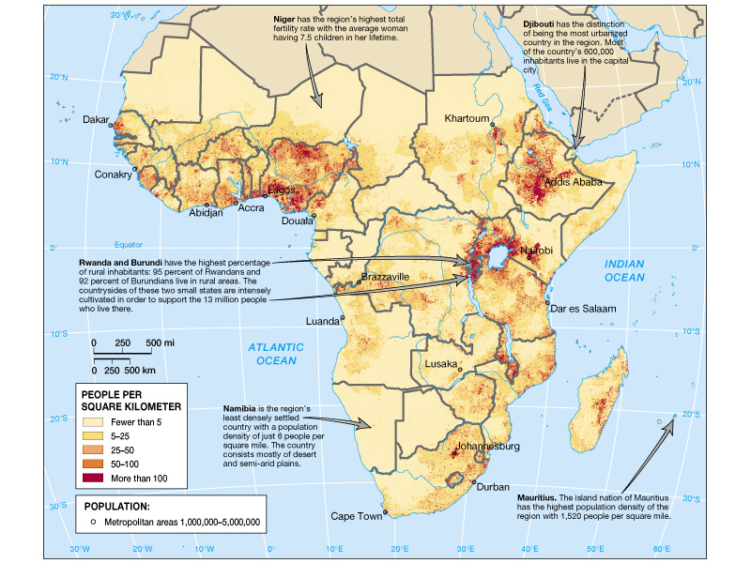
Population Distribution (Fig. 6.16)

Slide 42
Patterns of Settlement and Land Use
Widely scattered population
Concentrations in West Africa, highland East Africa, eastern half of South Africa
Rural-urban migration; Lagos (Nigeria) has 10+ million people

Slide 43
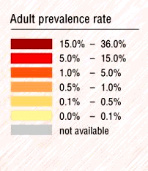
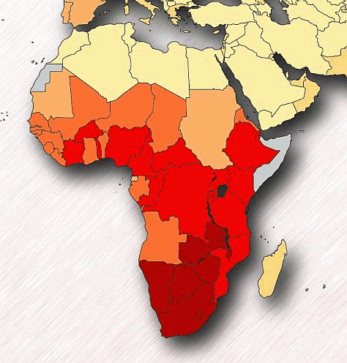
AIDS
IN AFRICA
1999
NOT A HOMOSEXUAL DISEASE IN AFRICA!
SOURCE:
UNAIDS, 2000

Slide 44
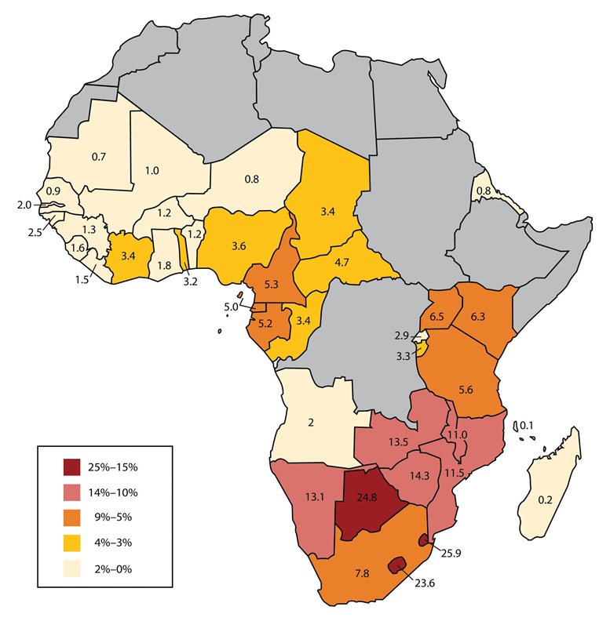
This map shows the estimated percentage of adults with HIV in Subsaharan Africa for each state based on best estimates by the World Health Organization and the UN, 2010.
Considerable improvement in 12 years

Slide 45
Population Trends (cont.)
The Impact of AIDS on Africa
Southern Africa is ground zero for the AIDS epidemic
2/3 of world’s AIDS cases are found in Sub-Saharan Africa – many cases go undiagnosed
AIDS may reduce growth rate in the region
Drugs too expensive, education is best way to stem epidemic
Today, AIDS is manageable if one has access to and money dor the medications

Slide 46
Patterns of Settlement and Land Use (cont.)
Agricultural Subsistence
Staple crops of millet, sorghum, corn
Swidden agriculture practiced in areas with poorer tropical soils
Shifting cultivation: burning natural vegetation to release fertility, then plant indigenous crops; allow fallow periods
Often fine-tuned to local conditions, but unable to support high population densities
Plantation Agriculture
Crops for export are critical to the economies of many African states
Coffee, peanuts, cotton, cocoa, rubber

Slide 47
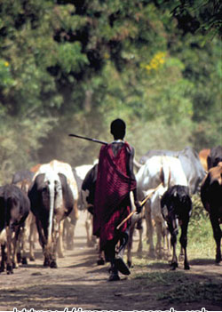
Patterns of Settlement and Land Use (cont.)
Herding and Livestock
Most engaged in this activity are pastoralists
Pastoralists specialize in grazing animals
Tsetse fly impact – insects that spread sleeping sickness to cattle, humans, and some wildlife
Urban Life
Least urbanized region in the developing world
But most cities growing at twice the national rates
At 12 million people, Lagos is largest city
West African Urban Traditions
West African coast has many cities, most with indigenous origins

Slide 48
Cultural Coherence and Diversity:
Language Patterns
Complex pattern includes local, African trade, and European and Asian languages
African Language Groups
Three groups unique to the region: Niger-Congo, Nilo-Saharan, Khoisan
Language and Identity
Ethnic identity in the region has been fluid
Tribes: consist of a group of families or clans with a common kinship, language, and definable territory
European Languages
Francophone, Anglophone
Also Afrikaans (Dutch-based) and Arabic

Slide 49
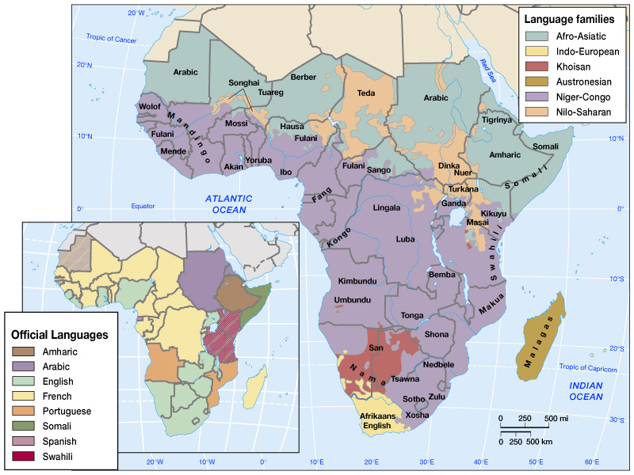
African Language Groups and Official Languages

Slide 50
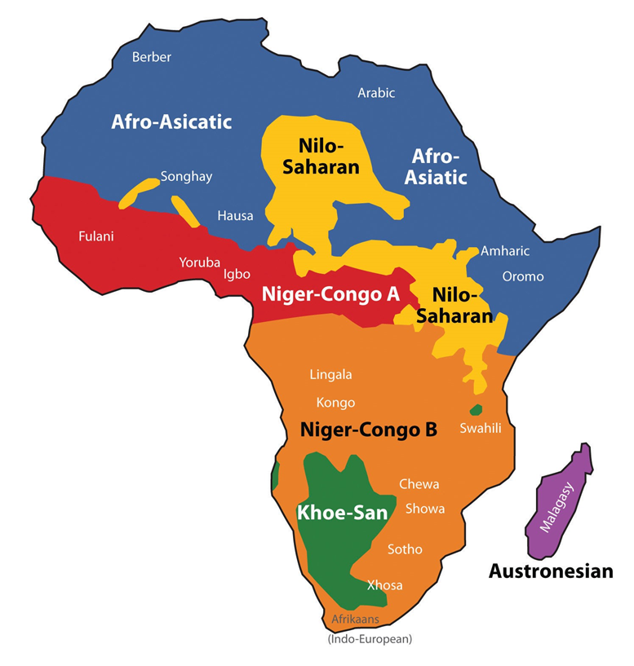
There are six main language families with many variations of each. It is estimated that more than two thousand languages are spoken in all Africa.

Slide 51
Religion
Indigenous religions tend to be animistic
The Introduction and Spread of Christianity
Entered northeast Africa around 300 A.D.
Coptic Christians - Ethiopia & Eritrea; other Christians in Sudan
Dutch brought Calvinism to South Africa in 1600s
The Introduction and Spread of Islam
Introduced about 1,000 years ago
Today, orthodox Islam prevails in most of the Sahel
Interaction Between Religious Traditions
Religious conflict most acute in northeastern Africa
Sudan: conflict between Muslims in north and Non-Muslims in the south

Slide 52
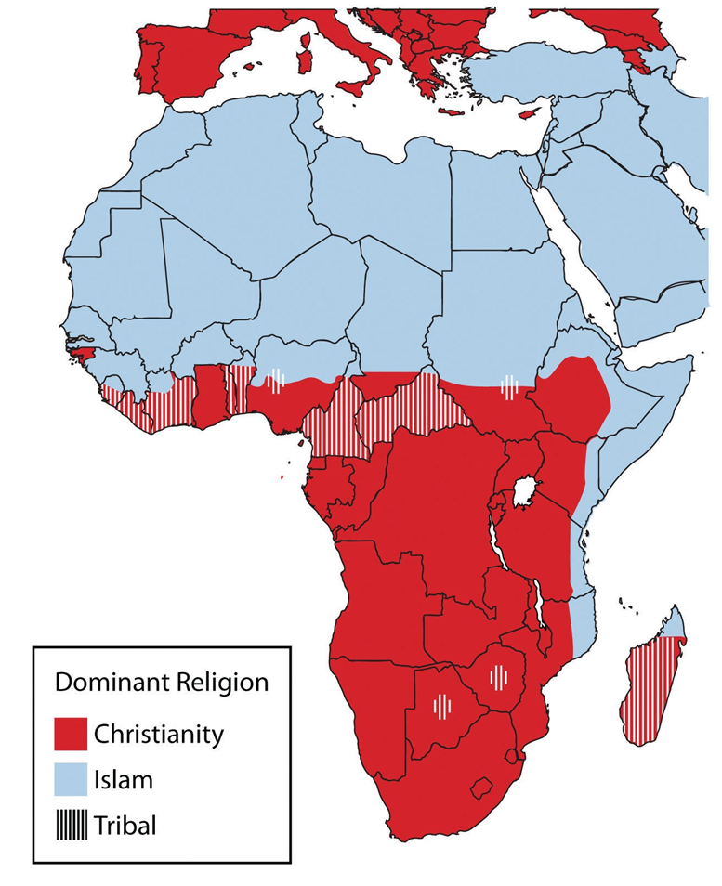
Islam is prominent north of the African Transition Zone, and Christianity is more prominent south of the African Transition Zone
Islam is the fastest growing
More Africans in Christian seminaries than there are seminarians in North America.

Slide 53
Geopolitical Framework: Legacies of Colonialism and Conflict (cont.)
Decolonization and Independence
Decolonization began in 1957
Organization of African Unity (OAU) – a continent-wide organization whose goal includes mediating disputes between neighboring states

Slide 54
INDEPENDENT STATES IN AFRICA
1960
1950
1970
INDEPENDENT

Slide 55
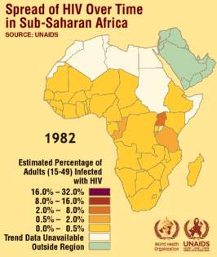
Past, Present, & Future
Click on the map to see the video

Slide 56
Legacies of Colonialism and Conflict (cont.)
Decolonization and Independence (cont.)
Southern Africa’s Independence Battles
Southern Rhodesia – Zimbabwe
Portuguese colonies of Angola and Mozambique
Apartheid’s Demise in South Africa
Townships – segregated neighborhoods for nonwhites, located on outskirts of cities
Opposition began in the 1960s
Blacks and coloureds led opposition
Pressure for change from outside sources
Free elections held in 1994

Slide 57
Legacies of Colonialism and Conflict (cont.)
Continuing Political Conflict
The Tyranny of the Map
Difficult to establish cohesive states in Africa because of legacy of Berlin Conference
Tribalism: loyalty to ethnic group not to a state
Has led to many internal conflicts
Refugees: people who flee their country from a well-founded fear of persecution based on race, ethnicity, religion, or political orientation
Internally displaced persons: people who have fled from conflict but remain in their country of origin

Slide 58
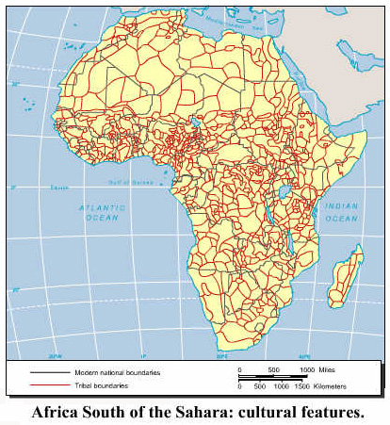
Tribalism problem
Tribalism is often a stronger force than nationalism.
Political parties based on tribes
Problem of creating nationalism artificially.

Slide 59
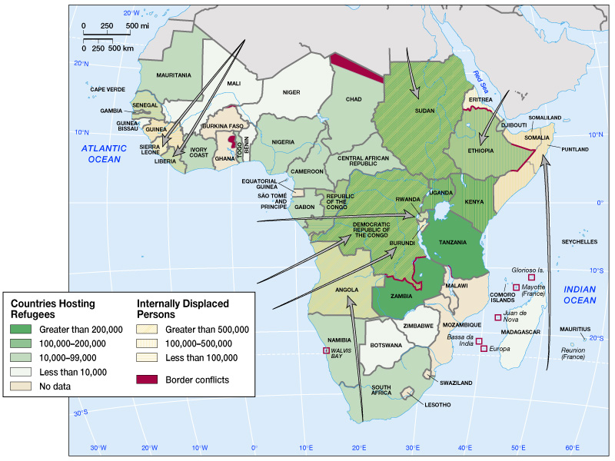
Postcolonial Conflicts

Slide 60
Geopolitical Framework: Legacies of Colonialism and Conflict (cont.)
Continuing Political Conflict (cont.)
Ethnic Conflict in Rwanda
1994 genocide between Hutus and Tutsis
Belgian colonists privileged one group
Millions of refugees, half a million deaths
Secessionist Movements
Shaba Province in Zaire
Eritrea

Slide 61
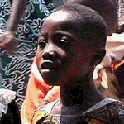
Tribalism & Genocide
Click the picture to see the video

Slide 62
The Struggle to Rebuild
Economic Situation
Poorest, least-developed region in the world
Low economic base and high population growth
Structural adjustment programs: reduce govt. spending, cut food subsidies, encourage private sector
Roots of African Poverty
Environmental limitations and slavery
Failed Development Policies
Economic nationalism: inefficient, often corrupt governments took over large segments of economy
Corruption
Kleptocracy: state where corruption is so institutionalized politicians & govt. bureaucrats take huge % of country’s wealth

Slide 63
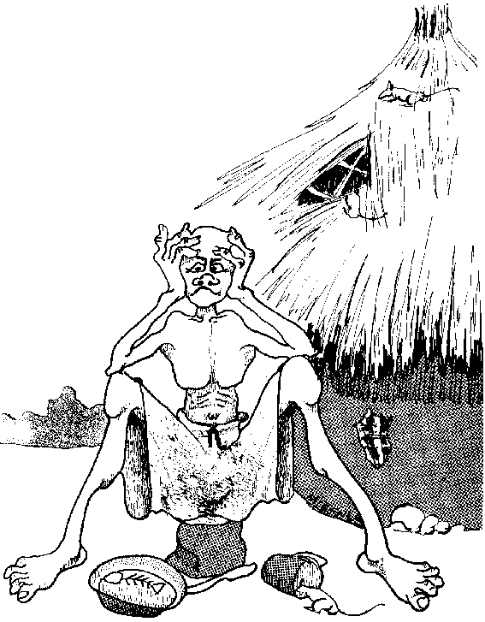
10 PROBLEMS AFFECTING DEVELOPMENT
Poverty
Disease
Internal ethnic problems
Illiteracy
Government instability – dictatorships, military rule
Lack of infrastructure
Environmental problems
Single-product economies
“Brain drain”
Peripheral relative location

Slide 64

Peripheral Relative Location on the Land Hemisphere
Central Location
Periphery

Slide 65
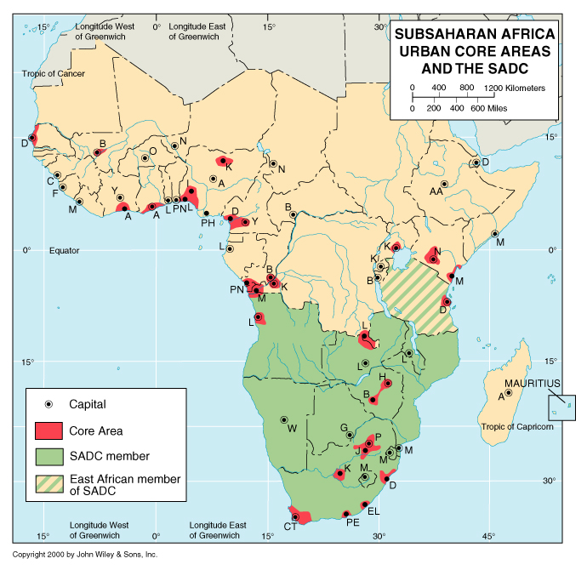
15 Landlocked countries

Slide 66
Economic and Social Development:
Links to the World Economy
Most African exports to European Union or U.S.
Low connectivity: few phones and TVs
Multinational providers now competing for mobile-phone customers
Aid Versus Investment
More aid than investment
Poverty & political instability discourage investment
Debt Relief
World Bank/IMF will reduce debt for countries with “unsustainable” debt burdens
Savings can be used for basic services

Slide 67
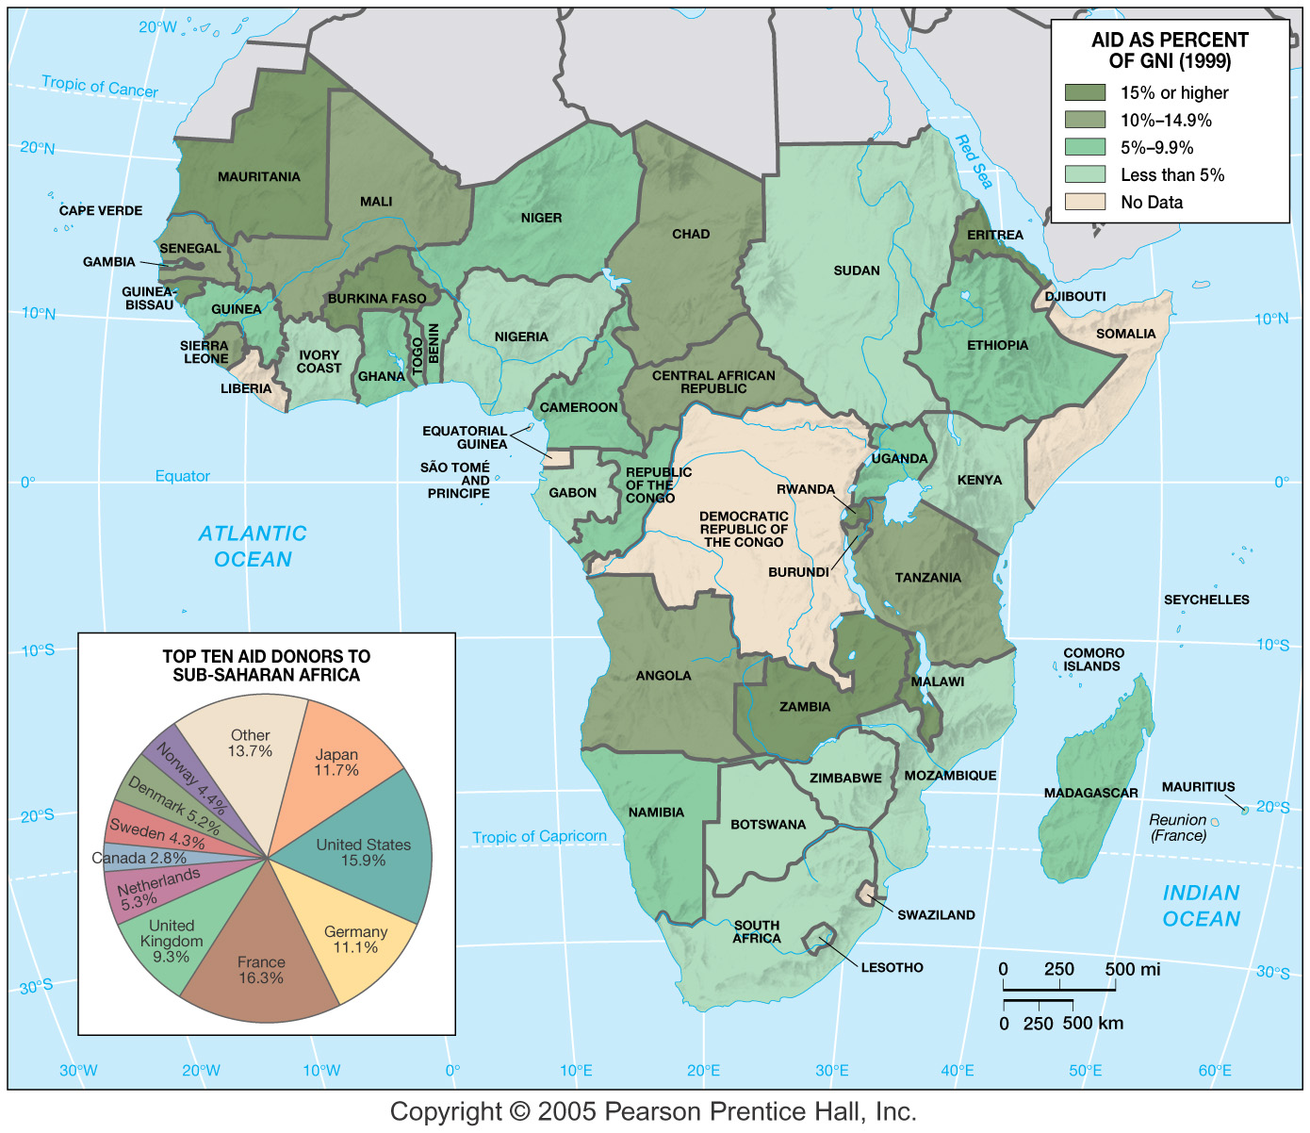
Global Linkages: Aid Dependency (Fig. 6.34)

Slide 68
Economic Differentiation Within Africa
Trade blocks: Southern African Development Community (SADC), Economic Community of West African States (ECOWAS), Economic Community of Central African States (CEEAC)
South Africa
Well-developed & -balanced industrial economy
Oil and Mineral Producers
Substantial oil and mineral reserves, small populations
The Leaders of ECOWAS
Economic Community of West African States
Nigeria has largest oil reserves

Slide 69
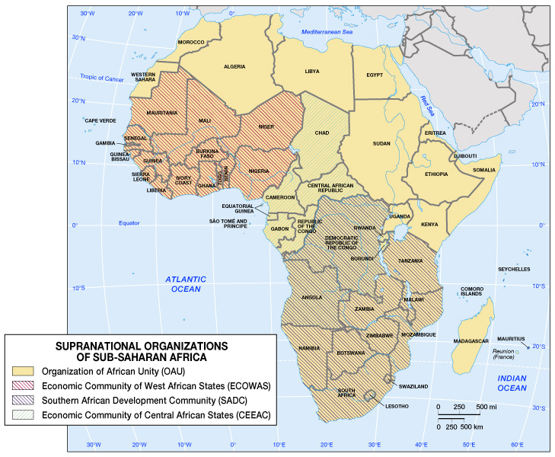
Supranational Organizations of Sub-Saharan Africa

Slide 70
Economic Differentiation Within Africa (cont.)
The Poorest States
Located in the Sahel, the Horn, and the southeast
Measuring Social Development
Overall low levels of social development, but rates of child survival have increased since 1980
Life Expectancy
World’s lowest rates: regional average of 51 yrs.
Caused by extreme poverty
Health Issues
Scarcity of doctors and persistence of diseases

Slide 71
Economic and Social Development: The Struggle to Rebuild (cont.)
Women and Development
Account for 75% of the labor that produces more than 50% of the food consumed
Status of Women
Considerable political and economic power
Polygamy prevalent, female circumcision, denial of property inheritance
Building from Within
Women’s market associations

Slide 72
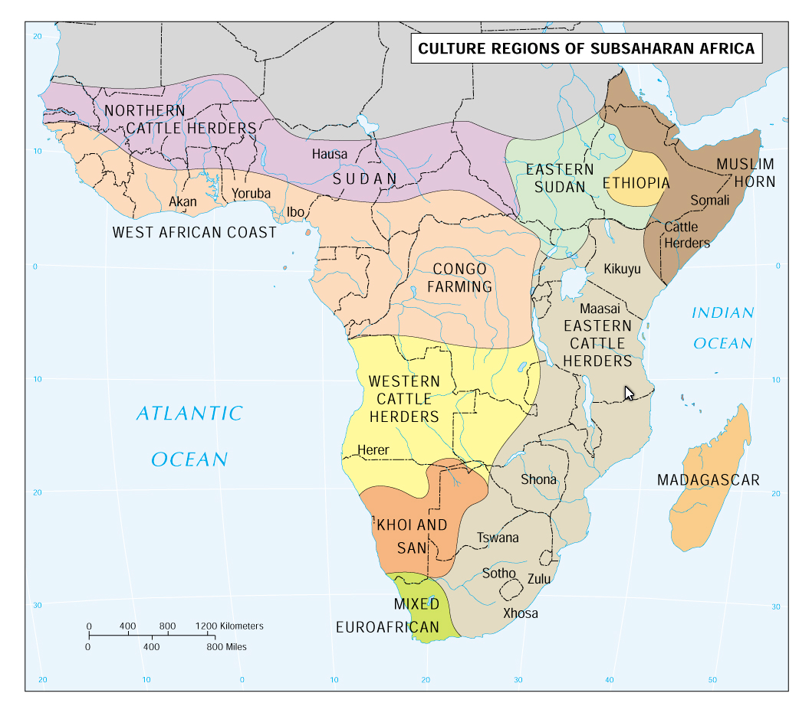
Regions based mostly on climate and major occupations –race, ethnicity, and religion considered where those factors were more important.

Slide 73
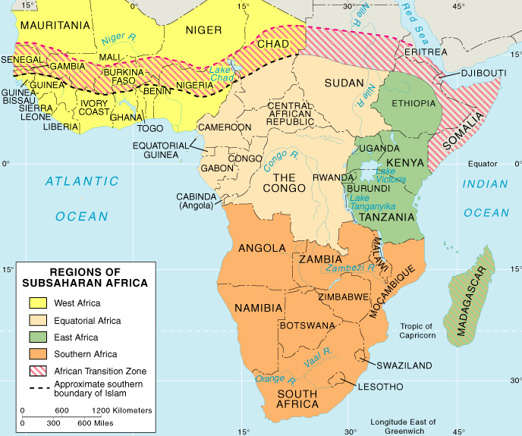
REGIONS OF SUBSAHARAN AFRICA
One of the best examples of a transition zone in the world.

Slide 74
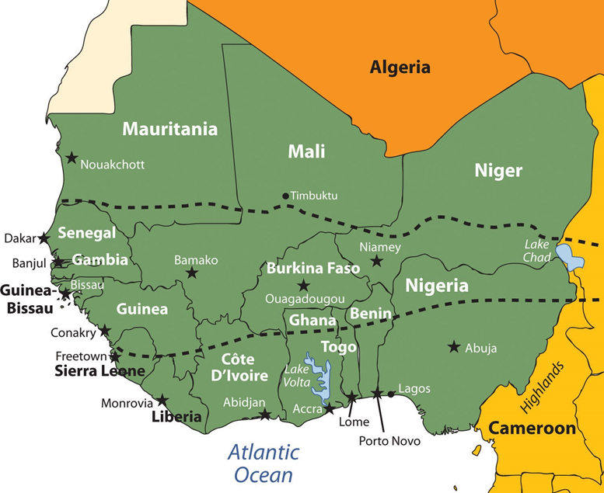
West Africa
Sahel Transition Zone

Slide 75
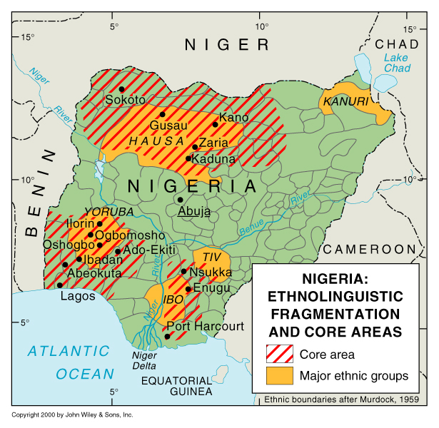
NIGERIA: WEST AFRICA’S CORNERSTONE
Example of boundaries putting together different ethnic groups
Three core areas based on large ethnic groups
More than 100 total ethnic groups

Slide 76
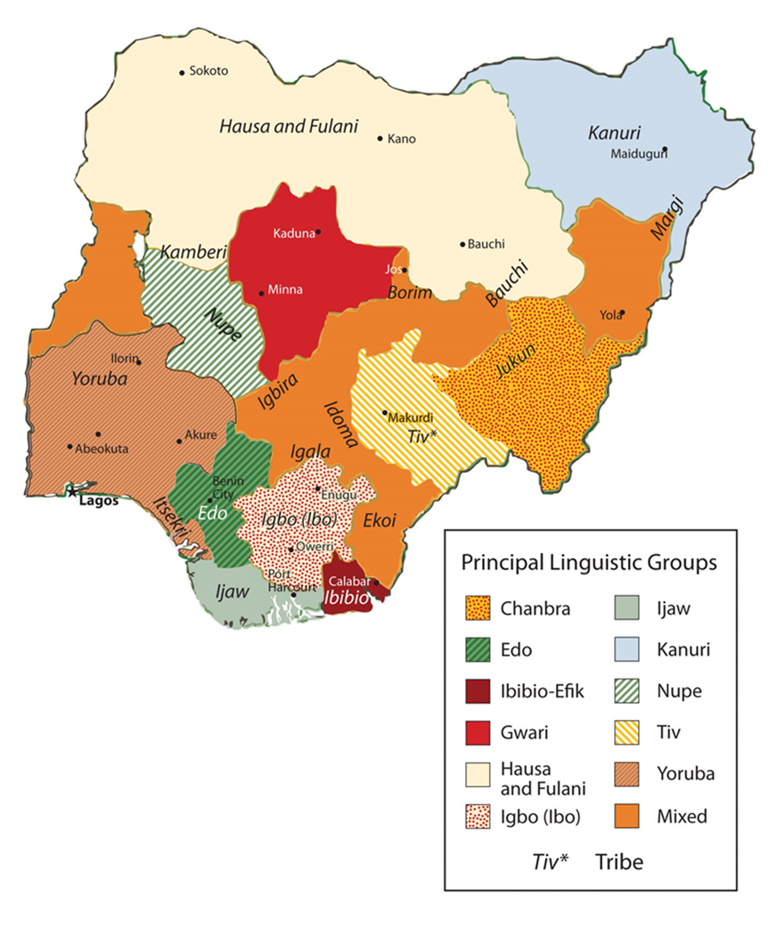
Linguistic and Tribal Multiplicity
English chosen as the national language
English was the colonial language of the schools, government, and commerce beyond the village level.
There was a good English foundation I n place, and choosing English didn’t show favoritism to one tribe. English is also the world lingua franca for commerce.
Anything that didn’t add to tribal rivalries was a good thing.

Slide 77
NIGERIA: Cornerstone in Spite of Problems
Largest population
Good economic foundation – Largest GDP
Oil deposits
One of the larger rivers
Commercially usable forests
However, very active centrifugal forces tearing apart society – 1960s civil war
However, democracy has yet to work!

Slide 78
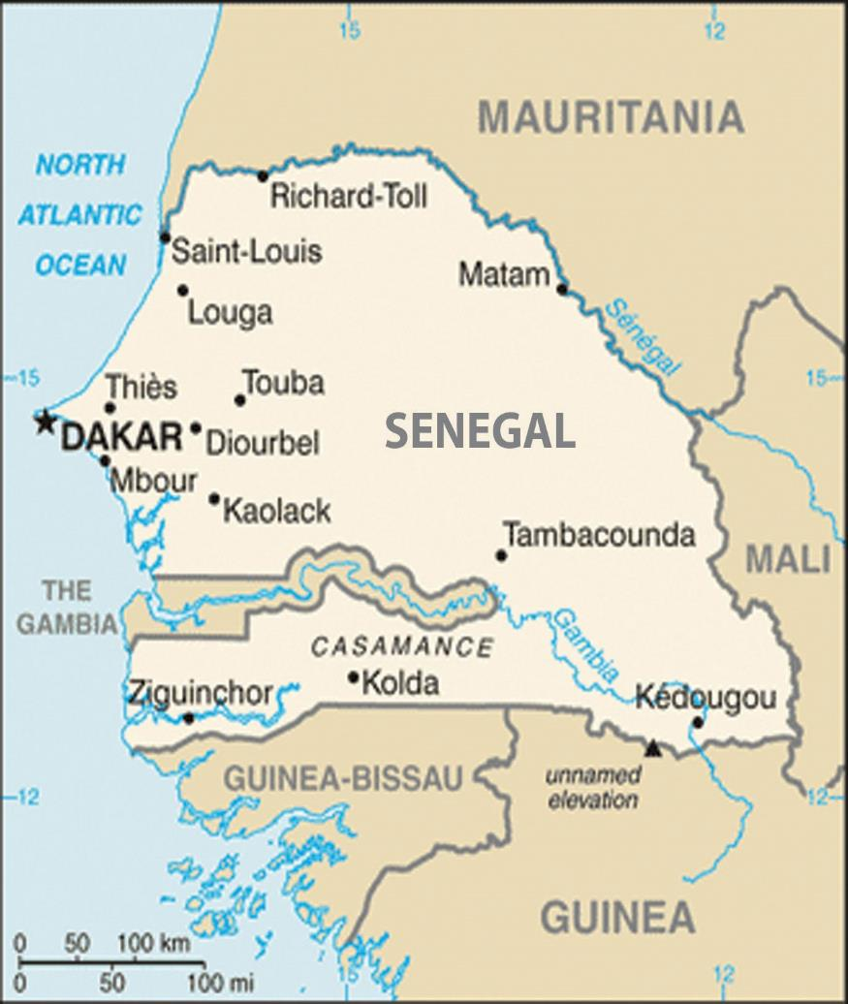
The Gambia is totally surrounded by the country of Senegal. The Gambia was once a British colony and Senegal was once a French colony.
The two countries of Senegal and the Gambia were united into the confederation of Senegambia from 1982 to 1989 when it was dissolved. They have kept separate political identities ever since.

Slide 79

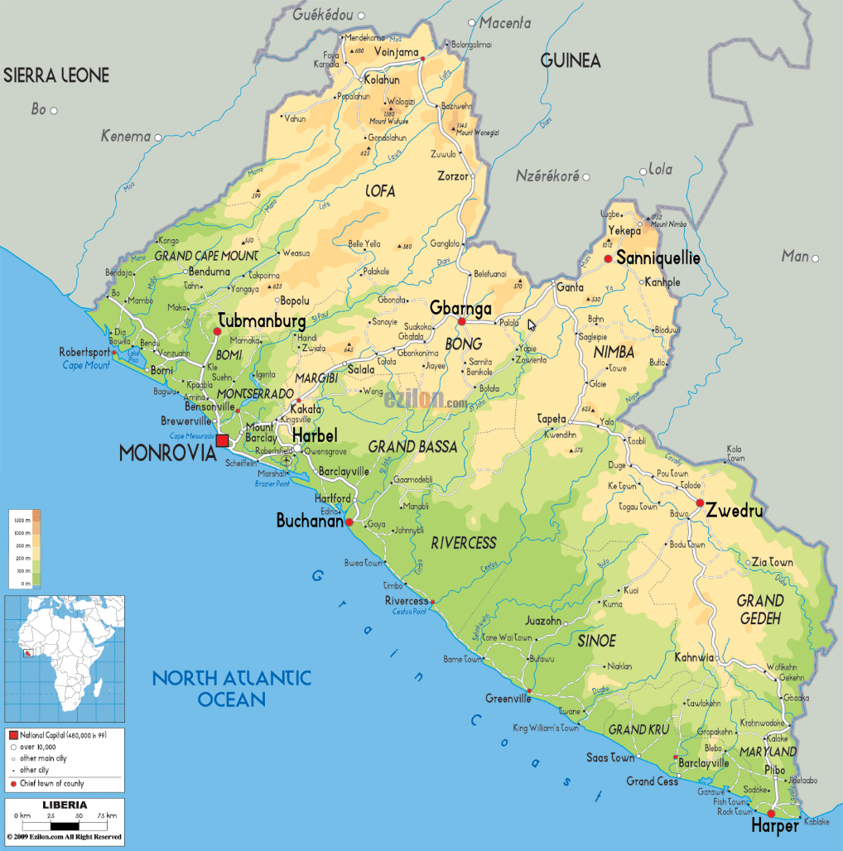
Unusual Liberia
Established by former slaves from the USA
English-speaking immigrants took over as the upper, ruling class – the ruled the country for 0ver a century – it didn’t end peacefully
Indigenous Africans and their descendants were second-class citizens

Slide 80
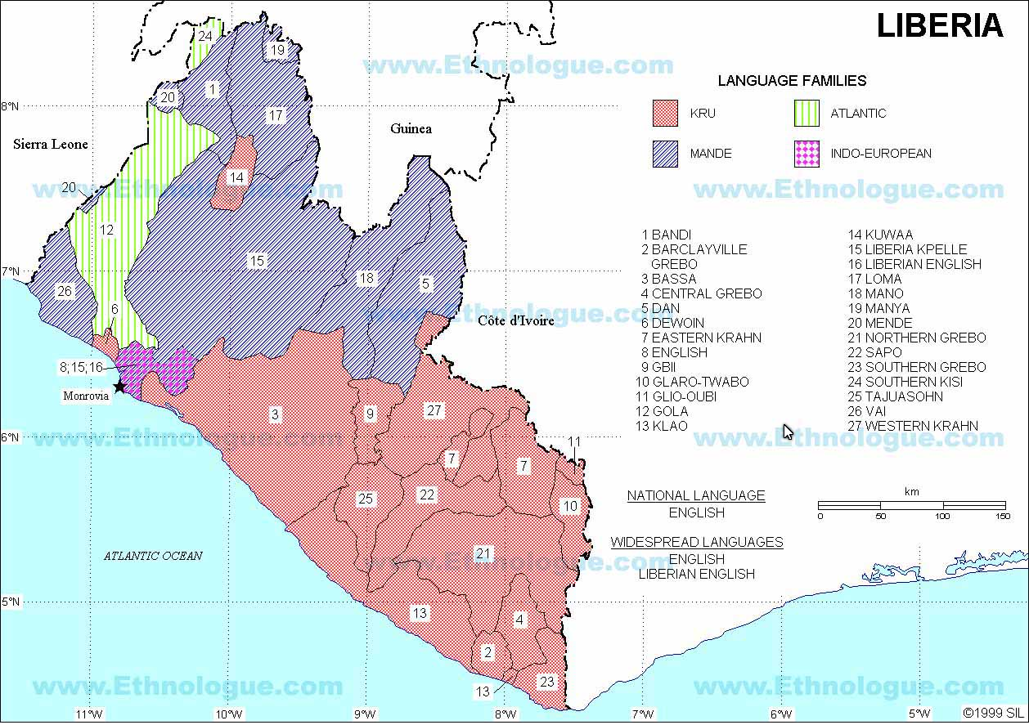
Major English-speaking area

Slide 81
The Gold Coast Countries
Cultural differences – North and South
North – semiarid to arid climate (in the Sahel) Inhabitants – nomadic Muslims
South – Tropical rain forest and Monsoon rain forest – Inhabitants are sedentary agriculturists practicing Christianity or tribal religions
Ghana was the first to gain independence
Tribalism complicates things further – multiplicity of tribes
Nigeria estimates run from 250 to400 tribes (languages and dialects)
National language in most is either French or English
Irrational boundaries established by ignorant Europeans
Didn’t know the physiography, the exact location and nature of the rivers, the cultures of tribes, the range of land through which nomads passed annually
Tribal lands divided between two or more colonies, disrupted traditional movements
Tribes with great cultural differences or ages old animosities were included in a colony (Information in red applies to the entire realm)

Slide 82
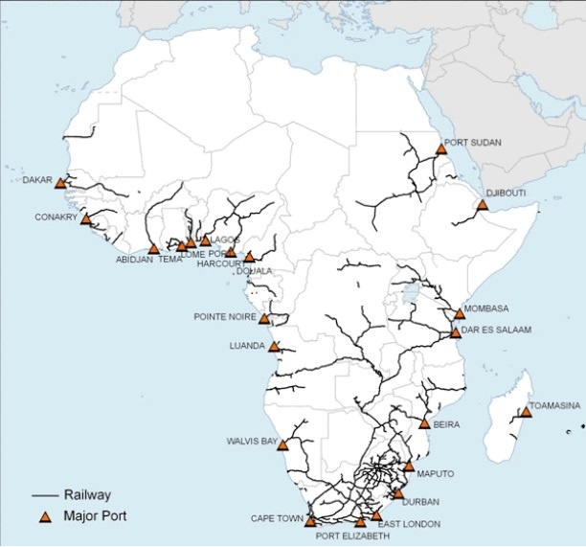
Infrastructure problems
Often neighboring colonies were held by different European countries, transportation infrastructure was aligned from the interior to a port on the coast to facilitate the export of whatever resources or products desired by the European rulers.
No infrastructure connections were established between colonies held by different European countries. This hampered cooperation among neighboring countries after independence.

Slide 83
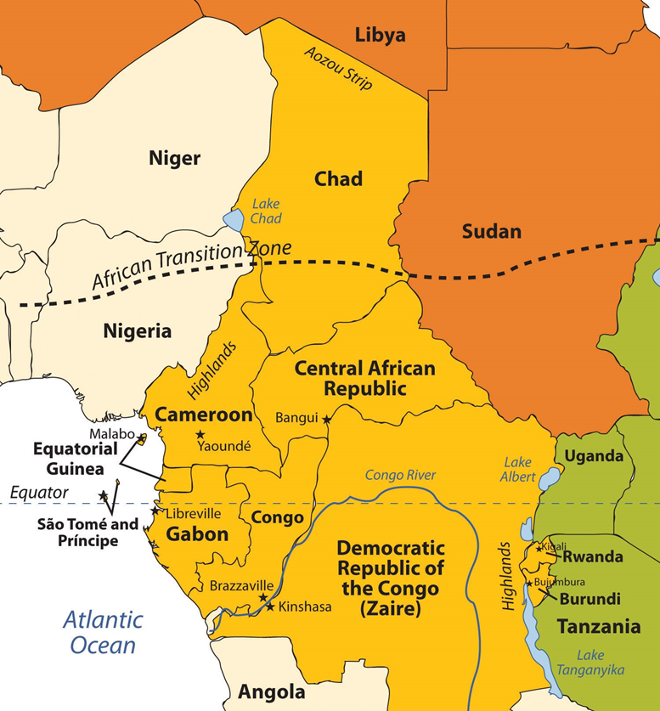
Central African countries
South Sudan
Now that Sudan has split into two countries, South Sudan should be included in this region

Slide 84
EQUATORIAL AFRICA - Regional Features
Dominated by Congo River and Basin
Equatorial rainforest
Impeded in transportation and communication
French is predominant in most states except Sao Tome and Principe
The most underdeveloped region in this realm
Resources
Copper (Democratic Republic of Congo)
Timber, oil (Gabon, Cameroon)
Gold, manganese and uranium

Slide 85
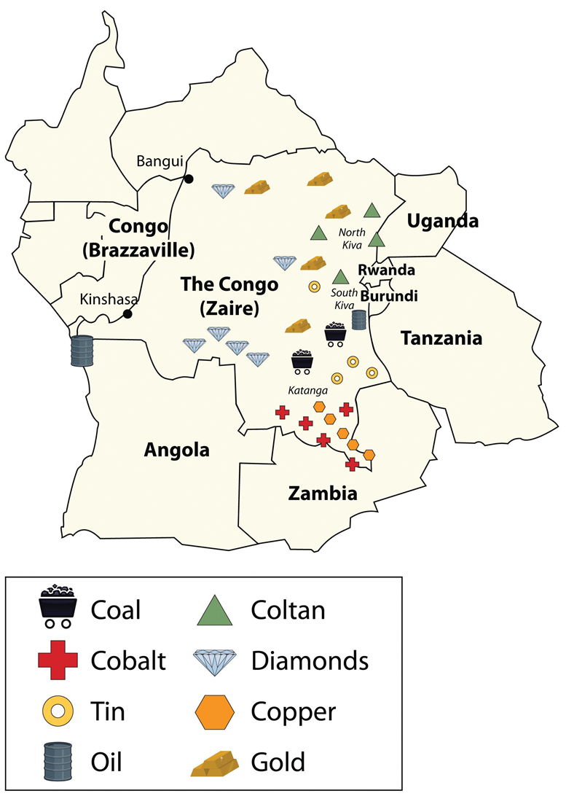

Generalizations
South Sudan
Wealth of resources
Democracy hasn’t done well
Intratribal hostilities
Congo (Zaire)
Rwanda
Rivers beset by waterfalls
Very heavy rainy season
Good breeding ground for insect disease vectors
Malaria
Yellow fever
Sleeping Sickness

Slide 86
The Congo: Largest area (U.S. east of Mississippi) and population (52 million)
Tiny coastline – almost a landlocked country
Congo river is beset with waterfalls which makes it less useful for transportation
Became and independent country with practically no experience or preparation for democracy or self-government
Civil War shortly after becoming independent early 1960s – Mineral rich Katanga tried to secede (site of copper mines)
Approximately 1995-96 struggle for power replaced one dictator with another

Slide 87
Congo’s Difficulties
Stability achieved after the civil war through dictatorship under President Mobutu – economic development lagged
Civil wars of the 1990s
Affected by Hutu/Tutsi ethnic war (Genocide) in Rwanda and Burundi
Many refugees entered northeast Congo (Zaire)
Tutsi supported Tutsi-related forces in eastern Zaire under Laurent Kabila took control of the government and renamed the country Congo
2001 – coup attempt resulted in Kabila being killed and his son named ruler

Slide 88

East africa

Slide 89


Beautiful Rift Valleys are where East Africa is separating from the rest of the continent

Slide 90

Excellent example of problems caused by European drawn boundaries

Slide 91
Eastern Highlands
Highlands of the east produce cooler & drier climate
Temperature seasons are more in evidence in the highlands (lowland tropics have seasons based on precipitation)
Savanna and steppe
Savanna – tall grasslands – big game country
Steppe – short grasslands transitioning into desert climate and vegetation

Slide 92
EAST AFRICA - Kenya
Dominant state in region
Capitalist approach to development
White citizens were promised fair treatment as citizens if they stayed and chose citizenship
Nairobi (2.6 million)
Coffee, tea, tourism revenues
Swahili is the lingua franca
1980s - world’s fastest growing populations
AIDS epidemic

Slide 93

South Africa

Slide 94

SOUTHERN AFRICA
10 countries: Northern and Southern Tiers
6 landlocked states
Northern zone marks limit of Congo basin
Plateau country
Rich in natural resources
Agricultural diversity

Slide 95
General Information
Physiography & Climate
Plateaus and “mountains”
The Great Escarpment
Does not have the volcanic activity that is present in East Africa
Cooler climate due to altitude and latitude – four-season climates found in the southern part
Most severe racial problems developed here

Slide 96
Urban Industrial South Africa
Most major cities in southern Africa have colonial origins
South Africa is the most urbanized country in the region
Apartheid – official policy of racial segregation that shaped cities and social relations in South Africa for nearly half century. Ended in the late 20th century
Coloured – South African term describing people of mixed African and European ancestry

Slide 97

Racial Segregation in Cape Town

Slide 98

SOUTH AFRICA: Perforated State

Slide 99

South Africa redesigned its internal provincial boundaries in 1994. The two large former provinces of Cape in the south and Transvaal in the north were divided up into seven smaller units. The province of Orange Free State was changed to Free State and
the province of Natal was changed to Kwazulu-Natal; both kept their main boundaries intact.

Slide 100
Conclusions
Problems lead to pessimism
Civil wars
Health problems
Poverty
Reasons for optimism
Large areas of land available for farming
Signs of declining birth rates
Some wars have ended
Improving infrastructure
To date, successful change in South Africa
End of Chapter 6: Sub-Saharan Africa

