Slide 1
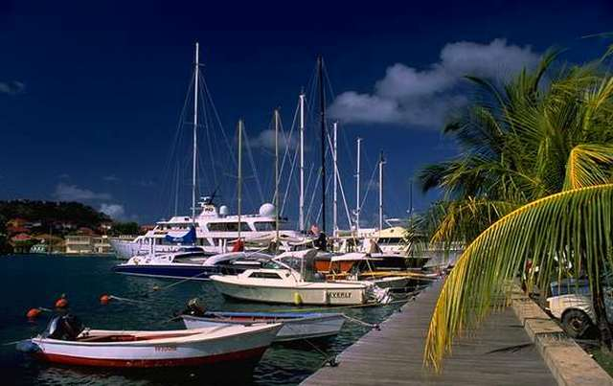
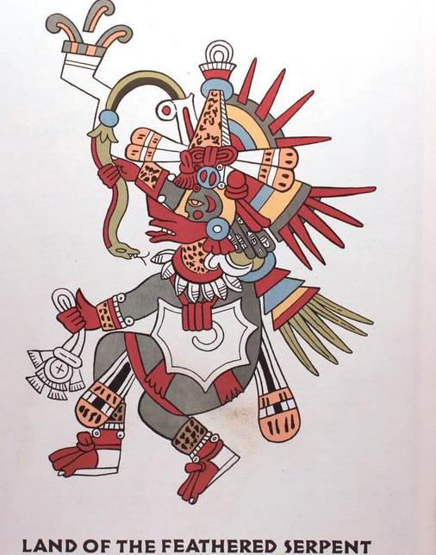
Chapter 5: Middle America
modified by Joe Naumann, UMSL

Slide 2
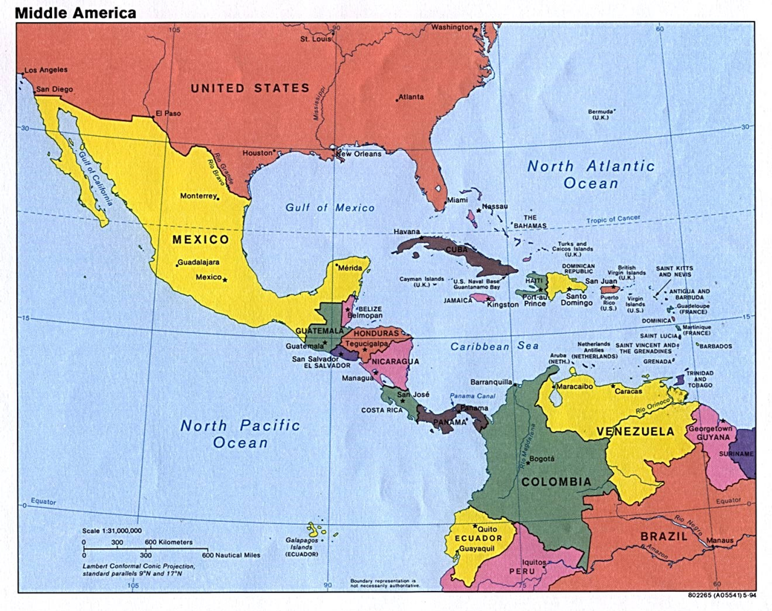

Slide 3
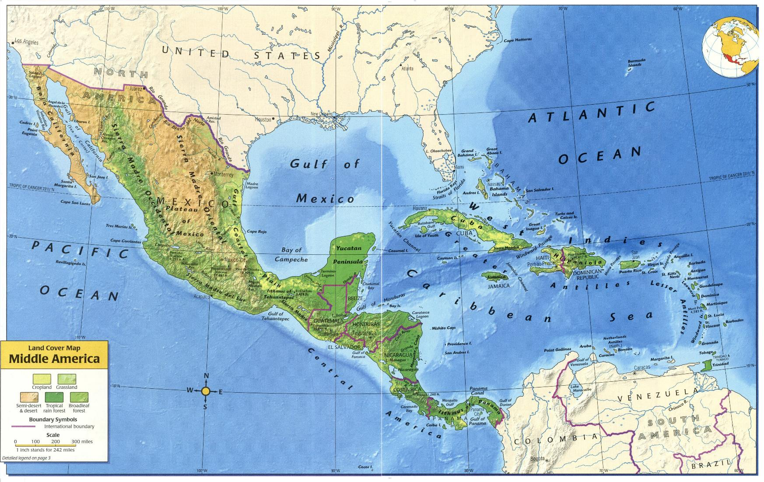

Slide 4
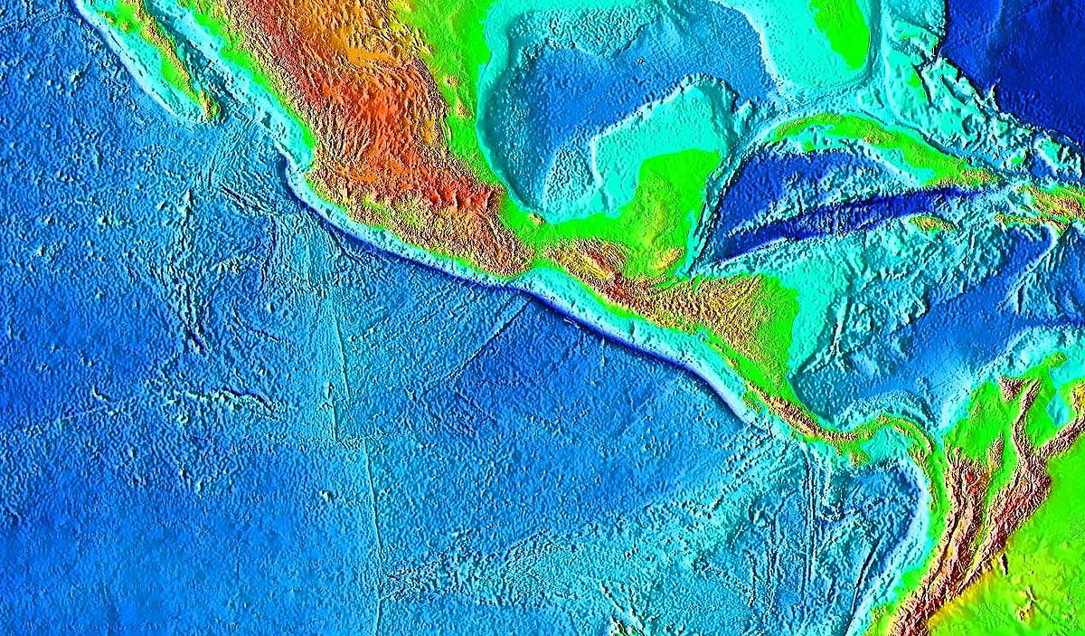

Slide 5
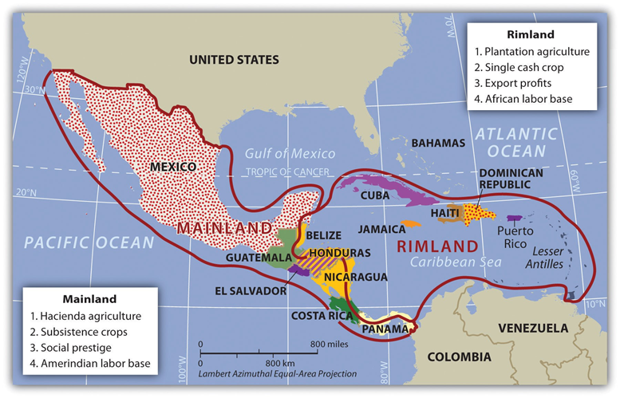

Slide 6

Learning Objectives
Compare and contrast two seemingly similar regions (Middle America & South America)
You should understand the following concepts and models
Plantation agriculture, “Plantation America”
“Brain drain”
Hurricanes
Maroons
Free trade zones
Offshore banking

Slide 7
Introduction
Middle America includes 32 countries and dependent territories, located on the mainland of North America and the Caribbean Sea
1st Europeans, then U.S., influenced the region
Plantation agriculture has been important – efforts to diversify, particularly in Costa Rica
High tech & eco-tourism (efforts to maintain the rain forest)
High population densities, environmental problems
Economy based on tourism, offshore banking, manufacturing, exports (e.g., flowers, coffee, bananas, tropical fruits, etc.)
Disparities in wealth

Slide 8
COLONIAL HERITAGE
BRITAIN
SPAIN
FRANCE

Slide 9
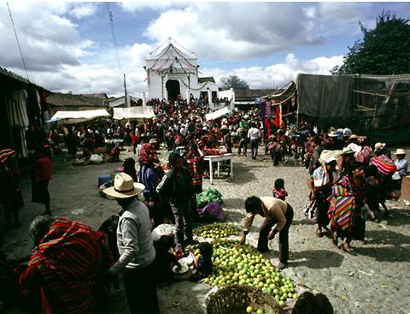
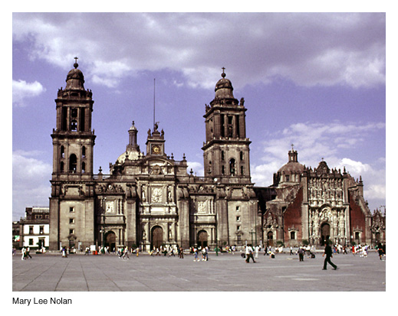
Mainland/Rimland:

Slide 10
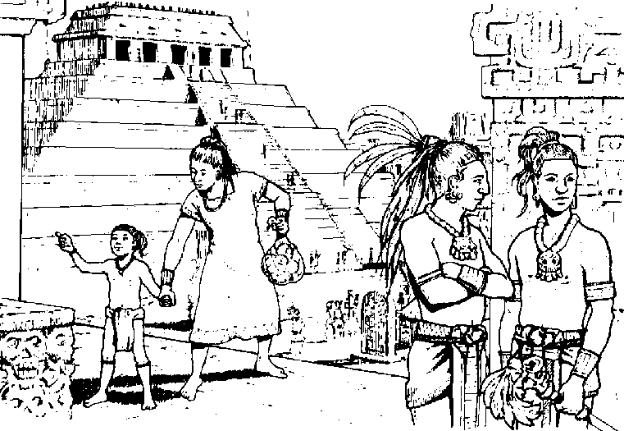
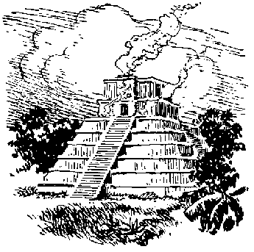
REGIONS OF MIDDLE AMERICA
Greater Antilles
Mexico
Lesser Antilles
Central America

Slide 11
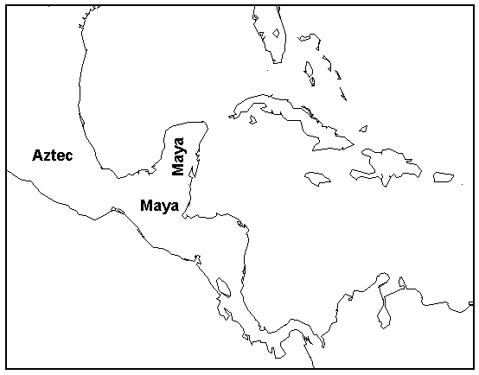
INDIAN CULTURE HEARTHS
SOURCE AREAS from which radiated ideas, innovations, and ideologies that changed the world beyond.
MA Hearths
Aztecs
Mayans

Slide 12

PHYSICAL GEOGRAPHY
LAND BRIDGE – Somewhat funnel shaped
ARCHIPELAGO – Chain or arc of islands
GREATER ANTILLES – 4 larger islands
LESSER ANTILLES – many smaller islands
NATURAL HAZARDS
EARTHQUAKES
VOLCANOES
HURRICANES
Realm ranks among the world’s most hazardous areas.
I wonder why?

Slide 13
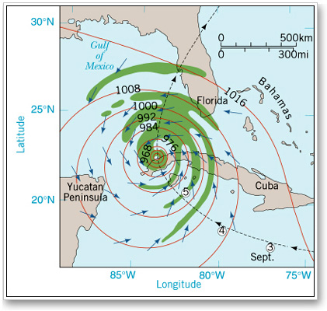
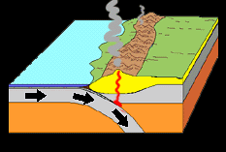
Middle America: Hazardous
One of the most hazardous areas in the world to live.
West Coast subduction zone
Active volcanoes
Earthquake prone
Tsunamis – coastal flooding
Caribbean Hurricane Prone
Wind damage
Flooding damage

Slide 14
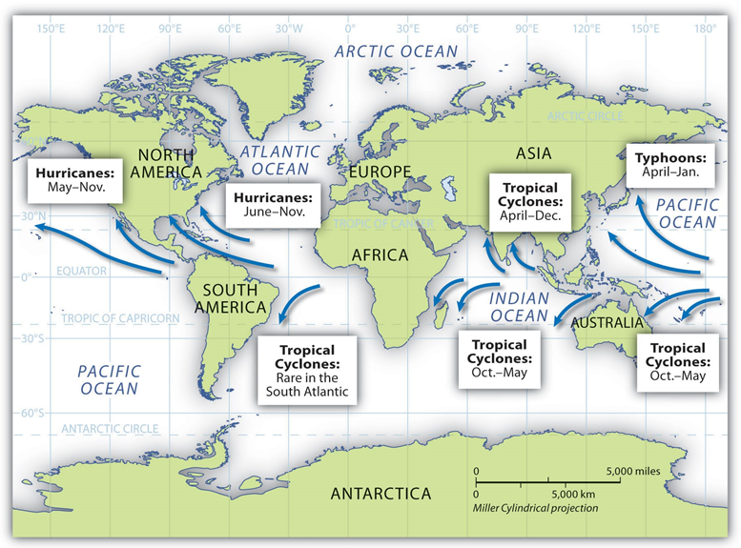
WORLD HURRICANE TRACKS They don’t just occur in the Atlantic, Gulf of Mexico, & Caribbean

Slide 15
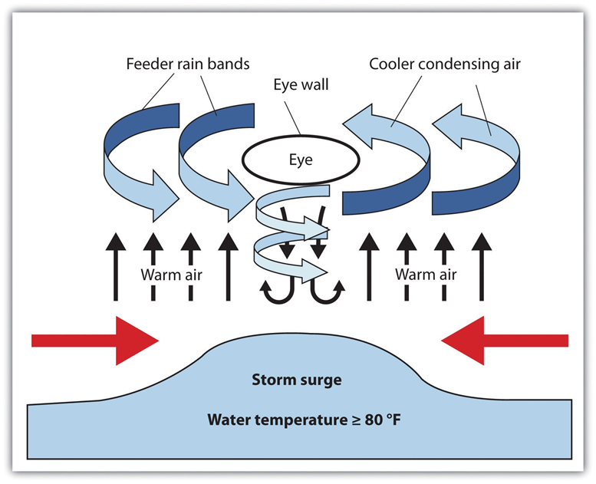
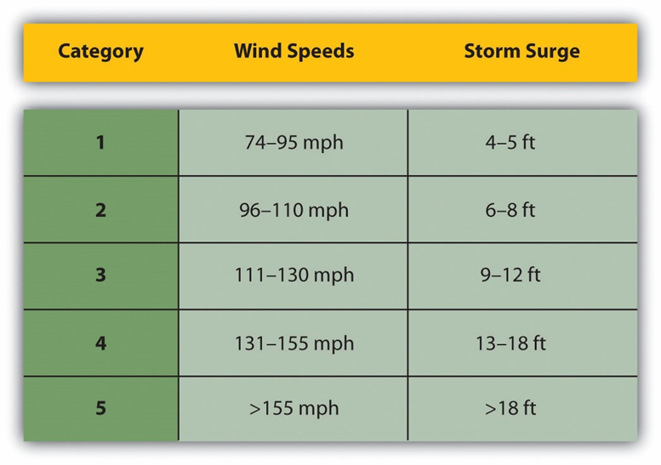
Mechanics
Categories

Slide 16
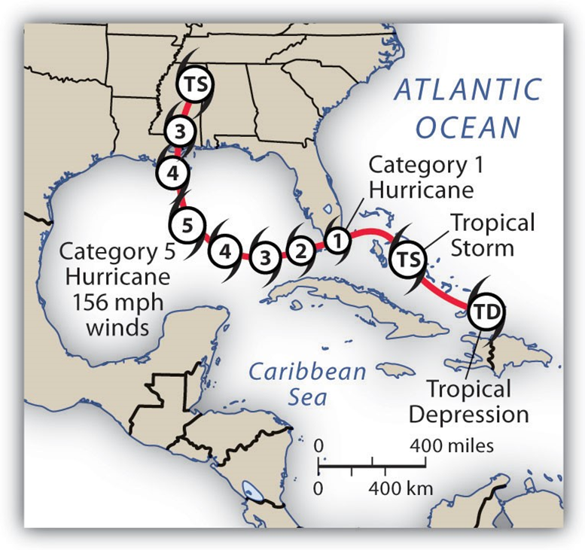
Finish
Start
TS
TD
1. Starts as a Tropical Depression (a low pressure system)
2. Passing over warn water (lowering pressure), the convectional updraft strengthens and the incoming winds circulate around the convectional updraft in the center.
3. The longer this cyclone travels over warm water, the stronger and more damaging it becomes
4. If or when the system reaches land its strength begins to drop back and it becomes less intense and is reduced to a tropical storm that continues to weaken and peters out if it remains over land.

Slide 17
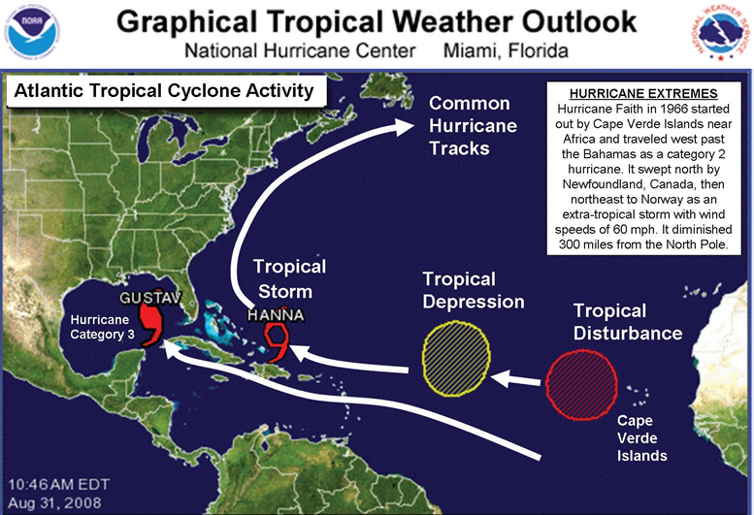

Slide 18
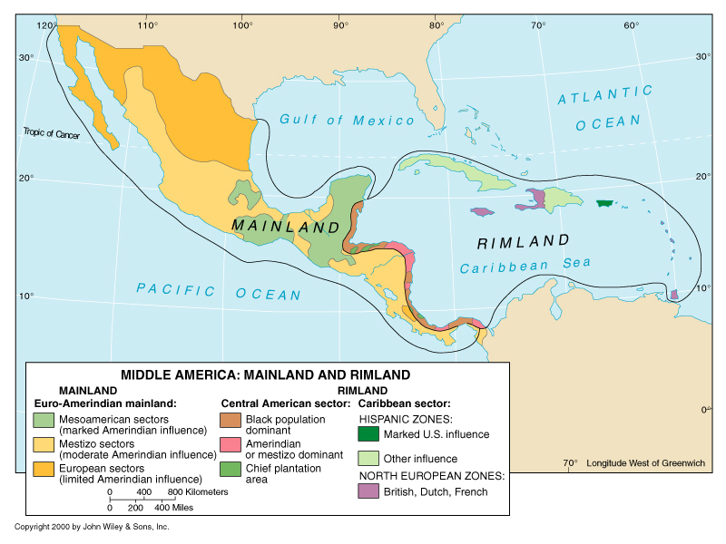
MAINLAND – RIMLAND DISTINCTION

Slide 19
MAINLAND/RIMLAND FRAMEWORK
MAINLAND -- Leading Spanish activity was in Central and southern Mexico
EURO-INDIAN INFLUENCE -- Mestizo
GREATER ISOLATION
HACIENDA PREVAILED (Feudal Structure)
Spanish interests largely on Pacific side, whereas Caribbean area (Rimland) was where countries competed for sugar cane producing land. – Spanish, French, Dutch, & British
Panama focus of attention for inter-oceanic contact

Slide 20
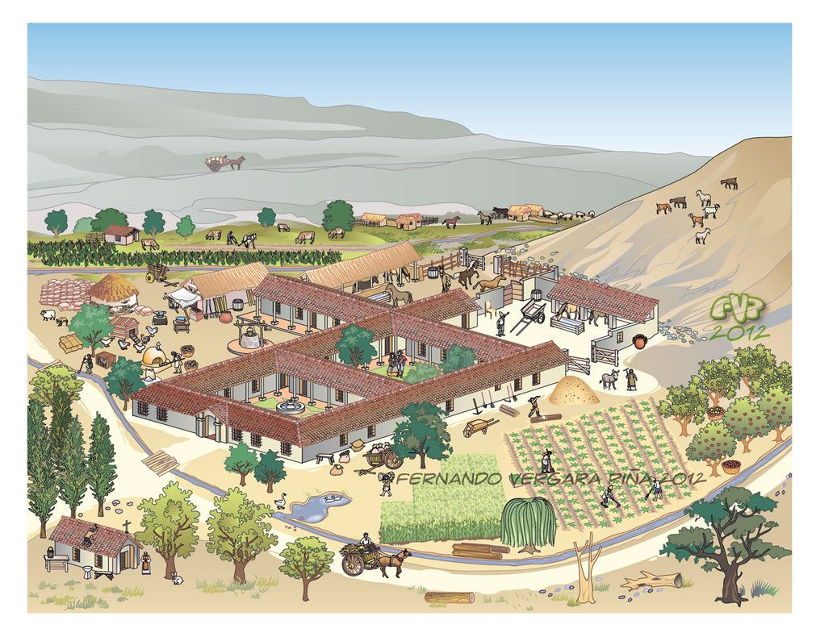
Hacienda

Slide 21
RIMLAND
EURO-AFRICAN INFLUENCE -- Amerindians died off and slaves were brought in
HIGH ACCESSIBILITY
PLANTATION ECONOMY – an export crop “factory” – sugar cane & bananas
Attracted foreign investment after independence – Plantations did not contribute to the self-sufficiency of the colony, country, area
Much competition for colonies before early 19th century – Spain, France, Britain, etherlands (Dutch)

Slide 22
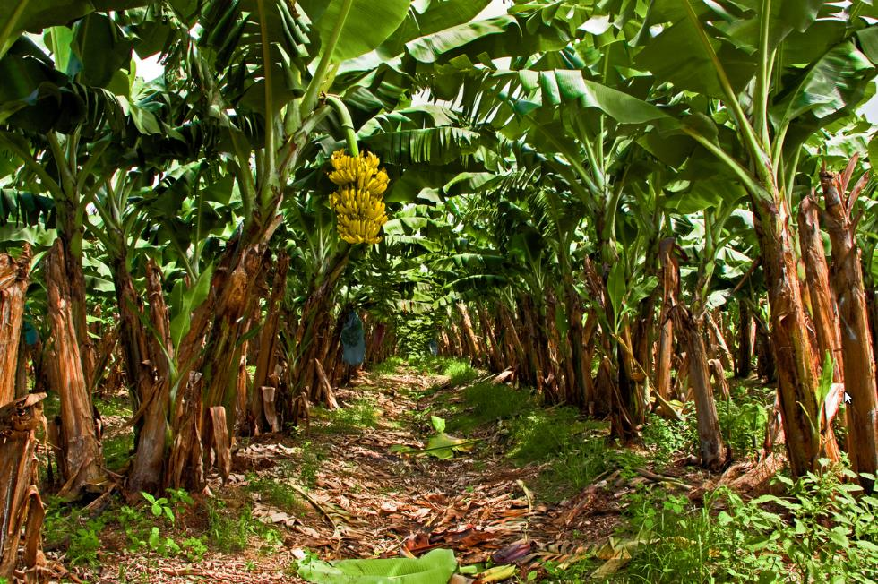
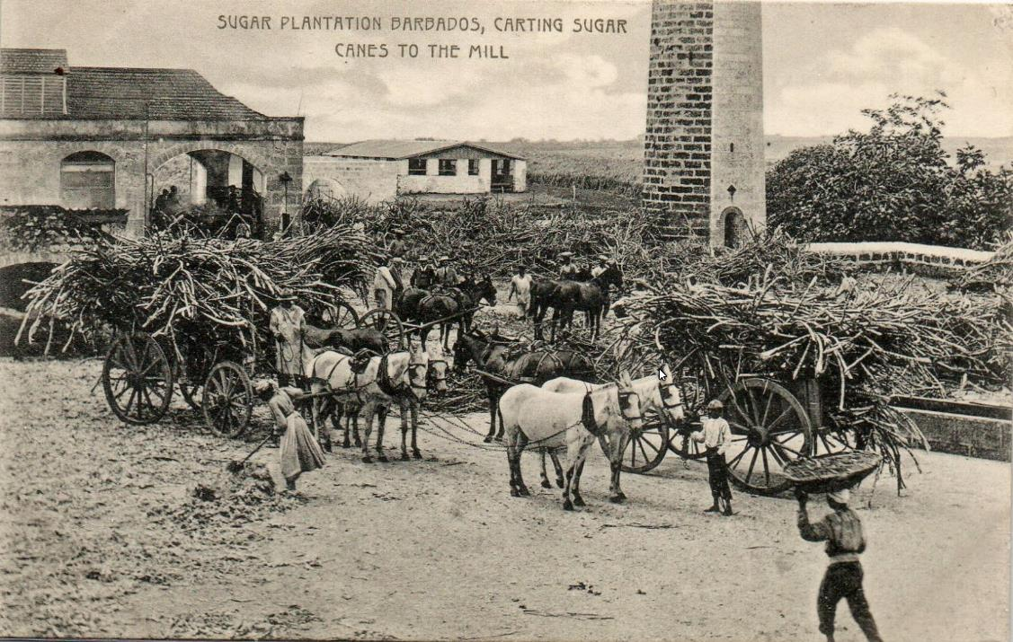
Plantations

Slide 23
MAINLAND vs RIMLAND
MAINLAND
RIMLAND
Location greater isolation greater accessibility
Climate altitudinal tropical
zonation
Physiography mountains islands & coastlands
Culture Euro/Indian African-European
Race Mestizo Mulatto
Landholding
Patterns haciendas plantations

Slide 24




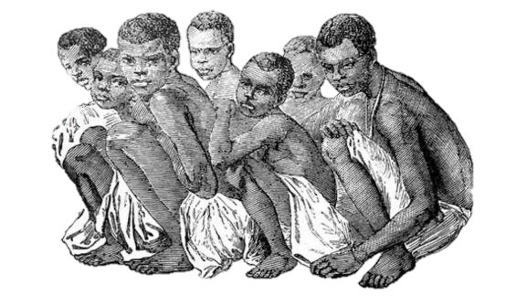

HACIENDA vs PLANTATION
HACIENDA
SPANISH INSTITUTION
NOT EFFICIENT BUT SOCIAL PRESTIGE
WORKERS LIVED ON THE LAND
SIMILAR TO EUROPEAN FEUDAL MANORS
PLANTATION
NORTHERN EUROPEAN ORIGINS
EXPORT ORIENTED MONOCROPS
IMPORTED CAPITAL AND SKILLS
SEASONAL LABOR
EFFICIENCY IS KEY

Slide 25
AGRICULTURAL INSTITUTIONS
Plantation (Rimland)
History of foreign owners
Production for export
Single cash crop
Seasonal Employment
Profit motive $$$
Market Vulnerability
“Banana” republics
Hacienda (Mainland)
Domestic market
Diversified Crops
Year round jobs
Pressure on large ones for land redistribution
Small plot of land
Self-sufficient

Slide 26
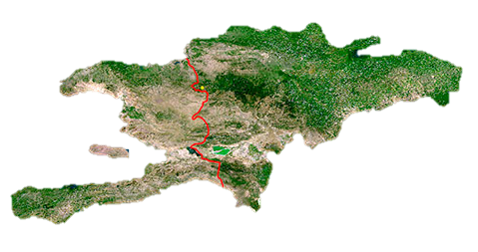
Paradise Undone
Isolated proximity: a concept used to explain Caribbean’s unusual and contradictory position in world
Isolation sustains cultural diversity (but limits economic opportunity)
Proximity to North America ensures transnational connection and economic dependence
Environmental Issues
Agriculture’s Legacy of Deforestation
Much rainforest cover removed after arrival of Europeans
Removed to grow sugar cane and to produce fuel to refine sugar
Often resulted in Erosion and ruined land
Haiti’s forests almost gone; 30% left in Jamaica and Dominican Republic; less in Puerto Rico and Cuba
Haiti
Dominican Republic

Slide 27
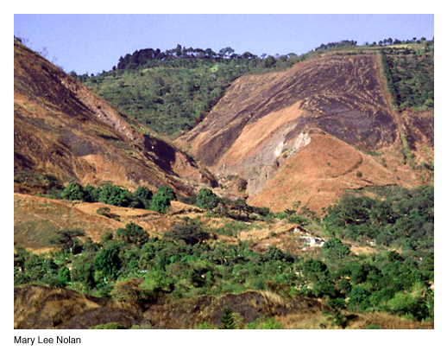
Erosion
Particularly bad in Haiti due to massive deforestation

Slide 28
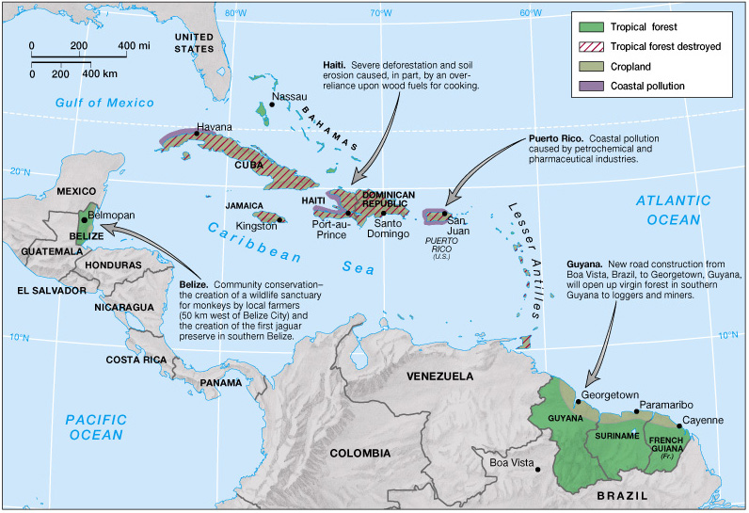
Environmental Issues in the Caribbean

Slide 29
Environmental Issues (cont.)
Managing the Rimland Forests
Rimland: coastal mainland, from Belize to S. America
This region less threatened, has more forests
Supports diverse wildlife
Protected by successful conservation efforts
Guyana conservation efforts less successful
Failures in Urban Infrastructure
Local environmental problems include water contamination and sewage disposal
Urban poor most vulnerable
Only 50% of Haiti’s population has access to clean water
A problem for public health (lives) and tourism ($)

Slide 30
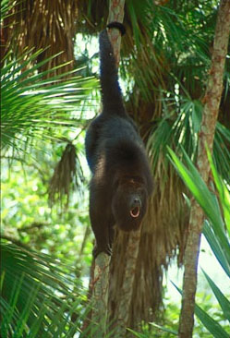
Tropical forests are immeasurably valuable treasures of the whole earth!
Click on the picture to see the video

Slide 31
Paradise Undone (cont.)
The Sea, Islands, and Rimland
The Caribbean Sea links the countries in this region
Greater Antilles
Four large islands of Cuba, Jamaica, Hispaniola (Haiti and the Dominican Republic), and Puerto Rico
Lesser Antilles
Double arc of small islands from Virgin Islands to Trinidad
Rimland States
Includes Belize and the Guianas on the South American coast
Still contain significant amounts of forest cover

Slide 32
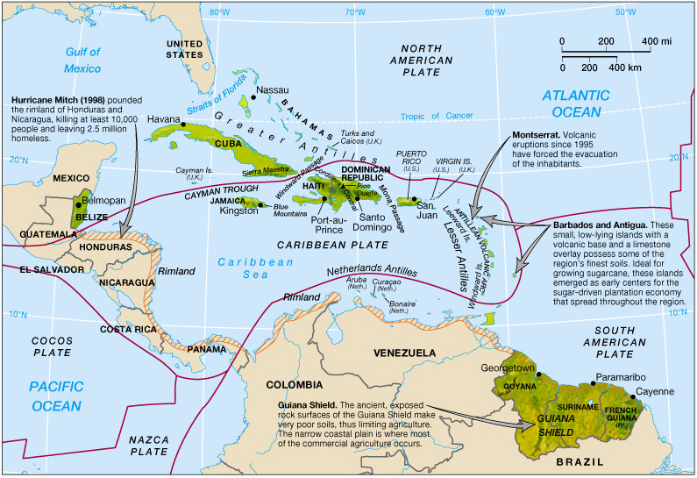
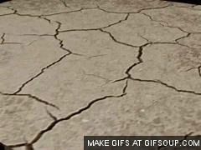

Physical Geography of the Caribbean
Tectonic plate boundaries (red lines) mean the area is subject to earthquakes and volcanoes.

Slide 33
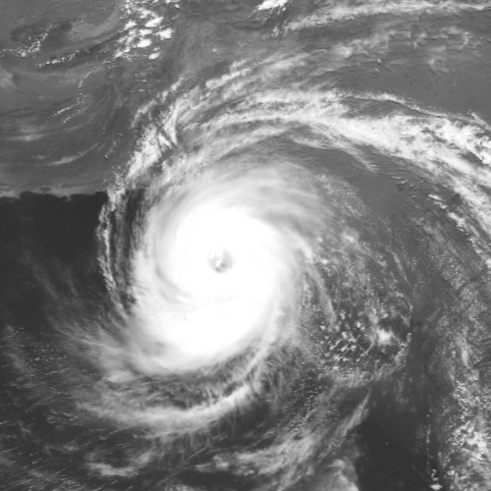
Paradise Undone (cont.)
Climate and Vegetation
Warm all year with abundant rainfall
Forests and naturally occurring grasslands in Cuba, Hispaniola, and Guyana
Seasonality determined more by rainfall, and less by temperature changes
Hurricanes
Storms w/heavy rains & fierce winds (> 75 miles per hour)
6 to 12 move through the region annually
Can have deadly consequences
Hurricane Mitch (1998) killed at least 10,000, was the most deadly tropical storm of the 20th century

Slide 34
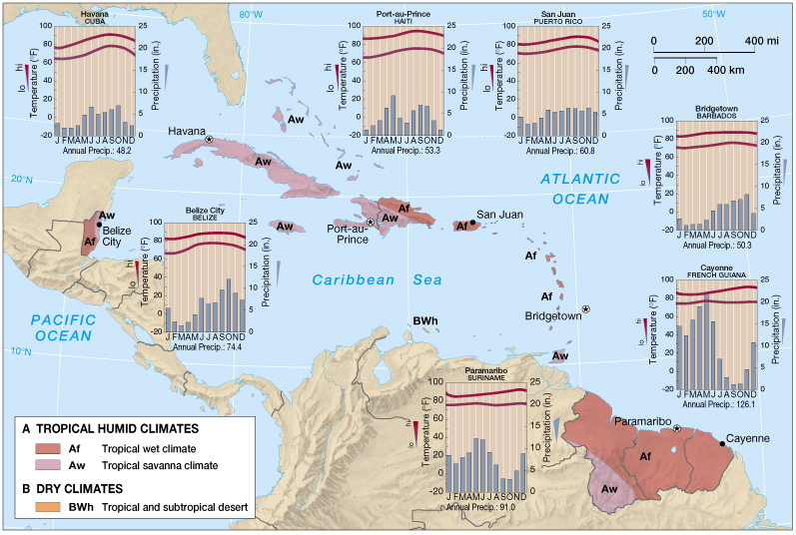
Climate Map of the Caribbean

Slide 35
Settlement:
86% of the region’s population is concentrated on the four islands of the Greater Antilles
Largest population in Cuba
Highest population density in Puerto Rico
Mainland territories are lightly populated
Demographic Trends
Region is currently growing at a rate of 1.3%
Fertility Decline
Cuba and Barbados have lowest RNI (rate of natural increase)
Education of women and out-migration responsible
The Rise of HIV/AIDS
Infection rate more than three times that of North America
More than 2% of the Caribbean population between ages 15 and 49 has HIV/AIDS

Slide 36
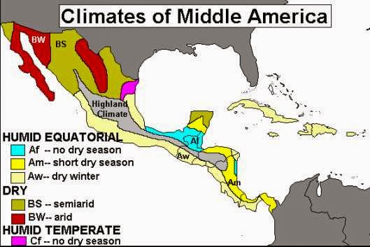

Slide 37
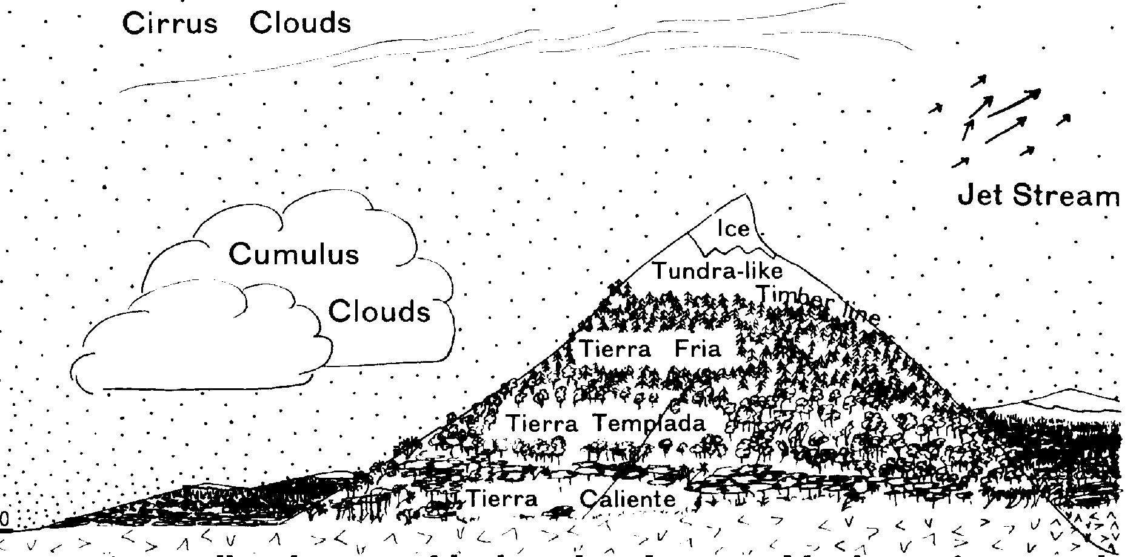
Altitudinal Zonation & Climate
Windward side will be wet and leeward side will be dry
Leeward
Windward

Slide 38
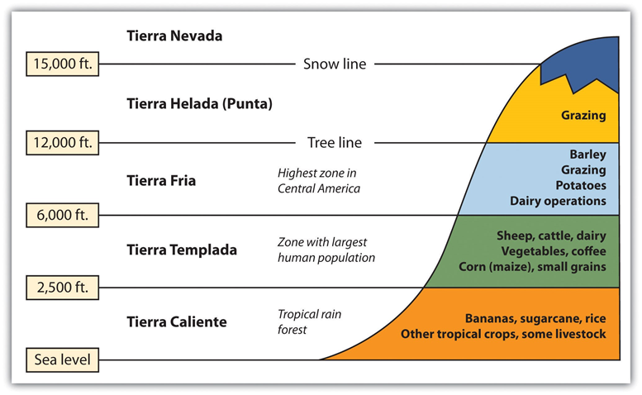
ALTITUDINAL ZONATION AND AGRICULTURE

Slide 39
Altitudinal Zonation
Elevation zones may vary depending on a particular location’s distance from the equator (latitude).
1. Tierra caliente (hot land): Sea level to 2,500 feet
2. Tierra templada (temperate land): 2,500 to 6,000 feet
3. Tierra fria (cold land): 6,000 to 12,000 feet
4. Tierra helada (frozen land): 12,000 to 15,000 feet
5. Tierra nevada (snowy land): Above 15,000 feet

Slide 40
Effects of Central America’s Mountains
Country | Population | Physiologic density
Guatemala | 12.3 million | 696.6 per sq. mi.
Honduras | 6.2 million | 539.1
El Salvador | 6.1 million | 1155.2
Nicaragua | 4.8 million | 157.2
Costa Rica | 3.5 million | 316.8
Panama | 2.8 million | 331.1
Belize | 240,000 | 451.2

Slide 41
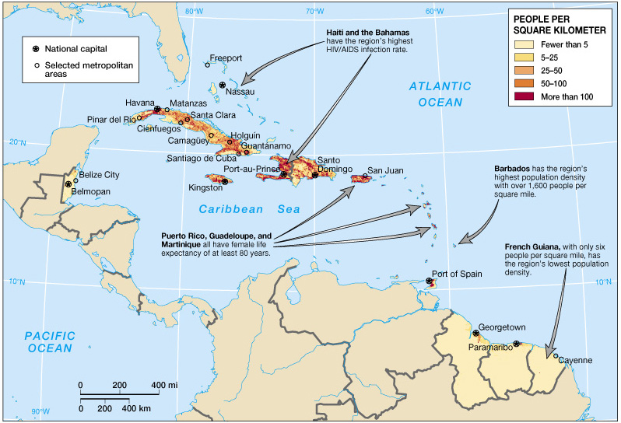
Population of the Caribbean (Fig. 5.9)

Slide 42
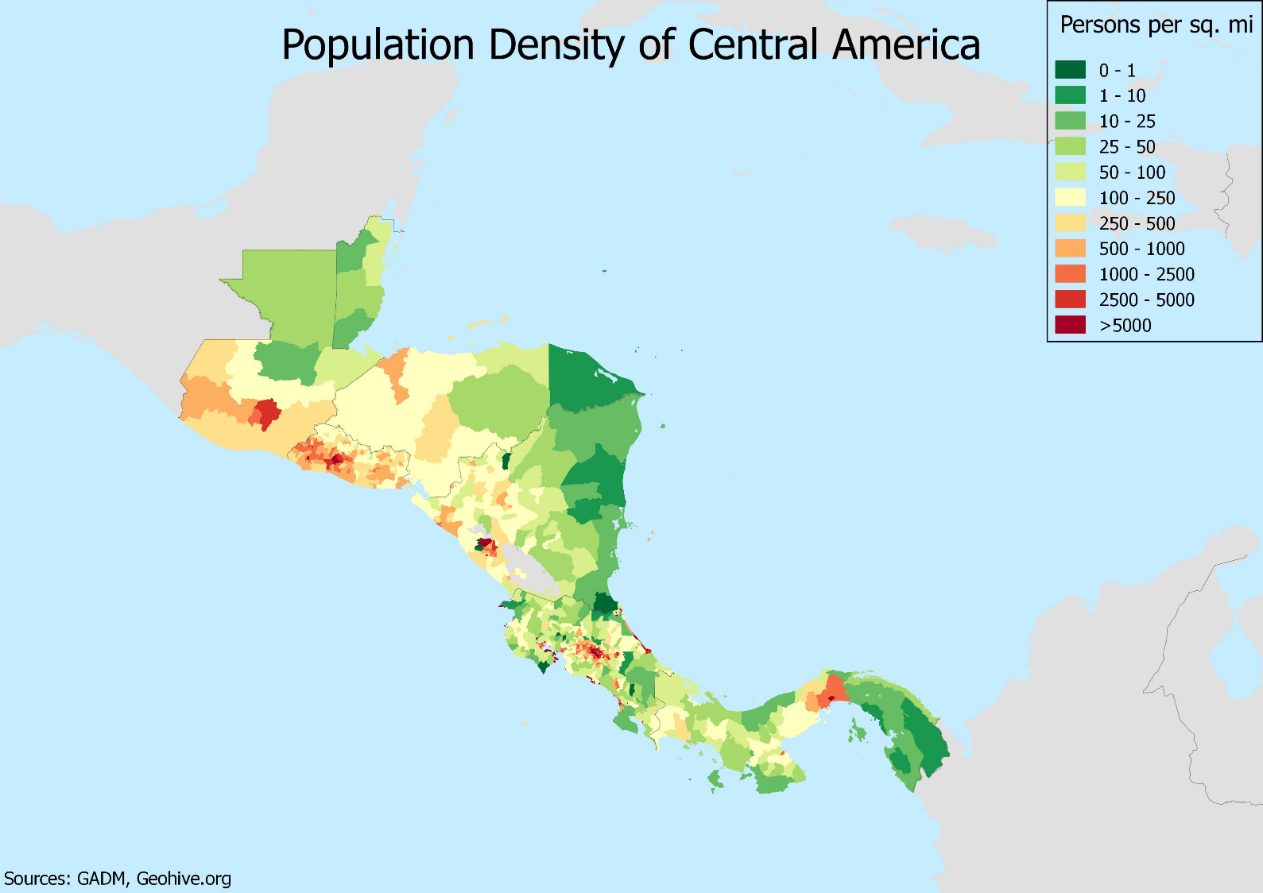
Why so dense here?

Slide 43
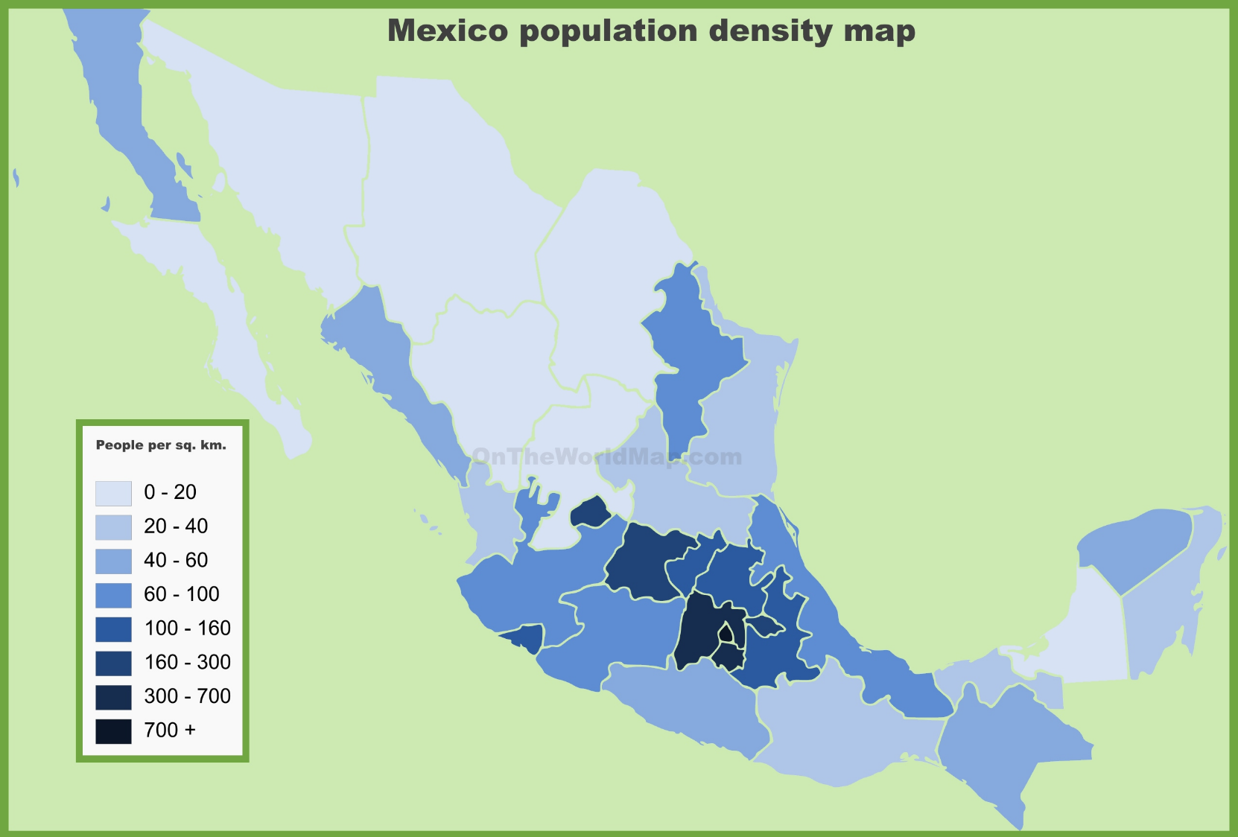

Slide 44
Population and Settlement (cont.)
Emigration
Caribbean diaspora: the economic flight of Caribbean peoples across the globe
Barbadians to England;
Surinamese to Netherlands;
Puerto Ricans, Cubans, and Jamaicans to U.S. (colonial link)

Slide 45
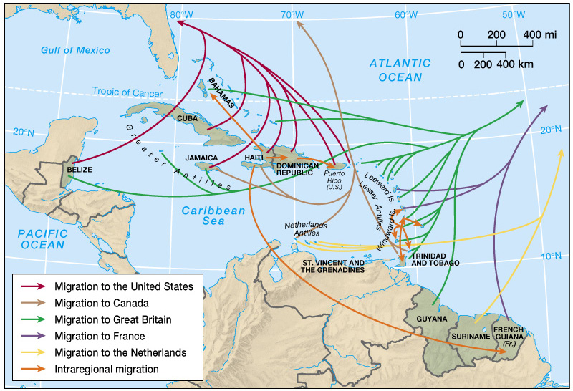


Caribbean Diaspora

Slide 46
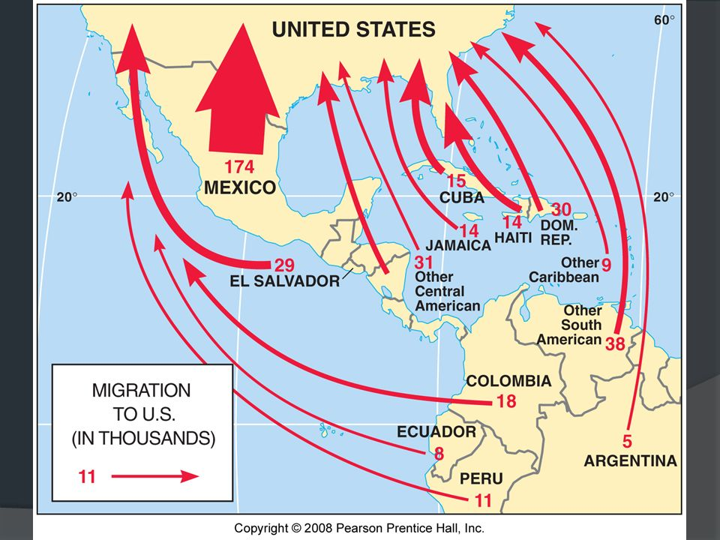

Slide 47
Settlement (cont.)
The Rural-Urban Continuum
Plantation & subsistence farming shaped patterns
Farmlands owned by elite; small plots for subsistence agriculture
No effort to develop major urban centers
Middle American Cities
Rural-to-urban migration since 1960s
Causes: mechanization of agriculture, offshore industrialization, and rapid population growth
60% of region today is classified as urban
Cuba most urban (75%); Haiti the least (35%)
Cities reflect colonial influences

Slide 48
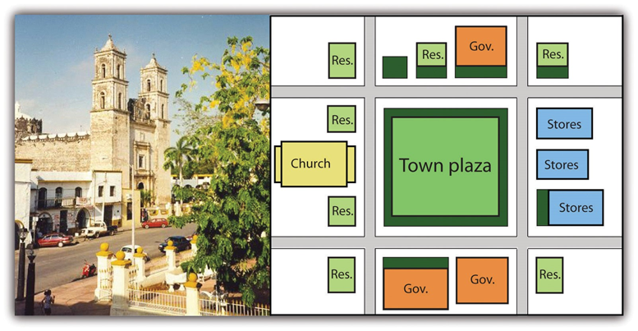
A trait passed down from the Roman Empire

Slide 49
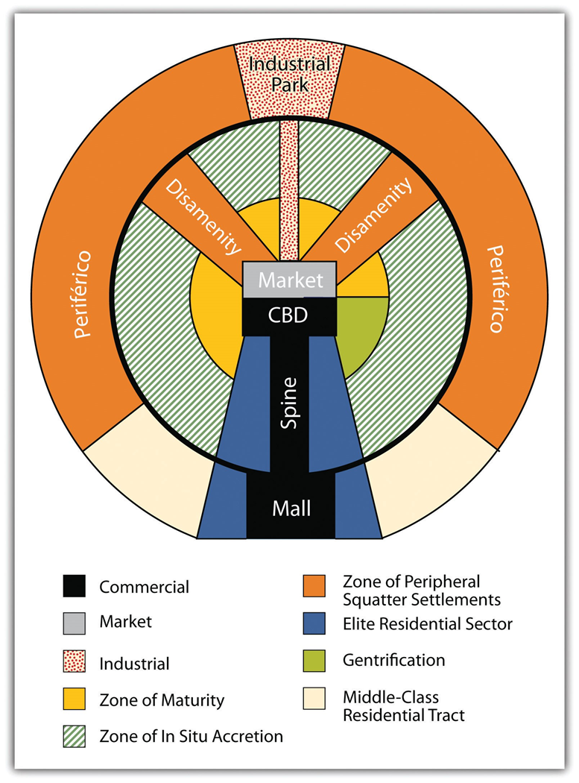
This is a model – real cities will deviate due to terrain and whether the city is on the coast or interior.

Slide 50
The Rural-Urban Continuum (cont.)
Housing
Decrease in urban jobs played a major role in the surge in urbanization
As urbanization occurred, thousands poured into the cities
Erected shantytowns; filled informal sector
Electricity pirated from power lines
In Cuba, government-built apartment blocks reflect socialism
Housing landscape homogeneity

Slide 51
A Neo-Africa in the Americas
Region is comprised of millions of descendants of ethnically distinct individuals (Africa, Asia, Europe)
Creolization – process in which African and European cultures are blended in the Caribbean
The Cultural Imprint of Colonialism
Plantation system destroyed indigenous systems and people and replaced them with different social systems and cultures through slavery
Plantation America
Designates cultural region extending midway up coast of Brazil through the Guianas & the Caribbean to S.E. U.S.
Characteristics include European elite ruling class dependent on African labor force
Mono-crop production: a single commodity, such as sugar

Slide 52
Cultural Diversity
The Cultural Imprint of Colonialism (cont.)
Asian Immigration
Result of colonial govts. freeing slaves by mid 19th cent.
Indentured labor: workers contracted for a set period of time
Largest Asian populations in Suriname, Guyana, Trinidad, and Tobago
> 1/3 of Surinamese population is South Asian (from India)
Creating a Neo-Africa
Beginning in the 16th century, African diaspora – forced removal of Africans from their native area
At least 10 mil. were brought to Americas, & 2 mil. died en route
Influx of enslaved Africans, plus elimination of most indigenous peoples

Slide 53
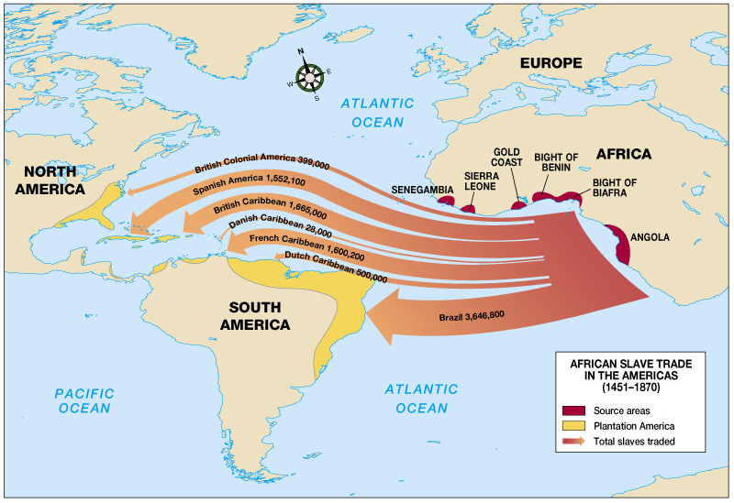

Slide 54
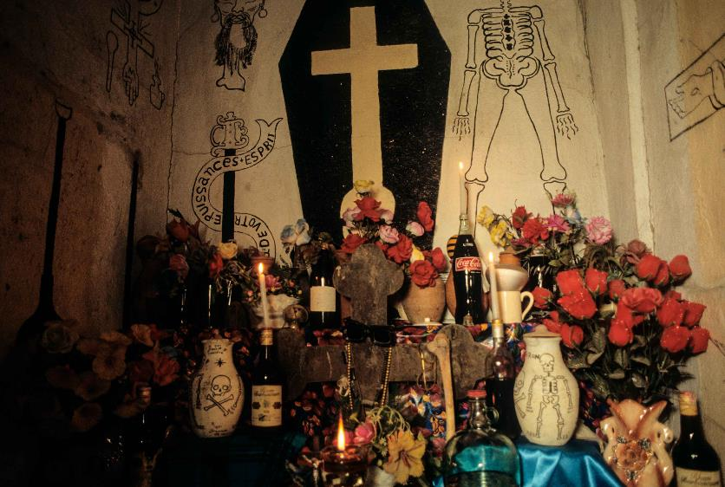
Cultural Diversity
Creating a Neo-Africa
Maroon Societies
Communities of runaway slaves (“Maroons”)
Many short-lived, but others survived and helped African traditions and farming practices to survive
In isolated areas, like Bush Negroes of Suriname
African Religions
Most strongly associated with northeastern Brazil and the Caribbean
Voodoo most widely practiced (syncretic)
Interbreeding = Garifuna

Slide 55
Cultural Diversity
Creolization and Caribbean Identity
Creolization: blending of African, European, Amerindian cultural elements into a unique system
Language
Spanish (24 mil.), French (8 mil.), English (6 mil.), Dutch (500,000)
In some places, new languages have emerged
Patois (French Creole) spoken in Haiti
Creole languages are an expression of nationalism
Music
Several forms emerged in the region
Reggae, calypso, merengue, rumba, zouk, Afro-Caribbean, others
Steel drums
Music of Bob Marley reflects Jamaica’s political situation

Slide 56
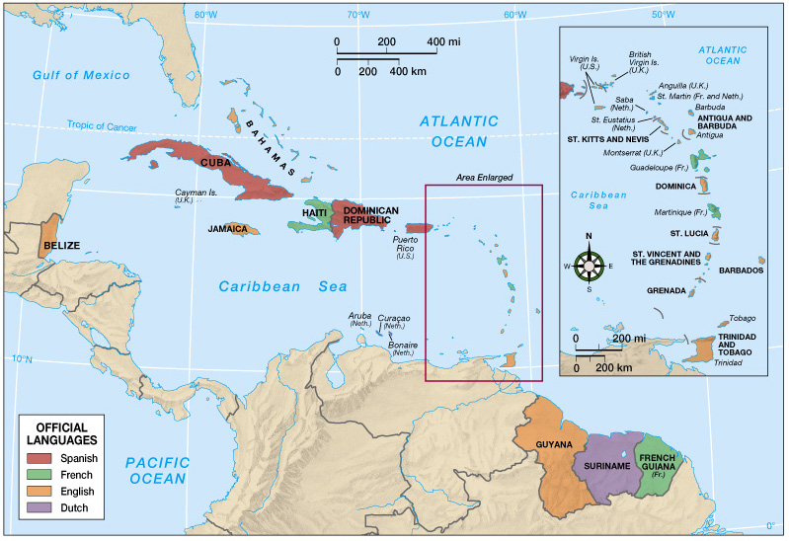
Caribbean Language Map

Slide 57
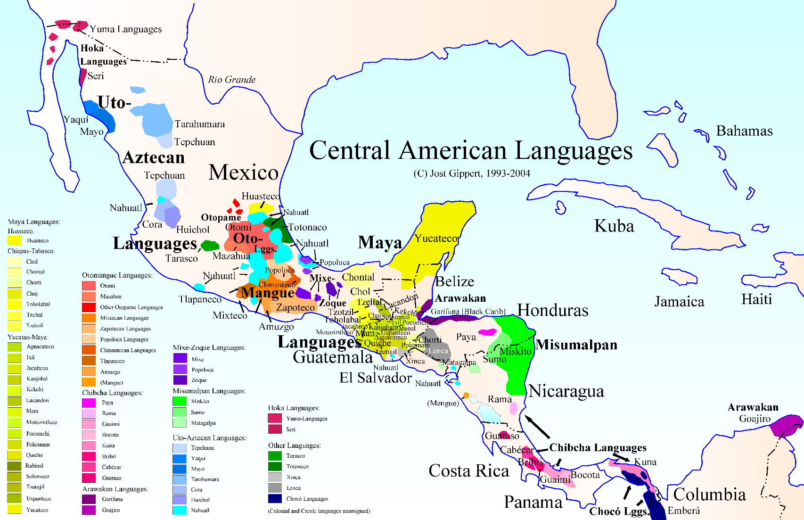
Official language is Spanish except in Belize it is English

Slide 58
Colonialism, Independence, & Neocolonialism
Monroe Doctrine: proclaimed U.S. would not tolerate European military involvement in Western Hemisphere
Example of neocolonialism: economic & political strategies that powerful states use to extend control over other, weaker states.
Instead, the US interfered in these countries
Life in the “American Backyard”
U.S. maintains a controlling attitude toward the Caribbean & imposes its will via economic and military force
Often designed to protect U.S. business interests, sometimes at the expense of local autonomy and democracy
Commonwealth of Puerto Rico
Commonwealth of the U.S., its people are U.S. citizens
Independence movements seek secession from U.S.
Reflected in protests on Vieques Island
Not treated fairly after Hurricane Maria

Slide 59
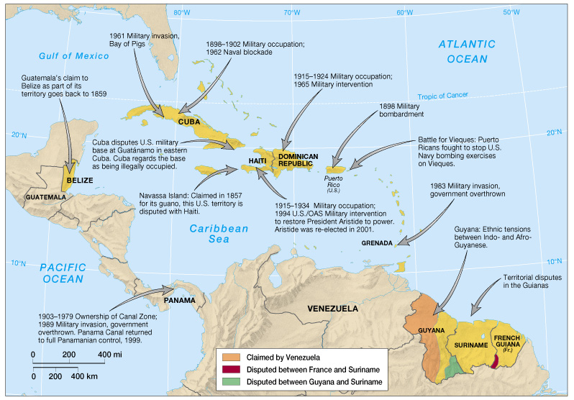
U.S. Military Involvement & Regional Disputes

Slide 60
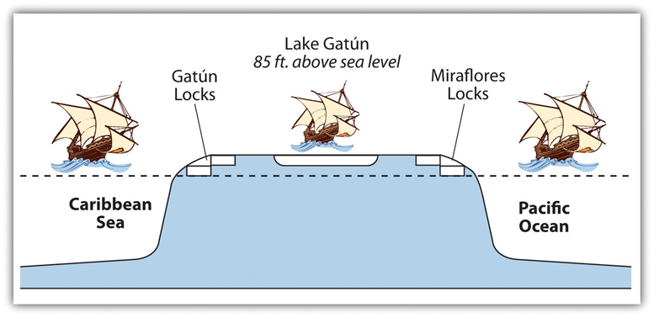
Panama Canal
Engineering Marvel that lowered the cost of shipping from Europe to the west coast of the Americas
By the late 20th century, the locks were not large enough for some commercial and military ships
Panama built and opened a third system of larger locks in the early 21st century
The nature of this system with fresh water in the middle prevents sea species from one side migrating to the other side. For ecological reasons, this ia good

Slide 61
Life in the “American Backyard”
Cuba and Regional Politics
Cuba began as a Spanish colony
Gained freedom in 1898
Revolution brought Fidel Castro to power in 1959
He nationalized economy and established ties with U.S.S.R.
Cuban Missile Crisis challenged U.S. Caribbean dominance
U.S. and Cuba still have a strained relationship - There were signs of some improvement before the Trump administration – it’s uncertain if that will continue.
Independence and Integration
Independence Movements
Haiti: slaves revolted, gained independence in 1804
Today, most Caribbean countries are independent

Slide 62
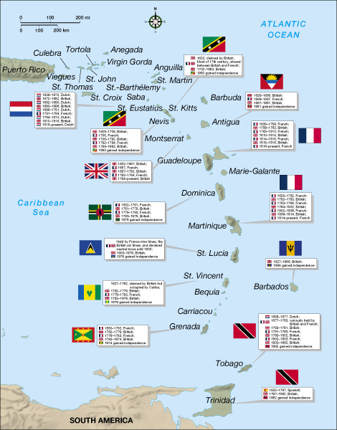
Colonial Holdings

Slide 63
Geopolitical
Independence and Integration (cont.)
Regional Integration
Beginning in the 1960s, experiments with regional trade associations to improve economic competitiveness
Caribbean Community and Common Market (CARICOM) – proposed regional industrialization and creation of Caribbean Development Bank to help poorer states
13 full members (former English colonies)

Slide 64
From Cane Fields to Cruise Ships
From Fields to Factories and Resorts
Historically linked to world economy through agriculture
Tourism, offshore banking, assembly plants more important now
Sugar
Crucial to the economic history of the Caribbean
Importance of sugarcane has declined somewhat
Since 1990 Cuban sugarcane harvest reduced by 50%
The Banana Wars
Major exporters are in Latin America (not Caribbean)
Several states in Lesser Antilles are dependent on banana production
Sales depend on trade agreements and consumer whims
Experiments with other crops to reduce dependency on bananas

Slide 65
From Fields to Factories & Resorts
Assembly-Plant Industrialization
Foreign companies invited to build factories
Free trade zones (FTZs): duty-free and tax-exempt industrial parks to attract foreign corporations
Companies may benefit more than host countries
Assembly plants found in major cities
Offshore Banking
Offers specialized services that are confidential and tax-exempt
Localities make money from registration fees, not taxes
Bahamas ranked 3rd in 1976, but now 15th
Proximity to U.S. is appealing
Attracts money from drug trade

Slide 66
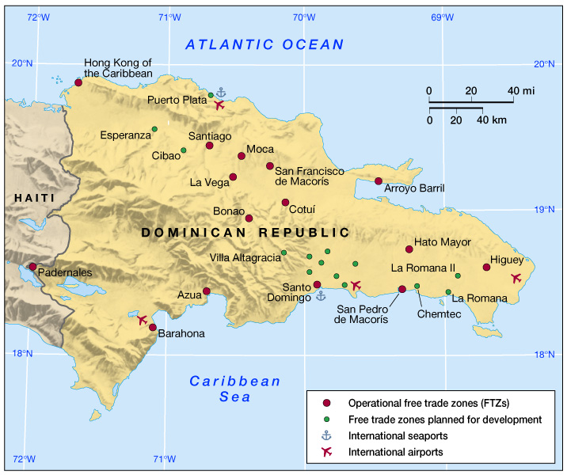
Free Trade Zones in the Dominican Republic

Slide 67
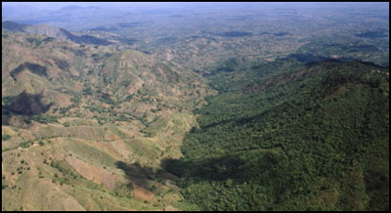
Border between Haiti and the Dominican Republic

Slide 68
Economic and Social Development (cont.)
Tourism
Cuban role as tourist destination stopped with the rise of Castro
Beginning to reopen
Other islands now popular
Five islands hosted 70% of the 14 million tourists who came to the region in 1999 (Puerto Rico, Bahamas, Dominican Republic, Jamaica, Cuba)
Tourism is dependent on overall health of world economy and is vulnerable to natural disasters
Capital leakage: serious problem involving huge gap between gross receipts and total tourist dollars that remain in Caribbean
Many corporate headquarters outside of the region, and profits flow out of the host country

Slide 69
Mexico/NAFTA

Slide 70
NAFTA
Effective 1 January 1994
Established a trade agreement between Mexico, Canada and the US, which:
Reduced and regulated trade tariffs, barriers, and quotas between members
Standardized finance & service exchanges
May expand membership
2017-18 President Trump threatens to withdraw from the treaty – renegotiates some points. He’s also rude and offensive to the government of Mexico

Slide 71
MAQUILADORAS
Ciudad
Juarez
Tijuana
Nogales
Chihuahua
Reynosa
Matamoros
Monterrey

Slide 72

NAFTA and Maquiladoras

Slide 73
MAQUILADORAS
Initiated in the 1960s
Assembly plants in Mexico that pioneered the migration of industries in the 1970s
Today
>4,000 maquiladoras
>1 million employees

Slide 74
MAQUILADORAS
Modern industrial plants
Assemble imported, duty-free components/raw materials
Export the finished products
Mostly foreign-owned (U.S., Japan)
80% of goods reexported to U.S.
Tariffs limited to value added during assembly

Slide 75
MAQUILADORAS
Maquiladora products
Electronic equipment
Electric appliances
Auto parts
Clothing
Furniture

Slide 76
MAQUILADORAS
ADVANTAGES
Mexico gains jobs & Mexican workers have more money to spend on both Mexican and U.S.-made products.
Foreign owners benefit from cheaper labor costs.
EFFECTS
Regional development
Development of an international growth corridor between Monterrey and Dallas - Fort Worth

Slide 77

MEXICO AND NAFTA
Foremost, it promises a higher standard of living – more people with higher incomes may also buy more U.S. products.
NAFTA creates more jobs for Mexicans as US companies begin to invest more heavily in the Mexican market.
Mexican exporters increase their sales to the US and Canada.
Is that the entire story?
Effect of Trump negotiations?

Slide 78



Slide 79


Slide 80
WAGE RATES COMPARED
$20.21
$25
$17.38
$20
$15
Mexico
$10
U.S.
$1.55
$2.87
$5
$0
Assemblers
Skilled Labor
History shows that over time, wages will increase in Mexico, closing the gap somewhat

Slide 81


Slide 82


Slide 83

Population pyramids for Mexico in 1980 and again in 2010. The 1980 pyramid indicates rapid population growth. The 2010 pyramid illustrates a slight decline in the past few years.

Slide 84

Opportunities and advantages drive the push-pull of migrants searching for improved economic conditions.
Still uncertain what the total effect of the Trump administration will be.

Slide 85

Slave labor was prominent during European colonial era, whereas cheap labor is the target in neocolonial activity—that is, corporate colonialism.

Slide 86

Drug Problem

Slide 87
Important Recent Developments
Mexico’s “one-party democracy” seems to have ended – Presidente Fox of PAN
Presidency has switched between parties several times peacefully since the first time with fox
Democratically elected governments in all countries except Cuba –
even in Cuba communism is changing due to the loss of Soviet/Russian financial assistance
When Castro retired there was greater change – i.e., the Pope’s visit would have been unheard of 20 years ago
One can even see the possibility of the resumption of U.S. diplomatic relations on the horizon\
Some tourism has resumed

Slide 88
Nicaragua/Iran-Contra

Slide 89
Very Brief History - Post-Colonial
Independence (1821) – land, economic, and political power held by Blancos
United States occupation (1909–33)
To protect US citizens and business interests (bad policy used many times in this realm – fostered distrust of the US that still lingers
Helped the Somoza family rise to power and begin a dynastic dictatorship
Somoza dynasty (1927–1979)
Nicaraguan Revolution (1960s–1990)
Leftist Sandinista gain control (US not happy with that}
Contras opposed the Sandinista (Reagan Administration illegally aided the Contras with money obtained from illegal sales of weapons to Iran)
Post-war (1990–present)
Democratic elections 1990-2006
2006, Daniel Ortega won (Sandinista) – now in his 3rd term – is dictatorship returning?

Slide 90

Illegal action taken by the Reagan Administration

Slide 91
Panama and the Panama Canal

Slide 92
Brief History of US Involvement
Colombia and the US were unable to agree on a treaty for building a canal through Panama
Panama seceded from Colombia with US help 1903.
Unfair (to Panama) treaty allows US to lease the canal zone forever with a fixed rent.
Recognizing the unfairness of the fixed rent, the US reluctantly agrees to increase the rent payment several times in the approximately 70 years the US operated the canal.
President Jimmy Carter agrees to end the lease and return full control of the Panama Canal Zone to Panama in 1977. Many US citizens thought Carter had given away US property. When one leases something, one can use it but does not own it. The US leased the canal zone, It never owned it!
1989, Pres. Bush sent troops to Panama to capture its president, Manuel Noriega. Took him to US and tried him for drug crimes. Noriega was convicted and sentenced to prison.

Slide 93
Economic and Social Development in Middle America
Social Development
Overall improvements socially, but Haiti still in bad shape
Education
Low illiteracy in Cuba and former English colonies
Brain drain: a large percentage of the best-educated people leave the region
Status of Women
Many men leave home for seasonal work
Women control many activities, but lack status of men
Labor-Related Migration
Intra-regional, seasonal migration is traditional
Remittances – monies sent back home

Slide 94


Developing countries seek a bigger and better “piece of the pie”
Banana plantations are declining in importance in Costa Rica, whereas there are growing numbers of workers in high-tech fields and tertiary and quaternary activities.

Slide 95

Global Linkages: International Tourism

Slide 96
End of Chapter 5: Middle America
Conclusions
The Middle America is better integrated into the global economy than most of the developing world
The European influence in this region is still apparent in the economic and urban systems of the realm
Although agriculture was an important part of the region’s economic development, today industrialization, banking and tourism are the major sources of development

