Slide 1
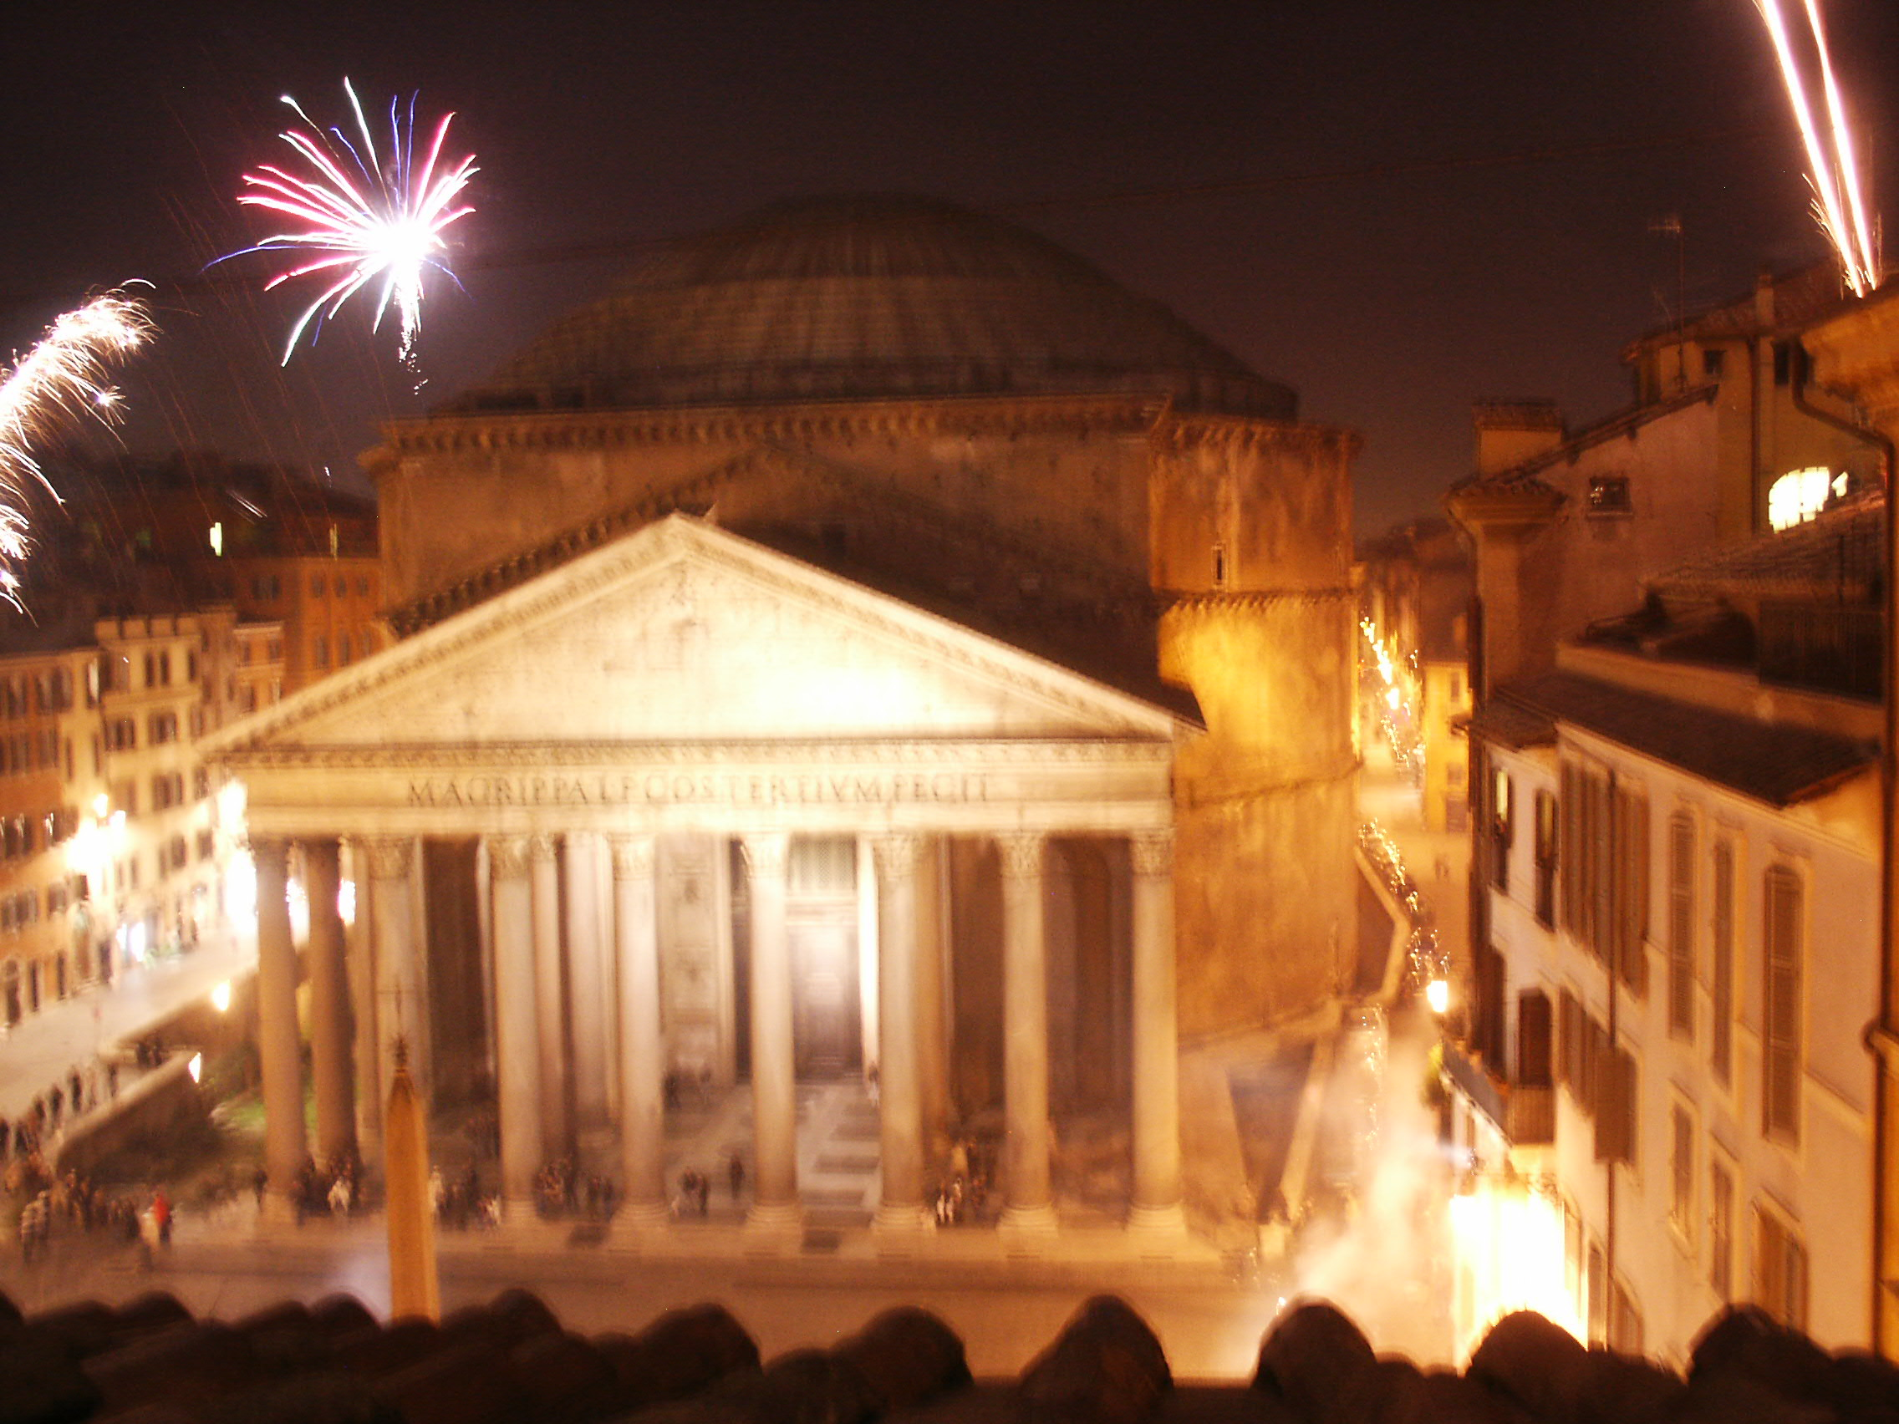
Europe – Chapter 2
Modified by Joe Naumann, UMSL

Slide 2
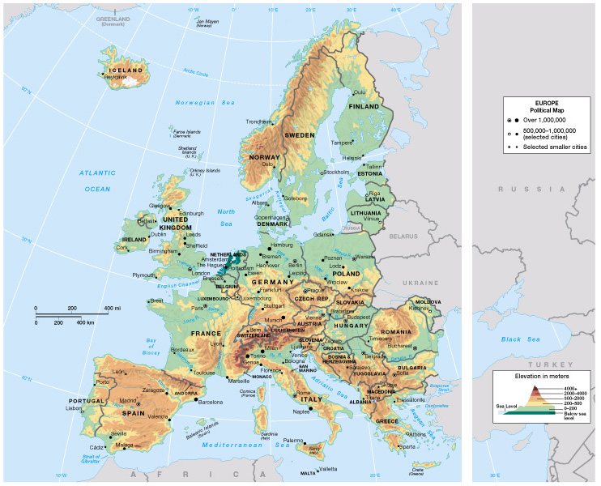
Chapter 2:
Europe

Slide 3
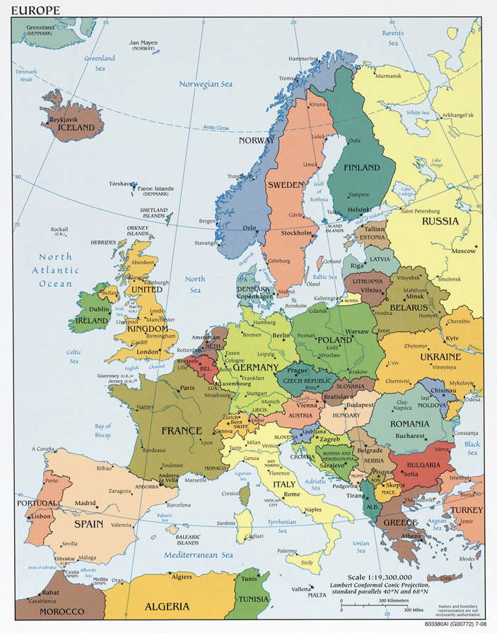

Slide 4
Learning Objectives
Learn about supranationalism in Europe
Understand the nationalism that has thrown the region into armed conflict many times
Understand the formation of the European Union, and the evolution of a common currency, the euro
Become familiar with the locational, physical, demographic, cultural, political, and economic characteristics of Europe
Understand these concepts and models:
Balkanization
Cold War
Command Economy
European Union
Feudalism
Hierarchical Diffusion
Privatization
Secularization

Slide 5
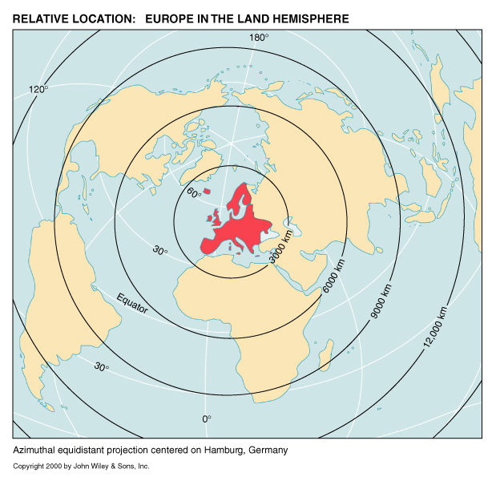
Centrality
Many advantages to a central location
Helps:
Panama Canal -H
Suez Canal -H
Strait of Malacca -N
Arctic Ocean - GWH
H – human construction
N – condition of nature
GWH – Climate change accelerated by humans

Slide 6
Introduction
Europe is diverse
  Different climates, landforms, agricultural output
  37 different countries
  Many different languages and cultures
  Long history of warfare, mostly along national lines
  Europe is globalizing, was a major colonial power
  European Union, a supranational organization
  Yugoslavia, Czechoslovakia broke up; Germanies reunited
  Cradle of the Industrial Revolution
  Center of 19th century imperialism

Slide 7
The European Realm (culture region)
Defining the Realm largely a realm which has been highly influenced by “Western Culture” (the result of classical civilizations, Christianity, the Renaissance & Reformation, the Enlightenment, and the Industrial and Scientific Revolutions). It was the first to enter the industrial revolution which has greatly altered many kinds of relationships in the world. The various countries within the realm have a history of interaction among themselves.

Slide 8
Environmental Geography:
Human Transformation of a Diverse Landscape
explain Four factors Europe’s diversity
  Complex geology with newest and oldest formations (Physical Place)
  Latitudinal extent (from Arctic to Mediterranean Subtropics) (Relative and Absolute Location)
  Modification of latitudinal controls by land and water interaction (Physical Place)
    Marine (maritime) influence
    Continental influence (Continentality)
  Thousands of years of humans living there caused changes (Human-Environment Interaction)

Slide 9
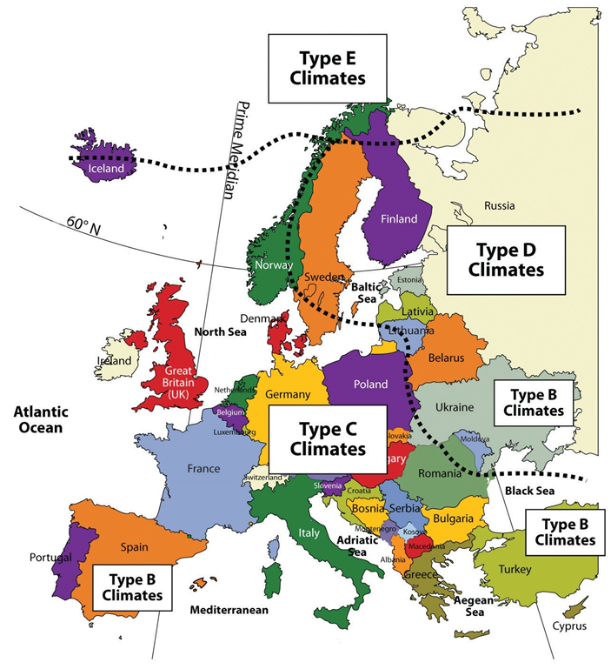
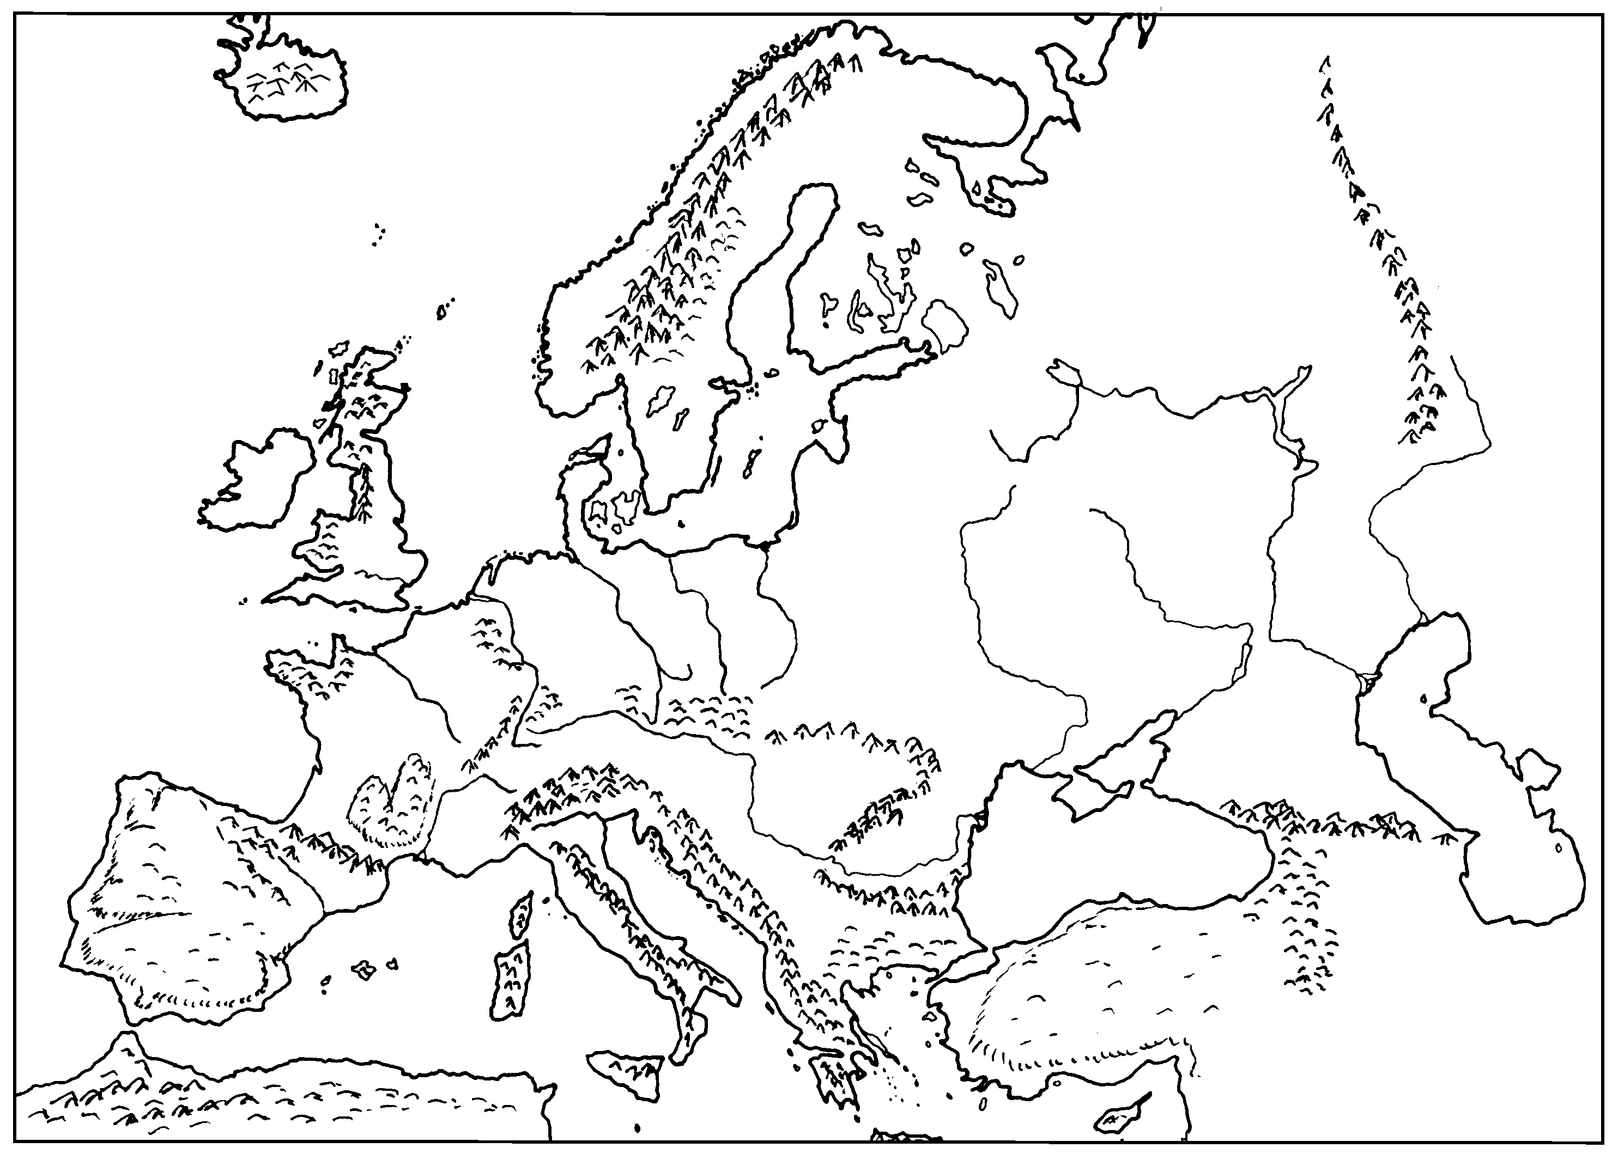
The red arrows show the North Atlantic Drift (strong, warm ocean current) which moderates the climates of western Europe

Slide 10
Europe’s Climates
  Climates moderated by North Atlantic Current (a warm water current from N America’s Gulf Stream)
  Europe has 3 climate types
    Marine west coast climate – no winter months average below freezing, but cold rain, snow are common; summers often cloudy with frequent drizzle and rain (e.g., Ireland)
    Continental climates – hotter summers, colder winters, 1-2 months average below freezing; rainfall adequate for farming
    Mediterranean climate –dry summer season, drought possible, irrigation is common for farming

Slide 11
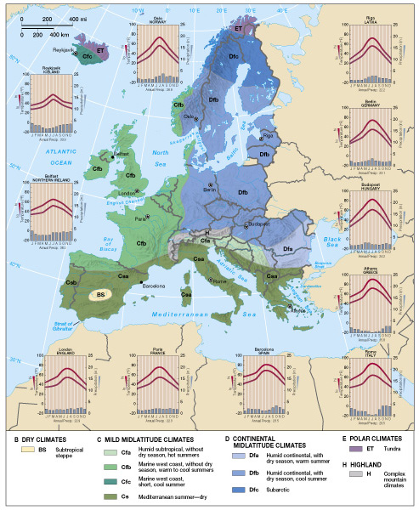
Europe’s
Climate
Map

Slide 12
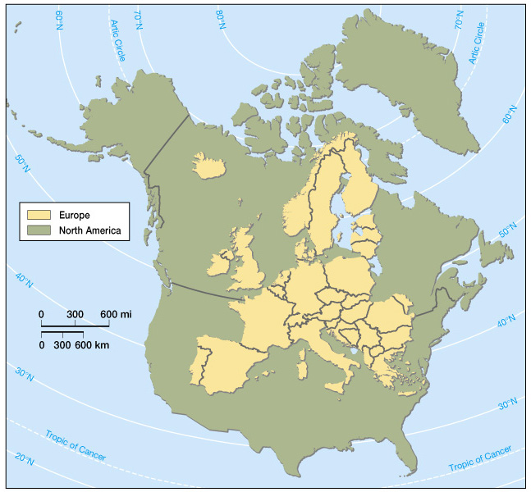
Size and
Northerly
Location
of Europe
Why did the winter in Plymouth colony almost kill the English settlers – they settled south of where they came from?

Slide 13
Environmental Geography: Human Transformation of a Diverse Landscape
Environmental Issues, Local and Global, East and West
    Agriculture, resource-extraction, industrial manufacturing, urbanization create air and water pollution and acid rain
    Western Europe is one of the world’s greenest regions because of pro-environment policies since 1970s
    European voters support environment in Europe and globally, including reduction of greenhouse gases
    Eastern Europe neglected its environment under Soviet-style economics; Soviet-designed nuclear plants may be dangerous
    Ongoing economic and political evolution make it difficult to solve Eastern Europe’s environmental problems

Slide 14
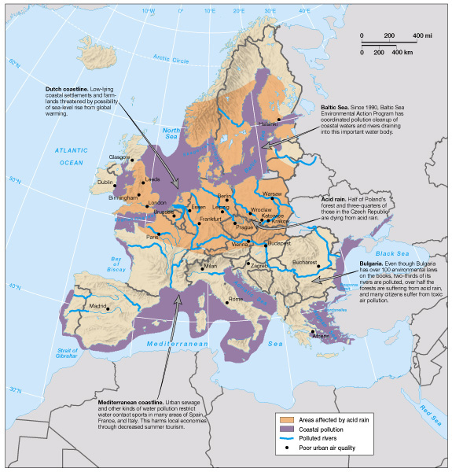
Environmental
Issues
in Europe

Slide 15
Landform & Landscape Regions
European Lowland (a.k.a. North European Plain)
  Reaches from SW France to Poland, includes SE England – becomes the Russian Plain in western Russia
  Focus of West Europe
  Major rivers, high population density, major cities
  Agriculture, industries
Alpine Mountain System
  “Spine of Europe,” east-west mountain ranges, from Atlantic Ocean to the Black Sea, 20 million years old
  Alps run 500 miles from France to Austria, tallest peak over 15K feet
  Pyrenees (Spain & France); Appenines (Italy); Carpathians (east edge)

Slide 16
Landform & Landscape Regions
Central Uplands
  Between Alps and Lowland (from France to Czech republic)
  Has iron, coal, other resources for manufacturing
Western Highlands
  (Portugal to Finland + part of British Isles)
  Contains fjords (flooded valleys carved by glaciers) in the north
  “Shield landscape” contains the world’s oldest rocks (600 million years)

Slide 17
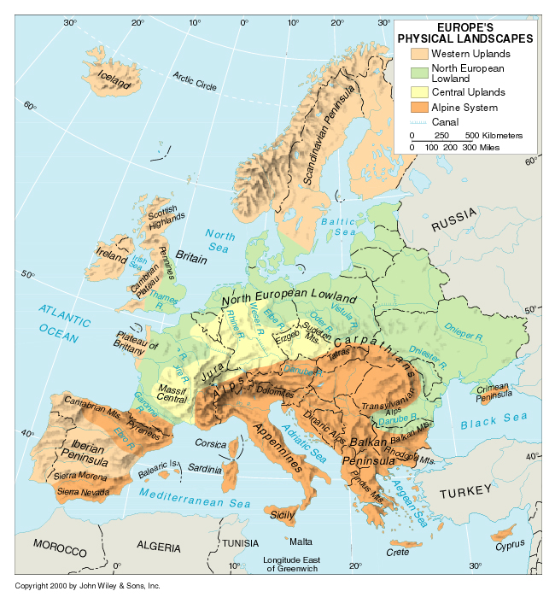
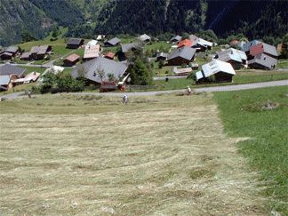
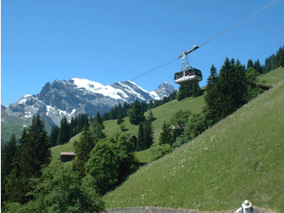
Swiss Alps

Slide 18
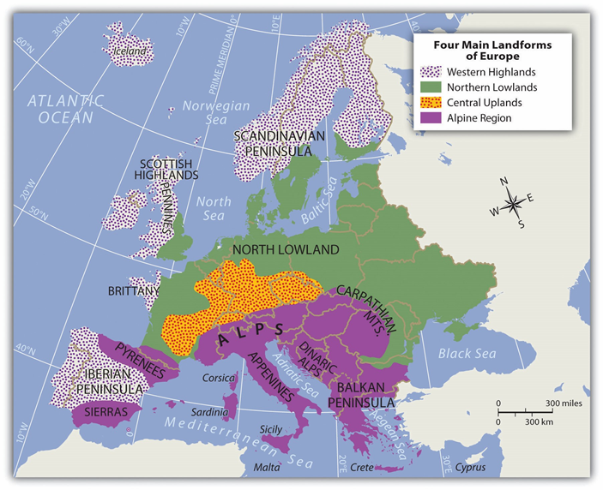
The High Alps, which range from eastern France to Slovenia, are central to the Alpine region. Included in the Alpine Range are the Pyrenees, located on the border between France and Spain; the Apennines, running the length of Italy; the Carpathians, looping around Romania from Slovakia; and finally, the shorter Dinaric Alps in former Yugoslavia. Mountains usually provide minerals and ores that were placed there when the earth’s internal processes created the mountains. Mountains also isolate people by acting as a dividing range that can separate people into cultural groups.
DIFFICULT BORDER TO DEFEND

Slide 19
Environmental Geography: Human Transformation
Seas, Rivers, Ports, and Coastline
  Europe’s Ring of Seas
    Baltic Sea, North Sea, English Channel, Mediterranean Sea, Black Sea (Black Sea has fisheries, oil, natural gas)
  Rivers and Ports
    Many rivers navigable, connected by canals for barges
    Seine, Rhine, Elbe, Danube (the longest)
    Rotterdam (Rhine), London (Thames), Gdansk (Wisla)
  Reclaiming the Dutch Coastline
    Polders – protected and reclaimed landscapes; dikes and windmills prevent floods (threatened by rising sea levels)
    Distributaries – delta channels on the Rhine subject to flooding

Slide 20
N
Rhine River
Danube River
Hub of Radial Stream Pattern

Slide 21
Setrrlement And Development

Slide 22
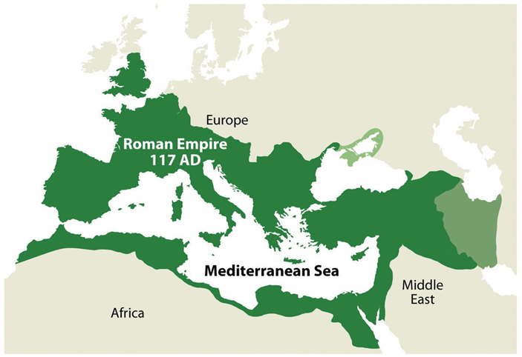
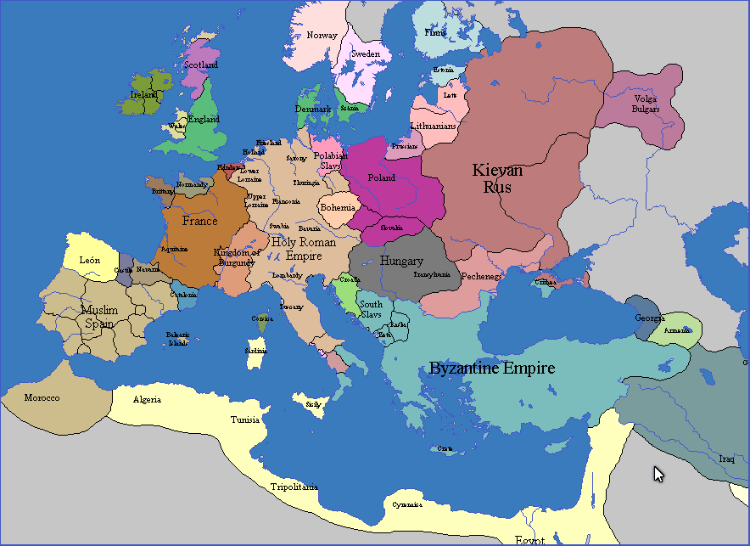
EARLY MIDDLE AGES

Slide 23
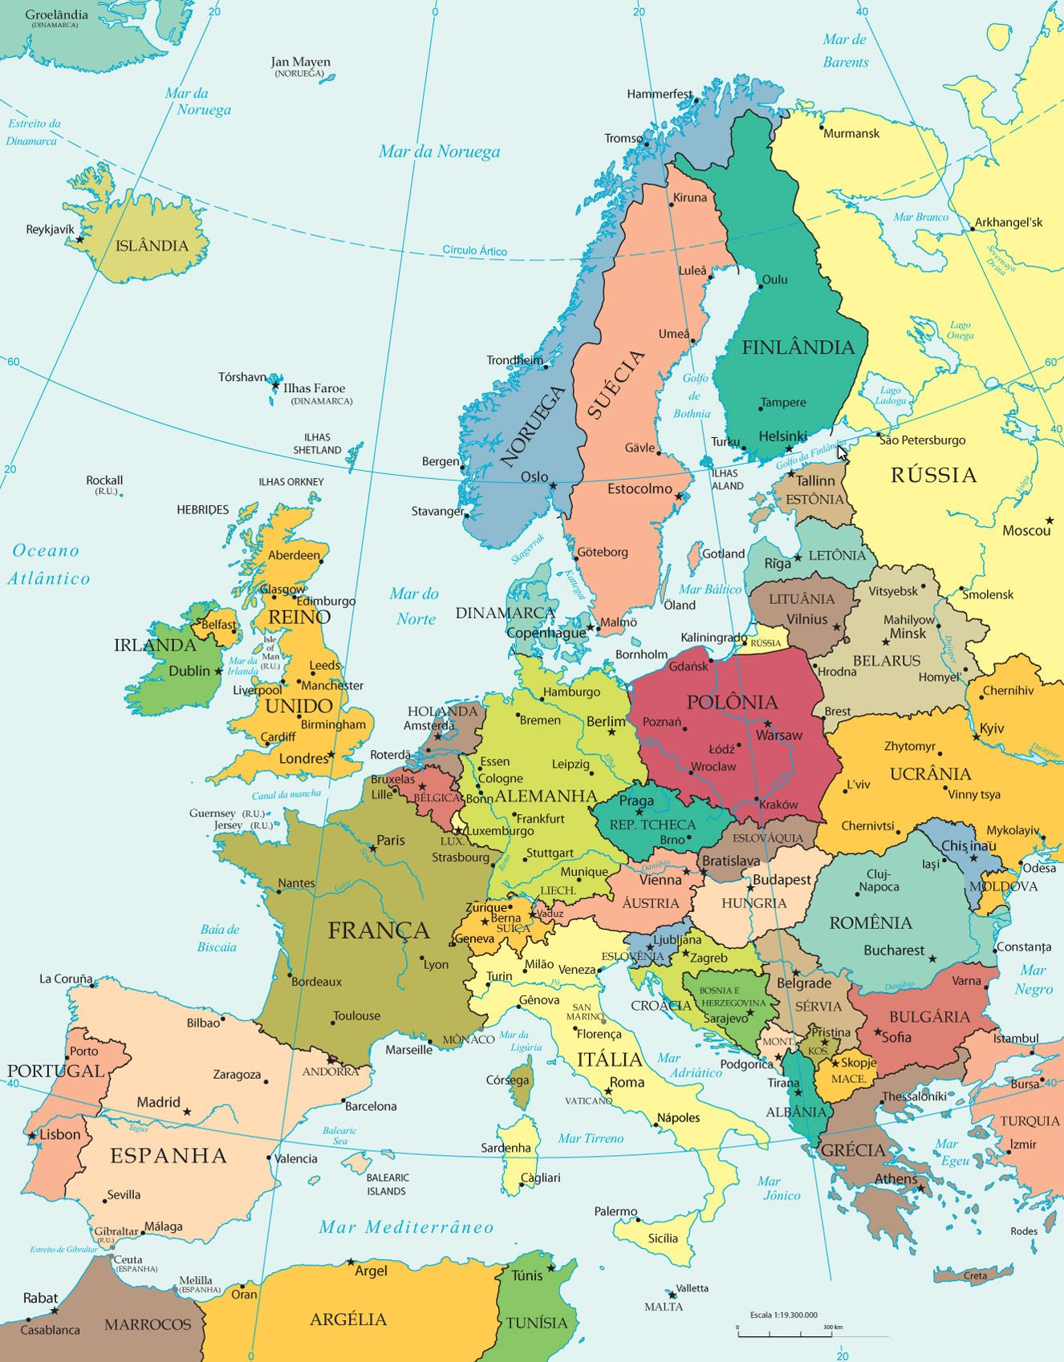
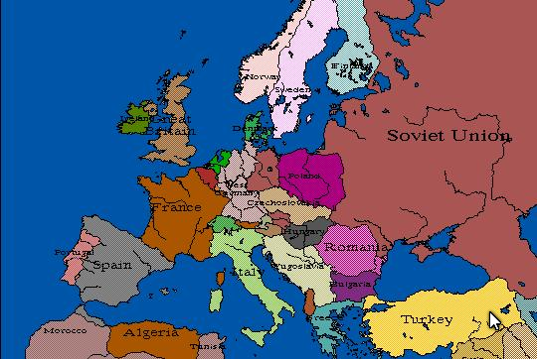
2019
1950

Slide 24
Settlement and Population: Slow Growth and Rapid Migration
Population Density in the Core and Periphery
    523 million people in Europe (more than half a billion)
    Highest densities in historic industrial core (England, Netherlands, N. France, N. Italy, western Germany)
Natural Growth: Beyond the Demographic Transition
    Europe continues to experience slow natural growth (birth rates lower than death rates; immigration prevents population loss)
    In last stage of Demographic Transition (or beyond)
      Causes: women in workforce; widespread contraception; shortage of affordable housing
      Some countries offer incentives to increase national growth

Slide 25
Europe’s Population Implosion
Shrinking population rather than a growing population – below ZPG
Reaction to urbanization and the expense of raising children in urban/industrial societies – so fertility rates in some countries have dropped below 2.1 (replacement rate)
Industrialization and urbanization usually move a country to the fourth stage of the demographic transition

Slide 26
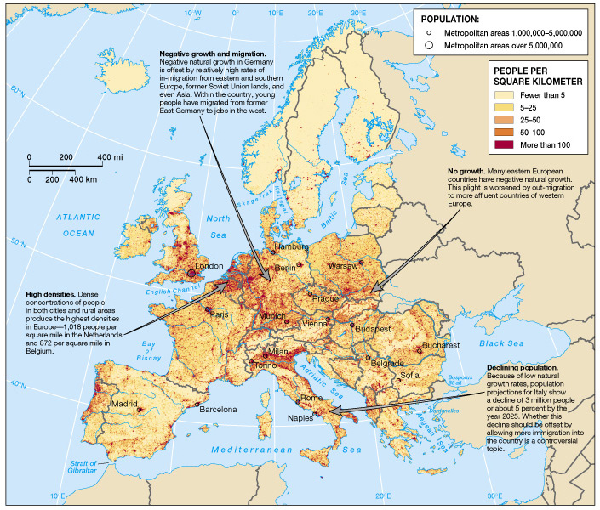
Europe’s
Population

Slide 27
Slow Growth and Rapid Migration (cont.)
Migration to and Within Europe
  Growing resistance to unlimited migration
    Scarce jobs should go to Europeans first
    Concerns about international terrorism
    Concern about dilution of national culture
  Immigration may be only way to solve labor shortage
    Workers needed to keep up tax revenues, support retirees
  EU working to establish common immigration policy
    Guest workers – migrant workers from other countries, usually doing low-wage work
    Called Gastarbeiter in Germany (mostly Turks); other European countries have migrants from their former colonies
    Additional migration from Eastern to Western Europe

Slide 28
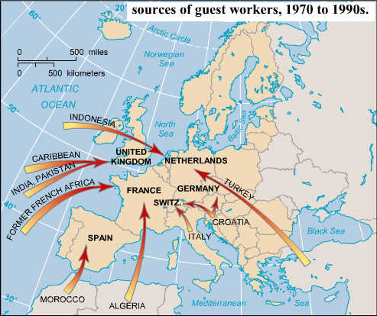
EU facilitates movement of workers to developed
Areas – problem in economic downturn

Slide 29
Settlement and Population
The Landscapes of Urban Europe
  Europe highly urbanized
    Over 50% most countries; 90% in UK and Belgium
  The Past in the Present (3 landscape types)
    Medieval landscape (900-1500 A.D.) – densely settled, buildings next to streets; green space only near churches and public squares
    Renaissance-Baroque (1500-1800) – wider streets, large gardens, monuments, more open space; ornate architecture
    Industrial (1800-present) – walls and fortifications removed; factories and industrial areas build on edge of cities; urban sprawl developed

Slide 30
Key Elements of Western Civivilization
Greece – Philosophy, democracy, roots of science, art & architecture
Rome – Law, engineering, infrastructure (city structure, roads & aqueducts), establishment & spread of Christianity, and areal functional specialization
Coming out of the Middle Ages
  Renaissance & Reformation
  Rise of the nation state
  Enlightenment & scientific revolutions

Slide 31
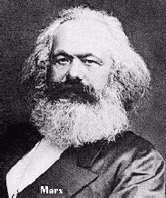
Revolutions modernizing Europe
Agrarian Revolution
Industrial Revolution & colonial empires
Political Revolutions
  French Revolution
  Revolutions of 1848
Rise of socialist thinking

Slide 32
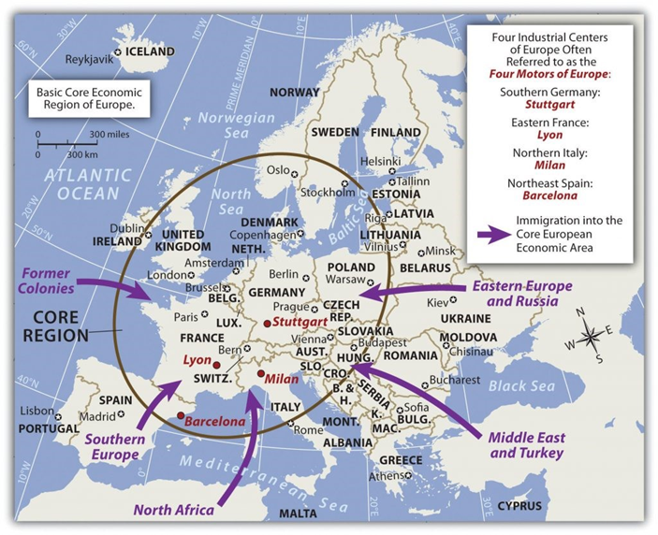

Slide 33
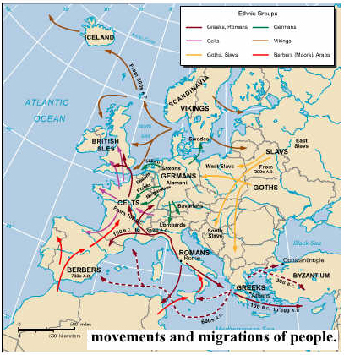
Much Ethnic Mixing in the Making of Europe as a Culture Region

Slide 34
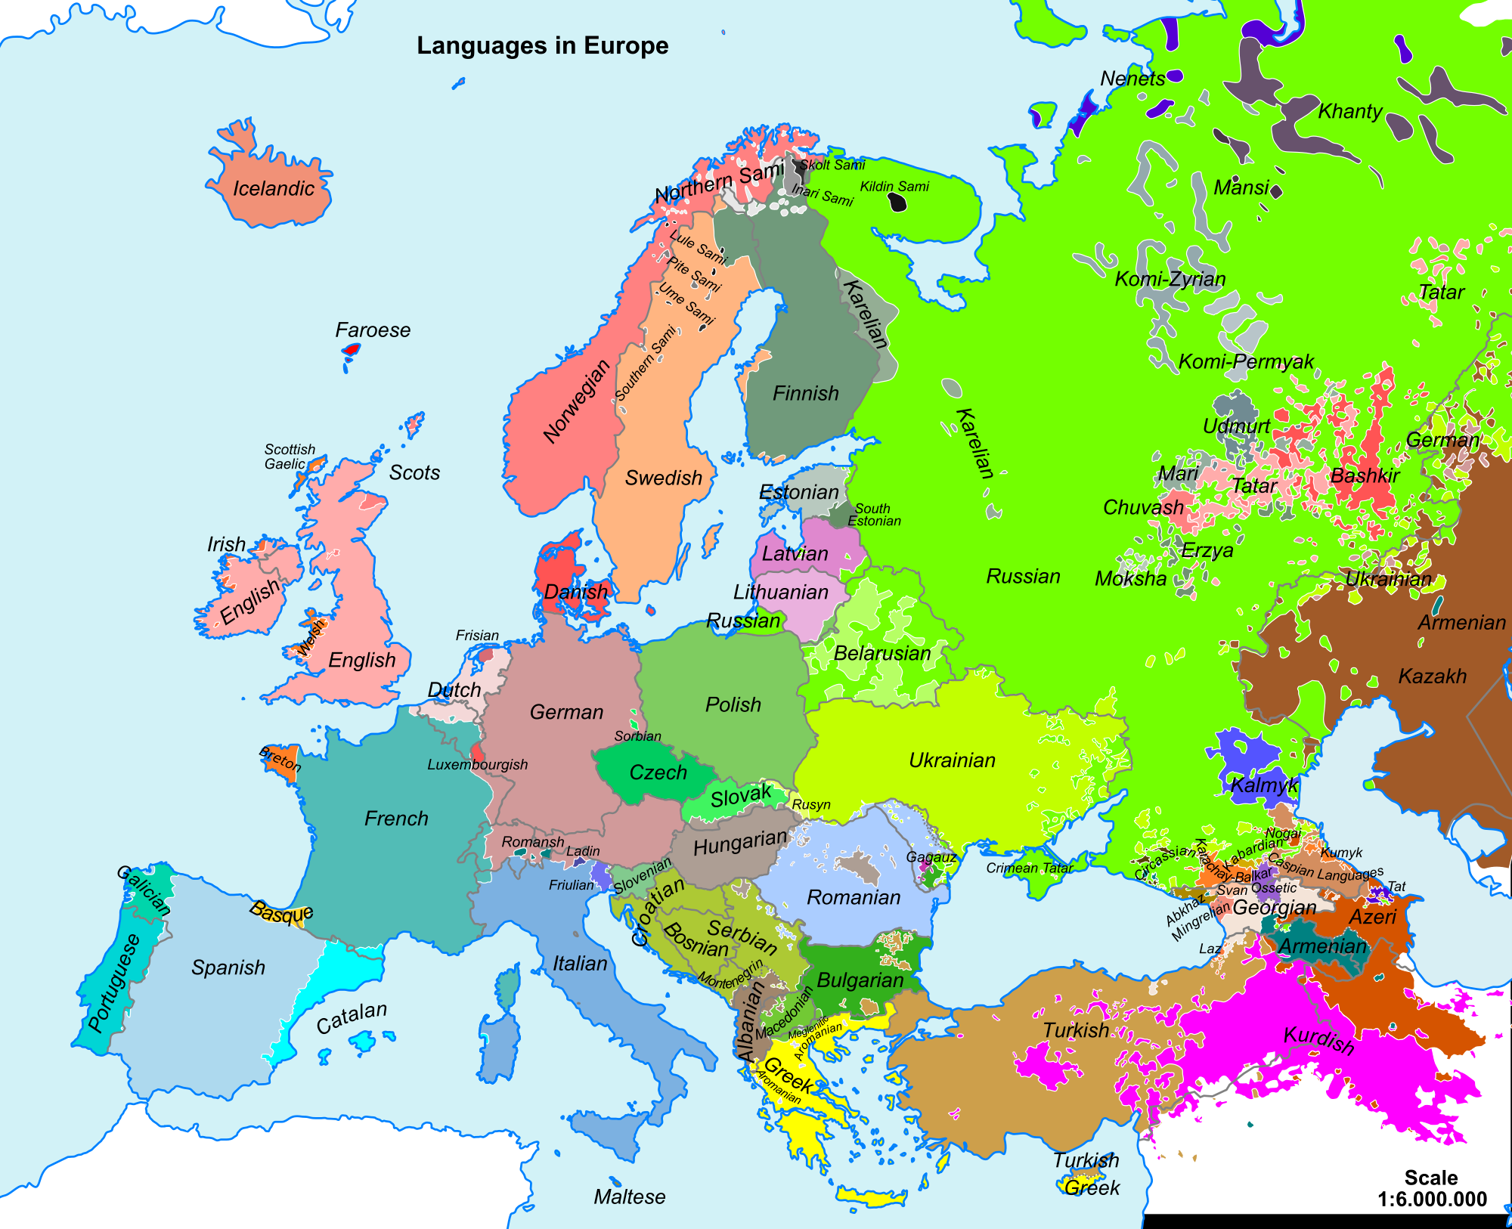
Language differences are good indicators of cultural differences

Slide 35
Key European Cultural Traits
Political system – parliamentary democratic republic ideal
Legal system – Napoleonic Code derived from Roman Law
Economic system – capitalism or market economy
Industrialization & urbanization
Government services
  Education
  Medical & health care
  Retirement

Slide 36
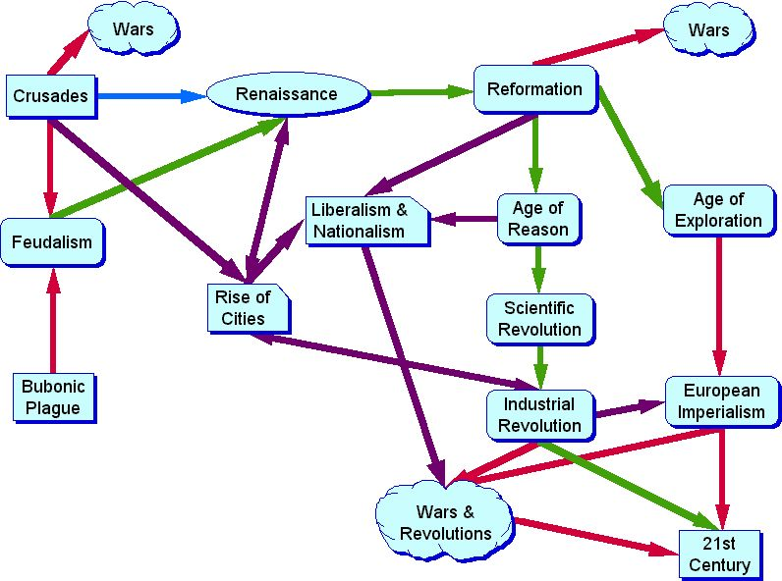
Influences on European Culture After the Fall of the Western Roman Empire

Slide 37
Cultural Diversity: A Mosaic of Differences
Geography of Languages
  Germanic Languages (200 million speakers)
    German, English, Dutch, Norwegian, Swedish, Danish, Icelandic
    In British Isles, Scandinavia, and Central Europe (north)
  Romance Languages (200 million speakers)
    Italian, French, Spanish, Portuguese, Catalan, Romanian
    Spoken throughout Southern Europe
  Slavic Languages (80 million speakers)
    Largest family of European languages (including Russian)
    Polish, Czech, Slovakian, Serbo-Croatian, Bulgarian, Slovenian
    Roman Catholic countries use Latin alphabet; Eastern Orthodox countries use Cyrillic (Greek) alphabet

Slide 38
Geographies of Religion, Past and Present
  The Schism Between Western and Eastern Christianity
    Division in 1054 A.D. of Roman Catholic and Eastern Orthodox Churches
    Greek missionaries refused to accept Roman Catholic hierarchy and rule by Roman bishops
    Roman Catholics - Latin alphabet; Eastern Orthodox – Cyrillic
  Conflicts with Islam
    East Europe: Ottoman Turks brought Islam to Balkans (almost to Vienna, Austria)
    Western Europe: Moors (Moroccans) brought Islam to Spain

Slide 39
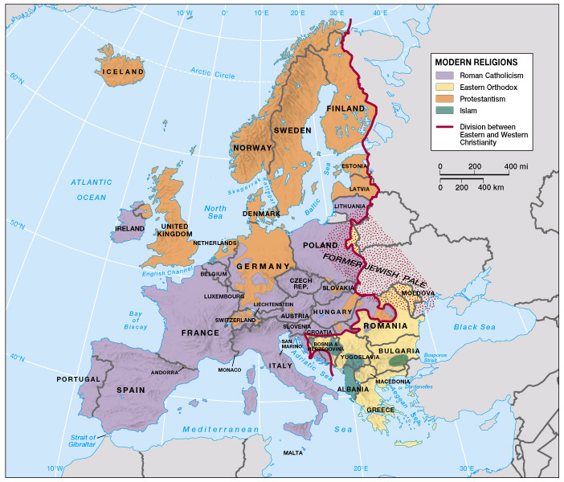
Religions of Europe
Probable change in the future resulting from simple mathematics:
Sizable Muslim minorities exist in several traditionally “Christian” countries.
Non-Muslim population is declining – TFR well below 2.1. Christian influence may be declining as the percentage of “Nones” (no religious affiliation) increases.
Muslim population is increasing - TFR is above 2.1 plus possibility of more refugee immigrants.

Slide 40
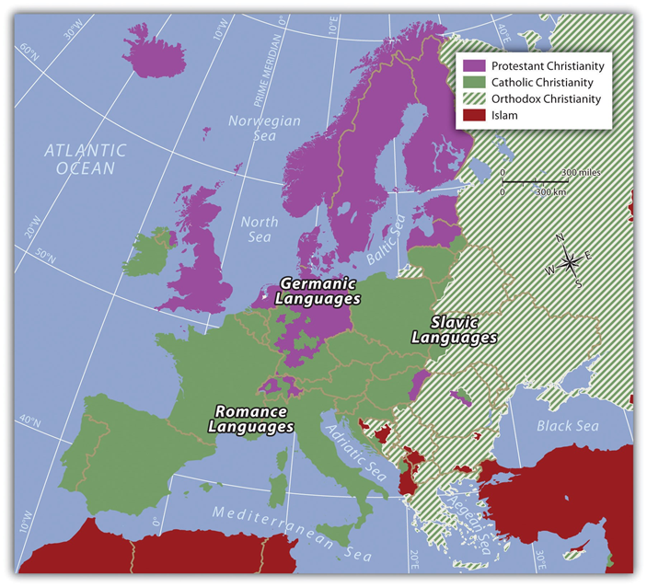
Map from the current textbook adds language families.

Slide 41
Geographies of Religion, Past and Present (cont.)
  The Protestant Revolt
    Began in 16th century with split in Catholic Church’s teachings & Papacy
  A Geography of Judaism
    Jews expelled from Palestine during Roman Empire, settled in Moorish (Islamic) Spain (There was a time when Muslims & Jews coexisted)
    When Christians conquered this region, they expelled Jews
    Many Jews settled in “the Pale” of eastern Europe (east Poland and further east) – faced persecution in “Christian” countries
    Murder of 6 million Jews during Nazi occupation in 1940s, others suffered in concentration camps

Slide 42
The Patterns of Contemporary Religion
Europe becoming a secularized society
  Secularization: movement away from traditional organized religions - the rise of the “Nones”
Roman Catholicism (250 million Roman Catholics)
  Italy, Spain, Ireland, France, Austria, southern Germany, Poland, Croatia, Czech Republic, Hungary (south)
  Conflict in Northern Ireland has had a religious component
Protestantism (fewer than 100 million Protestants)
  Northern Germany, Scandinavia, England
Eastern Orthodox Christianity
  Yugoslavia, Romania, and Bulgaria
Islam growing in numerous countries

Slide 43
European Culture in Global Context
Globalization and Cultural Nationalism Since World War II, Europe has been inundated with North American culture (music, TV, consumer goods)
    UK, Italy, Hungary accept it
    France, Germany resist, subsidize indigenous films and create “academies” to keep English out of the language (officially, e-mail in France is “courriel”)
Migrants and Culture
  Many Muslim migrants to Europe (4.5 million in France; 2.5 million Muslim Turks in Germany)
    Ethnic clustering and ghettoization are common
    Far right-wing nationalists (e.g., skinheads, neo-Nazis) – radical reaction to change
    (You can see this in the U.S.A. in 2016-19 – the White Supremacists, etc. became visible)

Slide 44

Birthplace of the Nation-State
Centripetal Forces promote unity
  Relatively mobile available labor force
  Common history -- heritage
  Common cause – external threat
  Common religion & language
Centrifugal Forces promote division and fragmentation (devolution)
  More than one ethnic group
  More than one religion and/or language
  State not “organic”
  Physical barriers separating groups
  Regional economic/development disparities

Slide 45
Nationalism in a minority can be centrifugal, whereas nationalism in the majority is centripetal

Slide 46
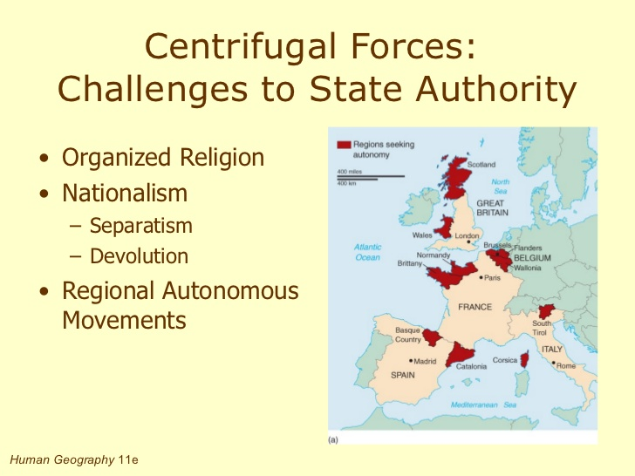

Slide 47
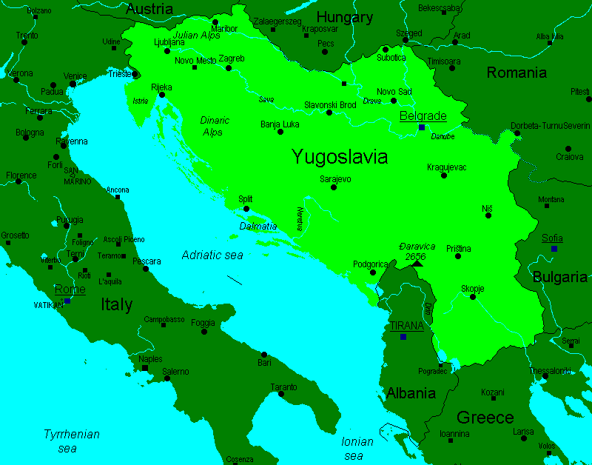
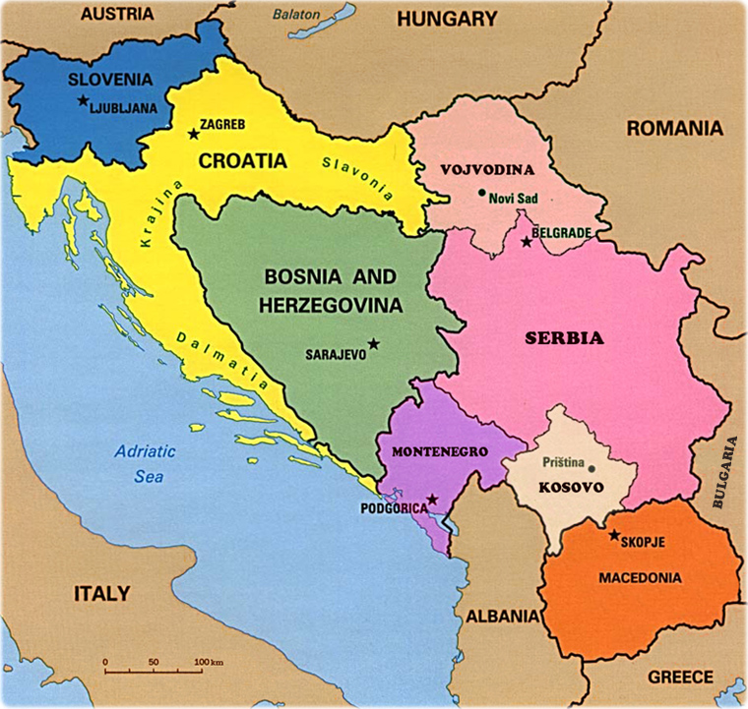
Yugoslavia where centrifugal forces greatly outweighed centripetal forces
Created at Versailles 1918 – Dictatorship of Tito after WWII
2019 there are 7 or 8 ethnic-based countries – Status of Vojvodina?

Slide 48
Status

Slide 49
Geopolitical Framework: A Dynamic Map
Europe has 37 independent states (countries) more or less
  Europe invented the nation-state (a relatively homogenous cultural group (nation) with its own political territory (state); fostered by ethnic and cultural nationalism)
Redrawing the Map of Europe Through War
  World War I
    France, UK, Russia vs. Germany, Italy, Austria-Hungary
    Outcome encouraged irredentism: state policies designed to reclaim lost territory
  1930s (Depression Era): 3 ideologies emerged
    Western democracy and capitalism, Soviet-style communism, Fascist totalitarianism in Germany and Italy
  World War II era (1939-45)
    Germany occupied neighboring countries, beginning with Austria & Czechoslovakia but war was declared when they attacked Poland
    Axis (Germany, Italy, Japan) vs. Allies (Britain, France, U.S.S.R., U.S.)
    Axis surrendered in 1945, Allies divided Europe & U.S. occupied Japan - Cold War began

Slide 50
A Divided Europe, East and West
  Cold War Geography (1946-1991)
    USSR (Russia) occupied countries of E Europe to create a buffer zone (region to protect Russia from further European invasion)
    Western Allies occupied Western Europe; the 2 groups divided Berlin, Germany
    The Iron Curtain was a symbolic separation between East and West
    Berlin Wall an actual physical structure separating E and W Berlin
  Cold War
    NATO (North Atlantic Treaty Organization) in W Europe (U.S.), and Warsaw Pact in E Europe (U.S.S.R.)
    Both sides stockpiled weapons, waged propaganda war, raised fears
    “Peace” maintained by MAD (Mutually Assured Destruction) –will hypersonic missiles cancel out MAD? 2019 Russia says they have them

Slide 51
Geopolitical Framework: A Dynamic Map (cont.)
  Cold War Thaw - - - Is it warming up again in 2019?
    Began in 1989 when Poland elected a non-communist leader
    Causes: political instability in U.S.S.R.; desire for economic and political change in Eastern European countries
    Revolutions in most Warsaw Pact countries were non-violent, except in Romania
    Outcome: revival of national feelings (Natiomalism)
      Czechoslovakia divided peacefully (Czech Republic and Slovakia)
      Yugoslavia divided through armed conflicts, “ethnic cleansing”
      Germany reunited
      Soviet Union dissolved

Slide 52
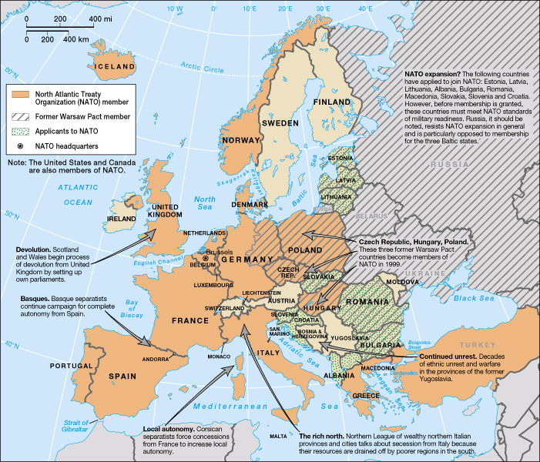
Geopolitical Issues in Europe

Slide 53
Economic and Social Development: Integration and Transition
Europe’s Industrial Revolution (1730-1850)
  Machines replaced people in manufacturing
  Inanimate energy sources (water, steam, fossil fuels) powered machines
Centers of change
  England’s textile industry the center of industrial innovation
      Water sources (power waterwheels, clean wool)
      Weak guilds
      Ample raw materials (wool and cotton)
      Favorable government policies
      Changes in agriculture produced an available labor force

Slide 54
Economic and Social Development: Integration and Transition
  Locational Factors of Early Industrial Areas
    Steam engine improvements made water power obsolete
    Coal a cheap fuel source, factories built near coal mines
    Iron and steel manufacturing became important
    London became an important port and financial center
  Development of Industrial Regions-Continental Europe
    First industrial regions established about 1820 on French-Belgian border
    Near coal fields of Sambre-Meuse Rivers
    Remain important today

Slide 55
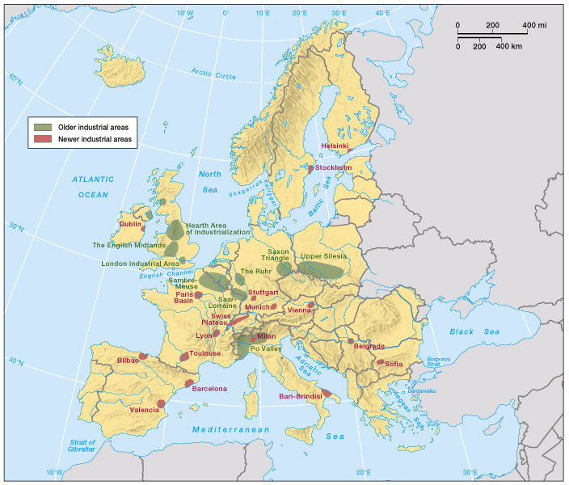
Industrial Regions of Europe
(Fig. 8.28)

Slide 56
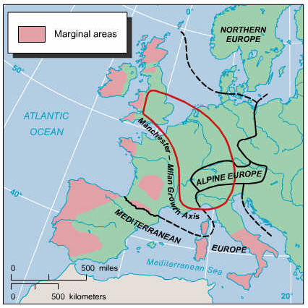
Regional Industrial Contrasts
Primary
Industrial
Core Area

Slide 57
Previous, older map indicates a Manchester England) Milan (Italy) axis
Barcelona had a lesser status then.

Slide 58
Economic and Social Development: Integration and Transition (cont.)
Rebuilding Postwar Europe: Economic Integration in the West
    The Marshall Plan helped rebuild Western Europe after WWII
    Council for Mutual Economic Assistance (CMEA) – linked eastern European aid and recovery to the centralized command economies of communism
  ECSC and EEC
    European Coal and Steel Community (ECSC) and European Economic Community (EEC)
      Ancestors of today’s European Union
      Started as coordinated effort to drop coal and steel tariffs
      Grew to create a common market for France, Germany, Italy, Netherlands, Belgium, Luxembourg

Slide 59
Economic and Social Development: Integration and Transition (cont.)
  European Community and Union
    In 1965 the EEC created a council, court, parliament and commission and changed its name to European Community
    In 1991, EC became European Union (EU), more members joined
    EU has wider mission, established by Maastricht Treaty: common foreign policies and mutual security agreements, greater economic integration and common currency

Slide 60
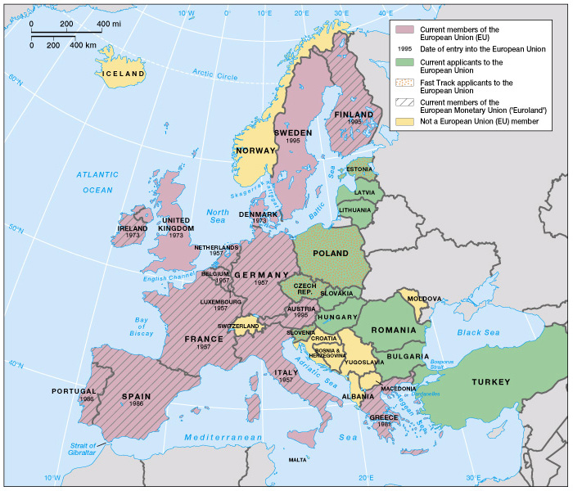
The European Union
(Fig. 8.38)

Slide 61
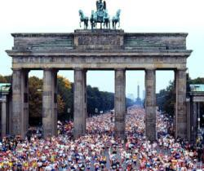
Berlin – Expanding EU offers the chance of a greatly enhanced relative location in Europe!
Click on the picture to see the video (may work on an UMSL computer but not elsewhere)

Slide 62
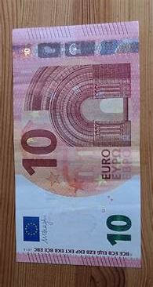
Economic and Social Development: Integration and Transition (cont.)
  Euroland: The European Monetary Union
    January 1, 1999: Eleven of the 15 EU member nations joined the European Monetary Union and adopted the euro
      The euro was a common currency for business and trade transactions
      On January 1, 2002, citizens in the “Euroland” countries began using the euro in their everyday lives

Slide 63
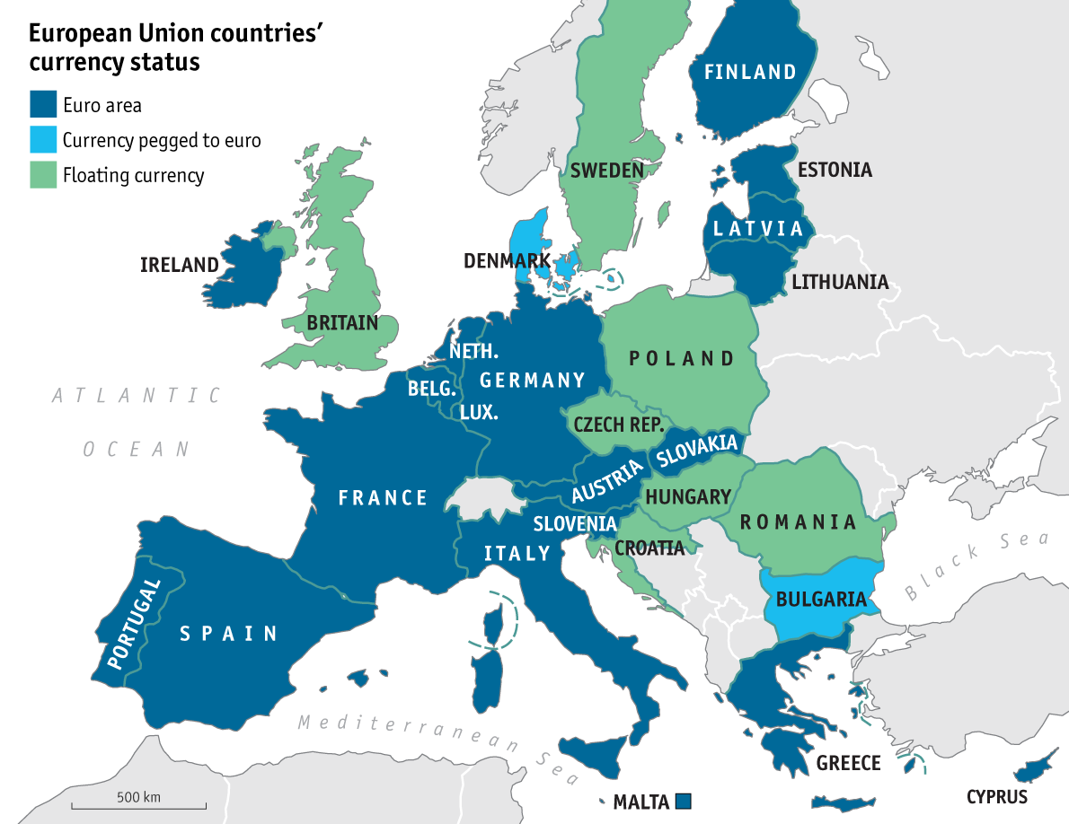

Slide 64
Economic and Social Development: Integration and Transition (cont.)
Economic Integration, Disintegration, and Transition in Eastern Europe
  Historically, Eastern Europe has been less well developed than Western Europe
    Has been under control of outsiders (Ottoman Turks, Hapsburgs, Germans, Soviet Russians)
  The Soviet Plan
    Soviet Russians (communists) redeveloped Eastern Europe after WWII as a command economy (centrally planned and controlled economy, generally associated with socialist or communist countries, in which all goods, services, agricultural and industrial products are strictly regulated)

Slide 65
Economic and Social Development: Integration and Transition (cont.)
  Results of Soviet Plan
    Poland and Yugoslavia resisted collectivization
    Collectivization did not improve food production
    Focus on heavy industry that was reliant on cheap fuel and raw materials from U.S.S.R.
  Transition and Changes Since 1991
    After U.S.S.R. disintegrated, Eastern European countries went through major change
    Many E Europe countries introduced privatization – the transfer to private ownership of those firms and industries previously owned and run by state governments
    Loss of cheap raw materials and fuel from U.S.S.R. resulted in a drop in industrial output; unemployment and inflation rose

Slide 66
Economic and Social Development: Integration and Transition (cont.)
  Regional Disparities Within Eastern Europe
    Successful transitions in Czech Republic, Slovenia, Hungary, Poland
      Never adopted centralized communism
      Had good transportation links to the West
      Developed strong manufacturing centers with skilled workforce
    Unsuccessful transitions in Macedonia, Moldova, and Albania
      Adopted centralized communism
      Had few links to the West (no market for goods)
      Were dependent on Soviet Russia for raw materials
      Had agriculture-based economies
      Had internal political conflict
    Other countries in the middle, with a combination of good and bad outcomes
    Democratic ideals not as deeply rooted as in Western Europe

Slide 67
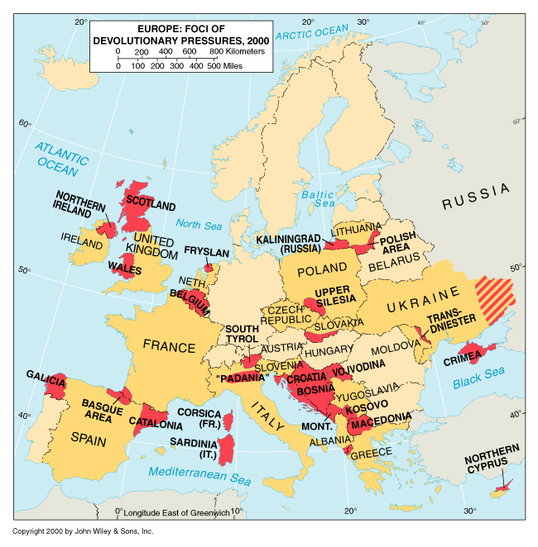
Foci of Devolution
* Scottish referendum failed
* Catalonian referendum passed but govt. intervened
* N. Ireland and the Basques have been relatively quiet
* Yugoslavia split into 7 or 8 countries
* Crimea taken by Russia
*East Ukraine separating with Russian help

Slide 68
Will Brexit go through? (UK leave the EU)
Scotland, Northern Ireland, and Gibraltar voted to remain in the EU.
If the UK does leave the EU, Will one or all of these vote to separate from the UK and remain in the EU?
Would the UK hold a new referendum? (not too likely)
  Did the Russians influence the election as they may have in the USA?
  Many feel they were misled and would have voted differenty

Slide 69
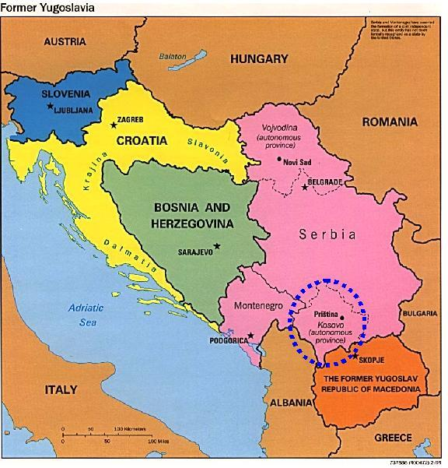
Kosovo
Click on the map to see the video (same as previous video)

Slide 70
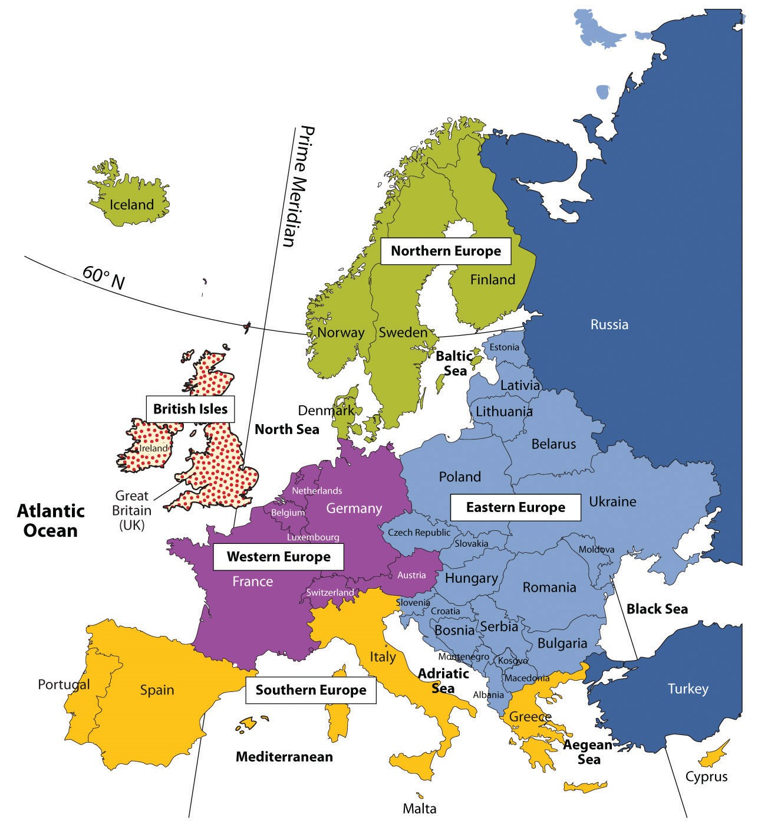
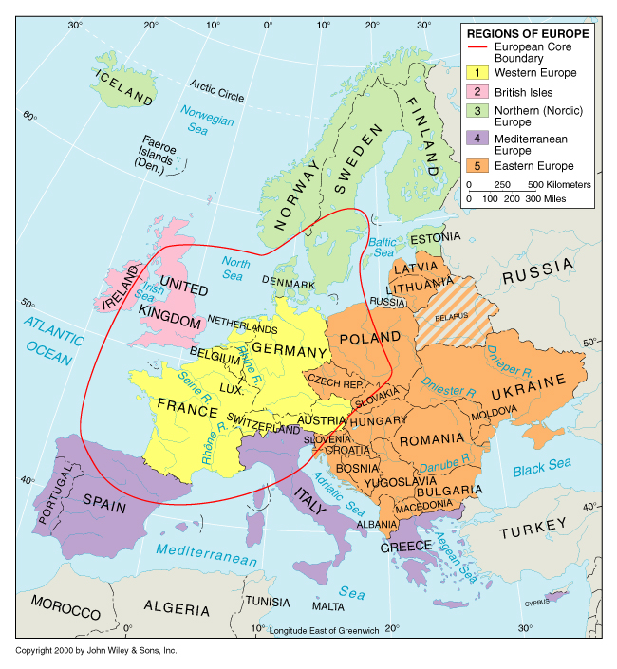
Subregions of the European Region

Slide 71
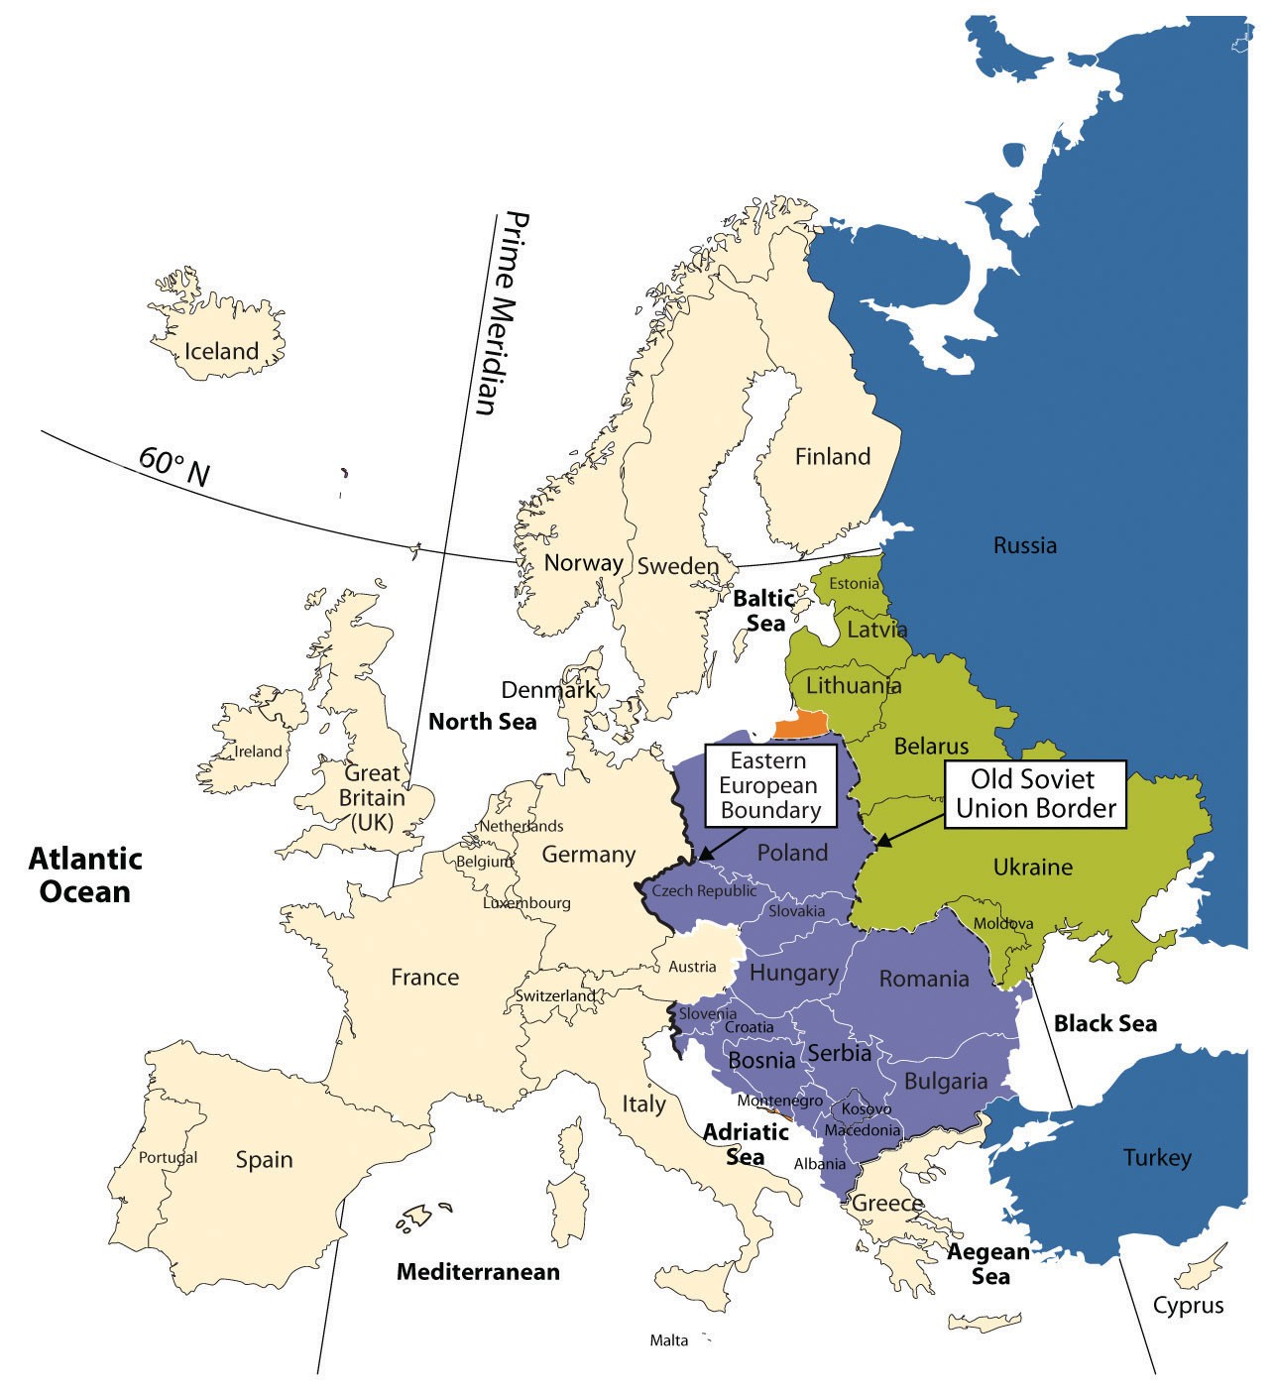
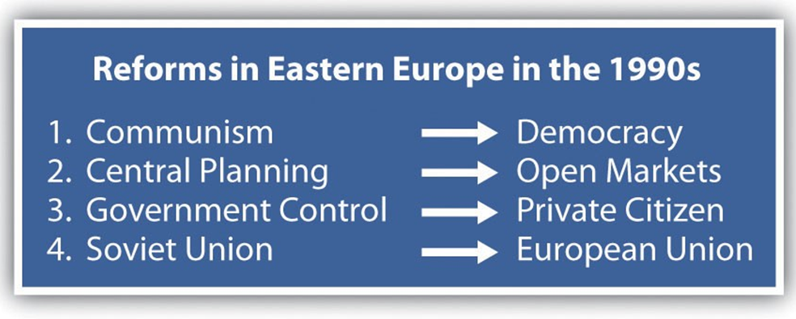
Most of these countries have joined the EU and NATO
Not popular with Russia
Great challenges exist here

Slide 72
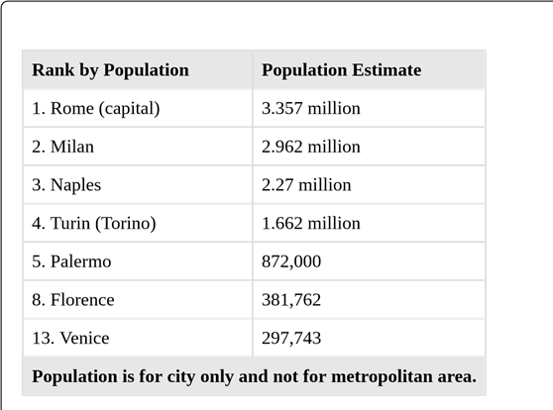
Urban Italy

Slide 73
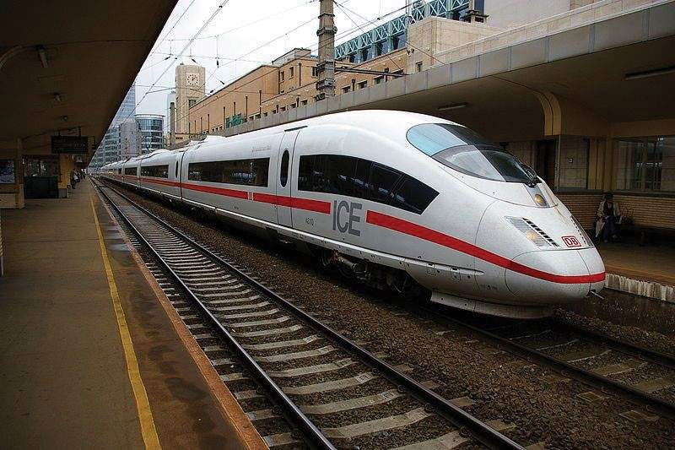
European Public Transportation
Euro-rail goes practically everywhere (gauges standardized inn the EU)
Many main lines have “bullet” trains (100 MPH plus)
Many modern divided highways built after WWII, particularly in Western Europe

Slide 74
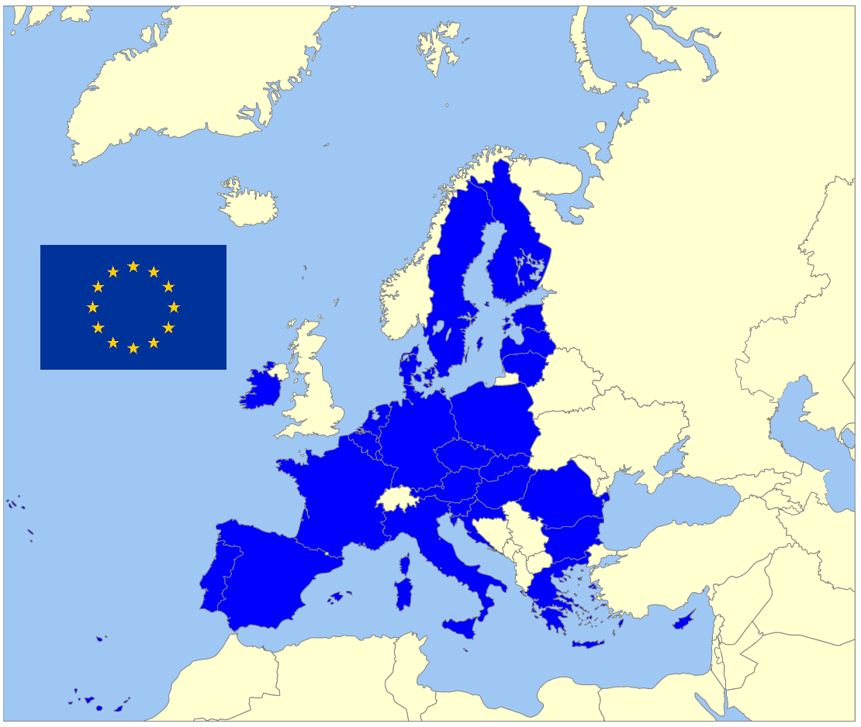
EU showing the UK out of it

Slide 75
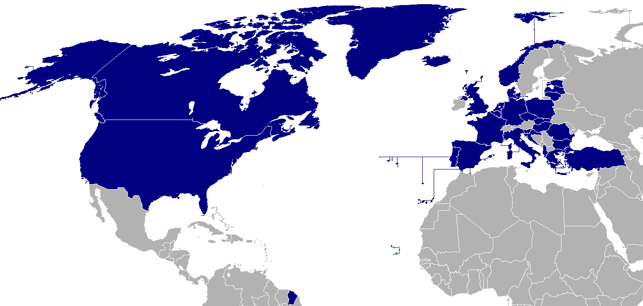
NATO

Slide 76
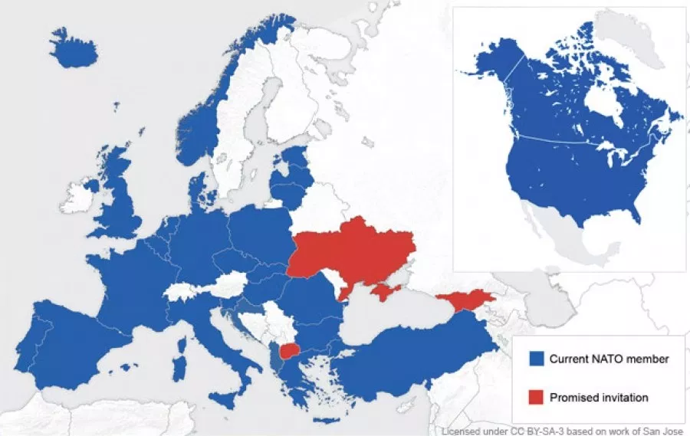

Russia
?
NATO

Slide 77
Conclusions
Europe’s challenges vary
  Western Europe is one of the wealthiest areas on earth
    Progressive approach to environment
    Ideas of nationalism seem to be giving way to pan-European identity and a region-wide currency
    Europe must deal with immigrants and resulting political tension, and address political problems in other regions
    If Brexit goes through, how will the European Union react
  Eastern Europe faces very different challenges
    Political strife
    Economic stagnation
    Environmental degradation
    Eastern Europe wishes to join the west
    End of Chapter 2: Europe

