Slide 1
Makkah (Mecca), Medina, & the Hajj

Slide 2
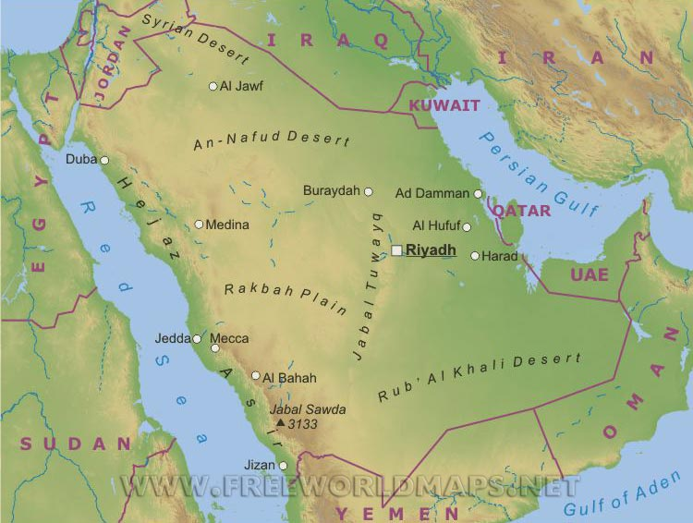

Slide 3
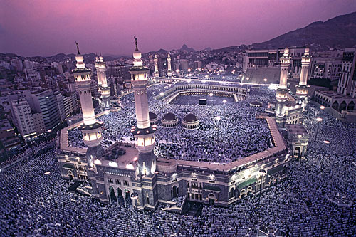
Makkah & the hajj

Slide 4
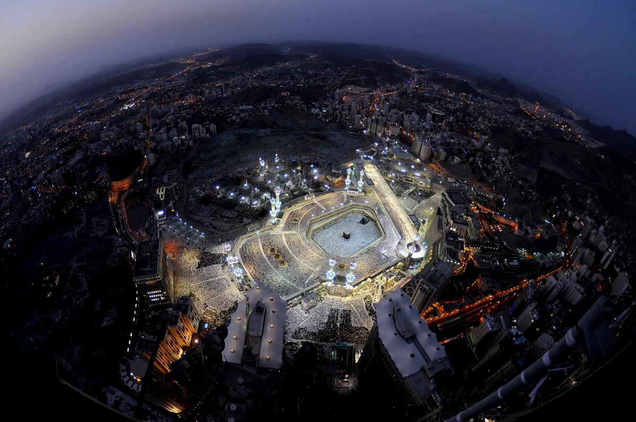
Masjid al-Haram - Makkah

Slide 5
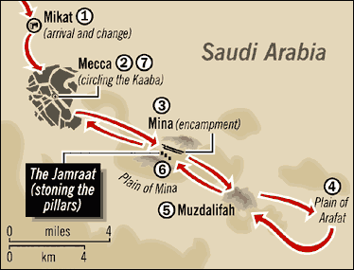
The path and sequence of the Hajj

Slide 6
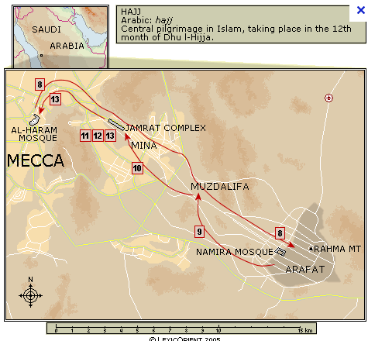

Slide 7
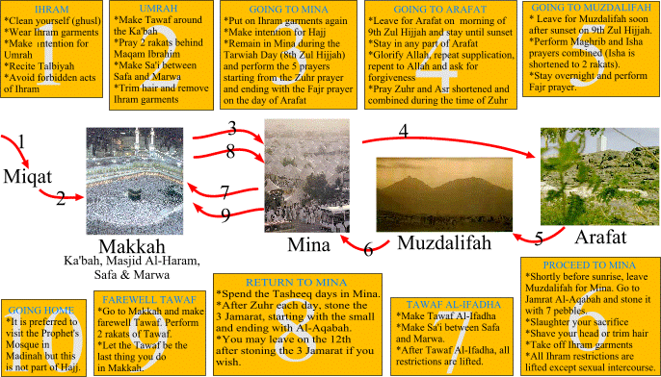

Slide 8
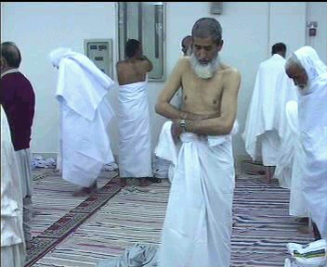
Ihram

Slide 9
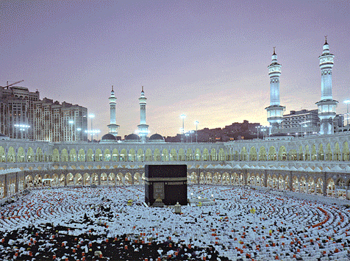
Tawaf around the holy Ka’abah – at the beginning and at the end of the Hajj

Slide 10
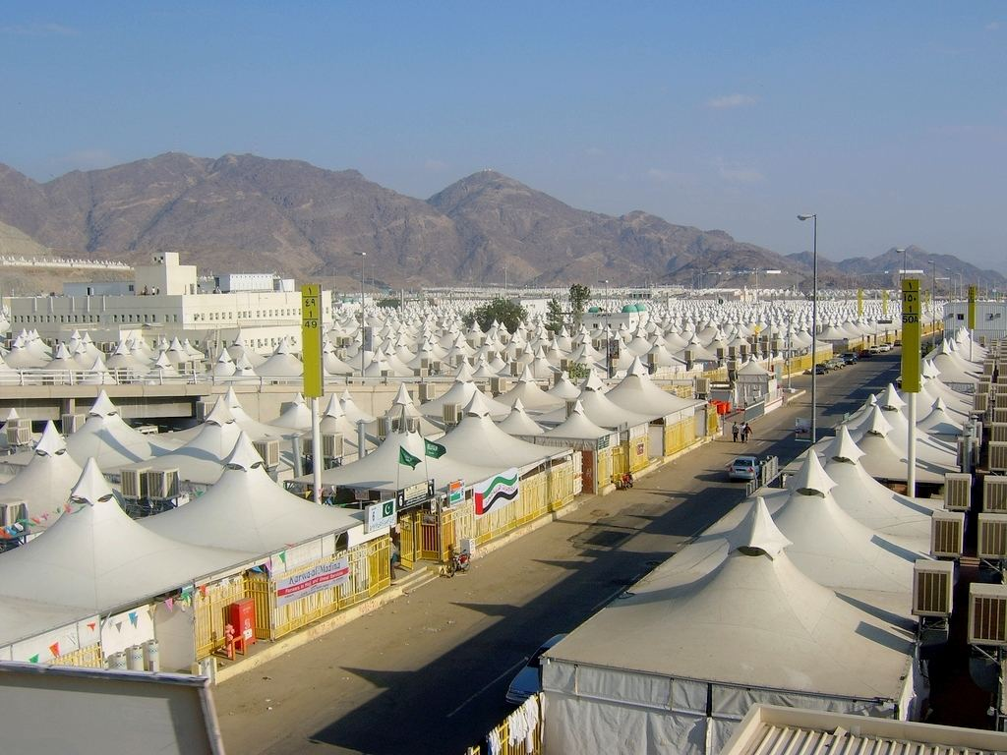
Mina (Encampment)

Slide 11
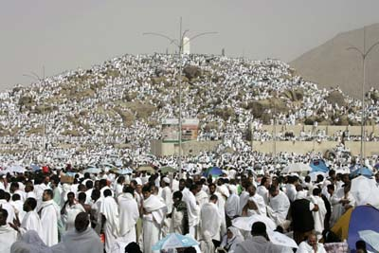
Climbing Jebel al-Rahma at the Plain of Arafat

Slide 12
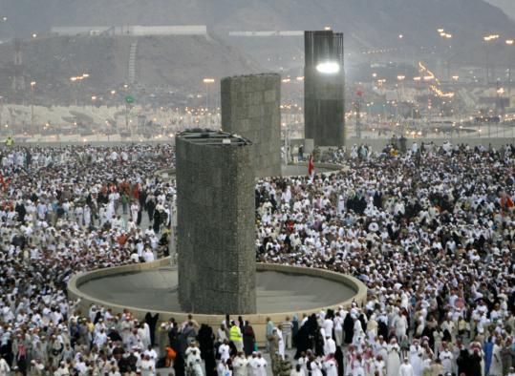
Stoning the three pillars

Slide 13
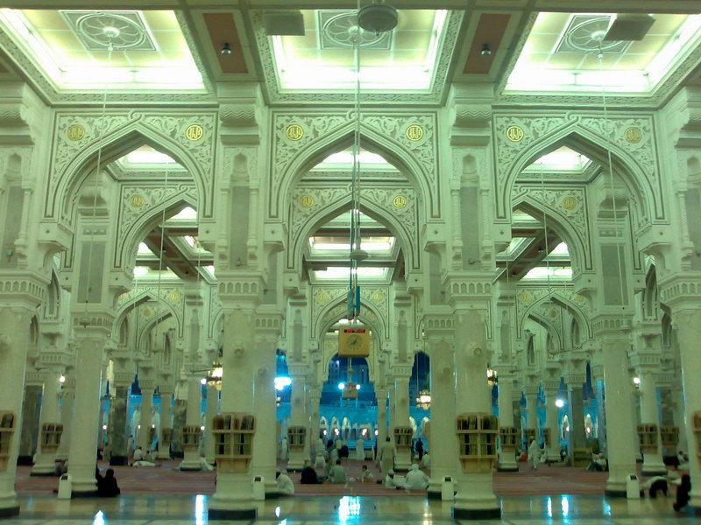
Al-Masjid al-Ḥaram, "The Sacred Mosque," is the largest mosque in the world. Located in the city of Mecca (Makkah), it surrounds the Kaaba, the place which Muslims worldwide turn towards while performing daily prayers and is Islam's holiest place. The mosque is also known as the Grand Mosque.

Slide 14
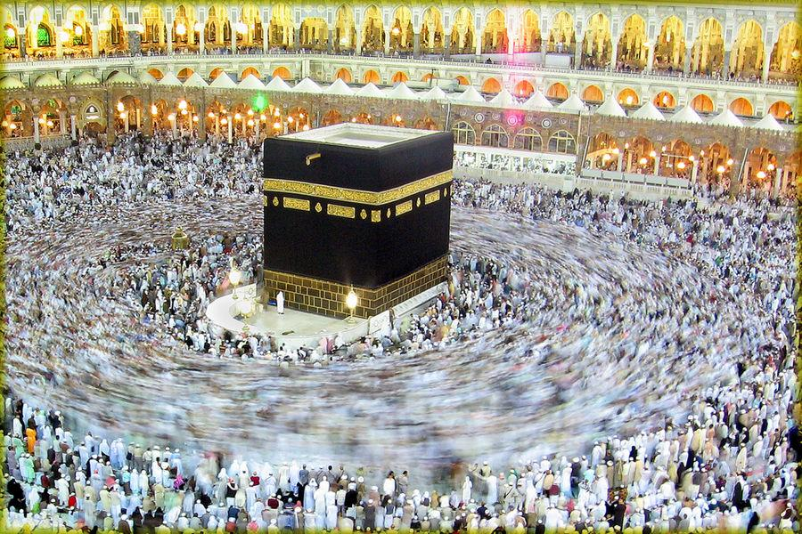
Kaaba and Hajj

Slide 15
The Kaaba is a cuboid-shaped building in Mecca, Saudi Arabia, and is the most sacred site in Islam. The Quran states that the Kaaba was constructed by Abraham (Ibrahim in Arabic), and his son Ishmael (Ismaeel in Arabic), after the latter had settled in Arabia. The building has a mosque built around it, the Masjid al-Haram. All Muslims around the world face the Kaaba during prayers, no matter where they are. This is called facing the Qiblah.
One of the Five Pillars of Islam requires every Muslim to perform the Hajj pilgrimage at least once in his or her lifetime if able to do so. Multiple parts of the Hajj require pilgrims to walk seven times around the Kaaba in a counter-clockwise direction (as viewed from above). This circumambulation, the Tawaf, is also performed by pilgrims during the Umrah (lesser pilgrimage).

Slide 16
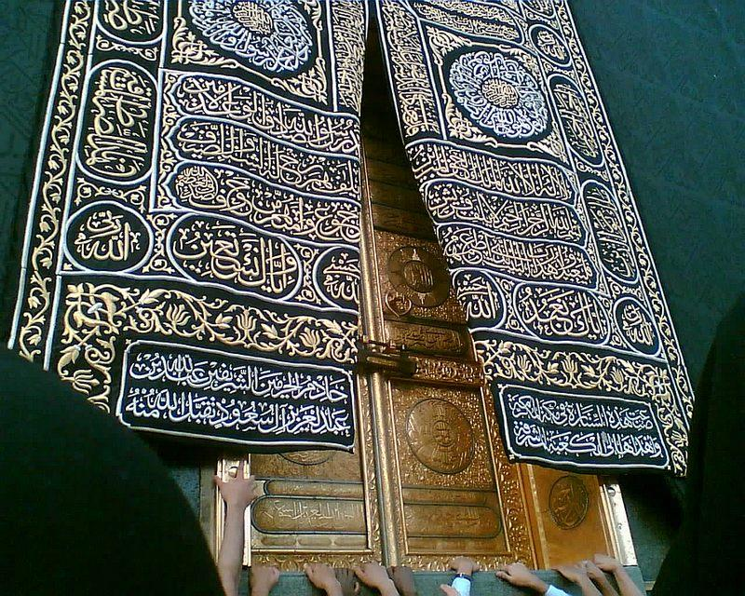
The Gate of Kaaba & the Kaaba cover

Slide 17
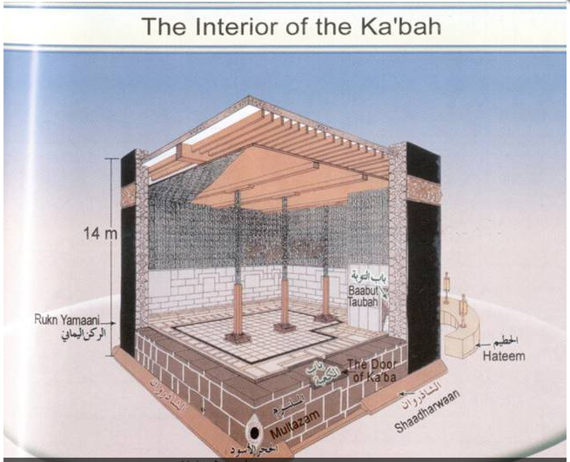

Slide 18
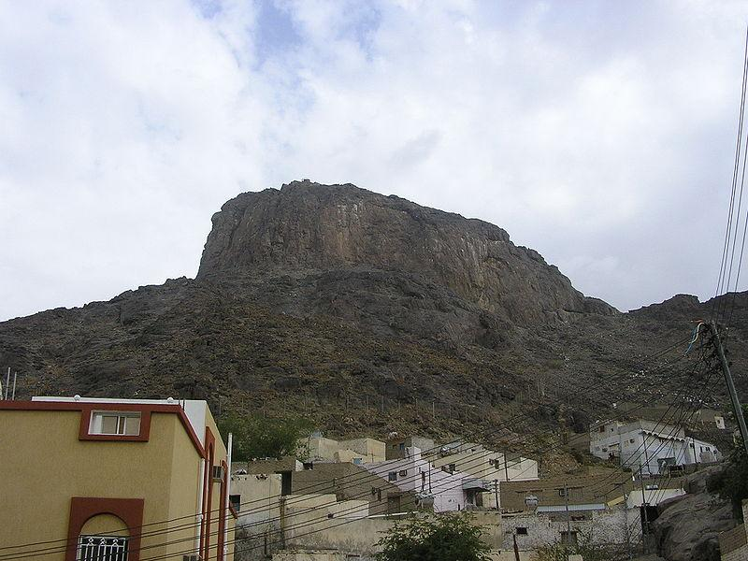
Jabal an-Nour (also Jabal an-Nur or Jabal Nur), meaning "The Mountain of Light", is a mountain near the city of Mecca in Saudi Arabia. It houses the Hira cave where Muhammad is said to have received his first revelation from God (Arabic Allah) through the angel Gabriel.

Slide 19
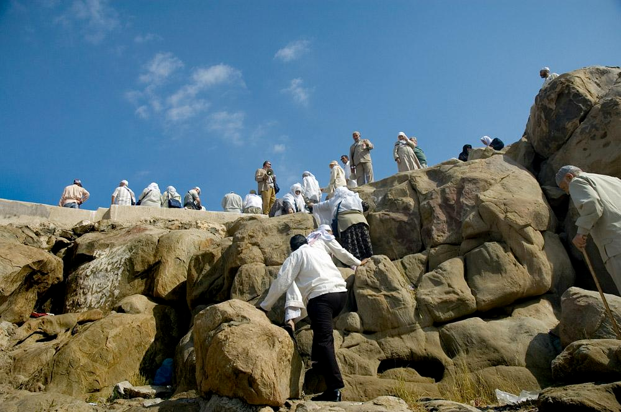
Jabal Al-Rahmah

Slide 20
On the eighth of Dhu al-Hijjah, the pilgrims proceed to Mina where they spend the night in prayer. On the ninth day, they leave Mina for Mt. Arafat where they stand in contemplative vigil and pray and recite the Quran, near a hill from which Prophet Muhammad gave his last sermon, this hill is called Jabal Al Rahmah (The Hill of Forgiveness, Mount Arafat). This is known as Wuquf, considered the highlight of the Hajj. Pilgrims must spend the afternoon within a defined area on the plain of Arafat until after sunset. No specific rituals or prayers are required during the stay at Arafat, although many pilgrims spend time praying, and thinking about the course of their lives. A pilgrim's Hajj is considered invalid if they do not spend the afternoon on Arafat.

Slide 21
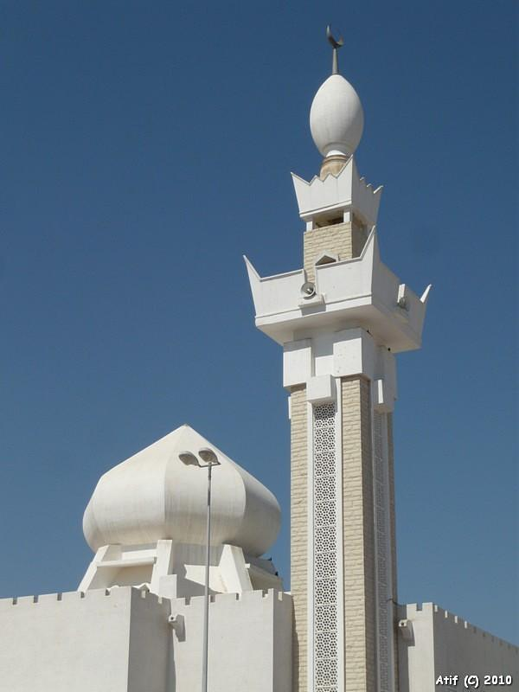
Mosque Jarana-Makkah

Slide 22
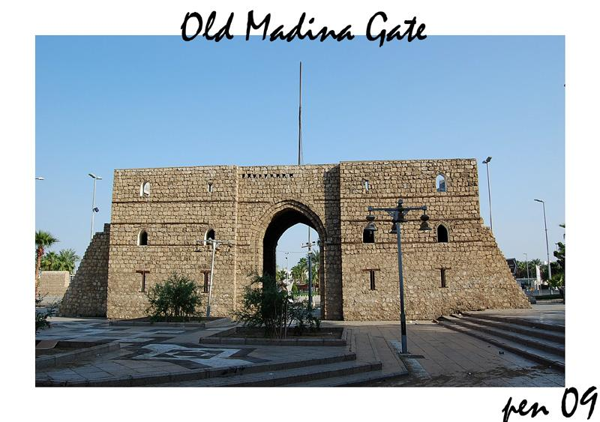
Mosques of Medina

Slide 23
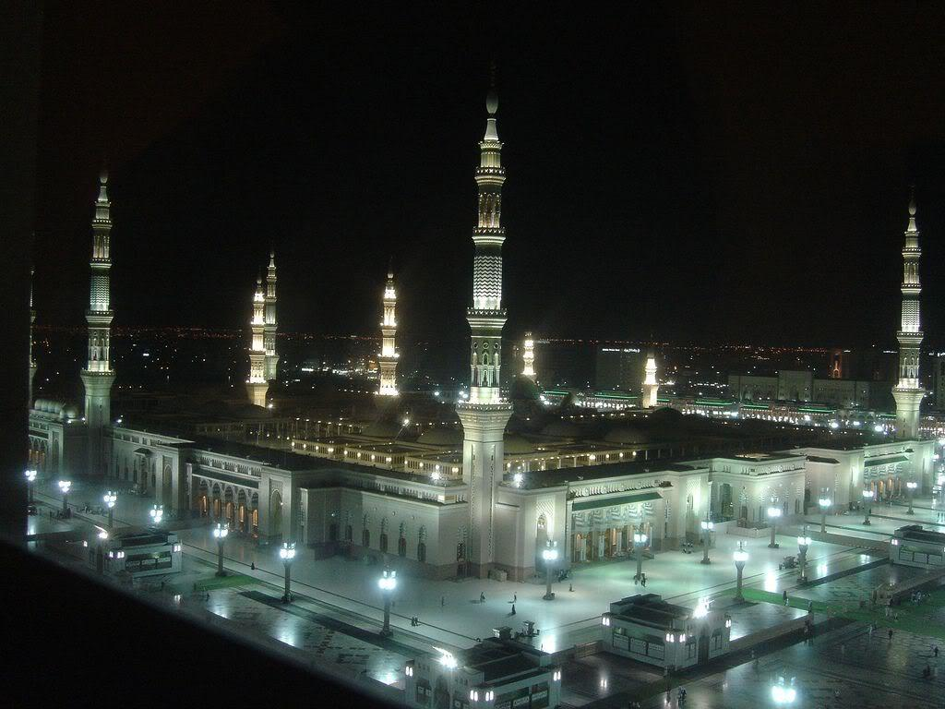
Masjid Nabawi

Slide 24
Al-Masjid al-Nabawi ("Mosque of the Prophet"), often called the Prophet's Mosque, is a mosque built by the Islamic prophet Muhammad situated in the city of Medina. It is the second holiest site in Islam (the first being the Masjid al-Haram in Mecca). It was the second mosque built in history and one of the largest mosques in the world. After an expansion during the reign of al-Walid I, it also now incorporates the site of the final resting place of Muhammad and early Muslim leaders Abu Bakr and Umar.
After completing the final Tawaf in Makkah, many pilgrims journey to Medina to visit the “Mosque of the Prophet.”

Slide 25
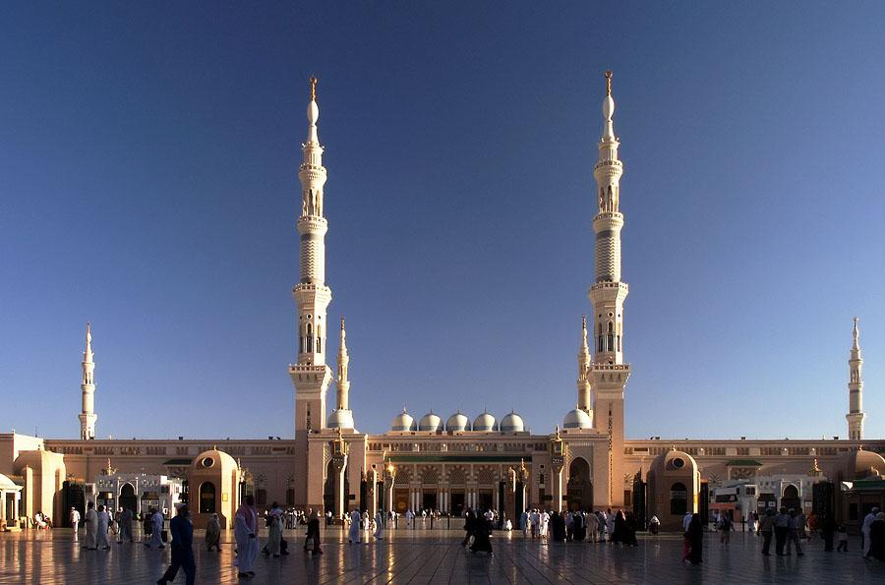
Masjid Nabawi

Slide 26
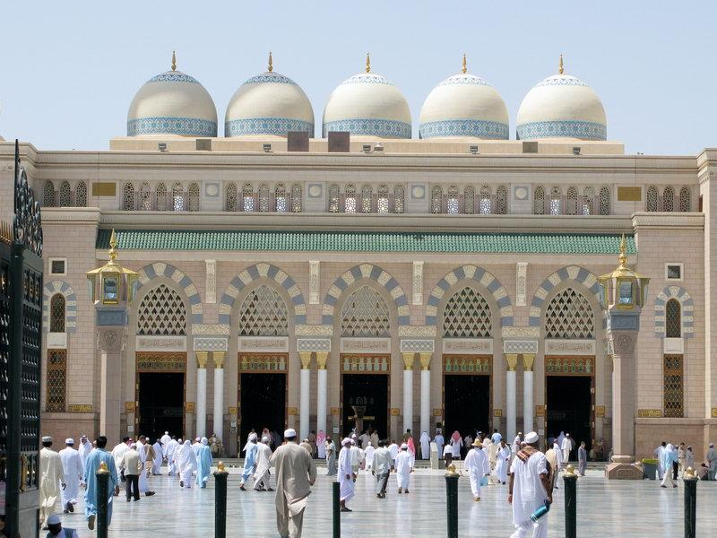
Masjid Nabawi

Slide 27
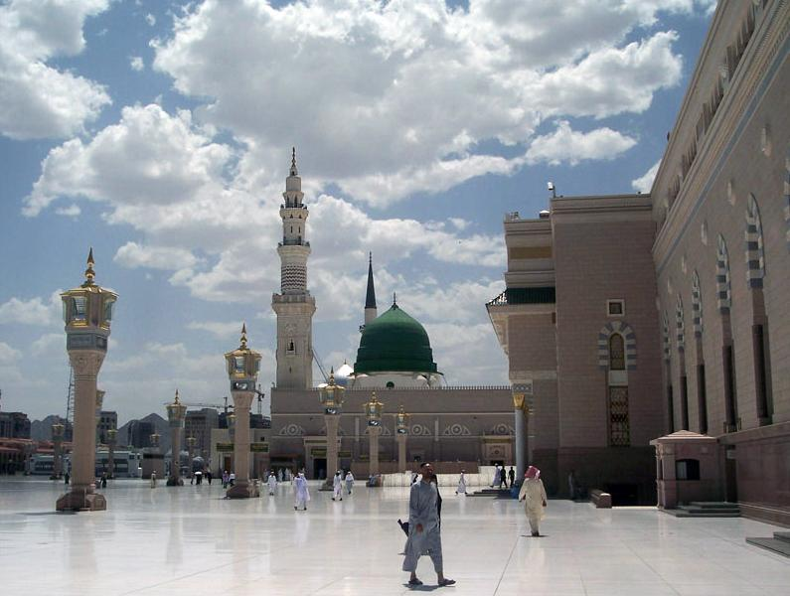
Muhammad's (Prophet of Islam) tomb is located under the Green Dome of Al-Masjid al-Nabawi.

Slide 28
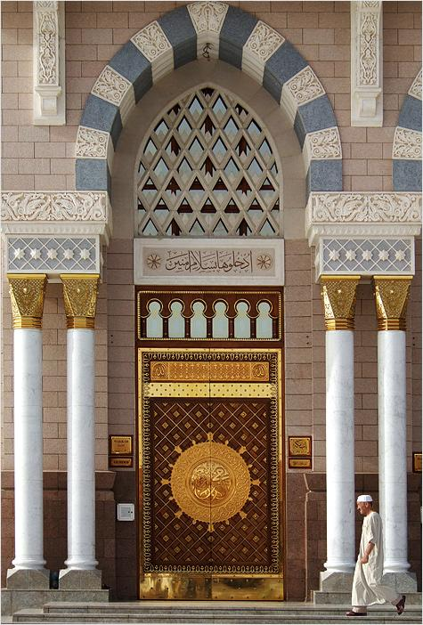
Al Medina Al Munauwara

Slide 29
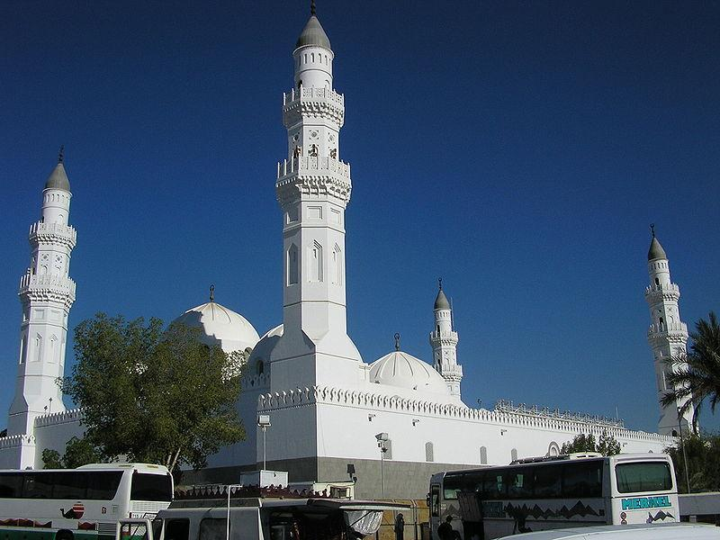
The Quba Mosque is the first mosque in history built by Muhammad upon arrival in Medina

