Slide 1
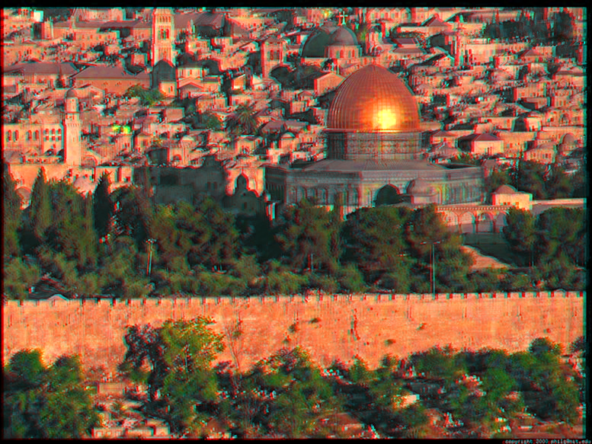
Jerusalem
You’ll like our shiny buildings

Slide 2


Slide 3
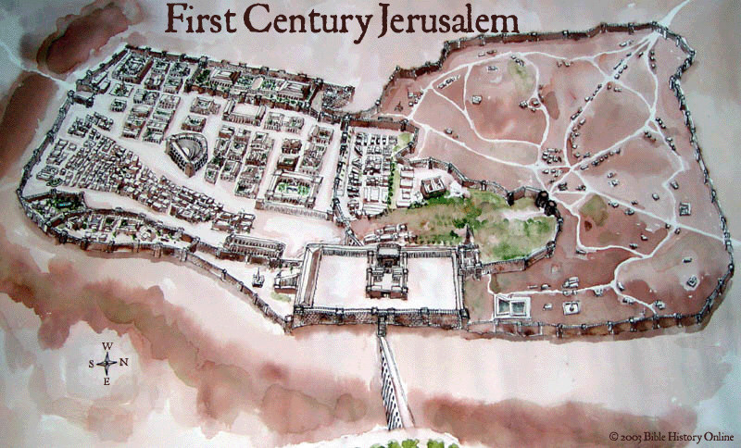

Slide 4
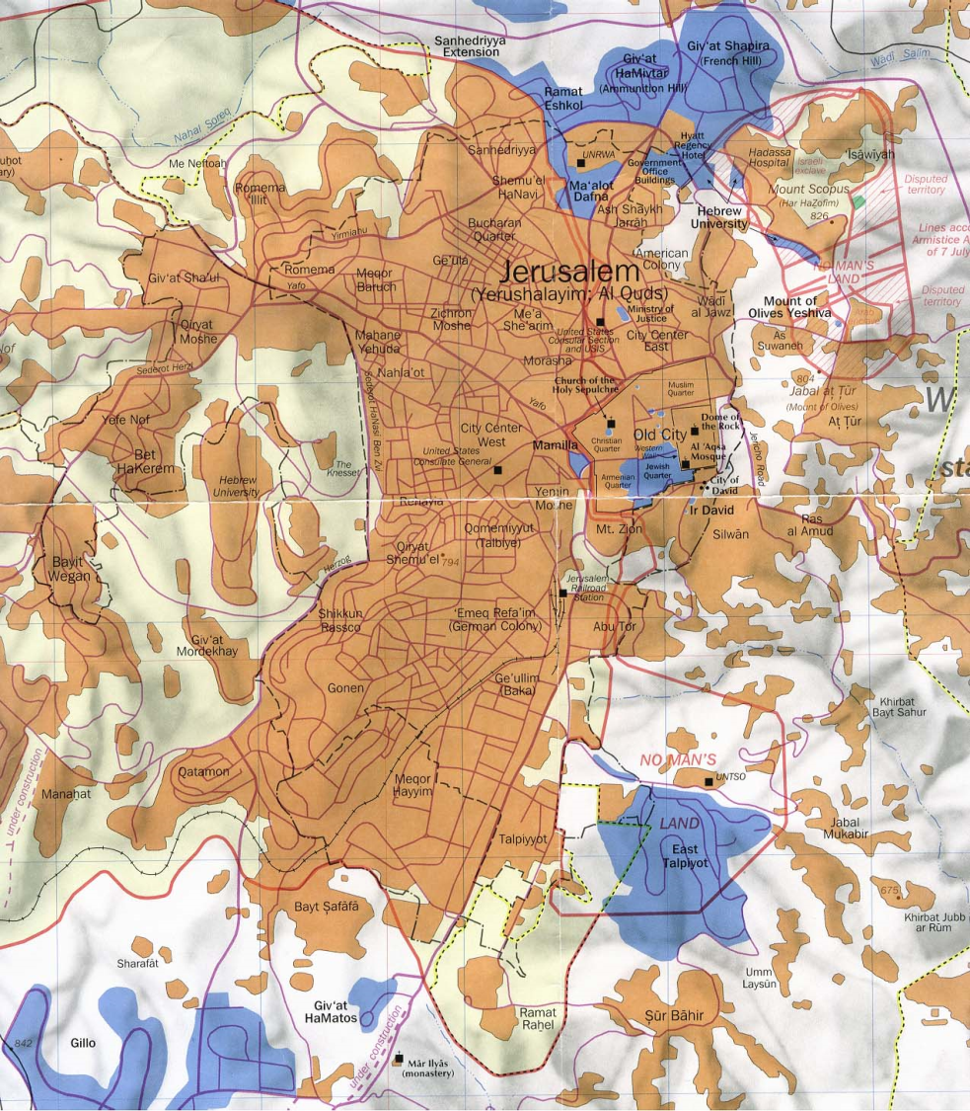
Modern Jerusalem

Slide 5
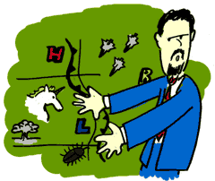
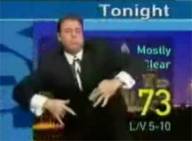
Weather
Humidity:64%
Dew Point:40 °F / 4 °C
Wind: Calm
Wind Gust:2.0 mph / 3.2 km/h
Pressure:30.14 in / 1020.5 hPa
Visibility:5.6 miles / 9.0 kilometers UV:0 out of 16
Clouds:Few 5000 ft / 1524 m
(Above Ground Level)
.

Slide 6
A Holy City to . . . .
Jews: The city of King David; where King Solomon built the first temple; the central place for worship
Christians: Jesus was a practicing Jew; he taught in the temple; he attempted to cleanse the temple.
Muslims: Muhammad stood on the temple mount (where the Jewish temple had been) and was lifted up and given a vision of heaven.

Slide 7
Apparently…
The religious sites of the city are so important that people have fought over them – Jews, Christians, and Muslims.
Past and present violence have so triggered people’s emotional “buttons,” that there seems to be little hope that they might work out a plan to share this city that is “Holy” to all three religions.

Slide 8
The irony of who these religions worship?
All three religions begin with the covenant between Abraham and God
  Two sons of Abraham
    Ishmael from whom the Arabs descended
    Isaac from whom the Jews (Hebrews) descended
      Jesus was a Jew descended from Isaac, at least on his mother’s side.
So . . . . .
  They all worship the same God.

Slide 9
Tourist/Religious Attractions!

Slide 10
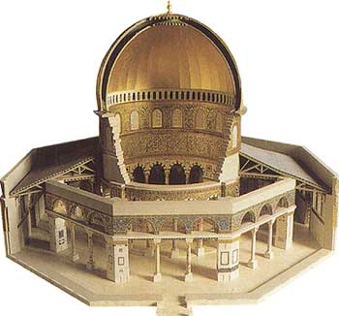
Dome of the Rock

Slide 11
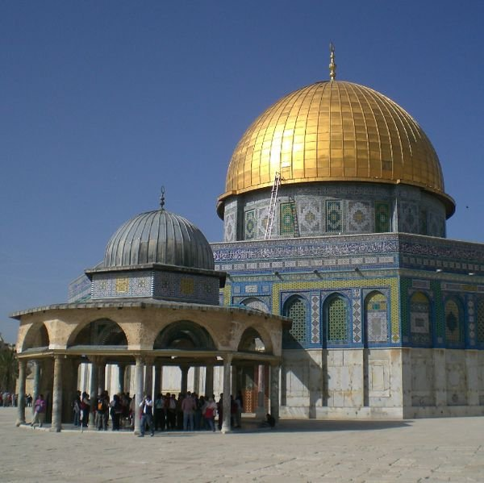
Dome of the Rock

Slide 12
The Dome’s Significance
The Dome of the rock is a holy place where Muslims touch the rock from which Mohammad was lifted up to heaven.
It is situated on the site of the Temple of Herod which was destroyed by the Romans in 70 CE.

Slide 13
The Wailing Wall
Part of what had been part of the Temple build by King Herod in Jerusalem.
It’s all the Jewish people have that is left from the temple that was destroyed in 70 C.E.
Daily, many Jewish people gather there to pray.

Slide 14
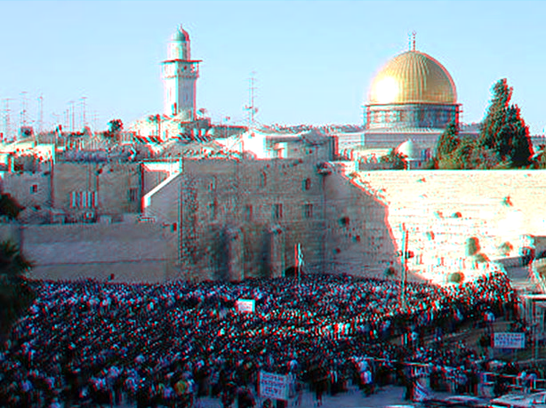
The Wailing Wall
THE DOME
THE WALL

Slide 15
Some Jews want to rebuild the Temple again!
The Dome of the Rock and a mosque are now built where the Temple stood.
To rebuild the Temple, the Dome of the Rock and the mosque would have to be demolished.
There doesn’t seem to be any kind of compromise that would satisfy both sides on this issue.

Slide 16
Christian Sites of Significance
The Church of the Holy Sepulchre
  A church built over the cave where Jesus’ body was burried
The Via Dolorosa
  The streets upon which Jesus walked while carrying his cross to his crucifixion
Calvary
  The site of the crucifixion

Slide 17
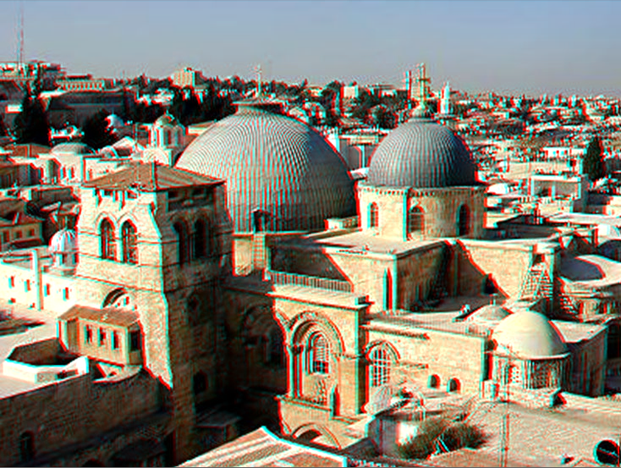
The Church of the Holy Sepulchre

Slide 18
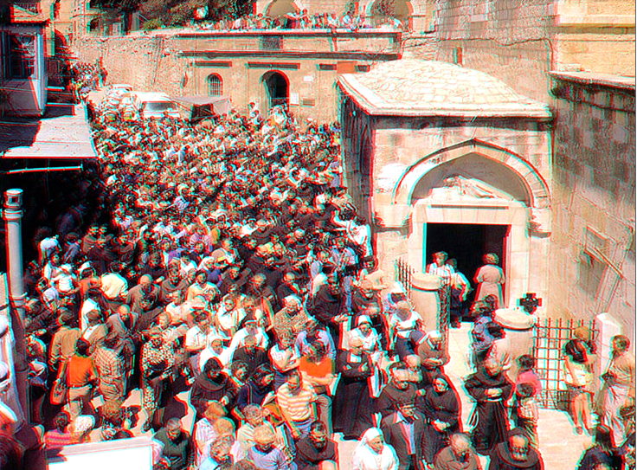
Pilgrims walking the Via Dolorosa

Slide 19
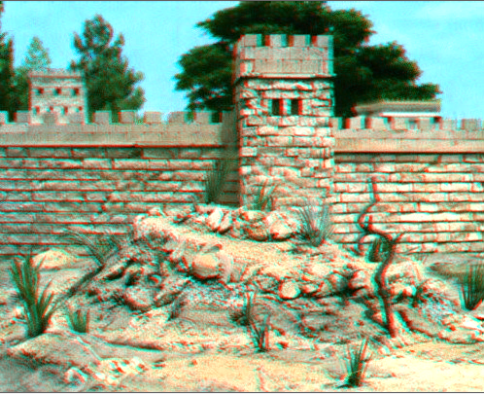
Calvary?
Scholars still aren’t in complete agreement as to the real location of Calvary.

Slide 20
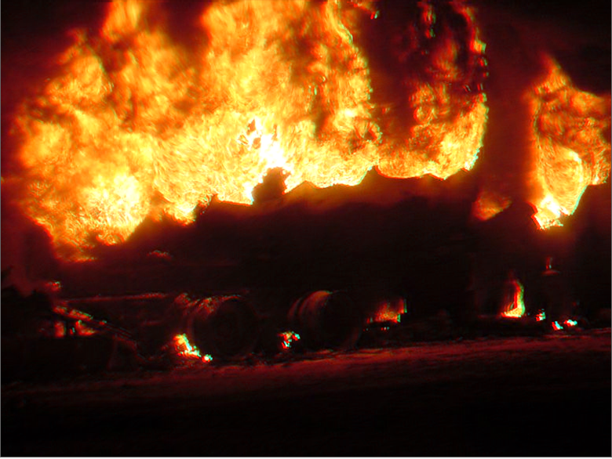
It’s an explosive situation!

Slide 21
Major wars between religious factions!
The Crusades – Christians vs. Muslims
  1096 – 1270 C.E. (at least 8 separate crusades)
Anti-Israel Wars – Jews vs Palestinian Muslims
  1948
  1956
  1967
  1973
  2009 – Israel vs. Gaza

Slide 22
The most reasonable solution
Make Jerusalem and international city administered by the United Nations
  Open to all peaceful people
This has been rejected by Muslims, Jews, and many Christians.

Slide 23
A sad truth . . . .
The thing that parents seem to be best able to teach their children is hatred
  It gets passed from generation to generation
    Examples: Israel/Palestine; Northern Ireland; Bosnia; Rwanda etc.

Slide 24
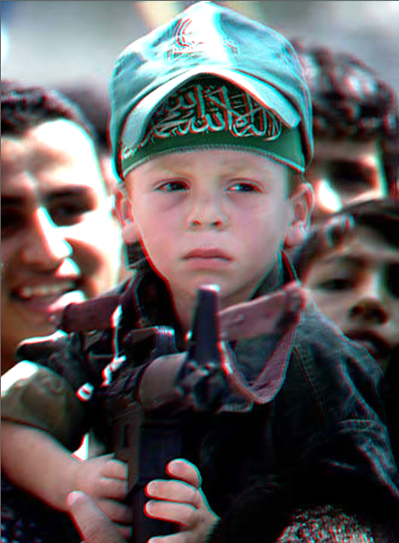
This is not the way to teach peace and cooperation!!!!!

Slide 25
When will it ever end?

