Slide 1
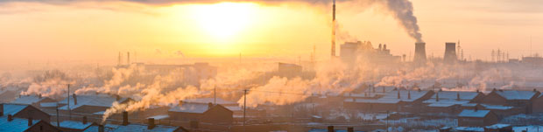
China May be #1 in Air Pollution

Slide 2
Some Key Points
China burns half of the coal burned in the world
China’s efforts to control pollution have been woefully inadequate
January 2014, when the air pollution index in Los Angeles was 93, Bejing’s index was above 600
Beijing’s air quality is 20 times higher than the highest level considered safe.

Slide 3
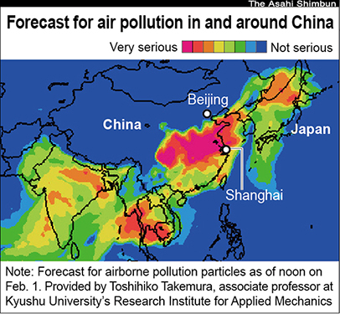

Slide 4
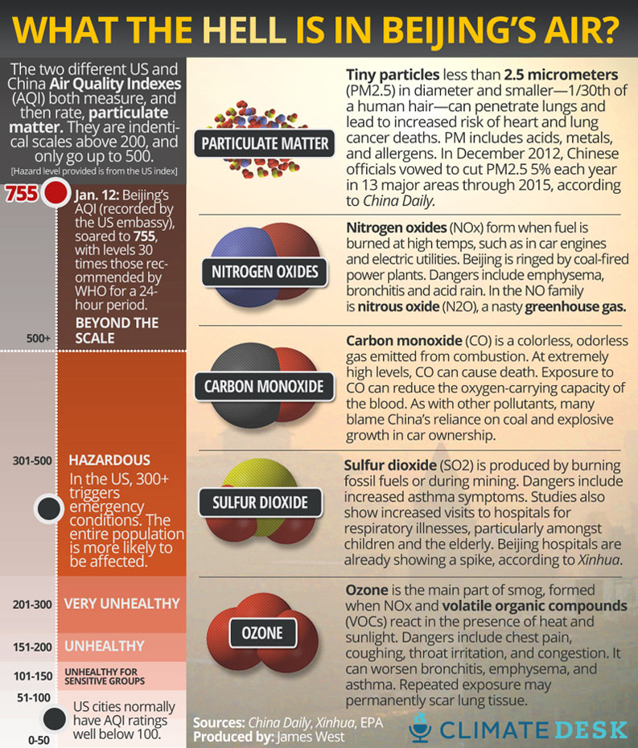

Slide 5
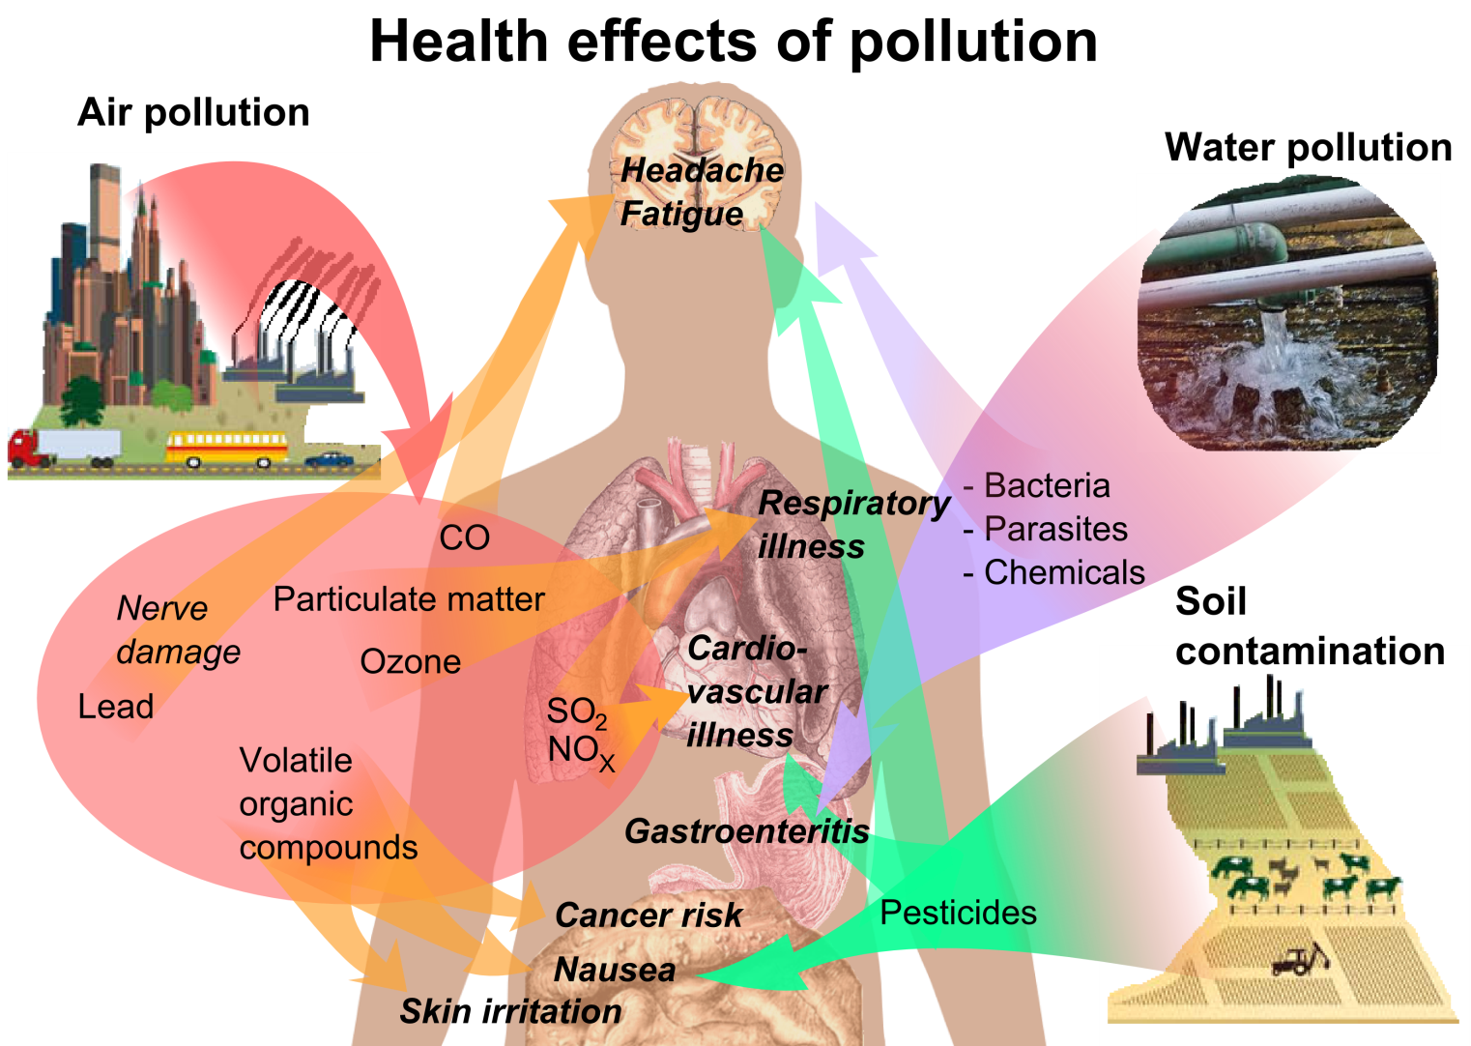

Slide 6
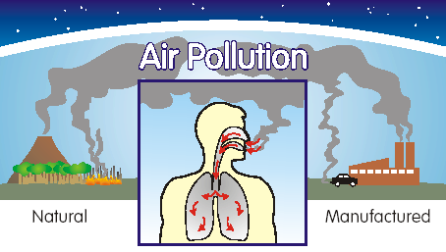

Slide 7
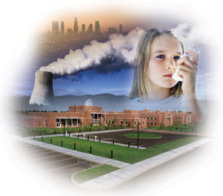

Slide 8
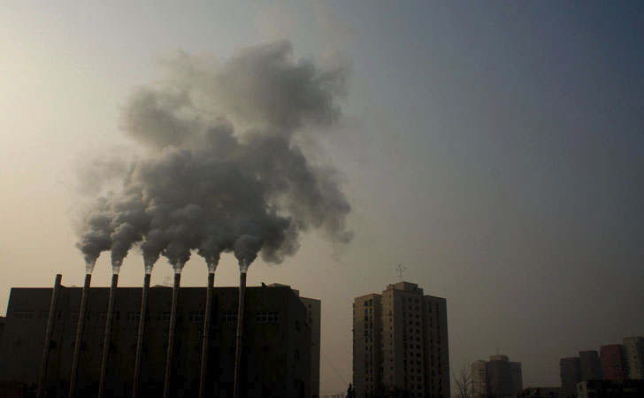
SOURCE: Heavy smoke coming out from chimneys in the Wangjing community, Beijing.

Slide 9
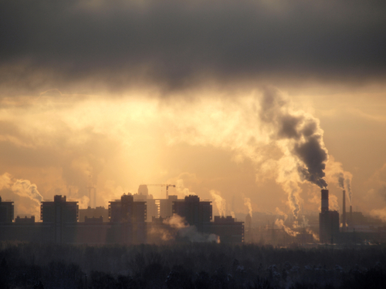

Slide 10
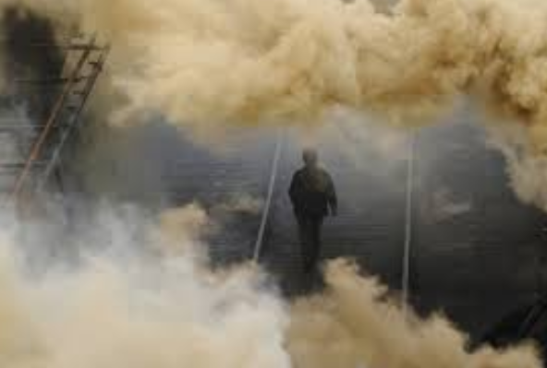

Slide 11
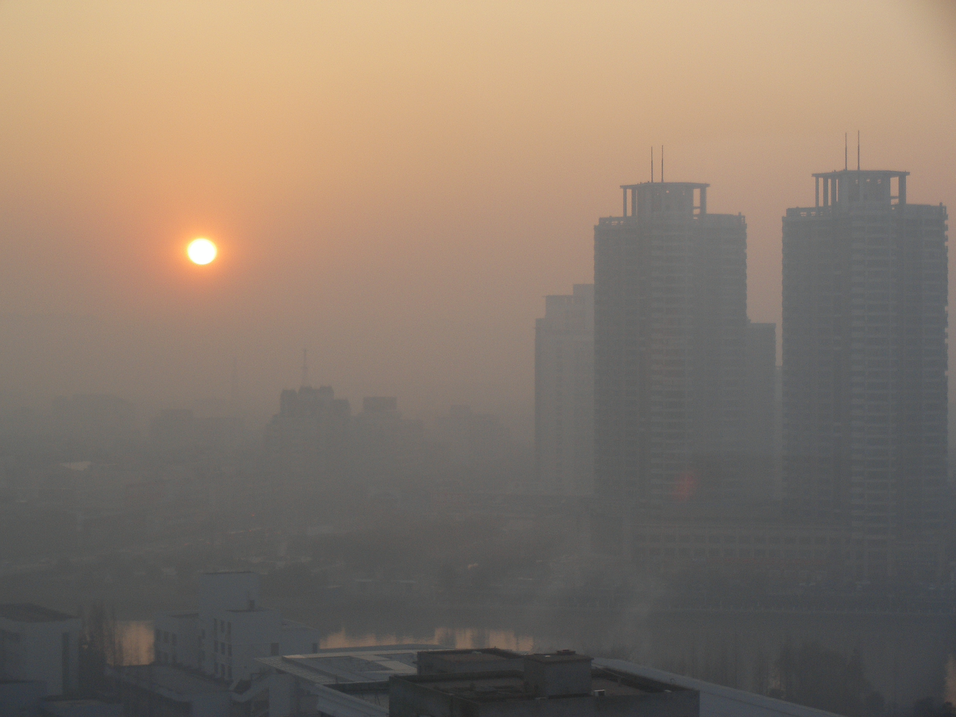
A sunny day in Beijing

Slide 12
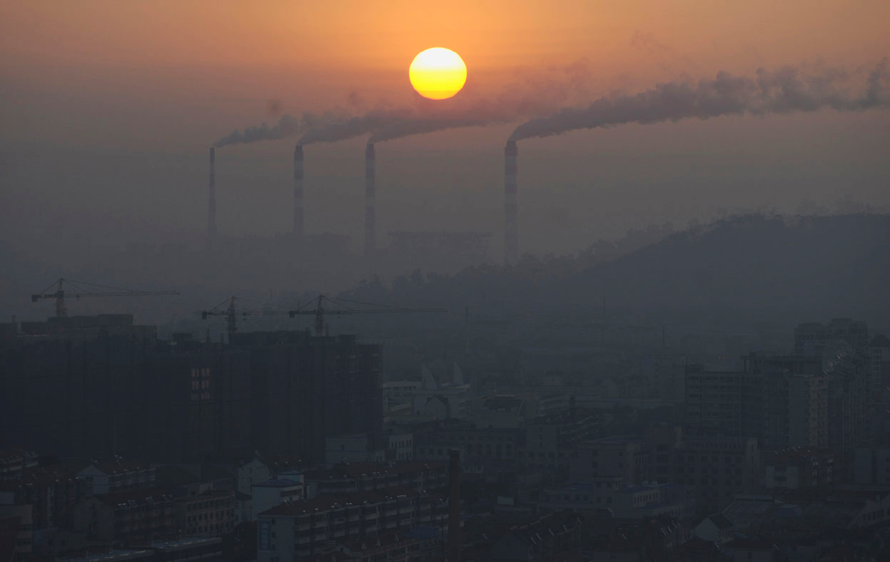
Another sunny day picture

Slide 13
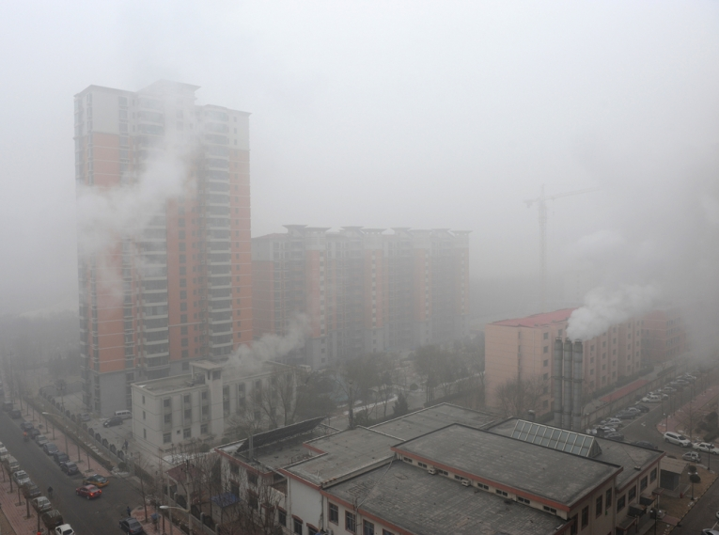

Slide 14
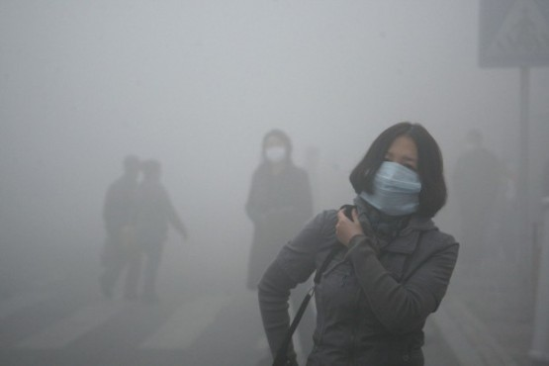
Surgical masks may help some, but are inadequate

Slide 15
It isn’t just in beijing

Slide 16
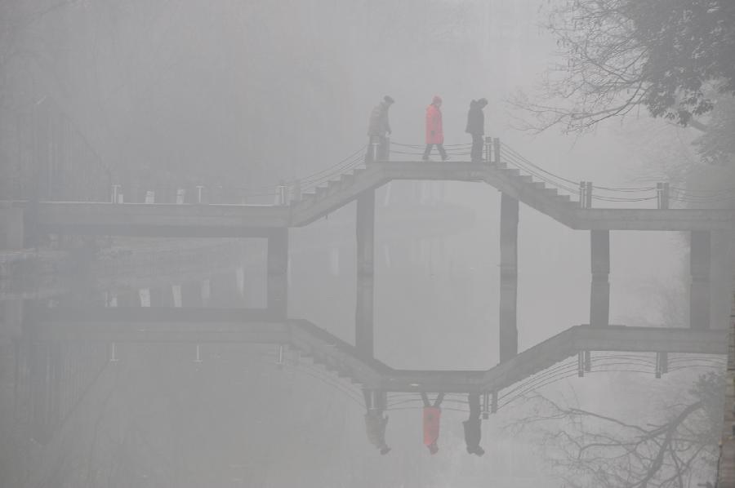
Hefei, capital of Anhui Province

Slide 17
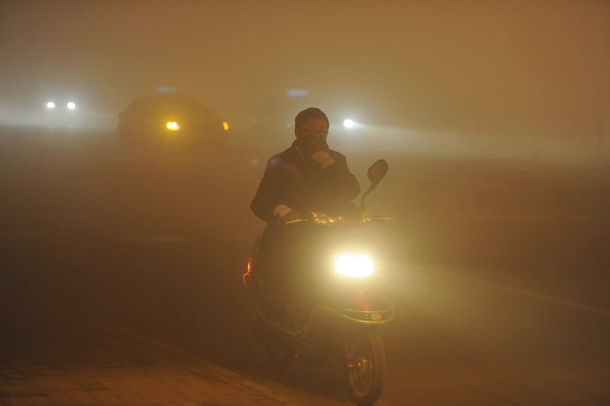
A man covering his mouth with his hand as he rides amidst the heavy fog in Hefei, central China's Anhui province.

Slide 18
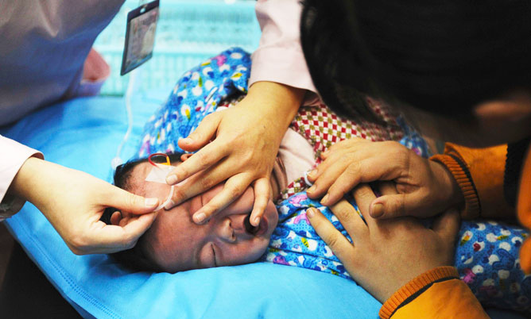
A nurse puts in a drip for a baby diagnosed with respiratory diseases at a provincial children's hospital in Hefei, Anhui province.

Slide 19
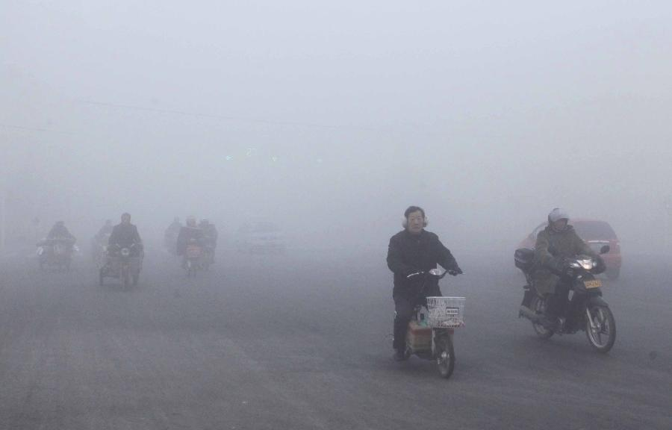
Jiangsu Province

Slide 20
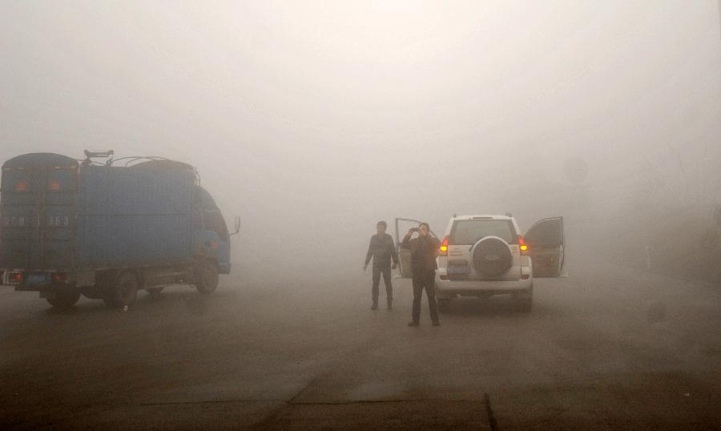
Guangxi Zhuang Autonomous Region

Slide 21
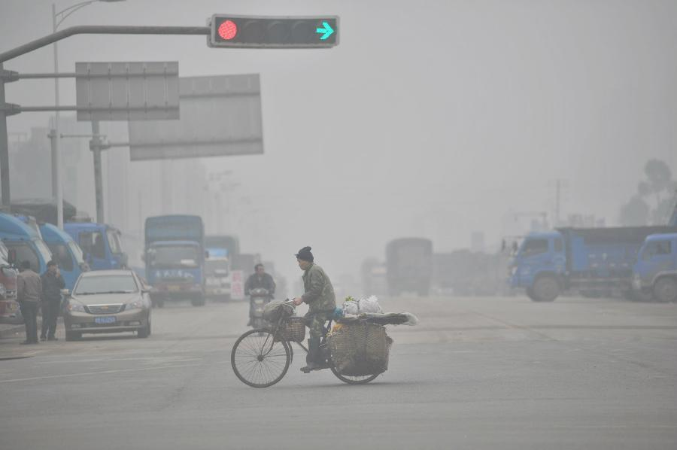
Liuzhou City, southwest China's Guangxi Zhuang Autonomous Region

Slide 22
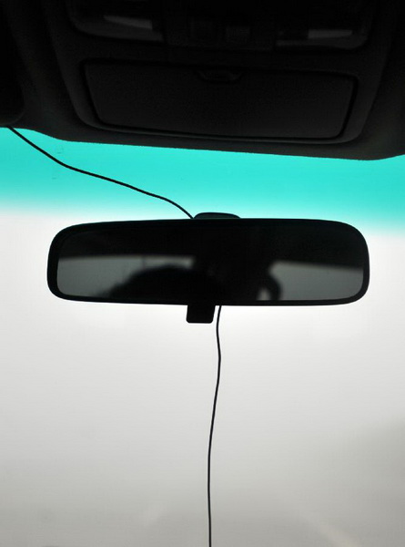
Photo taken on Jan. 13, 2013 from the car windscreen shows a fog-shrouded road in Guilin, southwest China's Guangxi Zhuang Autonomous Region, Jan.

Slide 23
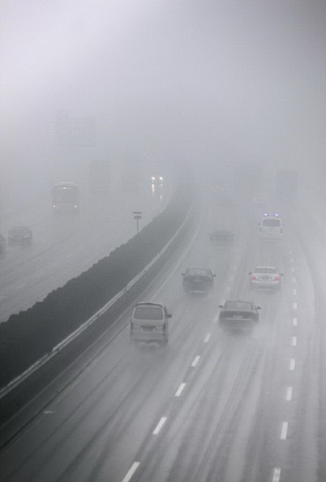
Shenyang-Haikou Expessway in Nantong, east China's Jiangsu Province

Slide 24

a boat on the West Lake in the fog in Hangzhou, capital of east China's Zhejiang Province

Slide 25
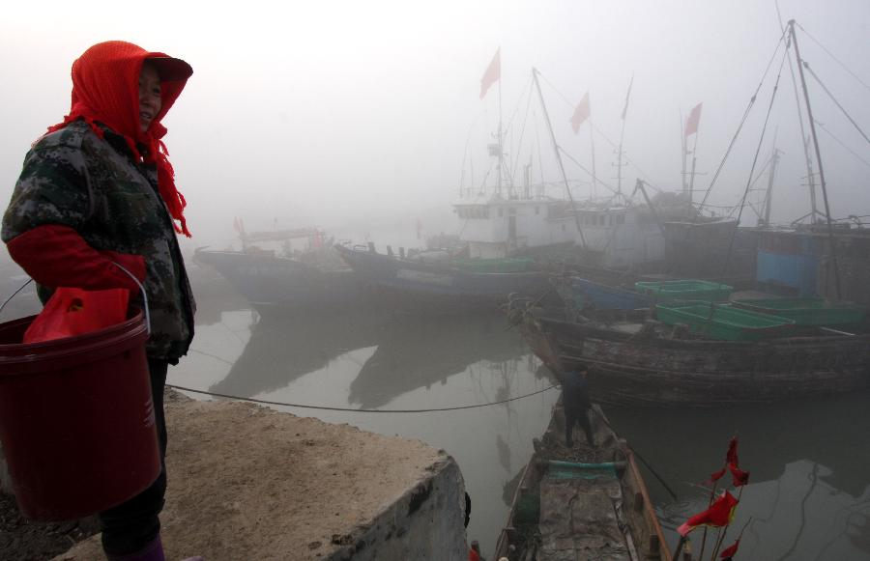
a fog-shrouded fishing port in Lianyungang City, east China's JIangsu Province

Slide 26
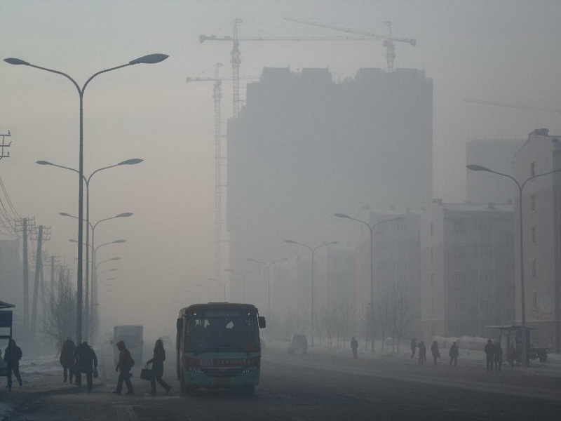
Qiqihar, northeast China's Heilongjiang Province

Slide 27
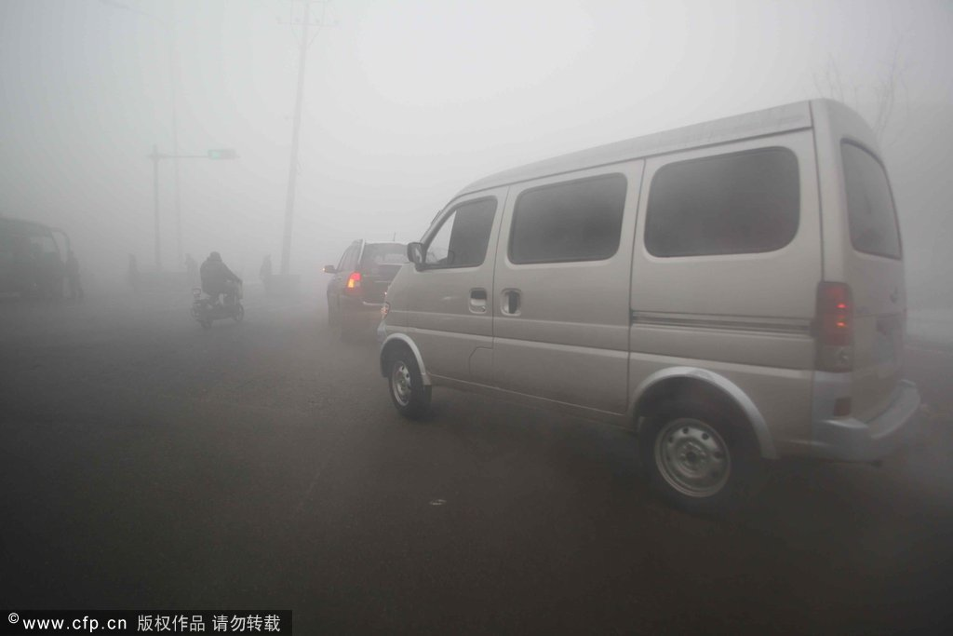
China's Tianjin municipality

Slide 28
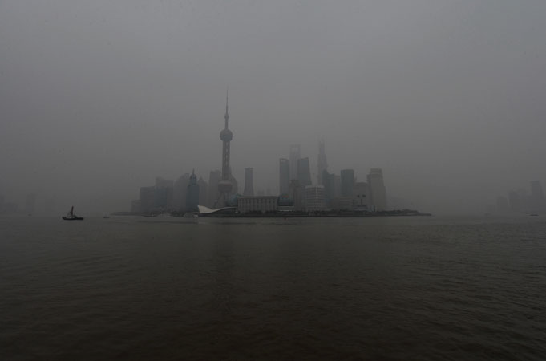
The Pudong business district is shrouded by heavy air pollution in Shanghai.

Slide 29
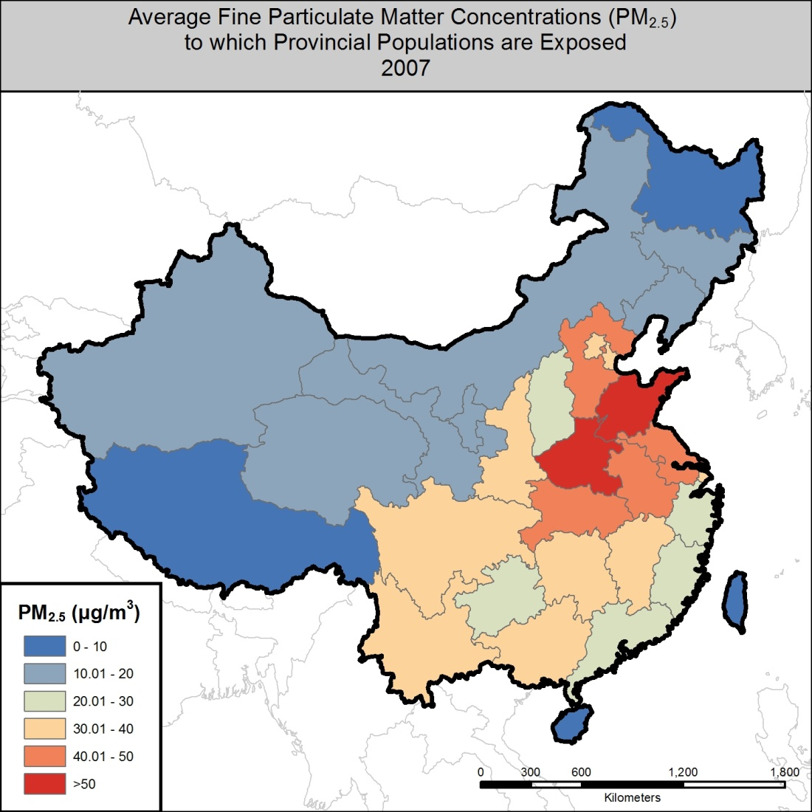
This was 2007; it’s worse now in 2014

Slide 30
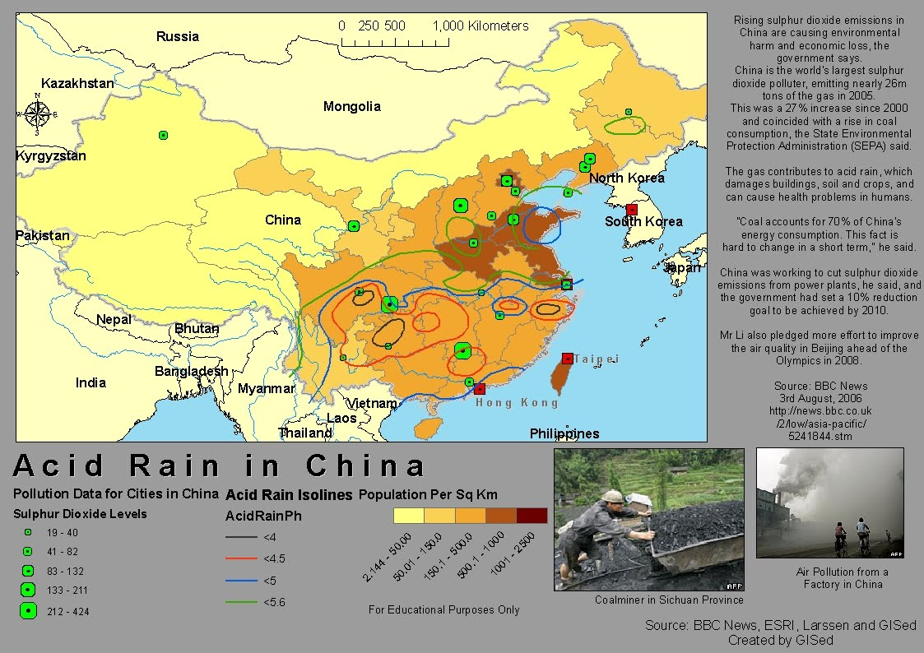

Slide 31
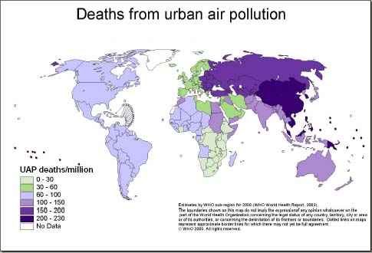

Slide 32
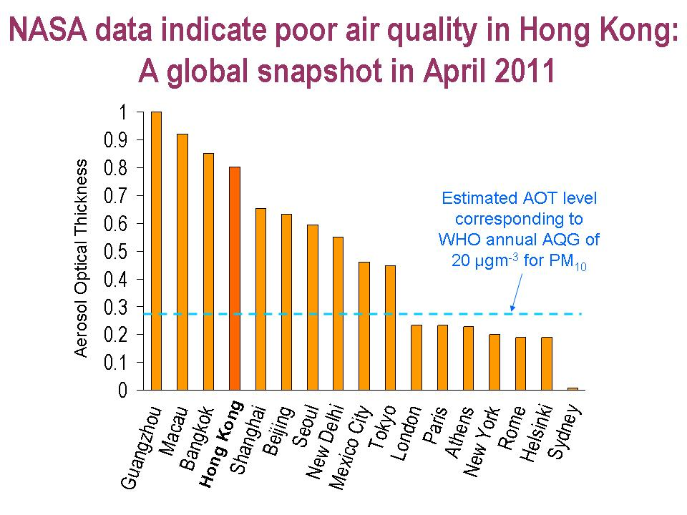

Slide 33
It doesn’t just affect China!

Slide 34
BEIJING (Reuters) - Pollution from China travels in large quantities across the Pacific Ocean to the United States, a new study has found, making environmental and health problems unexpected side effects of U.S. demand for cheap China-manufactured goods.
On some days, acid rain-inducing sulphate from burning of fossil fuels in China can account for as much as a quarter of sulphate pollution in the western United States, a team of Chinese and American researchers said in the report published by the U.S. National Academy of Sciences, a non-profit society of scholars.

Slide 35
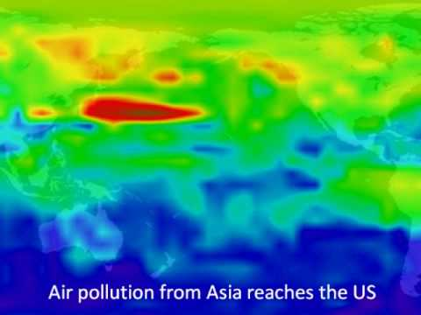

Slide 36
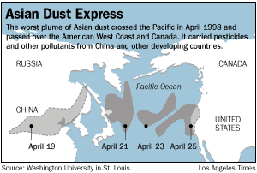

Slide 37
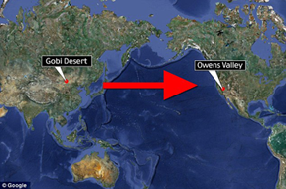

Slide 38
