Slide 1
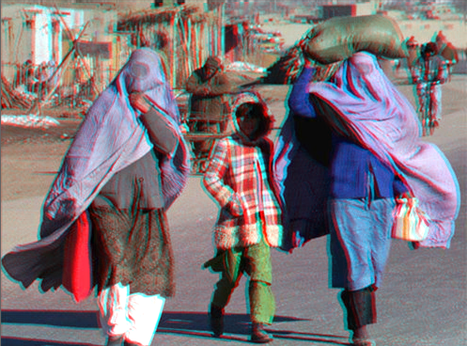
Afghanistan -- An overview:
Physical, Cultural, & Political
Developed by Joe Naumann
From a lesson plan by
Steve Pierce
North Carolina Geographic Alliance

Slide 2
Background
Afghanistan has had a long history of internal and external conflicts, including two wars with the United Kingdom in the 1800s and an invasion by the Soviet Union in 1979. Since the Soviets left in 1989, Afghanistan has experienced many internal conflicts over control of the country.

Slide 3
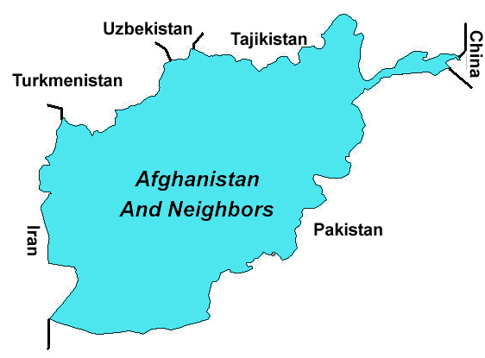
A Crossroads and a Buffer State
Caught between many neighboring states
  Crossroads on ancient trade routes
  Buffer between differing religions
  Buffer between major powers

Slide 4
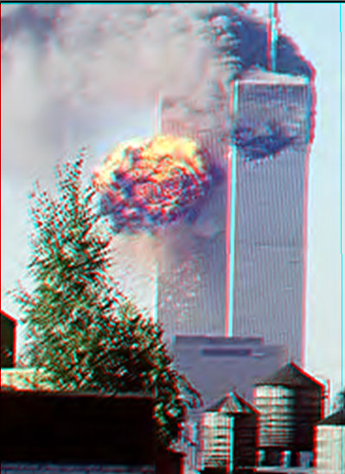
American interest began when . .
Terrorist attack on the World Trade Center in New York on September 11, 2001
Osama Bin Laden was identified as being the leader of a terrorist organization with headquarters in Afghanistan that planned the attack

Slide 5
Background
In 1996 a group called the Taliban seized control of most of the country. The Taliban was accused of supporting the terrorists that attacked the World Trade Center and the Pentagon on September 11, 2001. U.S. and allied military forces began conducting air strikes on Taliban facilities in Afghanistan on October 7, 2001.

Slide 6
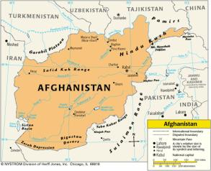
Political Map

Slide 7
Afghanistan in Spatial Terms
Absolute Location: 33ºN, 65ºE
Relative Location: Landlocked country in southwest Asia
Neighbors: North and west of Pakistan; east of Iran; South of Turkmenistan, Uzbekistan, and Tajikistan
  China shares a border with Afghanistan on the east along the Wakhan Corridor
  The disputed region of Kashmir lies south of the Wakhan Corridor
Area: 251,825 sq. mi. (about size of Texas)

Slide 8
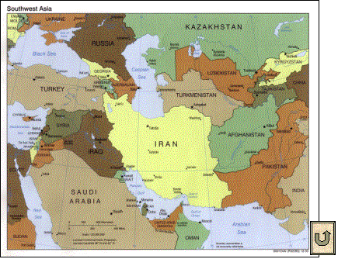
Southwest Asia Map

Slide 9
Places & Regions
Afghanistan lies at the crossroads of three major regions.
  South Asia - Pakistan and India lie to the east
  Southwest Asia/Middle East - Iran, Iraq, and the Persian gulf lie to the west.
  Central Asia - five republics of the former Soviet Union lie to the north: Turkmenistan, Uzbekistan, Tajikistan, Kyrgystsan, and Kazakstan.

Slide 10
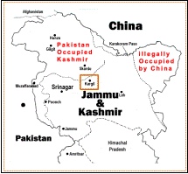
Kashmir
Kashmir, a region occupied by Pakistan and India, lies south of the Wakhan Corridor of Afghanistan. This disputed territory is the scene of sporadic fighting between the armies of Pakistan and India. China also occupies a part of Kashmir.

Slide 11
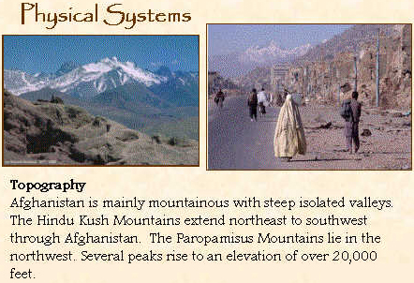

Slide 12
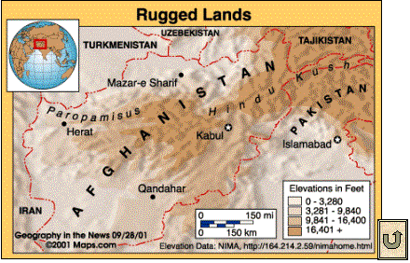

Slide 13
Physical Systems
Afghanistan has a wide variety of natural features including high mountains, large areas of desert and plains, and fertile valleys. The country has three main land regions
  The Northern Plains is the northernmost region in Afghanistan.
  The Central Highlands cover about two-thirds of the country. This region includes the Hindu Kush. Most of the people of Afghanistan live in the narrow valleys of the Hindu Kush.
  The Southwestern Lowlands mainly consist of deserts or semi-deserts.

Slide 14
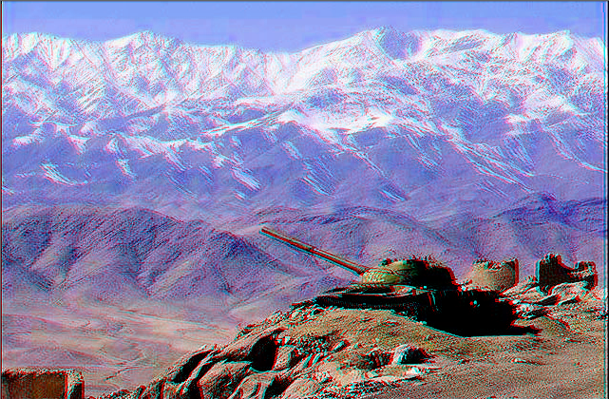
Rugged Terrain
Mountains in Afghanistan

Slide 15
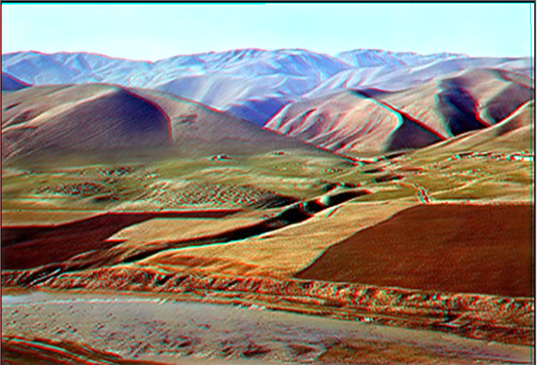
Rugged Terrain
Hills and river valley in Afghanistan
tan

Slide 16
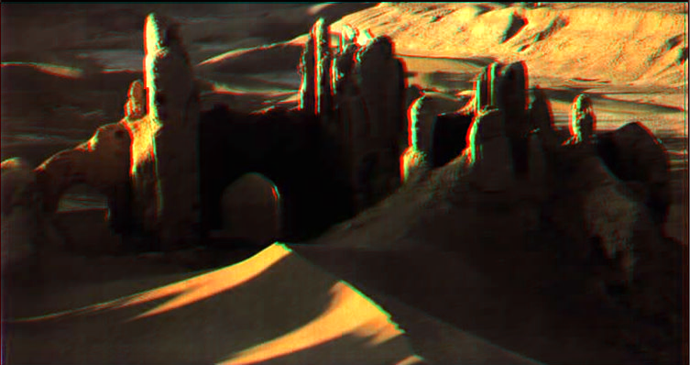
A Harsh, Difficult Place to Live
Barren highlands & valley in the background

Slide 17
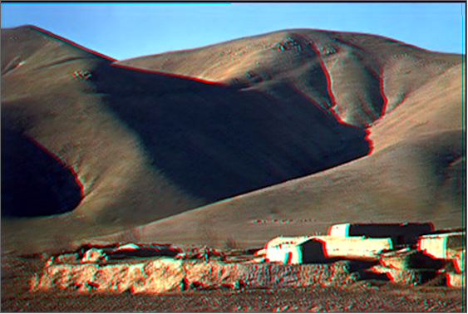
A Harsh, Difficult Place to Live
Raising sheep in a barren land

Slide 18
Climate
Afghanistan has a harsh continental climate. Harsh winters are accentuated by high elevation. Summers are warm, except at the highest elevations. Much of the country is arid or semi- arid. Precipitation is light, falling mostly in the spring and winter. Almost no precipitation falls from June to October.

Slide 19
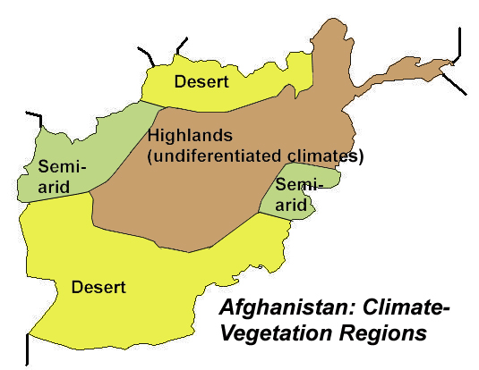
Generalized Climate Zones
Only about 12% of the land is arable.

Slide 20
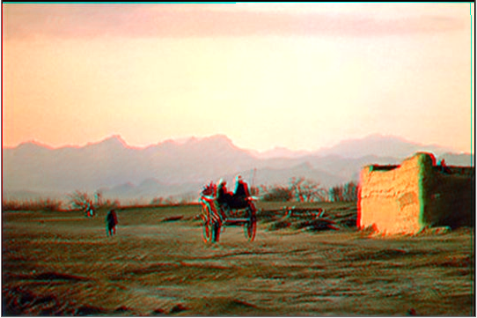
Dry as well as Cold Climate
Southern desert

Slide 21
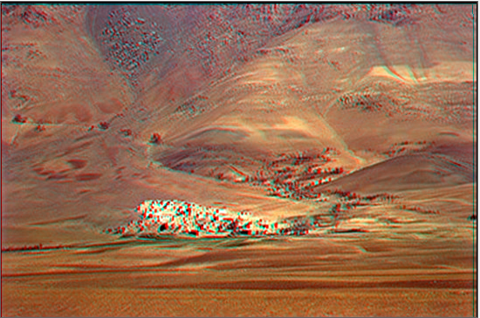
Dry as well as Cold Climate
Village in arid valley

Slide 22
More Climate
The climate graphs show the pattern of temperature and precipitation. January lows in Kabul can reach in the teens, while July highs can reach the low 90’s. In the south average high temperatures can reach the low hundreds in the summer. Precipitation ranges from about 13 inches per year in Kabul, and about 6 inches in Kandahar in the south

Slide 23
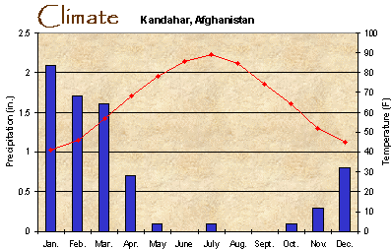

Slide 24
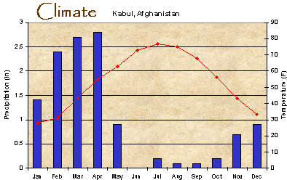
Climate Graphs

Slide 25
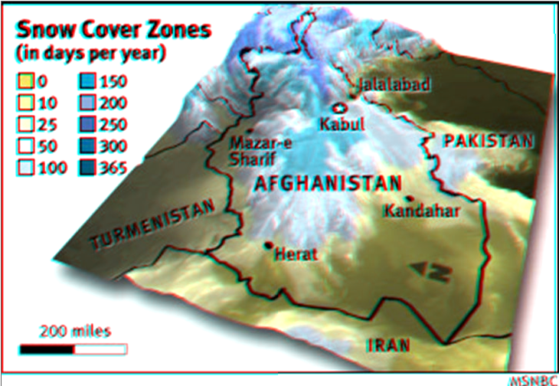
Harsh Winter
Nearly half of Afghanistan has 100 or more days of snow cover per year

Slide 26
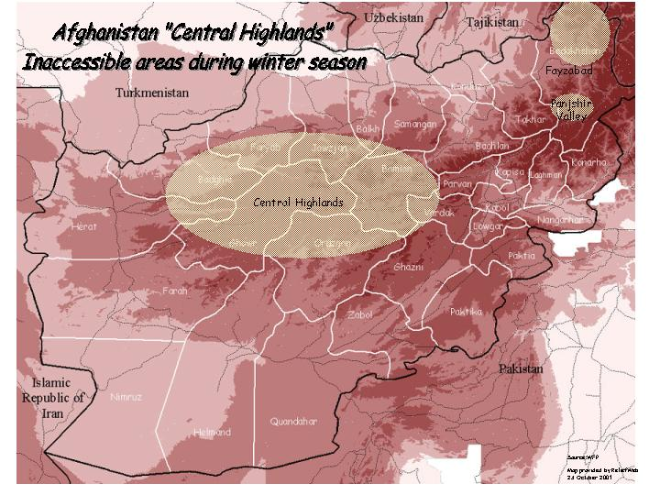
Inaccessible in the winter

Slide 27
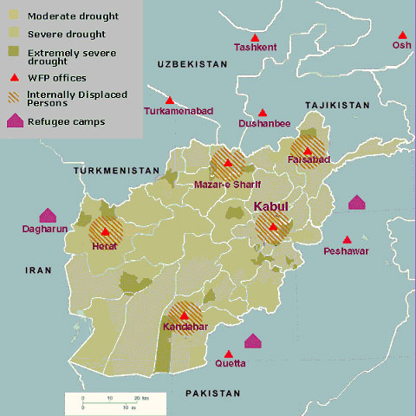
Drought 2001
Drought, the other side of harsh – moderate to severe all over the country

Slide 28
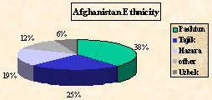
Human Systems
Most people live in rural areas - only 20% of the population is urban. Most live in fertile river valleys between high ridges that separate them. This leads to a fragmentation of the population and identification with tribe rather than nation.
  Pashtun - 38%
  Tajik - 25 %
  Hazara - 19%
  other groups - 12%
  Uzbeks - 6%

Slide 29
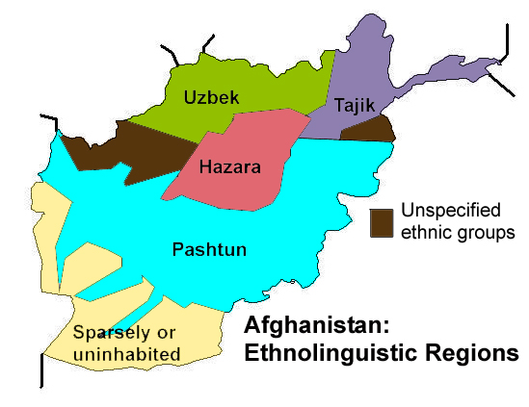
Simplified Ethnic Map

Slide 30
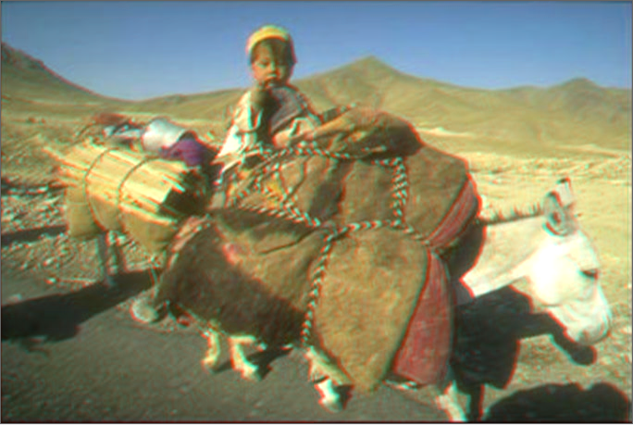
DIVERSITY: Child of Koochi nomad tribe

Slide 31
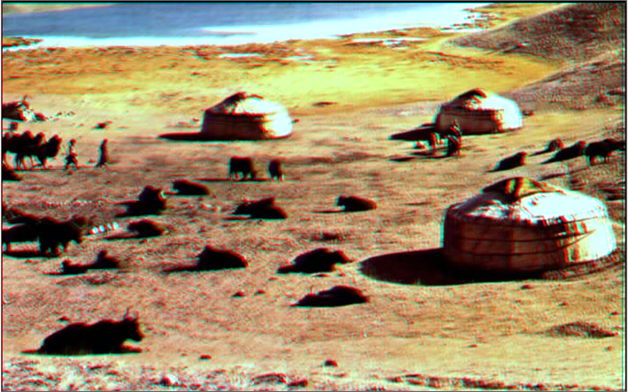
Kunduz Nomads
20 years of fighting have made life difficult for the nomadic pastoral tribes

Slide 32
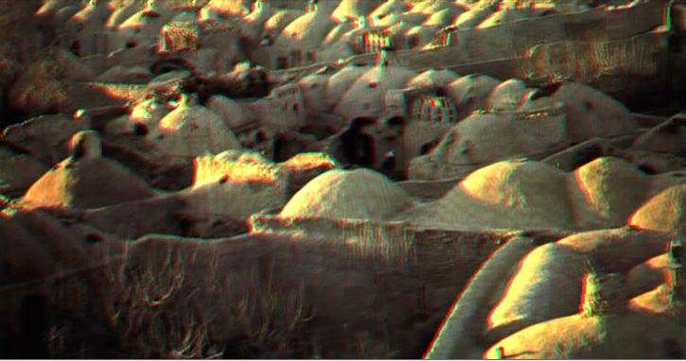
Traditional village
Gumbazee village built with no wood

Slide 33
Languages and Religion
The major languages spoken in the country are:
  Dari (Afghan Persian) - 50%
  Pashtun - 35%
  Turkic languages - 11%
Islam is the predominant religion
  84 % are Sunni Muslim
  15 % are Shi’a Muslim

Slide 34
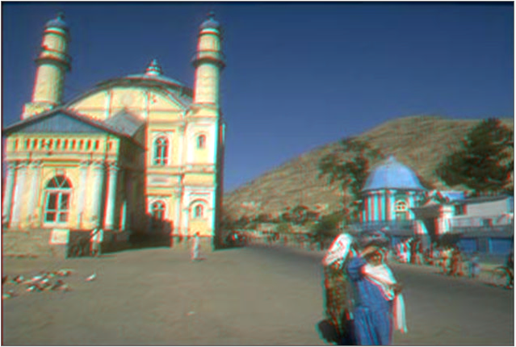
Islam is the dominant religion
Mosque in Kabul
The Taliban imposed their extremely strict, more than just fundamental, interpretation of Islam on everyone.

Slide 35
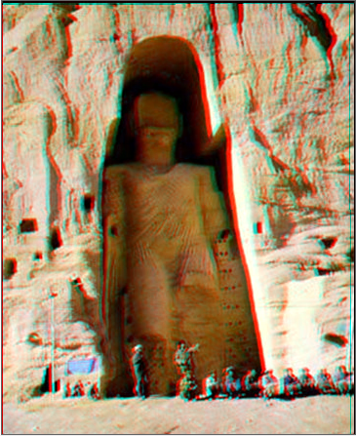
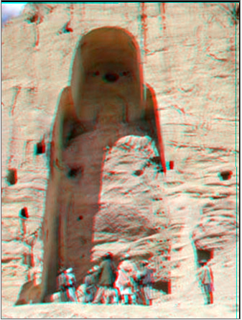
Taliban intolerant destruction of Historic Buddhist Religious Art
Bamyan Buddha before (left)
After the explosion (right)

Slide 36
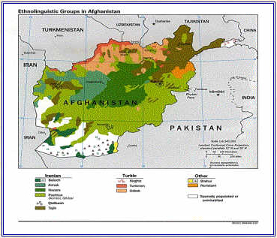
Linguistic Map

Slide 37
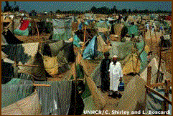
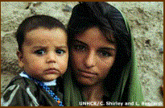
Refugees
Afghans constitute the largest single refugee population in the world with an estimated 6 million people or 30 percent of the global refugee population. The population has been greatly affected by a refugee problem for years. Large numbers of Afghans are refugees in Pakistan.

Slide 38
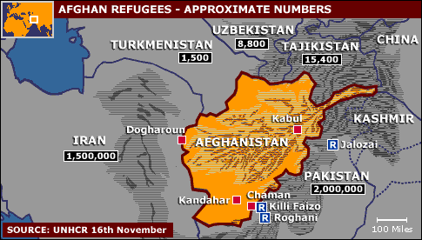
Refugees
Pakistan has received the most

Slide 39
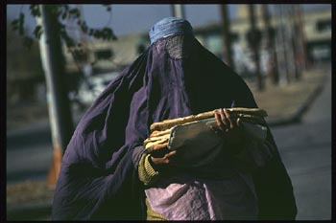
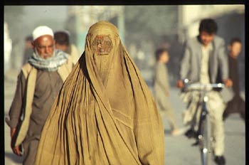
Women
In areas under Taliban control women were required to wear a burka when outside the home. This covers the body head to toe.
Schools were closed for girls, and professional women lost their jobs as they were not permitted to work outside the home. 30,000 widows in Kabul were been denied employment that had served as their only income.

Slide 40
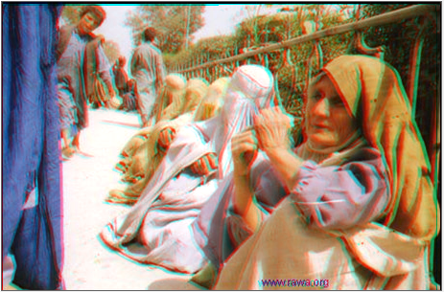
Difficult conditions
Women forced to beg in Mazar-e-Sharif by Taliban

Slide 41
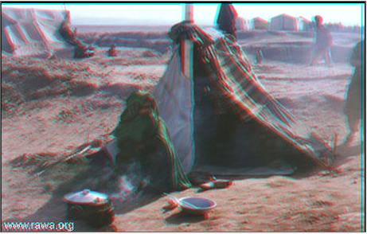
Difficult conditions
Cooking grass in refugee camp for lack of better food

Slide 42
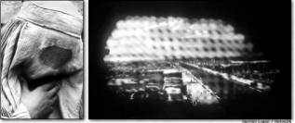
View Through the Burka
View through a veil, or burka, which all Afghan women are required to wear outside the home. Restricted vision has reportedly caused numerous accidents involving vehicles and women pedestrians.

Slide 43
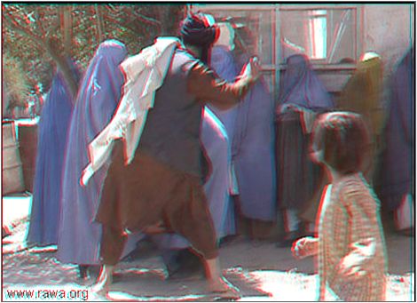
Harsh Treatment of Women by Taliban
Beating women

Slide 44
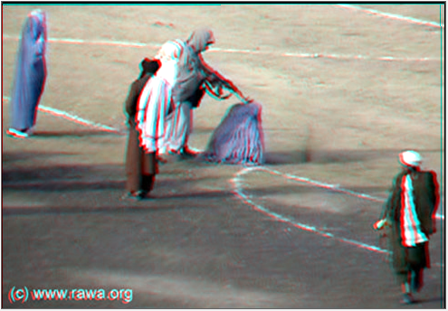
Harsh Treatment of Women by Taliban
Executing a woman publicly

Slide 45
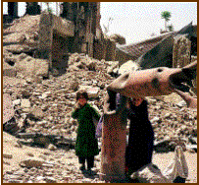
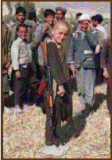
Suffer the Little Children
More than 10 million children have suffered under 10 years of drought and civil war.
  Afghanistan ranks number 1 in worldwide maternal mortality
  One in three Afghan children is an orphan
  Almost half of Afghan children suffer from chronic malnutrition

Slide 46
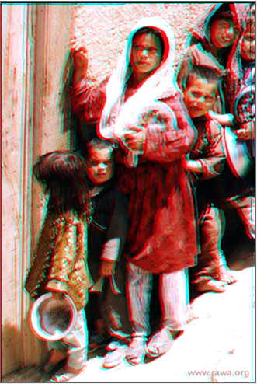
Hungry Children
Kids wait in line for food aid

Slide 47
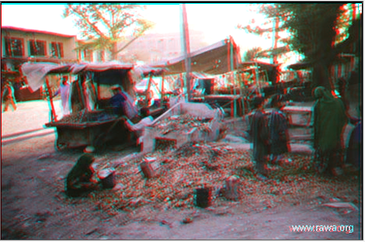
Hungry Children
Looking in garbage

Slide 48
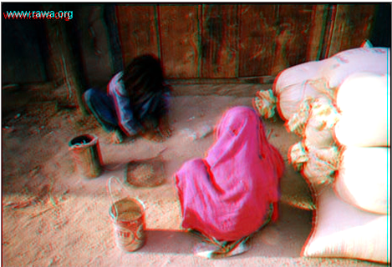
Hungry Children
Picking wheat grains from ground

Slide 49
Demographics
Population - 26,813,075 (2001 est.)
Age Distribution
  0-14 years - 42 %
  15-64 years - 55%
  65 + - 2.79%
Life Expectancy - 47 male; 45 female
Population Growth Rate - 2.5%
Population Doubling Time - 29 years
Infant Mortality Rate – 147:1,000 live births
Literacy Rate – total population - 32%; male - 47%; female - 15%

Slide 50
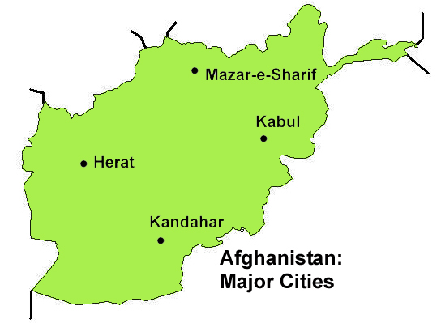
Major Cities of Afghanistan

Slide 51
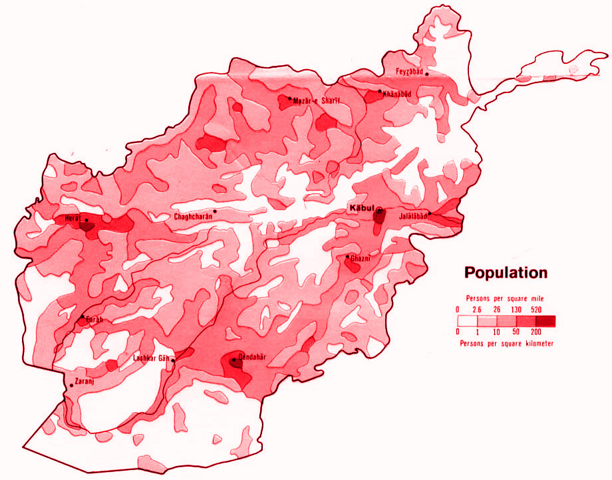
POPULATION DENSITY

Slide 52
Human Environment Interaction
FARMING: Most of the people of Afghanistan are subsistence farmers. Much of the land is too dry or too mountainous for farming. Only 12% of the land is arable. Crops include wheat, nuts and fruits; grown mainly in river valleys. Sheep, goats, chickens, and cattle are livestock raised.
MINERALS AND RESOURCES: Afghanistan is rich in minerals, but many are not developed. Natural gas, copper, and gold, are the main resources

Slide 53
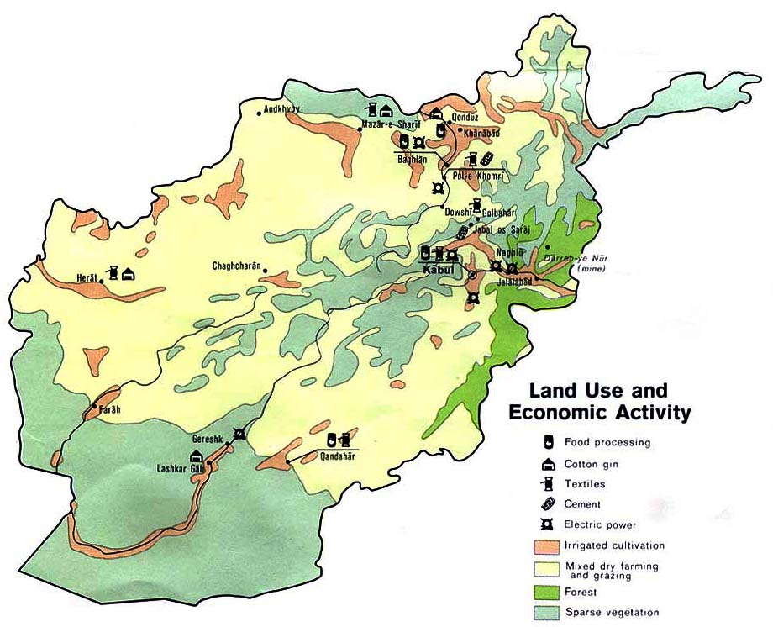
Economic Map – Land Use

Slide 54
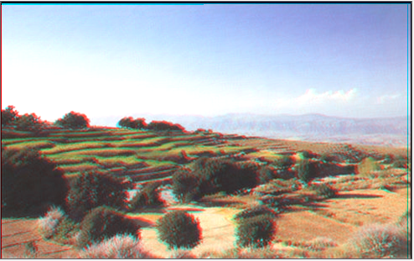
Agriculture

Slide 55
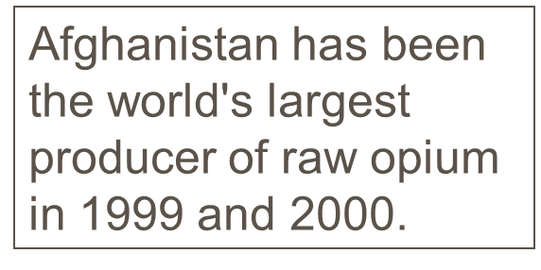
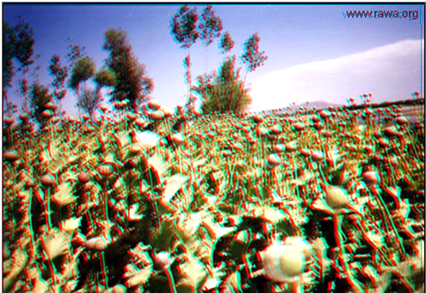
Drugs
Growing opium poppies – major source of money

Slide 56
Human Environment Interaction
INDUSTRY: Industry is not well developed. Textiles, and craft industries such as metalwork, jewelry, leather goods, and rugs are the major industries.
ECONOMIC FACTS
  Gross National Product - $18.1 billion - per capita $800
  Trade- Imports - $150 million - Exports - $80 million

Slide 57

Industry & U.S. Influence
Homemade soda bottling warehouse Afghanistan and child labor

Slide 58


Traditional Crafts
Rug making by women (right)
Women in textile factory (below)

Slide 59

MOVEMENT: Transportation
The rugged terrain makes transportation difficult. Outside of cities roads are mainly dirt or gravel.
  16 miles of railroads
  35,000 private automobiles
  32,000 commercial vehicles
The Khyber Pass is a 33 mile mountain pass on the border between Afghanistan and Pakistan. At its narrowest point it is only 10 feet wide. This has been the historic route between Afghanistan and South Asia.

Slide 60
MOVEMENT: Communication
The mountains have been barriers to both transportation and communication. Government controls television and radio broadcasts. Communication systems are rudimentary
  10 television sets per 1,000 population
    U.S. - 776 television sets per 1,000 pop.
  74 radios per 1,000 population
    U.S. - 2,122 radios per 1,000 pop.
  Daily newspaper circulation - 11 per 1,000
    U.S. - 238 per 1,000 pop.

Slide 61
Brief Recent History
After the Soviet withdrawal, warring factions in Afghanistan fight to control the country – the Taliban gain the advantage but resistance continues to their rule continues.
The Northern Alliance (largely non-Pashtun) controls parts of Afghanistan and opposes the Taliban
After Sept. 11, 2001, the Northern Alliance and the U.S. military defeat the Taliban in the Anti-terrorism War
2002 – Shaky new government established

Slide 62

Recovering from Soviet occupation
Removing and deactivating mines

Slide 63

Recovering from Soviet occupation
Victim of Soviet mines

Slide 64

Effects of Soviet Actions
Destruction of Afghan village during the Soviet occupation of the 1990s

Slide 65
Taliban brought order and fundamental Islam at a price!
The Taliban imposed their harsh brand of Islamic law in the 90 percent of Afghanistan under their control. The Taliban say their version of Islam is a pure one that follows a literal interpretation of the Muslim holy book, The Koran.
Under Taliban laws, murderers were publicly executed by the relatives of their victims. Adulterers are stoned to death and the limbs of thieves were amputated. Lesser crimes were punished by public beatings.

Slide 66

Executions by the Taliban
Taliban executing a rebel on the spot

Slide 67

Executions by the Taliban
Dead bodies left in the street to rot by Taliban in Heart. People forbidden to bury the bodies

Slide 68


Public amputations & executions
There were almost weekly executions or amputations of criminals in the Kabul stadium before November 1999, when a woman was killed for hacking to death her abusive husband. The hiatus in public executions after that was attributed to a decline in crime in the capital.

Slide 69
Anti-Taliban war against terrorism
Original objective to capture Osama Bin Laden
Taliban government seemed to be harboring Osama Bin Laden and his terrorist associates
U.S. gave the Taliban opportunities to turn over Bin Laden or cooperate in capturing him
When the Taliban did not comply, the U.S. objective expanded to also removing the Taliban from power in Afghanistan.
U.S. assisted the Northern Alliance rebels (who sometimes fight among themselves)

Slide 70

Osama Bin Laden
"I am not afraid of death. I came here to die. Some of my supporters followed me here just to die for the cause of Islam. They are ready to defend me and to kill anyone who thinks of attacking our positions or sites." Osama Bin Laden

Slide 71

Al Qaeda
The U.S. government charges that Osama bin Laden heads an international terrorist network called "Al Qaeda," an Arabic word meaning 'the base.'

Slide 72

Northern Alliance
Teen Mujaheddin in Bamiyan - northern alliance

Slide 73

Northern Alliance
“Baby” fighter in Barniyan

Slide 74

FIGHTING – Taliban and anti-Taliban

Slide 75


Taliban Forces
Taliban commander
Taliban fighter

Slide 76

Seeking Bin Laden – Tora Bora

Slide 77

Attacking Tora Bora

Slide 78

Key Battles & Mined Areas

Slide 79

Bombing Population Centers

Slide 80

Situation Map
Kandahar about to be liberated
Aid & information being disseminated

Slide 81

People fleeing US action 2001
Fleeing Kabul by any means possible

Slide 82


Early 2002
Taliban defeated
Shaky coalition government formed
Osama Ben Laden still free or possibly dead
Pressing agenda
  Rebuild the country
  Heal the people
  Achieve stable, internal peace

Slide 83


President & Female Ministers
Prime Minister Hamid Karzai (left)
Deputy Premier Dr. Sima Samar (right) – one of two women in the government

Slide 84

War Lords
War lords control large parts of Afghanistan. When the Taliban were removed, cooperation among war lords decreased

Slide 85

Celebration over Taliban withdrawal
Children play

Slide 86

Celebration over Taliban withdrawal
Music could be made again

Slide 87

Celebration over Taliban withdrawal
people celebrated

Slide 88

Some gains for women
Girls and women return to schools – education was banned for them by the Taliban – no burkas seen here

Slide 89

Some gains for women
Family receiving USA aid (grain) – woman has shed the burka

Slide 90

United States Aid
Distribution of wheat from the USA

Slide 91

United States Aid

Slide 92

United States Aid

Slide 93
Help from private sources has been great; however, religious-based aid organizations must not proselytize.

Slide 94

Update 2012

Slide 95
March 2003, U.S. attacks Iraq
President Bush focused on Iraq and neglected the efforts in Afghanistan
  By 2008, the Taliban had regained control of some parts of Afghanistan
  Taliban continued terrorist attacks against U.S. forces and Afghan towns and cities
President Obama reconsidered priorities
  Withdrew all US forces from Iraq by Dec. 31, 2011.
  Increased efforts in Afghanistan
  Liberated some areas from Taliban control
  Killed Osama bin Laden & other Al Qaeda leaders

Slide 96

Taliban Control in Afghanistan in 2009
Maps showing at risk areas in Afghanistan. 2005 upper left, 2007 upper right, 2009 bottom
2009 U.N. map shows that 40 percent of Afghanistan is vulnerable to Taliban

Slide 97

December 2009

Slide 98


Slide 99
As of January 2012
U.S. plans to remove all troops from Afghanistan in 2014
Encouraging talks between the government of Afghanistan and the Taliban

