Slide 1

Hungary
One of the “brighter” spots in Eastern Europe

Slide 2
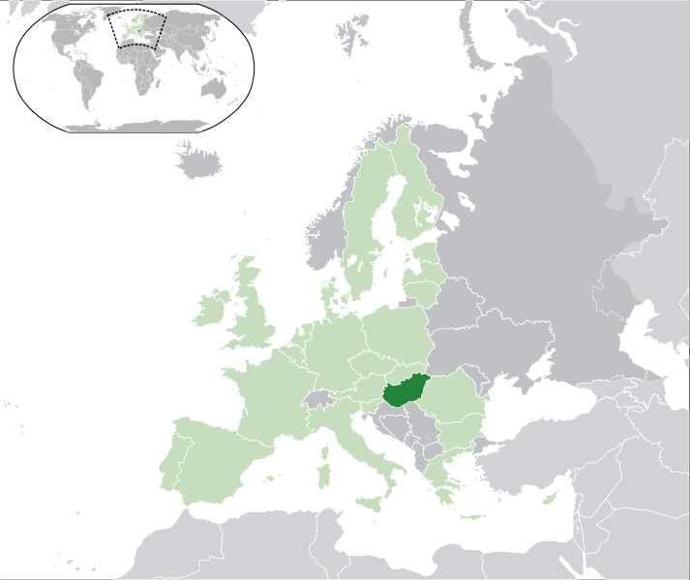

Slide 3
Geographic – General Information
Location: Central Europe, northwest of Romania
Area: 93,028 sq km
  Comparative: slightly smaller than Indiana
Land boundaries:
  total: 2,185 km
  border countries: Austria 366 km, Croatia 329 km, Romania 443 km, Serbia 166 km, Slovakia 676 km, Slovenia 102 km, Ukraine 103 km
Natural resources: bauxite, coal, natural gas, fertile soils, arable land
Land use:
  arable land: 49.58%
  permanent crops: 2.06%
  other: 48.36% (2005)
Climate: temperate; cold, cloudy, humid winters; warm summers
Terrain: mostly flat to rolling plains; hills and low mountains on the Slovakian border
Coastline: none Hungary is a landlocked country
Major River: Danube R.

Slide 4
Demographics
Population: 9,880,059 (July 2010 est.)
Age structure:
  0-14 years: 14.8%
  65 years and over: 16%
Population growth rate: -0.26% (2010 est.)
Infant mortality rate: 7.7 deaths/1,000 live births
Life expectancy at birth: 73.69 years
Total fertility rate: 1.36
Literacy: age 15 and over can read and write 99.4%
Urban population: 68%
Ethnic groups: Hungarian 92.3%, Roma 1.9%, other or unknown 5.8% (2001 census)
Religions: Roman Catholic 51.9%, Calvinist 15.9%, Lutheran 3%, Greek Catholic 2.6%, other Christian 1%, other or unspecified 11.1%, unaffiliated 14.5% (2001)
Languages: Hungarian 93.6%,

Slide 5
Economy
GDP - per capita (PPP):
  $18,600 (2009 est.)
  $20,000 (2008 est.)
  $19,800 (2007 est.)
GDP - real growth rate:
  -6.7% (2009 est.)
  0.6% (2008 est.)
  1.2% (2007 est.)
GDP - share by sector:
  agriculture: 2.8%
  industry: 34.7%
  services: 62.5% (2009 est.)
Unemployment rate:
  10.8% (2009 est.)
  7.8% (2008 est.)
Labor force - by occupation:
  agriculture: 4.5%
  industry: 32.1%
  services: 63.4% (2008)
Population below poverty line: 12% (2010 est.)
Agriculture - products: wheat, corn, sunflower seed, potatoes, sugar beets; pigs, cattle, poultry, dairy products
Industries: mining, metallurgy, construction materials, processed foods, textiles, chemicals, motor vehicles

Slide 6
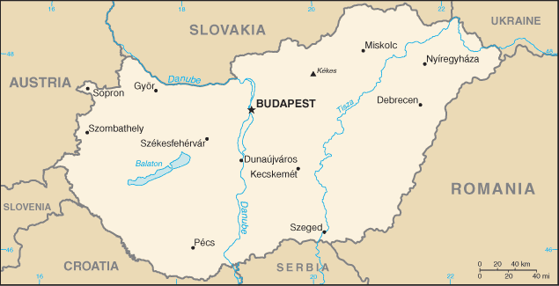

Slide 7
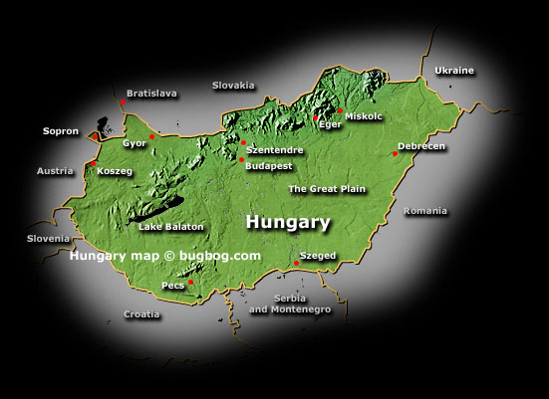

Slide 8
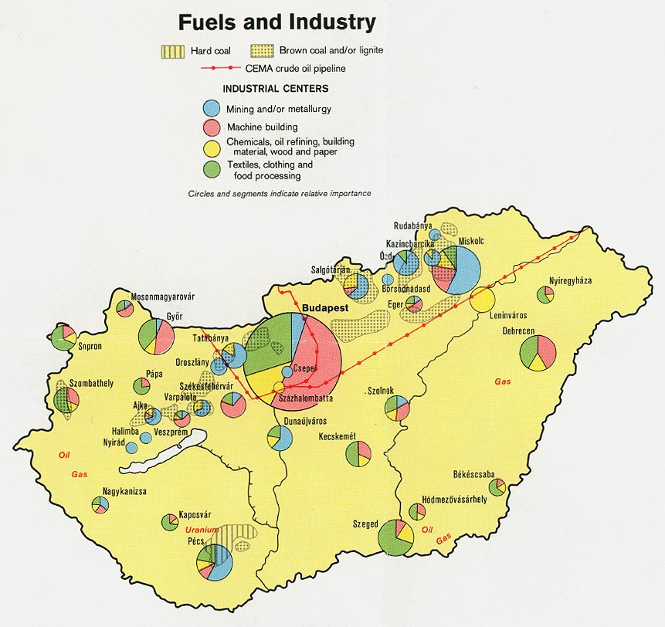

Slide 9
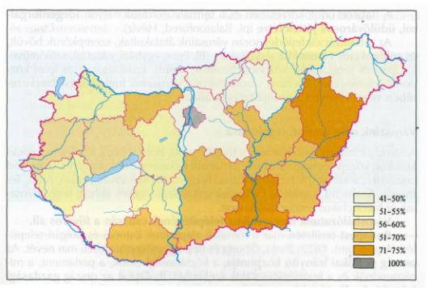
The proportion of urban population by counties (%), 1998

Slide 10
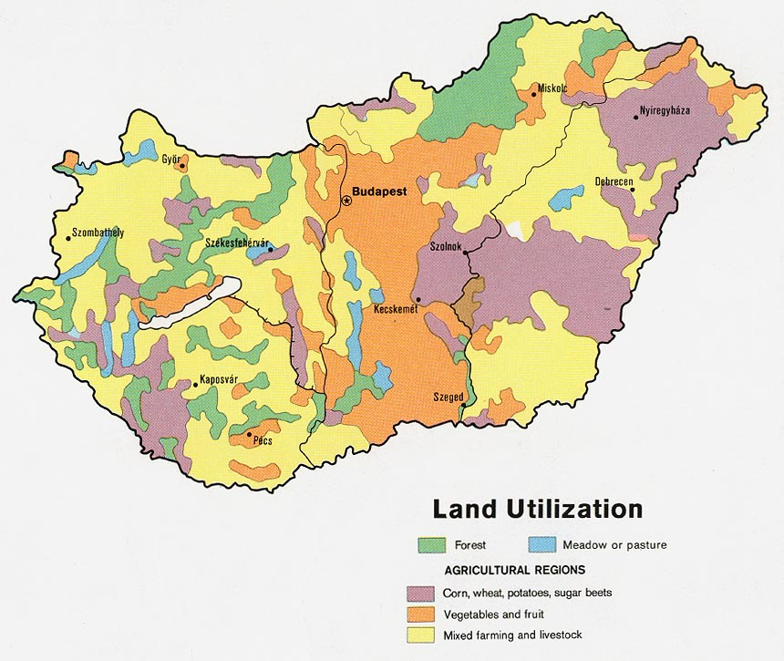

Slide 11
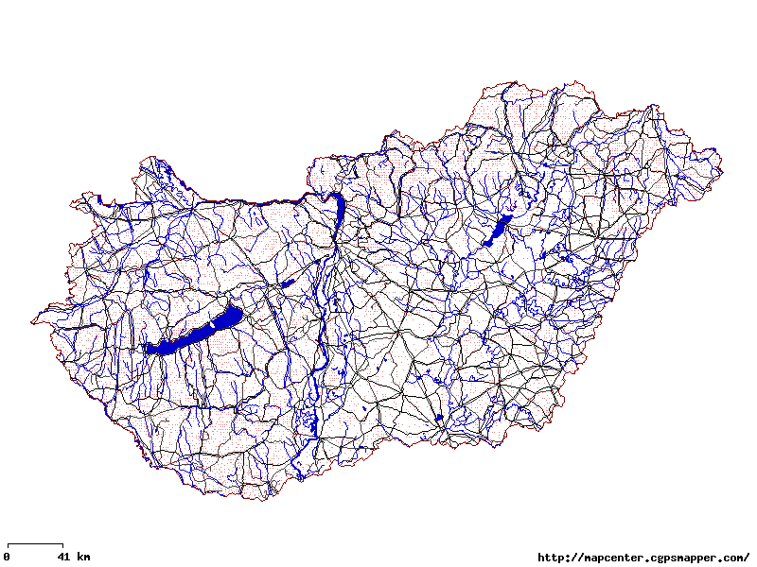
Road Network

Slide 12
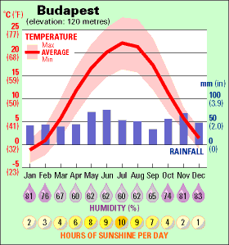
Climograph

Slide 13
Budapest (capital)

Slide 14
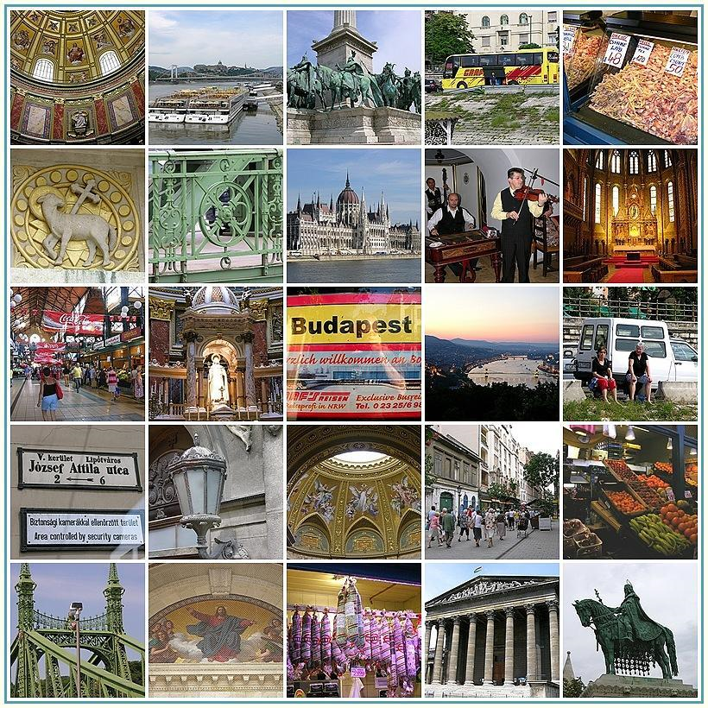

Slide 15
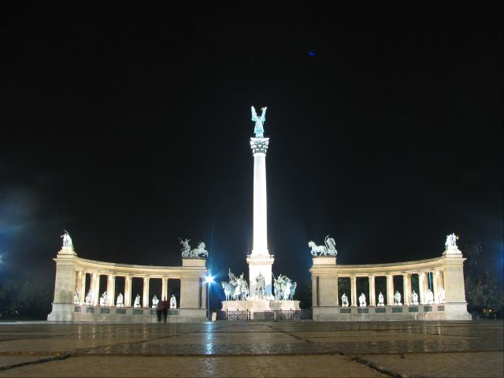
Heroes Square

Slide 16
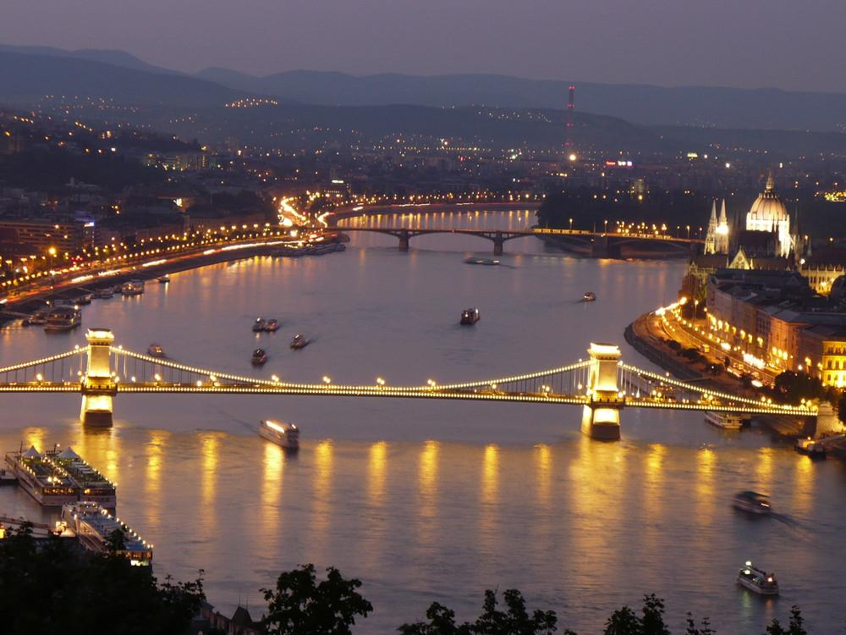

Slide 17
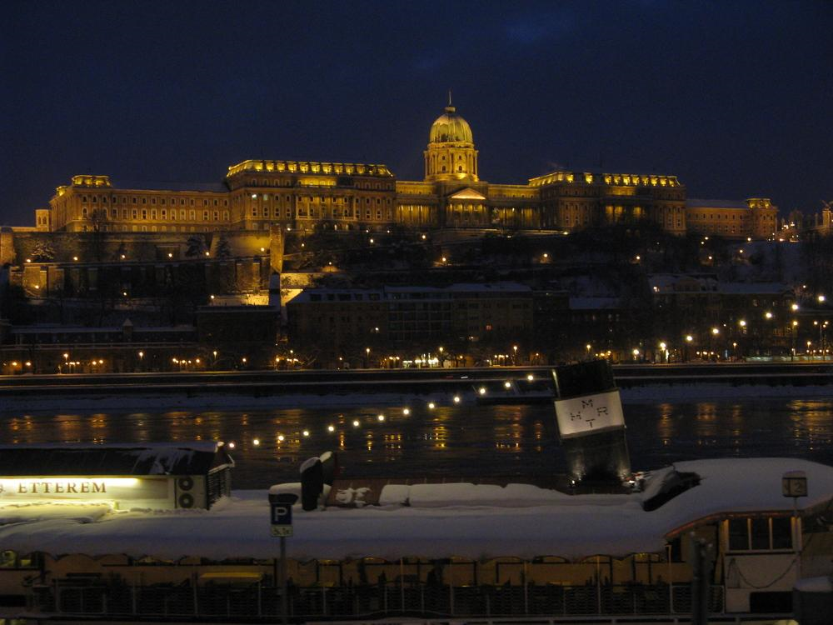
King’s Palace

Slide 18
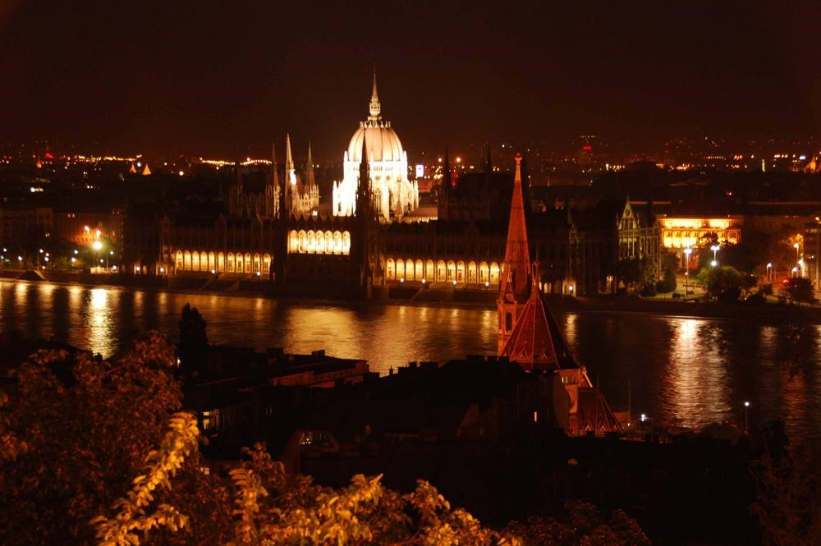
Parliament on the Danube

Slide 19
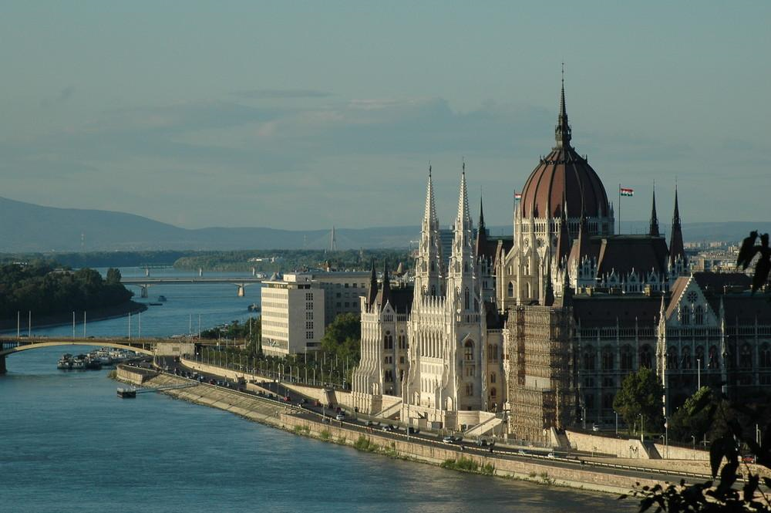
Parliament in daylight

Slide 20
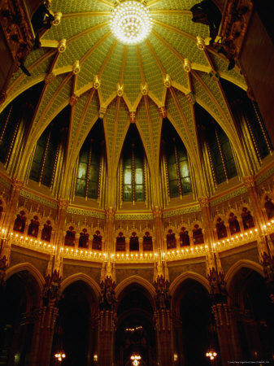
Rotunda of the Parliament Building

Slide 21
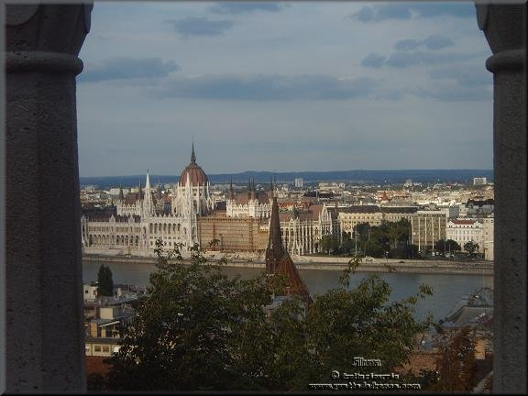

Slide 22
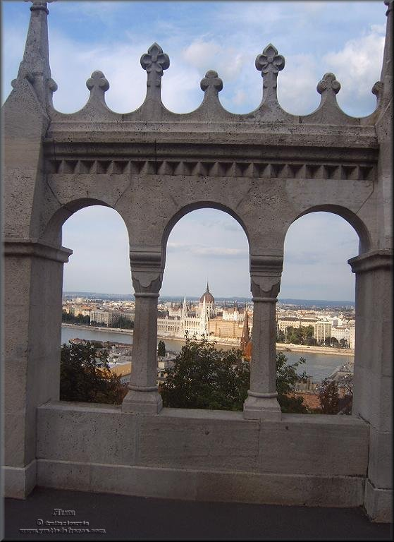

Slide 23
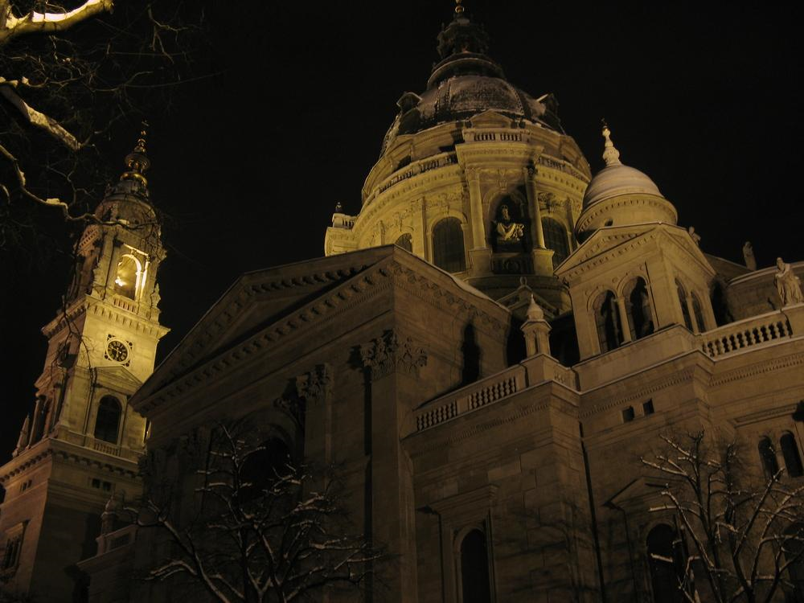
Saint Stephen's basilica

Slide 24
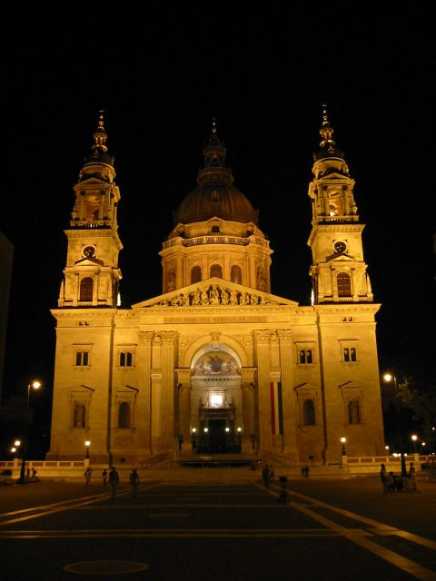
Saint Stephen's basilica

Slide 25
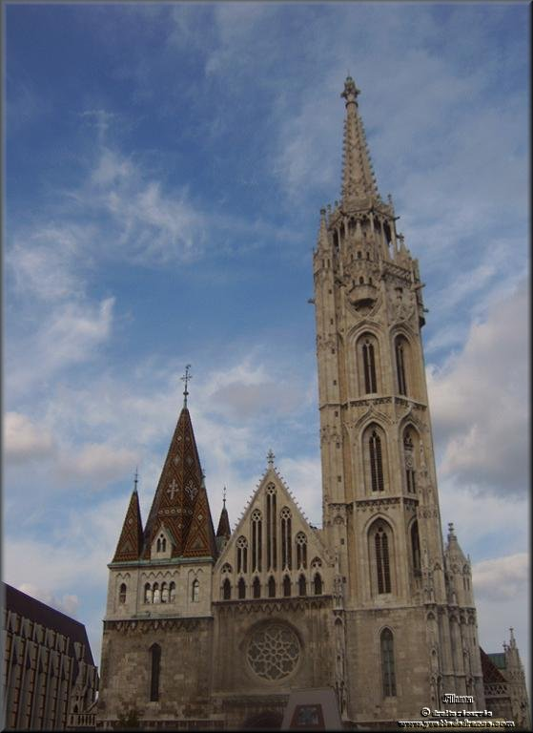
Matthias church

Slide 26
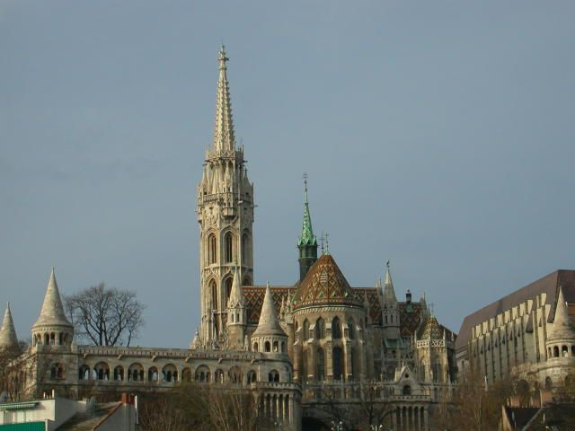
Matthias church

Slide 27
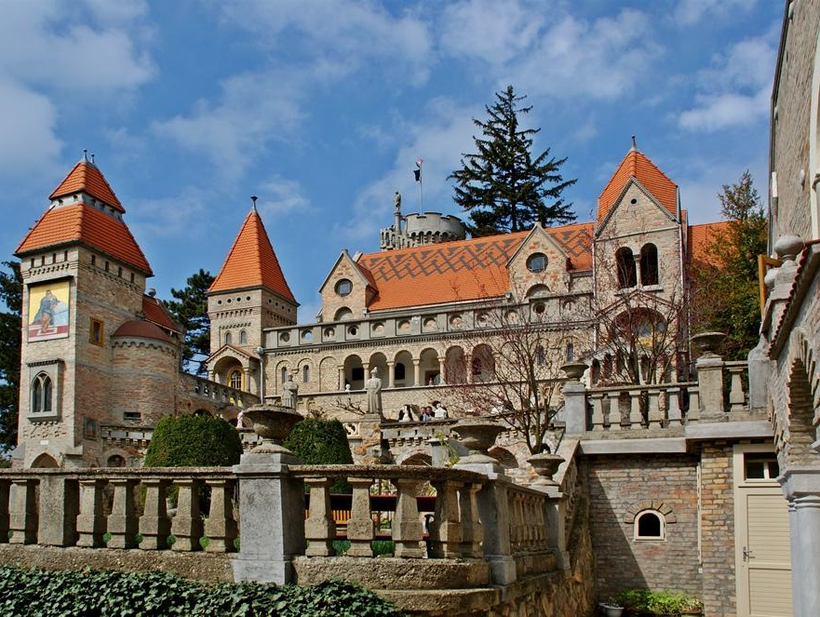
THE BORY CASTLE

Slide 28
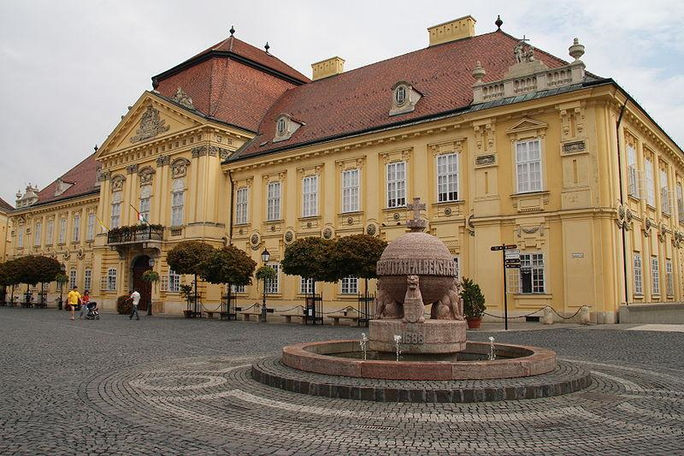
Episcopal Palace

Slide 29
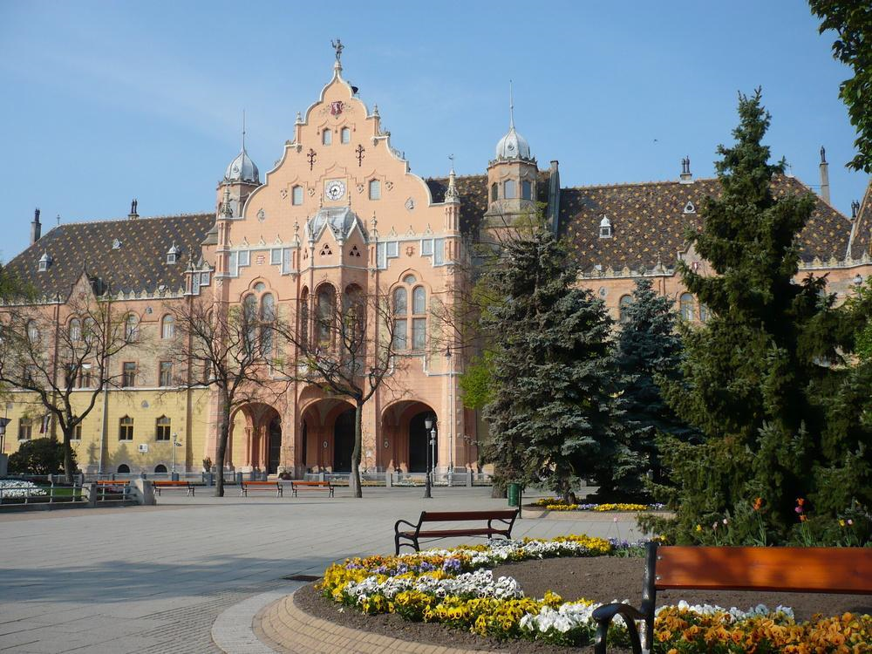
City Hall

Slide 30
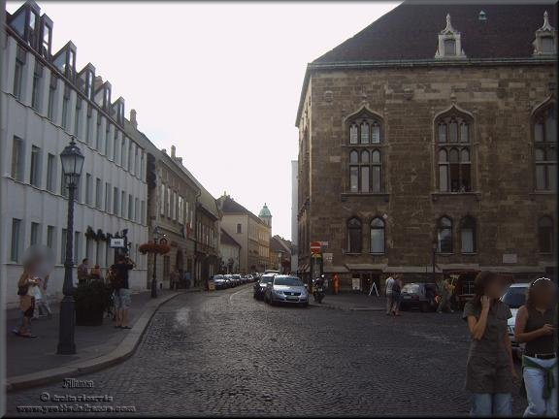

Slide 31
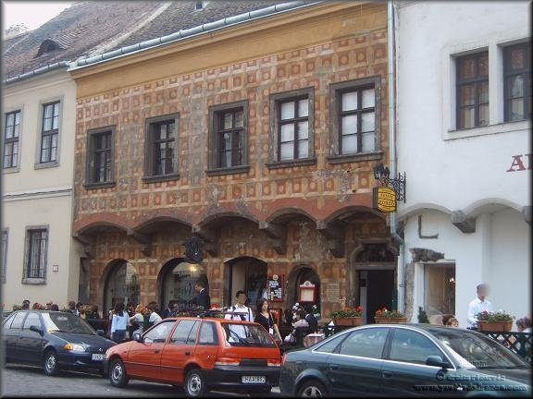

Slide 32
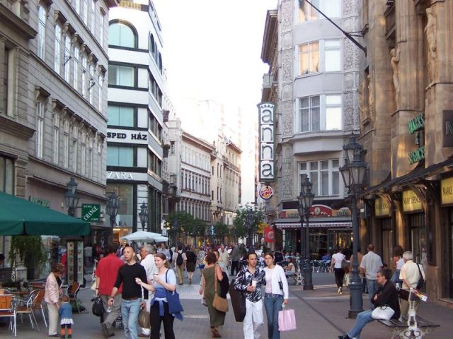
Vaci Street

Slide 33
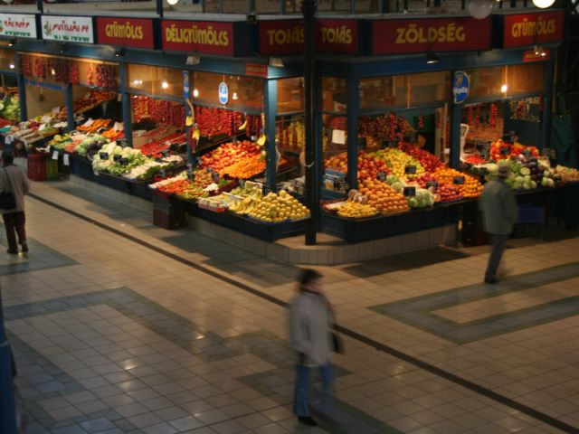
Central Market, Budapest

Slide 34
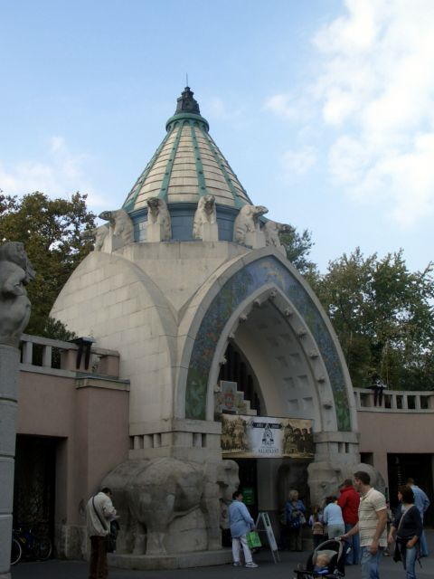
Budapest Zoo

Slide 35
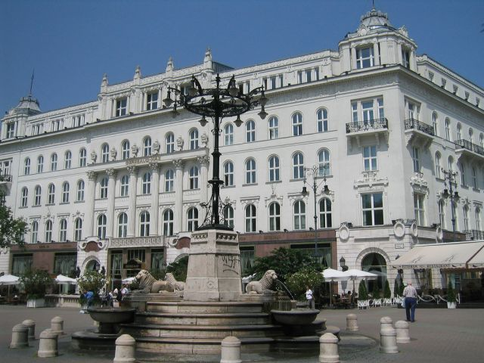
Vörösmarty Square

Slide 36
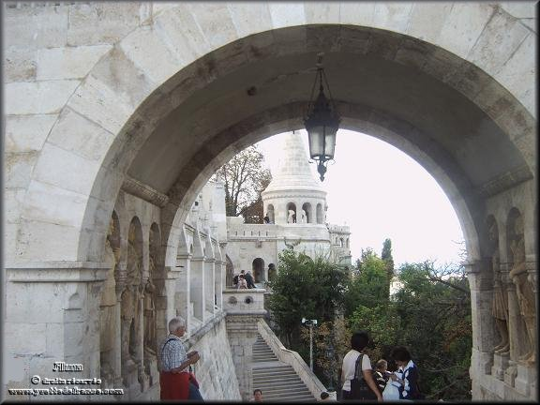

Slide 37
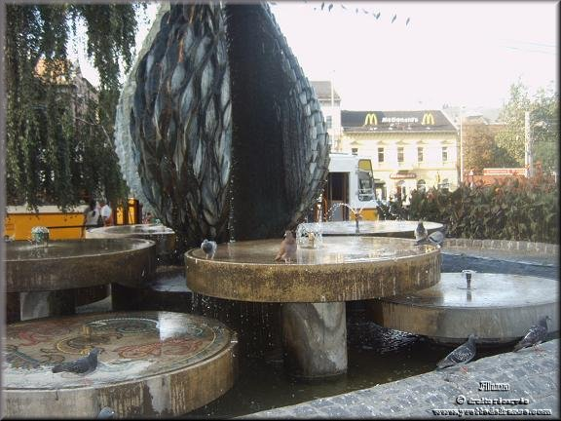

Slide 38
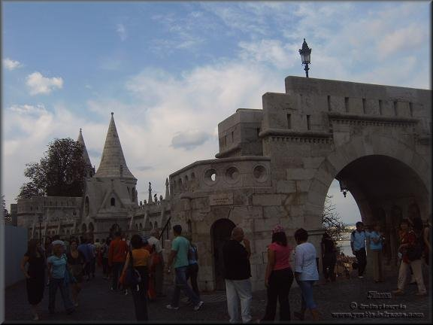

Slide 39
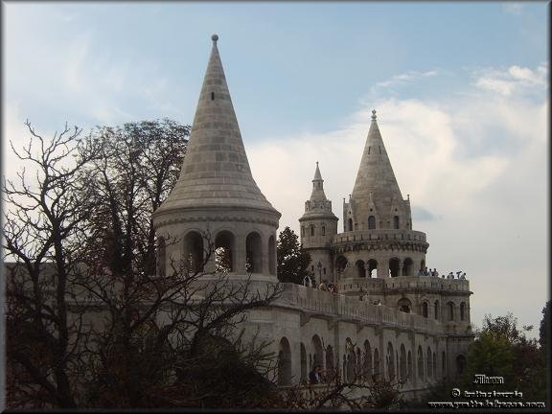

Slide 40
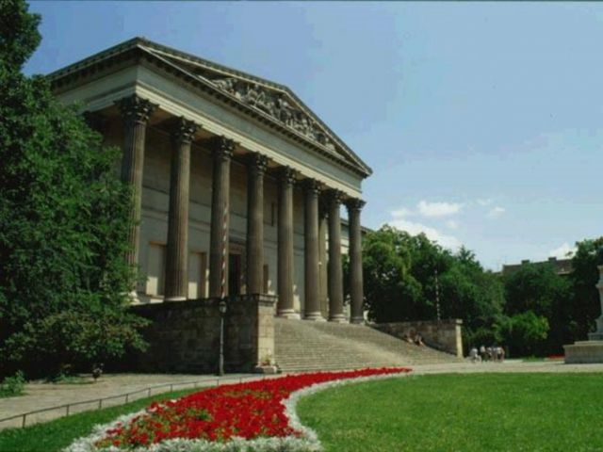
Hungarian National Museum

Slide 41
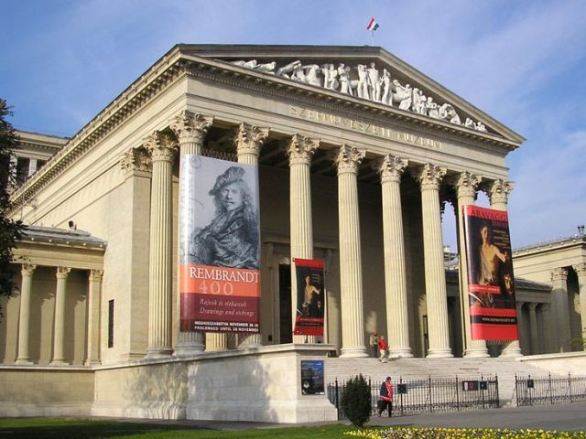
Museum of Fine Arts

Slide 42
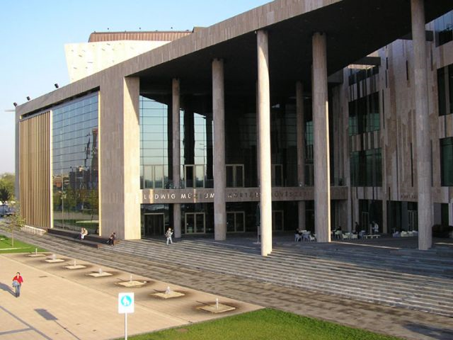
Palace of Arts

Slide 43
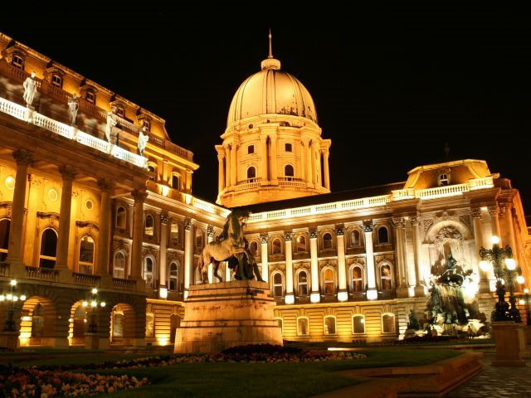
Hungarian National Gallery

Slide 44
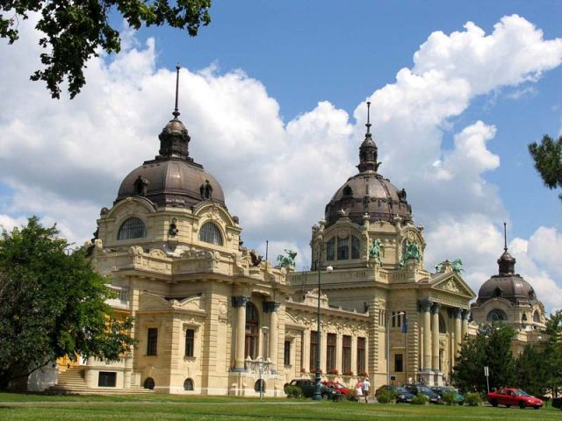
Szechenyi Thermal Bath

Slide 45
The Chain Bridge is one of Budapest's most famous landmarks. The magnificent suspension bridge was built in the 19th century across the River Danube between Pest and Buda, at the time still separate cities.

Slide 46
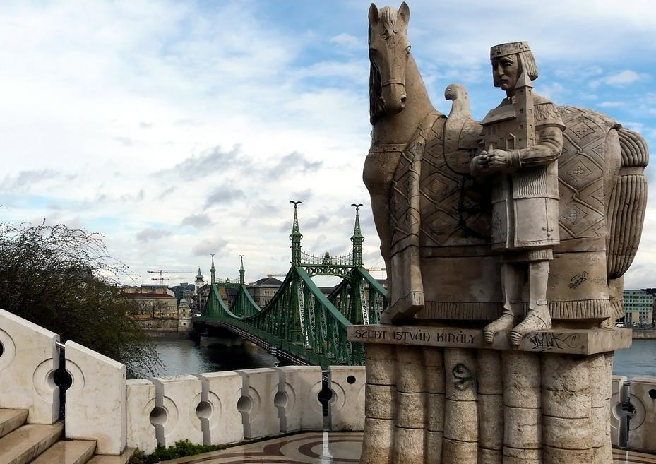

Slide 47
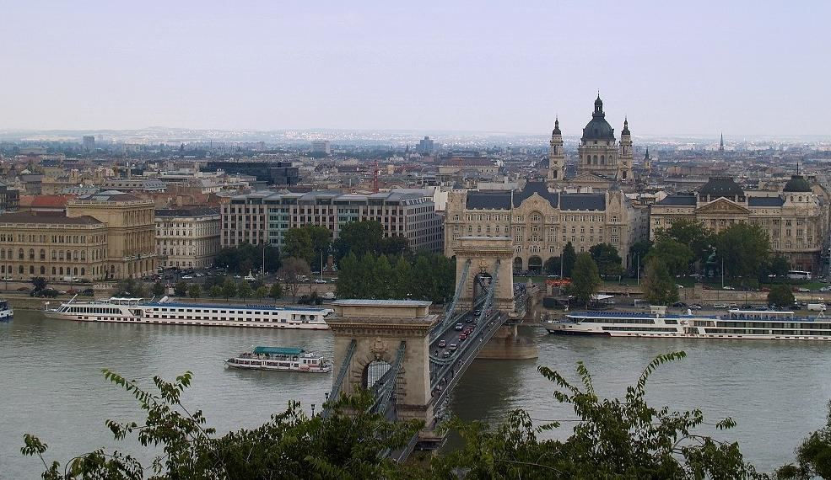

Slide 48
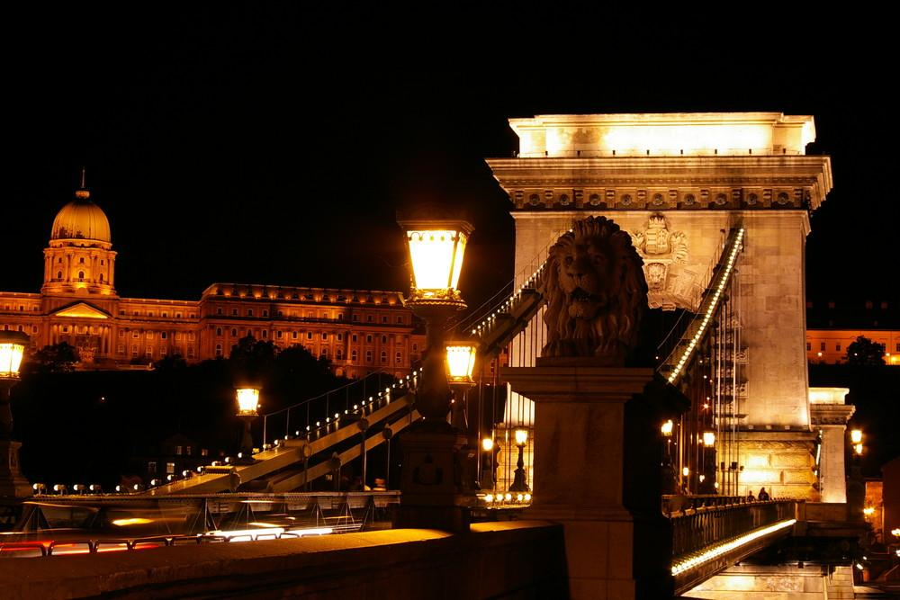

Slide 49
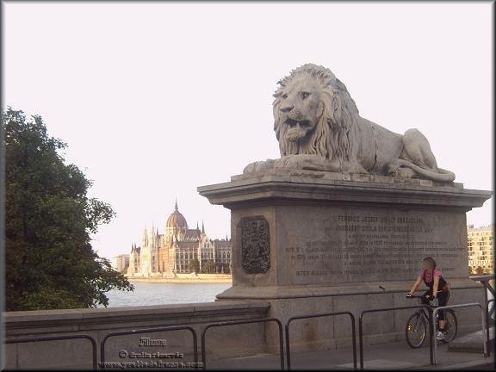

Slide 50
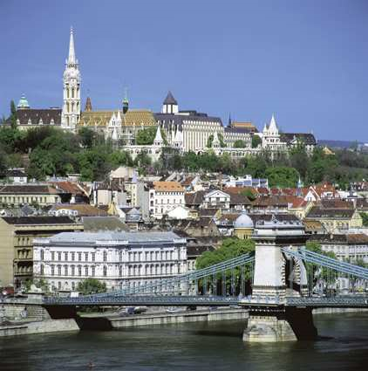

Slide 51
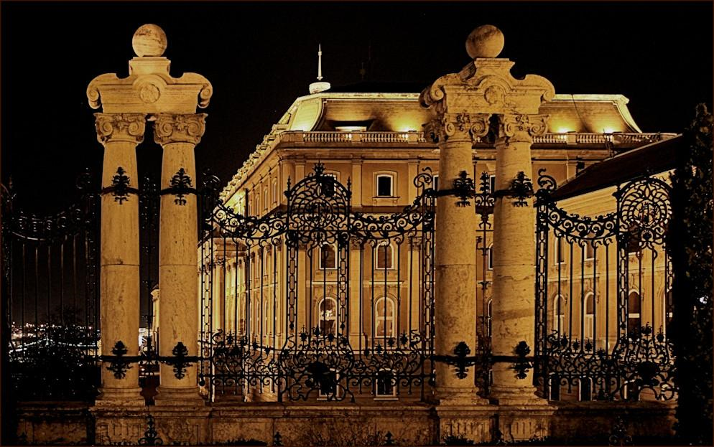
Castle Palace

Slide 52
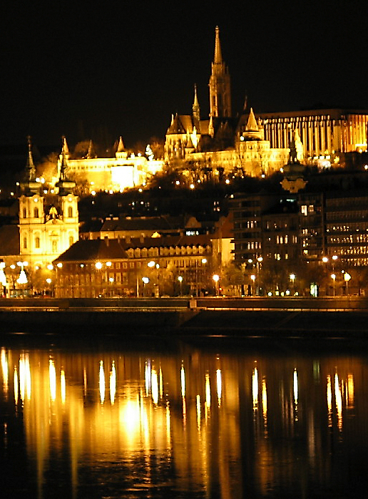
Fishermen's bastion by night.

Slide 53
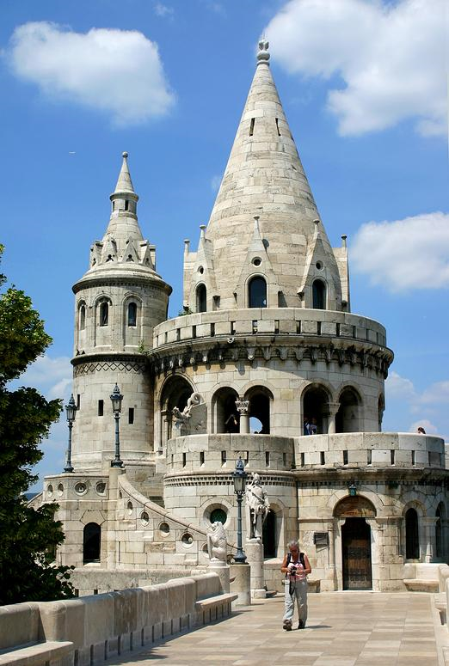
Fisherman’s Bastion

Slide 54
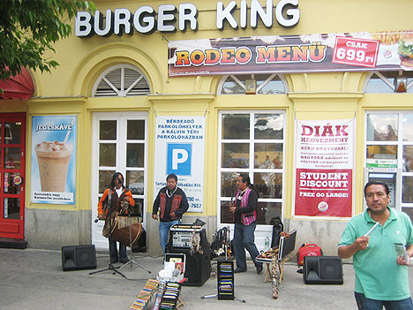
Globalization in Budapest

Slide 55
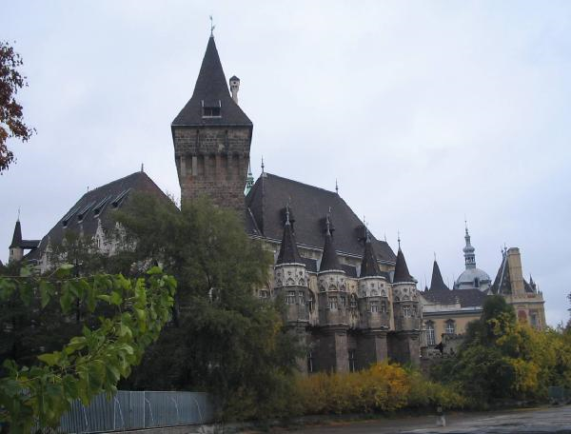
Vajda Hunyadi Castle

Slide 56
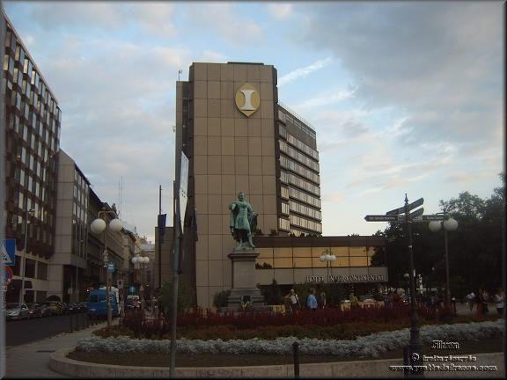

Slide 57

Budapest Synagogue

Slide 58


Slide 59

Margaret Island, Budapest

Slide 60
Other Towns & Cities

Slide 61

Debrecen

Slide 62

Debrecen – Kossuth Square

Slide 63

Debrecen – Town Square

Slide 64

Szeged

Slide 65

Szeged - Klauzál Square

Slide 66

Szeged

Slide 67

Pecs, Hungary

Slide 68

Holloko, Hungary

Slide 69
Gyula, hungary
It is one of the most important arts centres of the south of the Large Plain, because it is rich in monuments and the relics of the historical past.

Slide 70


Slide 71


Slide 72


Slide 73


Slide 74


Slide 75


Slide 76


Slide 77


Slide 78


Slide 79


Slide 80


Slide 81

Aerial Photos - Hungarian towns & Cities

Slide 82

Tokaj

Slide 83

Tiszatarján

Slide 84

Abádszalók

Slide 85

City Miskolc

Slide 86

Pilis (town)

Slide 87

Tápiószentmárton (Town)

Slide 88

Dunabogdány

Slide 89

Jászdózsa

Slide 90

TIHANY is a village on the northern shore of Lake Balaton on the Tihany Peninsula

Slide 91

Scenic Tourism

Slide 92

Operencias Family Resort in the beautiful and scenic Zala Valley

Slide 93

Rural Scene

Slide 94

Biking through the Hungarian forests

Slide 95

The Aggtelek Karst is located in the north-eastern corner of Hungary.

Slide 96

Cathedral of Kalocsa (Episcopalian)

Slide 97

The wine region of Tokaj-Hegyalja in Hungary

Slide 98

The scenic Wachau Valley

Slide 99


Slide 100


Slide 101


Slide 102


Slide 103

Shoppe with thatched roof

Slide 104


Slide 105


Slide 106


Slide 107

Pilis Mountains

Slide 108

Ox-bow lake at River Tisza

Slide 109

Nyékládháza-lakes

Slide 110
The Lake Balaton

Slide 111


Slide 112


Slide 113


Slide 114


Slide 115


Slide 116


Slide 117


Slide 118


Slide 119


Slide 120


Slide 121


Slide 122


Slide 123


Slide 124


Slide 125


Slide 126


Slide 127

Agriculture

Slide 128


Slide 129


Slide 130


Slide 131

Along the “Blue” Danube

Slide 132

Raising Chickens

Slide 133


Fruit Orchards

Slide 134



Livestock

Slide 135

Grain

Slide 136
Resources & Industry

Slide 137

Coal, crude oil and natural gas fields in Hungary

Slide 138

Strip-mined Hillside

Slide 139

Stone Mine

Slide 140

Százhalombatta, oil refinery

Slide 141

Nuclear Power Generation

