Slide 1

Subculture Change Example
The Royal Subculture

Slide 2
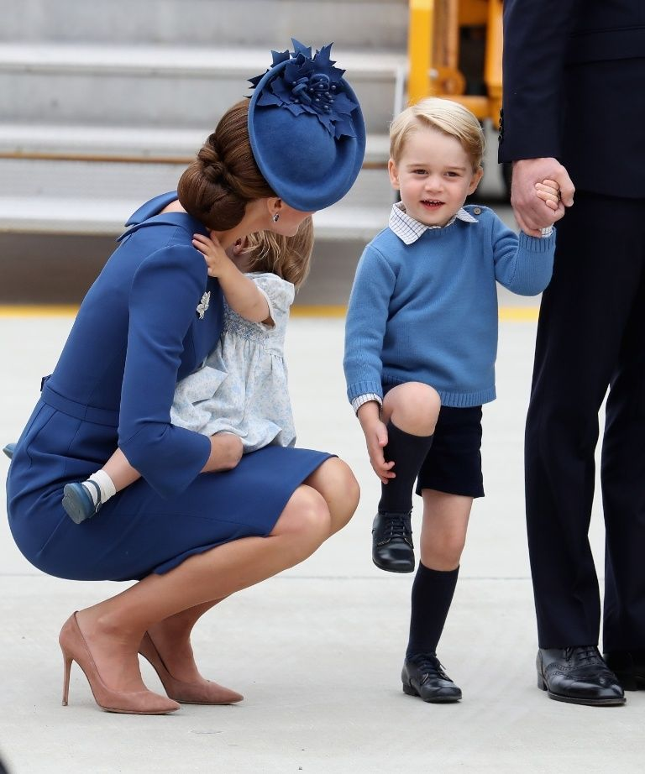
Headline
Queen Elizabeth Is Likely None to Happy About Kate's Crouching
She already scolded William for it once.

Slide 3
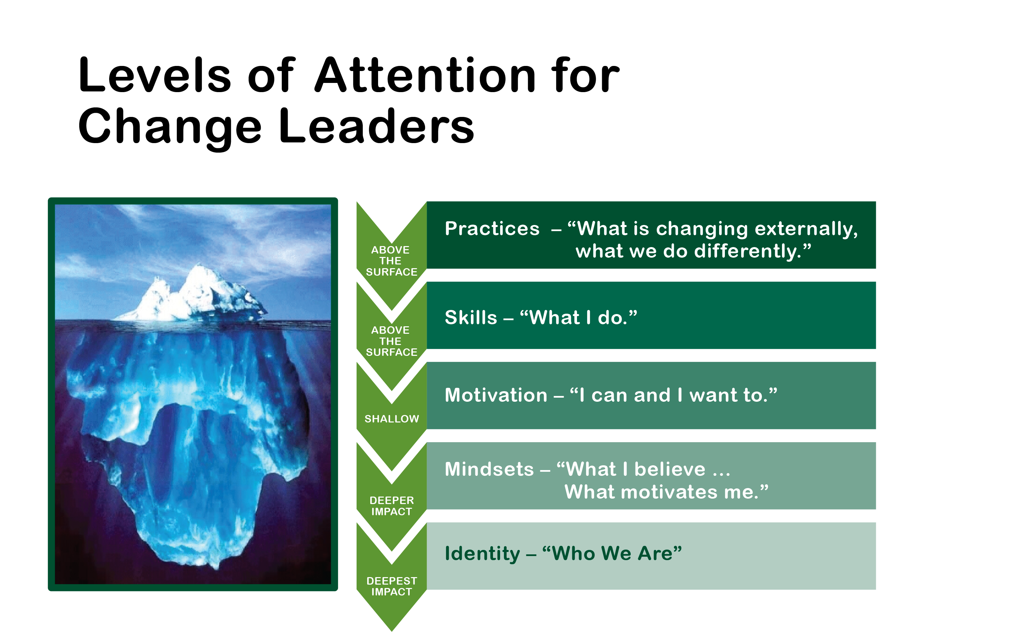

Slide 4
Elizabeth’s Background
Governesses or “nannies” performed the routine child care.
Became queen as a young married woman – assuming great responsibilities
Was queen when she had children
Followed the age-old pattern of leaving child rearing to governess, etc.
Main focus was on the responsibilities of being queen and always projecting a “royal” image.
Contact with ordinary folks largely ceremonial

Slide 5
Williams’s Background
Rather formal, distant father
Mother was not of the upper nobility – had a relatively normal childhood and was a more “hands-on” mother
Diana meaningfully interacted with ordinary people – a different example
A child of divorce
After the divorce, Diana exposed her boys to the real world and treated them more like ordinary children
Diana set the example of a caring “royal” who was comfortable with real people and with Mother Theresa of Calcutta

Slide 6
More on adult William
Has had a real job – helicopter piolet for emergency services
Has supported charities like his mother did
Dated Kate (a commoner) for a long time
Not ashamed to show his love of Kate publicly – smiles and hand-holding
More concerned with his children’s needs and concerns more than “keeping up appearances”
Hasn’t had responsibilities of being King when his children are young and developing
Understands how to effectively communicate with children

Slide 7
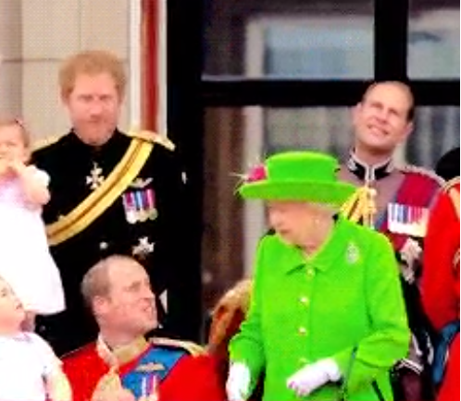
Elizabeth scolding William to stand up and look royal! Public appearance expectations trump concern for the needs of her great grandchild.

Slide 8
Kate’s Background
Parents not royals who provided a comfortable middle-class home
Grew up being comfortable being among the ordinary British subjects.
Well educated with a great sense of style
Will be an elegant and gracious queen when William becomes king.
Determined to raise her children with minimal use of “nannies.”
Determined to maintain close relations with her biological family, even missing royal holiday events to be with her family.
Does participate in royal duties with William

Slide 9
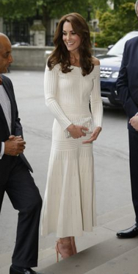
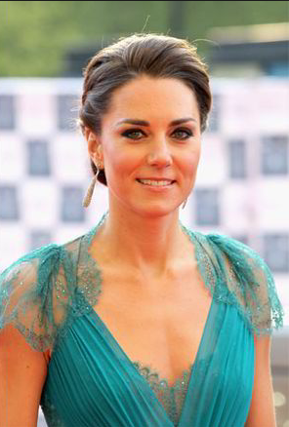
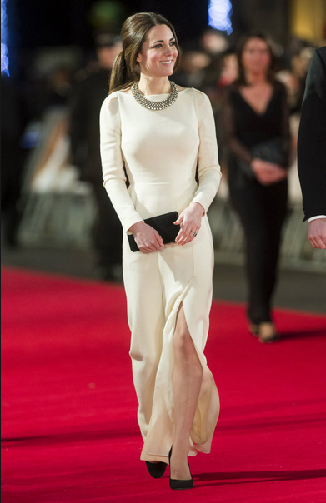
Regal and Gracious

Slide 10
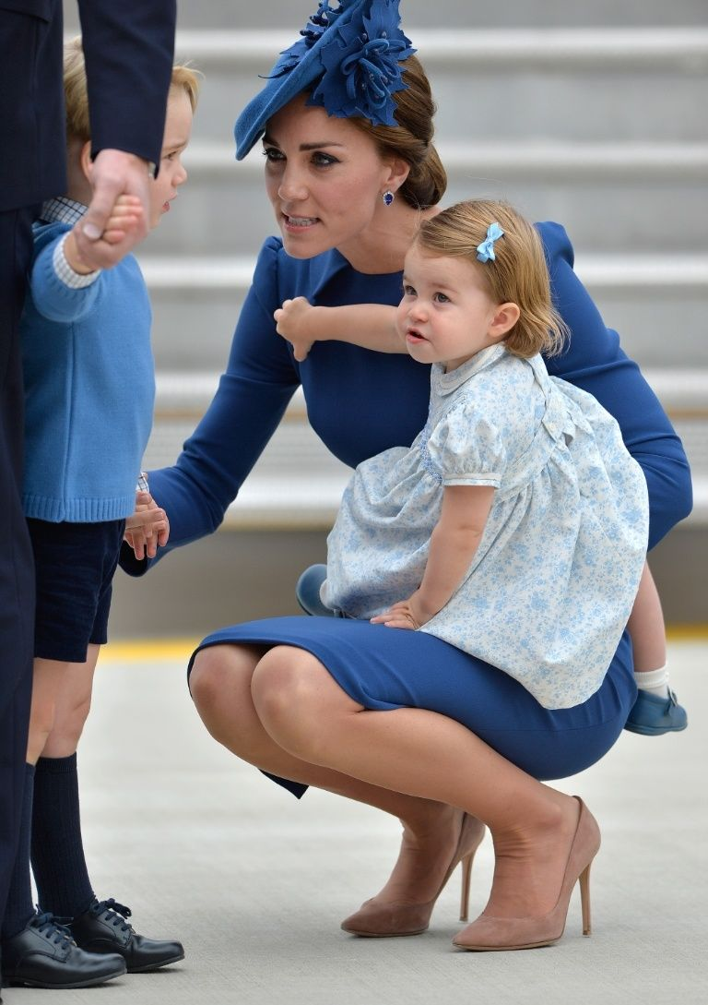
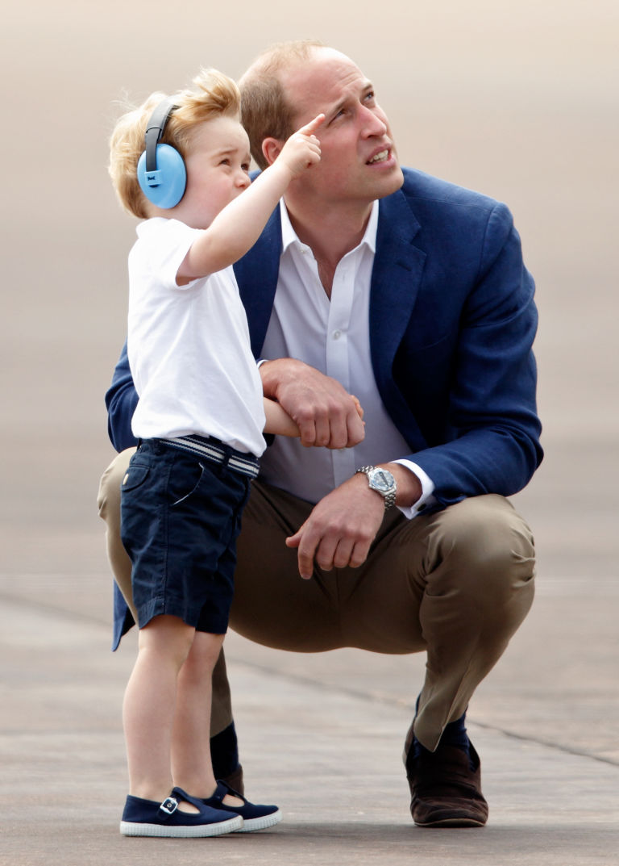
The young royals in Canada and back home

Slide 11
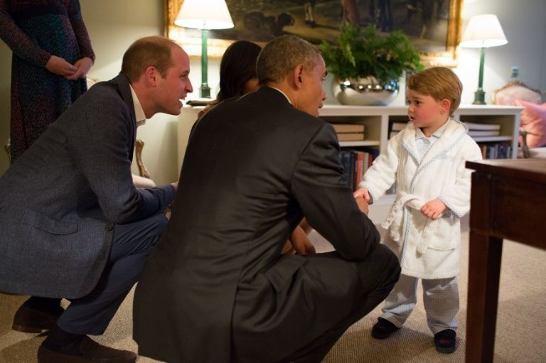
Even President Obama got on George’s level

Slide 12
The young royals are being great models of good parenting.
Good communication according to child psychologists:
Get down to the child’s level
Make eye contact with the child
Carefully listen to what the child has to share or inquire about
Have some physical contact, such as holding a hand while intently listening

Slide 13
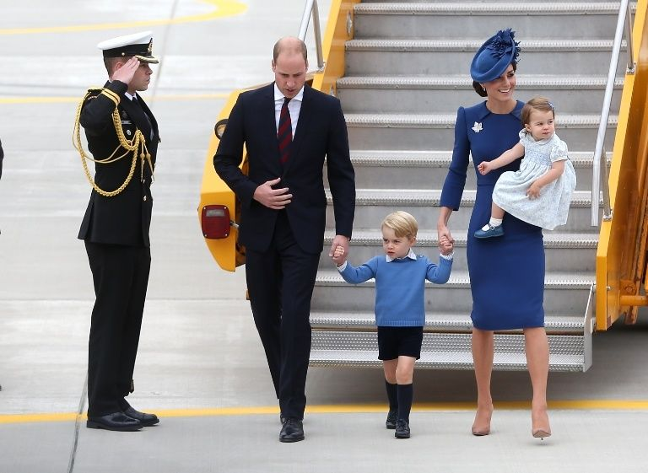

Slide 14
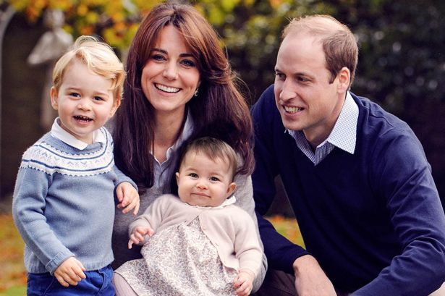

Slide 15
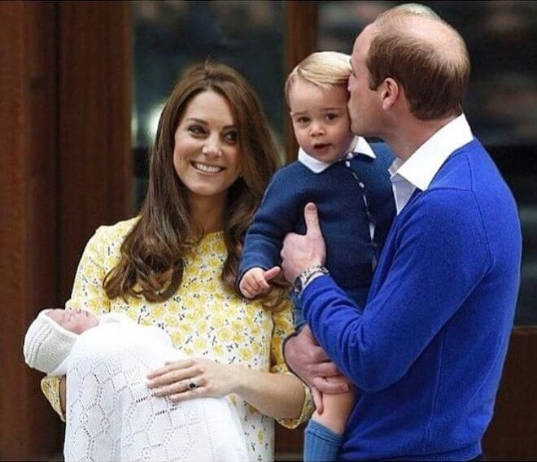

Slide 16
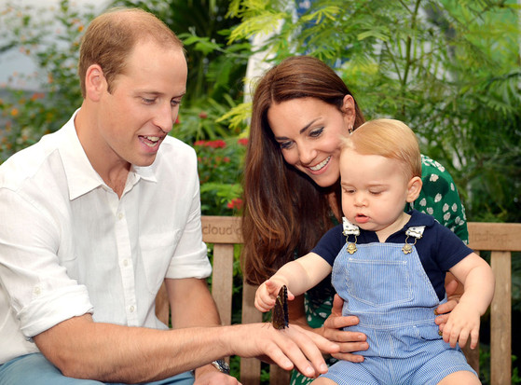

Slide 17
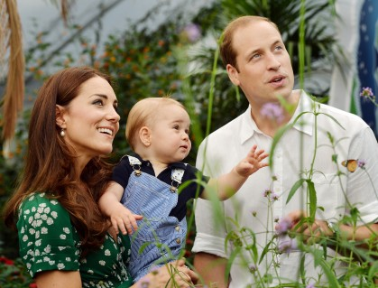

Slide 18
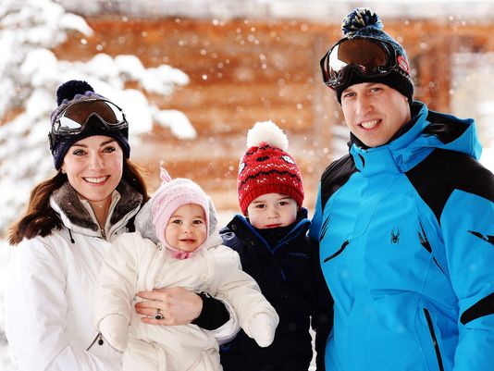

Slide 19
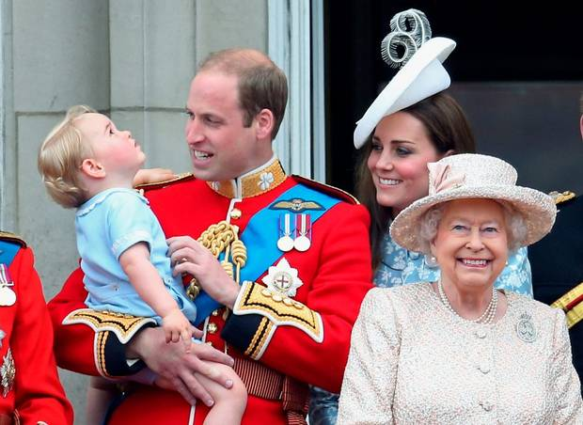

Slide 20
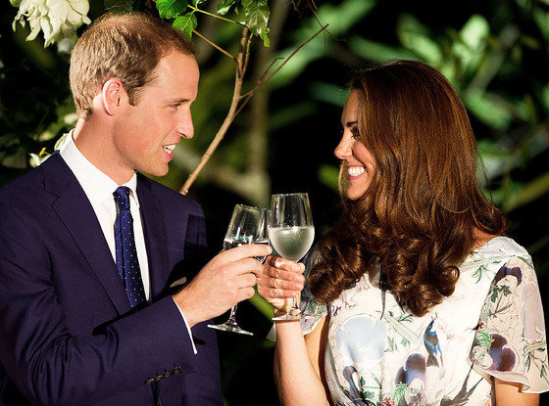
The Young Royals in Love

Slide 21
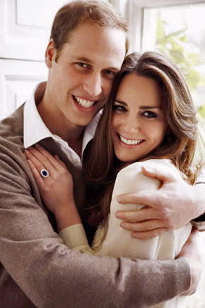
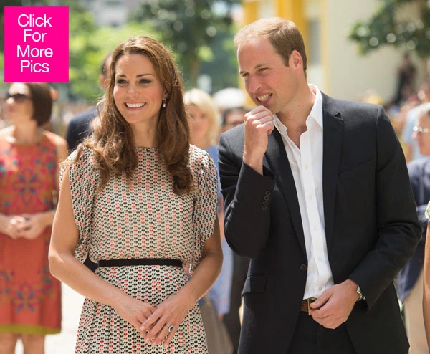

Slide 22
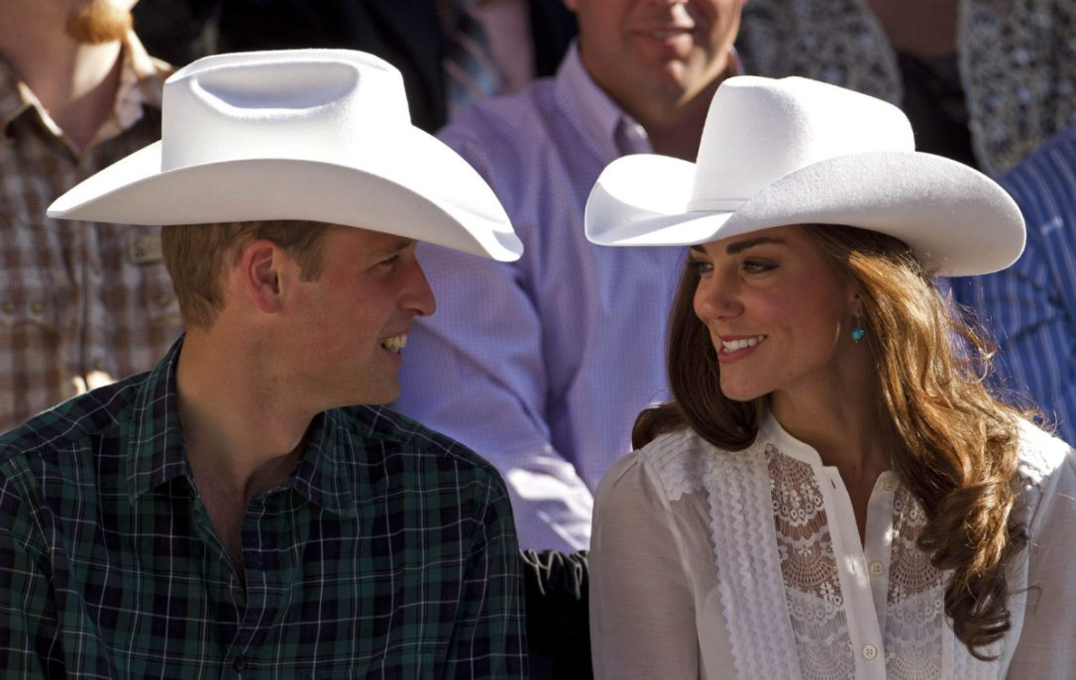
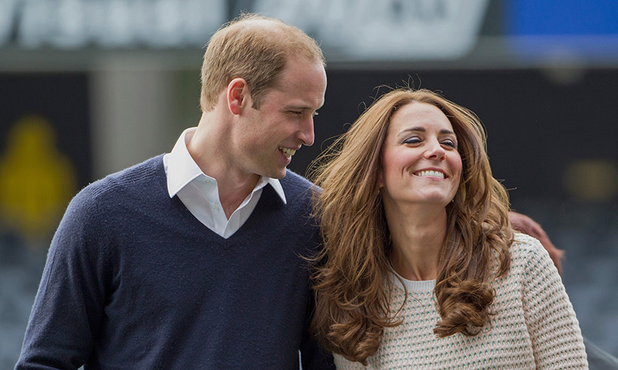

Slide 23
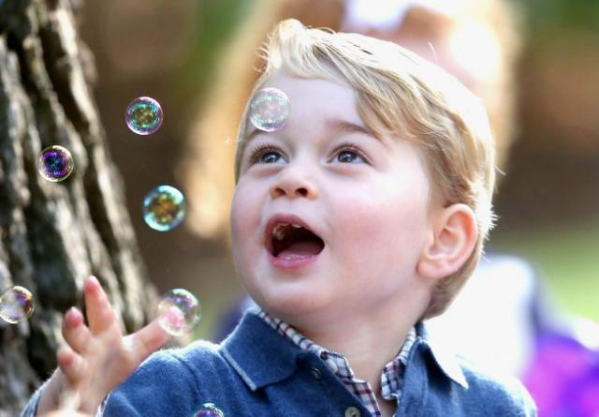
Kids being kids . . .

Slide 24
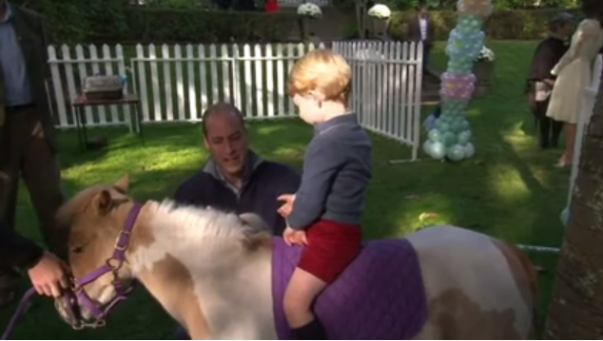

Slide 25
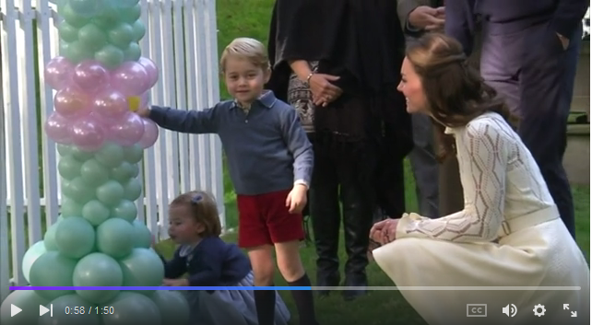

Slide 26
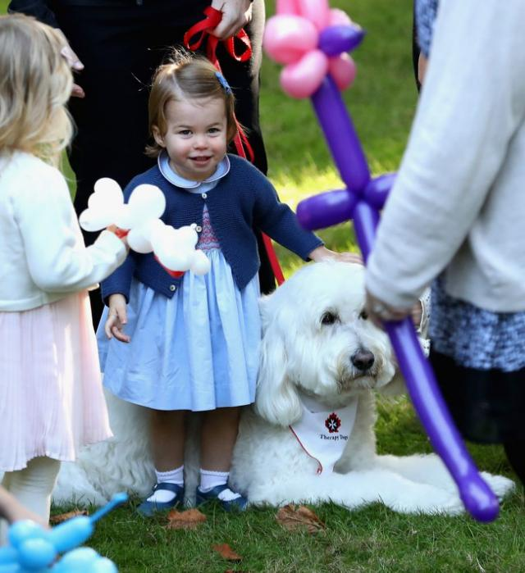
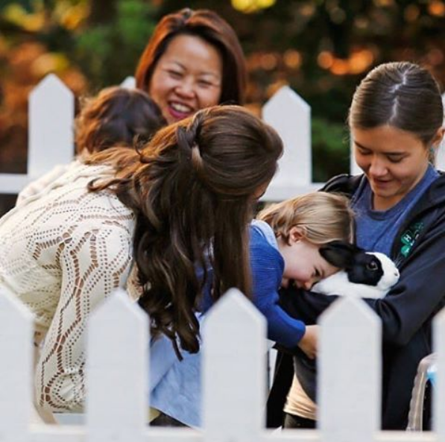

Slide 27
How much influence will they have on changing the royal subculture?
On other young royals in the UK and elsewhere?

