Slide 1

Gestures That Can Cause Offense Around the World
Sophie Forbes
March 24, 2015
Notes:
Half-circle picture with accent arcs
(Basic)
To reproduce the shape effects on this slide, do the following:
On the Home tab, in the Slides group, click Layout, and then click Blank.
On the Home tab, in the Drawing group, click Shapes, and then under Basic Shapes, click Arc (third row, 12th option from the left). On the slide, drag to draw an arc.
Select the arc. Under Drawing Tools, on the Format tab, in the Size group, do the following:
In the Shape Height box, enter 7.5”.
In the Shape Width box, enter 7.5”.
Drag the right yellow diamond adjustment handle to the bottom of the slide to create a half-circle.
Under Drawing Tools, on the Format tab, in the bottom right corner of the Shape Styles group, click the Format Shape dialog box launcher. In the Format Shape dialog box, click Fill in the left pane. In the Fill pane, select Picture or texture fill, and then under Insert from, click File.
In the Insert Picture dialog box, select a picture, and then click Insert.
Also in the Format Shape dialog box, in the Fill pane, under Insert from, select Tile picture as texture.
Also in the Format Shape dialog box, click Line Color in the left pane, and then select No line in the Line Color pane.
Also in the Format Shape dialog box, click Shadow in the left pane, and then do the following in the Shadow pane:
Click the button next to Presets, and then under Inner click Inside Diagonal Top Right (first row, third option from the left).
In the Transparency box, enter 70%.
In the Blur box, enter 20 pt.
In the Distance box, enter 20 pt.
Drag the half-circle to the left until the two middle yellow adjustment diamonds are lined up with the left edge of the slide. On the Home tab, in the Drawing group, click Arrange, point to Align, and then do the following:
Click Align to Slide.
Click Align Middle.
Select the arc. On the Home tab, in the Clipboard group, click the arrow under Copy, and then click Duplicate.
Select the second arc. Under Drawing Tools, on the Format tab, in the Size group, do the following:
In the Shape Height box, enter 6.79”.
In the Shape Width box, enter 10.03”.
On the Home tab, in the bottom right corner of the Drawing group, click the Format Shape dialog box launcher. In the Format Picture dialog box, click Fill in the left pane, and then in the Fill pane, select No fill.
Also in the Format Shape dialog box, click Line Color in the left pane. In the Line Color pane, select Solid line and then do the following:
Click the button next to Color, and then under Theme Colors click White, Background 1 (first row, first option from the left).
In the Transparency box, enter 50%.
Also in the Format Shape dialog box, click Line Style in the left pane. In the Line Style pane, in the Width box, enter 1.5 pt.
Drag the second arc left on the slide until the two middle yellow adjustment diamonds are lined up with the left edge of the slide. On the Home tab, in the Drawing group, click Arrange, point to Align, and then do the following:
Click Align to Slide.
Click Align Middle.
Select the second arc. On the Home tab, in the Clipboard group, click the arrow under Copy, and then click Duplicate.
Select the third arc. Under Drawing Tools, on the Format tab, in the Size group, do the following:
In the Shape Height box, enter 6.86”.
In the Shape Width box, enter 9.98”.
On the Home tab, in the bottom right corner of the Drawing group, click the Format Shape dialog box launcher. In the Format Shape dialog box, click Line Color in the left pane, select Gradient line in the Line Color pane, and then do the following:
In the Type list, select Linear.
Click the button next to Direction, and then click Linear Down (first row, second option from the left).
Under Gradient stops, click Add gradient stop or Remove gradient stop until two stops appear in the slider.
Also under Gradient stops, customize the gradient stops that you added as follows:
Select the first stop in the slider, and then do the following:
In the Position box, enter 0%.
Click the button next to Color, and then under Theme Colors click Blue, Accent 1, Lighter 40% (fourth row, fifth option from the left).
In the Transparency box, enter 77%.
Select the second stop in the slider, and then do the following:
In the Position box, enter 100%.
Click the button next to Color, click More Colors, and then in the Colors dialog box, on the Custom tab, enter values for Red: 208, Green: 215, Blue: 222.
In the Format Shape dialog box, in the Line Style pane, in the Transparency box, enter 90%.
Also in the Format Shape dialog box, click Line Style in the left pane. In the Line Style pane, in the Width box, enter 4.25 pt.
On the Home tab, in the Drawing group, click Arrange, point to Align, and then do the following:
Click Align to Slide.
Click Align Left.
Drag the third arc left on the slide until the two middle yellow adjustment diamonds are lined up with the left edge of the slide. Drag the third arc vertically as needed to position it slightly above the second arc on the slide.
To reproduce the background on this slide, do the following:
Right-click the slide background area, and then click Format Background. In the Format Background dialog box, click Fill in the left pane, select Gradient fill in the Fill pane, and then do the following:
In the Type list, select Linear.
Click the button next to Direction, and then click Linear Up (second row, second option from the left).
In the Angle box, enter 270⁰.
Under Gradient stops, click Add gradient stop or Remove gradient stop until four stops appear in the slider
Also under Gradient stops, customize the gradient stops that you added as follows:
Select the first stop in the slider, and then do the following:
In the Position box, enter 0%.
Click the button next to Color, click More Colors, and then in the Colors dialog box, on the Custom tab, enter values for Red: 167, Green: 185, Blue: 197.
Select the second stop in the slider, and then do the following:
In the Position box, enter 30%.
Click the button next to Color, and then under Theme Colors click White, Background 1 (first row, first option from the left).
Select the third stop in the slider, and then do the following:
In the Position box, enter 70%.
Click the button next to Color, and then under Theme Colors click White, Background 1 (first row, first option from the left).
Select the fourth stop in the slider, and then do the following:
In the Position box, enter 100%.
Click the button next to Color, click More Colors, and then in the Colors dialog box, on the Custom tab, enter values for Red: 167, Green: 185, Blue: 197.

Slide 2
One of the main problems travelers face is communicating with the locals. Even if you never leave home without your trusty phrase book, communication is as much about nonverbal cues as it is about talking.
In fact, people rely more heavily on hand gestures and body language when in situations where they are unable to verbally interact with someone.

Slide 3
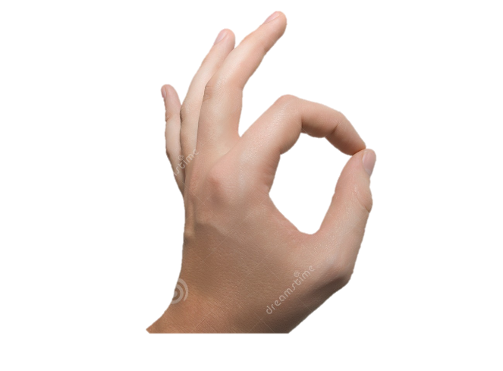
Take the OK sign — the simple hand signal where you put your thumb and first finger together to create a circular shape. In the U.S. we use it to convey agreement and compliance. Yet it is seen as offensive in Greece, Spain, and Brazil. In those countries it means that you are calling someone an asshole. In Turkey, that sign is also an insult toward gay people.

Slide 4
So aside from keeping your hands firmly in your pockets while you are traveling, what can you do to ensure that you don’t insult the locals or end up in a bar brawl? The last time I checked, there was no section in any of my phrasebooks for hand gestures.

Slide 5

1. The chin flick. Brushing the back of your hand underneath your chin in a flicking motion means “get lost” in Belgium, northern Italy, and Tunisia. In France, this gesture is known as la barbe (”the beard”) and is the hand-sign equivalent of macho grandstanding.

Slide 6
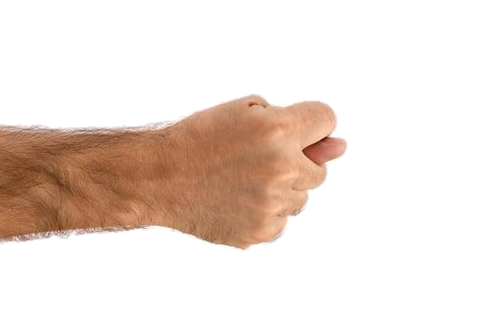
2. The fig. A clenched fist with your thumb between your first and second fingers means “screw you” (to put it mildly) in Turkey, Russia, and Indonesia. And in some countries it symbolizes lady parts. You know what I mean.

Slide 7

3. Forearm jerk. This is the action of punching your fist into your elbow joint while raising the other fist up in front of you. It will not get you a positive reaction in most parts of southern Europe or Brazil, and it’s used commonly by soccer fans wanting to send an offensive message to the fans of the opposing team.

Slide 8

4. The moutza. In Greece, Mexico, the Middle East, and Africa, the action of raising your open hand, palm out, with spread fingers in front of someone is a serious sign of displeasure. Possibly one of the oldest hand gestures still in use, it dates all the way back to ancient Byzantium, when criminals were chained to donkeys and paraded through the streets, where locals would rub their own feces onto the prisoner.

Slide 9
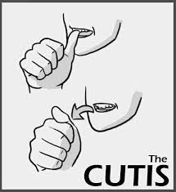

5. The cutis. Flicking your thumb from the back of your upper front teeth toward someone is seriously nasty in India and Pakistan and simply means “f*** you.” Very nice. This sign will likely get you ejected from any place of business and not welcomed back.

Slide 10

6. Five fathers. Arab and Caribbean countries see the action of pointing your right index finger and the grouped finger tips of your left hand as a way of saying, “you have five fathers.” Or, in harsher terms, “your mother is promiscuous.” So if you want to get deported in the Middle East, this is your go-to.

Slide 11
There are also several gestures that we use on a daily basis in the U.S., almost as a reflex, that mean something completely different elsewhere.

Slide 12

7. Head shake. Most people assume that nodding your head is the universal sign for “yes” and shaking your head is the sign for “no.” But in Greece and Bulgaria, these actions are reversed. This can lead to some serious confusion if you are being hit on or trying to order food off a menu.

Slide 13

8. Crossing your fingers. In Vietnam, crossing your fingers, as we would in the U.S. to wish for luck, depicts a woman’s genitalia and is considered extremely insulting if aimed at another person. It is the hand-sign alternative of calling someone the c-word.

Slide 14

9. Horns. The placement of your fingers to show horns, usually known as the symbol for “rock on,” has a different meaning in Spain, Greece, and Italy — where it is called the “corna” and is considered a suggestive gesture made to a man to imply that his wife is cheating on him. It dates back more than 2,500 years and signifies a bull’s horns.

Slide 15

10. Thumbs up. The thumbs-up sign does not mean “that’s great” in Australia as it does here. There, it means “up yours” or the painful-sounding “sit on it.” Basically, you are telling a person that you hope he gets something inserted up his bottom.

Slide 16
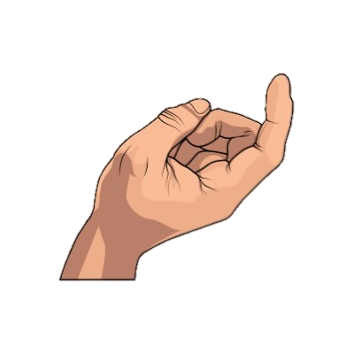
11. Come on over. In the Philippines, using your hand to make a “come here” gesture is one of the most offensive things you can do. In fact, this gesture is deemed so bad that you can actually get arrested for using it. We promise you that the last place you want to end up on your vacation is inside a Philippine prison.

Slide 17

12. Crossed arms. Crossing your arms in front of you is considered a huge sign of arrogance in Finland. Standing with this posture in a bar is likely to get you into a fight.

Slide 18
13. Fist shakes. In Austria, shaking two fists in front of you is a way of wishing someone good luck.
No visual available

Slide 19
15. Hand shakes. In Russia, shaking hands, or doing pretty much anything else, over a threshold is considered extremely unlucky.
No visual available

Slide 20
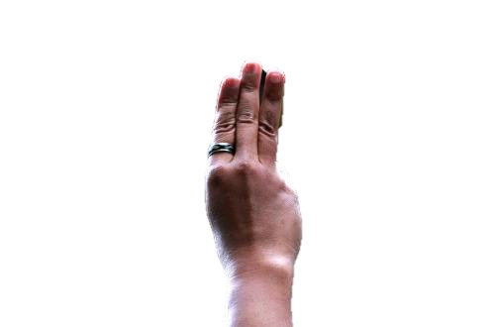
16. Three-fingered salute. In Thailand, the raised arm with three fingers extended (like the gesture used in The Hunger Games) was outlawed after it became a symbol of opposition to the country’s military coup in 2012. How very original.

Slide 21

17. Feet gestures. In India, one of the worst things you can do socially is to show a person the soles of your feet or use your feet to point to or touch things. Feet are seen as unclean and the lowest point of the body. Resist the urge to give yourself a pedicure in public, or you might be faced with some angry locals.

Slide 22
Additional information
Showing the sole of your shoe: It’s something that men in the U.S. often do without a second thought: sit down and then cross a foot over the opposite knee, exposing the sole of their shoe. But in much of the Middle East, this is extremely offensive: In Arab cultures, the soles of your shoes are considered dirty and shouldn’t be displayed to anyone. Former U.S. Congressman Bill Richardson learned that lesson the hard way: On a delicate diplomatic mission to Iraq in 1995, Richardson crossed his leg in that fashion while talking to Saddam Hussein. The Iraqi leader was so offended, Richardson says, that he walked out of the room.

Slide 23

Using the left hand: In certain countries (mostly in the Middle East, India, and parts of Africa), the left hand is considered very dirty because, historically, that was the hand used for certain sanitary activities. So using it to initiate a handshake, touch food, touch someone else, or present a gift is considered pretty disgusting.

Slide 24

Sitting in the back seat of a taxi: We all know the procedure: You hail a cab, wait until it stops, open the rear door, and climb into the back seat. Well, in Australia and New Zealand you’re doing OK — except for that last part. In those countries if you’re the sole passenger, some cabbies consider it extremely snobby for you to hop into the back seat as if they're your chauffeur (which, if you think about it, they kind of are, at least for a while).

Slide 25

Tipping: Many American travelers know that tipping isn’t expected in Europe. But not many know that in Japan, it could be taken as an insult. Before you go to any country, it’s a good practice to look up their tipping custom.

Slide 26

Putting your hand in your pocket: Considered disrespectful in Turkey

Slide 27

"The Number Two“ or “peace sign”- This doesn't mean "two" as it does in the U.S. In the U.K., Ireland, Australia, or New Zealand, holding up two fingers in a reverse peace sign (i.e., palm facing you) is an obscene gesture, the equivalent of what holding up half that gesture (i.e., just your middle finger) means here. Same gesture, just twice the number of fingers (is it because of the exchange rate?).

Slide 28
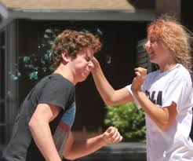
Touching Someone’s Head: Here, it’s almost instinctive: You see a cute kid and pat him or her on the head. But that’s a big no-no in countries with high Buddhist populations, such as Sri Lanka, Thailand, and China. Buddhists consider the head sacred; it’s where they believe the spirit lives. So hands off (and it’s probably not a good idea to walk around touching strangers, no matter where you are).

Slide 29

Point: It has different meaning in other countries, most of which doesn't invite a pleasant response. Wait, isn't it rude to point back in the U.S. also?

