Slide 1

Diversity Among Humans

Slide 2
Genetic Diversity
Humans have traditionally been classified into three racial categories; however, the ciassification system is too simplistic. There are a number of human groups who do not fit well in any of the three groupings, and cultural differences are more important than physical differences among humans.

Slide 3
Our common humanity far outweighs the “racial” differences
Only a tiny part of the human genetic code accounts for the physical differences. The truth is that humans of all categories are far more alike than they are different – unfortunately, many have chosen to focus on that tiny part and ignore the massive similarities.

Slide 4
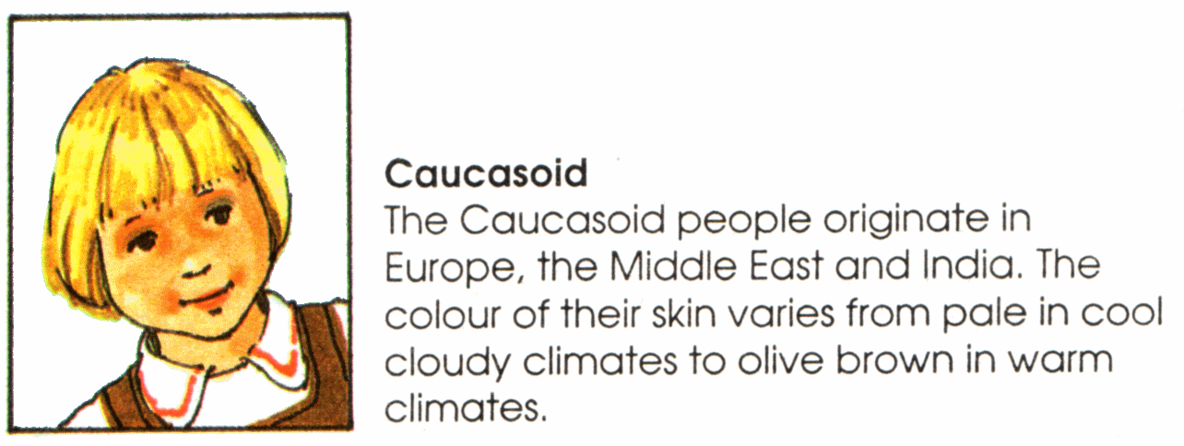
Problem: Some Indians (from India) have skin as dark as many Africans.

Slide 5
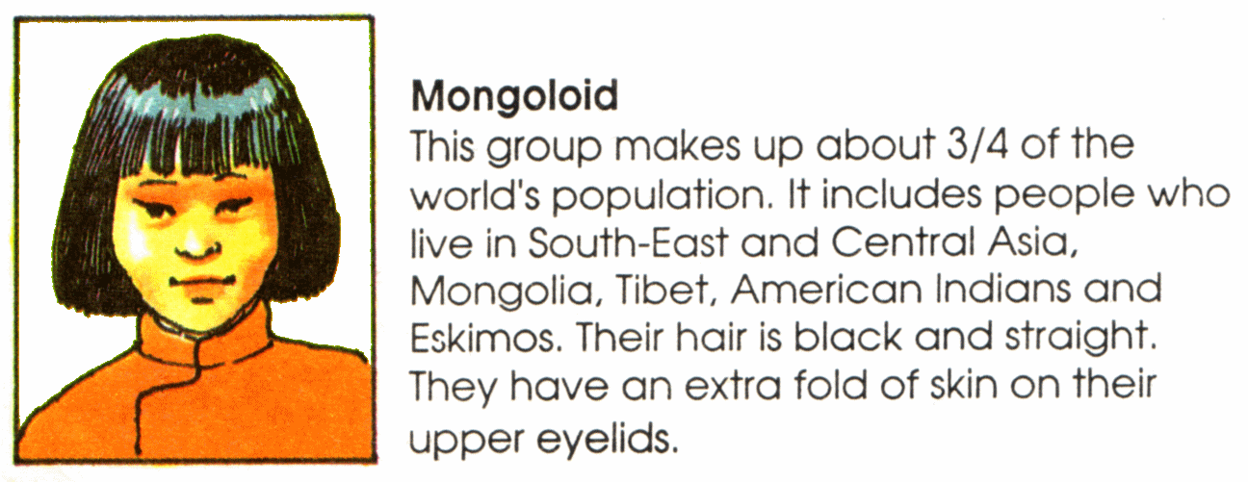
Some people do not like to use the term “Mongoloid” because of its association with Downs Syndrome.

Slide 6
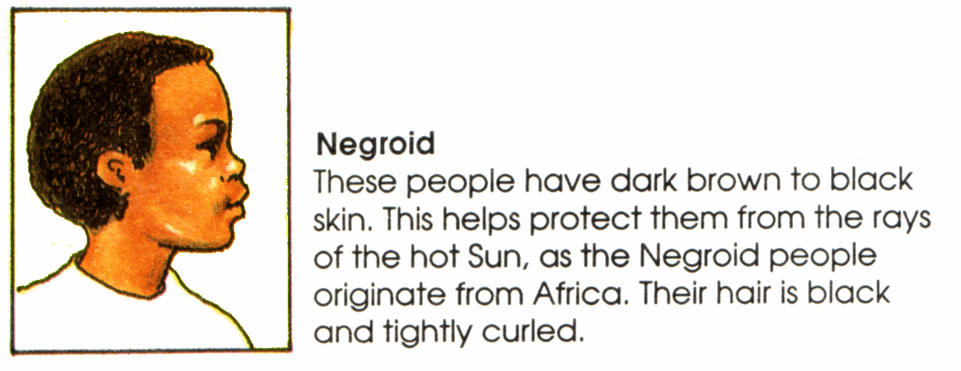
The San (Bushmen) have lighter, more yellow complexions.

Slide 7
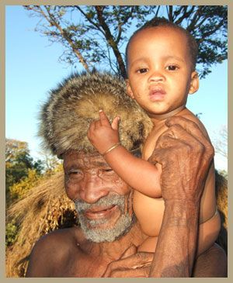
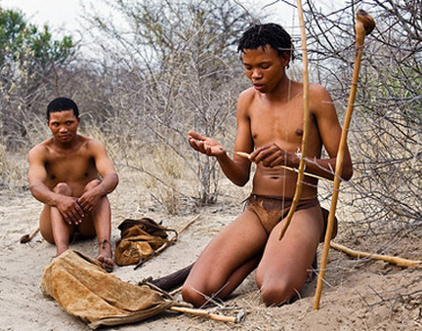
People who don’t fit well into the three traditional categories
Members of the San people

Slide 8
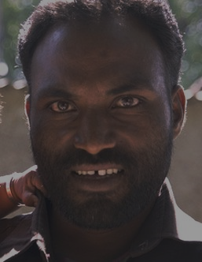
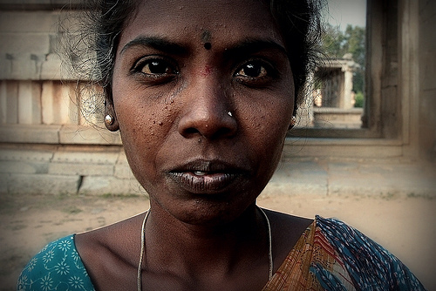
Dravidians in India

Slide 9
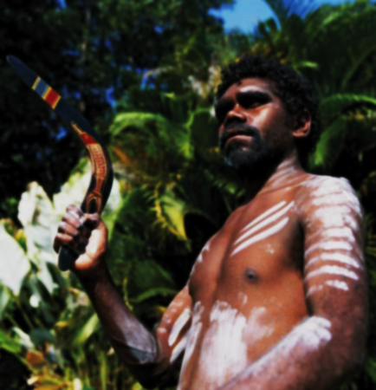
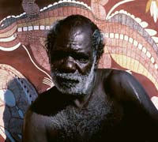
Australian Aborigines

Slide 10
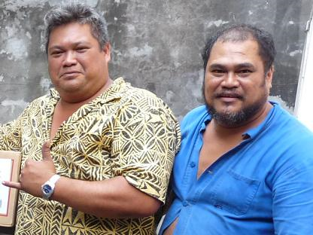
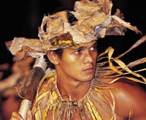
Polynesians

Slide 11
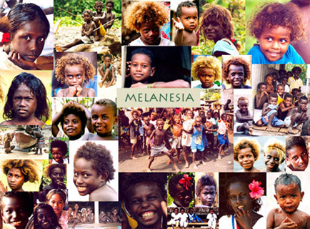
Melanesians

Slide 12
Cultural Differences
Cultural differences are learned because culture is a learned phenomenon – it isn’t hard-wired in the genetic code. It is most likely that these differences were partly the result of living in different climates and landforms and from differences in what materials were available from the environment for nutrition, clothing, housing, etc. Different religions also affect what some people eat and how they may dress.

Slide 13
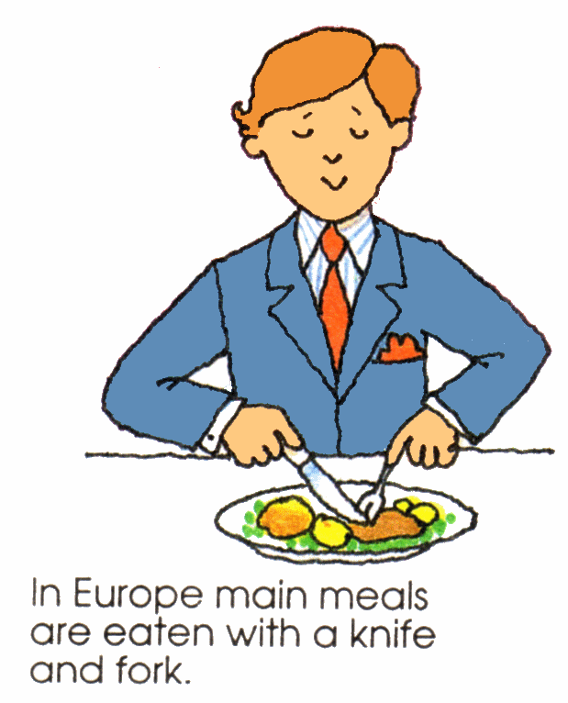

Slide 14
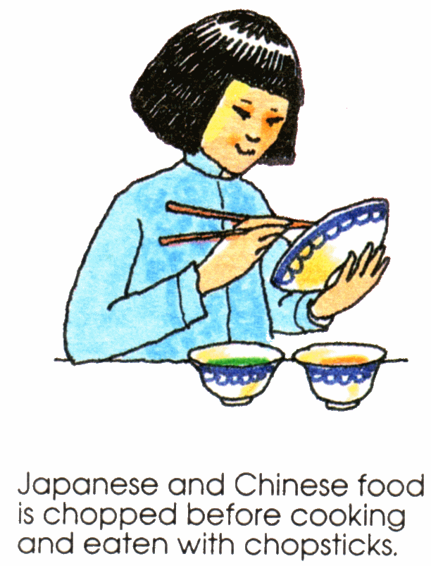

Slide 15
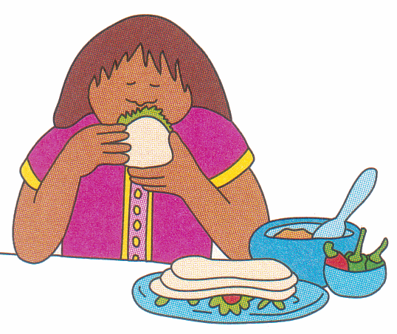
In Mexico, tortillas are used to bring many foods to one’s mouth

Slide 16
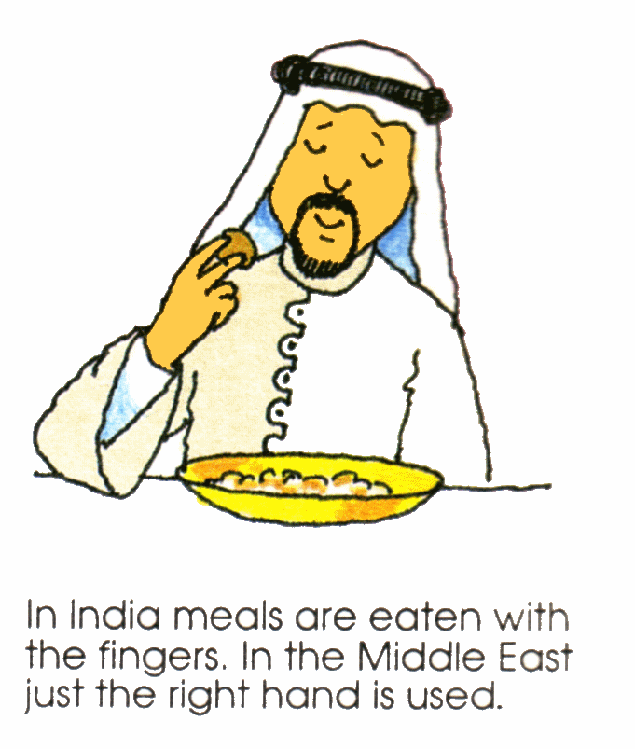

Slide 17
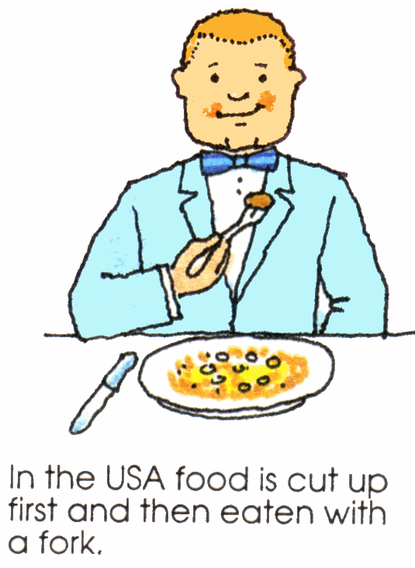

Slide 18


Slide 19
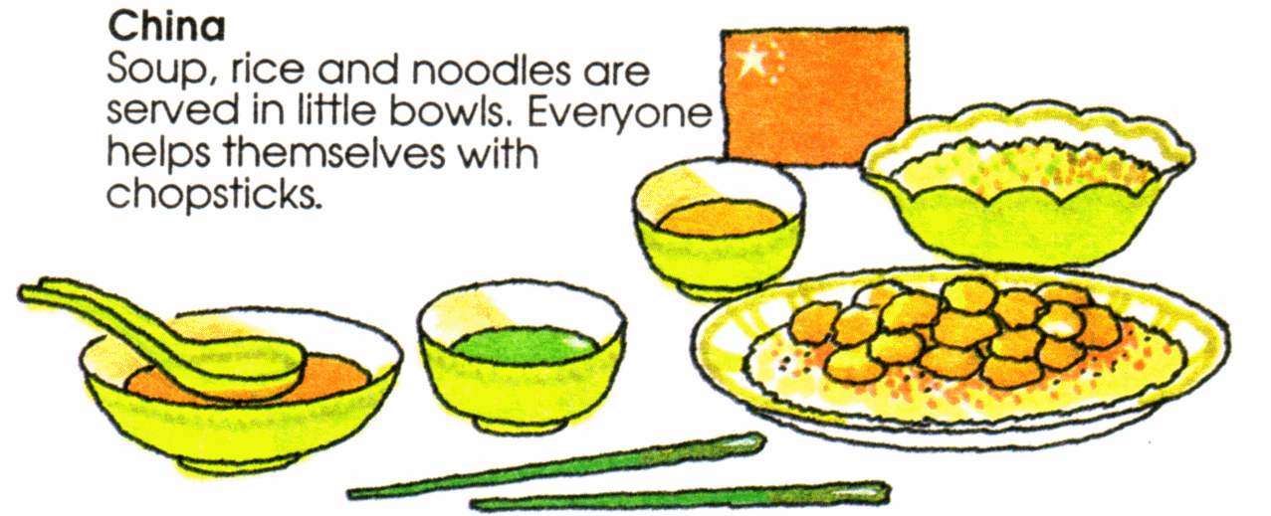

Slide 20
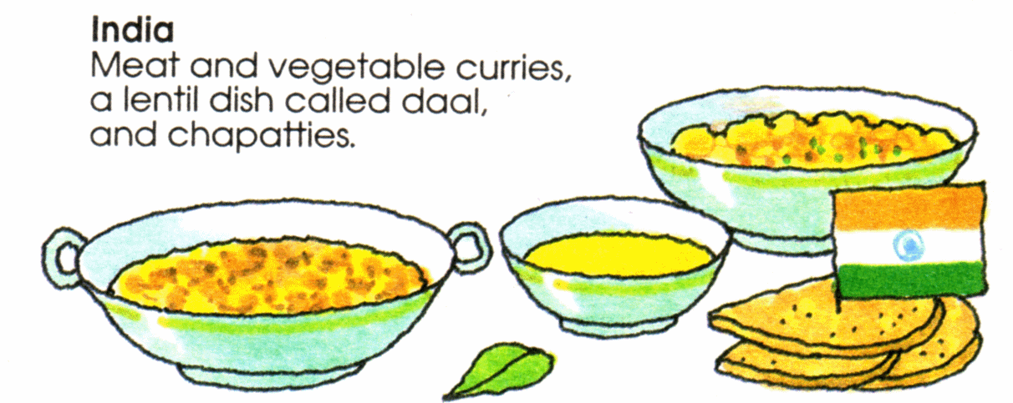

Slide 21
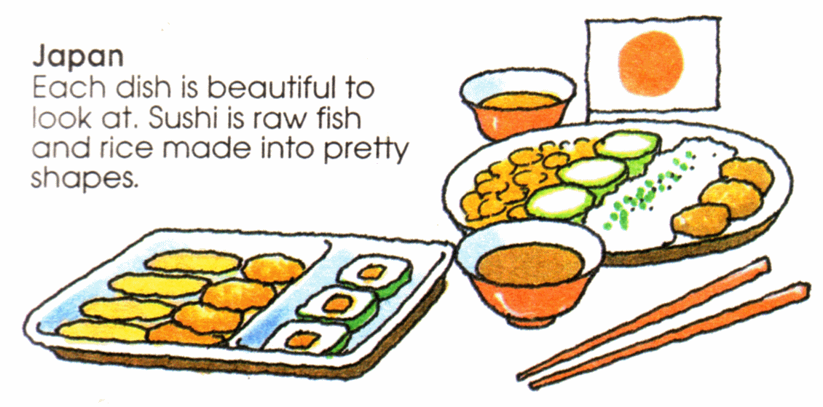

Slide 22
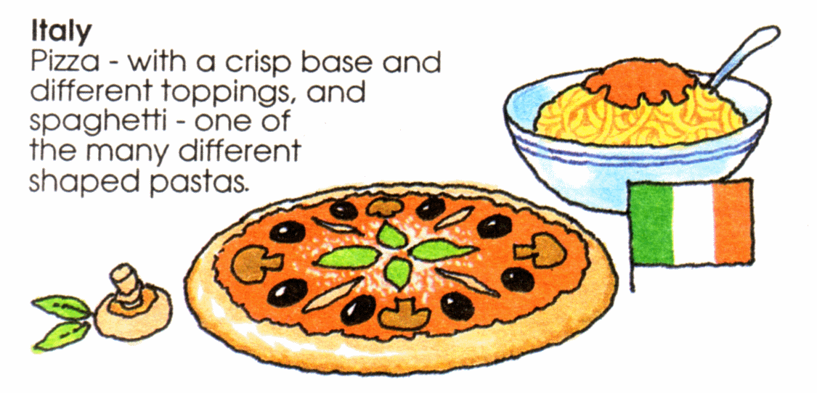

Slide 23
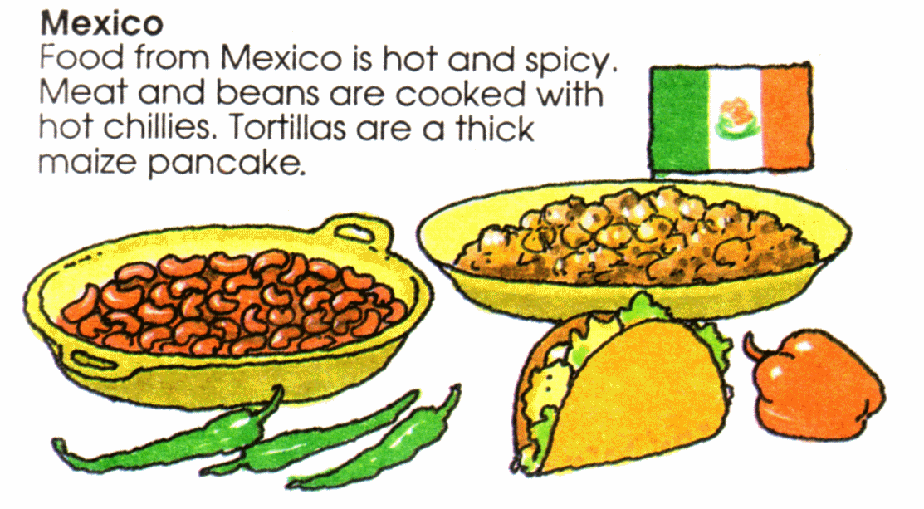

Slide 24
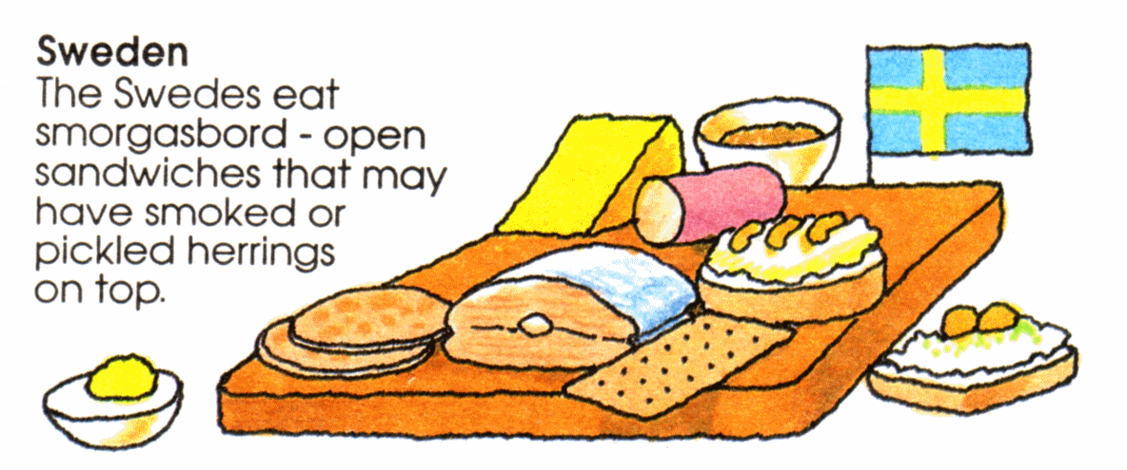

Slide 25
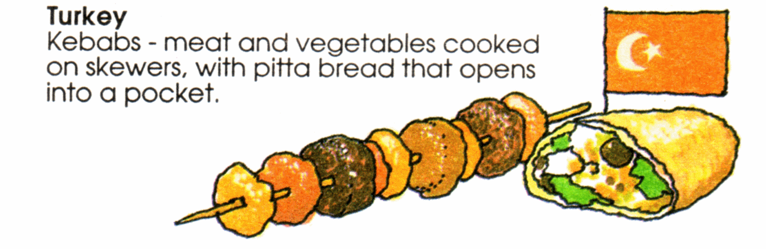

Slide 26
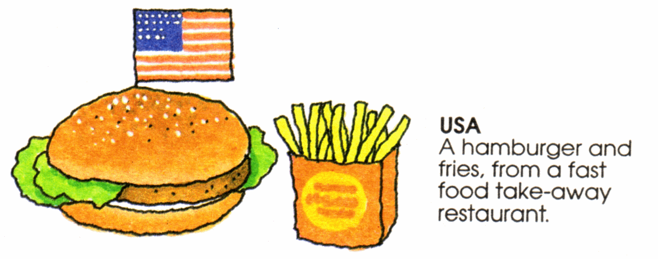

Slide 27
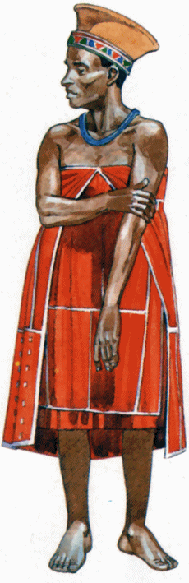
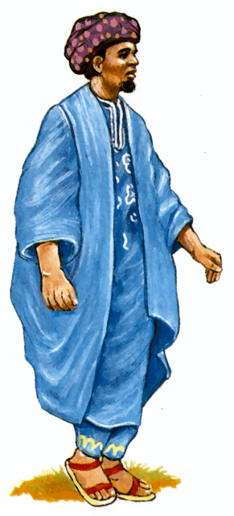
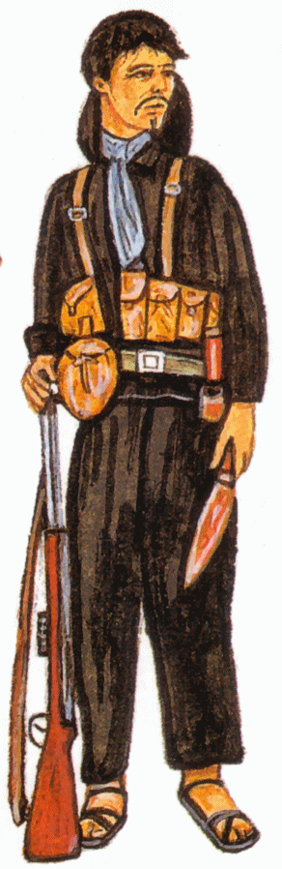
Differences in dress

Slide 28
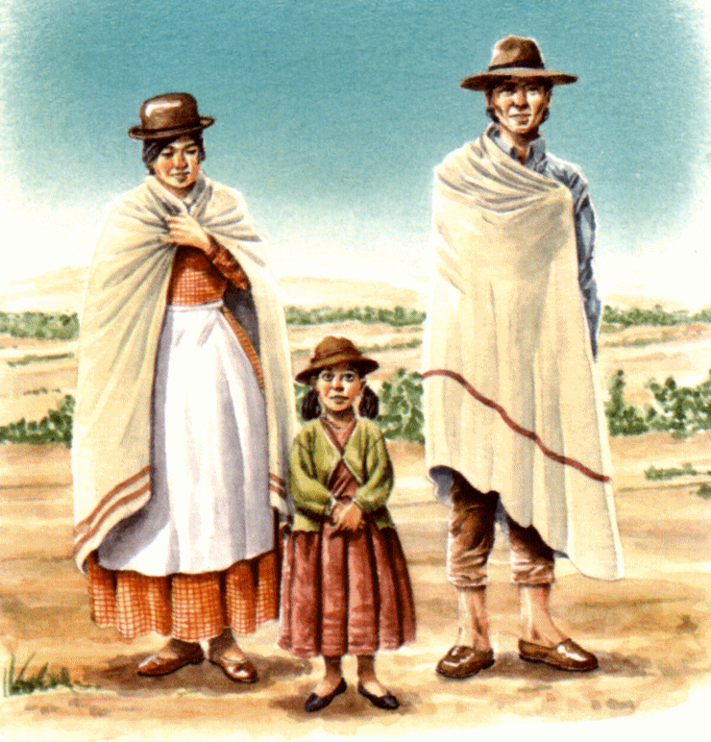

Slide 29
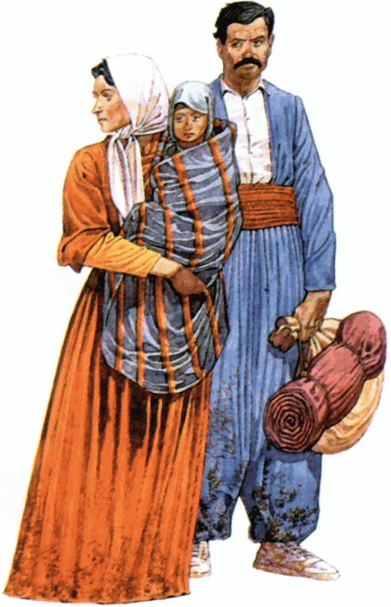

Slide 30
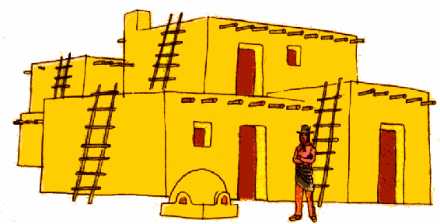
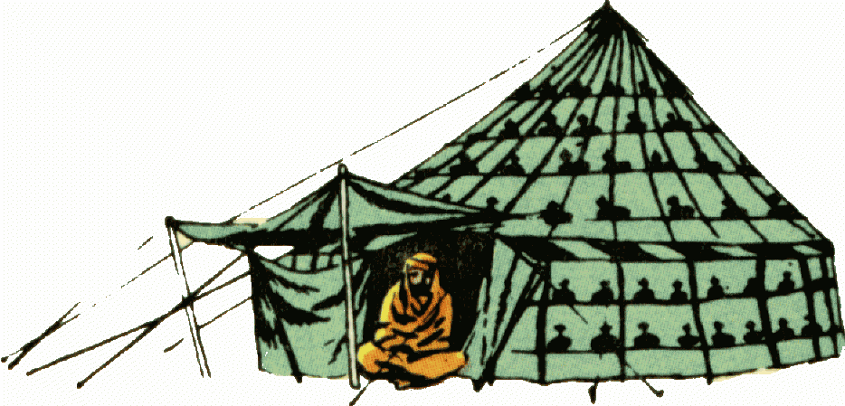
Differences in Housing

Slide 31
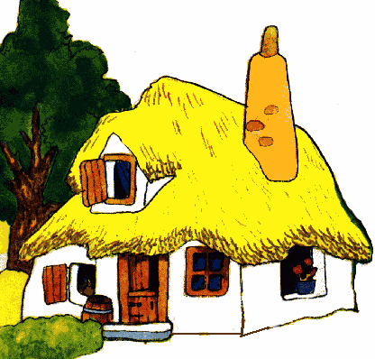
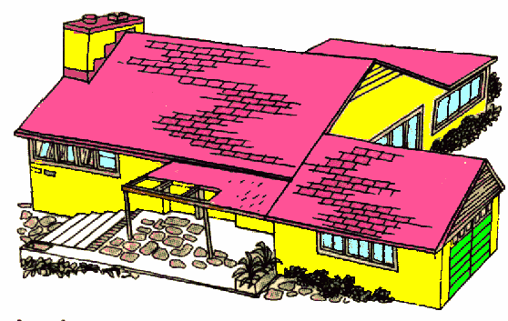
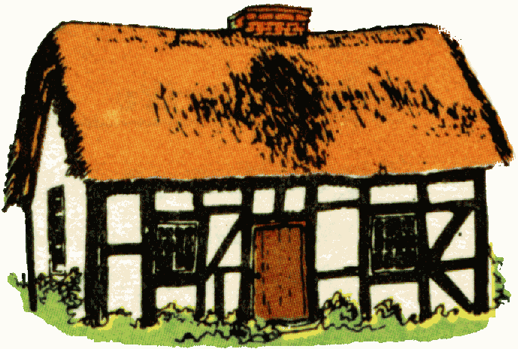

Slide 32
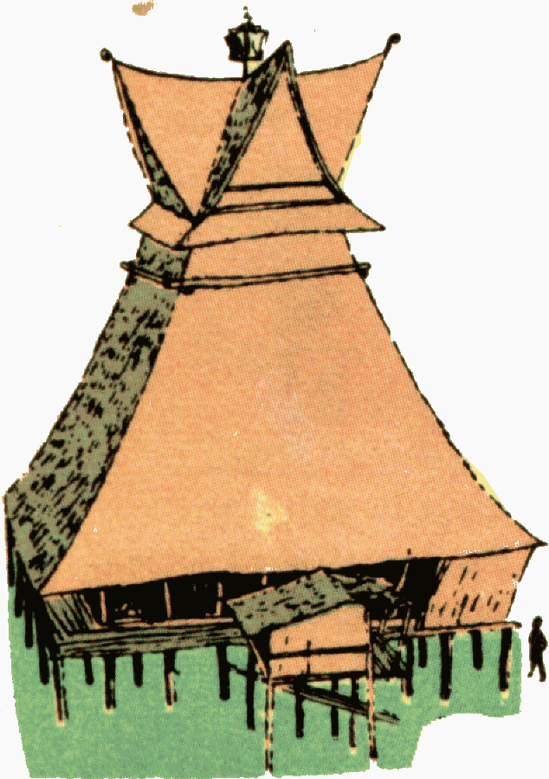


Slide 33
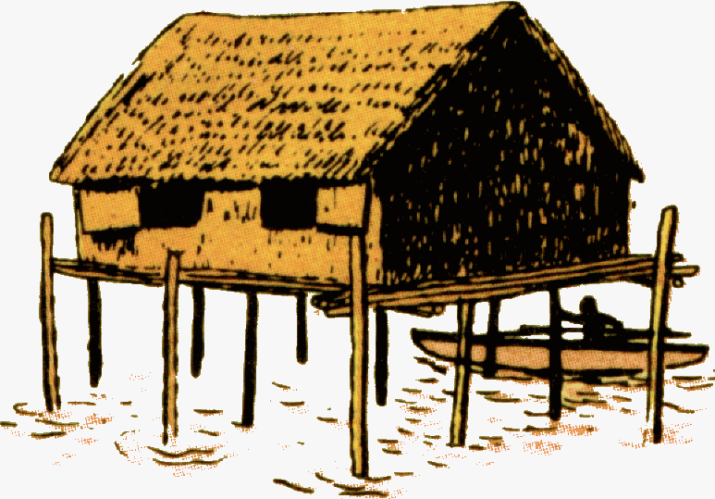
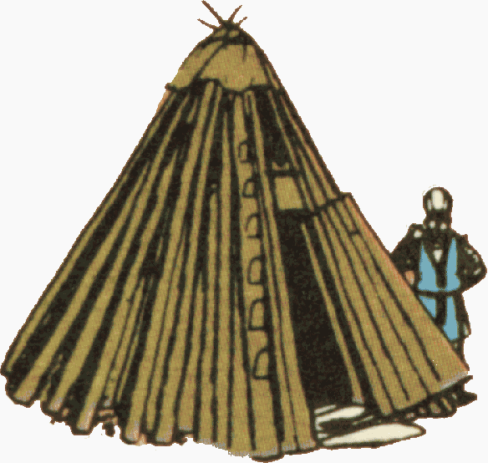

Slide 34
All the diversity makes for a very interesting world in which to live. If humans can be open to learning and change, cultural differences need not make them feel threatened. Imagine a world where diversity is accepted and celebrated – WOW!!!!!!

