Slide 1
Culture - As With Time, Cultures Change
These ads may have been acceptable when they were run; however, they’d be rejected in the 21st century.

Slide 2
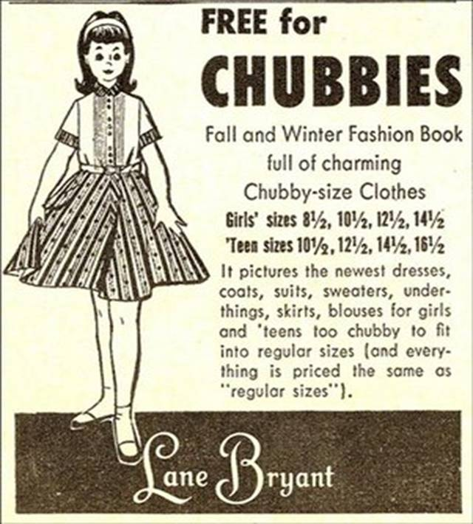

Slide 3


Slide 4
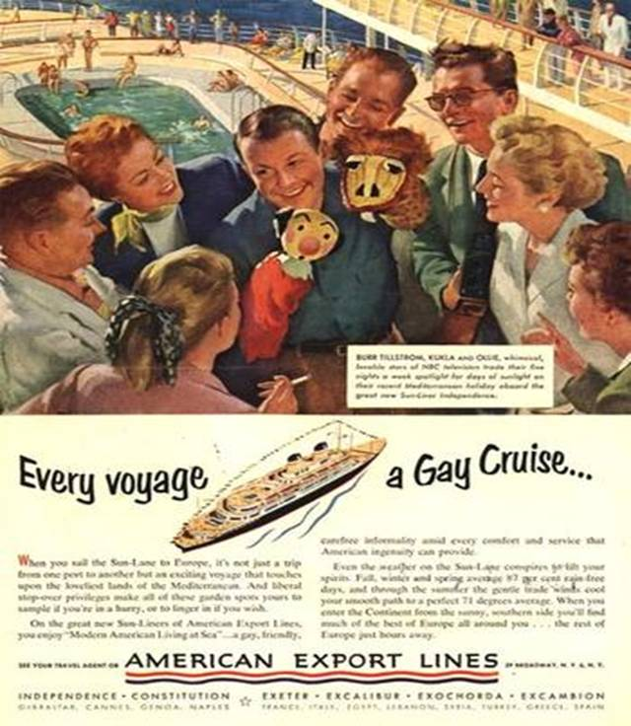

Slide 5
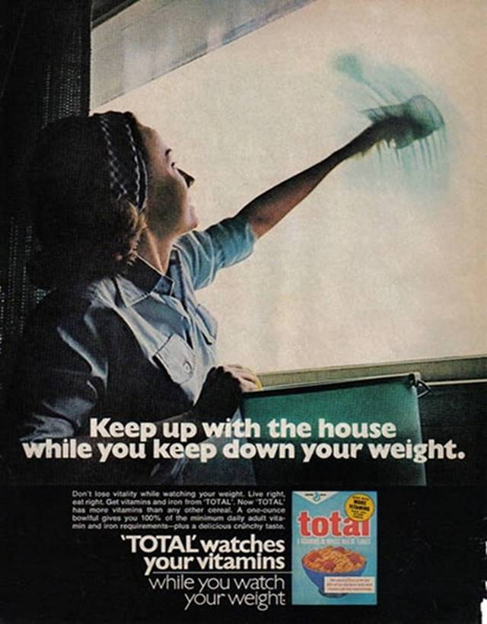

Slide 6


Slide 7
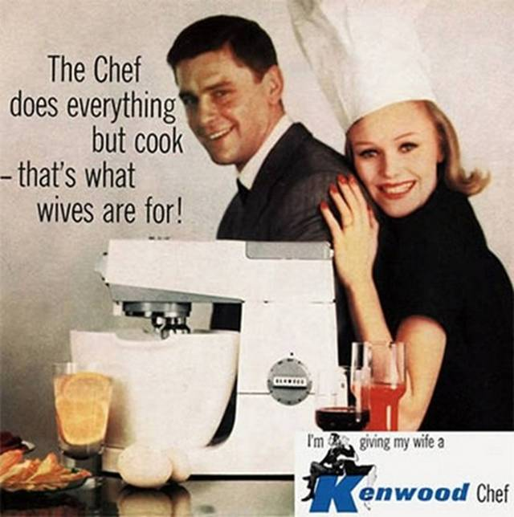

Slide 8
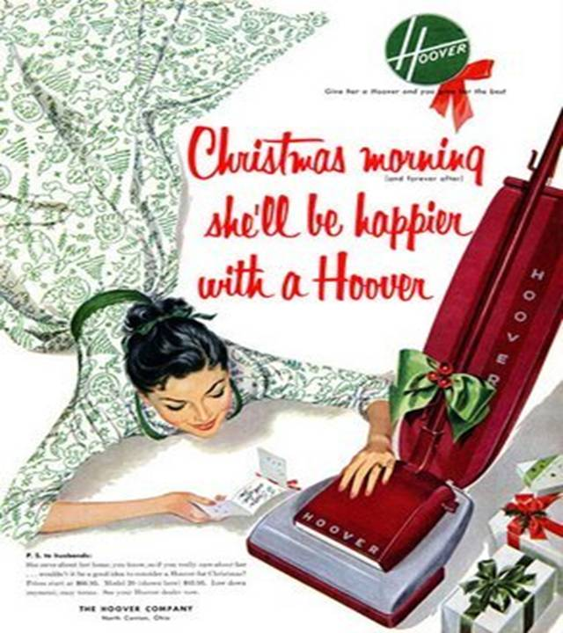

Slide 9


Slide 10
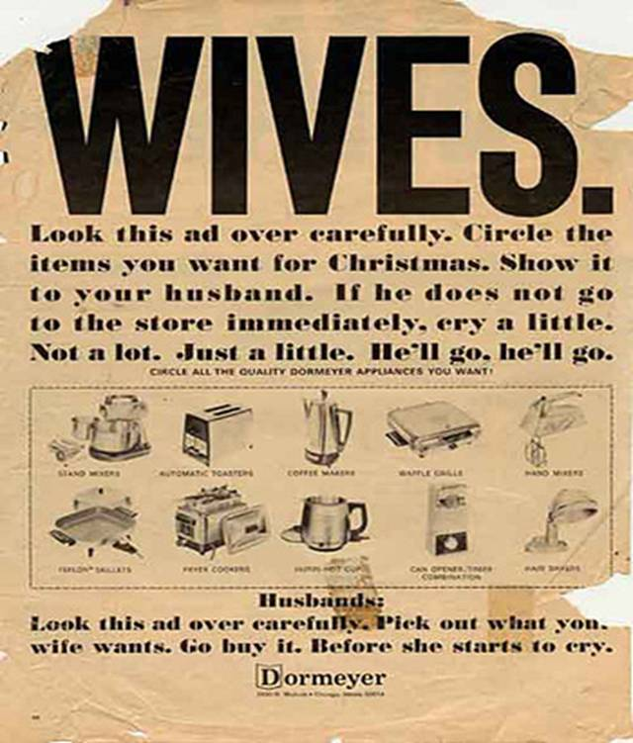

Slide 11


Slide 12
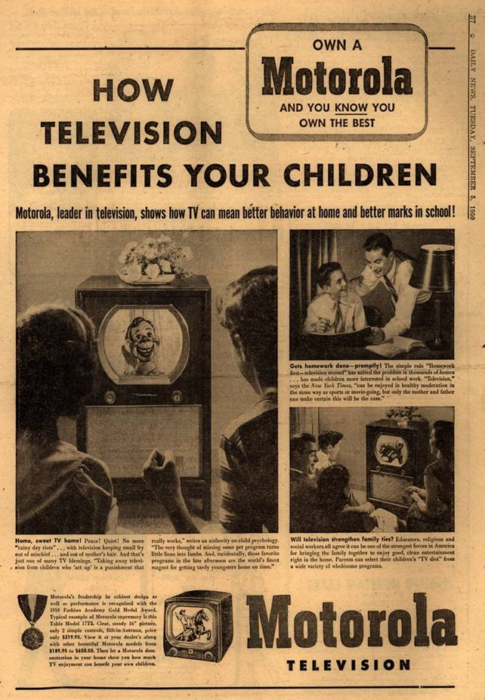

Slide 13


Slide 14
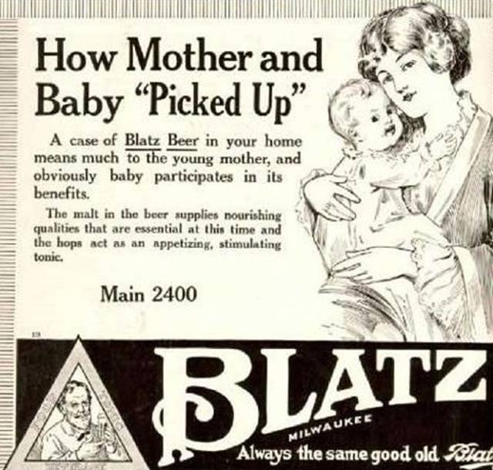

Slide 15
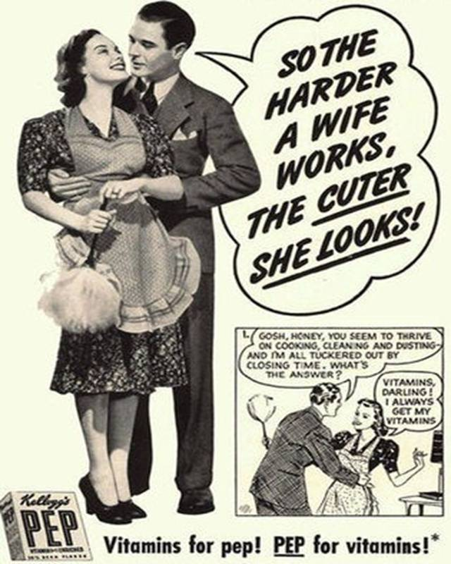

Slide 16
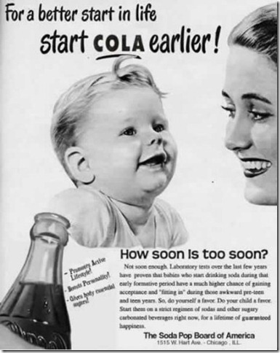

Slide 17
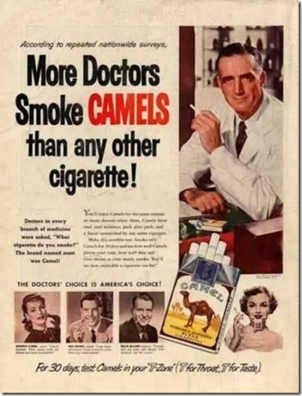

Slide 18


Slide 19
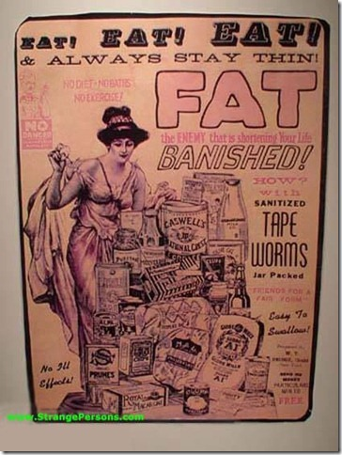

Slide 20
Why wouldn’t these be acceptable today? What changed?
Styles and fads change
New knowledge and experiences
Changed gender perceptions and roles
New laws
Changes in word meaning (what was an acceptable word has become unacceptable).
Increased sensitivity to the feelings of others

Slide 21
How has our culture changed in my 70 years (December 2011)? In the 1940s:
Proper dress for women was a dress or a skirt and blouse or sweater.
Women put on their “Sunday-best” clothes to go shopping “downtown.”
Except for the World War II period, most women kept house and raised children.
Well-bred women didn’t smoke in public.
Sophisticated men did smoke in public.
Children didn’t have to join a “league” to play outside in the summer.

Slide 22
Children did play outside in the summer (few people had air-conditioning).
If children didn’t progress in school, they were “held back.”
Children in trouble in school:
Then: they were in trouble at home too
Now: their parents threaten to sue the teacher and/or school district
Politicians and people in general didn’t think “compromise” was a bad word – our system probably wouldn’t have survived 2 centuries if we hadn’t been able to compromise.

Slide 23
Most businesses were closed (by law) on Sundays.
Not all urban dwellers had automobiles (pre-suburban sprawl days). Most urban families who had just one automobile if they had one.
Our major entertainment was the radio.
To research a topic, we went to the library.
The highest level of education for most people was 8th grade or high school – only a select minority went to college.
The electrical appliances found in most homes were: clock, radio, iron, toaster, record player, wringer washer (not automatic).

Slide 24
Most homes were heated by coal-fired furnaces.
Many families didn’t take summer vacation trips.
Most people hadn’t flown in an airplane.
Except for the wealthy, few people traveled to Europe or other places outside North America
Most people, including adults, could keep all their clothes in a 4-foot wide closet.
There were no frozen or “instant” foods available – wives/mothers cooked meals “from scratch.”

