Slide 1

Turkey – Antalya coast

Slide 2
Background
Antalya is known for being the most popular holiday resort of Turkey. Situated in the Mediterranean region, it is a cheap holiday spot that has excellent restaurants, designer shops and other major attractions. It attracts tourists more due to the fact that it has incomparable natural beauty in addition to attractive tourist spots that must be visited once in lifetime.

Slide 3
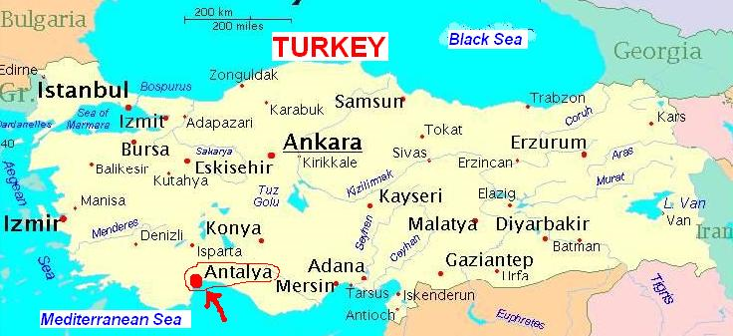

Slide 4
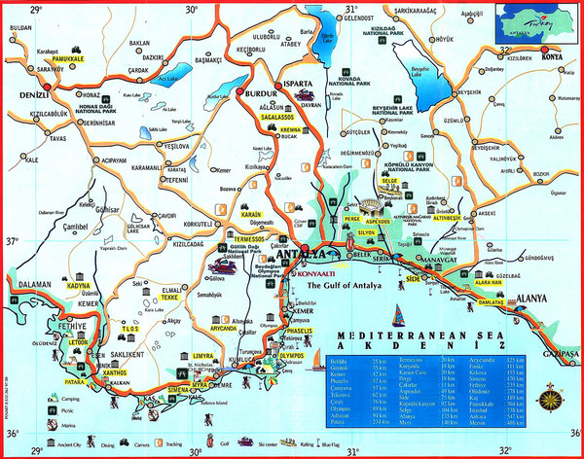

Slide 5


Slide 6
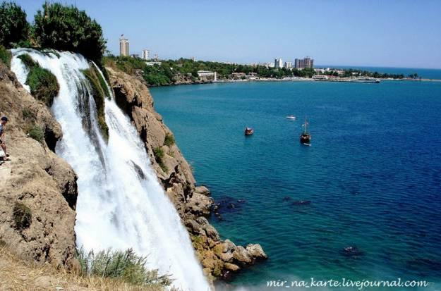

Slide 7
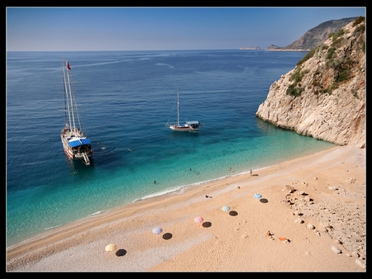

Slide 8
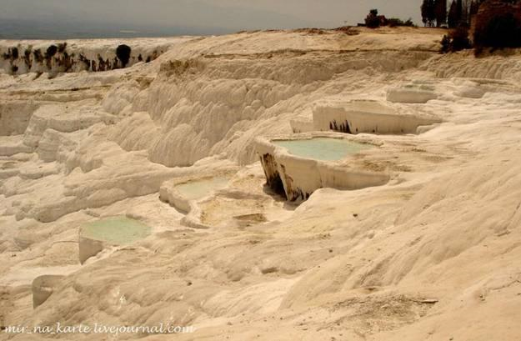

Slide 9
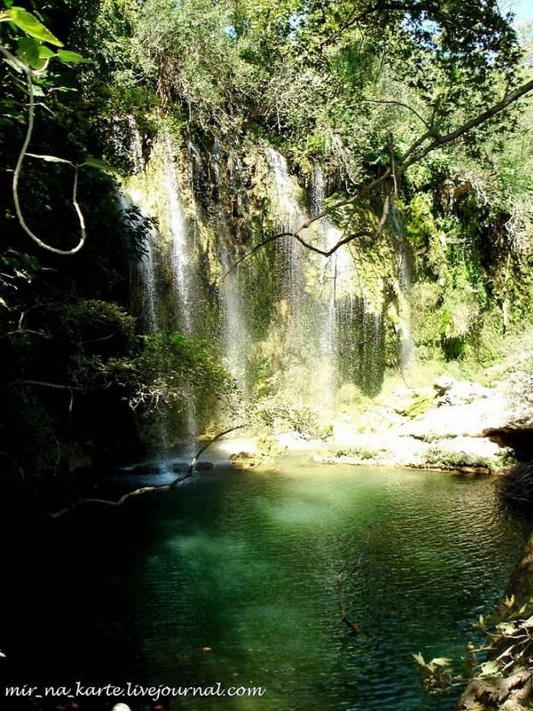

Slide 10
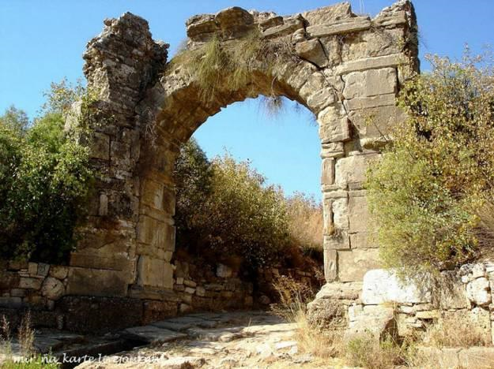

Slide 11
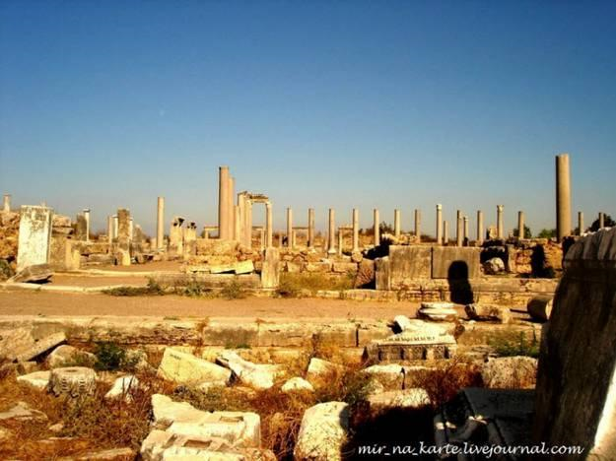

Slide 12


Slide 13
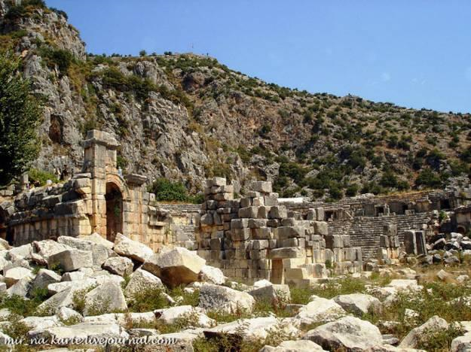

Slide 14
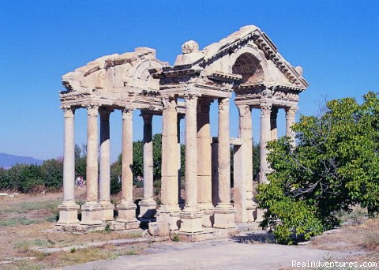

Slide 15
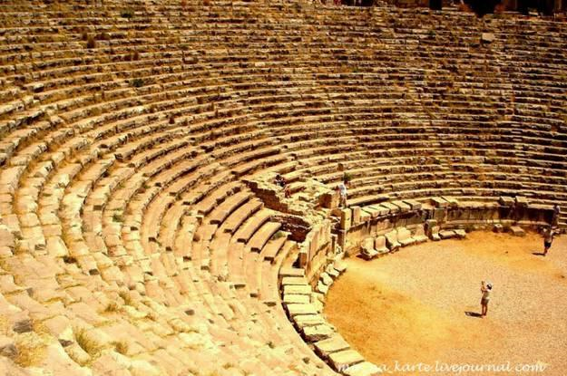

Slide 16
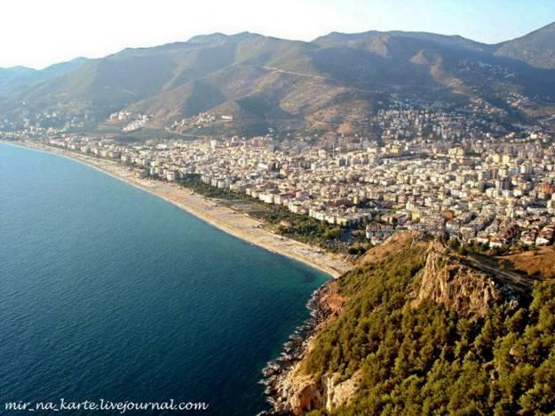

Slide 17
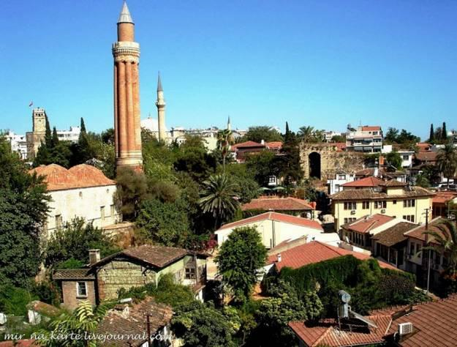

Slide 18
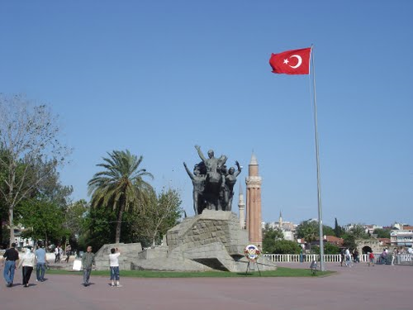

Slide 19
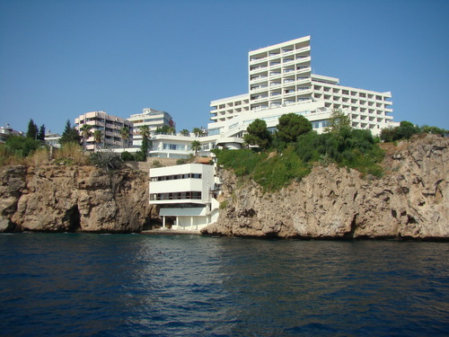

Slide 20
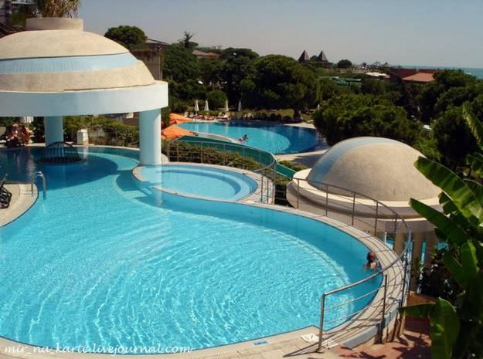

Slide 21
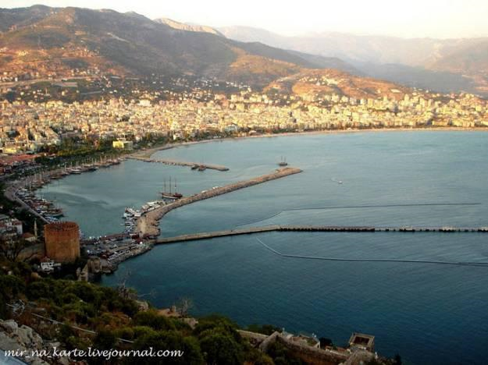

Slide 22


Slide 23
