Slide 1
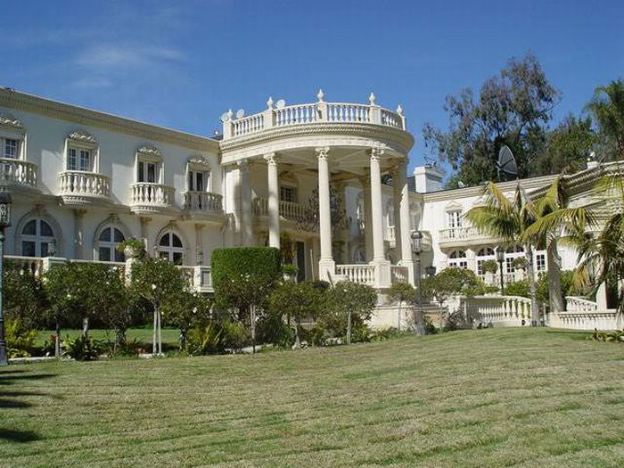
Who lives in this house?

Slide 2
Who?
Queen of England?
A Saudi Prince?
A Billionaire?
The answer is at the end of the PowerPoint.

Slide 3
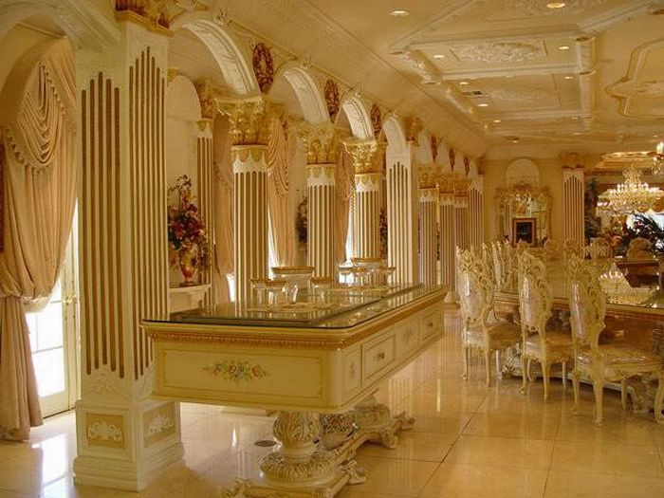

Slide 4
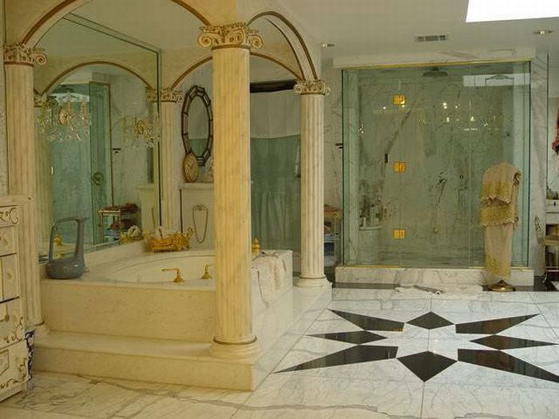

Slide 5
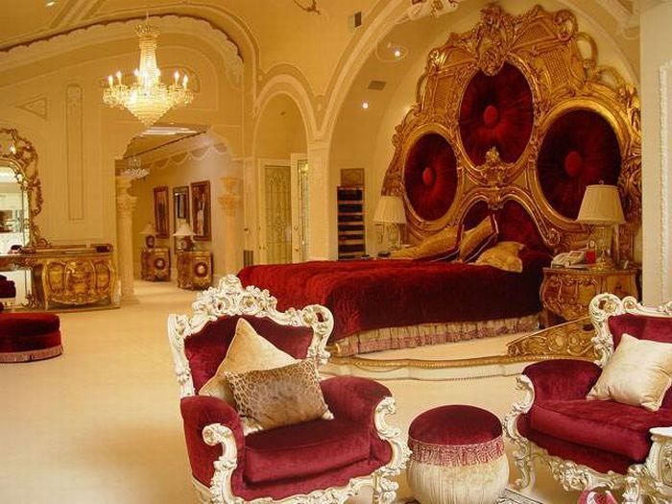

Slide 6
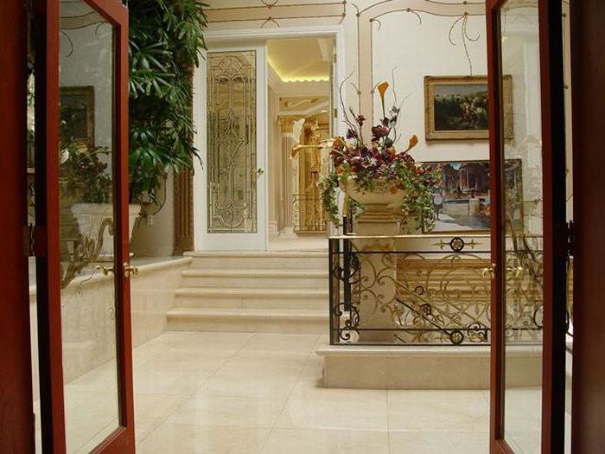

Slide 7
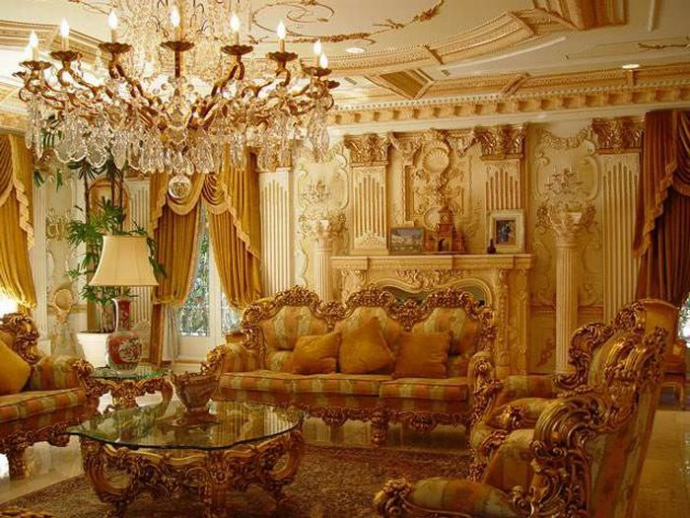

Slide 8
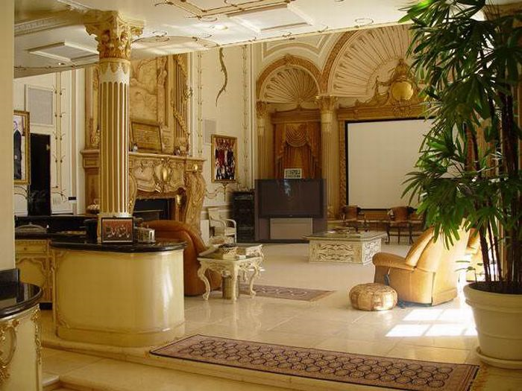

Slide 9
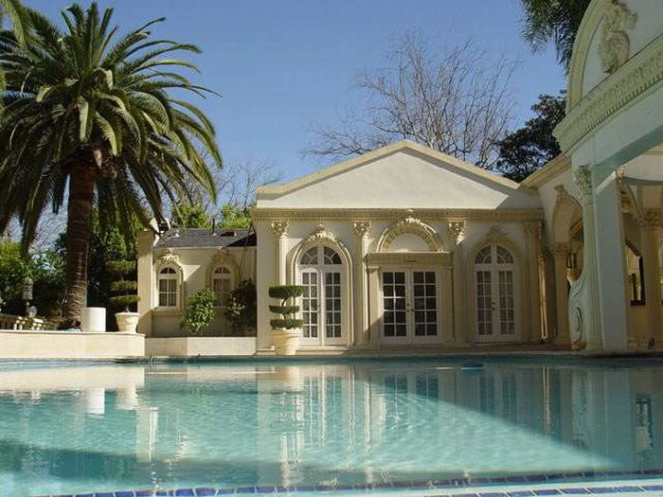

Slide 10
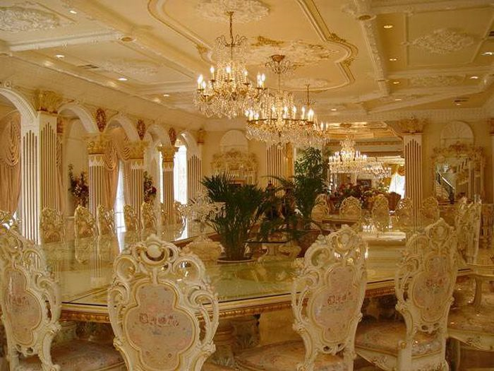

Slide 11
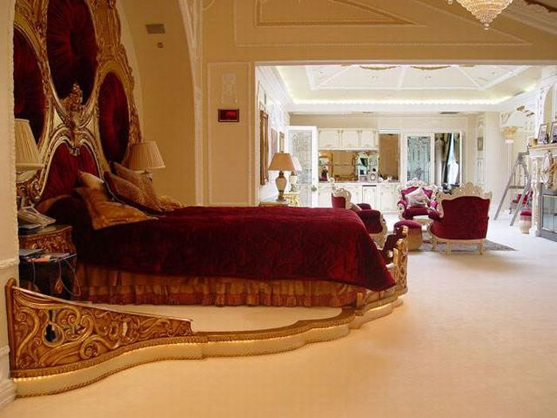

Slide 12
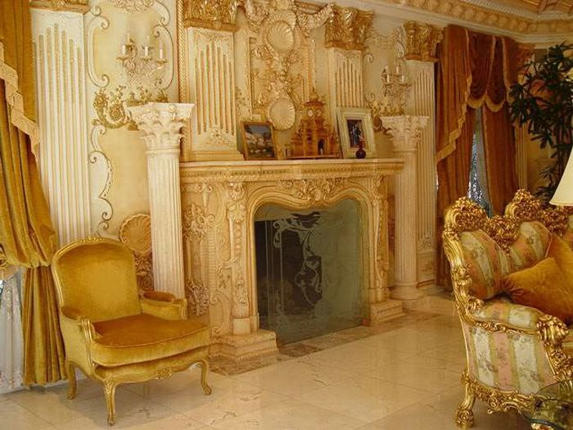

Slide 13
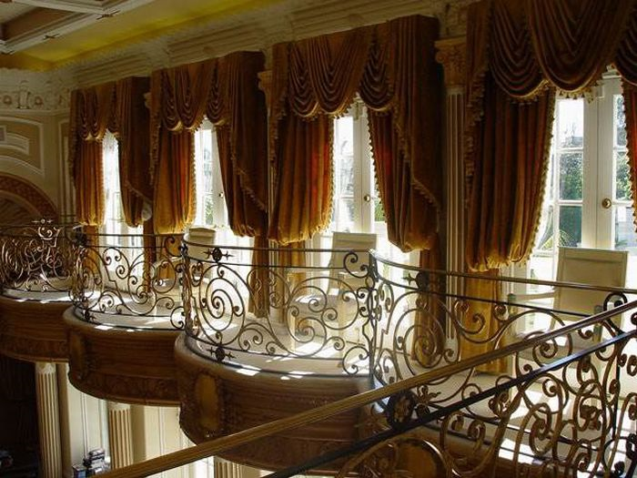

Slide 14
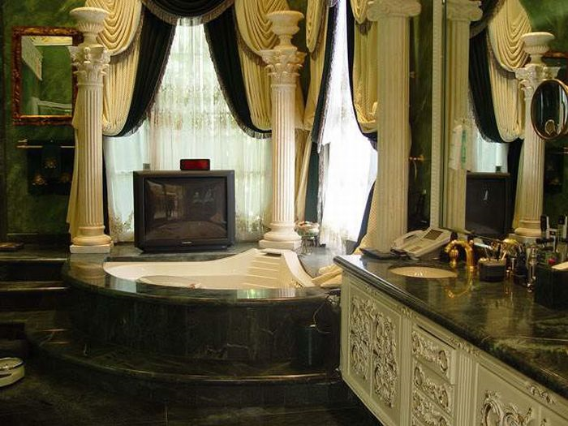

Slide 15

This Mansion is in Harare and belongs to the President (dictator) of Zimbabwe - Robert Mugabe.

Slide 16
Facts about Zimbabwe under Mugabe:
Life expectancy declined from 60 to 37 years for males, 34 years for females, the lowest in the world.
1.8 Million Zimbabweans live with HIV and receive no treatment as the health system has collapsed.
Inflation is the highest in the world and now stands at 231,000,000% . Prices double every 1.3 days.
80% of the population is unemployed.

Slide 17
Corruption is so blatant that money contributed for humanitarian projects is regularly confiscated by the Government for its private usage.
Due to the complete lack of interest by the government and the hunger of its people 60% of Zimbabwe’s wildlife has died since 2000.

Slide 18
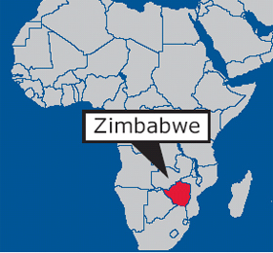


Slide 19

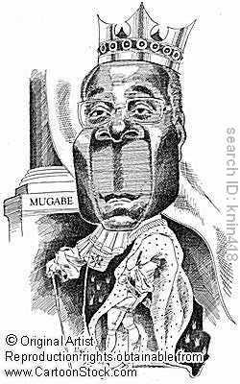
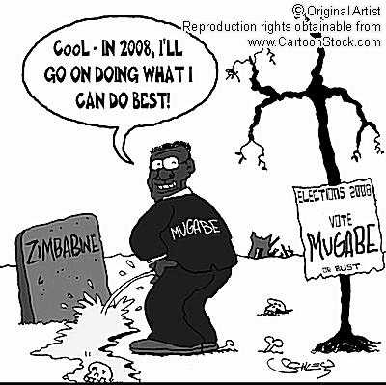

Slide 20


Slide 21



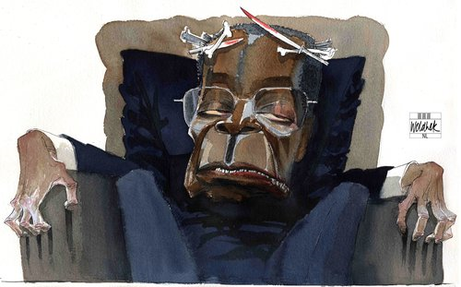

Slide 22


Slide 23


