Slide 1

Snake Park
Chennai, India

Slide 2
Overview
Snake Park was founded by one of the prominent wildlife conservationist Romulus Whitaker. The park was established in the year 1972 with the intention that is to preserve the endangered reptile species in the sub continent. The park features the breeding and captive place of many Indian snake species. Snake Park is maintained by a trust called Madras Snake Park Trust, which was established at the same time when park was. The park secured the recognition as Medium Zoo from the Central Zoo Authority in the year 1995. The park houses a number of snake species, lizards, crocodiles and turtles.

Slide 3
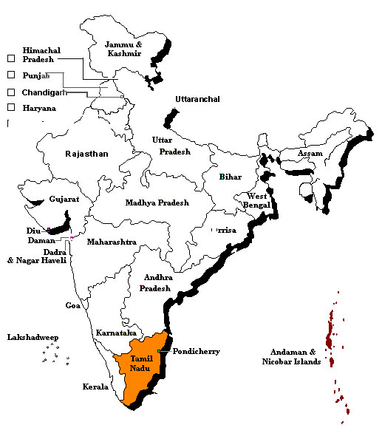

Slide 4
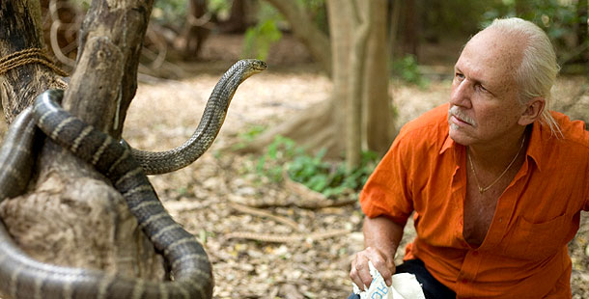
Rom Whitaker founded India’s first snake park in Madras in 1972.

Slide 5
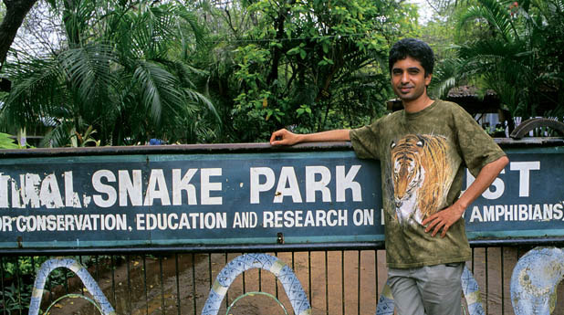

Slide 6
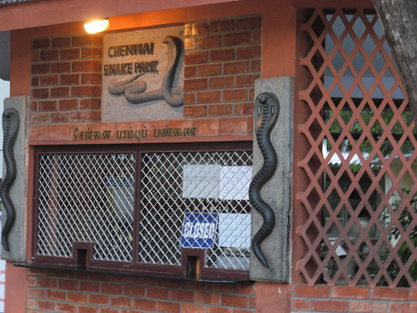
Get your ticket

Slide 7
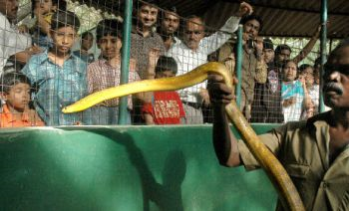
Python

Slide 8

Bird sanctuary at the park

Slide 9
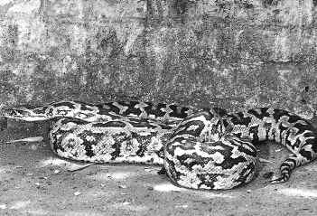
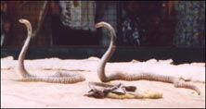
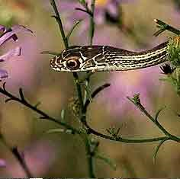

Slide 10
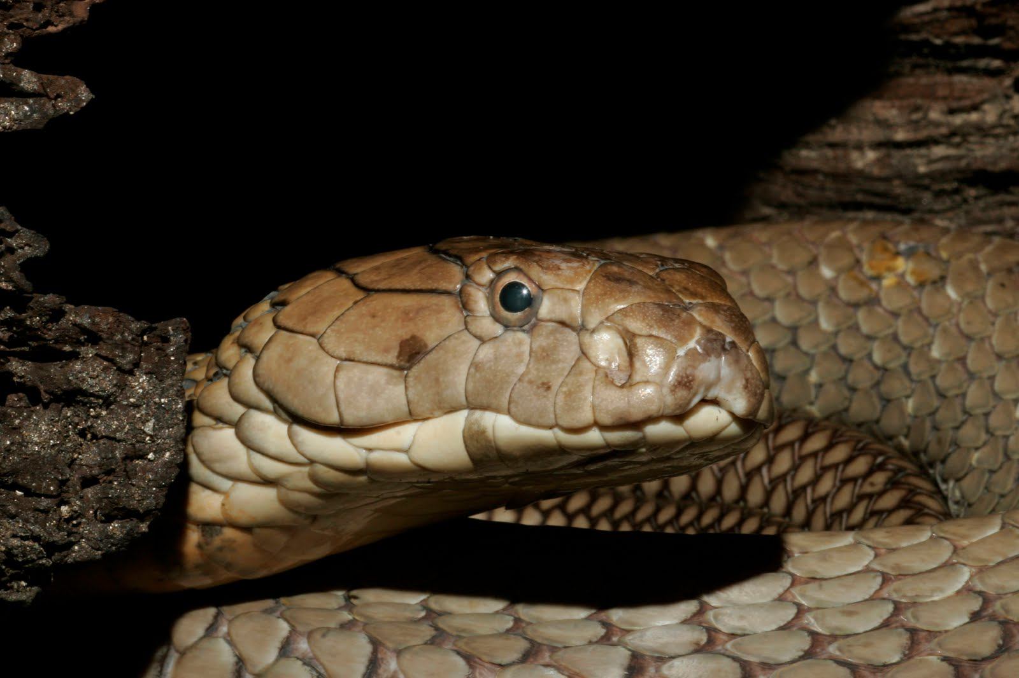

Slide 11

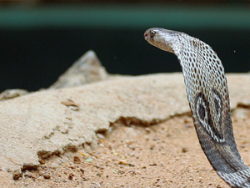

Slide 12
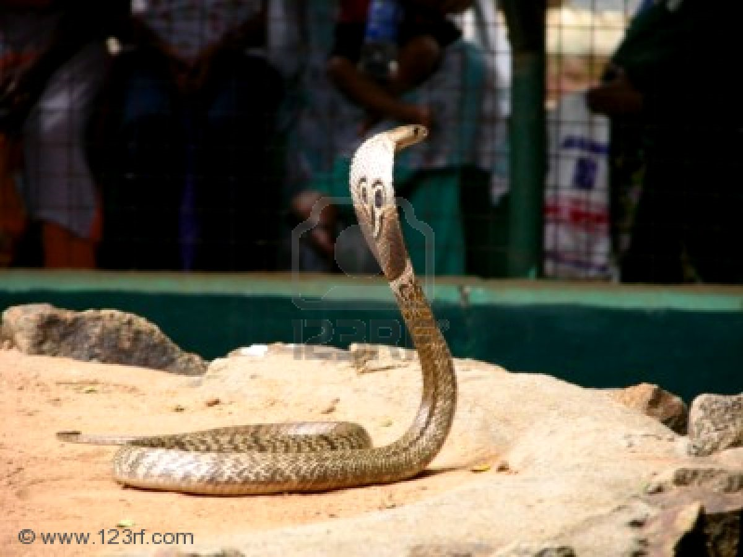

Slide 13

More than just snakes

Slide 14
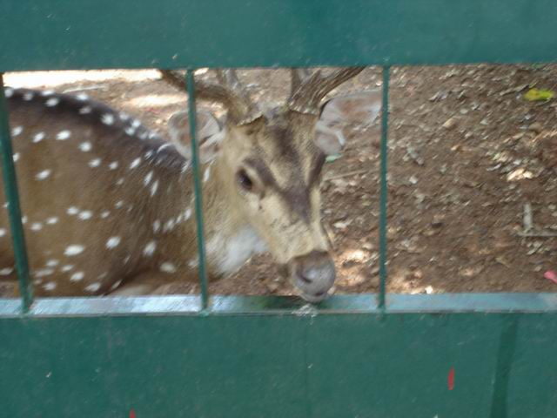

Slide 15
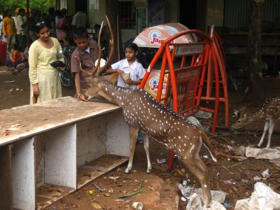

Slide 16
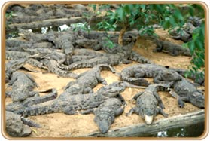
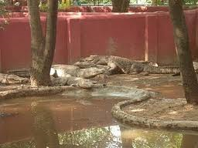
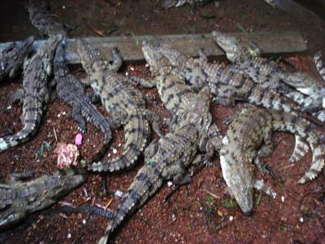

Slide 17
