Slide 1
Singapore

Slide 2
Singapore, formally the Republic of Singapore, is an island city-state and the smallest country in Southeast Asia. It is located on the southern tip of the Malay Peninsula, south of the Malaysian state of Johor, and north of the Indonesian Riau Islands. It lies just 137 kilometres (85 miles) north of the Equator.
The name Singapore is derived from the Malay words singa (lion) and pura (city), which were themselves derived from the Sanskrit words सिंह siMha and पुर pura. Hence, Singapore is also known as the Lion City.

Slide 3
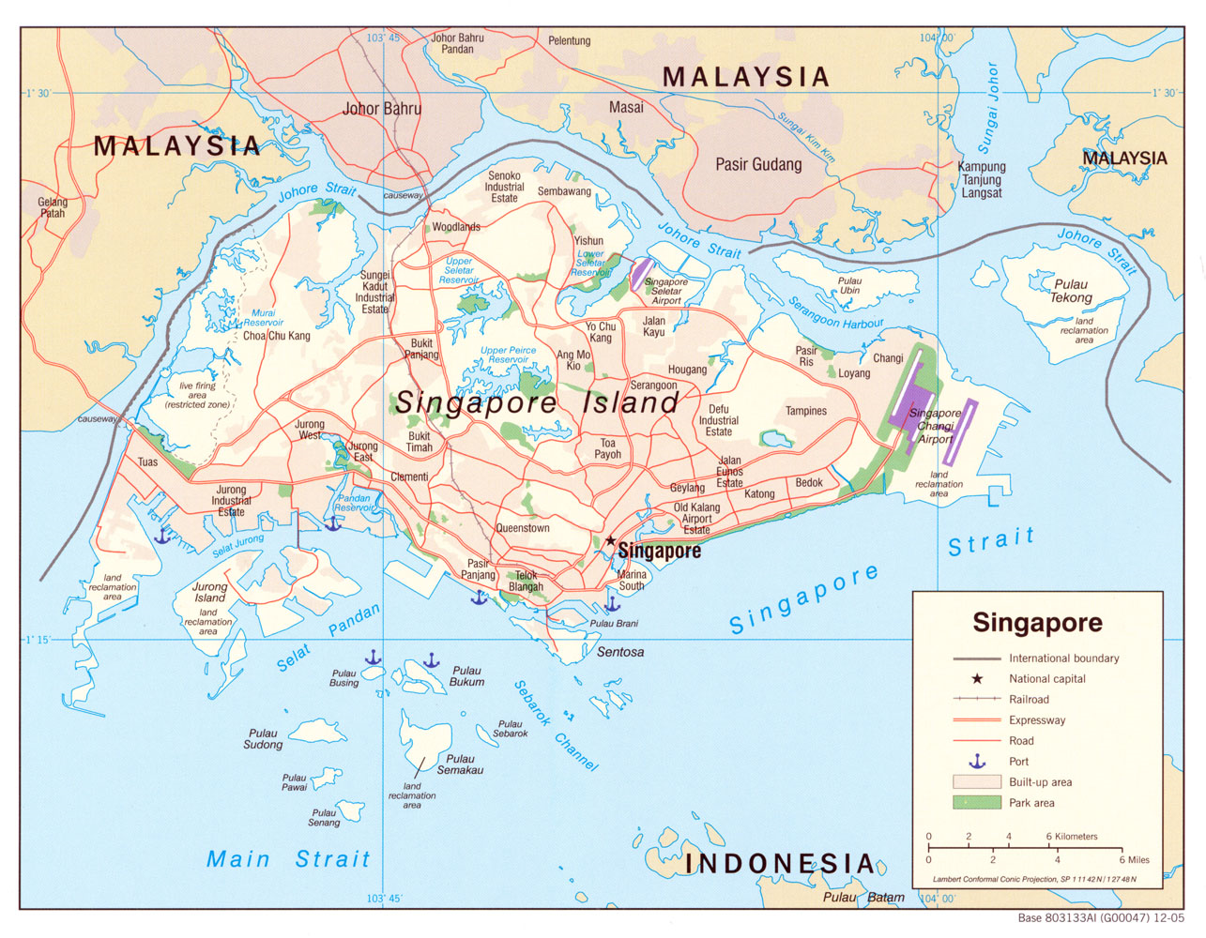

Slide 4
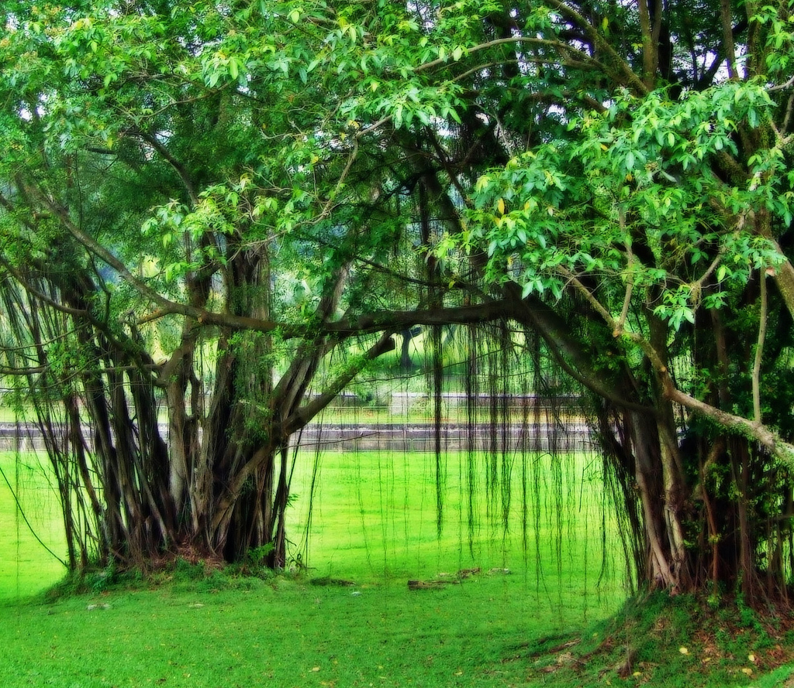

Slide 5
Singapore consists of 63 islands, including the main island itself. There are two connections from Singapore to the Malaysian state of Johor — a man-made causeway known as the Johor-Singapore Causeway to the north, crossing the Tebrau Straits, and Tuas Second Link, a bridge in the western part of Singapore that connects to Johor. Jurong Island, Pulau Tekong, Pulau Ubin and Sentosa are the largest of Singapore's many smaller islands. The highest point of Singapore is Bukit Timah Hill, with a height of 166 metres (538 ft).

Slide 6
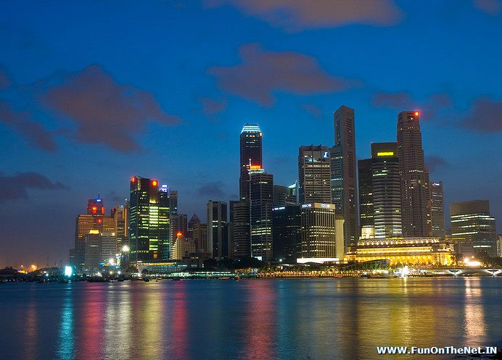

Slide 7
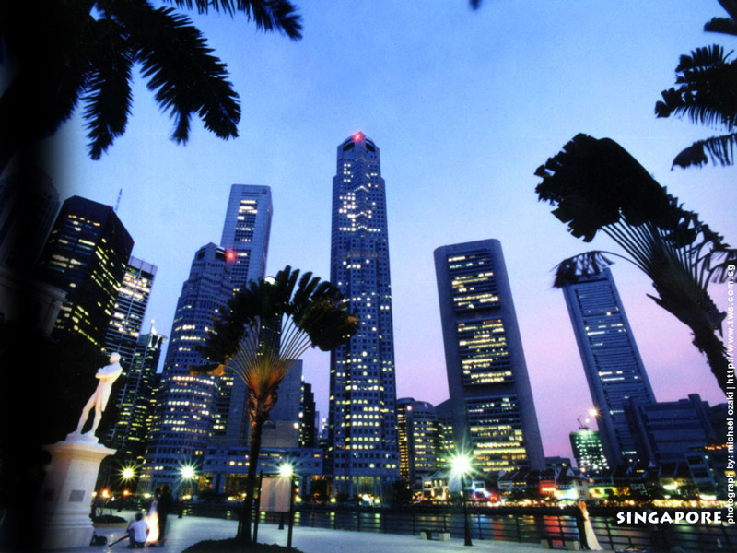

Slide 8


Slide 9
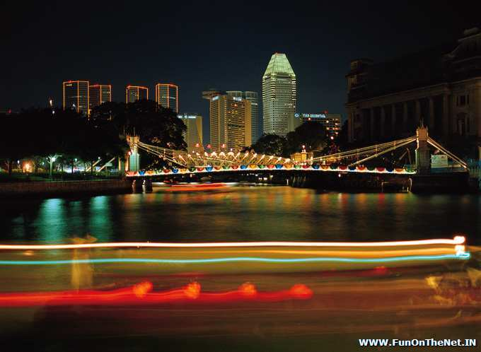

Slide 10
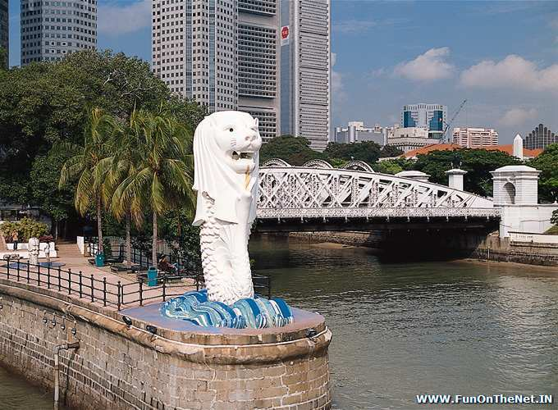

Slide 11
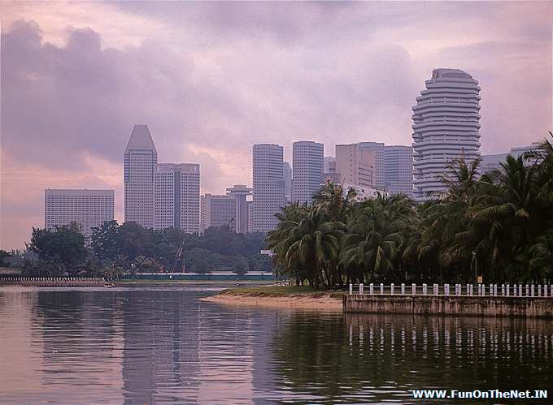

Slide 12
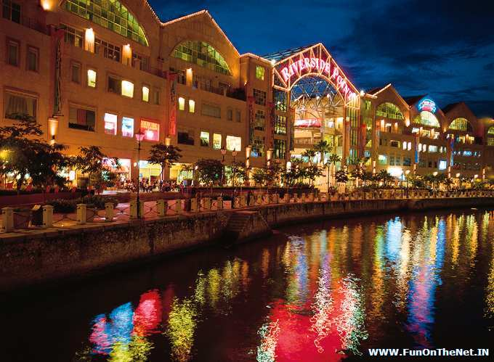

Slide 13
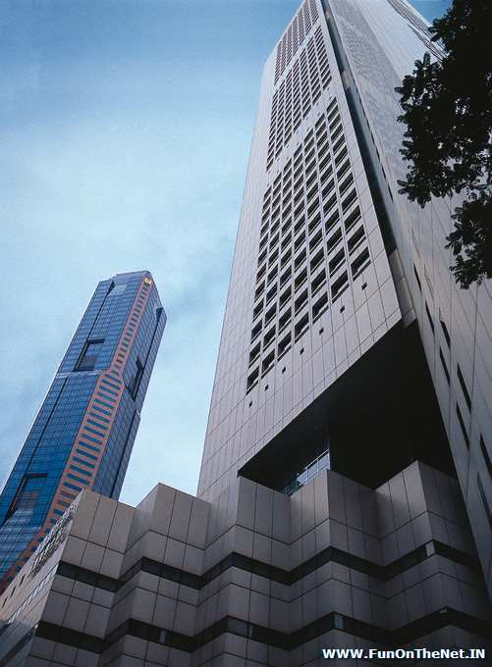

Slide 14
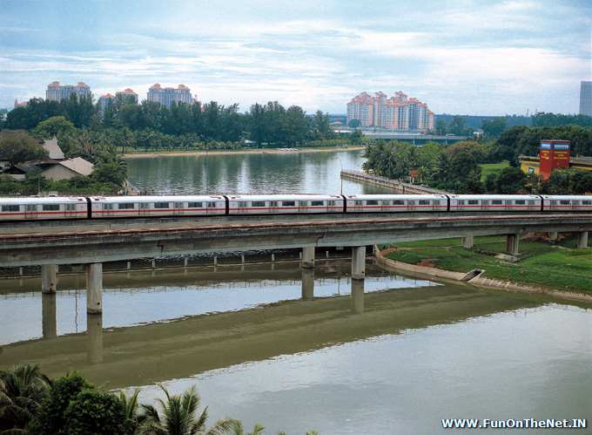

Slide 15
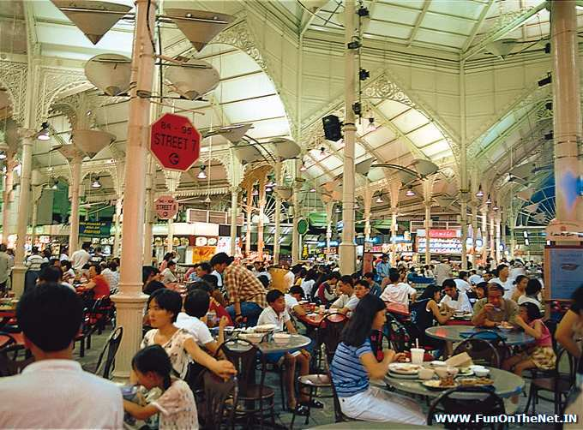

Slide 16
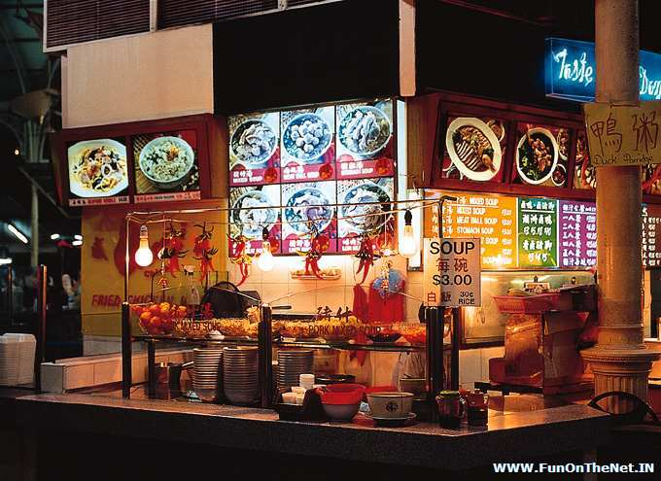

Slide 17
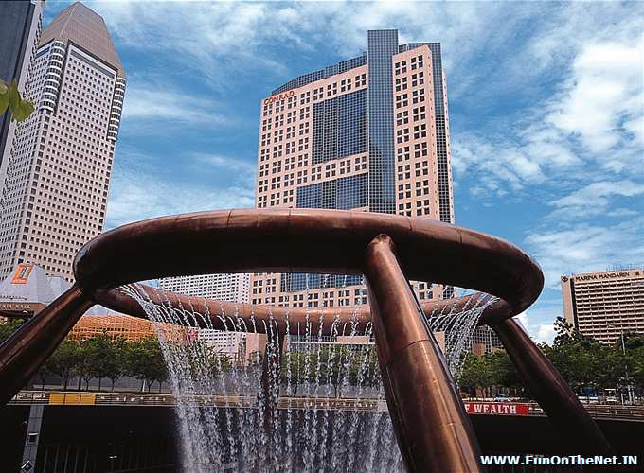

Slide 18
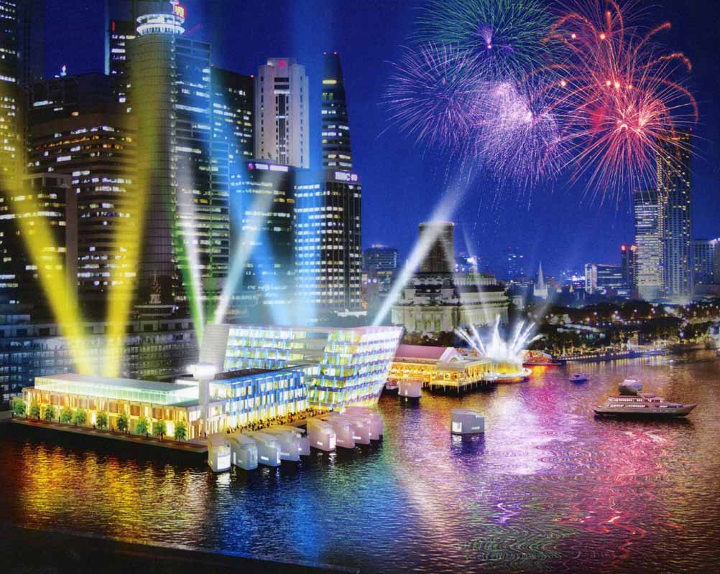

Slide 19
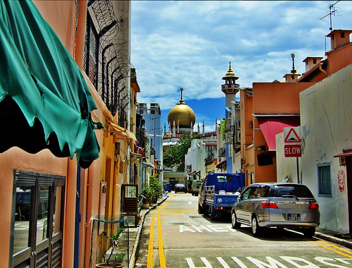

Slide 20
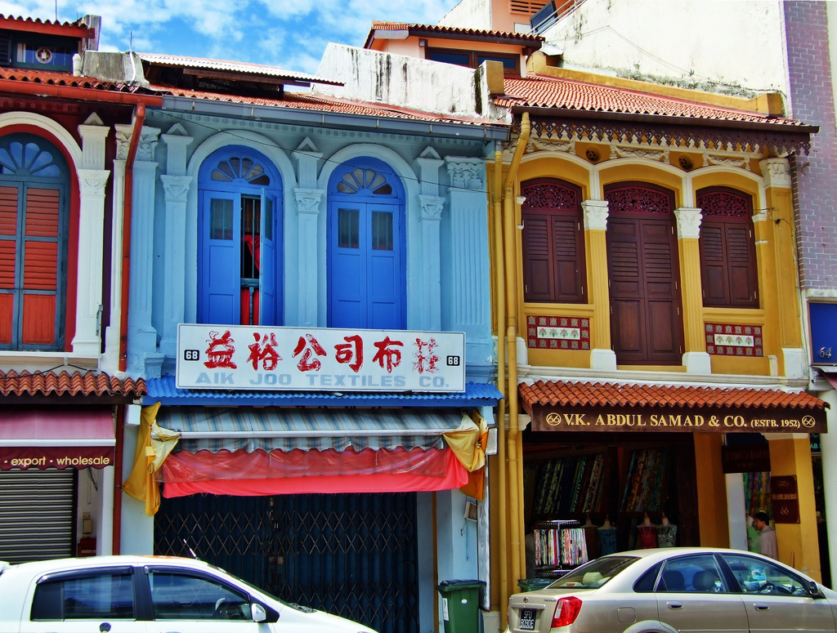

Slide 21
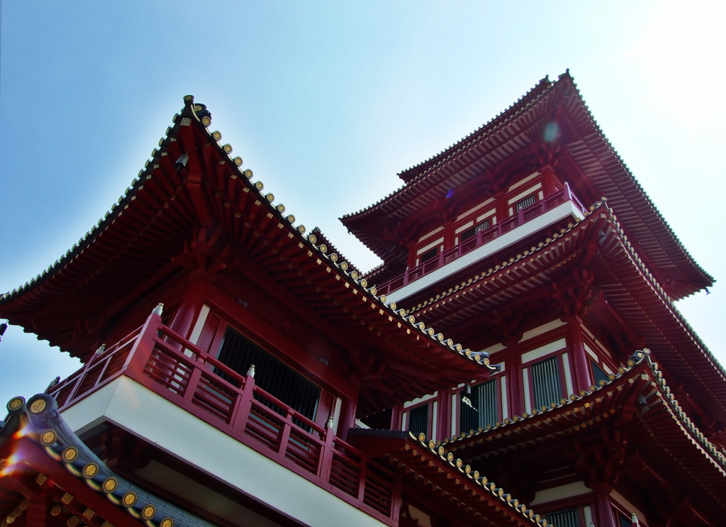

Slide 22
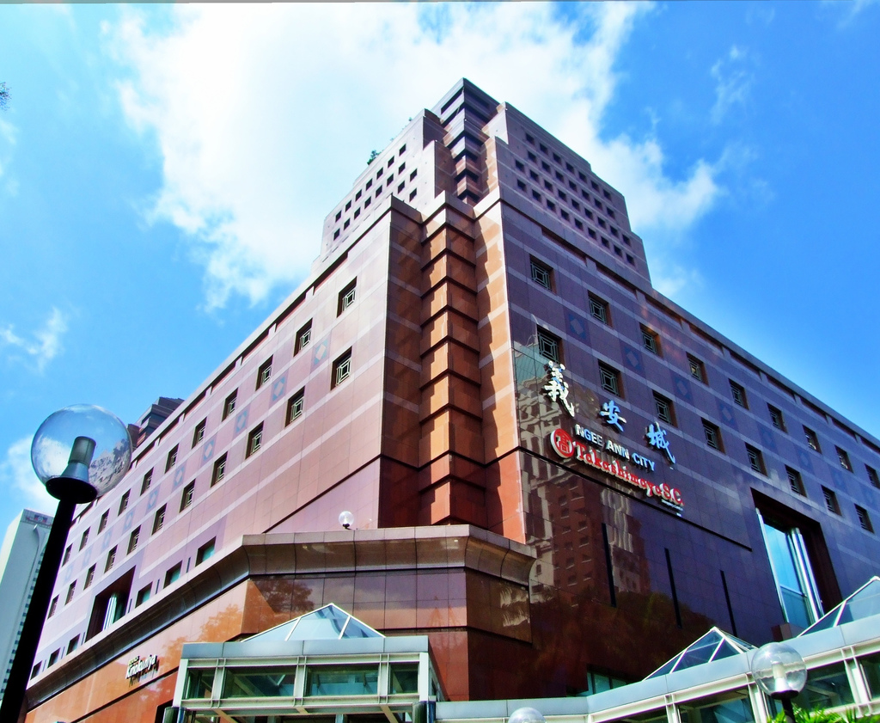

Slide 23
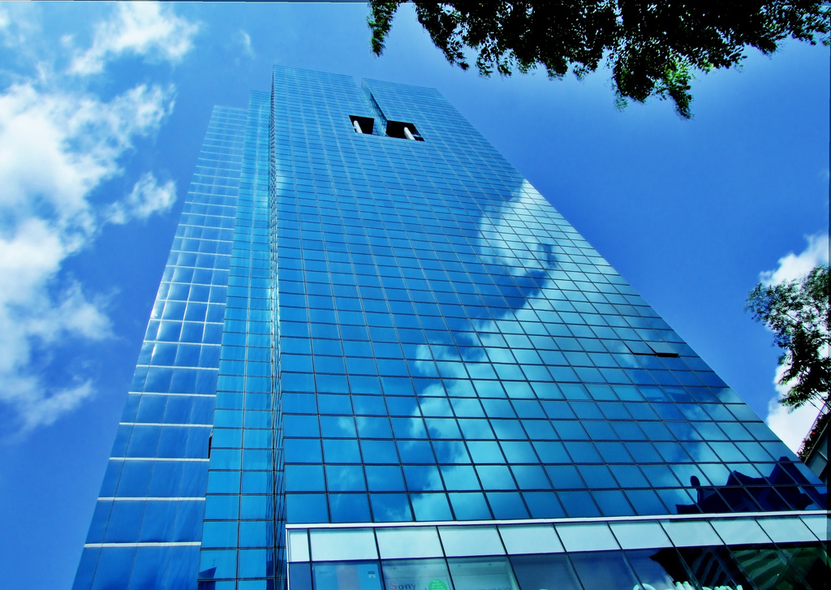

Slide 24
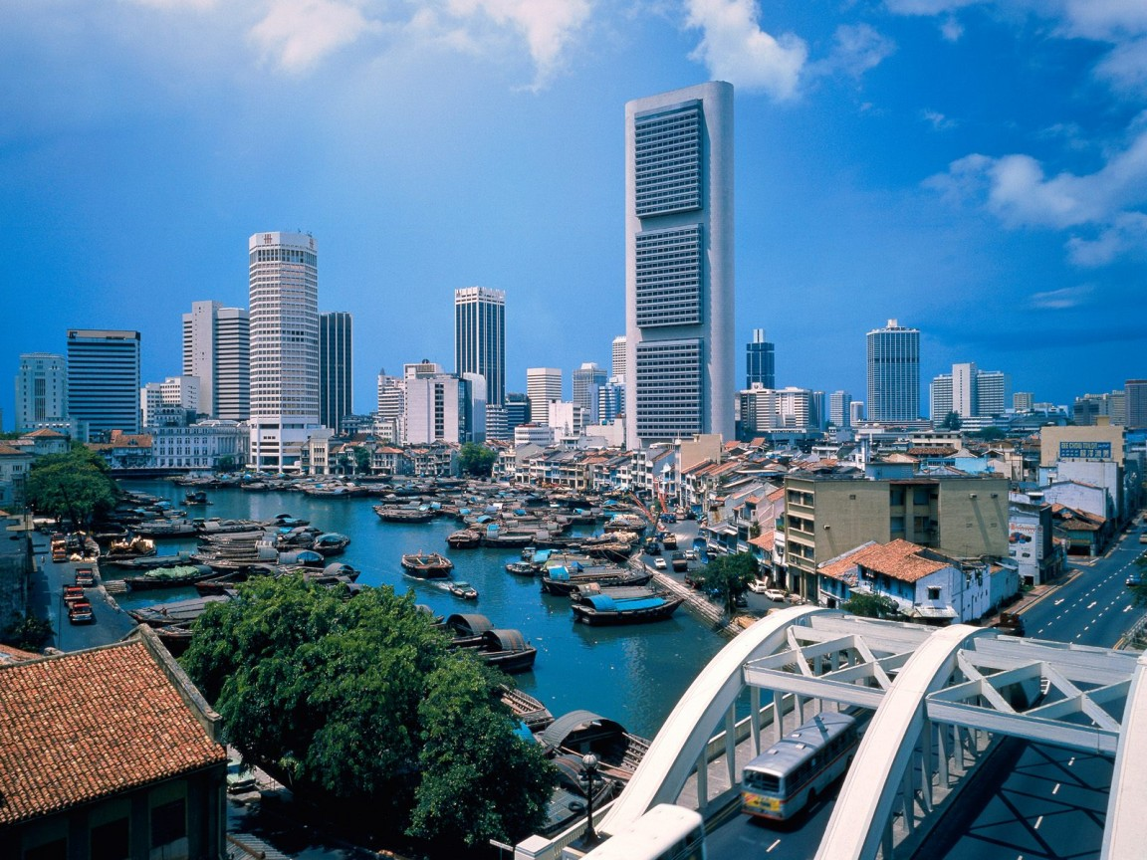

Slide 25
