Slide 1
THE KYOTO PROTOCOL AND RUSSIA:
WHAT IS TO BE DONE?
A. Illarionov
Adviser to the President of Russia
National Press Club, Washington, DC
January 30, 2004
© Institute of Economic Analysis

Slide 2
The Kyoto Protocol is discriminatory against Russia
Russia’s total CO₂ emissions are lower than those of other countries not adopting emission limits
With limited emissions
With unlimited emissions

Slide 3
The Kyoto Protocol is discriminatory against Russia
Russia’s CO₂ emissions per capita are lower than those of other countries not adopting emission limits
With limited emissions
With unlimited emissions

Slide 4
The Kyoto Protocol is discriminatory against Russia
Russia’s CO₂ emissions per unit of GDP are lower than those of other countries not adopting emission limits
With limited emissions
With unlimited emissions

Slide 5
The Kyoto Protocol is discriminatory against Russia
Russia’s GDP per capita is lower than those of other countries not adopting emission limits
With unlimited emissions
With limited emissions

Slide 6
The Russia's Kyoto Cross.
Under the Kyoto Protocol Russia will be a buyer, not a seller of CO₂ quotas.
(Actual Russia’s CO₂ emissions, conservative forecast and its Kyoto Protocol limits)
?

Slide 7
The Russia’s Kyoto Trap.
Under the Kyoto Protocol Russia won’t be able to sell its CO₂ quotas.
(Forecast of CO₂ quotas market in the EU in 2008-2012)
Potential Demand
P o t e n t I a l S u p p l y
(Превышение фактической эмиссии CO2 над обязательствами в 1-й фазе КП)
1
2
3
4
Sequence of purchases according to the EU Directive adopted by the EU Parliament 02.07.03 and accepted by the EU Council 22.07.03

Slide 8
The Kyoto protocol’s inefficiency.
The Kyoto Protocol is unable to achieve its proclaimed goals.
(The share of the KP Annex B countries in the World’s CO₂ emissions)

Slide 9
The Kyoto Protocol is not universal.
It is backed by the World minority.
The World majority did not adopt the Kyoto Protocol limits.
(The share of the KP Annex B countries in the World aggregates)

Slide 10
The Kyoto Protocol puts brakes on economic growth

Slide 11
The Kyoto Protocol incompatible with economic growth.
CO₂ emissions are associated with economic growth in the mid-income countries (47 countries),1960-2000
Doubling GDP
Kyoto 2012
Kyoto 2050
-3.5

Slide 12
The Kyoto Protocol is incompatible with poverty reduction.
CO₂ emissions are associated with economic growth in the low-income countries (52 countries),1960-2000

Slide 13
The Kyoto Protocol is incompatible with wealth accumulation.
СО₂ emission are associated with economic growth in developed economies, too (38 countries), 1991-2000

Slide 14
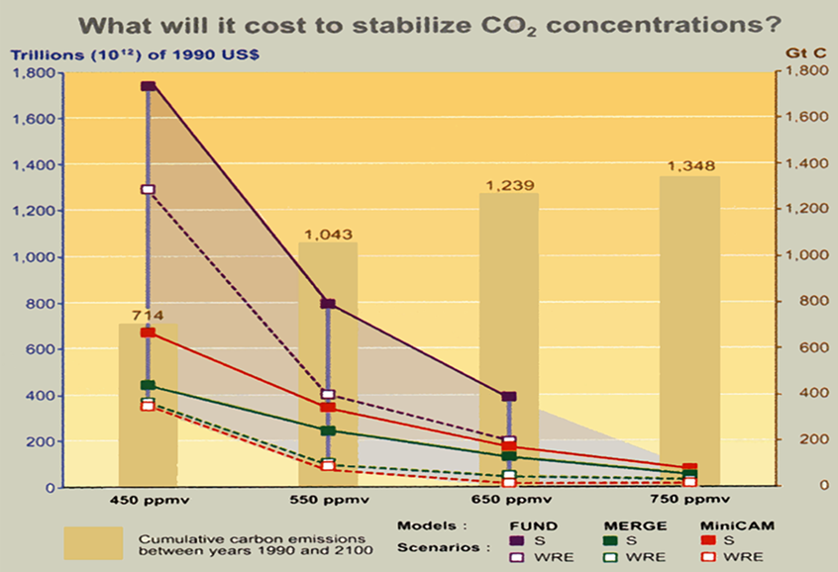
The Kyoto Protocol is unbearably expensive.
The cost of compliance can be as high as 1750 US$ tln between 1990 and 2100, or 15% of their annual GDP in affected countries
Source: Climate Change 2001 Synthesis Report, IPCC, p.119.

Slide 15
The Kyoto Protocol is oriented on technological illusions.
It’s impossible to switch away from hydrocarbons to another energy base in a short period of time
World energy consumption by source of origin

Slide 16
The Kyoto protocol is based on flawed science.
The variation of CO₂ concentration can not be explained by variation in CO₂ emissions of anthropogenic character
Source: Carbon Dioxide Information Analysis Center, 2003.

Slide 17
The Kyoto protocol is based on flawed science.
The variation in temperature can not be explained by the variation in CO₂ concentration
Source: Carbon Dioxide Information Analysis Center, 2003.

Slide 18
The Kyoto protocol is based on flawed science.
The variation in temperature can not be explained by variation in CO₂ emissions of anthropogenic character
Source: Carbon Dioxide Information Analysis Center, 2003.

Slide 19
The Kyoto Protocol is based on flawed science.
The variation in temperature is positively correlated with variation in CO₂ concentration only from 1976-2003. This is the ONLY such sub-period out of 6 sub-periods between 1860 and 2003

Slide 20
The very concept of “Global Warming” critically depends on the time horizon chosen.
It appears reasonable for short-term periods.
Absolute temperature (30 YMA), England, 1659-2002
Source: www.met-office.gov.uk.

Slide 21
The very concept of “Global Warming” critically depends on the time horizon chosen.
It appears unproven for longer-term periods.
Absolute temperature (30 YMA), NE Canada (Baffin Island), 752-1992
Source: World Data Center for Paleoclimatology, Boulder, USA.

Slide 22
The very concept of “Global Warming” critically depends on the time horizon chosen.
It appears unproven for longer-term periods.
Absolute temperature (30 YMA), Tasmania,1571 BC - 1991 AD
Source: World Data Center for Paleoclimatology, Boulder, USA.

Slide 23
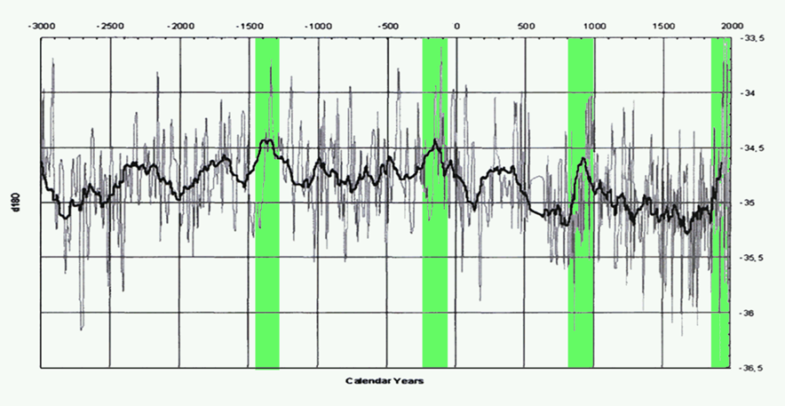
The very concept of “Global Warming” critically depends on the time horizon chosen. It appears unproven for longer-term periods.
The current “Global Warming” is not unique and is not strongest in the history of civilization.
Variation in temperature in the last 5000 years
Distribution of Oxygen δ¹⁸О in the upper part of the kern from drill GISР2 (last 5000 years)
Source: Grootes, P.M., Stuiver, M., White, J.W.C., Johnsen, S.J., Jouzel J., Comparison of oxygen isotope records from the GISP and GRIP Greenland ice cores. Nature 366, 1993, pp.552-554.

Slide 24
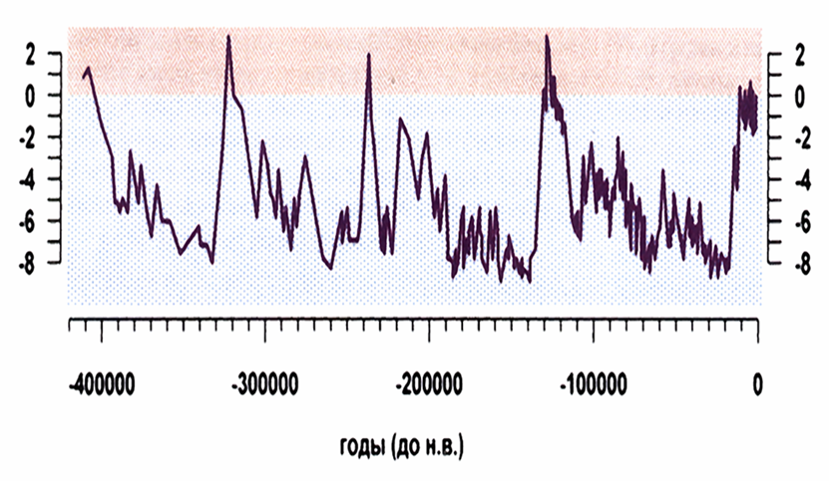
The very concept of “Global Warming” critically depends on the time horizon chosen. It appears unproven for long-term periods.
The current “Global Warming” is not unique and is not strongest in the history of Earth.
The long-term (M.Milankovitch) climatic cycles for the last 420 000 years.
Temperature anomalies (С^{о})
о
Source: J.R. Petit et al. (19 authors). Climate and atmospheric history of the past 420,000 years from the Vostok ice core, Antarctica. -Nature, 399 (1999), 429-436.

Slide 25
The asserted increase in the frequency of extraordinary climatic events appears unproven.
Variance in temperature (30 YMA), England, 1659-2002
Source: www.met-office.gov.uk.

Slide 26
The asserted increase in the frequency of extraordinary climatic events appears unproven.
Variance in temperature (30 YMA), NE Canada (Baffin Island), 752-1992
Source: World Data Center for Paleoclimatology, Boulder, USA.

Slide 27
The asserted increase in the frequency of extraordinary climatic events appears unproven.
Variance in temperature (30 YMA), Tasmania, 1751 BC – 1991 AD
Source: World Data Center for Paleoclimatology, Boulder, USA.

Slide 28
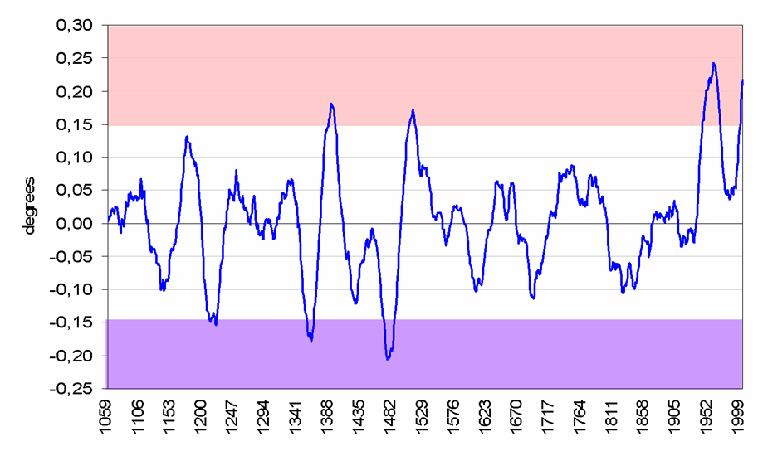
Asserted increase in the speed of the current temperature change appears unproven.
It is not unique and is not strongest in the last 1000 years.
Change in the global temperature over 30 preceding years

Slide 29
Asserted increase in the speed
of the current temperature change appears unproven.
It is not unique and is not strongest in the last 4000 years.
Change in temperature over 30 preceding years, Tasmania, 1751BC–1991AD
Source: World Data Center for Paleoclimatology, Boulder, USA.

Slide 30
Mother Nature’s Weapon of Mass Destruction is actually
Global Cooling, not Global Warming.
In the history of civilization climatic optimums are more associated with prosperity and progress, ice ages – with hardships and catastrophes.
Global absolute temperature (30 YMA), 1000-2003
New Climatic Optimum
Little Climatic Optimum
Little Ice Age
Source: World Data Center for Paleoclimatology, Boulder, USA.

Slide 31
Mother Nature’s Weapon of Mass Destruction is actually
Global Cooling, not Global Warming.
In the history of humanity climatic optimums are more associated with prosperity and progress, ice ages – with hardships and catastrophes.
Variation in temperature in the last 5000 years
Distribution of Oxygen δ¹⁸О in the upper part of the kern from drill GISР2 (last 5000 years)
Source: Grootes, P.M., Stuiver, M., White, J.W.C., Johnsen, S.J., Jouzel J., Comparison of oxygen isotope records from the GISP and GRIP Greenland ice cores. Nature 366, 1993, pp.552-554.

